Slide 1
ESE532: System-on-a-Chip Architecture
Day 19: November 6, 2017
Design Space Exploration

Slide 2
Today
Design-Space Exploration
Generic
Fast Fourier Transform (FFT)

Slide 3
Message
The universe of possible implementations (design space) is large
Many dimensions to explore
Formulate carefully
Approach systematically
Use modeling along the way for guidance

Slide 4
Design-Space Exploration
Generic

Slide 5
Design Space
Have many choices for implementation
Alternatives to try
Parameters to tune
Mapping options
Our freedom to impact implementation costs
Area, delay, energy

Slide 6
Design Space
Ideally
Each choice orthogonal axis in high-dimensional space
Want to understand points in space
Find one that bests meets constraints and goals
Practice
Seldom completely orthogonal
Requires cleverness to identify dimensions
Messy, cannot fully explore
But…can understand, prioritize, guide

Slide 7
Preclass 1
What choices (design-space axes) can we explore in mapping a task to an SoC?
What showed up in homework so far?

Slide 8
Design-Space Choices
Type of parallelism
How decompose / organize parallelism
Area-time points (level exploited)
What resources we provision for what parts of computation
Where to map tasks
How schedule/order computations
How synchronize tasks
How represent data
Where place data; how manage and move
What precision use in computations

Slide 9
Generalize Continuum
Encourage to think about parameters (axes) that capture continuum to explore
Start from an idea
Maybe can compute with 8b values
Maybe can put dist computation on FPGA fabric
Move data in 1KB chunks
Identify general knob
Tune intermediate bits for computation
How much of computation go on FPGA fabric
What is optimal data transfer size?

Slide 10
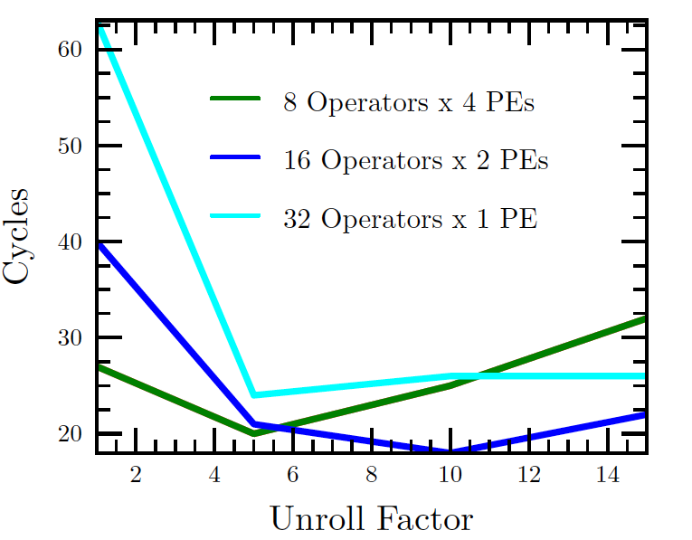
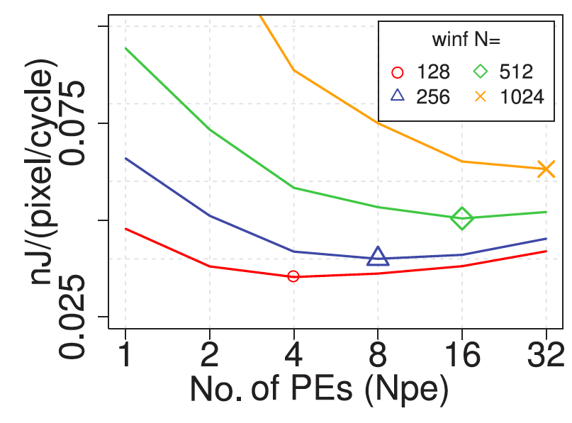
Finding Optima
Kapre, FPL 2009
Kadric, TRETS 2016

Slide 11
Design Space Explore
Think systematically about how might map the application
Avoid overlooking options
Understand tradeoffs
Large design space
more opportunities to find good solutions
Reduce bottlenecks

Slide 12
Elaborate Design Space
Refine design space as you go
Ideally identify up front
Practice bottlenecks and challenges
will suggest new options / dimensions
If not initially expect memory bandwidth to be a bottleneck…
Some options only make sense in particular sub-spaces
Bitwidth optimization not a big issue on the 64b processor
More interesting on vector, FPGA

Slide 13
Tools
Sometimes tools will directly help you explore design space
What SDSoC/Vivado HLS support?
Often they will not
What might you want that does not support?

Slide 14
Design-Space Exploration
Example FFT

Slide 15
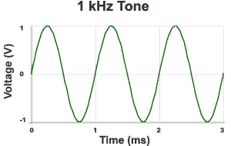
Sound Waves
Hz = 1/s
1kHz = 1000 cycles/s
Source: http://www.mediacollege.com/audio/01/sound-waves.html

Slide 16
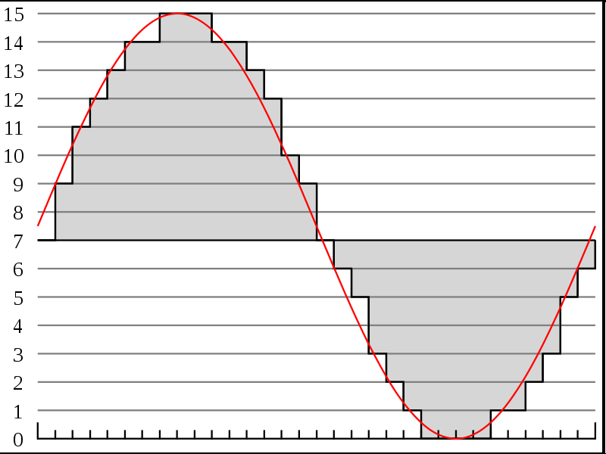
Discrete Sampling
Represent as time sequence
Discretely sample in time
What we can do directly with an Analog-to-Digital (A2D) converter.
http://en.wikipedia.org/wiki/File:Pcm.svg
http://en.wikipedia.org/wiki/File:Pcm.svg

Slide 17
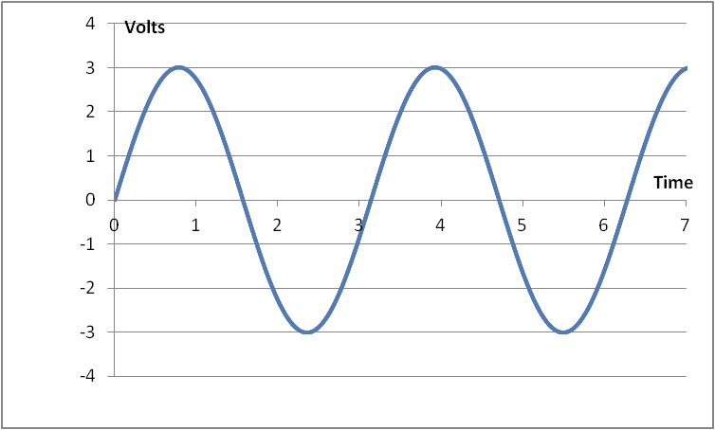
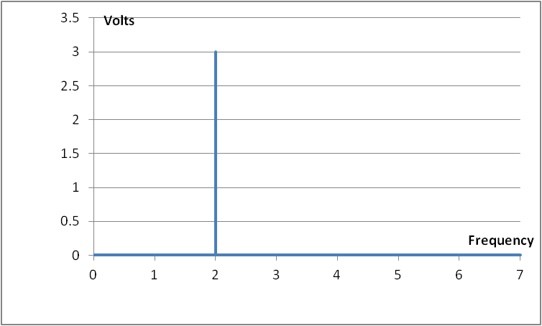
Frequency-domain
T = π, A = 3: s(t) = A*sin(2π*f*t) = 3*sin(2*t)

Slide 18
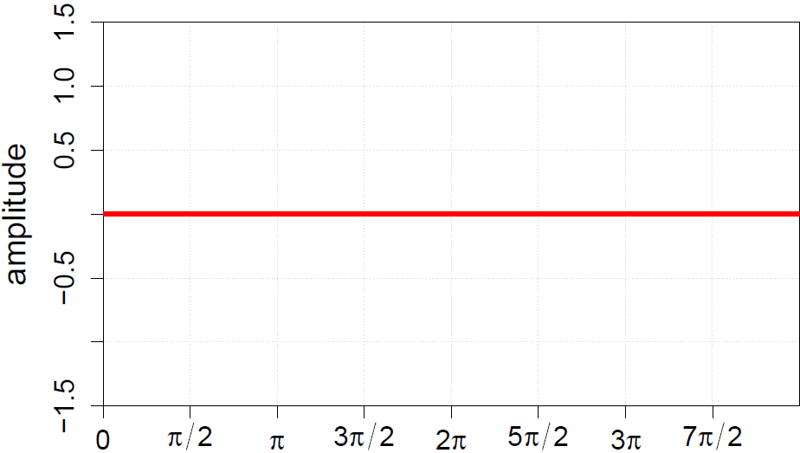
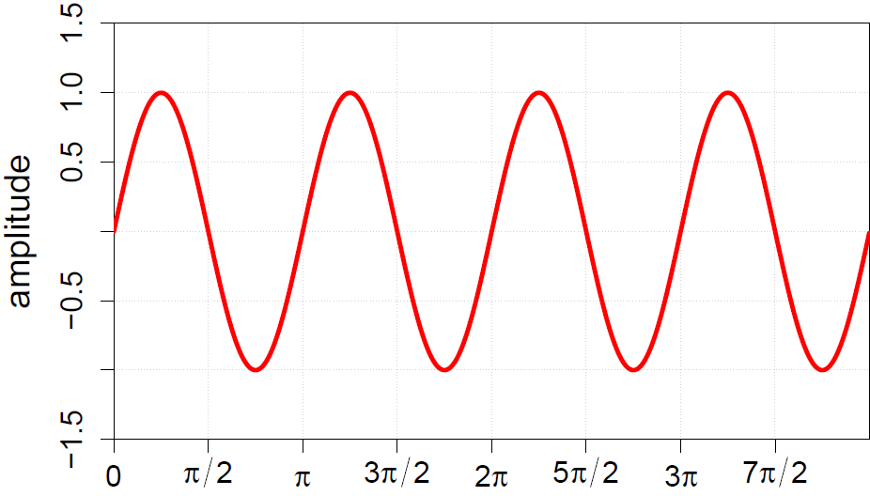
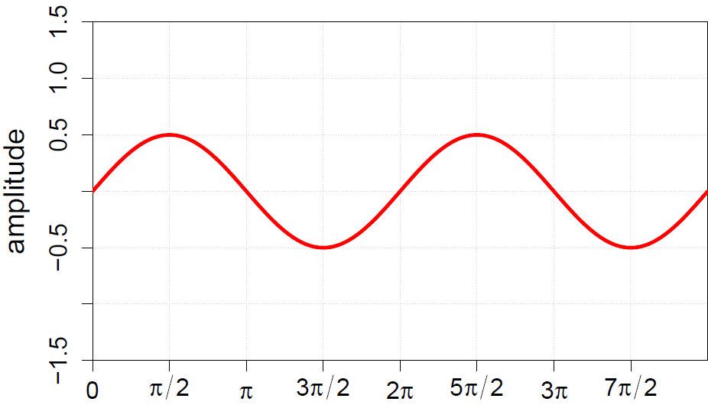
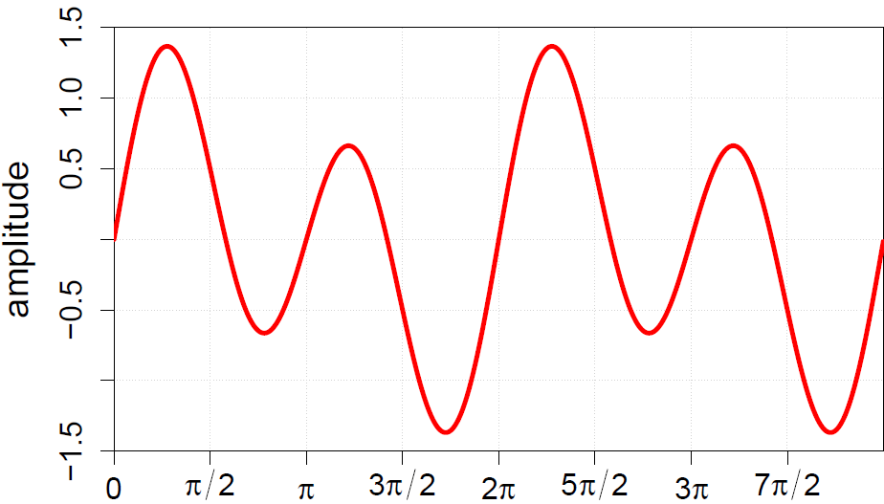
Frequency-domain
Can represent sound wave as linear sum of frequencies

Slide 19
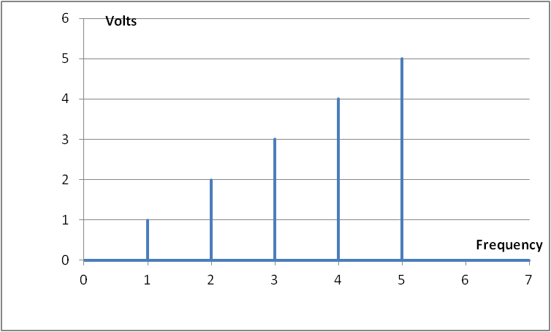
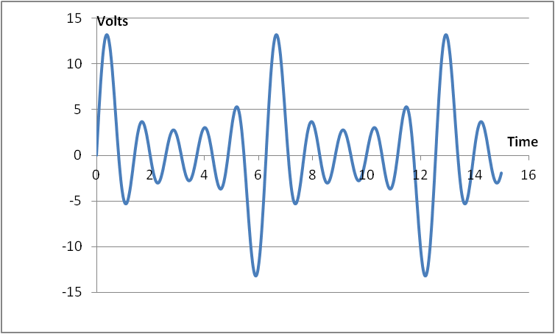
Time vs. Frequency

Slide 20
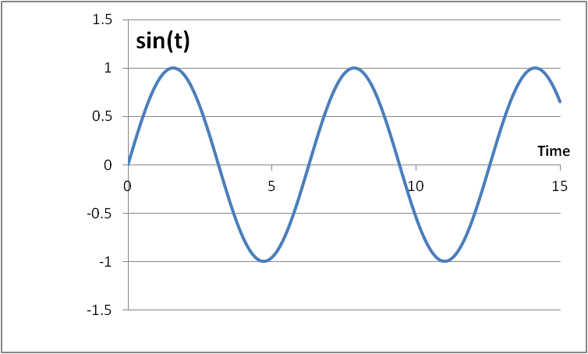
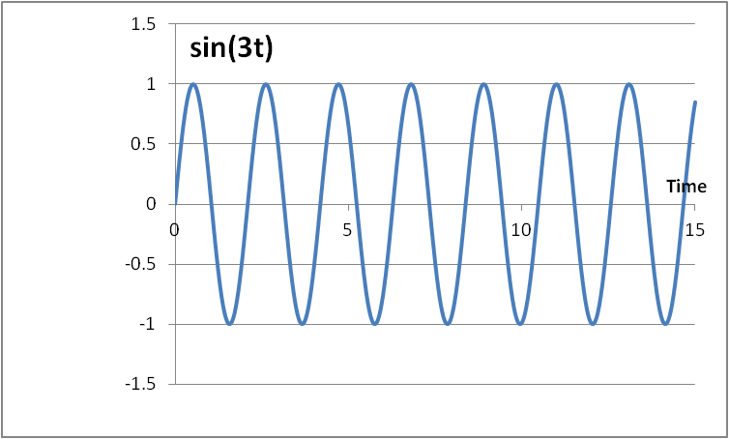
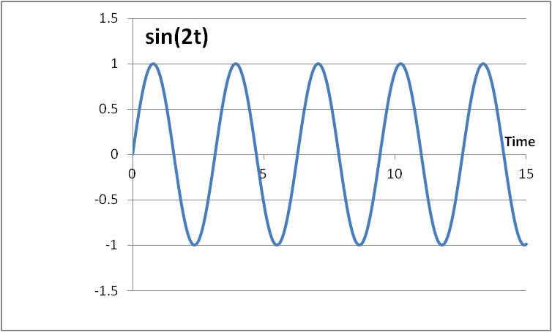
Fourier Series – Why does it work?
The cos(nx) and sin(nx) functions form an orthogonal basis: they allow us to represent any periodic signal by taking a linear combination of the basis components without interfering with one another

Slide 21
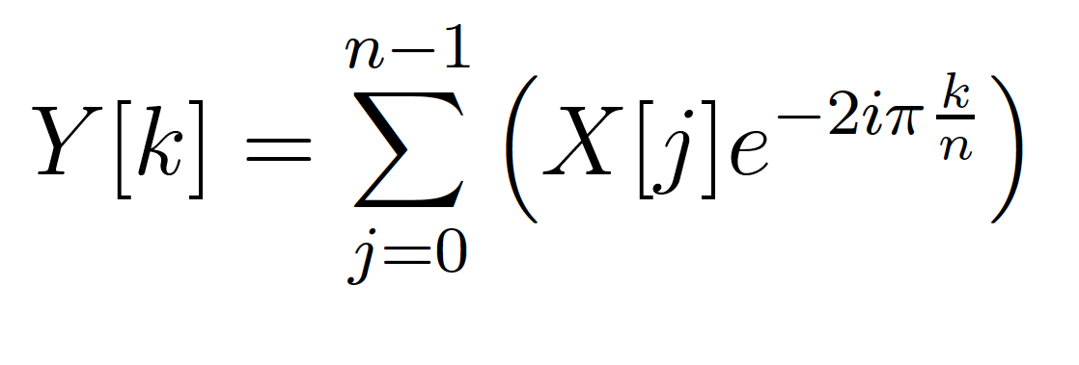
Fourier Transform
Identify spectral components
Convert between Time-domain to Frequency-domain
E.g. tones from data samples
Central to audio coding – e.g. MP3 audio

Slide 22
FT as Matching
Fourier Transform is essentially performing a dot product with a frequency
How much like a sine wave of freq. f is this?

Slide 23
Fast-Fourier Transform (FFT)
Efficient way to compute FT
O(N*log(N)) computation

Slide 24
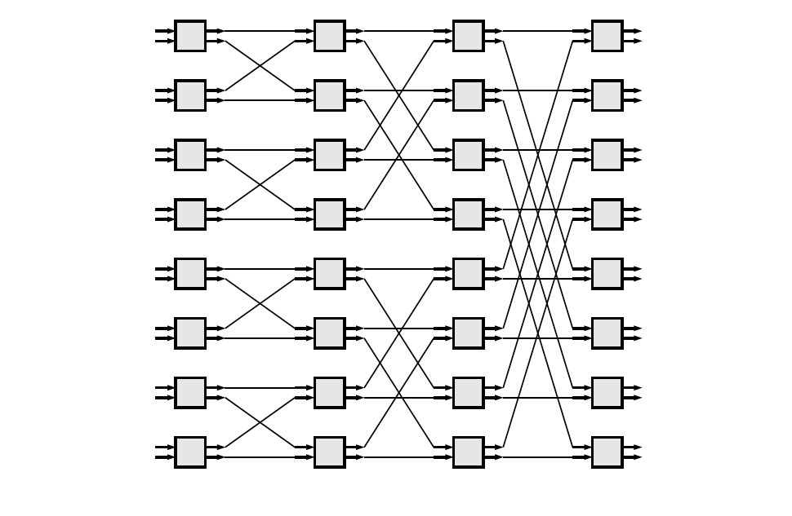
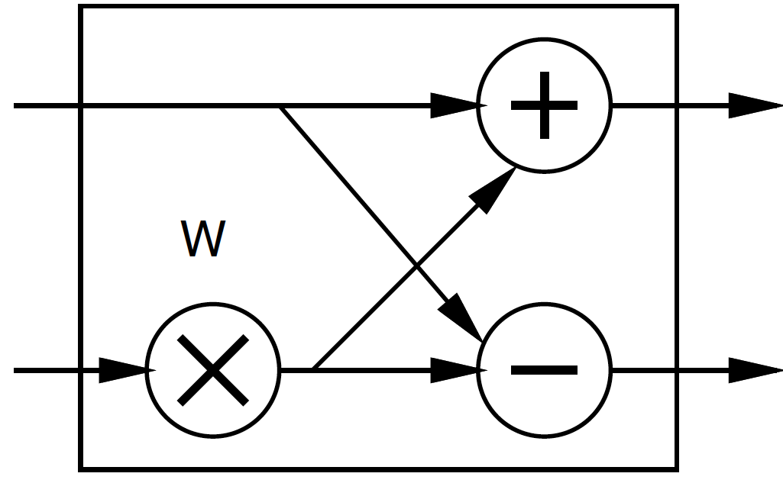
FFT
Large space of FFTs
Radix-2 FFT Butterfly

Slide 25
Basic FFT Butterfly
Y0=X0+W(stage,butterfly)*X1
Y1=X0-W(stage,butterfly)*X1
Common sub expression, compute once: W(stage,butterfly)*X1
X0
Y0
X1
Y1

Slide 26
Preclass 2
What parallelism options exist?
Single FFT
Sequence of FFTs

Slide 27
FFT Parallelism
Spatial
Pipeline
Streaming
By column
Choose how many Butterflies to serialize on a PE
By subgraph
Pipeline subgraphs

Slide 28
Streaming FFT

Slide 29
Preclass 3
How large of a spatial FFT can implement with 220 multipliers?

Slide 30
Bit Serial
Could compute the add/multiply bit serially
One full adder per adder
W full adders per multiply
50,000 LUTs
~= 2500 bit-serial butterflies for W=16?
Maybe 512-point FFT?
Another dimension:
How much serialize word-wide operators

Slide 31
Accelerator Building Blocks
What might we use as primitive, FFT-specific building blocks?

Slide 32
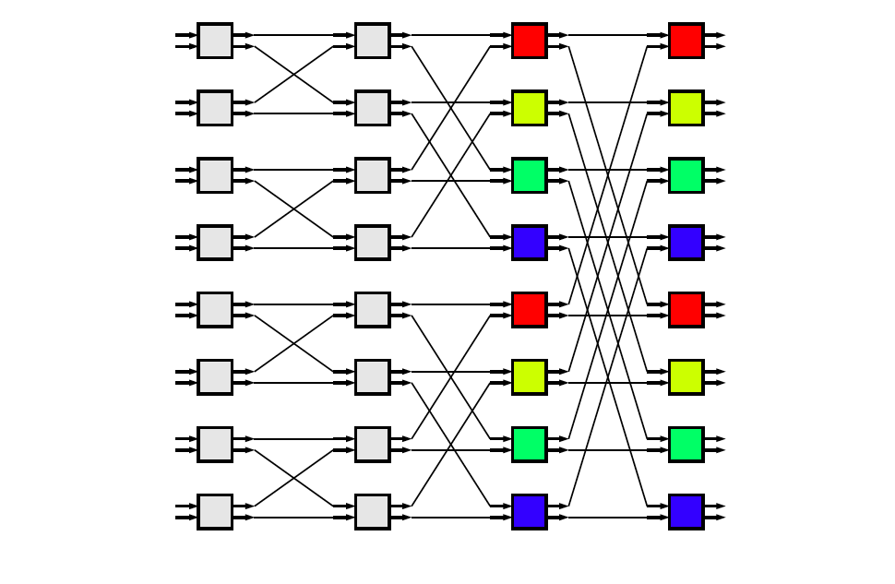
Common Subgraphs

Slide 33
Processor Mapping
How map butterfly operations to processors?
Implications for communications?

Slide 34
Preclass 4a
How large local memory to communicate from stage to stage?

Slide 35
Preclass 4b
How change evaluation order to reduce local storage memory?

Slide 36
Communication
How implement the data shuffle between processors or accelerators?
Memories / interconnect ?
How serial / parallel ?
Network?

Slide 37
Data Precision
Input data from A2D likely 12b
Output data, may only want 16b
What should internal precision and representation be?

Slide 38
Number Representation
Floating-Point
IEEE standard single (32b), double (64b)
With mantissa and exponent
…half, quad ….
Fixed-Point
Select total bits and fraction
E.g. 16.8 (16 total bits, 8 of which are fraction)
Represent 1/256 to 256-1/256

Slide 39
Heterogeneous Precision
May not be same in every stage
W factors less than 1
Non-fraction grows at most 1b per stage

Slide 40
W/Twiddle factors
Precompute and store in arrays
Compute as needed
How? sin/cos hardware? CORDIC? Polynominal approximation?
Specialize into computation
Many evaluate to 0, ±1, ±½, ….

Slide 41
FFT (partial) Design Space
Parallelism
Decompose
Size/granularity of accelerator
Area-time
Sequence/share
Communicate
Representation/precisions
Twiddle

Slide 42
Big Ideas:
Large design space for implementations
Worth elaborating and formulating systematically
Make sure don’t miss opportunities
Think about continuum for design axes
Model effects for guidance and understanding

Slide 43
Admin
1st milestone parallelism feedback
Should have seen Friday evening
2nd milestone due Friday
Asks you to identify design space

