Slide 1

ESE532:
System-on-a-Chip Architecture
Day 2: September 6, 2017
Analysis, Metrics, and Bottlenecks
Work Preclass
Lecture start 3:05pm

Slide 2
Today
Throughput
Latency
Bottleneck
Initiation Interval
Computation as a Graph, Sequence
Critical Path
Resource Bound
90/10 Rule
Amdahl’s Law

Slide 3
Today: Analysis
How do we quickly estimate what’s possible?
  Before (with less effort than) developing a complete solution
How should we attack the problem?
  Achieve the performance, energy goals?
When we don’t like the performance we’re getting, how do we understand it?
Where should we spend our time?

Slide 4
Message for Day
Identify the Bottleneck
  May be in compute, I/O, memory, data movement
Focus and reduce/remove bottleneck
  More efficient use of resources
  More resources
Repeat

Slide 5
Latency vs. Throughput
Latency: Delay from inputs to output(s)
Throughput: Rate at which can produce new set of outputs
  (alternately, can introduce new set of inputs)

Slide 6
Preclass
Washer/Dryer Example
10 shirt capacity
1 Washer Takes 30 minutes
1 Dryer Takes 60 minutes
How long to do one load of wash?
  → Wash latency
Cleaning Throughput?
W
D
W
D
60m

Slide 7
Pipeline Concurrency
W
D
Break up the computation graph into stages
  Allowing us to
    reuse resources for new inputs (data),
    while older data is still working its way through the graph
      Before it has exited graph
  Throughput > (1/Latency)
Relate liquid in pipe
  Doesn’t wait for first drop of liquid to exit far end of pipe before accepting second drop

Slide 8
Bottleneck
What is the rate limiting item?
  Resource, computation, ….

Slide 9
Preclass
Washer/Dryer Example
1 Washer Takes 30 minutes
  Isolated throughput 20 shirts/hour
1 Dryer Takes 60 minutes
  Isolated throughput 10 shirts/hour
Where is bottleneck in our cleaning system?
W
D
W
D
60m

Slide 10
Preclass
Washer/Dryer Example
1 Washer $500
  Isolated throughput 20 shirts/hour
1 Dryer $500
  Isolated throughput 10 shirts/hour
How do we increase throughput with $500 investment
W
D
W
D
60m

Slide 11
Preclass
Washer/Dryer Example
1 Washer $500
  Isolated throughput 20 shirts/hour
2 Dryers $500
  Isolated single dryer throughput 10 shirts/hour
Latency?
Throughput?
D
W
D

Slide 12
Preclass
Washer/Dryer Example
1 Washer $500
  Isolated throughput 20 shirts/hour
2 Dryers $500
  Isolated single dryer throughput 10 shirts/hour
Able to double the
throughput without doubling system cost
D
W
D

Slide 13
Preclass
Stain Example
3x
1 Washer Takes 30 minutes
  Isolated throughput 20 shirts/hour
1 Dryer Takes 60 minutes
  Isolated throughput 10 shirts/hour
Shirt need 3 wash cycles
Latency?
Throughput (assuming share)?
D
W

Slide 14
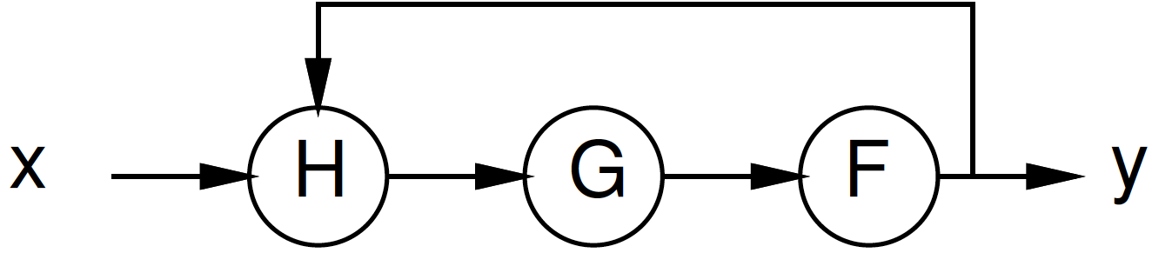
Preclass Cycle
F, G, H – each 1 cycle, throughput 1/cycle
Latency of y_{i} from y_{i-1} ?
Throughput? (rate of production of y_{i}’s)

Slide 15
Initiation Interval (II)
Cyclic dependencies can limit throughput
Due to dependent cycles,
  May not be able to initiate a new computation on every cycle
II – cycles (delay) before can initiate
Throughput = 1/II

Slide 16
Beyond Computation

Slide 17
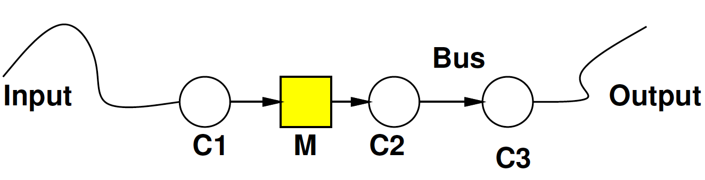
Bottleneck
Maybe be anywhere in path
  I/O, compute, memory, data movement

Slide 18
Bottleneck
Where bottleneck?
Ethernet
1Gb/s
(64b in 64ns)
64b every 4ns
64b→64b
In 5ns
64b→32b in 10ns
Serial
1Mb/s
(64b in 64μs)
64b→64b in 2ns
32b→64b in 10ns

Slide 19
Bottleneck
Where bottleneck?
Ethernet
1Gb/s
(64b in 64ns)
64b every 4ns
64b→64b
In 5ns
64b→32b in 10ns
Ethernet
1Gb/s
(64b in 64ns)
64b→64b in 2ns
32b→64b in 200ns

Slide 20
Bottleneck
Where bottleneck?
Ethernet
1Gb/s
(64b in 64ns)
64b every 4ns
64b→64b
In 1000ns
64b→32b in 10ns
Ethernet
1Gb/s
(64b in 64ns)
64b→64b in 2ns
32b→64b in 200ns

Slide 21
Feasibility / Limits
First things to understand
  Obvious limits in system?
Impossible?
Which aspects will demand efficient mapping?
Where might there be spare capacity

Slide 22
Generalizing

Slide 23
Computation as Graph
Shown “simple” graphs (pipelines) so far

Slide 24
Computation as Sequence
Shown “simple” graphs (pipelines) so far
For (i=1 to N)
  X=readX()
  T1=H(x,y)
  T2=G(T1)
  Y=F(T2)
  writeY(Y)

Slide 25
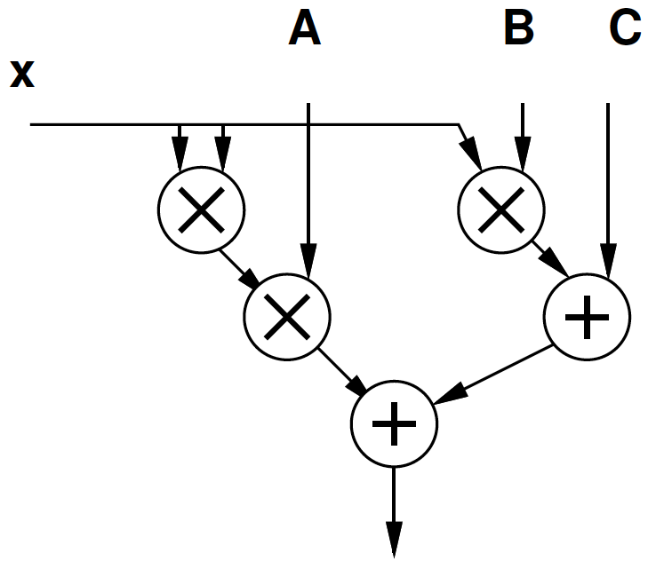
Computation as Graph
Y=Ax²+Bx+C
T1=x*x
T2=A*T1
T3=B*x
T4=T2+T3
Y=C+T4

Slide 26
Computation as Graph
Nodes have multiple input/output edges
Edges may fanout
  Results go to multiple successors

Slide 27
Computation as Graph
Latency multiply = 3
Latency add = 1
Latency from B to output?
Latency from x to output?
  Through Ax² ?
  Through Bx ?

Slide 28
Delay in Graphs
There are multiple paths from inputs to outputs
Need to complete all of them to produce outputs
Limited by longest path
Critical path: longest path in the graph

Slide 29
Computation as Graph
Latency multiply = 3
Latency add = 1
Critical Path?

Slide 30
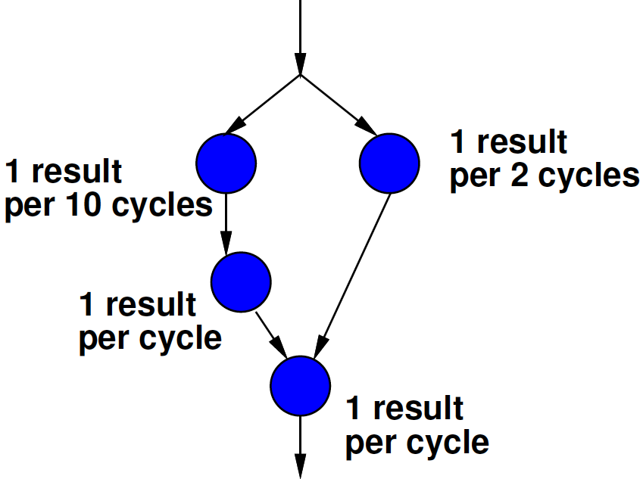
Bottleneck
Where is the bottleneck?

Slide 31
Time and Space

Slide 32
Space-Time
In general, we can spend resources to reduce time
  Increase throughput
D
W
D
Three wash stain removal case
W
W
W
D

Slide 33
Space Time
Computation
  A=x0+x1
  B=A+x2
  C=B+x3
Adder takes one cycle
Throughput on one adder?
Throughput on 3 adders?
+
+
+

Slide 34
Dependencies and S-T
Dependencies may limit throughput acceleration
  Give benefit less than 1/space

Slide 35
Computation as Graph
Latency multiply = 3
Thput mult = 1/3
Space multiply = 3
Latency add = 1
Space add = 1
Thput and Space
  3 mul, 2 add

Slide 36
Computation as Graph
Latency multiply = 3
Thput mult = 1/3
Space multiply = 3
Latency add = 1
Space add = 1
Thput and Space
  1 mul, 1 add
  Where is bottleneck?

Slide 37
Computation as Graph
Latency multiply = 3
Thput mult = 1/3
Space multiply = 3
Latency add = 1
Space add = 1
Thput and Space
  2 mul, 1 add

Slide 38
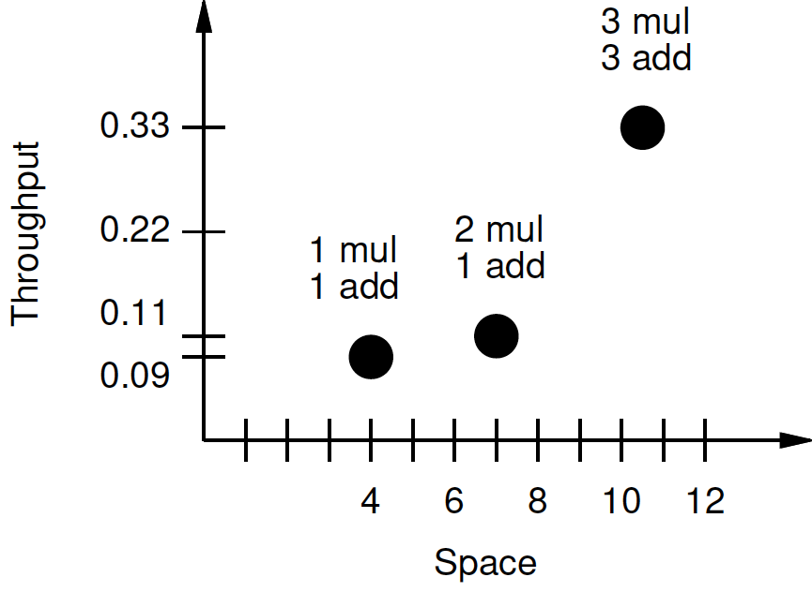
Space-Throughput Graph

Slide 39
Two Bounds
(still in Time and Space)

Slide 40
Bounds
Quick lower bounds can estimate
Two:
  CP: Critical Path
    Sometimes call it “Latency Bound”
  RB: Resource Bound
    Sometimes call it “Throughput Bound” or “Compute Bound”

Slide 41
Critical Path Lower Bound
Critical path assuming infinite resources
Certainly cannot finish any faster than that

Slide 42
Resource Capacity Lower Bound
Sum up all capacity required per resource
Divide by total resource (for type)
Lower bound on compute
  (best can do is pack all use densely)
  Ignores data dependency constraints

Slide 43
Example
Critical Path
Resource Bound (2 resources)
Resource Bound (4 resources)

Slide 44
Example
Critical Path
3
7/2=4
7/4=2
Resource Bound (2 resources)
Resource Bound (4 resources)

Slide 45
Critical Path
Latency multiply = 3
Thput mult = 1/3
Space multiply = 3
Latency add = 1
Space add = 1
Critical Path?

Slide 46
Resource Bound
Latency multiply = 3
Thput mult = 1/3
Space multiply = 3
Latency add = 1
Space add = 1
Resource Bound
  1 mul, 1 add
  2 mul, 1 add
  3 mul, 2 add

Slide 47
90/10 Rule (of Thumb)
Observation that code is not used uniformly
90% of the time is spent in 10% of the code
Knuth: 50% of the time in 2% of the code
Implications
  There will typically be a bottleneck
  We don’t need to optimize everything
  We don’t need to uniformly replicate space to achieve speedup
  Not everything needs to be accelerated

Slide 48
Amdahl’s Law
If you only speedup Y(%) of the code, the most you can accelerate your application is 1/(1-Y)
T_{before} = 1*Y + 1*(1-Y)
Speedup by factor of S
T_{after}=(1/S)*Y+1*(1-Y)
Limit S→infinity T_{before}/T_{after}=1/(1-Y)

Slide 49
Amdahl’s Law
T_{before} = 1*Y + 1*(1-Y)
Speedup by factor of S
T_{after}=(1/S)*Y+1*(1-Y)
Y=70%
  Possible speedup (S→infinity) ?
  Speedup if S=10?

Slide 50
Amdahl’s Law
If you only speedup Y(%) of the code, the most you can accelerate your application is 1/(1-Y)
Implications
  Amdhal: good to have a fast sequential processor
  Keep optimizing
    T_{after}=(1/S)*Y+1*(1-Y)
    For large S, bottleneck now in the 1-Y

Slide 51
Big Ideas
Identify the Bottleneck
  May be in compute, I/O, memory ,data movement
Focus and reduce/remove bottleneck
  More efficient use of resources
  More resources

Slide 52
Admin
Reading for Day 3 on canvas
HW1 due Friday
HW2 out
  Assigning partners (see canvas)
Remember feedback

