Slide 1

ESE532:
System-on-a-Chip Architecture
Day 22: November 15, 2017
Real Time

Slide 2
Today
Real Time
Demands
Challenges
  Algorithms
  Architecture
Approaches

Slide 3
Message
Real-Time applications demand different discipline from best-effort tasks
Look more like synchronous circuits
Can sequentialize, like processor
  But must avoid/rethink typical general-purpose processor common-case optimizations

Slide 4
Real-Time Tasks
What applications demand real-time computing tasks?

Slide 5
Real-Time Tasks
Human consumed media:
  video, audio, games, UI, graphics
Control
  Anti-lock brakes, cruise-control, auto-pilot, UAV, self-driving car, industrial automation
Stock trading
Network traffic handling
Crypto (avoid information leak)

Slide 6
Real-Time Guarantees
What guarantees might we want for real-time tasks?

Slide 7
Real-Time Guarantees
Attention/processing within fixed interval
  Sample new value every XX ms
  Produce new frame every 30 ms
  Both: schedule to act and complete action
Bounded response time
  Respond to keypress within 20 ms
  Detect object within 100 ms
  Return search results within 200 ms

Slide 8
Synchronous Circuit Model
A simple synchronous circuit is a good “model” for real-time task
  Run at fixed clock rate
  Take input every cycle
  Produce output every cycle
  Complete computation between input and output
  Designed to run at fixed-frequency
    Critical path meets frequency requirement

Slide 9
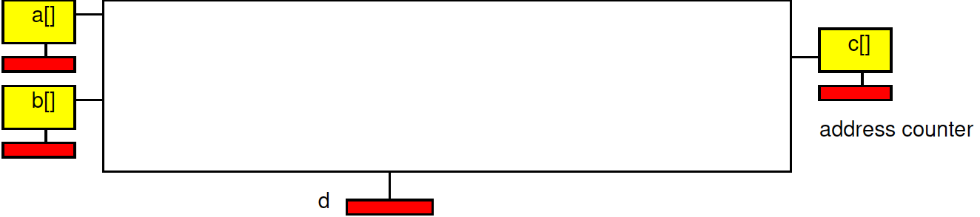

Preclass 1
How implement spatial pipeline?

Slide 10
Historically
Real-Time concerns grew up in EE
  Because an analog circuit was the only way could meet frequency demands
  …later a dedicated digital circuit…
Where worried about
  Signal processing, video, control, …

Slide 11
Technological Change
Why not be satisfied with this answer today?
  For real-time task need dedicated synchronous circuit?

Slide 12
Performance Scaling
As circuit speeds increased
  Can meet real-time performance demands with heavy sequentialization
Circuit and processor clocks
  from MHz to GHz
Many real-time task rates unchanged
  44KHz audio, 33 frames/second video
Even 100MHz processor
  Can implement audio in a small fraction of its computational throughput capacity

Slide 13
HW/SW Co-Design
Computer Engineers – know can implement anything as hardware or software
Want freedom to move between hardware and software to meet requirements
  Performance, costs, energy

Slide 14
Real-Time Challenge
Meet real-time demands / guarantees
  Economically using programmable architectures
Sequentialize and share resources with deterministic, guaranteed timing

Slide 15
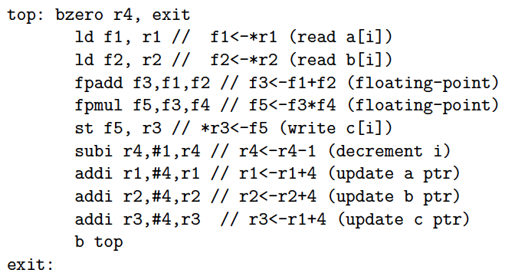
Preclass 2
Time for loop iteration case (a)?

Slide 16
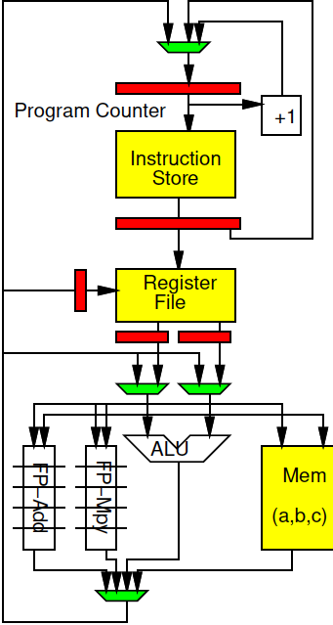
Preclass 2 Processor
With data hazard stalls, bypassing

Slide 17
Preclass 2
Time for loop iteration case (a)?

Slide 18
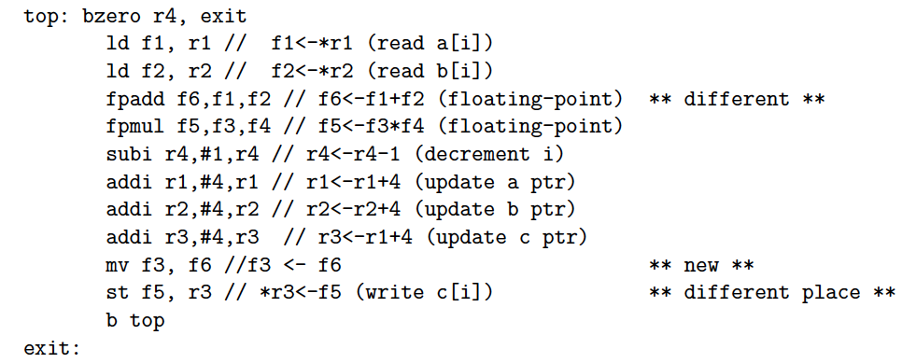
Preclass 2
Time for loop iteration case (b)?

Slide 19
Data-dependent hazard
Stalls instruction pipeline
  Only when data needed before computed

Slide 20
Observe
Instructions on “General Purpose” processors take variable number of cycles

Slide 21
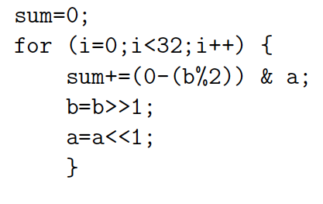
Preclass 3
How many cycles?

Slide 22
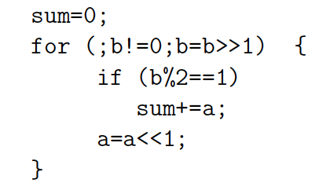
Preclass 3
How many cycles?

Slide 23
Observe
Data-dependent branching, looping
  Means variable time for operations

Slide 24
Two Challenges
Architecture – Hardware have variable (data-dependent) delay
  Esp. for General-Purpose processors
    Instructions take different number of cycles
Algorithm – computational specification have variable (data-dependent) operations
  Different number of instructions

Slide 25
Algorithm
What programming constructs are data-dependent (variable delay)?

Slide 26
Programming Constructs
Conditionals: if/then/else
Loops without compile-time determined bounds
  While with termination expressions
  For with data-dependent bounds
Recursion
Hash tables with variable-sized buckets
Memoization
Interrupts
  I/O events, time-slice

Slide 27
Programming Constructs
Dynamic Dataflow
  Variable rates
  Switch/select operators

Slide 28
…like Hardware
Many problematic constructs similar to C/Programming-Language constructs need to avoid for hardware
  Dynamic allocation (malloc)
  Recursive functions
  Loops without determined bounds
  Mux-conversion/predications for if/then/else

Slide 29
Architecture
What processor constructs are variable delay?

Slide 30
Processor Variable Delay
Data hazards
Caches
Data-dependent branching / branch delays
Speculative issue
  Out-of-Order, branch prediction
Dynamic arbitration for shared resources
  Bus, I/O, Crossbar output, memory, …

Slide 31
Cache Predictable?
Is an element in or out of cache?
  Accessed before?
  Had an address conflict?
  Depend on access pattern
If shared
  Did someone else write it?
  Depends on everything else sharing

Slide 32
Hardware Architecture
Some “optimizations” can cause variable delay even in dedicated hardware data path
  Caches
  Common-case optimizations
  Pipeline stalls

Slide 33
What can we do to make architecture more deterministic?
Explicitly managed memory
Fixed-delay pipelines
  Scheduled
  Multi-threaded
Deadlines
Offline-scheduled resource sharing

Slide 34
Explicitly Managed Memory
Make memory hierarchy visible
  Use Scratchpad memories instead of caches
Explicitly move data between memories
  E.g. DMA into OCM, movement into local memory
Already do for Register File in Processor
  Load/store between memory and RF slot
  …but don’t do for memory hierarchy

Slide 35
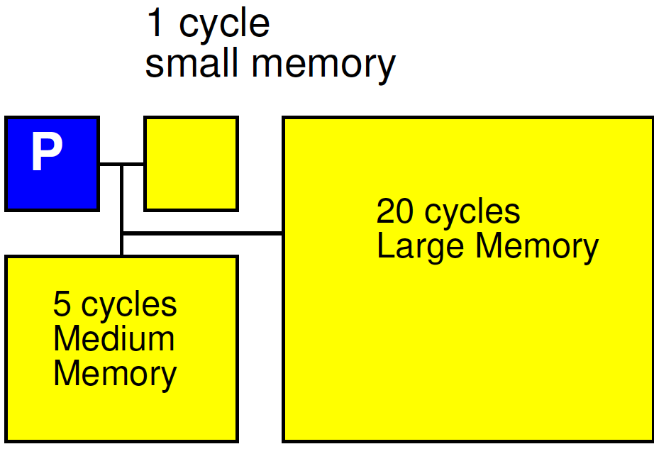
Explicitly Managed Memory

Slide 36
Fixed Delays (1)
Drop dynamic data hazards, branch speculation
Data becomes available after a predictable time
Branches take effect at a fixed time
  Likely delayed
Schedule to delays to get correct data

Slide 37
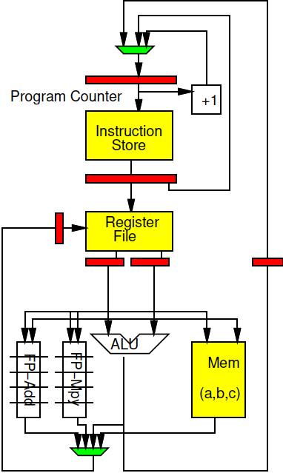
Fixed Delay Example
Branches occur
  1 cycle later (uncond)
  3 cycles later
Non-FP data
  Available on 2nd instr
FP data
  Available on 6th instr

Slide 38
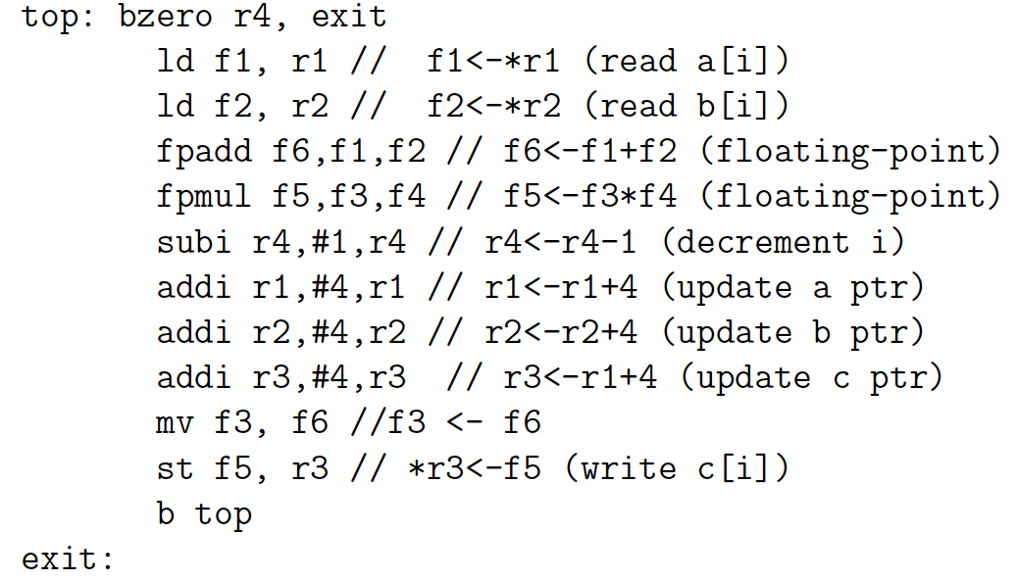
Preclass 4a
Where code not work?

Slide 39
Preclass 4a
Where code not work?

Slide 40
Preclass 4b
How fix?

Slide 41
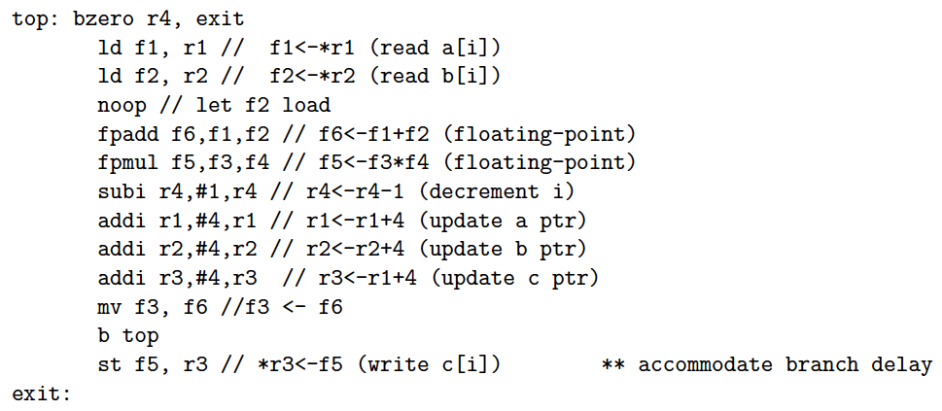
Preclass 4b: Quick Fix

Slide 42
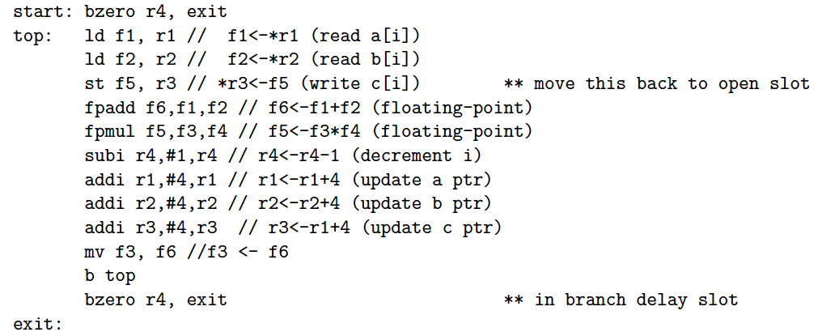
Preclass 4b: Avoid noop

Slide 43
Fixed-Delay (2)
Drop dynamic data hazards, branch speculation
Pipeline processor
But only feed one instruction per thread through processor at time
  Each instruction completes before next issues (no dependencies)
Use pipeline to issue from multiple threads
  For throughput, not latency

Slide 44
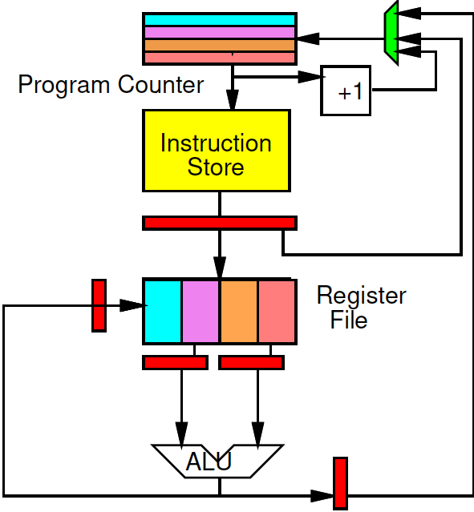
Multithreaded Pipeline
Only one instruction per thread in pipeline
C-slow (Day 7)
  looks like PIPEDEPTH slower processors
No interlock/bypass
  Smaller control
  Faster cycle?

Slide 45
Multithreaded Pipeline
Can run multiple threads
Non-real-time threads can share
Timing of threads not impact each other
Non-real-time threads take variable time
  Not interfere with real-time thread slots

Slide 46
Deadline Instruction
Set a hardware counter for thread
Demand counter reach 0 before allowed to continue
Orderly way to tolerate variable instructions in algorithm
Model: fixed rate of attention
  Stall if get there early
  Similar to flip-flop on a logic path
    Wait for clock edge to change value
Model: fixed-time

Slide 47
Offline Schedule Resource Sharing
Don’t arbitrate
Decide up-front when each shared resource can be used by each thread or processor
  Simple fixed schedule
  Detailed Schedule
What
  Memory bank, bus, I/O, network link, …

Slide 48
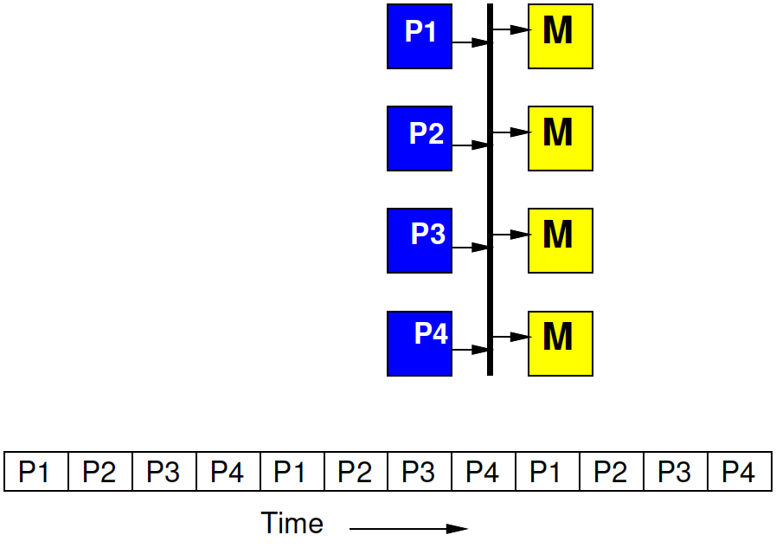
Time-Multiplexed Bus
Fixed by hardware master
4 masters share a bus
Each master gets to make a request on the bus every 4th cycle
  If doesn’t use it, goes idle

Slide 49
Time-Multiplexed Bus
Regular schedule
Fixed bus slot schedule of length N > masters
  (probably a multiple)
Assign owner for each slot
  Can assign more slots to one
E.g. N=8, for 4 masters
  Schedule (1 2 1 3 1 2 1 4)

Slide 50
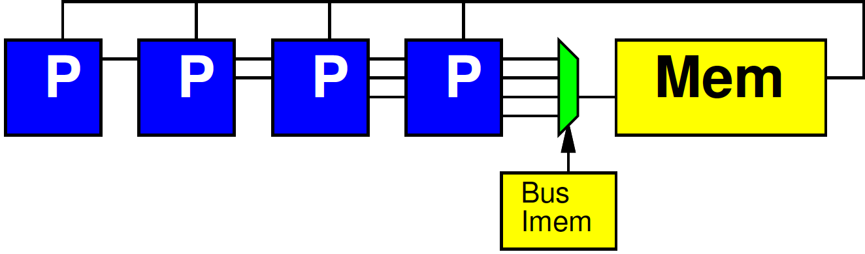
Fully Scheduled
At extreme, fully schedule which tasks gets resource on each cycle

Slide 51
Fully Scheduled
At extreme, fully schedule which tasks gets resource on each cycle
Sensible if all master’s sharing resource are also fully scheduled, running in lock-step
Think of instruction field for bus

Slide 52
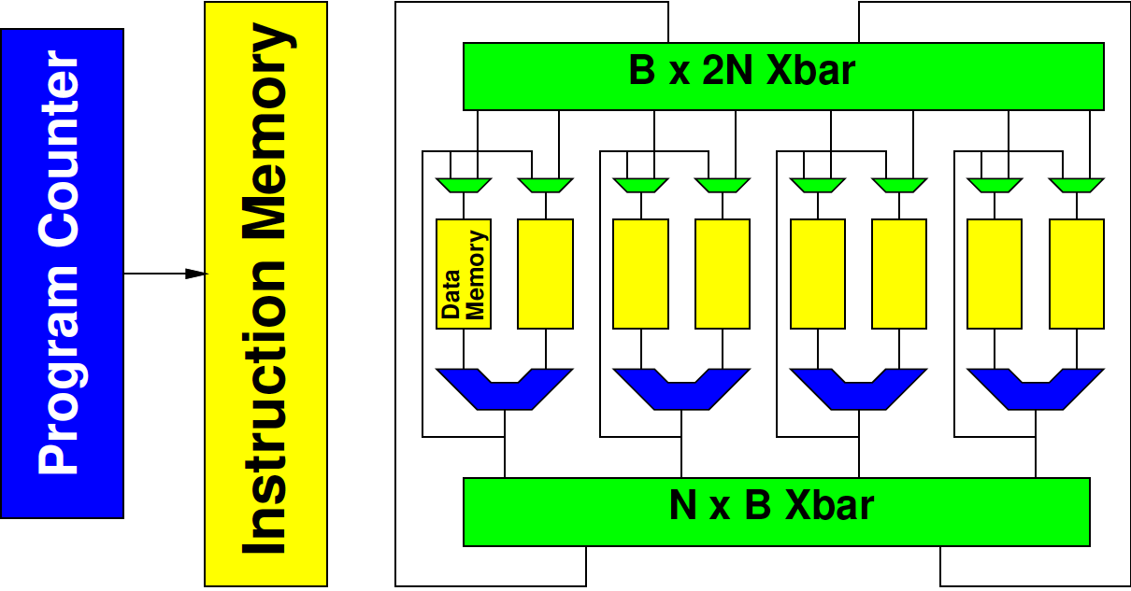
Fully Scheduled (before instr)

Slide 53
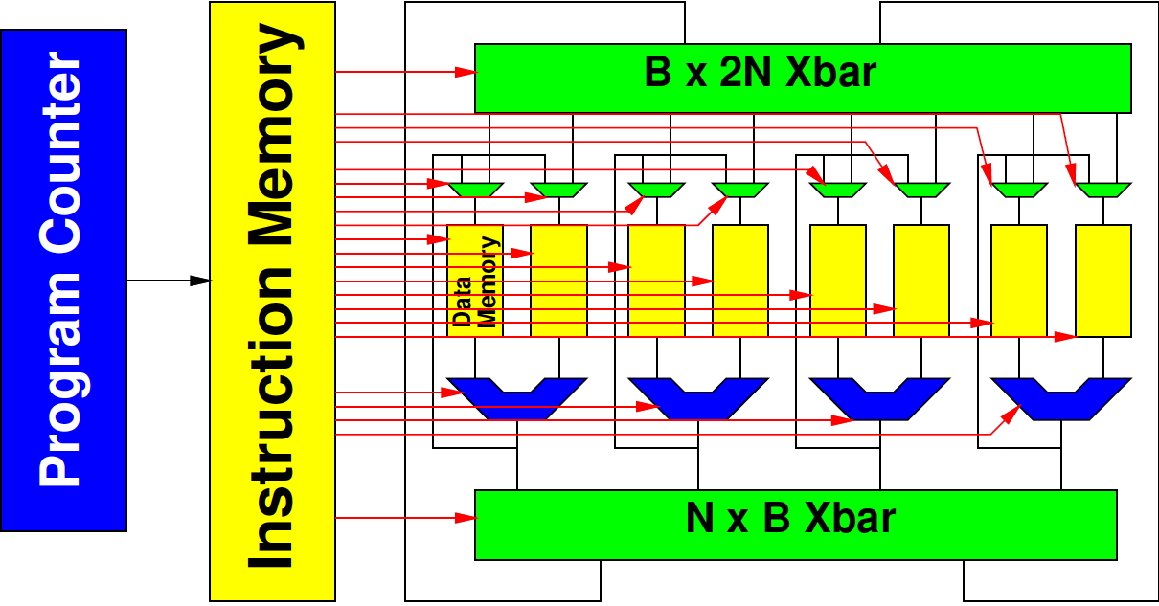
Fully Scheduled

Slide 54
SoC Opportunity
Can choose which resources are shared
Can dedicate resources to tasks
Isolate real-time tasks/portions of tasks from best-effort
  Separate hardware/processors
  Separate memories, network

Slide 55
Different Goals
General Purpose/Best Effort
ISA fixed
Want to run same assembly on different implementations
Tolerate different delays for different hardware
Run faster on newer, larger implementations
Real-Time
Willing to recompile to new hardware
Want time on hardware predictable
Willing to schedule for delays in particular hardware

Slide 56
WCET
WCET – Worst-Case Execution Time
Analysis when working with algorithms and architectures with data-dependent delay
  Need to meet real time
  Calculate the worst-case runtime of a task
    Like calculating the critical path (but harder)
    Worst-case delay of instructions
    Worst-case path through code
    Worst-case # loop iterations

Slide 57
Big Ideas:
Real-Time applications demand different discipline from best-effort tasks
Look more like synchronous circuits and hardware discipline
Can sequentialize, like processor
  But must avoid/rethink typical processor common-case optimizations
  Offline calculate static schedule for computation and sharing
    Instead of dynamic arbitration, interlocks

Slide 58
Admin
Function+Energy milestone due Friday
P4 (area, 1Gb/s) milestone
  Out now
  Due Friday 12/1
  (nothing due the Friday of Thanksgiving)
Next week
  Meet on Monday, but not Wednesday
    Because Wednesday is a logical Friday…

