Slide 1

ESE532:
System-on-a-Chip Architecture
Day 3: September 11, 2017
Memory

Slide 2
Today
Memory
Memory Bottleneck
Memory Scaling
Latency Engineering:
  Scheduling
  Data Reuse: Scratchpad and cache
Bandwidth Engineering
  Wide word
  Banking (form of parallelism for data)
DRAM

Slide 3
Message
Memory bandwidth and latency can be bottlenecks
Minimize data movement
Exploit small, local memories
Exploit data reuse

Slide 4
Memory Scaling

Slide 5
On-Chip Delay
Delay is proportional to distance travelled
Make a wire twice the length
  Takes twice the latency to traverse
  (can pipeline)
Modern chips
  Run at 100s of MHz to GHz
  Take 10s of ns to cross the chip
  Takes 100s of ns to reference off-chip data
What does this say about placement of computations and memories?

Slide 6
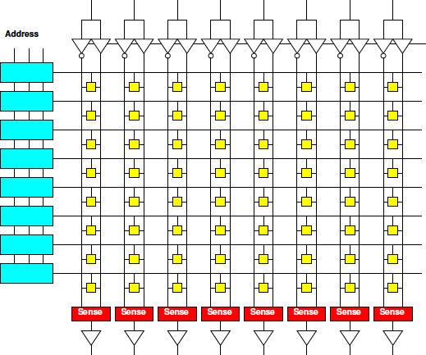
Memory Block
Linear wire delay with distance
Assume constant area/memory bit
N-bit memory, arranged in square
4x capacity
delay change?
width
depth

Slide 7
Memory Block
Linear wire delay with distance
Assume constant area/memory bit
N-bit memory, arranged in square
Width?
Depth?
Delay
scale N?
width
depth

Slide 8
Memory Block Bandwidth
N-bit memory, arranged in square
Bits/cycle
scale with N?

Slide 9
Memory Block Energy
Assume read full width,
  Energy scales with N
    Activate sqrt(N) wires
    Each wire sqrt(N)
    long
  Or, energy/bit
  scales as sqrt(N)
Larger memories
cost more energy

Slide 10
Memory Block Density
Address, sense amplifies are large
Scale slower than bit area
  Bits scale N
  Address sqrt(N)*log(N)
  Sense amps sqrt(N)
Large memories
pay less per bit
  denser

Slide 11
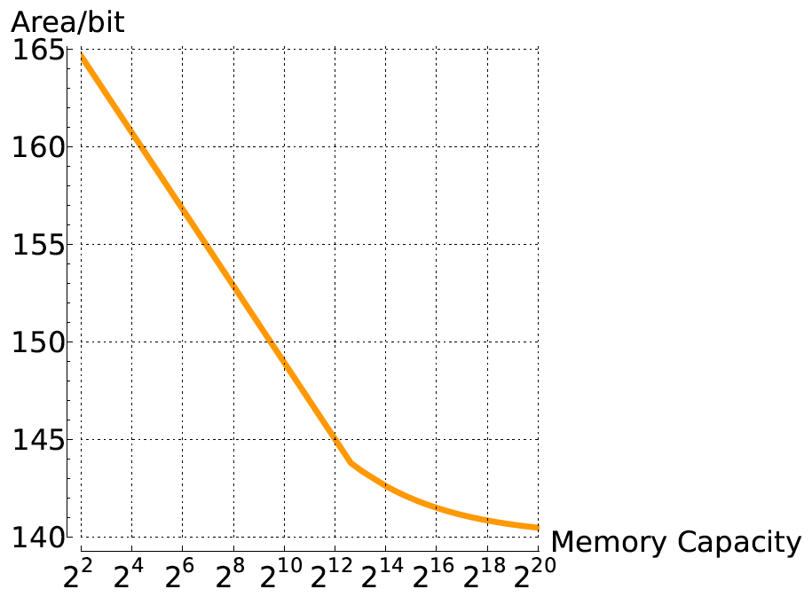
Compactness vs. Memory Size

Slide 12
Memory Scaling
Small memories are fast
  Large memories are slow
Small memories low energy
  Large memories high energy
Large memories dense
  Small memories cost
  more area per bit
Combining:
  Dense memories
  are slow

Slide 13
Latency Engineering
Scheduling

Slide 14
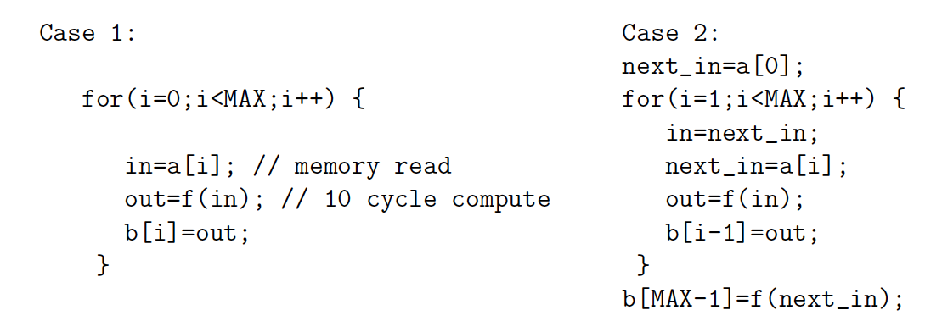
Preclass 2
10 cycle latency to memory
Throughput in each case?

Slide 15
Lesson
Long memory latency can impact throughput
  When must wait on it
  When part of a cyclic dependency
Overlap memory access with computations when possible
  exploit parallelism between compute and memory access

Slide 16
Latency Engineering
Data Reuse

Slide 17
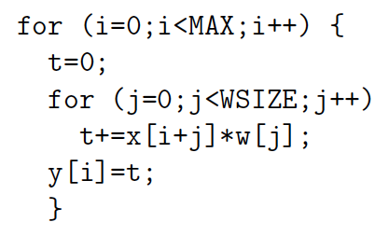
Preclass 3abc
MAX=10⁶ WSIZE=5
How many reads to x[] and w[]?
How many times execute t+=x[]*w[] ?
Runtime
read x,w 20
t+=… 5

Slide 18
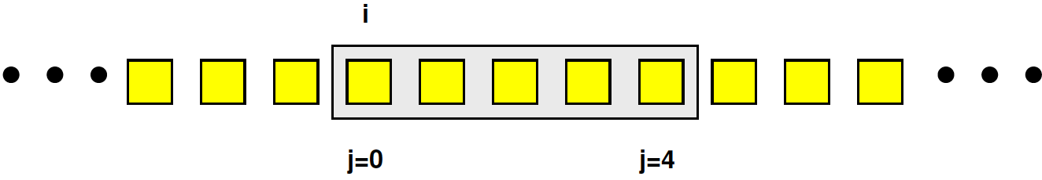
Preclass 3d
How many distinct x[], w[] read?

Slide 19
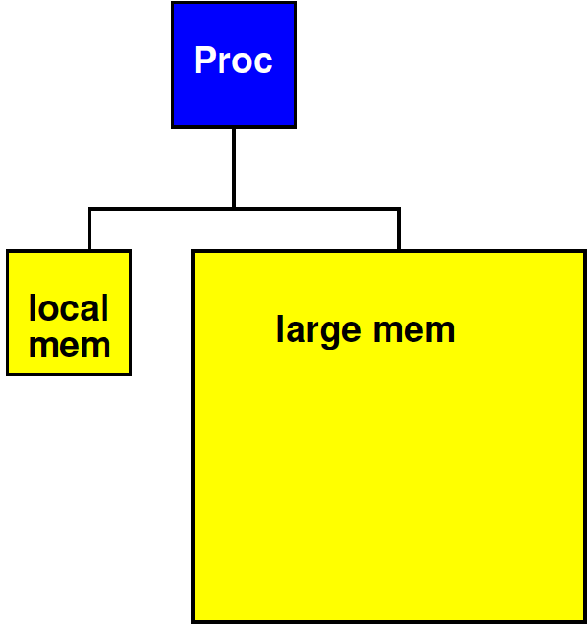
Strategy
Add small, local memory bank
  Small memories are faster

Slide 20
Preclass 3e
How use local memory to reduce large memory reads to 3d?
How much local memory need?
How much
faster might
small memory
be?

Slide 21
Lesson
Data can often be reused
  Keep data needed for computation in
    Closer, smaller (faster, less energy) memories
  Reduces latency costs
  Reduces bandwidth required from large memories
Reuse hint: value used multiple times
  Or value produced/consumed

Slide 22
Enhancing Reuse
Computations can often be (re-)organized around data reuse

Slide 23
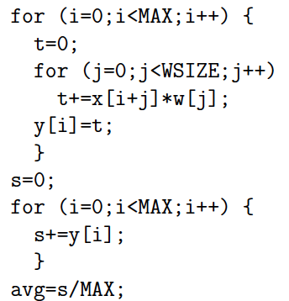
Reorganization Example
What reused?
Why problematic as written?
How revise code to promote local reuse?

Slide 24
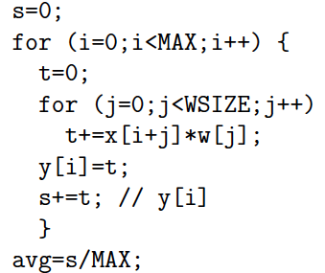
Reorganize

Slide 25
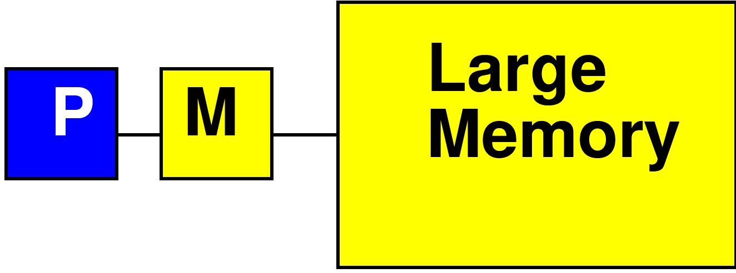
Processor Data Caches
Traditional Processor Data Caches are a heuristic instance of this
  Add a small memory local to the processor
    It is fast, low latency
  Store anything fetched from large/remote memory in local memory
    Hoping for reuse in near future
  On every fetch, check local memory before go to large memory

Slide 26
Cache
Goal: performance of small memory with density of large memory

Slide 27
Processor Data Caches
Demands more than a small memory
  Need to sparsely store address/data mappings from large memory
  Makes more area/delay/energy expensive than just a simple memory of capacity
Don’t need explicit data movement
Cannot control when data moved/saved
  Bad for determinism
Limited ability to control what stays in small memory simultaneously

Slide 28
Terminology
Cache
  Hardware-managed small memory in front of larger memory
Scratchpad
  Small memory
  Software (or logic) managed
  Explicit reference to scratchpad vs. large (other) memories
  Explicit movement of data

Slide 29
Bandwidth Engineering

Slide 30
Bandwidth Engineering
High bandwidth is easier to engineer than low latency
  Wide-word
  Banking
    Decompose memory into independent banks
    Route requests to appropriate bank

Slide 31
Wide Memory
Relatively easy to have a wide memory
As long as we share the address
  One address to select
  wide word or bits
Efficient if all read
together

Slide 32
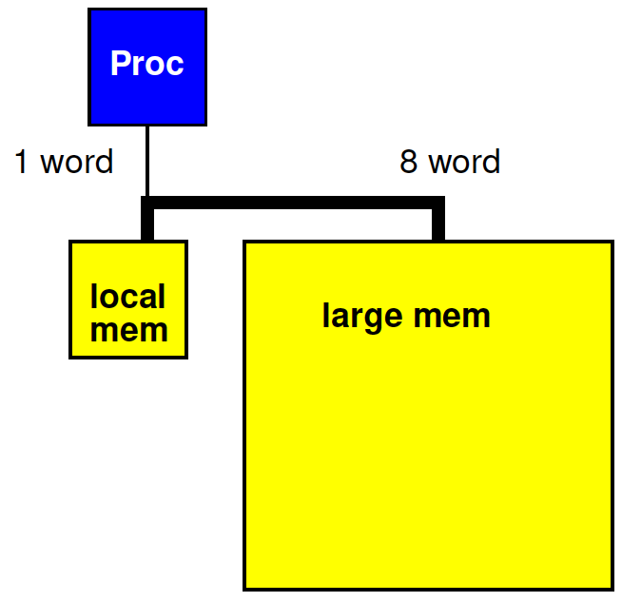
Revisit Preclass 3
Use wide memory access to move 8 words (x[]) between large and small memory in a single cycle

Slide 33
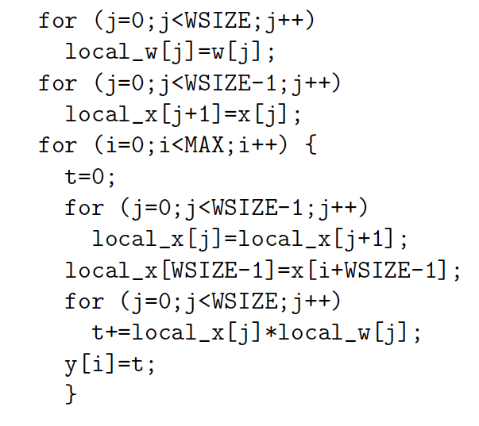
Preclass 3 + wide
Impact of 8 word datapath between
large and local memory?
WSIZE*MAX*(T_{comp}+3*T_{local})
+WSIZE*(T_{w}+T_{x})
+MAX*T_{x}
5*10⁶*(5+3)
+5*(20+20)
+10⁶*20
6*10⁷

Slide 34
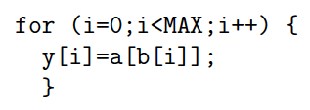
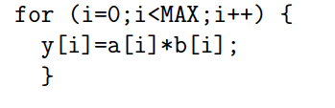
Preclass 4
Cycles reading from large memory for a, b
Cycles reading a, b from large memory.
20 cycle read latency; MAX=10⁶
 | a[i]*b[i] | a[b[i]]
1-word wide
8-word wide

Slide 35
Lesson
Cheaper to access wide/contiguous blocks memory
  In hardware
  From the architectures typically build
Can achieve higher bandwidth on large block data transfer
  Than random access of small data items

Slide 36
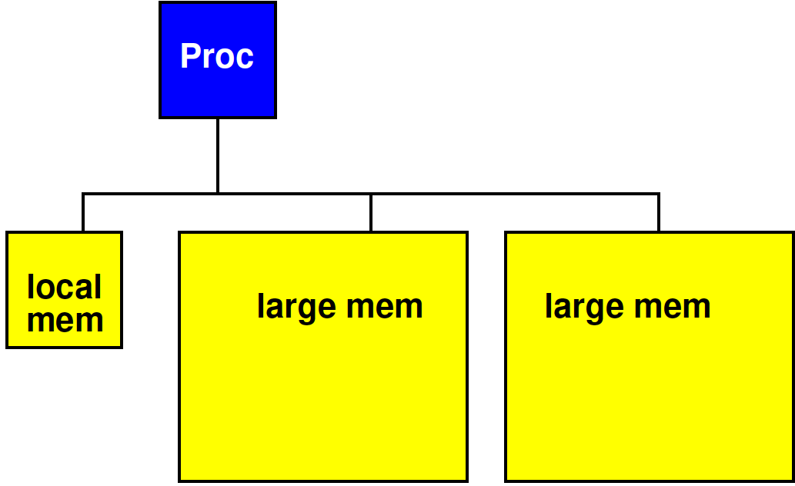
Bank Memory
Break memory into independent banks
  Allow banks to operate concurrently

Slide 37
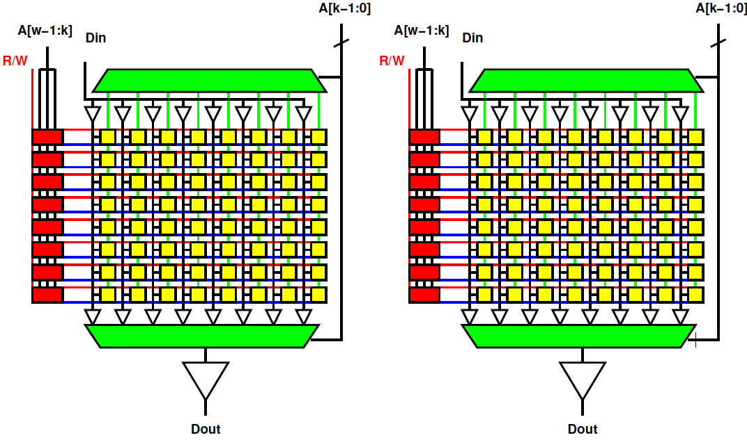
Bank Memory
Break memory into independent banks
  Allow banks to operate concurrently

Slide 38
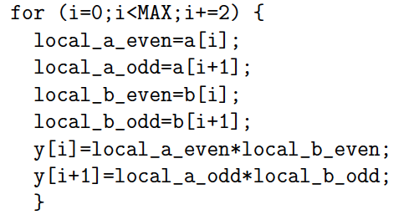
Preclass 4 Banked
20 cycle read latency; MAX=10⁶
Put odd a, b in one bank, even in other.
Cycles reading a, b from large memory?

Slide 39
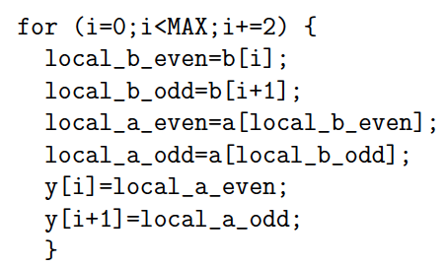
Preclass 4 Banked
20 cycle read latency; MAX=10⁶
Put odd a, b in one bank, even in other.
Cycles reading a, b from large memory?

Slide 40
Banking Costs
Area compare
  One memory bank
    Depth 1024, width 64
  Two memory banks
    Depth 1024, width 32

Slide 41
DRAM

Slide 42
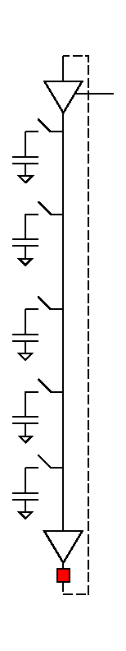
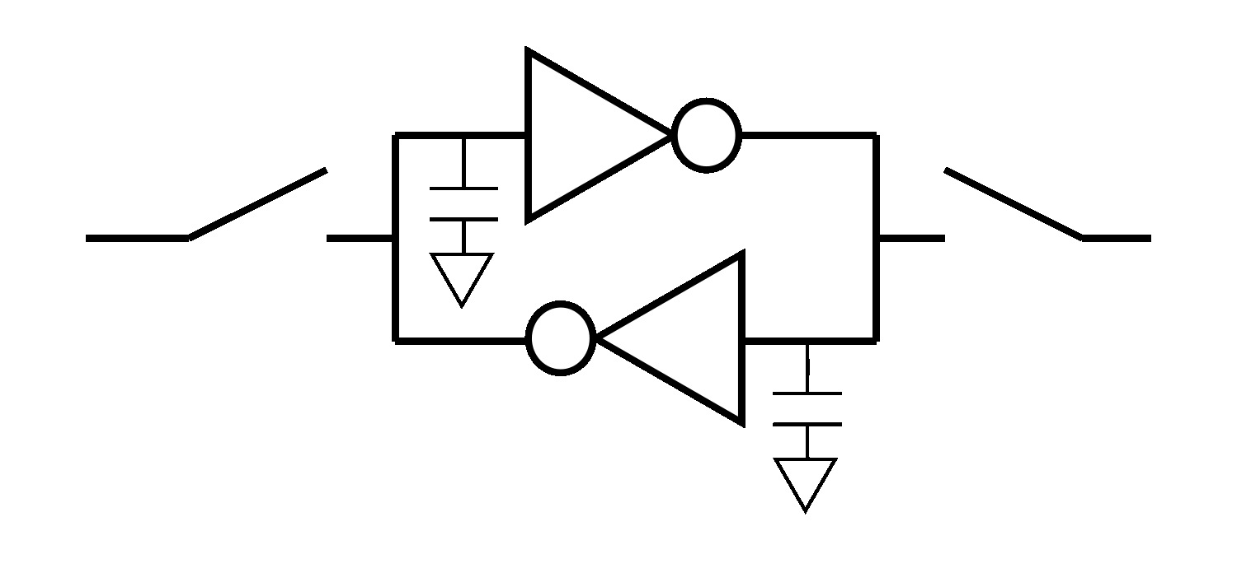
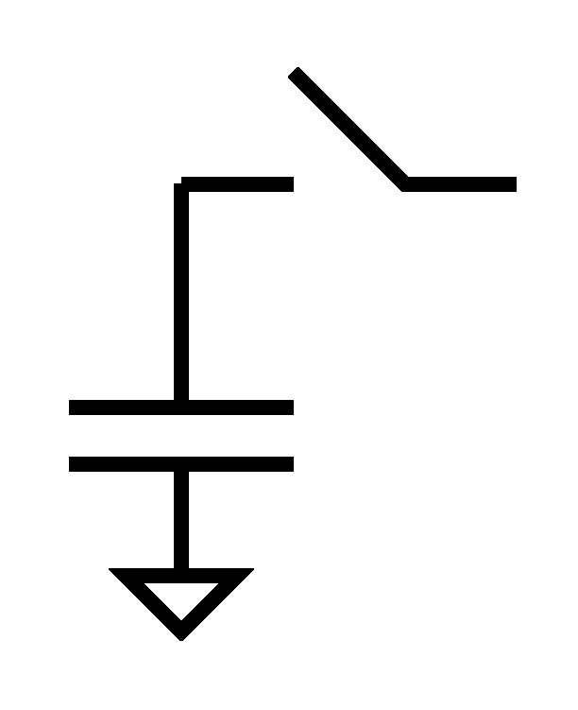
Dynamic RAM
Goes a step further
Share refresh/restoration logic as well
Minimal storage is a capacitor
“Feature” DRAM process is ability to make capacitors efficiently
Denser, but slower

Slide 43
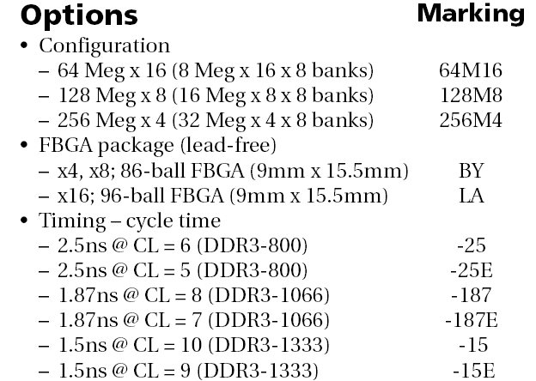
DRAM
1GB DDR3 SDRAM from Micron
  http://www.micron.com/products/dram/ddr3/
  96 pin pakage
  16b datapath IO
  Operate at 500+MHz
  37.5ns random access latency

Slide 44
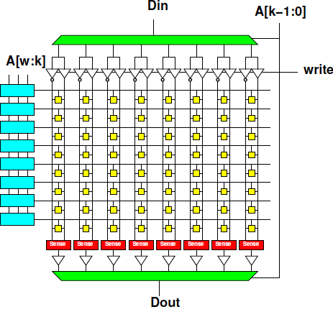
Memory Access Timing
Access:
  Address
  Row fetch
  Column select
  writeback/refresh
Optimization for access within a row

Slide 45
Memory Access Timing
Access
  Address
  Row fetch
  Column select
    Can repeat
  writeback/refresh
Row
1024b—8192b
Faster to access within row

Slide 46
DRAM
1GB DDR3 SDRAM from Micron
  http://www.micron.com/products/dram/ddr3/
  96 pin pakage
  16b datapath IO
  Operate at 500+MHz
  37.5ns random access latency

Slide 47
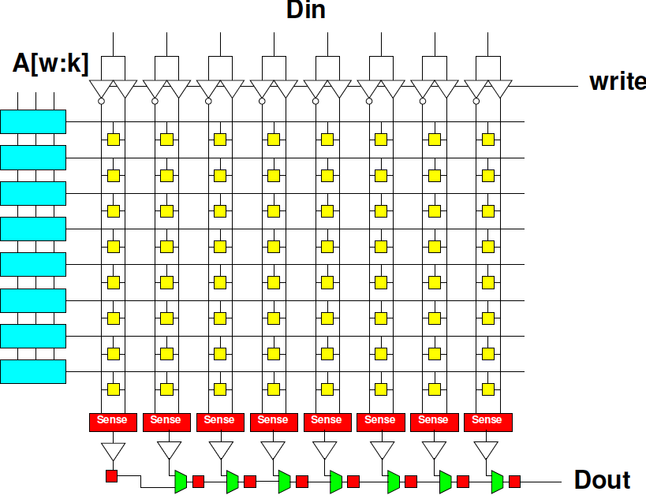
DRAM Streaming
Reading row
is 15ns
16b @ 500MHz
1024b row
1024/16
  64 words
  per row
How supply 16b/2ns

Slide 48
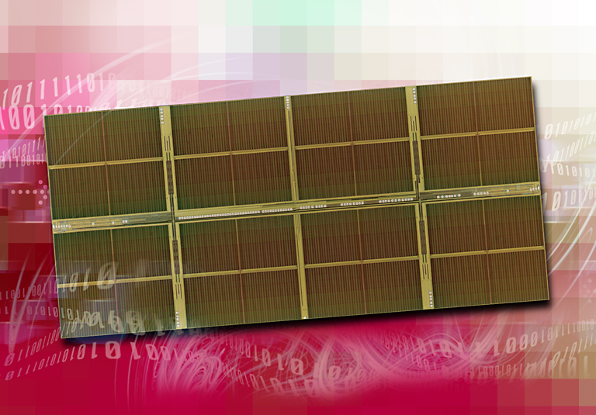
1 Gigabit DDR2 SDRAM
[Source: http://www.elpida.com/en/news/2004/11-18.html]

Slide 49
DRAM
Latency is large (10s of ns)
Throughput can be high (GB/s)
  If accessed sequentially
  If exploit wide word block transfers
Throughput low on random accesses
  As we saw for random access on wide-word memory

Slide 50
Memory Organization
Architecture contains
  Large memories
    For density, necessary sharing
  Small memories local to compute
    For high bandwidth, low latency, low energy
Need to move data
  Among memories
    Large to small and back
    Among small

Slide 51
Big Ideas
Memory bandwidth and latency can be bottlenecks
Exploit small, local memories
  Easy bandwidth, low latency, energy
Exploit data reuse
  Keep in small memories
Minimize data movement
  Small, local memories keep distance short
  Minimally move into small memories

Slide 52
Admin
Reading for Wednesday on canvas
HW2 due Friday

