Slide 1
ESE532: System-on-a-Chip Architecture
Day 4: September 13, 2017
Parallelism Overview

Slide 2
Today
Types of Parallelism
Compute Models

Slide 3
Message
Many useful models for parallelism
Help conceptualize
One-size does not fill all
Match to problem

Slide 4
Types of Parallelism

Slide 5
Types of Parallelism
Data Level – Perform same computation on different data items
Thread or Task Level – Perform separable (perhaps heterogeneous) tasks independently
Instruction Level – Within a single sequential thread, perform multiple operations on each cycle.

Slide 6
Pipeline Parallelism
Pipeline – organize computation as a spatial sequence of concurrent operations
Can introduce new inputs before finishing
Instruction- or thread-level
Use for data-level parallelism
Can be directed graph

Slide 7
Sequential
Build 1
Single person build E
Latency?
Throughput?

Slide 8
Data Parallel
Build 2
Everyone in class build own E
Latency?
Throughput?
Ideal speedup?
Resource Bound?
100 Es, 12 people
When useful?

Slide 9
Data-Level Parallelism
Data Level – Perform same computation on different data items
Ideal: T_{dp} = T_{seq}/P

Slide 10
Thread Parallel
Build 3
Each person build indicated letter
Latency?
Throughput?
Speedup over sequential build?

Slide 11
Thread-Level Parallelism
Thread or Task Level – Perform separable (perhaps heterogeneous) tasks independently
Ideal: T_{dp} = T_{seq}/P
Can produce a diversity of calculations
Useful if have limited need for the same calculation

Slide 12
Instruction-Level Data Parallel
Build 4
Build E together in lock step
Instructions from slides
To get proper flavor, please stay together
(do not build ahead)

Slide 13
Step 1

Slide 14
Step 2

Slide 15
Step 3

Slide 16
Step 4

Slide 17
Step 5

Slide 18
Step 6

Slide 19
Step 7

Slide 20
Step 8

Slide 21
Instruction-Level Data Parallel
Latency?
Throughput?

Slide 22
Instruction-Level Data Parallel
Instruction Level – Within a single sequential thread, perform multiple operations on each cycle.
+ Data parallel
Able to share instructions

Slide 23
Instruction-Level Parallelism
Build 5
Build word in lock step
Announce step from slides
Don’t build ahead
Consult local instructions on what to do on step

Slide 24
Step 0

Slide 25
Step 1

Slide 26
Step 2

Slide 27
Step 3

Slide 28
Step 4

Slide 29
Step 5

Slide 30
Step 6

Slide 31
Step 7

Slide 32
Step 8

Slide 33
Instruction-Level Parallelism
Latency?
Throughput?

Slide 34
Instruction-Level Data Parallel
Instruction Level – Within a single sequential thread, perform multiple operations on each cycle.
Able to perform different calculations concurrently
Requires local instructions

Slide 35
Instruction-Level Parallelism
Build 6
Build single letter in lock step
4 groups of 3
Resource Bound for 3 people building 9-brick letter?
Announce steps from slide
Stay in step with slides

Slide 36
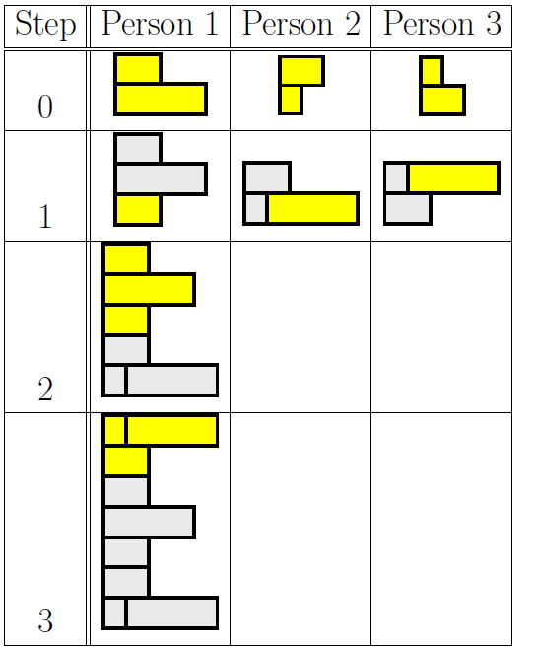
Group Communication
Groups of 3
Note who was person 1 task
2, 3 will need to pass completed substructures

Slide 37
Step 0

Slide 38
Step 1

Slide 39
Step 2

Slide 40
Step 3

Slide 41
Instruction-Level Parallelism
Latency?
Throughput?
Can reduce latency for single letter
Ideal: T_{latency} = T_{seqlatency}/P

Slide 42
Instruction-Level Pipeline
Build 7
Each person adds one brick to build
Run pipeline once alone
Latency?
Then run pipeline with 5 inputs
Throughput?

Slide 43
Thread Pipeline
Build 8
Each person builds letter and adds to work
Identify where pipeline flows
Run once
Latency?
Throughput?

Slide 44
Thread Graph
Build 9
Each person build designated sub-assembly and pass off
Who gets E, S?
Who gets 3, 2?
Who gets E, 5, and ES, 32 sub-assemblies?
Run once
Latency?
Throughput?

Slide 45
Parallel Compute Models

Slide 46
Sequential Control Flow
Control flow
Program is a sequence of operations
Operation reads inputs and writes outputs into common store
One operation runs at a time
defines successor
Model of correctness is sequential execution
Examples
C (Java, …)
FSM / FA

Slide 47
Parallelism can be explicit
ILP Build example
Coordinate data parallel operations
Multiply, add for quadratic equation
Coordinate ILP
cycle | mpy | add
1 | B,x
2 | x,x | (Bx)+C
3 | A,x²
4 |  | Ax²+(Bx+C)

Slide 48
Parallelism can be implicit
Sequential expression
Infer data dependencies
T1=x*x
T2=A*T1
T3=B*x
T4=T2+T3
Y=C+T4
Or
Y=A*x*x+B*x+C

Slide 49
Implicit Parallelism
d=(x1-x2)*(x1-x2) + (y1-y2)*(y1-y2)
What parallelism exists here?

Slide 50
Parallelism can be implicit
Sequential expression
Infer data dependencies
for (i=0;i<100;i++)
y[i]=A*x[i]*x[i]+B*x[i]+C
Why can these operations be performed in parallel?

Slide 51
Term: Operation
Operation – logic computation to be performed

Slide 52
Dataflow / Control Flow
Dataflow
Program is a graph of operations
Operation consumes tokens and produces tokens
All operations run concurrently
Control flow (e.g. C)
Program is a sequence of operations
Operation reads inputs and writes outputs into common store
One operation runs at a time
defines successor

Slide 53
Token
Data value with presence indication
May be conceptual
Only exist in high-level model
Not kept around at runtime
Or may be physically represented
One bit represents presence/absence of data

Slide 54
Token Examples?
What are familiar cases where data may come with presence tokens?
Network packets
Memory references from processor
Variable latency depending on cache presence
Start bit on serial communication

Slide 55
Operation
Takes in one or more inputs
Computes on the inputs
Produces results
Logically self-timed
“Fires” only when input set present
Signals availability of output

Slide 56
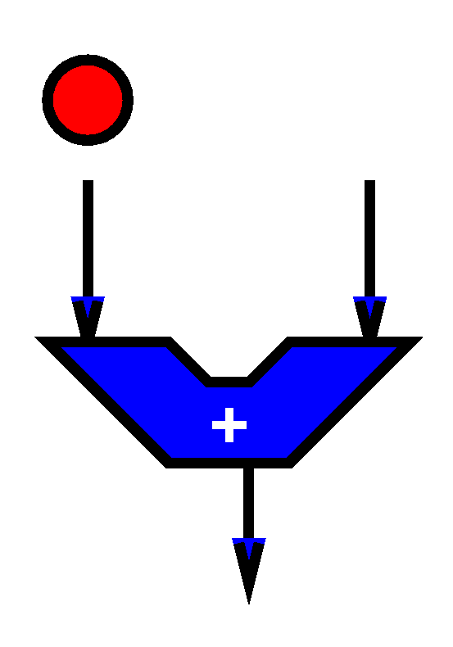
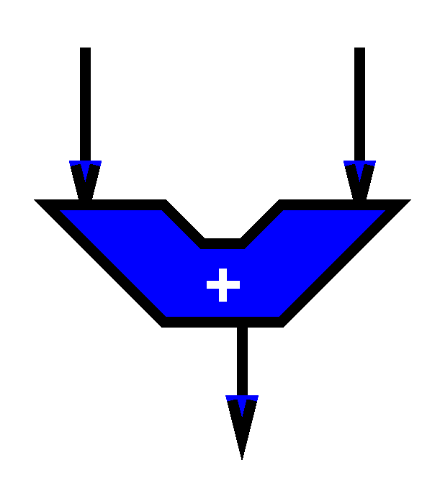
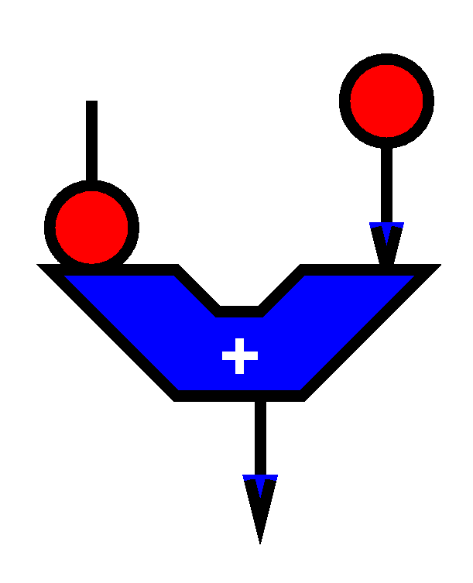
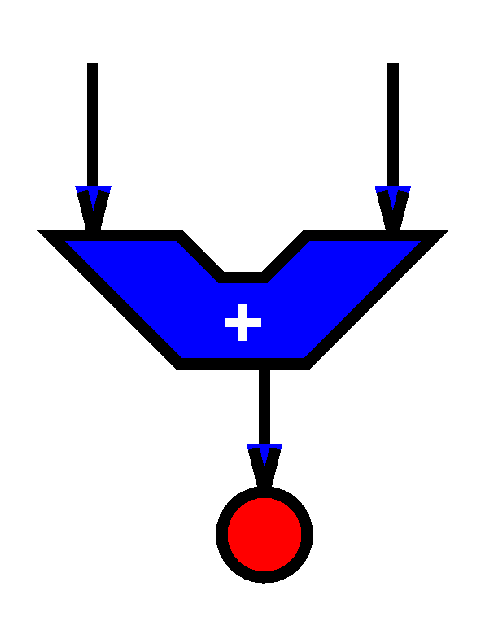

Slide 57
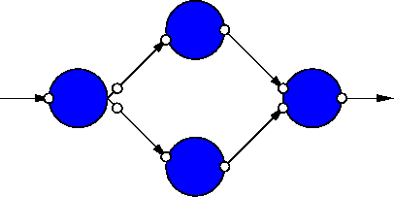
Dataflow Graph
Represents
computation sub-blocks
linkage
Abstractly
controlled by data presence

Slide 58
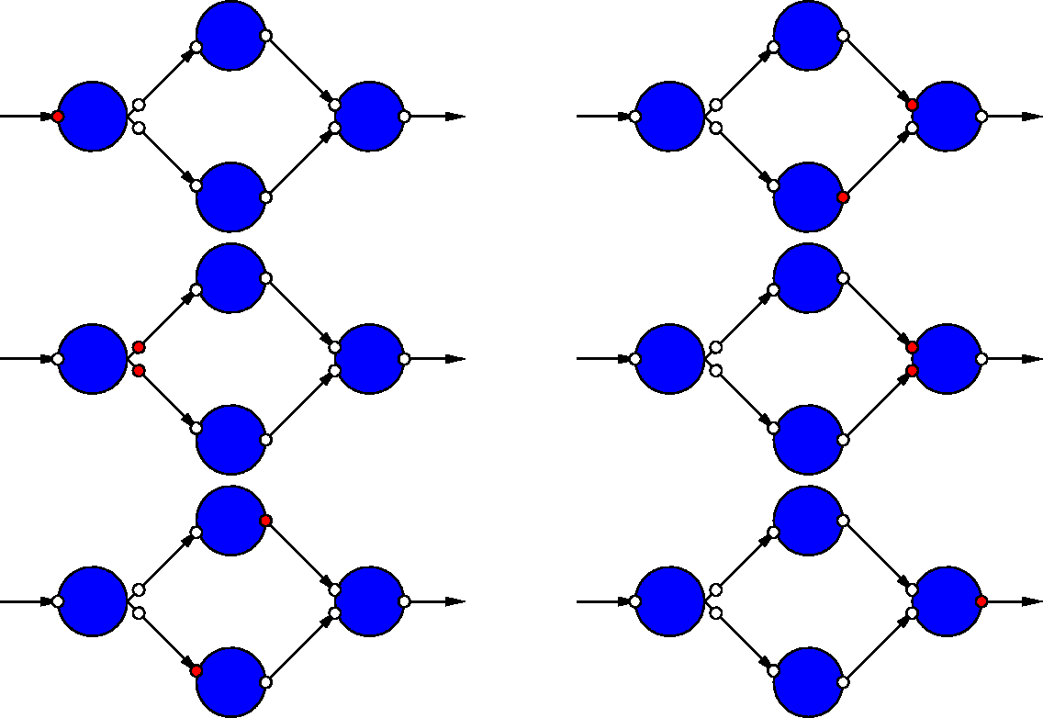
Dataflow Graph Example

Slide 59
Sequential / FSM
FSM is degenerate dataflow graph where there is exactly one token
S1
x not
present?
cycle | mpy | add | next
S1 | B,x |  | x-->S2, else S1
S2 | x,x | (Bx)+C | S3
S3 | A,x² |  | S4
S4 |  | Ax²+(Bx+C) | S1
S2
S3
S4

Slide 60
Sequential / FSM
FSM is degenerate dataflow graph where there is exactly one token
S1
cycle | mpy | add | next
S1 | B,x |  | x-->S2, else S1
S2 | x,x | (Bx)+C | S3
S3 | A,x² |  | S4
S4 |  | Ax²+(Bx+C) | S1
S2
S3
S4

Slide 61
Communicating Threads
Computation is a collection of sequential/control-flow “threads”
Threads may communicate
Through dataflow I/O
(Through shared variables)
View as hybrid or generalization
CSP – Communicating Sequential Processes → canonical model example

Slide 62
Video Decode
Audio
Sync to HDMI
Parse
Video
Why might need to synchronize to send to HDMI?

Slide 63
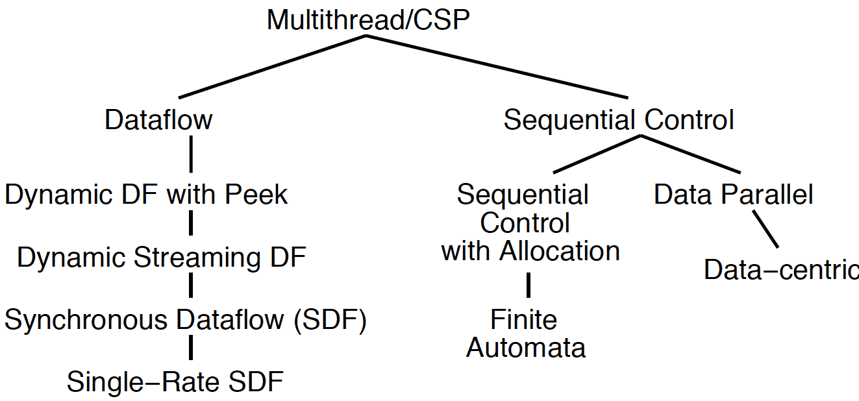
Compute Models

Slide 64
Value of Multiple Models
When you have a big enough hammer, everything looks like a nail.
Many stuck on single model
Try to make all problems look like their nail
Value to diversity / heterogeneity
One size does not fit all

Slide 65
Big Ideas
Many parallel compute models
Sequential, Dataflow, CSP
Find natural parallelism in problem
Mix-and-match

Slide 66
Admin
Reading Day 5 …
HW2 due Friday

