Slide 1
ESE532: System-on-a-Chip Architecture
Day 5: September 18, 2017
Dataflow Process Model

Slide 2
Today
Dataflow Process Model
Motivation
Issues
Abstraction
Basic Approach
Dataflow variants
Motivations/demands for variants

Slide 3
Message
Parallelism can be natural
Expression can be agnostic to substrate
Abstract out implementation details
Tolerate variable delays may arise in implementation
Divide-and-conquer
Start with coarse-grain streaming dataflow
Basis for performance optimization and parallelism exploitation

Slide 4
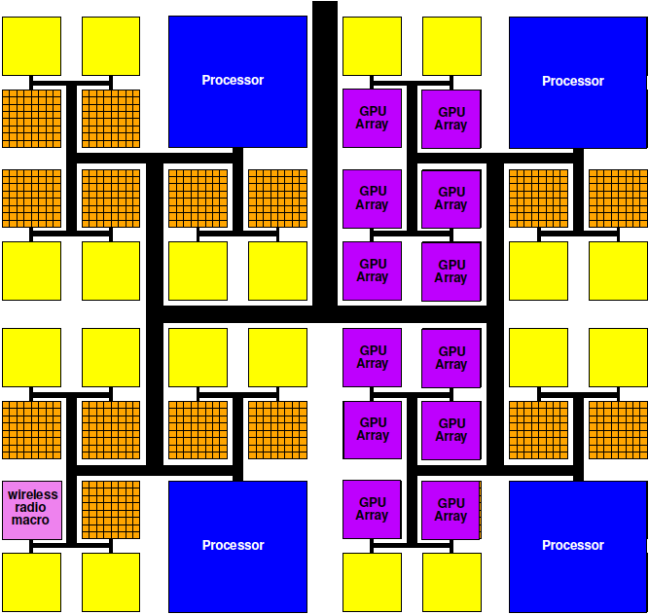
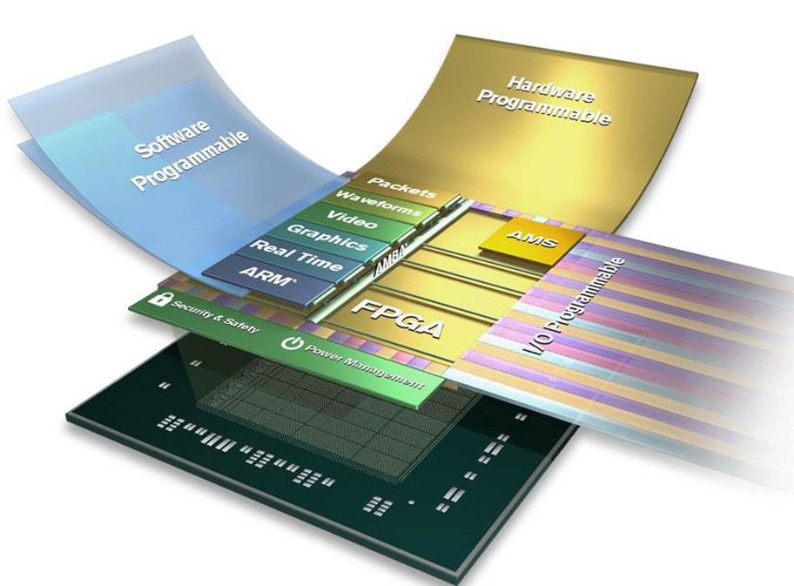
Programmable SoC
Implementation Platform for innovation
This is what you target (avoid NRE)
Implementation vehicle

Slide 5
Reminder
Goal: exploit parallelism on heterogeneous PSoC to achieve desired performance (energy)

Slide 6
Process
Abstraction of a processor
Looks like each process is running on a separate processor
Has own state, including
Program Counter (PC)
Memory
Input/output
May not actually run on processor
Could be specialized hardware block

Slide 7
Thread
Has a separate locus of control (PC)
May share memory
Run in common address space with other threads

Slide 8
FIFO
First In First Out
Delivers inputs to outputs in order
Data presence
Consumer knows when data available
Back Pressure
Producer knows when at capacity
Typically stalls
Decouples producer and consumer
Hardware: maybe even different clocks

Slide 9
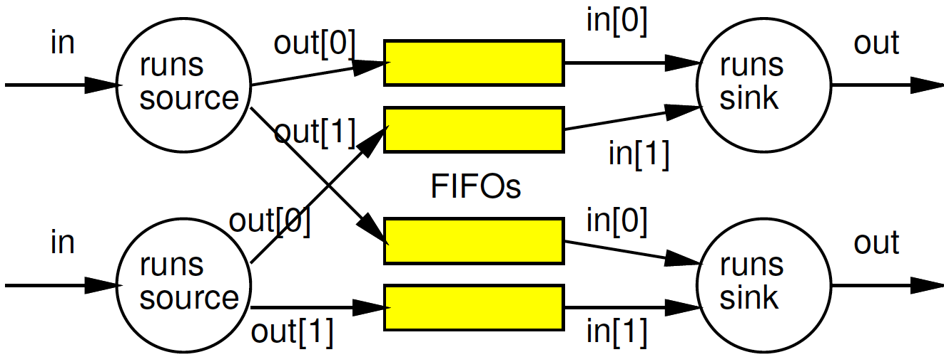
Preclass 1
Value of separate processes?

Slide 10
Process
Processes allow expression of independent control
Convenient for things that advance independently
Performance optimization resource utilization

Slide 11
Issues
Communication – how move data between processes?
What latency does this add?
Throughput achievable?
Synchronization – how define how processes advance relative to each other?
Determinism – for the same inputs, do we get the same outputs?

Slide 12
Today’s Stand
Communication – FIFO-like channels
Synchronization – dataflow with FIFOs
Determinism – how to achieve
…until you must give it up.

Slide 13
Dataflow Process Model

Slide 14
Operation/Operator
Operation – logic computation to be performed
A process that communicates through dataflow inputs and outputs
Operator – physical block that performs an Operation

Slide 15
Dataflow / Control Flow
Dataflow
Program is a graph of operations
Operation consumes tokens and produces tokens
All operations run concurrently
All processes
Control flow (e.g. C)
Program is a sequence of operations
Operation reads inputs and writes outputs into common store
One operation runs at a time
defines successor

Slide 16
Token
Data value with presence indication
May be conceptual
Only exist in high-level model
Not kept around at runtime
Or may be physically represented
One bit represents presence/absence of data

Slide 17
Stream
Logical abstraction of a persistent point-to-point communication link between operators
Has a (single) source and sink
Carries data presence / flow control
Provides in-order (FIFO) delivery of data from source to sink
stream

Slide 18
Streams
Captures communications structure
Explicit producer→consumer link up
Abstract communications
Physical resources or implementation
Delay from source to sink

Slide 19
Streams
Stream: logical communication link
What would we use
Two threads running on a single processor?
Two processes running on different processors on the same die?
Two processes running on different hosts
E.g. one at Penn, one on Amazon cloud

Slide 20
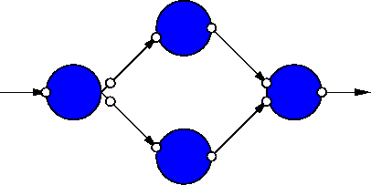
Dataflow Process Network
Collection of Operators
Connected by Streams
Communicating with Data Tokens

Slide 21
Dataflow Abstracts Timing
Doesn’t say
on which cycle calculation occurs
Does say
What order operations occur in
How data interacts
i.e. which inputs get mixed together
Permits
Scheduling on different # and types of resources
Operators with variable delay
Variable delay in interconnect

Slide 22
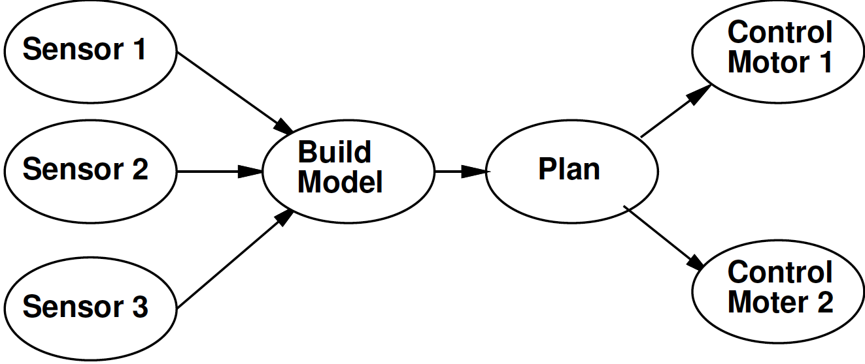
Some Task Graphs

Slide 23
Synchronous Dataflow (SDF) with fixed operators
Particular, restricted form of dataflow
Each operation
Consumes a fixed number of input tokens
Produces a fixed number of output tokens
Operator performs fixed number of operations (in fixed time)
When full set of inputs are available
Can produce output
Can fire any (all) operations with inputs available at any point in time

Slide 24
SDF Operator
FFT
1024 inputs
1024 outputs
10,240 multiplies
20,480 adds
(or 30,720 primitive operations)
1024
1024
30,720

Slide 25
Processor Model
Simple
Assume one primitive operation per cycle
Could embelish
Different time per operation type
Multiple memories with different timings

Slide 26
Time for Graph Iteration
Single processor
One processor per Operator
General
c(x,y) – 1 if Processor x runs task y

Slide 27
Intel Xeon Phi Pricing

Slide 28
Intel Knights Landing
https://www.nextplatform.com/2016/06/20/intel-knights-landing-yields-big-bang-buck-jump/
[Intel, Micro 2016]

Slide 29
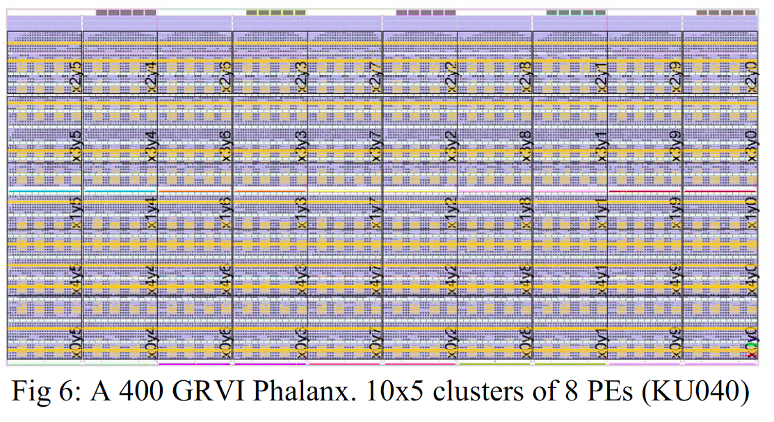
GRVI/Phallanx
Puts 1680 RISC-V32b Integer cores
On XCVU9P FPGA
http://fpga.org/2017/01/12/grvi-phalanx-joins-the-kilocore-club/
[Gray, FCCM 2016]

Slide 30
Map to different processors
30,000
15,000
3,000
2,000
Map to
One processor performance?
One process per processor performance?
Two processors
How
Performance?

Slide 31
Refine Data Parallel
If component is data parallel, can split out parallel tasks

Slide 32
Refine Pipeline
If operation internally pipelineable, break out pipeline into separate tasks
6,000
6,000
6,000
6,000
6,000
2,000
7,500
3,000

Slide 33
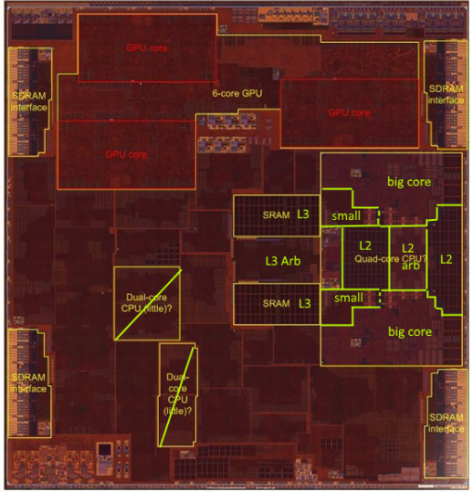
Today SoC: Apple A10
3.3B transistors
Quad=Dual Dual Core
Dual 64-bit ARM 2.3GHz
Dual 64-bit ARM low energy
3MB L2 cache
6 GPU cores
Custom accelerators
Image Processor?
125mm² 16nm FinFET
Chipworks Die Photo

Slide 35
Heterogeneous Processor
30,000
15,000
3,000
2,000
GPU perform 10 primitive FFT Ops per cycle
Fast CPU can perform 2 ops/cycle
Slow CPU 1 op/cycle
Map: FFT→ GPU, Select to 2 Fast CPUs, quantize and Entropy each to won Slow CPU
Cycles/graph iteration?

Slide 36
Custom Accelerator
Dataflow Process doesn’t need to be mapped to a processor
Map FFT to custom datapath on FPGA logic
Read and produce one element per cycle
1024 cycles to process 1024-point FFT
1024
15,000
3,000
2,000

Slide 37
Operations
Can be implemented on different operators with different characteristics
Small or large processor
Hardware unit
Different levels of internal
Data-level parallelism
Instruction-level parallelism
May itself be described as
Dataflow process network, sequential, hardware register transfer language

Slide 38
Add Delay
What do to computation if add an operator that copies inputs to outputs with some latency?
Function?
Performance if Identity operator has
Latency 10, throughput 1 value per cycle?
30,000
1024
15,000
3,000
2,000

Slide 39
Communication Latency
Once map to multiple processors
Need to move data between processors
That costs time

Slide 40
On-Chip Delay
Day 3
Delay is proportional to distance travelled
Make a wire twice the length
Takes twice the latency to traverse
(can pipeline)
Modern chips
Run at 100s of MHz to GHz
Take 10s of ns to cross the chip

Slide 41
Dataflow gives Clock Independent Semantics
Interconnect
Takes n-clocks
Latency

Slide 42
Semantics
Need to implement semantics
i.e. get same result as if computed as indicated
But can implement any way we want
That preserves the semantics
Exploit freedom of implementation

Slide 43
Basic Approach

Slide 44
Approach (1)
Identify natural parallelism
Convert to streaming flow
Initially leave operators software
Focus on correctness
Identify flow rates, computation per operator, parallelism needed
Refine operators
Decompose further parallelism?
E.g. data parallel split, ILP implementations
model potential hardware

Slide 45
Approach (2)
Refine coordination as necessary for implementation
Map operators and streams to resources
Provision hardware
Scheduling: Map operations to operators
Memories, interconnect
Profile and tune
Refine

Slide 46
Dataflow Variants

Slide 47
Process Network Roundup
Model | Deterministic Result | Deterministic Timing | Turing Complete
SDF+fixed-delay operators | Y | Y | N
SDF+variable delay operators | Y | N | N
DDF blocking | Y | N | Y
DDF non-blocking | N | N | Y

Slide 48
Synchronous Dataflow (SDF) with fixed operators
Particular, restricted form of dataflow
Each operation
Consumes a fixed number of input tokens
Produces a fixed number of output tokens
Operator performs fixed number of operations (in fixed time)
When full set of inputs are available
Can produce output
Can fire any (all) operations with inputs available at any point in time

Slide 49
Synchronous Dataflow (SDF)
Particular, restricted form of dataflow
Each operation
Consumes a fixed number of input tokens
Produces a fixed number of output tokens
(can take variable computation for operator)
When full set of inputs are available
Can produce output
Can fire any (all) operations with inputs available at any point in time

Slide 50
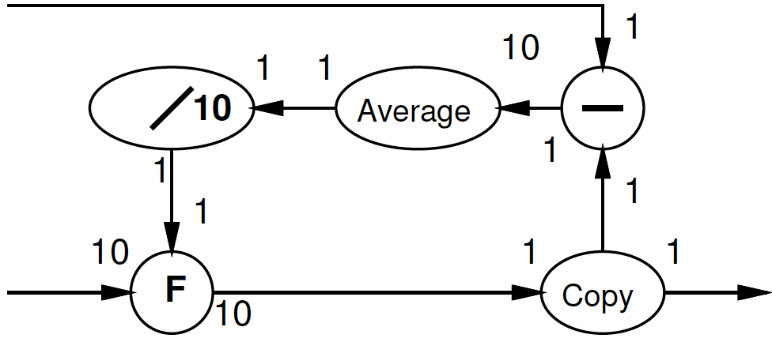
Multirate Synchronous Dataflow
Rates can be different
Allow lower frequency operations
Communicates rates to tools
Use in scheduling, provisioning
Rates must be constant
Data independent
2
decimate
1

Slide 51
Dynamic Dataflow
(Less) restricted form of dataflow
Each operation
Conditionally consume input based on data value
Conditionally produce output based on data value
When full set of inputs are available
Can (optionally) produce output
Can fire any (all) operations with data-specified necessary inputs available at any point in time

Slide 52
Blocking
Key to determinism: behavior doesn’t depend on timing
Cannot ask if a token is present
If (not_empty(in))
Out.put(3);
Else
Out.put(2);

Slide 53
Process Network Roundup
Model | Deterministic Result | Deterministic Timing | Turing Complete
SDF+fixed-delay operators | Y | Y | N
SDF+variable delay operators | Y | N | N
DDF blocking | Y | N | Y
DDF non-blocking | N | N | Y

Slide 54
Motivations and Demands for Options
Time Permitting

Slide 55
Variable Delay Operators
What are example of variable delay operators we might have?

Slide 56
GCD (Preclass 3)
Compute Data Parallel GCD
What is delay of GCD computation?
while(a!=b)
t=max(a,b)-min(a,b)
a=min(a,b)
b=t
return(a);

Slide 57
Preclass 4
How long to process each input?
Correlation in delays?
What benefit from FIFO and processes?

Slide 58
Dynamic Rates?
When might static rates be limiting? (prevent useful optimizations?)

Slide 59
When non-blocking necessary?
What are cases where we need the ability to ask if a data item is present?

Slide 60
Non-Blocking
Removed model restriction
Can ask if token present
Gained expressive power
Can grab data as shows up
Weaken our guarantees
Possible to get non-deterministic behavior

Slide 61
Process Network Roundup
Model | Deterministic Result | Deterministic Timing | Turing Complete
SDF+fixed-delay operators | Y | Y | N
SDF+variable delay operators | Y | N | N
DDF blocking | Y | N | Y
DDF non-blocking | N | N | Y

Slide 62
Big Ideas
Capture gross parallel structure with Process Network
Use dataflow synchronization for determinism
Abstract out timing of implementations
Give freedom of implementation
Exploit freedom to refine mapping to optimize performance
Minimally use non-determinism as necessary

Slide 63
Admin
Reading for Day 6 on web
HW3 due Friday

