Slide 1
ESE532: System-on-a-Chip Architecture
Day 7: September 25, 2017
Pipelining

Slide 2
Previously
Pipelining in the large
Not just for gate-level circuits
Throughput and Latency
Form of parallelism

Slide 3
Today
Pipelining details (for gates, primitive ops)
Systematic Approach
Justify Operator and Interconnect Pipelining
Loop Bodies
Cycles
C-slow

Slide 4
Message
Pipelining efficient way to reuse hardware to perform the same set of operations at high throughput

Slide 5
Synchronous Circuit Discipline
Registers that sample inputs at clock edge and hold value throughout clock period
Compute from registers-to-registers
Cycle time large enough for longest logic path between registers
Min cycle = Max path delay between registers
Comb
logic

Slide 6
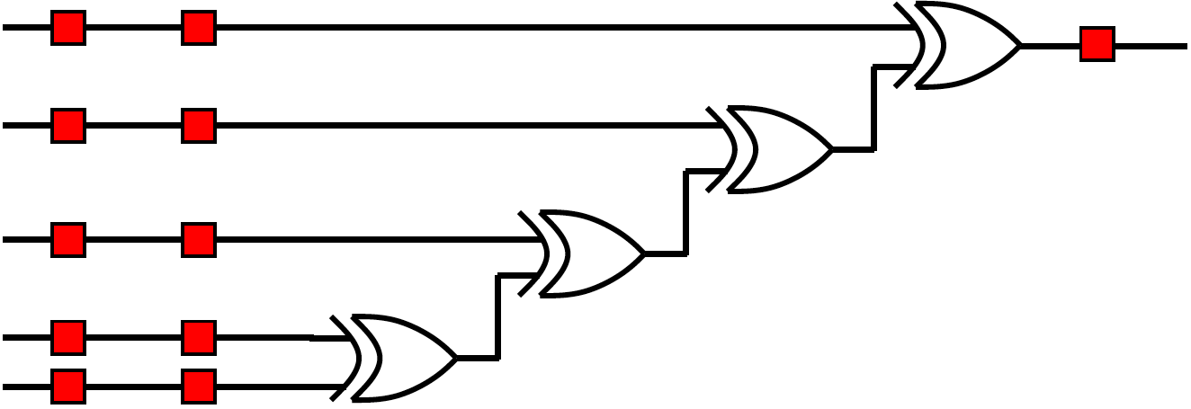
Preclass 1
Delay between registers as shown?

Slide 7
Preclass 1
Move registers so can clock at 2-xor-delays?

Slide 8
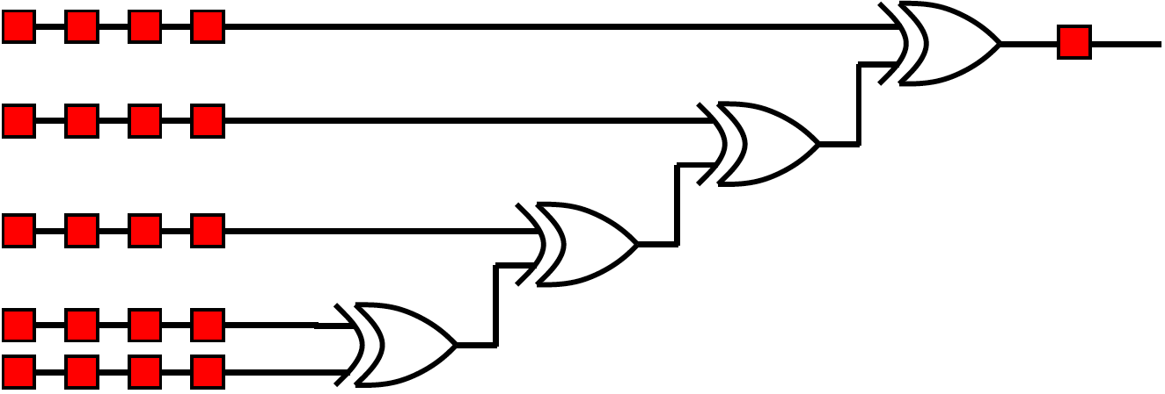
Preclass 2
Move registers so can clock at xor-delays?

Slide 9
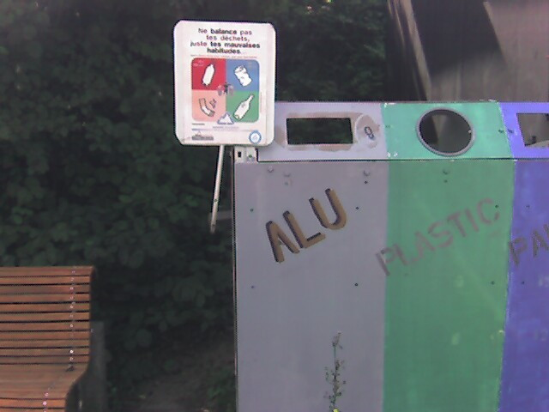
Pipeline Reuse
Lower delay between clocks
Higher clock rate
Higher potential throughput
Faster we reuse our logic
More capacity get out of design
Assuming registers cheap in are and time overhead

Slide 10
Levelize-and-Cut Pipelining
Assuming willing to pipeline into as many cycles as necessary
Draw circuit in levels by delay from input
Level=max(level of inputs)+delay operator
Given cycle time target
Count forward to target
Bisect circuit adding register on every cut link
Repeat count-and-bisect until done

Slide 11
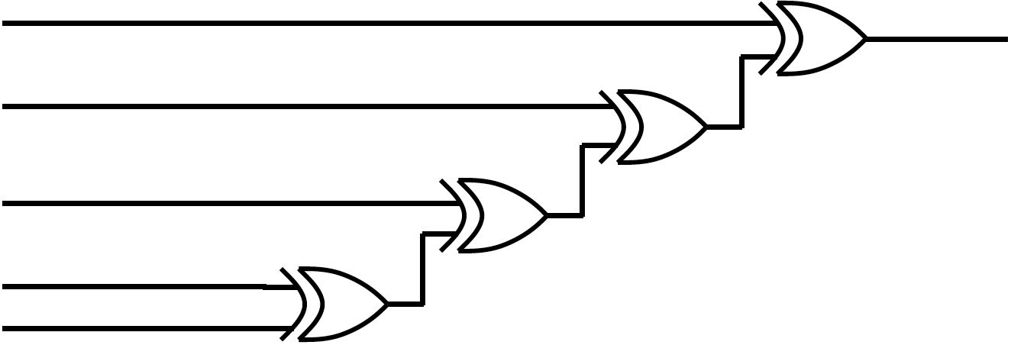
Apply to xor-chain
Levelize and Cut

Slide 12
Note Registers on Links
Some links end up with multiple registers.
Why?

Slide 13
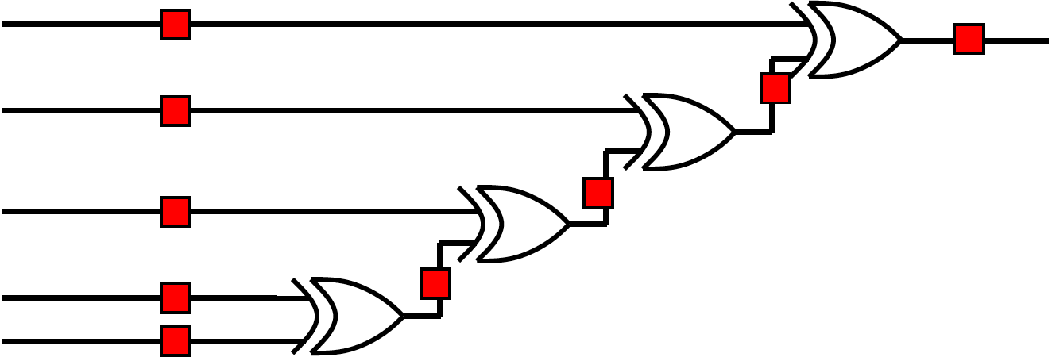
What Happens?
What would be wrong with this pipelining?

Slide 14
Consistent Pipelining
Levelize-and-cut guarantees path from input to any gate input passes through the same number of registers
Makes sure a consistent input set arrives at each gate/operator
Don’t get mixing between input sets

Slide 15
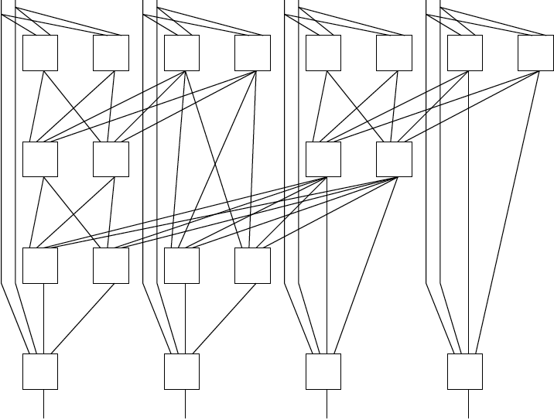
Levelize and Cut
Pipeline to operator level

Slide 16
Add Registers and Move
If we’re willing to add pipeline delay
Add any number of pipeline registers at input
Move registers into circuit to reduce cycle time
Reduce max delay between registers

Slide 17
Add Registers at Input

Slide 18
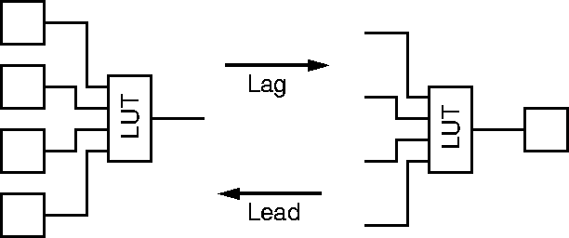
Legal Register Moves
Retiming Lag/Lead

Slide 19
Add Register and Retime
Add chain of registers on every input
Retime registers into circuit
Minimizing delay between registers

Slide 20
Preclass 1
Retime

Slide 21
Add Registers and Retime
Lets us think about behavior
What the pipelining is doing to cycles of delay
Separate from details of how redistribute registers
Behavioral equivalence between the registers-at-front and properly retimed version of circuit

Slide 22
Automation
RTL Synthesis tools will take care of retime
RTL Synthesis will not add registers
Changes behavior
Changes number of clocks
Add registers and retime --- leave retiming to automated tools

Slide 23
Justify Pipelining
(or composing pipelined operators)

Slide 24
Handling Pipelined Operators
Given a pipelined operator
(or a pipelined interconnect)
Discipline of picking a frequency target and designing everything for that
May be necessary to pipeline operator since it’s delay is too high
Due to hierarchy
Pipelined this operator and now want to use it as a building block

Slide 25
Examples
Run at 500MHz
Floating-point unit that takes 9ns
Can pipeline into 5, 2ns stages
Multiplier that takes 6ns
Memory can access in 2ns
Only if registers on address/inputs and output
i.e. exist in own clock stage

Slide 26
Interconnect Delay
Chips >> Clock Cycles
May have chip 100s of Operators wide
May only be able to reach across 10 operators in a 2ns cycle
Must pipeline long interconnect links

Slide 27
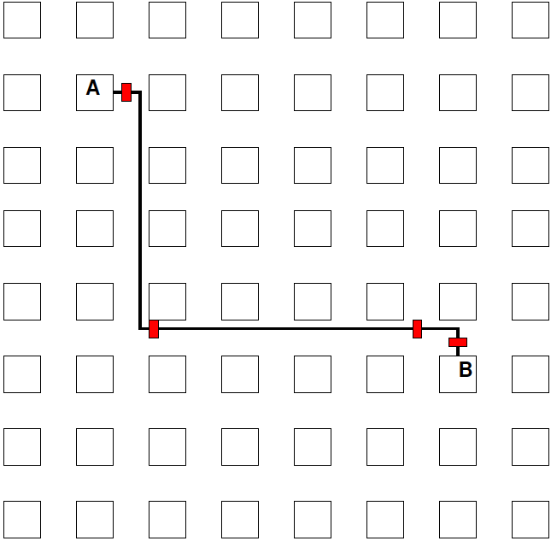
Interconnect Example

Slide 28
Pipelined Operator Graph
Start with logical, unpipelined graph
Treat each pipelined operator as a set of unit-delay operators of mandatory depth
Treat each interconnect pipeline stage as a unit-delay buffer
Add registers as input
Retime into graph

Slide 29
Model
3-stage Multiplier
Interconnect Delay
A
I1
M1
I2
M2
I3
M3
B

Slide 30
Pipeline Loop
(and use for justify pipeline example)

Slide 31
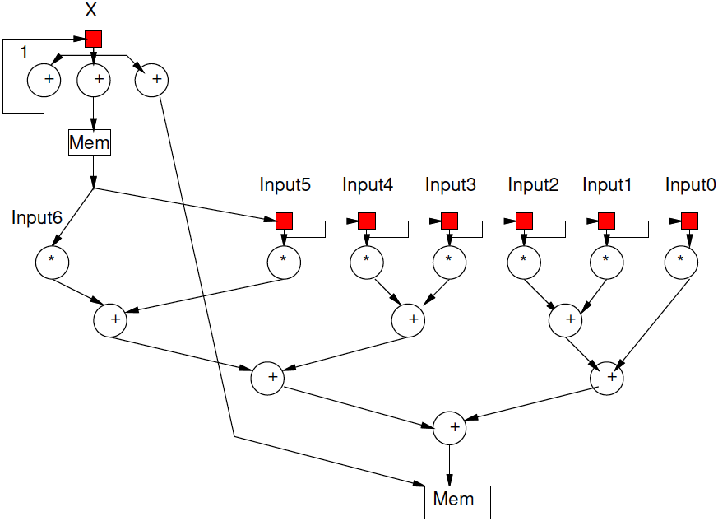
Preclass 4
Logical (unpipelined) dataflow graph for loop body

Slide 32
Example Operators
Operator and Interconnect delays
Multiplier 3 cycles
Reading from input
Memory op is cycle after computing address
Takes one cycle delay bring data back to multiplier

Slide 33
Example Need
What happens if just use graph as is (with operators pipelined as required)?

Slide 34
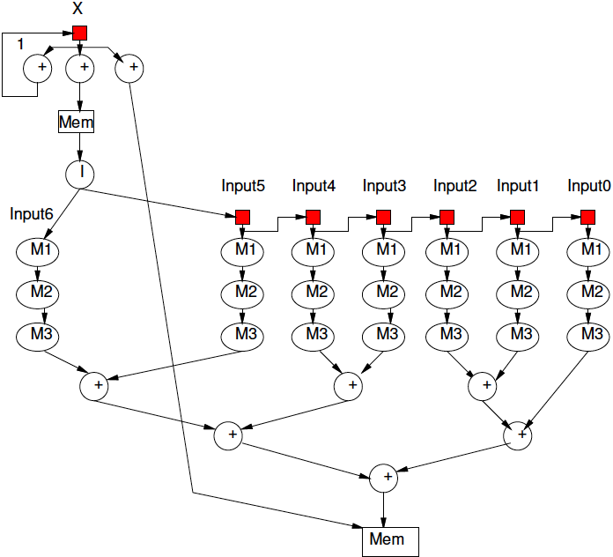
Model Graph
Revised graph for modeling

Slide 35
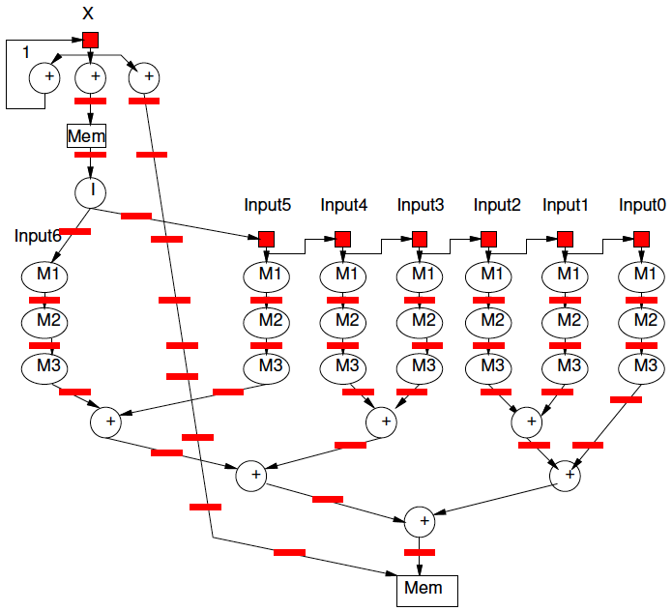
Pipeline Graph
Result after pipelining?

Slide 36
Pipelining Result
Can always pipeline an acyclic graph to fixed frequency target
fixed pipelining of primitive operators
Pipeline interconnect delays
Need to keep track of registers to balance paths
So see consistent delays to operators

Slide 37
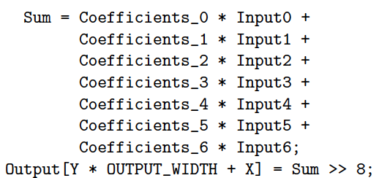
Preclass 5
How preclass 5 relate to preclass 4?

Slide 38
Loop Unrolling
Instantiate the loop body multiple times (with suitable change of loop variables)
Full unrolling
Replace whole loop with straight-line code sequence that performs the same thing
Roughly with N copies of the loop body
Partial
Some number of instances

Slide 39
Simple Unrolling
For (i=0;i<4;i++)
C[i]=A[i]*B[i];
Unroll 2
For (i=0;i<4;i+=2)
C[i]=A[i]*B[i];
C[i+1]=A[i+1]*B[i+1];
Full Unroll
C[0]=A[0]*B[0]
C[1]=A[1]*B[1]
C[2]=A[2]*B[2]
C[3]=A[3]*B[3]

Slide 40
Graph Cycles

Slide 41
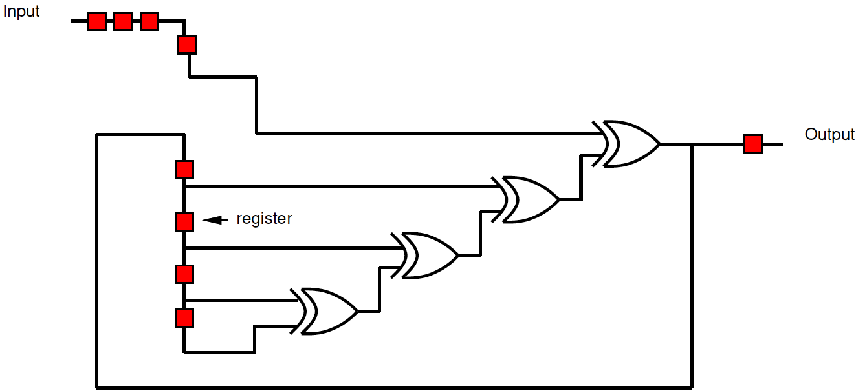
Preclass 3
What cycle time can we achieve?
How retime?

Slide 42
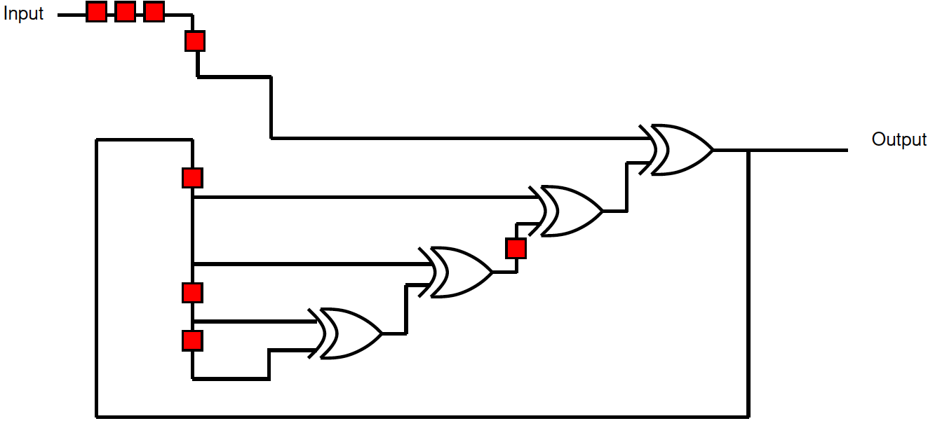
Retimed Preclass 3

Slide 43
Retiming Limits?
What prevents us from further retiming?

Slide 44
Cycle Observation
Retiming does not allow us to change the number of registers inside a cycle.
Limit to cycle time
Max delay in cycle / Registers in cycle
Pipelining doesn’t help inside cycle
Cannot push registers into cycle

Slide 45
Simple Cycle
What happens to cycle if try to apply lead/lag?

Slide 46
Retiming

Slide 47
Loop
What does graph look like for this loop body?
[multiply and mod each take 3 cycles]
For (i=0;i<N;i++)
C[i]=(C[i-1]*A[i])%N;

Slide 48
Loop
For (i=0;i<N;i++)
C[i]=(C[i-1]*A[i])%N;

Slide 49
Initiation Interval (II)
Cyclic dependencies can limit throughput
Due to dependent cycles,
May not be able to initiate a new computation on every cycle
II – cycles (delay) before can initiate
Throughput = 1/II

Slide 50
Loop
For (i=0;i<N;i++)
C[i]=(C[i-1]*A[i])%N;
Initiation Interval?

Slide 51
Class Ended Here

Slide 52
C-Slow

Slide 53
Problem
Pipelining cannot push registers into cycle
Graph cycles can prevent running at full pipeline target (maximum frequency)
If not reusing operators at full pipeline target are underutilizing resources
Can we use the resources for something?

Slide 54
C-Slow
Observation: if we have data-level parallelism, can use to solve independent problems on same hardware
Transformation: make C copies of each register
Guarantee: C computations operate independently
Do not interact with each other

Slide 55
2-Slow Simple Cycle
Replace register with pair
Retime

Slide 56
2-Slow Simple Cycle
Replace register with pair
Retime
Observe independence of red/blue computations

Slide 57
Equivalence
The 2-slow operator is equivalent to two data parallel operators running at half the speed

Slide 58
Automation
No mainstream tool today will perform C-slow transformation for you automatically
Synthesis tools will retime registers

Slide 59
Lesson
Cyclic dependencies limit throughput on single task or data stream
Cycle-length / registers-in-cycle
Can use on C independent (data parallel) tasks

Slide 60
Big Ideas
Pipeline computations to reuse hardware and maximize computational capacity
Can compose pipelined operators and accommodate fixed-frequency target
Be careful with data retiming
Cycles limit pipelining on single stream
C-slow to share hardware among multiple, data-parallel streams

Slide 61
Admin
Reading for Day 8 on web
HW4 due Friday

