Slide 1

ESE532:
System-on-a-Chip Architecture
Day 8: September 27, 2017
Spatial Computations

Slide 2
Today
Accelerator Pipelines
FPGAs
Zynq Computational Capacity

Slide 3
Message
Custom accelerators efficient for large computations
  Exploit Instruction-level parallelism
  Run many low-level operations in parallel
Field Programmable Gate Arrays (FPGAs)
  Allow post-fabrication configuration of custom accelerator pipelines
  Can offer high computational capacity

Slide 4
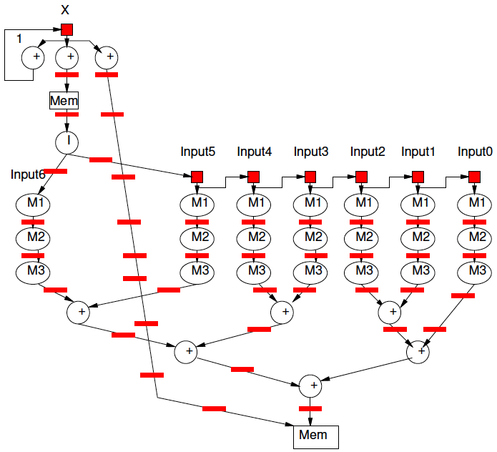
Pipeline for Unrolled Loop

Slide 5
Preclass 1
For fully unrolled loop shown,
how many instructions per pipeline cycle?
  Add
  Mpy
  Load
  Store

Slide 6
Spatial Pipeline
Can compute equivalent of tens of “instructions” in a cycle
Wire up primitive operators
  No indirection through RF, memory
Pipeline for operator latencies
Any dataflow graph of computational operations

Slide 7
Operators
Can assemble any custom operators
  Ones may not have in generic processor
Processor
  Add, bitwise-xor/and/or, multiply
  Maybe: floating-point add, multiply
Less likely
  Square-root, exponent, cosine, encryption (AES) step, polynomial evaluate,
  log-number-system

Slide 8
Accelerators
Compression/decompression
Encryption/decryption
Encoding (ECC, Checksum)
Discrete Cosine Transform (DCT)
Sorter
Taylor Series Approximation of function
Transistor evaluator
Tensor or Neural Network evaluator

Slide 9
Streaming Dataflow
Replace operator with custom accelerator
Stream data to/from it

Slide 10
Streaming Dataflow Example

Slide 11
Application-Specific SoCs
For dedicated applications
may build custom hardware for accelerators
  Layout VLSI, fab unique chips
  ESE370, 570
Tensillica – custom instructions
Video-encoder – include custom DCT, motion-estimation engines

Slide 12
Customizable Accelerators
With post-fabrication configurability
can exploit without unique fabrication
Need programmable substrate that allows us to wire-up computations

Slide 13
Field-Programmable
Gate Arrays
FPGAs

Slide 14
FPGA
Idea: Can wire up programmable gates in the “field”
  After fabrication
  At your desk
  When part “boots”
Like a “Gate Array”
  But not hardwired

Slide 15
Gate Array
Idea: Provide a collection of uncommitted gates
Create your “custom” logic by wiring together the gates
Less layout and masks than full custom
  Since only wiring together pre-fab gates
  → lower cost (fewer masks)
  → lower manufacturing delay

Slide 16
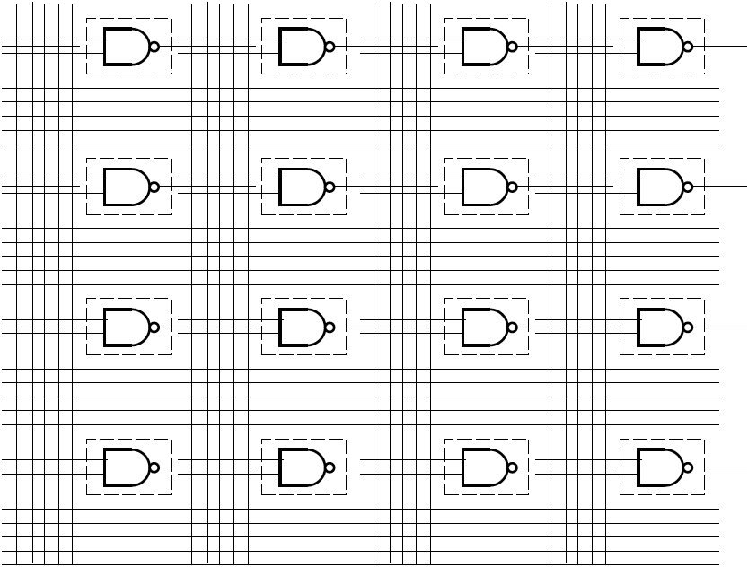
Gate Array

Slide 17
GA→FPGA
Remove the need to even fabricate the wiring mask
Make “customization” soft
Key trick:
  Use reprogrammable configuration bits
  Typically: static-RAM bits
    Like SRAM cells or latches
    Hold a configuration value

Slide 18
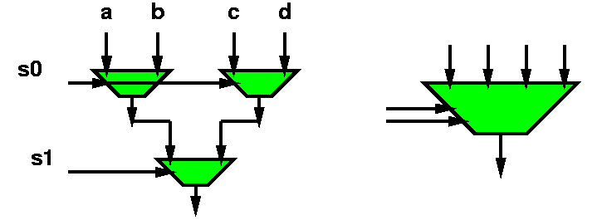
Mux with configuration bits
= programmable gate
bool mux4(bool a, b, c, d, s0, s1) {
  return(mux2( mux2(a,b,s0),
  mux2(c,d,s0),
  s1));
  }

Slide 19
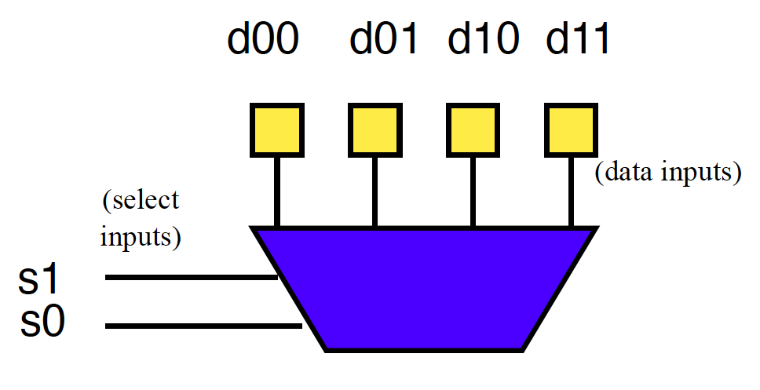
Preclass 2a
How do we program to behave as and2?

Slide 20
Mux as Logic
bool and2(bool x, y)
{return (mux4(false,false,false,true,x,y));}

Slide 21
Preclass 2b
How do we program to behave as xor2?

Slide 22
Mux as Logic
bool and2(bool x, y)
{return (mux4(false,false,false,true,x,y));}
bool xor2(bool x, y)
{return (mux4(false,true,true,false,x,y));}
Just by “configuring” data into this mux4,
  Can select any two input function

Slide 23
LUT – LookUp Table
When use a mux as programmable gate
  Call it a LookUp Table (LUT)
  Implementing the Truth Table for small # of inputs
    # of inputs =k (need mux-2^{k})
  Just lookup the output result in the table

Slide 24
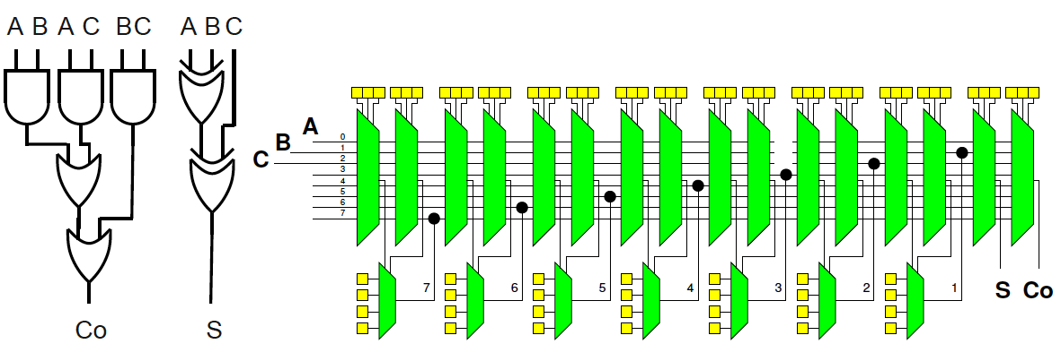
Preclass 3
How do we program full adder?

Slide 25
FPGA
Programmable gates + wiring
  (both built from muxes w/ config. bits)
Can wire up any collection of gates
  Like a gate array

Slide 26
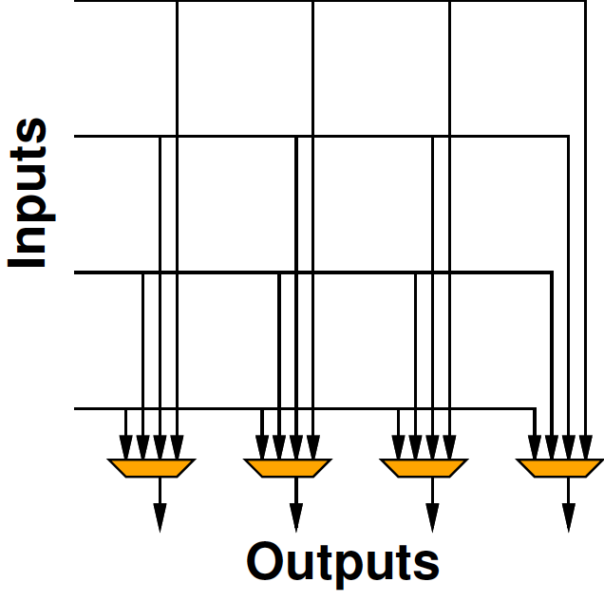
Crossbar Interconnect
I-inputs
O-outputs
Can connect any input to any output
Functionally equivalent to
  I-input Mux for each output

Slide 27
Crossbar Scaling
How many 2-input muxes to build an
I-input mux?
How does crossbar scale with I, O?

Slide 28
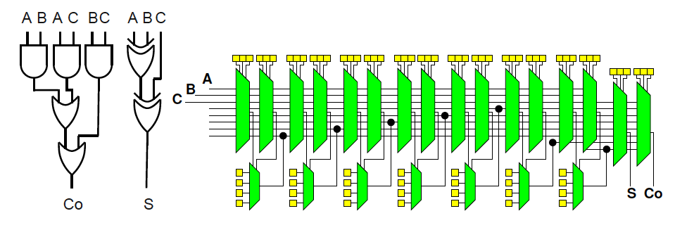
Crossbar Interconnect
How would crossbar interconnect scale with number of gates N?

Slide 29
Crossbar Interconnect
Crossbar interconnect is too expensive
  And not necessary
Want
  To be able to wire up gates
  Economical with wires and muxes
    …and configuration bits
  Exploit locality (keep wires short)

Slide 30
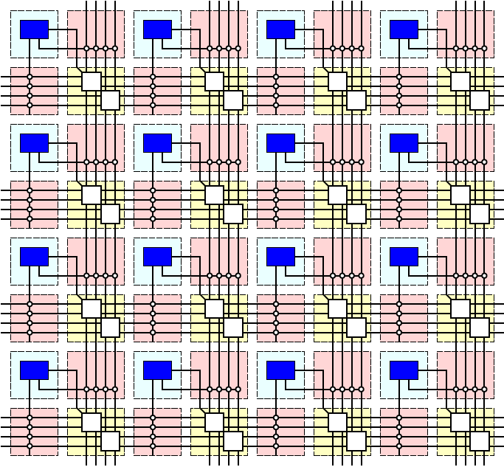
Simple FPGA

Slide 31
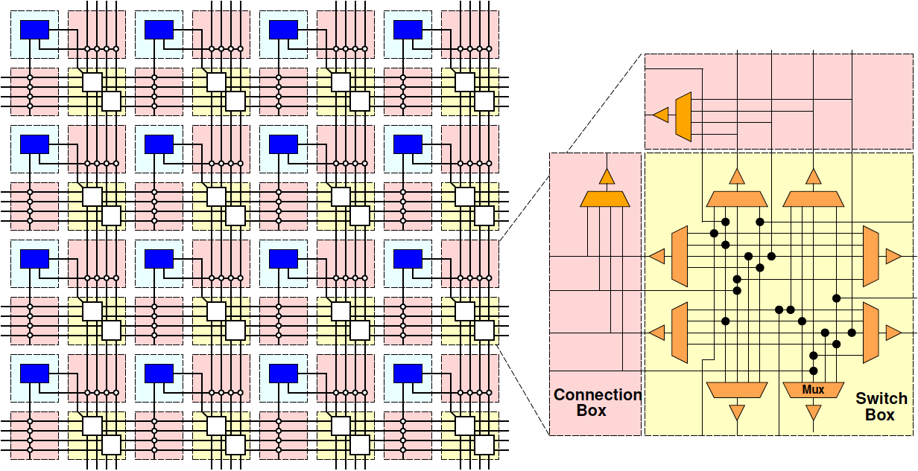
Simple FPGA

Slide 32
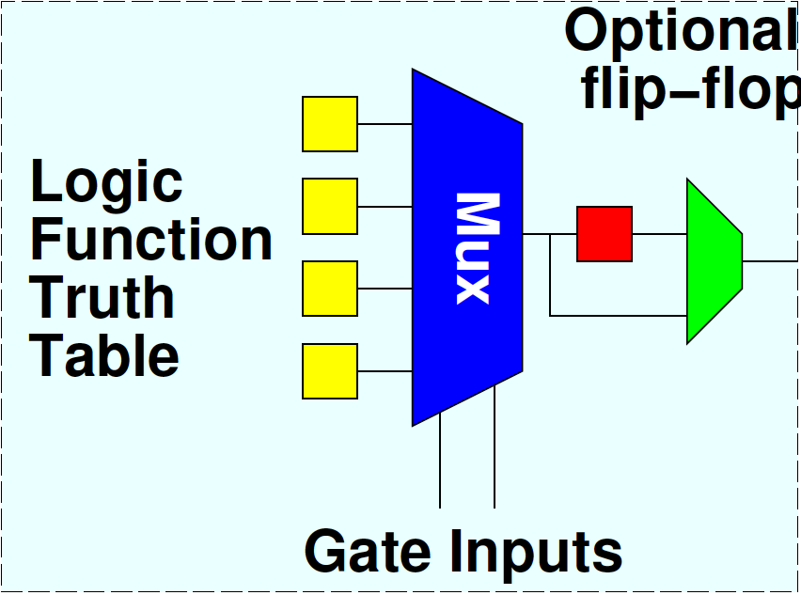
Flip-Flops
Want to be able to pipeline logic
…and generally hold state
  E.g. implement hold Input-N in preclass 1
Add optional flip-flop on each gate

Slide 33
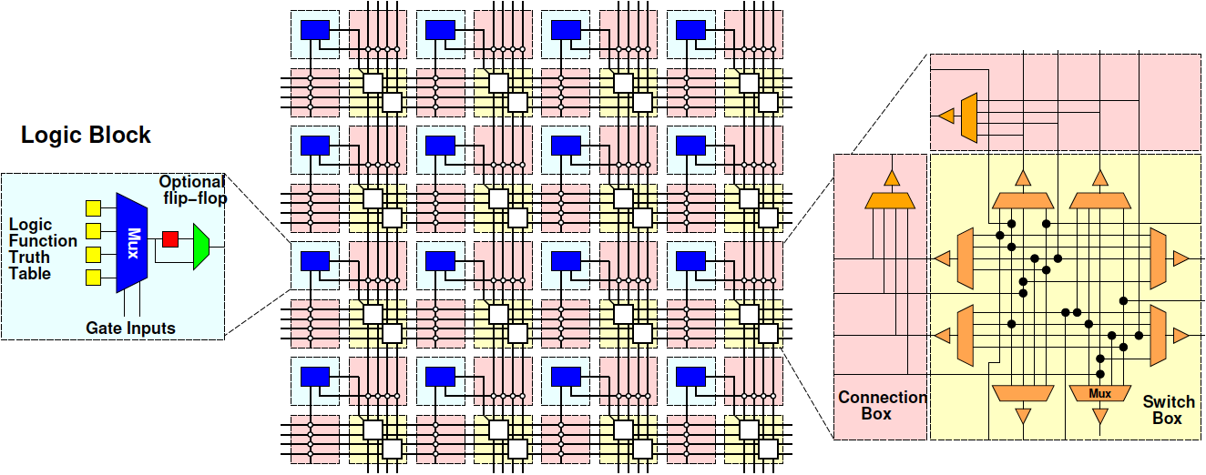
Simple FPGA

Slide 34
FPGA Design
Raises many architectural design questions
  How big (many inputs) should the gates have?
    Are LUTs really the right thing…
  How rich is the interconnect?
    Wires/channel
    Wire length
    Switching options

Slide 35
Modern FPGAs
Logic Blocks
  hardwired fast-carry logic
    Can implement adder bit in single “LUT”
  Speed optimized: 6-LUTs
  Energy, Cost optimization: 4-LUTs
  Clusters many LUTs into a tile
Interconnect
  Mesh, segments of length 4 and longer

Slide 36
More than LUTs
Should there be more than LUTs in the “array” fabric?
What else might we want?

Slide 37
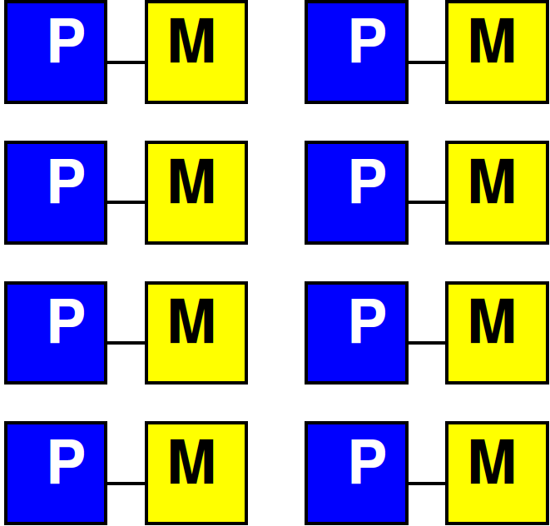
Embedded Memory
One flip-flop per LUT doesn’t store state densely
Want memory close to logic

Slide 38
Embed Memory in Array
Replace logic clusters
Convenient to replace columns
  Since area of memory may not match area of logic cluster

Slide 39
Embedded Memory in FPGA
Logic
Cluster
Memory
Bank
Memory
Frequency

Slide 40
Hardwired Multipliers
Can build multipliers out of LUTs
  Just as can implement multiplies on processor out of adds
But, custom multiplier is smaller than LUT-configured multiplier
  …and multipliers common in signal processing, scientific/engineering compute

Slide 41
Multiplier Integration
Integrate like memories
  Replace columns

Slide 42
More FPGA Architecture Design Questions
Size of Memories? Multipliers?
Mix of LUTs, Memories, Multipliers?
Add processors? Floating-point?
Other hardwired blocks?
How manage configuration?

Slide 43
Zynq

Slide 44
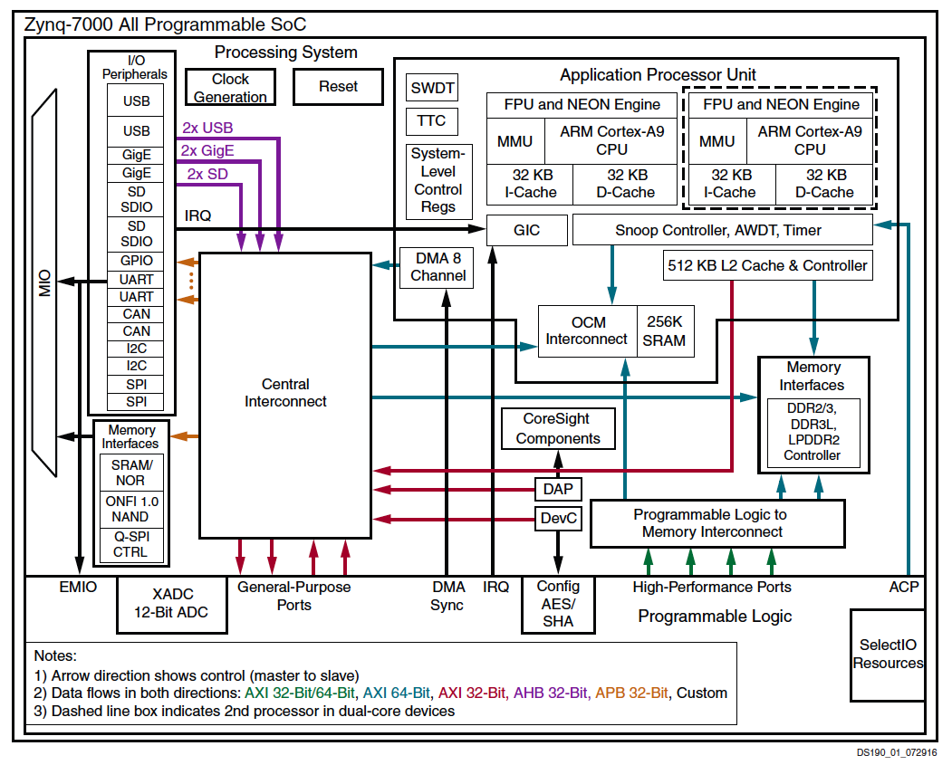

Slide 45
XC7Z020
6-LUTs: 53,200
DSP Blocks: 220
  18x25 multiply, 48b accumulate
Block RAMs: 140
  36Kb
  Dual port
  Up to 72b wide

Slide 46
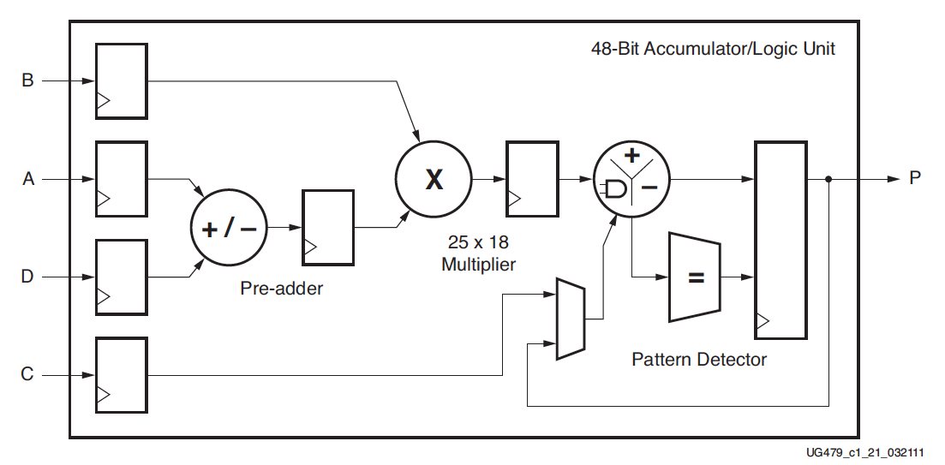
DSP48
Xilinx UG479 DSP48E1 User’s Guide

Slide 47
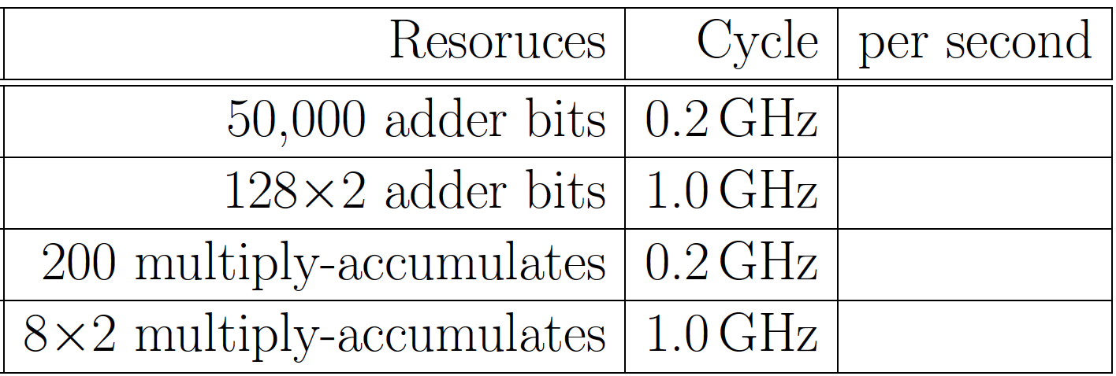
Preclass 4

Slide 48
Compute Capacity
How compare between ARM/NEON and FPGA array?
  Adder-bits/second?
  Multiply-accumulators/second?

Slide 49
Capacity → Density
Says Zynq has high computational capacity in FPGA
More broadly
  FPGA can have more compute/area than processor
    E.g., more adder bits in some fixed area
  SIMD can have more compute/area than processor
    How wide SIMD can you exploit?

Slide 50
FPGA Potential
FPGA Array has high raw capacity
Exploitable when computation has high regularity
  Uses the same computation over-and-over
  High throughput on a computation
  Build customized accelerator pipeline to match the computation
Low-hanging fruit
  Operator/function takes most of the compute time

Slide 51
90/10 Rule (of Thumb)
Observation that code is not used uniformly
90% of the time is spent in 10% of the code
Knuth: 50% of the time in 2% of the code
Opportunity
  Build custom datapath in FPGA (hardware) for that 10% (or 2%) of the code

Slide 52
Big Ideas
Custom accelerators efficient for large computations
  Exploit Instruction-level parallelism
  Run many low-level operations in parallel
Field Programmable Gate Arrays (FPGAs)
  Allow post-fabrication configuration of custom accelerator pipelines
  Can offer high computational capacity

Slide 53
Admin
Reading for Day 9 on canvas
HW4 due Friday
No homework due 10/6 (Fall Break)
HW5 out
  Due 10/13
  SDSoC synthesis at end slow (plan for it)

