Slide 1

ESE532:
System-on-a-Chip Architecture
Day 9: October 2, 2017
High Level Synthesis (HLS)
C-to-gates

Slide 2
Today
Spatial Computations from C specification
  Basic transforms
  Limitations from C semantics

Slide 3
Message
C (or any programming language) specifies a computation
Can describe spatial computation
Underlying semantics is sequential
  Watch for unintended sequentialization
  Write C for spatial differently than you write C for processors

Slide 4
Coding Accelerators
Want to exploit FPGA logic on Zynq to accelerate computations
Traditionally has meant develop accelerators in
  Hardware Description Language (HDL)
    E.g. Verilog → undergrads see in CIS371
  Directly in schematics
  Generator language (constructs logic)

Slide 5
Course “Hypothesis”
C-to-gates synthesis mature enough to use to specify hardware
  Leverage fact everyone knows C
    (must, at least, know C to develop embedded code)
  Avoid taking time to teach Verilog or VHDL
    Or making Verilog a pre-req.
  Focus on teaching how to craft hardware
    Using the C already know
    …may require thinking about the C differently

Slide 6
Discussion [open]
Is it obvious we can write C to describe hardware?
What parts of C translate naturally to hardware?
What parts of C might be problematic?
What parts of hardware design might be hard to describe in C?

Slide 7
Advantage
Use C for hardware and software
  Test out functionality entirely in software
    Debug code before put on hardware where harder to observe what’s happening
  Explore hardware/software tradeoffs by targeting same code to either hardware or software

Slide 8
Context
C most useful for describing behavior of leaf operators
C alone doesn’t naturally capture task parallelism

Slide 9
Preclass F
Ready for preclass f?
Skip to preclass f

Slide 10
C Primitives
Arithmetic Operators
Unary Minus (Negation) -a
Addition (Sum) a + b
Subtraction (Difference) a - b
Multiplication (Product) a * b
Division (Quotient) a / b
Modulus (Remainder) a % b
Things might have a hardware operator for…

Slide 11
C Primitives
Bitwise Operators
Bitwise Left Shift a << b
Bitwise Right Shift a >> b
Bitwise One's Complement ~a
Bitwise AND a & b
Bitwise OR a | b
Bitwise XOR a ^ b
Things might have a hardware operator for…

Slide 12
C Primitives
Comparison Operators
Less Than a < b
Less Than or Equal To a <= b
Greater Than a > b
Greater Than or Equal To a >= b
Not Equal To a != b
Equal To a == b
Logical Negation !a
Logical AND a && b
Logical OR a || b
Things might have a hardware operator for…

Slide 13
Expressions: combine operators
a*x+b
a
x
b
*
+
A connected set of operators
→ Graph of operators

Slide 14
Expressions: combine operators
a*x+b
a*x*x+b*x+c
a*(x+b)*x+c
((a+10)*b < 100)
A connected set of operators
→ Graph of operators

Slide 15
C Assignment
Basic assignment statement is:
Location = expression
f=a*x+b
a
x
b
*
+
f

Slide 16
Straight-line code
a sequence of assignments
What does this mean?
  g=a*x;
  h=b+g;
  i=h*x;
  j=i+c;
a
x
b
c
*
g
+
h
*
i
+
j

Slide 17
Variable Reuse
Variables (locations) define flow between computations
Locations (variables) are reusable
  t=a*x;
  r=t*x;
  t=b*x;
  r=r+t;
  r=r+c;

Slide 18
Variable Reuse
Variables (locations) define flow between computations
Locations (variables) are reusable
  t=a*x; t=a*x;
  r=t*x; r=t*x;
  t=b*x; t=b*x;
  r=r+t; r=r+t;
  r=r+c; r=r+c;
Sequential assignment semantics tell us which definition goes with which use.
  Use gets most recent preceding definition.

Slide 19
Dataflow
Can turn sequential assignments into dataflow graph through def→use connections
  t=a*x; t=a*x;
  r=t*x; r=t*x;
  t=b*x; t=b*x;
  r=r+t; r=r+t;
  r=r+c; r=r+c;
a
x
b
c
*
*
*
+
+

Slide 20
Dataflow Height
t=a*x; t=a*x;
  r=t*x; r=t*x;
  t=b*x; t=b*x;
  r=r+t; r=r+t;
  r=r+c; r=r+c;
Height (delay) of DF graph may be less than # sequential instructions.
a
x
b
c
*
*
*
+
+

Slide 21
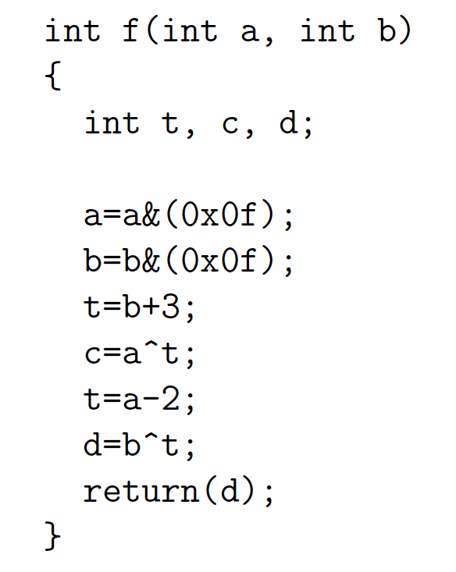
Lecture Checkpoint
Happy with
  Straight-line code
  Variables
Graph for preclass f
Next topic: Memory

Slide 22
C Memory Model
One big linear address space of locations
Most recent definition to location is value
Sequential flow of statements
New value
000
001
Addr
002
004
005
006
007
008
009
010
011
Current value

Slide 23
C Memory Operations
Read/Use
a=*p;
a=p[0]
a=p[c*10+d]
Write/Def
*p=2*a+b;
p[0]=23;
p[c*10+d]=a*x+b;

Slide 24
Memory Operation Challenge
Memory is just a set of location
But memory expressions can refer to variable locations
  Does *q and *p refer to same location?
  p[0] and p[c*10+d]?
  *p and q[c*10+d]?
  p[f(a)] and p[g(b)] ?

Slide 25
Pitfall
P[i]=23
r=10+P[i]
P[j]=17
s=P[j]*12
Value of r and s?
Could do:
P[i]=23; P[j]=17;
r=10+P[i]; s=P[j]*12
….unless i==j
Value of r and s?

Slide 26
C Pointer Pitfalls
*p=23
r=10+*p;
*q=17
s=*q*12;
Similar limit if p==q

Slide 27
C Memory/Pointer Sequentialization
Must preserve ordering of memory operations
  A read cannot be moved before write to memory which may redefine the location of the read
    Conservative: any write to memory
    Sophisticated analysis may allow us to prove independence of read and write
  Writes which may redefine the same location cannot be reordered

Slide 28
Consequence
Expressions and operations through variables (whose address is never taken) can be executed at any time
  Just preserve the dataflow
Memory assignments must execute in strict order
  Ideally: partial order
  Conservatively: strict sequential order of C

Slide 29
Forcing Sequencing
Demands we introduce some discipline for deciding when operations occur
  Could be a FSM
  Could be an explicit dataflow token
  Callahan uses control register
Other uses for timing control
  Control
  Variable delay blocks
  Looping

Slide 30
Scheduled Memory Operations
Source: Callahan

Slide 31
Hardware/Parallelism Challenge
Can we give enough information to the compiler to
  allow it to reorder?
  allow to put in separate embedded memories?
Is the compiler smart enough to exploit?

Slide 32
Multiple Memories
How might we want this to be implemented using multiple memories?
for(i=0;i<MAX;i++)
  C[i]=A[i]*B[i];

Slide 33
Idioms
Hard?
void fun(int *A)
for(i=0;i<MAX;i++)
  A[i]=A[f(i)];
  Data-dependent relationship
Easier
Int A[1024];
for (i=0;i<MAX;i++)
  A[2*i+3]=A[i]+A[i+2];
  Linear equations, can potentially solve for relationship

Slide 34
Memory Allocation?
How support malloc() in hardware?

Slide 35
Hardware Memory
Typically small, fixed, local memory blocks
Reuse memory blocks
  Not allocate new blocks
  Cannot make data-dependent memory sized blocks
Different hardware units → different local memories
  move data not pass pointers

Slide 36
Control

Slide 37
Conditions
If (cond)
  DoA
Else
  DoB
While (cond)
  DoBody
No longer straightline code
Code selectively executed
Data determines which computation to perform

Slide 38
Basic Blocks
Sequence of operations with
  Single entry point
  Once enter execute all operations in block
  Set of exits at end
Can dataflow schedule operations within a basic block
  As long as preserve memory ordering

Slide 39
Connecting Basic Blocks
Connect up basic blocks by routing control flow token
  May enter from several places
  May leave to one of several places

Slide 40
Connecting Basic Blocks
Connect up basic blocks by routing control flow token
  May enter from several places
  May leave to one of several places
BB0
begin:
x=y;
y++;
z=y;
t=z>20;
brfalse t, finish
y=4
finish:
x=x*y
end:
BB0:
x=y;
y++;
z=y;
t=z>20
br(t,BB1,BB2)
BB1:
y=4;
br BB2
BB1
BB2
BB2:
x=x*y;

Slide 41
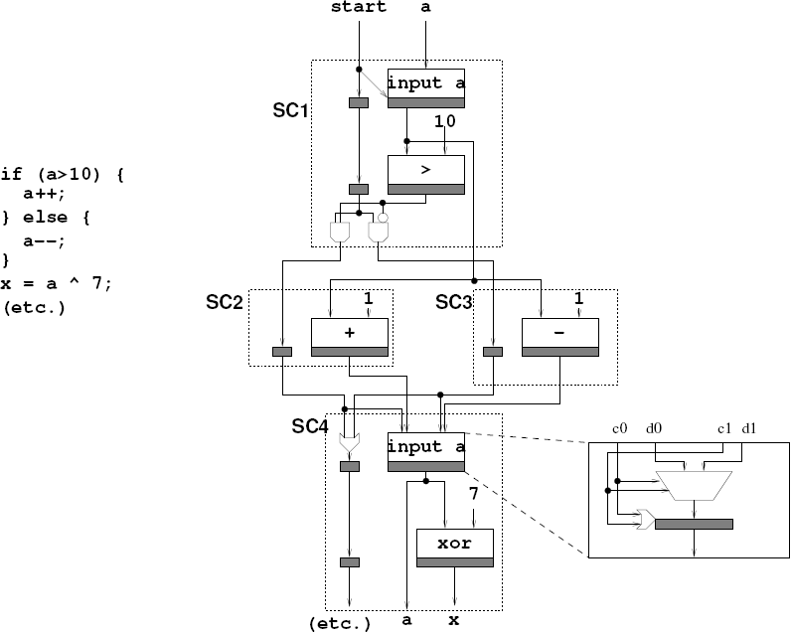
Basic Blocks for if/then/else
Source: Callahan

Slide 42
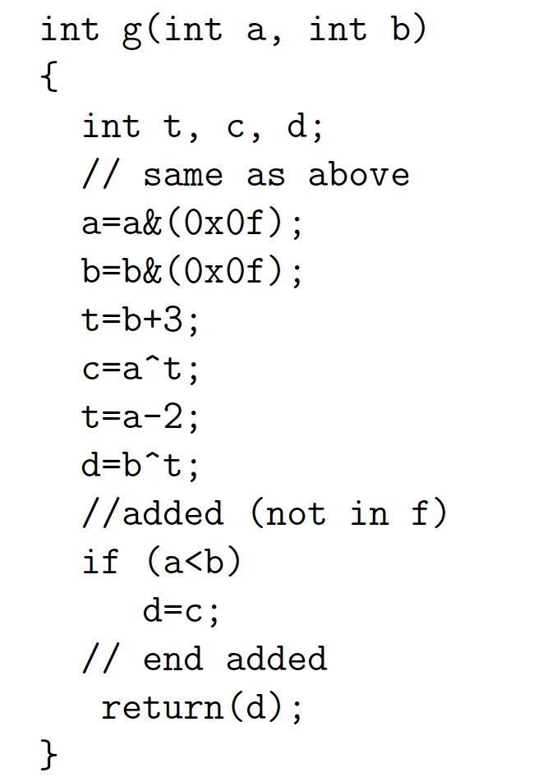
Preclass G
Basic Blocks for G?
Control flow graph?

Slide 43
Loops
sum=0;
i=0;
sum=0;
for (i=0;i<imax;i++)
  sum+=i;
r=sum<<2;
i<imax
sum+=i;
i=i+1;
r=sum<<2;

Slide 44
Lecture Checkpoint
Happy with
  Straight-line code
  Variables
  Memory
  Control

Slide 45
Function Call
What do we do with function calls?

Slide 46
Inline
int f(int a, int b)
  return(sqrt(a*a+b*b));
for(i=0;i<MAX;i++)
  D[i]=f(A[i],B[i]);
for(i=0;i<MAX;i++)
  D[i]=sqrt(A[i]*A[i]+B[i]*B[i]);

Slide 47
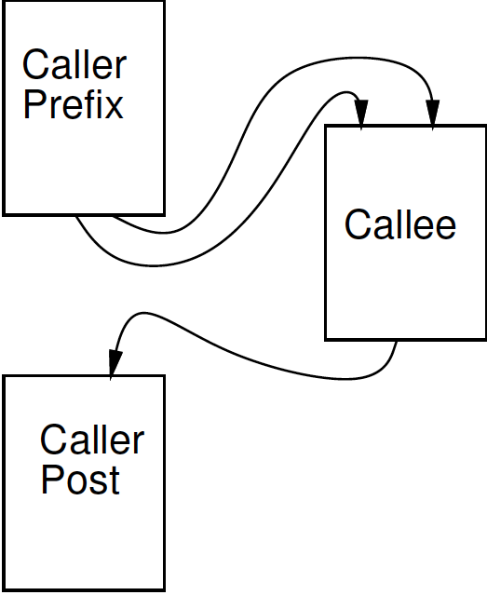
Treat as data flow
Implement function as an operation
Send arguments as input tokens
Get result back as token

Slide 48
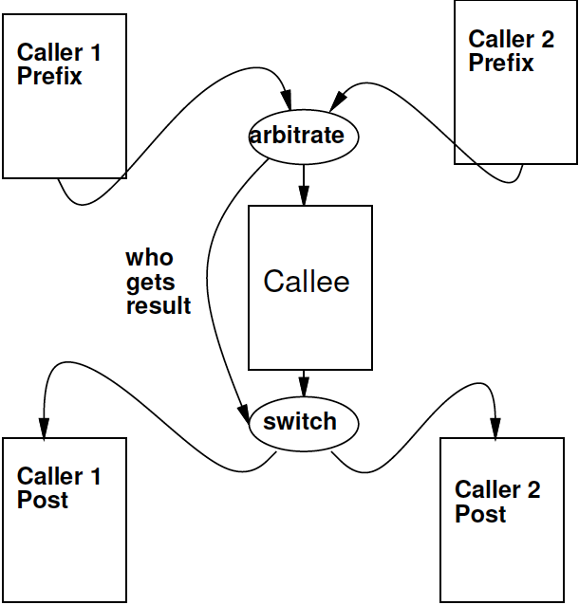
Shared Function

Slide 49
Recursion?
int fib(int x) {
if ((x==0) || (x==1)) return(1);
else return(fib(x-1)+fib(x-2));
}
In general won’t work.
  Problem?
Smart compiler might be able to turn some cases into iterative loop.
…but don’t count on it.
  VivadoHLS will not

Slide 50
Beyond Basic Blocks
Basic blocks tend to be limiting
Runs of straight-line code are not long
For good hardware implementation
  Want more parallelism

Slide 51
Simple Control Flow
If (cond) { … } else { …}
Assignments become conditional
In simplest cases (no memory ops),
can treat as dataflow node
cond
then
else
choose

Slide 52
Simple Conditionals
if (a>b)
c=b*c;
else
c=a*c;
a>b
b*c
a*c
c

Slide 53
Simple Conditionals
v=a;
if (b>a)
v=b;
If not assigned, value flows from before assignment
b>a
b
a
v

Slide 54
Simple Conditionals
a
max=a;
min=a;
if (a>b)
{min=b;
c=1;}
else
{max=b;
c=0;}
May (re)define many values on each branch.
a>b
b
1
0
min
max
c

Slide 55
Preclass G
Graph for preclass G
as mux-conversion?

Slide 56
Recall: Basic Blocks for if/then/else
Source: Callahan

Slide 57
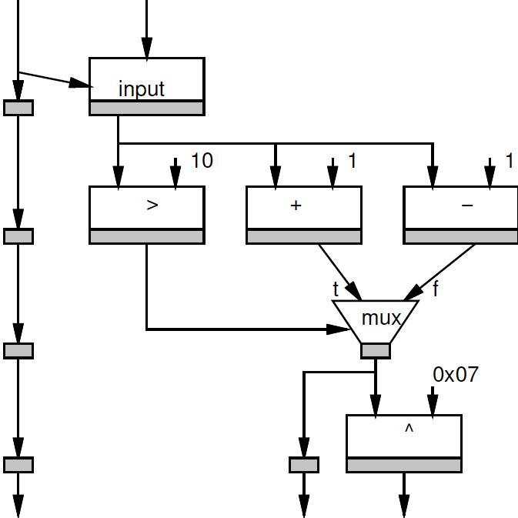
Mux Converted
if (a>10)
a++;
else;
a—
x=a^0x07

Slide 58
Height Reduction
Mux converted version has shorter path (lower latency)
Why?

Slide 59
Height Reduction
Mux converted version has shorter path (lower latency)
Can execute condition in parallel with then and else clauses

Slide 60
Mux Conversion and Memory
What might go wrong if we mux-converted the following:
If (cond)
  *a=0
Else
  *b=0

Slide 61
Mux Conversion and Memory
What might go wrong if we mux-converted the following:
If (cond)
  *a=0
Else
  *b=0
Don’t want memory operations in non-taken branch to occur.

Slide 62
Mux Conversion and Memory
If (cond)
  *a=0
Else
  *b=0
Don’t want memory operations in non-taken branch to occur.
Conclude: cannot mux-convert blocks with memory operations (without additional care)

Slide 63
Hyperblocks
Can convert if/then/else into dataflow
  If/mux-conversion
Hyperblock
  Single entry point
  No internal branches
  Internal control flow provided by mux conversion
  May exit at multiple points
a>b
b*c
a*c
c

Slide 64
Basic Blocks → Hyperblock
Source: Callahan

Slide 65
Hyperblock Benefits
More code → typically more parallelism
  Shorter critical path
Optimization opportunities
  Reduce work in common flow path
  Move logic for uncommon case out of path
    Makes smaller faster

Slide 66
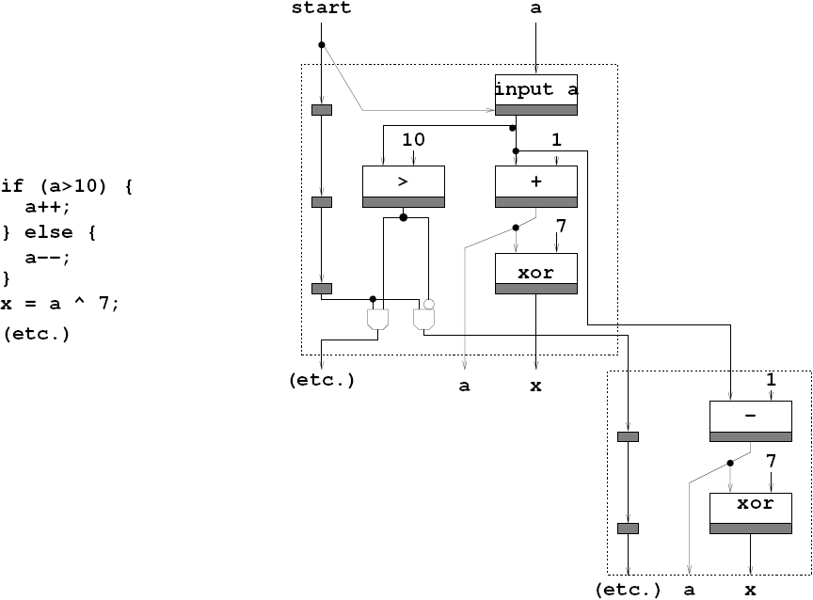
Common Case Height Reduction
Source: Callahan

Slide 67
Common-Case Flow Optimization
Source: Callahan

Slide 68
Optimizations
Constant propagation: a=10; b=c[a];
Copy propagation: a=b; c=a+d; → c=b+d;
Constant folding: c[10*10+4]; → c[104];
Identity Simplification: c=1*a+0; → c=a;
Strength Reduction: c=b*2; → c=b<<1;
Dead code elimination
Common Subexpression Elimination:
  C[x*100+y]=A[x*100+y]+B[x*100+y]
  t=x*100+y; C[t]=A[t]+B[t];
Operator sizing: for (i=0; i<100; i++) b[i]=(a&0xff+i);

Slide 69
Additional Concerns?
What are we still not satisfied with?
Parallelism in hyperblock
  Especially if memory sequentialized
    Disambiguate memories?
    Allow multiple memory banks?
Only one hyperblock active at a time
  Share hardware between blocks?
Data only used from one side of mux
  Share hardware between sides?
Most logic in hyperblock idle?
  Couldn’t we pipeline execution?

Slide 70
Pipelining
i<MAX
+
x
i
for (i=0;i<MAX;i++)
  o[i]=(a*x[i]+b)*x[i]+c;
If know memory operations independent
What II?
read
a
*
b
+
*
c
+
o
write

Slide 71
Unrolling
Put several (all?) executions of loop into straight-line code in the body.
for (i=0;i<MAX;i++)
  o[i]=(a*x[i]+b)*x[i]+c;
for (i=0;i<MAX;i+=2)
  o[i]=(a*x[i]+b)*x[i]+c;
  o[i+1]=(a*x[i+1]+b)*x[i+1]+c;

Slide 72
Unrolling
If MAX=4:
  o[0]=(a*x[0]+b)*x[0]+c;
  o[1]=(a*x[1]+b)*x[1]+c;
  o[2]=(a*x[2]+b)*x[2]+c;
  o[3]=(a*x[3]+b)*x[3]+c;
for (i=0;i<MAX;i++)
  o[i]=(a*x[i]+b)*x[i]+c;
for (i=0;i<MAX;i+=2)
  o[i]=(a*x[i]+b)*x[i]+c;
  o[i+1]=(a*x[i+1]+b)*x[i+1]+c;

Slide 73
Unrolling
If MAX=4:
  o[0]=(a*x[0]+b)*x[0]+c;
  o[1]=(a*x[1]+b)*x[1]+c;
  o[2]=(a*x[2]+b)*x[2]+c;
  o[3]=(a*x[3]+b)*x[3]+c;
  Benefits?
for (i=0;i<MAX;i++)
  o[i]=(a*x[i]+b)*x[i]+c;
for (i=0;i<MAX;i+=2)
  o[i]=(a*x[i]+b)*x[i]+c;
  o[i+1]=(a*x[i+1]+b)*x[i+1]+c;

Slide 74
Unrolling
If MAX=4:
  o[0]=(a*x[0]+b)*x[0]+c;
  o[1]=(a*x[1]+b)*x[1]+c;
  o[2]=(a*x[2]+b)*x[2]+c;
  o[3]=(a*x[3]+b)*x[3]+c;
  Create larger basic block.
  More scheduling freedom.
  More parallelism.
for (i=0;i<MAX;i++)
  o[i]=(a*x[i]+b)*x[i]+c;
for (i=0;i<MAX;i+=2)
  o[i]=(a*x[i]+b)*x[i]+c;
  o[i+1]=(a*x[i+1]+b)*x[i+1]+c;

Slide 75
Loop Interpretations
What does a loop describe?
  Sequential behavior
  Spatial construction
  Data Parallelism
We will want to use for all 3
Sometimes need to help the compiler understand which we want

Slide 76
Unroll
Vivado HLS has pragmas for unrolling
UG901: Vivado HLS User’s Guide
  P180—229 for optimization and directives
#pragma HLS UNROLL factor=…
Use to control area-time points
  Use of loop for spatial vs. temporal description

Slide 77
Flow Review

Slide 78
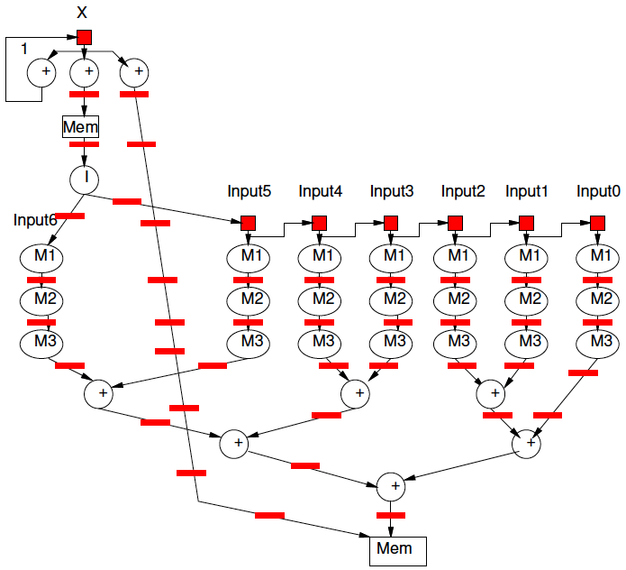
C Loops
Adequate to define hardware pipelines

Slide 79
Summary
Language (here C) defines meaning of operations
Dataflow connection of computations
Sequential precedents constraints to preserve
Create basic blocks
Link together
Optimize
  Merge into hyperblocks with if-conversion
  Pipeline, unroll
Result is dataflow graph
  (can schedule to registers and gates)

Slide 80
Big Ideas:
C (any prog lang) specifies a computation
Can describe spatial computation
  Has some capabilities that don’t make sense in hardware
    Shared memory pool, malloc, recursion
  Watch for unintended sequentialization
C for spatial is coded differently from C for processor
  …but can still run on processor
Good for leaf functions (operations)
  Limiting for full task

Slide 81
Admin
Reading for Wednesday on Web
  Xilinx HLS documents
Do have lecture on Wednesday
  But no homework due on Friday
HW5 due next Friday (10/13)

