Slide 1

ESE532:
System-on-a-Chip Architecture
Day 1: August 29, 2018
Introduction and Overview
Everyone grab:
Preclass
Feedback Sheet (1/2 page)

Slide 2
Today
Case for Programmable SoC
Course Goals
Outcomes
New/evovling Course, Risks, Tools
Sample Optimization
This course (incl. policies, logistics)
Zed Boards

Slide 3
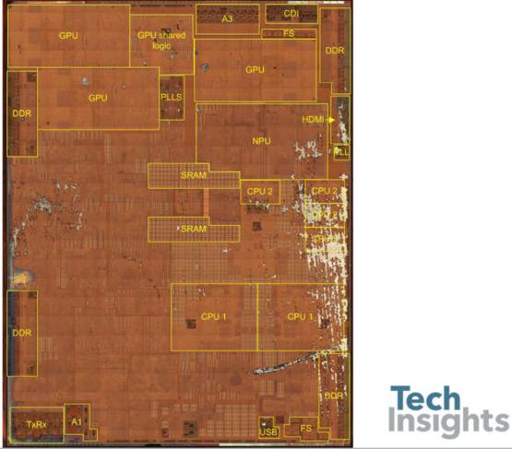
Apple A11 Bionic
90mm² 10nm FinFET
4.3B transistors
iPhone 8, 8s, X
6 ARM cores (64b)
  2 fast (2.4GHz)
  4 low energy
3 custom GPUs
Neural Engine
  600 Bops?
Motion, image accel.
8MB L2 cache
https://wccftech.com/apple-iphone-8-plus-a11-bionic-complete-teardown/

Slide 4
Questions
Why do today’s SoC look like they do?
How approach programming modern SoCs?
How design a custom SoC?
When building a System-on-a-Chip (SoC)
  How much area should go into:
    Processor cores, GPUs,
    FPGA logic, memory,
    interconnect,
    custom functions (which) …. ?

Slide 5
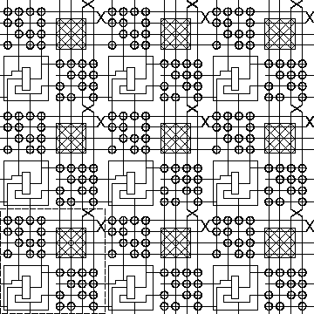
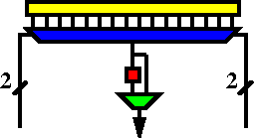
FPGA
Field-Programmable Gate Array
K-LUT (typical k=4)
Compute block
w/ optional
output Flip-Flop
ESE171, CIS371

Slide 6
Case for Programmable SoC

Slide 7
The Way things Were
20 years ago
Wanted programmability
  used a processor
Wanted high-throughput
  used a custom IC
Wanted product differentiation
  Got it at the board level
  Select which ICs and how wired
Build a custom IC
  It was about gates and logic

Slide 8
Today
Microprocessor may not be fast enough
  (but often it is)
  Or low enough energy
Time and Cost of a custom IC is too high
  $100M’s of dollars for development, Years
FPGAs promising
  But build everything from prog. gates?
Premium for small part count
  And avoid chip crossing
  ICs with Billions of Transistors

Slide 9
Non-Recurring Engineering (NRE) Costs
Costs spent up front on development
  Engineering Design Time
  Prototypes
  Mask costs
Recurring Engineering
  Costs to produce each chip

Slide 10
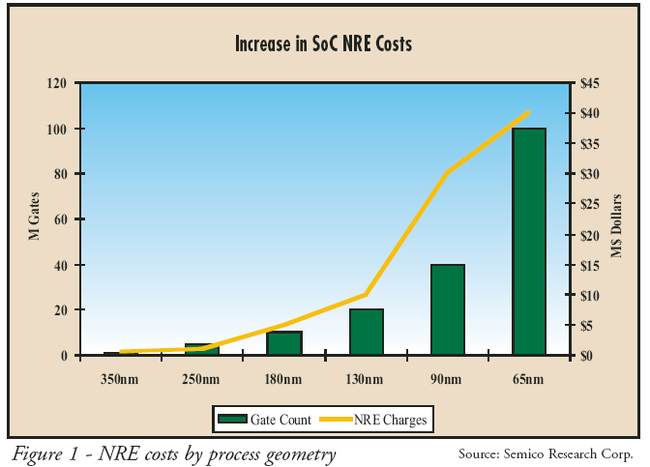
NRE Costs
28-nm SoC development costs doubled over previous node – EE Times 2013
  28nm+78%, 20nm+48%, 14nm+31%, 10nm+35%

Slide 11
Amortize NRE with Volume

Slide 12
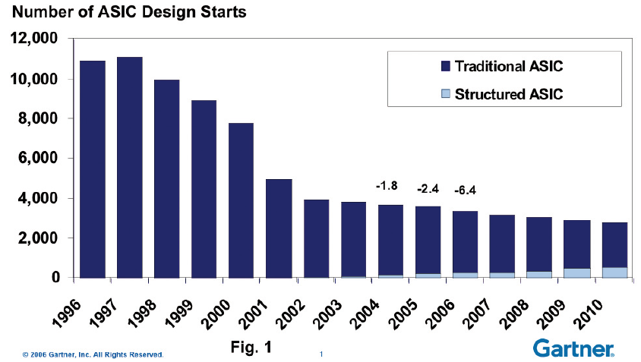
Economics
Forcing fewer,
more
customizable
chips
Economics force fewer, more customizable chips
  Mask costs in the millions of dollars
  Custom IC design NRE 10s—100s of millions of dollars
    Need market of billions of dollars to recoup investment
    With fixed or slowly growing total IC industry revenues
    ➔ Number of unique chips must decrease
    Chips must be programmable

Slide 13
Large ICs
Now contain significant software
  Almost all have embedded processors
Must co-design SW and HW
Must solve complete computing task
  Tasks has components with variety of needs
  Some don’t need custom circuit
  90/10 Rule

Slide 14
Given Demand for Programmable
How do we get higher performance than a processor, while retaining programmability?

Slide 15
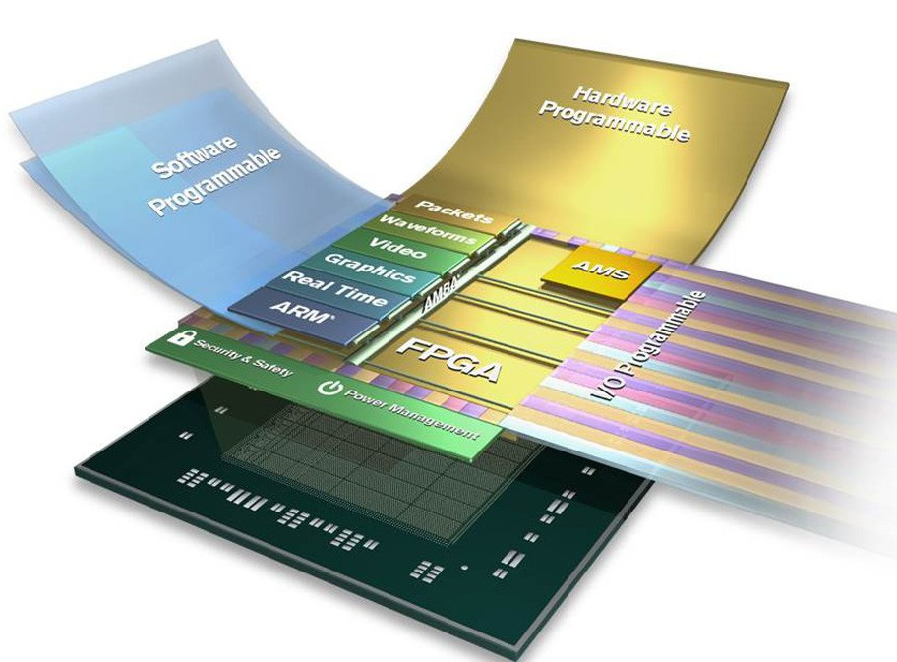
Programmable SoC
Implementation Platform for innovation
  This is what you target (avoid NRE)
  Implementation
  vehicle

Slide 16
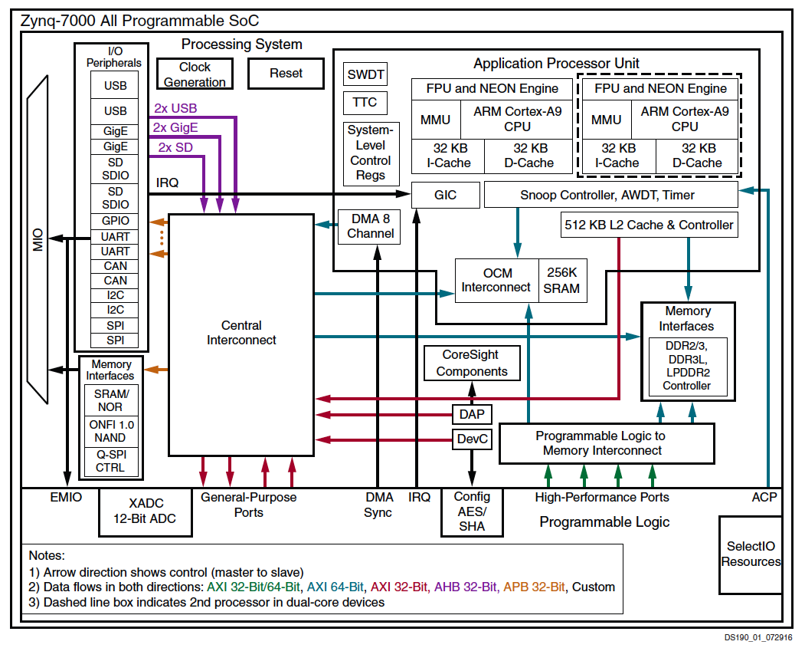
Programmable SoC

Slide 17
Then and Now
20 years ago
Programmability?
  use a processor
High-throughput
  used a custom IC
Wanted product differentiation
  board level
  Select & wired IC
Build a custom IC
  It was about gates and logic
Today
Programmability?
  uP, FPGA, GPU, PSoC
High-throughput
  FPGA, GPU, PSoC, custom
Wanted product differentiation
  Program FPGAs, PSoC
Build a custom IC
  System and software

Slide 18
Course
Goals, Outcomes

Slide 19
Goals
Create Computer Engineers
  SW/HW divide is wrong, outdated
  Parallelism, data movement, resource management, abstractions
  Cannot build a chip without software
SoC user – know how to exploit
SoC designer – architecture space,
hw/sw codesign
Project experience – design and optimization

Slide 20
Roles
PhD Qualifier
  One broad Computer Engineering
CMPE Concurrency
Hands-on Project course

Slide 21
Outcomes
Design, optimize, and program a modern System-on-a-Chip.
Analyze, identify bottlenecks, design-space
  Modeling → write equations to estimate
Decompose into parallel components
Characterize and develop real-time solutions
Implement both hardware and software solutions
Formulate hardware/software tradeoffs, and perform hardware/software codesign

Slide 22
Outcomes
Understand the system on a chip from gates to application software, including:
  on-chip memories and communication networks, I/O interfacing, design of accelerators, processors, firmware and OS/infrastructure software.
Understand and estimate key design metrics and requirements including:
  area, latency, throughput, energy, power, predictability, and reliability.

Slide 23
New and Evolving Course
Spring 2017 – first offering
  Raw, all assignments new … some buggy
  Assignments too tedious, long
Fall 2017 – second offering
  Refine assignments, project
  Increased explicit modeling emphasis
  Hard, not insane
Fall 2018 – now
  Not much different from 2017
  Hopefully fewer rough edges

Slide 24
Tools
Are complex
Will be challenging, but good for you to build confidence can understand and master
Tool runtimes can be long
Learning and sharing experience will be part of assignments

Slide 25
Distinction
CIS240, 371, 501
ESE532
Best Effort Computing
  Run as fast as you can
Binary compatible
ISA separation
Shared memory parallelism
Hardware-Software codesign
  Willing to recompile, maybe rewrite code
  Define/refine hardware
Real-Time
  Guarantee meet deadline
Non shared-memory parallelism models

Slide 26
Abstraction Stack
Systems
SoC Arch:
ESE 532
Processors
Processor Arch:
CIS 371/501
(CIS240)
Mixed Signal:
ESE 568
Gates, Memories
Circuits/VLSI
Digital: ESE370/570
Analog: ESE419/572
(ESE319)
Transistors
Devices: ESE521
(ESE218)

Slide 27
Approach -- Example

Slide 28
Abstract Approach
Identify requirements, bottlenecks
Decompose Parallel Opportunities
  At extreme, how parallel could make it?
  What forms of parallelism exist?
    Thread-level, data parallel, instruction-level
Design space of mapping
  Choices of where to map, area-time tradeoffs
Map, analyze, refine
  Write equations to understand, predict

Slide 29
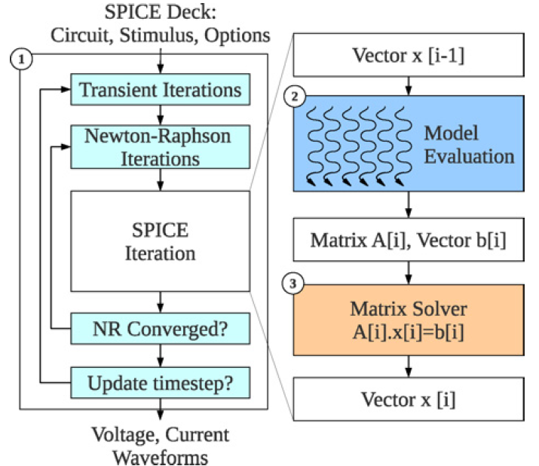
SPICE Circuit Simulator
Matrix Solve
Ax=B
A matrix
B vector
x unknown vector
Solve for x
Linear Algebra
solving n eqns
in n unknowns.
Example: Kapre+DeHon, TRCAD 2012

Slide 30
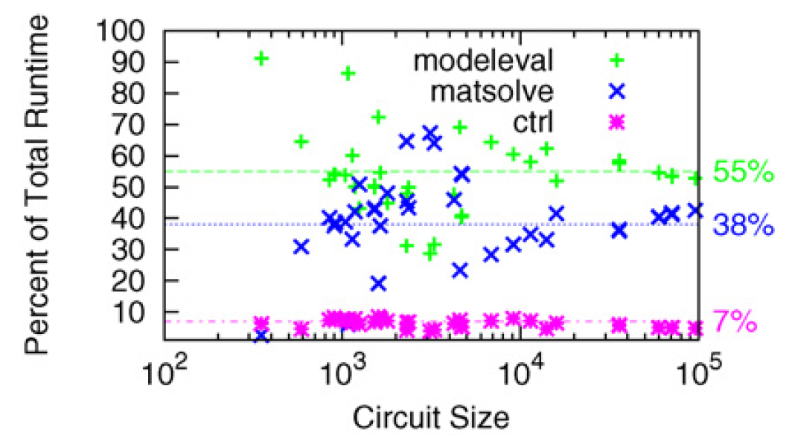
Analyze

Slide 31
Analyze
T=T_{modeleval}+T_{matsolve}+T_{ctrl}

Slide 32
Speedup
T=T_{modeleval}+T_{matsolve}+T_{ctrl}
What should we speedup first?
What happens if only speedup modeleval?
  T=T_{matsolve}+(T_{modeleval})/S+T_{ctrl}

Slide 33
Analyze
If only accelerated model evaluation
only about 2x speedup
If want better than 14x speed,
must also attack control

Slide 34
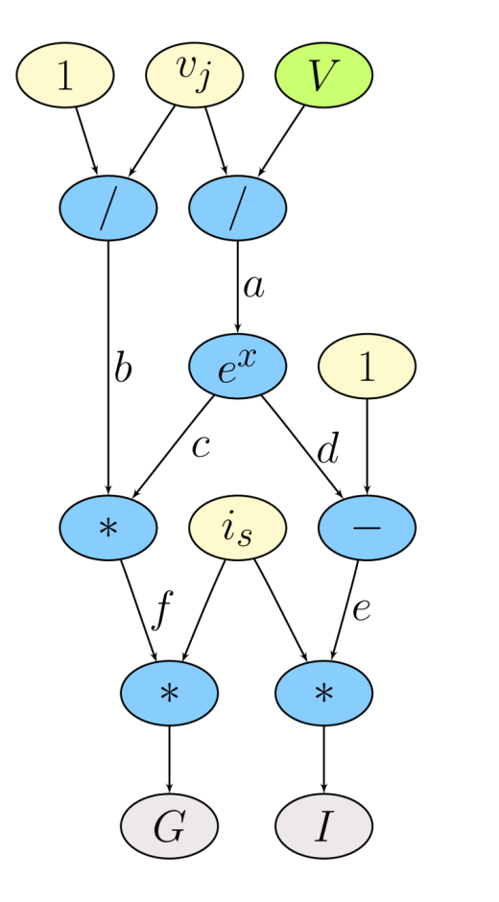
Model Evaluation: Trivial Hardware Implementation
*
*
÷
e
f
b
-
*
÷
d
c
a
e^{x}
Verilog-AMS as Domain-Specific Language

Slide 35
Spatial Parallelism
Every operation (*, + /) gets dedicated hardware.
Implement task in space → use additional area for each operator.
Parallel – all operations occur simultaneously.
*
*
÷
e
f
b
-
*
÷
d
c
a
e^{x}

Slide 36
Parallelism: Model Evaluation
Every device independent
Many of each type of device
Can evaluate in parallel
  T=T_{seq}/N_{proc}
Build pipelined circuit for model
  T_{seq}=N_{comp}*T_{cycle}
  vs. T_{pipe}=T_{cycle}

Slide 37
Spatial Too Big?
Fully spatial circuit
Custom VLIW
*
÷
*
*
÷
b
e
f
-
*
÷
+
d
c
a
e^{x}
e^{x}
~100x Speedup
Multiple FPGAs
~10x Speedup
1 FPGA
VLIW=Very Long Instruction Word
exploits Instruction-Level Parallelism

Slide 38
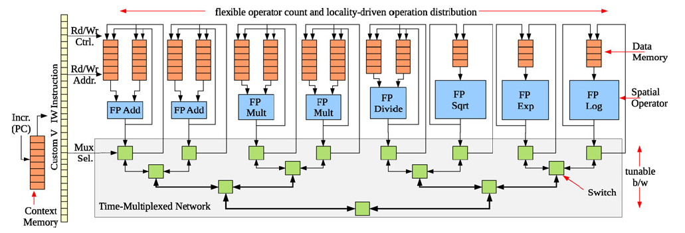
Parallelism: Model Evaluation
Spatial end up bottlenecked by other components
Use custom evaluation engines
…or GPUs

Slide 39
Parallelism: Matrix Solve
Needed direct solver?
E.g. Gaussian elimination
Data dependence on previous reduce
Parallelism in subtracts
Some row independence

Slide 40
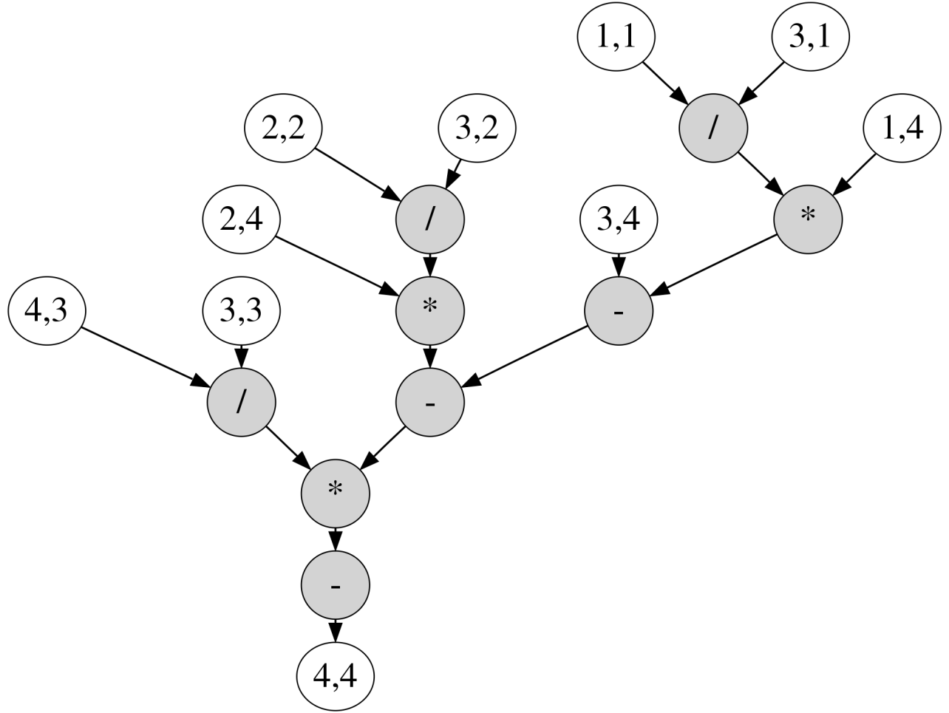
Example Matrix

Slide 41
Example Matrix

Slide 42
Example Matrix
Reduce to critical path:
from 9 sequential operations
to path of 5 operations.

Slide 43
Dataflow PE
Graph
Nodes
Incoming Messages
Dataflow trigger
*
+
÷
Graph
Fanout
Outgoing Messages

Slide 44
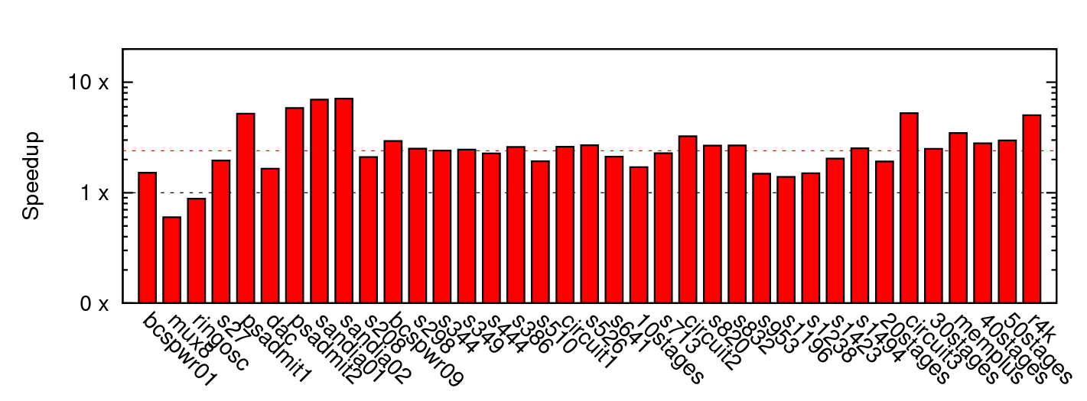
Matrix Solve Only
~2.4x mean

Slide 45
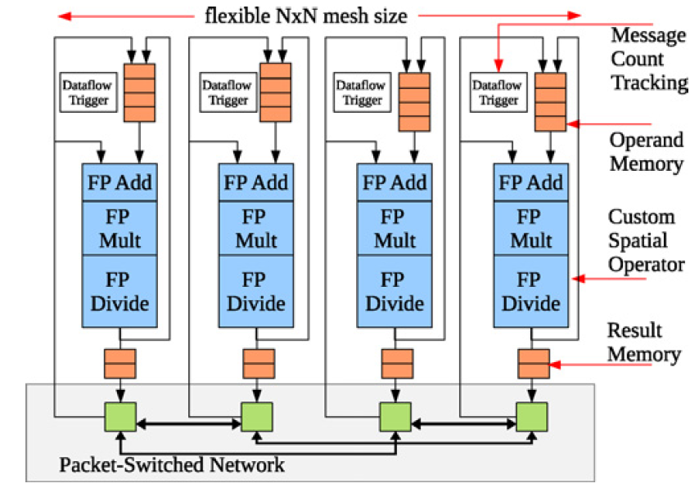
Parallelism: Matrix Solve
Settled on constructing dataflow graph
Graph can be iteration independent
  Statically scheduled
  (cheaper)
This is bottleneck to further acceleration

Slide 46
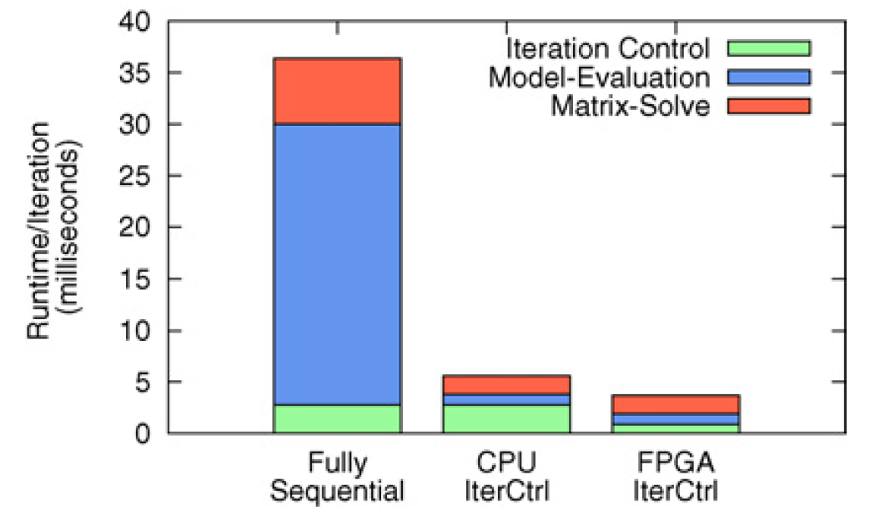
Parallelism Controller?
Could leave sequential
For some designs, becomes the bottleneck once others accelerated
Has internal parallelism in condition evaluation
  T=T_{modeleval}/S₁+(T_{matsolve})/S₂+T_{ctrl}

Slide 47
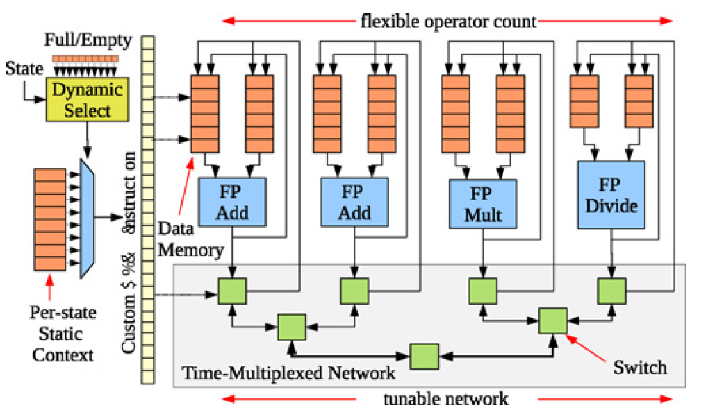
Parallelism Controller
Customized datapath controller
T_{seqctrl}=N_{add}+N_{mul}+10*N_{divide}
T_{vliwctrl}=Max(N_{add}/2,N_{mul},10*N_{divide})

Slide 48
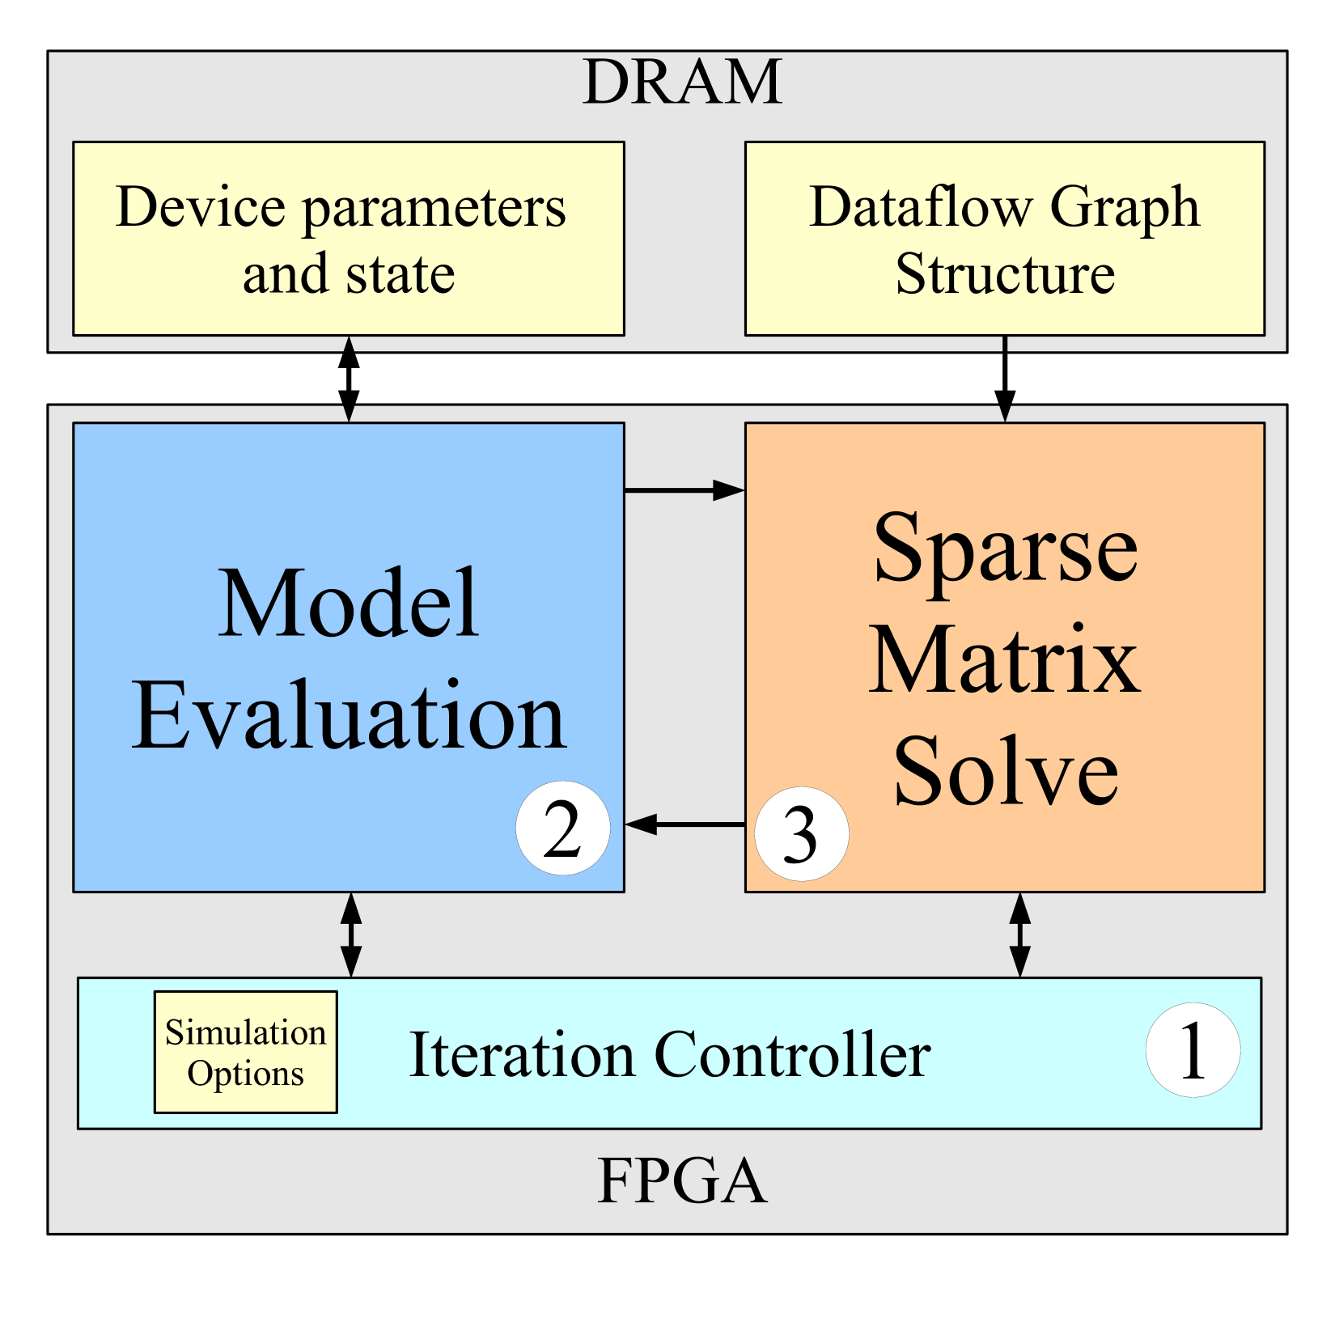
Single-Chip Solution

Slide 49
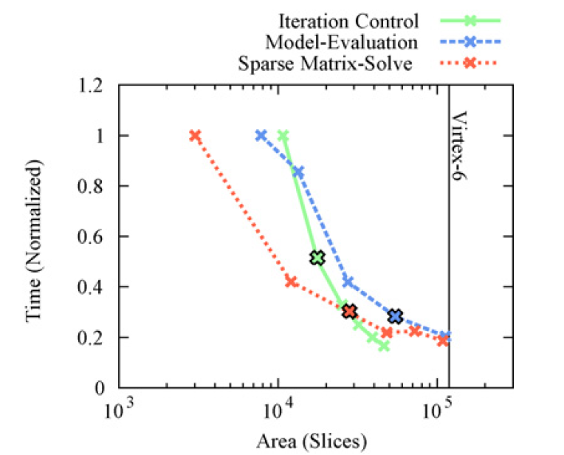
Area-Time for Each

Slide 50
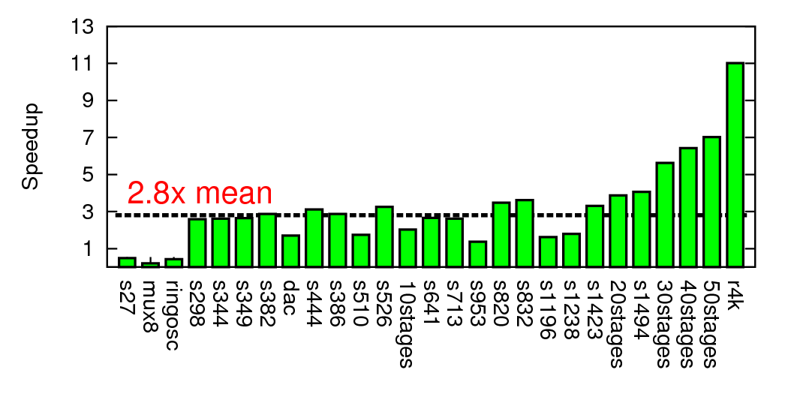
Composite Speedup

Slide 51
Modern SoC

Slide 52
Class Components

Slide 53
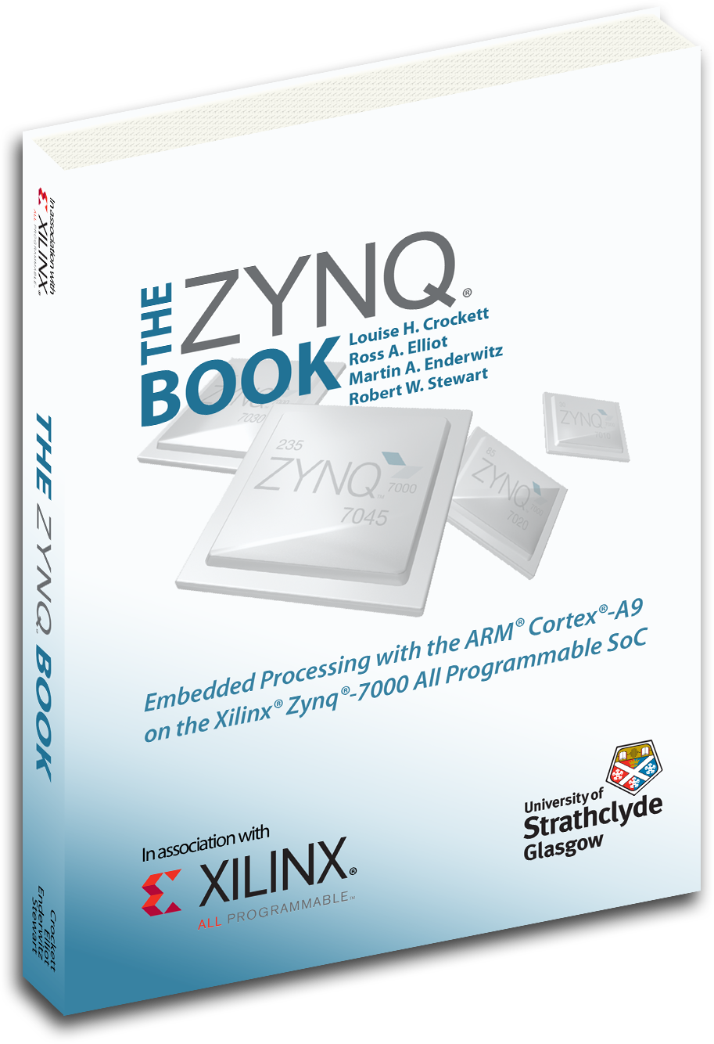
Class Components
Lecture (incl. preclass exercise)
  Slides on web before class
    (you can print if want a follow-along copy)
  N.B. I will encourage (force) class participation
    Questions (“warm” calls)
Reading [~1 required paper/lecture]
  online: Canvas, IEEE, ACM, also ZynqBook,
  Parallel Programming for FPGAs
Homework
  (1 per week due F5pm)
Project – open-ended (~6 weeks)
Note syllabus, course admin online

Slide 54
First Half
Quickly cover breadth
Metrics, bottlenecks
Memory
Parallel models
SIMD/Data Parallel
Thread-level parallelism
Spatial, C-to-gates
Real-time
Reactive
Line up with homeworks

Slide 55
Second Half
Use everything on project
Schedule more tentative
  Adjust as experience and project demands
Going deeper
Memory
Networking
Energy
Scaling
Chip Cost
Verification
Defect + Fault tolerance

Slide 56
Teaming
HW and Project in Groups of 2
HW: we assign
Project: you propose, we review
Individual assignment turnin

Slide 57
Office & Lab Hours
Andre: T 4:15pm—5:30pm Levine 270
Renzhi & Han: M R 6—8pm in Ketterer
  Start tomorrow 8/30

Slide 58
C Review
Course will rely heavily on C
  Program both hardware and software in C
HW1 has some C warmup problems
TA will hold C review
  Ketterer on Sept. 4th at 6pm
  (before our next class meeting since Monday 9/3 is Labor day)
  Watch piazza for details

Slide 59
Preclass Exercise
Motivate the topic of the day
  Introduce a problem
  Introduce a design space, tradeoff, transform
Work for ~5 minutes before start lecturing
Do bring calculator class
  Will be numerical examples

Slide 60
Feedback
Will have anonymous feedback sheets for each lecture
  Clarity?
  Speed?
  Vocabulary?
  General comments

Slide 61
Policies
Canvas turn-in of assignments
No handwritten work
Due on time (3 free late days total)
Collaboration
  Tools – allowed
  Designs – limited to project teams as specified on assignments
See web page

Slide 62
Boards and Wait List
Believe everyone on the wait list has been offered a permit
To accommodate, does mean we have
  Boards < Students < 2*Boards
Will be one board per pair of students

Slide 63
Admin
Your action:
  Find course web page
    Read it, including the policies
    Find Syllabus
      Find homework 1
      Find lecture slides
        Will try to post before lecture
      Find reading assignments
  Find reading for lecture 2 on canvas and web
    …for this lecture if you haven’t already
  Find/join piazza group for course

Slide 64
Big Ideas
Programmable Platforms
  Key delivery vehicle for innovative computing applications
  Reduce TTM, risk
  More than a microprocessor
  Heterogeneous, parallel
Demand hardware-software codesign
  Soft view of hardware
  Resource-aware view of parallelism

Slide 65
Zedboard Checkout
Ketterer (Moore 200) – card key access
  tiny.cc/detkin-access
Will need SD Card writer for HW2+
  (can get $<10 on amazon.com)
By numbers

