Slide 1

ESE532:
System-on-a-Chip Architecture
Day 10: October 3, 2018
High Level Synthesis (HLS)
C-to-gates
Maybe: C-for-gates

Slide 2
Today
Motivation
Spatial Computations from C specification
  Variables and expression (skip?)
  Simple Conditionals
  Loops
  Functions
  Arrays
  Memories
Complexities from C semantics

Slide 3
Message
C (or any programming language) specifies a computation
Can describe spatial computation
Underlying semantics is sequential
  Watch for unintended sequentialization
  Write C for spatial differently than you write C for processors

Slide 4
Coding Accelerators
Want to exploit FPGA logic on Zynq to accelerate computations
Traditionally has meant develop accelerators in
  Hardware Description Language (HDL)
    E.g. Verilog → undergrads see in CIS371
  Directly in schematics
  Generator language (constructs logic)

Slide 5
Course “Hypothesis”
C-to-gates synthesis mature enough to use to specify hardware
  Leverage fact everyone knows C
    (must, at least, know C to develop embedded code)
  Avoid taking time to teach Verilog or VHDL
    Or making Verilog a pre-req.
  Focus on teaching how to craft hardware
    Using the C already know
    …may require thinking about the C differently

Slide 6
Discussion [open]
Is it obvious we can write C to describe hardware?
What parts of C translate naturally to hardware?
What parts of C might be problematic?
What parts of hardware design might be hard to describe in C?

Slide 7
Three Perspectives
How express spatial/hardware computations in C
  May want to avoid some constructs in C
How express computations
  Hopefully agnostic to spatial vs. sequential
Given C code: how could we implement in spatial hardware
  Some corner cases and technicalities make tricky
[copy to board]

Slide 8
Advantage
Use C for hardware and software
  Test out functionality entirely in software
    Debug code before put on hardware where harder to observe what’s happening
    …without spending time in place and route
  Explore hardware/software tradeoffs by targeting same code to either hardware or software

Slide 9
Context
C most useful for describing behavior of leaf operators
C alone doesn’t naturally capture task parallelism

Slide 10
Preclass F
Ready for preclass f?
Skip to preclass f

Slide 11
C Primitives
Arithmetic Operators
Unary Minus (Negation) -a
Addition (Sum) a + b
Subtraction (Difference) a - b
Multiplication (Product) a * b
Division (Quotient) a / b
Modulus (Remainder) a % b
Things might have a hardware operator for…

Slide 12
C Primitives
Bitwise Operators
Bitwise Left Shift a << b
Bitwise Right Shift a >> b
Bitwise One's Complement ~a
Bitwise AND a & b
Bitwise OR a | b
Bitwise XOR a ^ b
Things might have a hardware operator for…

Slide 13
C Primitives
Comparison Operators
Less Than a < b
Less Than or Equal To a <= b
Greater Than a > b
Greater Than or Equal To a >= b
Not Equal To a != b
Equal To a == b
Logical Negation !a
Logical AND a && b
Logical OR a || b
Things might have a hardware operator for…

Slide 14
Expressions: combine operators
a*x+b
a
x
b
*
+
A connected set of operators
→ Graph of operators

Slide 15
Expressions: combine operators
a*x+b
a*x*x+b*x+c
a*(x+b)*x+c
((a+10)*b < 100)
A connected set of operators
→ Graph of operators

Slide 16
C Assignment
Basic assignment statement is:
Location = expression
f=a*x+b
a
x
b
*
+
f

Slide 17
Straight-line code
a sequence of assignments
What does this mean?
  g=a*x;
  h=b+g;
  i=h*x;
  j=i+c;
a
x
b
c
*
g
+
h
*
i
+
j

Slide 18
Variable Reuse
Variables (locations) define flow between computations
Locations (variables) are reusable
  t=a*x;
  r=t*x;
  t=b*x;
  r=r+t;
  r=r+c;

Slide 19
Variable Reuse
Variables (locations) define flow between computations
Locations (variables) are reusable
  t=a*x; t=a*x;
  r=t*x; r=t*x;
  t=b*x; t=b*x;
  r=r+t; r=r+t;
  r=r+c; r=r+c;
Sequential assignment semantics tell us which definition goes with which use.
  Use gets most recent preceding definition.

Slide 20
Dataflow
Can turn sequential assignments into dataflow graph through def→use connections
  t=a*x; t=a*x;
  r=t*x; r=t*x;
  t=b*x; t=b*x;
  r=r+t; r=r+t;
  r=r+c; r=r+c;
a
x
b
c
*
*
*
+
+

Slide 21
Dataflow Height
t=a*x; t=a*x;
  r=t*x; r=t*x;
  t=b*x; t=b*x;
  r=r+t; r=r+t;
  r=r+c; r=r+c;
Height (delay) of DF graph may be less than # sequential instructions.
a
x
b
c
*
*
*
+
+

Slide 22
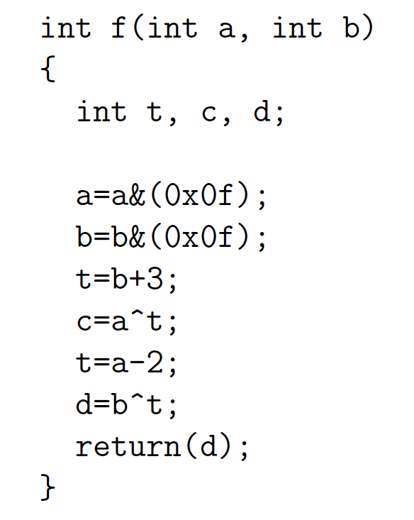
Lecture Checkpoint
Happy with ?
  Straight-line code
  Variables
Graph for preclass f

Slide 23
Straight Line Code
C is fine for expressing straight-line code and variables
  Has limited data types
    Address with tricks like masking
    Address with user-defined types

Slide 24
Optimizations can probably expect compiler to do
Constant propagation: a=10; b=c[a];
Copy propagation: a=b; c=a+d; → c=b+d;
Constant folding: c[10*10+4]; → c[104];
Identity Simplification: c=1*a+0; → c=a;
Strength Reduction: c=b*2; → c=b<<1;
Dead code elimination
Common Subexpression Elimination:
  C[x*100+y]=A[x*100+y]+B[x*100+y]
  t=x*100+y; C[t]=A[t]+B[t];
Operator sizing: for (i=0; i<100; i++) b[i]=(a&0xff+i);

Slide 25
Conditionals
What can we do for simple conditionals?
if (a<b)
  res=b-a
Else
  res=a-b

Slide 26
Simple Control Flow
If (cond) { … } else { …}
Assignments become conditional
In simplest cases (no memory ops),
can treat as dataflow node
cond
then
else
choose

Slide 27
Simple Conditionals
if (a>b)
c=b*c;
else
c=a*c;
a>b
b*c
a*c
c

Slide 28
Simple Conditionals
v=a;
if (b>a)
v=b;
If not assigned, value flows from before assignment
b>a
b
a
v

Slide 29
Simple Conditionals
a
max=a;
min=a;
if (a>b)
{min=b;
c=1;}
else
{max=b;
c=0;}
May (re)define many values on each branch.
a>b
b
1
0
min
max
c

Slide 30
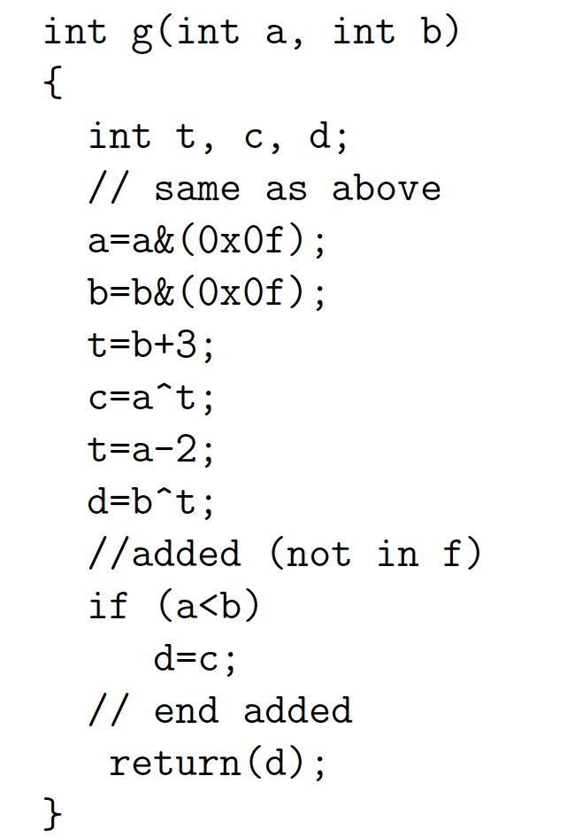
Preclass G
Graph for preclass G
as mux-conversion?

Slide 31

Mux-Conversion and Real Time
How does mux conversion of
if/then/else interact with Real Time?
if (a)
y=b;
else
y=sqrt(b);

Slide 32
Function Call
What do we do with function calls?

Slide 33
Inline
int f(int a, int b)
  return(sqrt(a*a+b*b));
for(i=0;i<MAX;i++)
  D[i]=f(A[i],B[i]);
for(i=0;i<MAX;i++)
  D[i]=sqrt(A[i]*A[i]+B[i]*B[i]);
Functions provide descriptive convenience and compactness.
…but don’t need to force implementation.

Slide 34
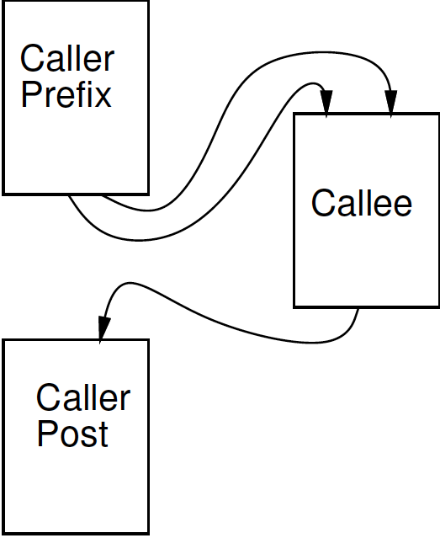
Treat as data flow
Implement function as an operation
Send arguments as input tokens
Get result back as token
Functions provide potential division between substrates?

Slide 35
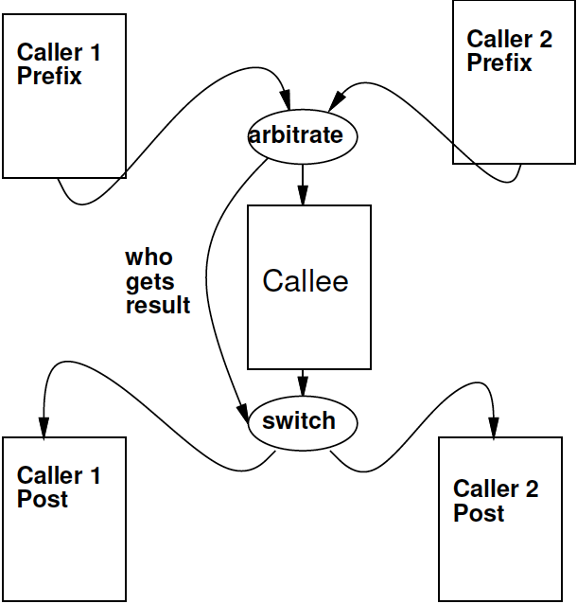
Shared Function
Functions express shared operators.

Slide 36
Recursion?
int fib(int x) {
if ((x==0) || (x==1)) return(1);
else return(fib(x-1)+fib(x-2));
}
In general won’t work.
  Problem?
Smart compiler might be able to turn some cases into iterative loop.
…but don’t count on it.
  VivadoHLS will not

Slide 37
Loops…
From an express computation standpoint, have several roles
  Compact code
  Unbounded computation
From describe hardware
  Compact expression of parallel hardware
  Express pipelines
Express hardware/software tradeoff

Slide 38
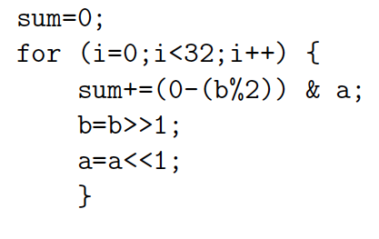
Loop Compact Expression
What express?
  Sequential, fully unrolled, partially unrolled?

Slide 39
Stream
Day 5
Logical abstraction of a persistent point-to-point communication link between operators
  Has a (single) source and sink
  Carries data presence / flow control
  Provides in-order (FIFO) delivery of data from source to sink
stream

Slide 40
Stream
For the moment assume way to read and write to streams:
  stream.read() – return next value on stream
  stream.write(val); put val onto stream
stream

Slide 41

Unbounded, Pipelined Operator
What describe?
int c=12;
while(true)
  {
  int aval=astream.read();
  int bval=bstream.read();
  int res=a*b+c;
  resstream.write(res);
    }

Slide 42
With function call, loop in function
int c=12;
while(true)
  {
  int aval=astream.read();
  int bval=bstream.read();
  int res=multiply(a,b)+c;
  resstream.write(res);
    }

Slide 43
Compact Expression: Arrays
Useful to be able to refer to different values (a large number of values) with the same code.
Arrays + Loops: give us a way to do that
Useful: general expression, hardware description

Slide 44
Compact Expression: Arrays+Logic
Vector sum:
  c3=a3+b3; c2=a2+b2; c1=a1+b1; c0=a0+b0;
  for(i=0;i<3;i++) c[i]=a[i]+b[i];
Chose small length to fit non-array on slide
  #define K 16
  for(i=0;i<K;i++) c[i]=a[i]+b[i];

Slide 45
Compact Expression: Arrays+Logic
Dot Product:
  Y=a3*b3; c2=a2*b2; c1=a1*b1; c0=a0*b0;
  Y=0; for(i=0;i<3;i++) Y+=a[i]*b[i];

Slide 46
Compact Expression: Arrays+Logic
Vector sum:
  c3=a3+b3; c2=a2+b2; c1=a1+b1; c0=a0+b0;
  for(i=0;i<3;i++) c[i]=a[i]+b[i];
These array elements may be nodes in dataflow graph, just like the variables we saw for function f
  Express large dataflow graphs
  Make area-time choices for implementation

Slide 47
Foreshadowing:
C Array Challenge
C programmers think of arrays as memory (or memory as arrays)
  …and sometimes we will want to
Be careful understanding (and expressing) arrays that don’t have to be memories
  …and treated with memory semantics

Slide 48
Loop Interpretations
What does a loop describe?
  Sequential behavior [when to execute]
  Spatial construction [when create HW]
  Data Parallelism [sameness of compute]
We will want to use for all 3
Sometimes need to help the compiler understand which we want

Slide 49
Loop Bounds
Loops without constant bounds
  while (sum+a[i]<100) {
  sum+=a[i];
  b[i]=a[i]>>2;
  i++; }
How many times loop execute?
Typically force sequentialization
  Cannot unroll into hardware
Bad for Real Time
  Cannot say how long they will run

Slide 50
Loop Increment
Loops with variable increment also force sequentialization
  for (i=0;i<100;i+=f(i))
  { b[i]=a[i]; sum+=a[i]; }
What are values of I for which evaluate body?
Also bad for Real Time

Slide 51
Loop Interpretations
What does a loop describe?
  Sequential behavior [when execute]
  Spatial construction [when create HW]
  Data Parallelism [sameness of compute]
We will want to use for all 3
C allows expressive loops
  Some expressiveness
    Not compatible with spatial hardware construction
    Same ones typically not compatible with Real Time

Slide 52
Unroll
Vivado HLS has pragmas for unrolling
UG901: Vivado HLS User’s Guide
  P180—229 for optimization and directives
#pragma HLS UNROLL factor=…
Use to control area-time points
  Use of loop for spatial vs. temporal description

Slide 53

Arrays as Memory Banks
Hardware expression: Sometimes we will want to describe computations with separate memory banks
int a[1024], b[1024],
c[1024];
for(i=0;i<1024;i++)
  a[i]=bigmem[offset+i];
for (i=0;i<1024;i++)
  c[i]=a[i]*b[i];

Slide 54

Arrays as Memory Banks
If single memory has only one port
  Can perform only one memory operation per cycle
  What happens if a, b, c
  all in bigmem? (II ?)
for (i=0;i<1024;i++)
  c[i]=a[i]*b[i];

Slide 55
Physical Memory Port as Limited Shared Resource
Typically single memory port
  Must sequentialize on use of memory port
  Reason for banking
    Put in separate memories,
    so operations can occur simultaneously
Zed DRAM 1 port
Virtex BRAM 2 ports

Slide 56

Arrays as things to put in Memory Banks
Computational expression: sometimes useful to express computation
  Then decide how to pack array state into memory banks for different
    Hardware availability
    Area-Time tradeoffs

Slide 57
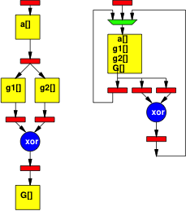
Implementations
unsigned char a[K];
int G[K];
int g1[256], g2[256];
for (i=0;i<K;i++)
  G[i]=g1(a[i]) ^ g2(a[i]);

Slide 58
Arrays as Inputs and Outputs
Computational Expression: arrays are often a natural way of expression set of inputs and outputs
int c=12;
while(true)
  {
  int aval=astream.read();
  int bval=bstream.read();
  int res=a*b+c;
  resstream.write(res);
    }
void op(int a[BLOCK], b[BLOCK], out[BLOCK]) {
for (i=0;i<BLOCK;i++)
  {
  out[i]=a[i]*b[i]+c;
    }
  }

Slide 59

Arrays as Local Memory
Hardware/Computational expression: natural way of describing local state
hist(int a[SIZE], out[EVENTS]) {
int local[EVENTS];
for(i=0;i<EVENTS;i++)
local[i]=0;
for(i=0;i<SIZE;i++)
local[a[i]]++;
for(i=0;i<EVENTS;i++)
out[i]=local[i];
}

Slide 60
C Memory Model
One big linear address space of locations
Most recent definition to location is value
Sequential flow of statements
New value
000
001
Addr
002
004
005
006
007
008
009
010
011
Current value

Slide 61
Challenge: C Memory Model
One big linear address space of locations
Assumes all arrays live in same memory
Assumes arrays may overlap?
New value
000
001
Addr
002
004
005
006
007
008
009
010
011
Current value

Slide 62

Example
Assume a, b live in same memory
Placed in sequence as shown
What happens when
  int a[16];
  int b[16];
  Write to a[17]
  Read from b[-2]

Slide 63
Memory Operation Challenge
Memory is just a set of location
But memory expressions in C can refer to variable locations
  Does A[i], B[j] refer to same location?
  A[f(i)], B[g(j)] ?

Slide 64
C Memory/Pointer Sequentialization
Must preserve ordering of memory operations
  A read cannot be moved before write to memory which may redefine the location of the read
    Conservative: any write to memory
    Sophisticated analysis may allow us to prove independence of read and write
  Writes which may redefine the same location cannot be reordered

Slide 65
C Memory/Pointer Sequentialization
Must preserve ordering of memory operations
  A read cannot be moved before write to memory which may redefine the location of the read
  Writes which may redefine the same location cannot be reordered
True for read/write to single array even if know arrays isolated
  So expression issue broader than C

Slide 66
Consequence
Expressions and operations through variables (whose address is never taken) can be executed at any time
  Just preserve the dataflow
Memory assignments must execute in strict order
  Ideally: partial order
  Conservatively: strict sequential order of C

Slide 67
Forcing Sequencing
Demands we introduce some discipline for deciding when operations occur
  Could be a FSM
  Could be an explicit dataflow token
  Callahan (reading) uses control register
Other uses for timing control
  Control
  Variable delay blocks
  Looping

Slide 68
Scheduled Memory Operations
Source: Callahan

Slide 69
Hardware/Parallelism Challenge
Can we give enough information to the compiler to
  allow it to reorder?
  allow to put in separate embedded memories (separate banks)?
Is the compiler smart enough to exploit?

Slide 70
Mux Conversion and Memory
What might go wrong if we mux-converted the following:
if (cond)
  a[i]=0;
else
  b[i]=0;

Slide 71
Mux Conversion and Memory
What might go wrong if we mux-converted the following:
if (cond)
  a[i]=0;
else
  b[i]=0;
Don’t want memory operations in non-taken branch to occur.

Slide 72
Mux Conversion and Memory
if (cond)
  a[i]=0;
else
  b[i]=0;
  Don’t want memory operations in non-taken branch to occur.
Conclude: cannot mux-convert blocks with memory operations (without additional care)

Slide 73
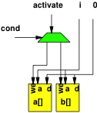
Conditions and Memory
if (cond)
  a[i]=0;
else
  b[i]=0;

Slide 74
Dependence in Loops
for(i=0;i<K;i++)
Y[i]=a[i]*Y[i-1];
If a value needed by one instance of the loop is written by another instance, can create cyclic dependence.
→ limit parallelism (pipeline II)

Slide 75
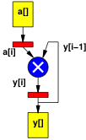
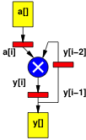
Dependence in Loops
for(i=0;i<K;i++)
Y[i]=a[i]*Y[i-1];
for(i=0;i<K;i++)
Y[i]=a[i]*Y[i-2];
Dependence distance same as
# registers in cycle.

Slide 76
Dependence Fixed/Predictable?
for(i=0;i<K;i++)
Y[i]=a[i]*Y[i-1]+Y[i-2];
for(i=0;i<K;i++)
Y[i]=a[i]*Y[b[i]];
If dependence data-dependent, forced to sequentialize.

Slide 77
Dependence Fixed/Predictable?
for(i=0;i<K;i++)
Y[i]=a[i]*Y[i-1]+Y[i-2];
for(i=0;i<K;i++)
Y[i]=a[i]*Y[2*i+3];
If dependence linear, aggressive compliers may be able to resolve.

Slide 78
Dependence Fixed/Predictable?
for(i=0;i<K;i++)
Y[i]=
a[i]*Y[ceil(sqrt(i)*sin(2i))];
If dependence too complicated, compiler not solve and will force sequential execution.

Slide 79
Memory Allocation?
How support malloc() in hardware?

Slide 80
Hardware Memory
Typically small, fixed, local memory blocks
  E.g. 36Kb BRAMs
Reuse memory blocks
  Not allocate new blocks
  Cannot make data-dependent memory sized blocks
  Cannot hold arbitrary-sized data
  …and processing on arbitrary-sized data not Real Time

Slide 81
Use of malloc()
Data-dependent object (array) size
Data-dependent number of objects
Processing data-dependent sizes or objects not consistent with Real Time
For Real Time
  Statically allocate maximum size will need

Slide 82
No malloc()
Generally don’t want to use malloc with
  Hardware Accelerated functions
  Real Time computations
Vivado HLS won’t let you use malloc()

Slide 83
Pointer Passing
What does it mean to pass a pointer into a function?
What if accelerator doesn’t have access to the memory holding the data pointed to by the pointer?

Slide 84
Pointer Passing
What happens if we give accelerators access to common memory holding data for pointer, but
  There’s only one port into memory
  Memory is 10 cycles away
  And there are 100 accelerators that may need access
  Memory can only handle one memory op per cycle

Slide 85
Avoid Pointer Passing
Tend to copy data into / move data among hardware accelerator memories rather than passing pointers.

Slide 86
Big Ideas:
C (any prog lang) specifies a computation
Can describe spatial computation
  Has some capabilities that don’t make sense in hardware
    Shared memory pool, malloc, recursion
  Watch for unintended sequentialization
C for spatial is coded differently from C for processor
  …but can still run on processor
Good for leaf functions (operations)
  Limiting for full task

Slide 87
Admin
Reading for Monday on Web
  Xilinx HLS documents
No homework due Friday (10/5)
  Enjoy Fall Break
HW5 due next Friday (10/12)
Return feedback
Class in here at noon

