Slide 1

ESE532:
System-on-a-Chip Architecture
Day 11: October 8, 2017
Coding HLS for Accelerators

Slide 2
Previously
We can describe computational operations in C
    Primitive operations (add, sub, multiply, and, or)
    Dataflow graphs primitives
    To bit level
    Conditionals and loops
    Memory reads/writes
    Function abstraction

Slide 3
Today
Arrays and Memory Sequentialization (from last time)
Pragmas in Vivado HLS C
Controlling Memories in Vivado HLS C
Time permitting
  malloc, pointers, more dependencies

Slide 4
Message
Can specify HW computation in C
Vivado HLS gives control over how design mapped (area-time, streaming…)
Code may need some care and stylization to feed data efficiently
Read Design Productivity Guide (UG 1197)
  C-based IP development
Reference Vivado HLS Users Guide (902)
  Design Optimization

Slide 5
Arrays and Memories

Slide 6
Arrays as Inputs and Outputs
Computational Expression: arrays are often a natural way of expression set of inputs and outputs
int c=12;
while(true)
  {
  int aval=astream.read();
  int bval=bstream.read();
  int res=a*b+c;
  resstream.write(res);
    }
void op(int a[BLOCK], int b[BLOCK], int out[BLOCK]) {
for (i=0;i<BLOCK;i++)
  {
  out[i]=a[i]*b[i]+c;
    }
  }

Slide 7
Arrays as Local Memory
Hardware/Computational expression: natural way of describing local state
hist(int a[SIZE], out[EVENTS]) {
int local[EVENTS];
for(i=0;i<EVENTS;i++)
local[i]=0;
for(i=0;i<SIZE;i++)
local[a[i]]++;
for(i=0;i<EVENTS;i++)
out[i]=local[i];
}

Slide 8
C Memory Model
One big linear address space of locations
Most recent definition to location is value
Sequential flow of statements
New value
000
001
Addr
002
004
005
006
007
008
009
010
011
Current value

Slide 9
Challenge: C Memory Model
One big linear address space of locations
Assumes all arrays live in same memory
Assumes arrays may overlap?
New value
000
001
Addr
002
004
005
006
007
008
009
010
011
Current value

Slide 10

Example
Assume a, b live in same memory
Placed in sequence as shown
What happens when
  int a[16];
  int b[16];
  Write to a[17]
  Read from b[-2]

Slide 11
Memory Operation Challenge
Memory is just a set of location
But memory expressions in C can refer to variable locations
  Does A[i], B[j] refer to same location?
  A[f(i)], B[g(j)] ?

Slide 12
C Memory/Pointer Sequentialization
Must preserve ordering of memory operations
  A read cannot be moved before write to memory which may redefine the location of the read
    Conservative: any write to memory
    Sophisticated analysis may allow us to prove independence of read and write
  Writes which may redefine the same location cannot be reordered

Slide 13
C Memory/Pointer Sequentialization
Must preserve ordering of memory operations
  A read cannot be moved before write to memory which may redefine the location of the read
  Writes which may redefine the same location cannot be reordered
True for read/write to single array even if know arrays isolated
  So expression issue broader than C

Slide 14
Consequence
Expressions and operations through variables (whose address is never taken) can be executed at any time
  Just preserve the dataflow
Memory assignments must execute in strict order
  Ideally: partial order
  Conservatively: strict sequential order of C

Slide 15
More at end of lecture
If time permits, more on Sequentialization and Dependencies

Slide 16
Vivado HLS Mapping Control

Slide 17
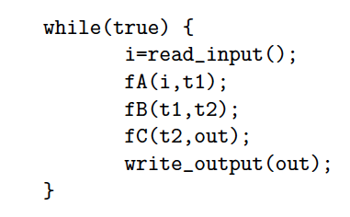
Preclass 2
What dataflow graph does this describe?

Slide 18
Vivado HLS Pragma DATAFLOW
Enables streaming data between functions and loops
Allows concurrent streaming execution
Requires data be produced/consumed sequentially
  i.e. can connect with fifo; not need reorder

Slide 19
Dataflow with Arrays

Slide 20
Streamable
Processes input and output in order

Slide 21
Cannot Stream Input
Why?

Slide 22
Streamable?
Can stream input?
Can stream output?

Slide 23
Vivado HLS Pragma DATAFLOW
Enables streaming data between functions and loops
Allows concurrent streaming execution
Requires data be produced/consumed sequentially
  i.e. can connect with fifo; not need reorder
Useful to use stream data type between functions – communicates sequence
  hls::stream<TYPE>

Slide 24
Streaming Operations
Functions can have stream inputs and outputs
  Must pass a pointers
  hls::stream<Type> &strm
Vivado HLS expressiveness to define hardware streaming operation pipelines

Slide 25
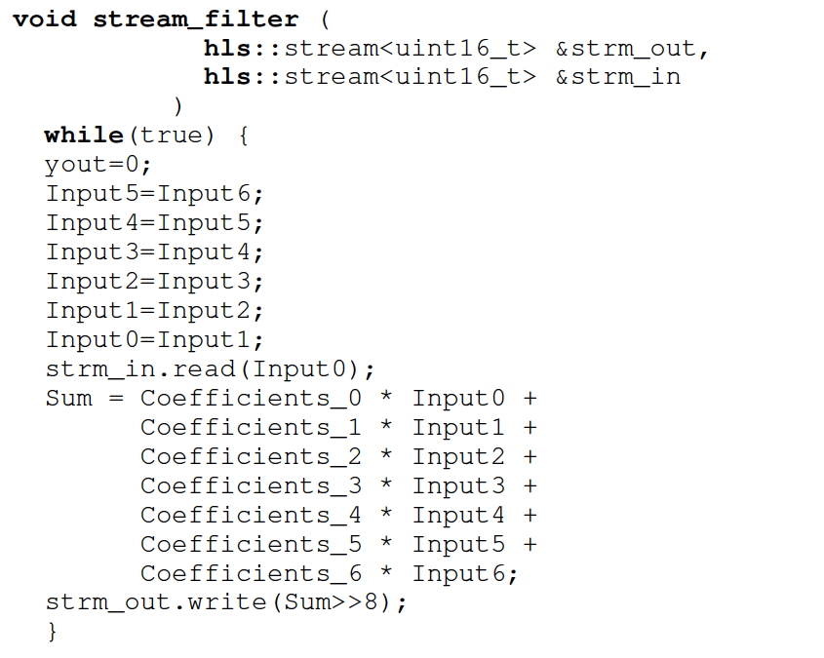

Slide 26
stream_filter Pipeline

Slide 27
Dataflow Streaming
Works between loops, as well

Slide 28
Between
Loops

Slide 29
Vivado HLS Pragma
PIPELINE
Direct a function or loop to be pipelined
Ideally start one loop or function body per cycle
  Can control II

Slide 30
for (i=0;i<N;i++)
yout=0;
#pragma HLS PIPELINE
for (j=0;j<K;j++)
yout+=in[i+j]*w[j];
y[i]=yout;
Which solution
from preclass 3?

Slide 31
Dataflow and pipelining
Dataflow allows coarse-grained pipelining among loops and functions
Pipeline causes loop bodies to be pipelined

Slide 32
Dataflow and Pipelining
Cycles for top loop unpipelined?

Slide 33
Dataflow and Pipelining
Cycles for top
loop pipelined?

Slide 34
Dataflow and Pipelining
Cycles for bottom loop unpipelined?

Slide 35
Dataflow and Pipelining
Cycles for bottom loop pipelined?

Slide 36
Dataflow and Pipelining
Composite time, no dataflow, no pipelining?

Slide 37
Dataflow and Pipelining
Composite time dataflow only?

Slide 38
Dataflow and Pipelining
Composite time pipelining only?

Slide 39
Dataflow and Pipelining
Composite
time dataflow
and pipelining?

Slide 40
Compare Cases
No Dataflow
Dataflow
Dataflow
Unpipe
Pipe

Slide 41
Vivado HLS Pragma
UNROLL
Unroll loop into spatial hardware
  Can control level of unrolling
Any loops inside a pipelined loop gets unrolled by the PIPELINE directive

Slide 42
for (i=0;i<N;i++)
yout=0;
#pragma HLS UNROLL
for (j=0;j<K;j++)
yout+=in[i+j]*w[j];
y[i]=yout;
Which solution
from preclass 3?

Slide 43
Dataflow, Unrolling, & Pipelining
Cycles unroll K-loop, dataflow, pipeline?

Slide 44
Unroll
Can perform partial unrolling
#pragma HLS UNROLL factor=…
Use to control area-time points
  Use of loop for spatial vs. temporal description

Slide 45
Vivado HLS Pragma
INLINE
Collapse function body into caller
  Eliminates interface code
  Allows optimization of inline code
Recursive option to inline a hierarchy
  Maybe useful when explore granularity of accelerator

Slide 46
Zynq BRAM
36Kb of memory
  Configurable width up to 72b
    512x72 or … 32Kx1
  Dual port
Can be operated as 2x18Kb memory banks
  Configurable width up to 36b
    512x36 or … 16Kx1
  Each memory dual port
Xilinx UG473, 7 Series FPGAs Memory Resources User Guide

Slide 47
Vivado HLS Pragma
ARRAY_PARTITION
Spread out array over multiple BRAMs
  By default placed in single BRAM
    At most 2 ports
  Use to remove memory bottleneck that prevents pipelining (limits II)

Slide 48
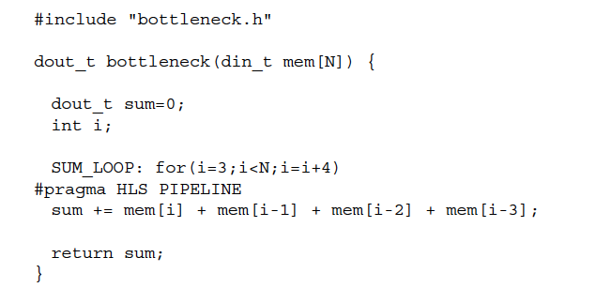
Memory Bottleneck Example
902 example p. 91-92
What problem if put mem
in single BRAM?
Xilinx UG1197 (2017.1) p. 50

Slide 49
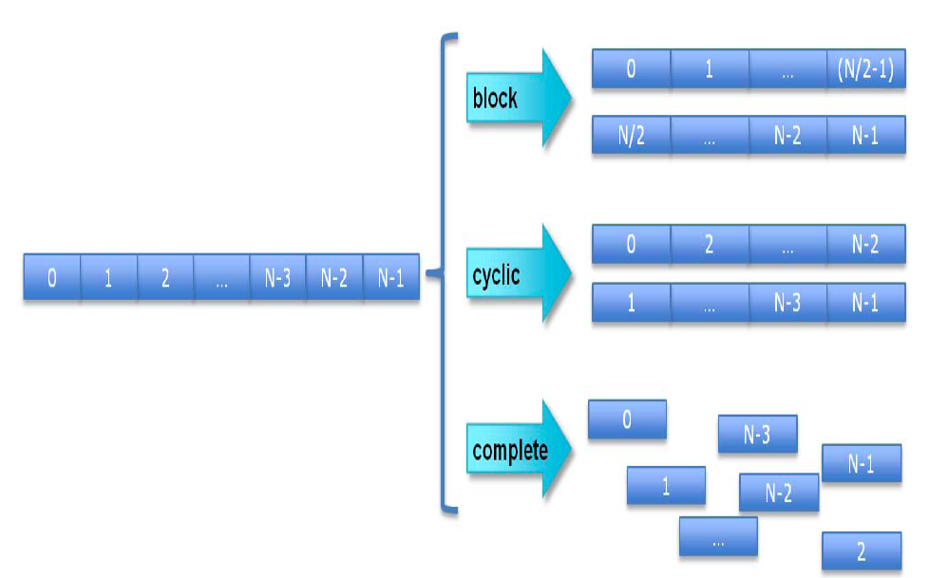
Array Partition
Xilinx UG902 p. 195 (145 in 2017.1 version)

Slide 50
Array Partition Example
#pragma ARRAY_PARTITION variable=mem cylic factor=4
Xilinx UG902 p. 91

Slide 51
Vivado HLS Pragma
ARRAY_RESHAPE
Pack data into BRAM to improve access (reduce BRAMs)
  May provide similar benefit to partitioning without using more BRAMs

Slide 52
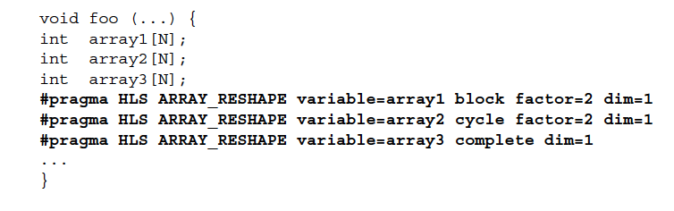
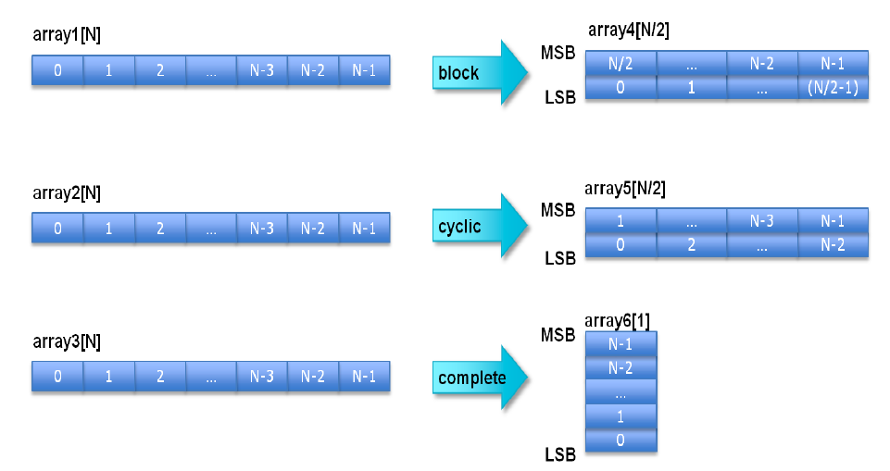
Xilinx UG902 (2017.1) p. 173

Slide 53
BRAM can be configured
for 72b wide output
902 example p. 91-92
How fix if dint_t is 16b?
Xilinx UG902 p. 91

Slide 54
Array Reshape Example
#pragma ARRAY_RESHAPE variable=mem cylic factor=4 dim=1
(if din_t 16b)
Xilinx UG902 p. 91

Slide 55
HLS Pragma Summary
pragmas allow us to control hardware mapping
  How interpret loops (spatial hw vs. temporal)
  Turn area-time knobs
  Specify how arrays get mapped to memories
Could have rewritten code by hand
  Unroll, separate arrays…
  Pragmas automate; we just need to provide instruction

Slide 56
Memory Allocation

Slide 57
Memory Allocation?
How support malloc() in hardware?

Slide 58
Hardware Memory
Typically small, fixed, local memory blocks
  E.g. 36Kb BRAMs
Reuse memory blocks
  Not allocate new blocks
  Cannot make data-dependent memory sized blocks
  Cannot hold arbitrary-sized data
  …and processing on arbitrary-sized data not Real Time

Slide 59
Demand for malloc()
Data-dependent object (array) size
Data-dependent number of objects
Processing data-dependent sizes or objects not consistent with Real Time
For Real Time
  Statically allocate maximum size will need

Slide 60
No malloc()
Generally don’t want to use malloc with
  Hardware Accelerated functions
  Real Time computations
Vivado HLS won’t let you use malloc()

Slide 61
Pointer Passing

Slide 62
Pointer Passing
What does it mean to pass a pointer into a function?

Slide 63
Pointer Passing
What if accelerator doesn’t have access to the memory holding the data pointed to by the pointer?

Slide 64
Pointer Passing
What happens if we give accelerators access to common memory holding data for pointer, but
  There’s only one port into memory
  Memory is 10 cycles away
  And there are 100 accelerators that may need access
  Memory can only handle one memory op per cycle

Slide 65
Avoid Pointer Passing
Tend to copy data into / move data among hardware accelerator memories rather than passing pointers.

Slide 66
Memory Sequentialization and Data Dependencies
(unlikely to cover in class;
Review on own)

Slide 67
C Memory Consequence
Expressions and operations through variables (whose address is never taken) can be executed at any time
  Just preserve the dataflow
Memory assignments must execute in strict order
  Ideally: partial order
  Conservatively: strict sequential order of C

Slide 68
Forcing Sequencing
Demands we introduce some discipline for deciding when operations occur
  Could be a FSM
  Could be an explicit dataflow token
  Callahan (reading) uses control register
Other uses for timing control
  Control
  Variable delay blocks
  Looping

Slide 69
Scheduled Memory Operations
Source: Callahan

Slide 70
Hardware/Parallelism Challenge
Can we give enough information to the compiler to
  allow it to reorder?
  allow to put in separate embedded memories (separate banks)?
Is the compiler smart enough to exploit?

Slide 71
Mux Conversion and Memory
What might go wrong if we mux-converted the following:
if (cond)
  a[i]=0;
else
  b[i]=0;

Slide 72
Mux Conversion and Memory
What might go wrong if we mux-converted the following:
if (cond)
  a[i]=0;
else
  b[i]=0;
Don’t want memory operations in non-taken branch to occur.

Slide 73
Mux Conversion and Memory
if (cond)
  a[i]=0;
else
  b[i]=0;
  Don’t want memory operations in non-taken branch to occur.
Conclude: cannot mux-convert blocks with memory operations (without additional care)

Slide 74
Conditions and Memory
if (cond)
  a[i]=0;
else
  b[i]=0;

Slide 75
Dependence in Loops
for(i=0;i<K;i++)
Y[i]=a[i]*Y[i-1];
If a value needed by one instance of the loop is written by another instance, can create cyclic dependence.
→ limit parallelism (pipeline II)

Slide 76
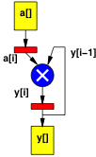
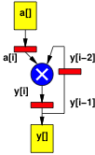
Dependence in Loops
for(i=0;i<K;i++)
Y[i]=a[i]*Y[i-1];
for(i=0;i<K;i++)
Y[i]=a[i]*Y[i-2];
Dependence distance same as
# registers in cycle.

Slide 77
Dependence Fixed/Predictable?
for(i=0;i<K;i++)
Y[i]=a[i]*Y[i-1]+Y[i-2];
for(i=0;i<K;i++)
Y[i]=a[i]*Y[b[i]];
If dependence data-dependent, forced to sequentialize.

Slide 78
Dependence Fixed/Predictable?
for(i=0;i<K;i++)
Y[i]=a[i]*Y[i-1]+Y[i-2];
for(i=0;i<K;i++)
Y[i]=a[i]*Y[2*i+3];
If dependence linear, aggressive compliers may be able to resolve.

Slide 79
Dependence Fixed/Predictable?
for(i=0;i<K;i++)
Y[i]=
a[i]*Y[ceil(sqrt(i)*sin(2i))];
If dependence too complicated, compiler not solve and will force sequential execution.

Slide 80
Big Ideas
Can specify HW computation in C
Create streaming operations
  Run on processor or FPGA
Vivado HLS gives control over how map to hardware
  Area-time point

Slide 81
Admin
Reading for Wednesday
  on web
  and Zynq book
HW5 due Friday

