Slide 1

ESE532:
System-on-a-Chip Architecture
Day 12: October 10, 2018
Data Movement
(Interconnect, DMA)

Slide 2
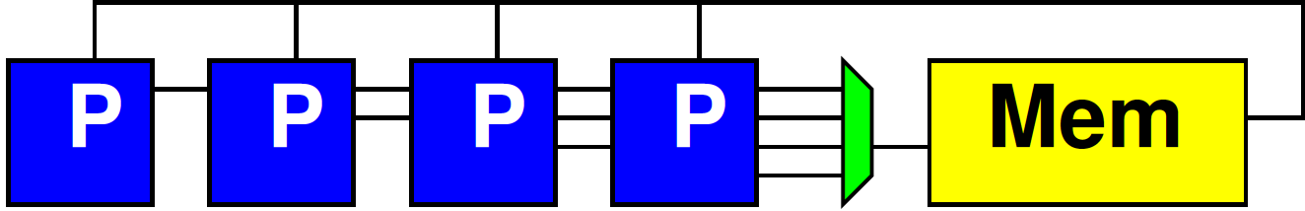
Preclass 1
N processors
Each: 1 read, 10 cycle compute, 1 write
Memory: 1 read or write per cycle
How many processors can support before saturate memory capacity?

Slide 3
Schedule Memory Port
12 | 13 | 14 | 15 | 16 | 17 | 18 | 19 | 20 | 21 | 22 | 23 | 24 | 25
P1.1 write | P1.2 read | P2.1 write | P2.2 read | P3.1 write | P3.2 read | P4.1 write | P4.2 read | P5.1 write | P5.2 read | P6.1 write | P6.2 read | P1.2 write | P1.3 read
 |  | P1 compute f on 2nd iteration
 |  |  |  | P2 compute f on 2nd iteration

Slide 4
Bottleneck
Sequential access to a common memory can become the bottleneck

Slide 5
Previously
Want data in small memories
  Low latency, high bandwidth
FPGA has many memories all over fabric

Slide 6
Embedded Memory in FPGA
Logic
Cluster
Memory
Bank
Memory
Frequency
XC7Z020 (Zed Board) has 140 36Kb BRAMs

Slide 7
Previously
Want data in small memories
  Low latency, high bandwidth
FPGA has many memories all over fabric
Want C arrays in small memories
  Partitioned so can perform enough reads (writes) in a cycle to avoid memory bottleneck

Slide 8
Today
Interconnect Infrastructure
Data Movement Threads
Peripherals
DMA -- Direct Memory Access

Slide 9
Message
Need to move data
Shared interconnect to make physical connections
Useful to move data as separate thread of control
  Dedicating a processor is inefficient
  Useful to have dedicated data-movement hardware: Direct Memory Access (DMA)

Slide 10
Memory and I/O Organization
Architecture contains
  Large memories
    For density, necessary sharing
  Small memories local to compute
    For high bandwidth, low latency, low energy
  Peripherals for I/O
Need to move data
  Among memories and I/O
    Large to small and back
    Among small
    From Inputs, To Outputs

Slide 11
Term: Peripheral
“On the edge (or perhiphery) of something”
Peripheral device – device used to put information onto or get information off of a computer
  E.g.
    Keyboard, mouse, modem, USB flash drive, …

Slide 12
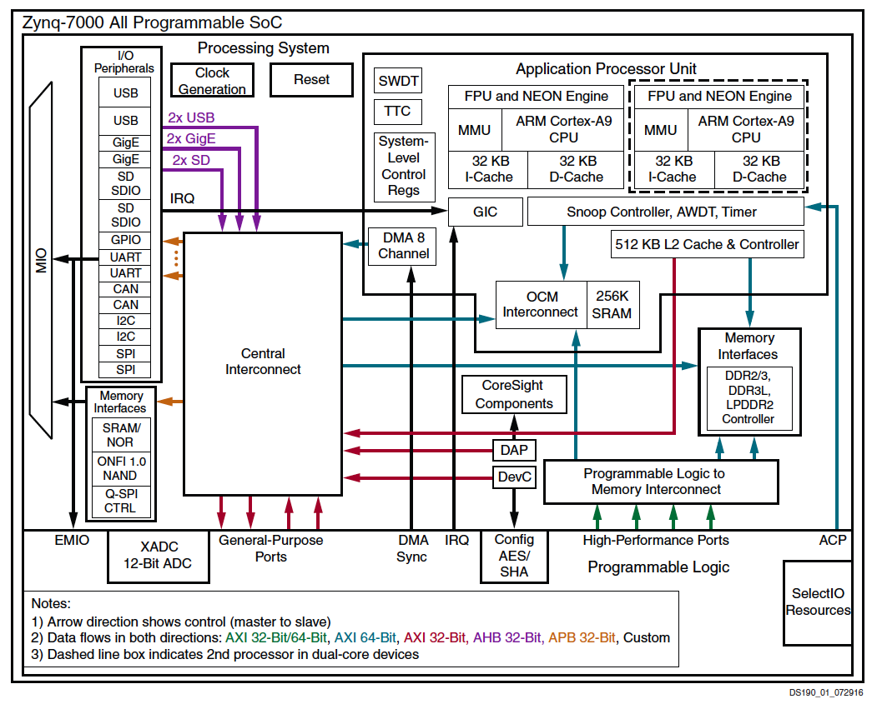

Slide 13
Memory and I/O Organization
Architecture contains
  Large memories
    For density, necessary sharing
  Small memories local to compute
    For high bandwidth, low latency, low energy
  Peripherals for I/O
Need to move data
  Among memories and I/O
    Large to small and back
    Among small
    From Inputs, To Outputs

Slide 14
How move data?
Abstractly, using stream links.
Connect stream between producer and consumer.
Ideally: dedicated wires

Slide 15
Dedicated Wires?
What might prevent us from having dedicated wires between all communicating units?

Slide 16
Making Connections
Cannot always be dedicated wires
  Programmable
  Wires take up area
  Don’t always have enough traffic to consume the bandwidth of point-to-point wire
  May need to serialize use of resource
    E.g. one memory read per cycle
  Source or destination may be sequentialized on hardware

Slide 17
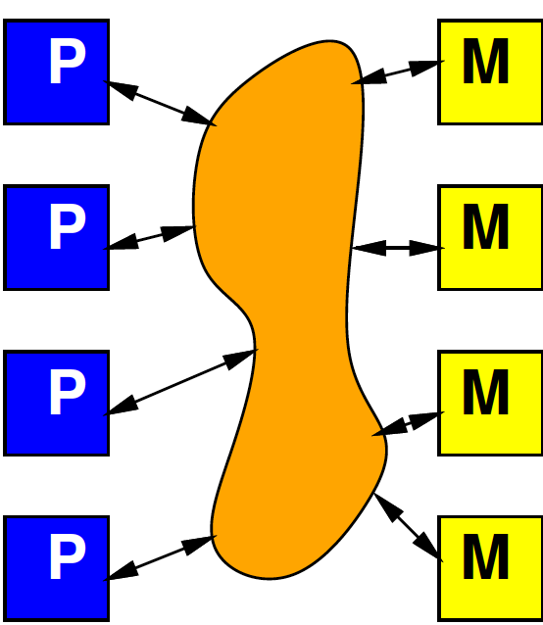
Model
Programmable, possibly shared interconnect

Slide 18
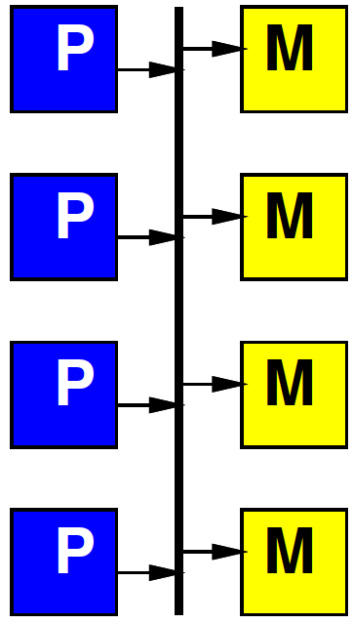
Simple Realization
Shared Bus
Write to bus with
address of destination
When address match,
take value off bus
Pros?
Cons?

Slide 19
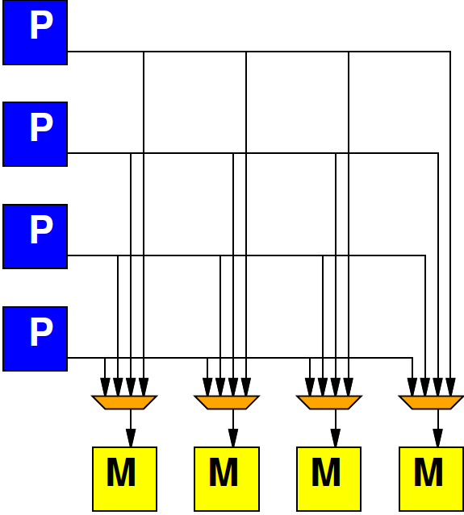
Alternate: Crossbar
Provide programmable connection between all sources and destinations
Any destination can be connected to any single source

Slide 20
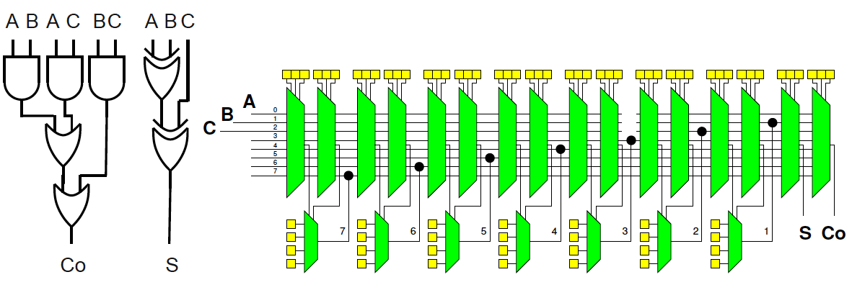
Simplistic FPGA
(illustrate possibility)
Day 8
Every LUT input has a mux
Every such mux has m=(N+I) inputs
  An input for each LUT output (N 2-LUTs)
  An input for each Circuit Input (I Circuit inputs)
Each Circuit Output has an m-input mux

Slide 21
Alternate: Crossbar
Provide programmable connection between all sources and destinations
Any destination can be connected to any single source

Slide 22
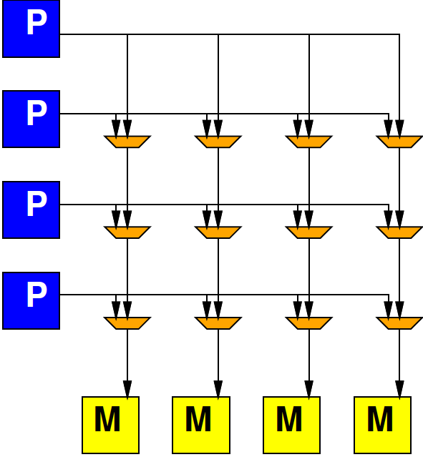
Crossbar

Slide 23
Preclass 2
K-input, O-output Crossbar
How many 2-input muxes?

Slide 24
Crossbar
Provides high bandwidth
  Minimal blocking
Costs large amounts of area
  Grows fast with inputs, outputs

Slide 25
General Interconnect
Generally, want to be able to parameterize designs
Here: tune area-bandwidth
  Control how much bandwidth provide

Slide 26
Interconnect
How might get design points between bus and crossbar?
How could reduce number
  Inputs to crossbar?
  Outputs from crossbar?

Slide 27
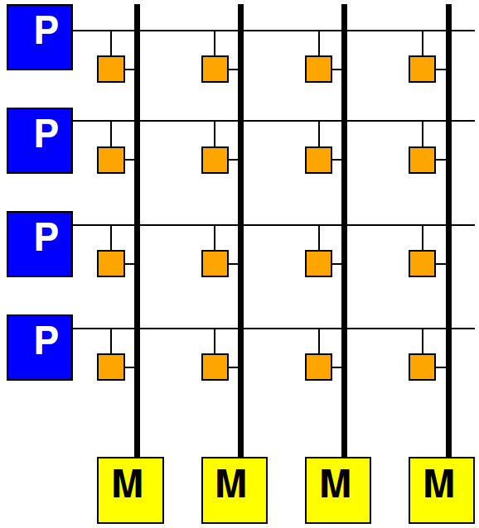
Multiple Busses
Think of crossbar as one bus per output
Simple bus is one bus total
In between,
  How many simultaneous
  busses support?

Slide 28
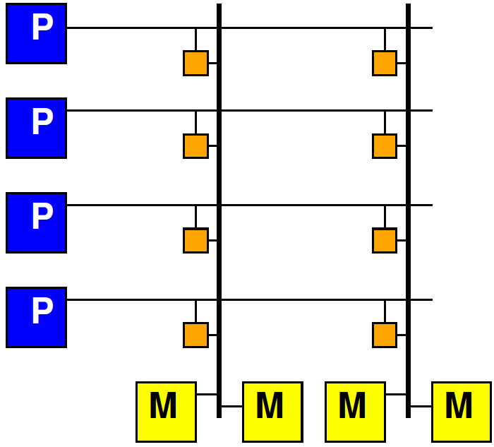
Share Crossbar Outputs
Group set of outputs together on a bus

Slide 29
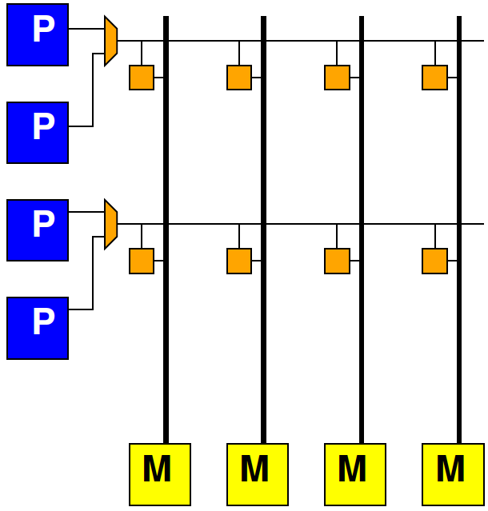
Share Crossbar Inputs
  Group number of inputs together on an input port to crossbar

Slide 30
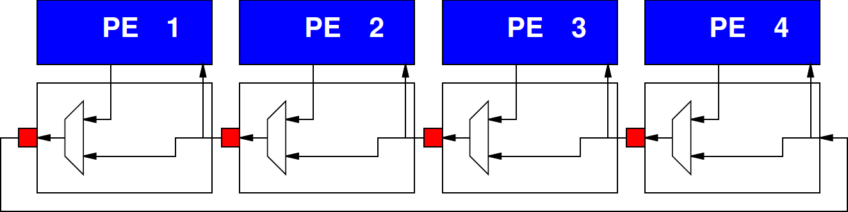
Delay
Delay proportional to distance
Pipeline bus to keep cycle time down
  Take many cycles to get travel long distance
  …but fewer cycles when distance small

Slide 31
Local Interconnect
How many cycles from:
  PE3 to PE2
  PE3 to PE1
  PE3 to PE4

Slide 32
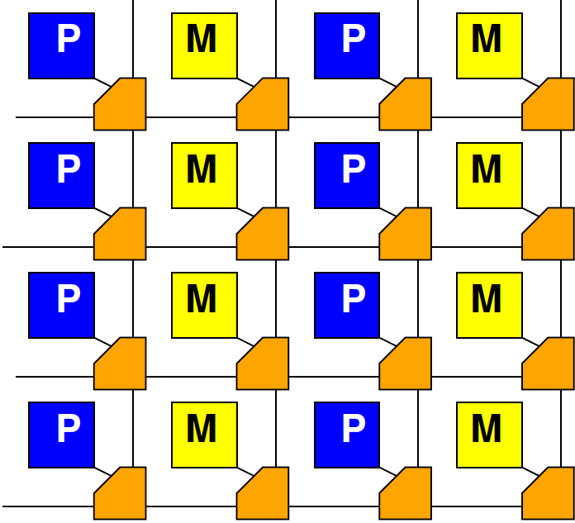
Mesh

Slide 33
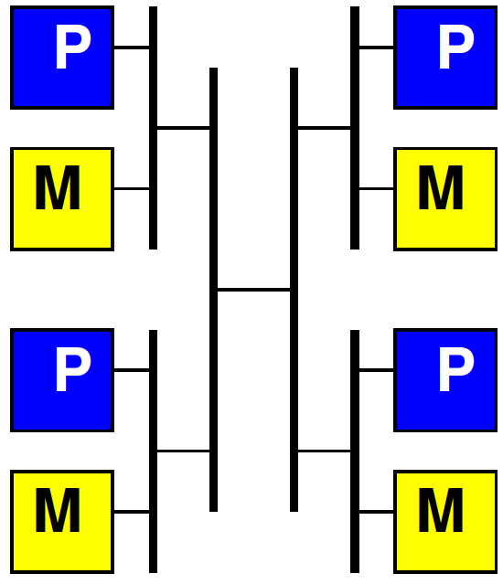
Hierarchical Busses

Slide 34
Interconnect
Will need an infrastructure for programmable connections
Rich design space to tune
area-bandwidth-locality
  Will explore more
  later in course

Slide 35
Long Latency Memory Operations

Slide 36
Day 3
Large memories are slow
  Latency increases with memory size
Distant memories are high latency
  Multiple clock-cycles to cross chip
  Off-chip memories even higher latency

Slide 37
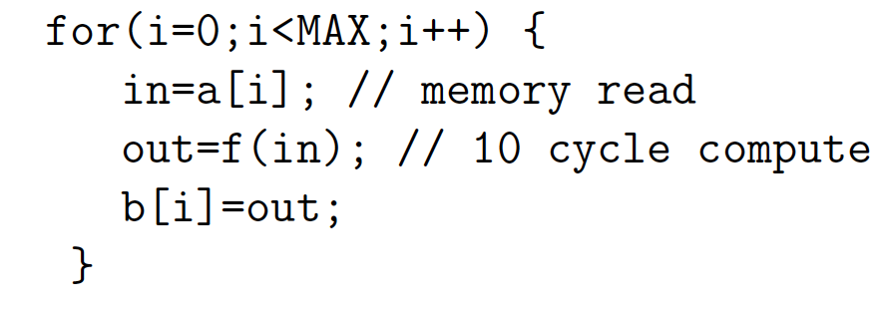
Day 3, Preclass 2
10 cycle latency to memory
If must wait for data return, latency can degrade throughput
10 cycle latency + 10 op + (assorted)
  More than 20 cycles / result

Slide 38
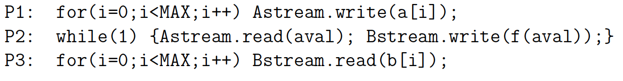
Preclass 3
Throughput using 3 threads?

Slide 39
Fetch (Write) Threads
Potentially useful to move data in separate thread
Especially when
  Long (potentially variable) latency to data source (memory)
Useful to split request/response

Slide 40
Peripherals

Slide 41
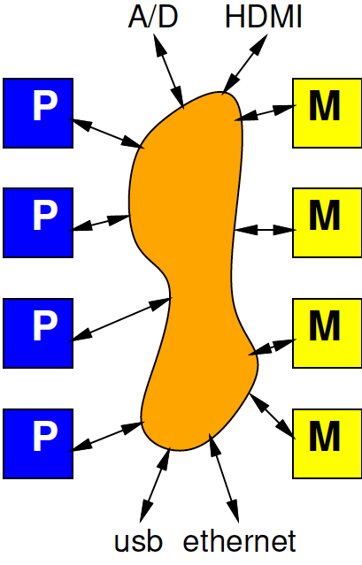
Input and Output
Typical SoC has I/O with external world
  Sensors
  Actuators
  Keyboard/mouse, display
  Communications
Also accessible from interconnect

Slide 42
Masters and Slaves
Two kinds of entities on interconnect
Master – can initiate requests
  E.g. processor that can perform a read or write
Slaves – can only respond to requests
  E.g. memory that can return the read data from a read request

Slide 43
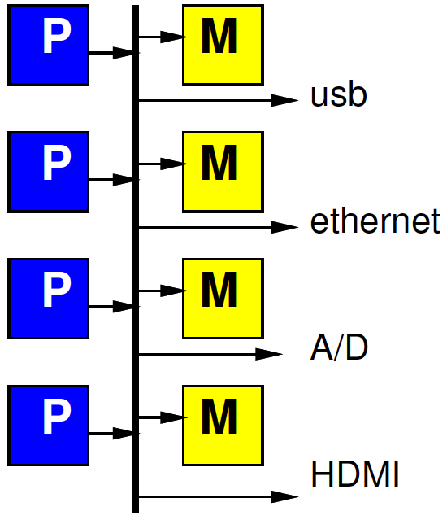
Simple Peripheral Model
Peripherals are slave devices
  Masters can read input data
  Masters can write output data
  To move data, master (e.g. processor) initiates

Slide 44
Simple Model Implications
What implication to processor grabbing/moving each input (output) value?

Slide 45
Timing Demands
Must read each input before overwritten
Must write each output within real-time window
Must guarantee processor scheduled to service each I/O at appropriate frequency
How many cycles between 32b input words for 1Gb/s network and 32b, 1GHz processor?

Slide 46
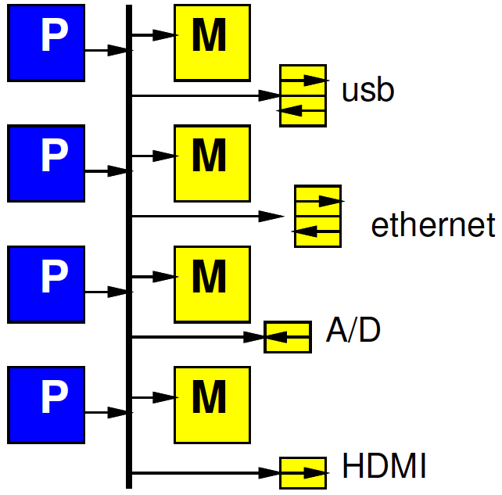
Refine Model
Give each peripheral local FIFO
Processor must still move data
How does this change requirements and impact?

Slide 47
DMA
Direct Memory Access

Slide 48
Preclass 4a

Slide 49
Preclass 4
How much hardware?
  Counter bits?
  Registers?
  Comparators?
  Control Logic gates? (4cd)
Compare to MicroBlaze
  small RISC Processor optimized for Xilinx
  minimum config 630 6-LUTs

Slide 50
Observe
Modest hardware can serve as data movement thread
  Much less hardware than a processor
  Offload work from processors
Small hardware allow peripherals to be master devices on interconnect

Slide 51

DMA
Direct Memory Access (DMA)
“Direct” – inputs (and outputs) don’t have to be indirectly handled by the processor between memory and I/O
I/O unit directly reads/write memory

Slide 52
DMA
Direct Memory Access (DMA)
Peripheral as Master
  Can write directly into (read from) memory
  Saves processor from copying
  Reduces demand to schedule processor
  to service

Slide 53
DMA Engine
Data Movement Thread
  Specialized Processor that moves data
Act independently
Implement data movement
Can build to move data between memories (Slave devices)
E.g., Implement P1, P3 in Preclass 3

Slide 54
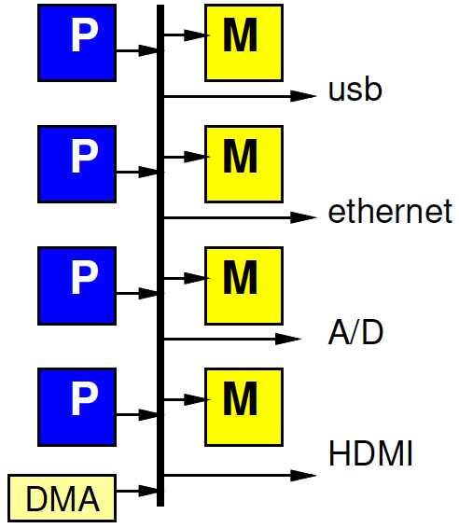
DMA Engine

Slide 55
Programmable DMA Engine
What copy from?
How much?
Where copy to?
Stride?
What size data?
Loop?
Transfer Rate?

Slide 56
Multithreaded DMA Engine
One copy task not necessarily saturate bandwidth of DMA Engine
Share engine performing many transfers (channels)
Separate transfer state for each
  Hence thread (or channel)
Swap among threads
  Simplest: round-robin:
    1, 2, 3, .. K, 1, 2, 3, .. K, 1, ….

Slide 58
Hardwired and Programmable
Zynq has hardwired DMA engine
Can also add data movement engines (Data Movers) in FPGA fabric

Slide 59
Example
Networking Application
Header on processor
Payload (encrypt, checksum) on FPGA
DMA from ethernet→main memory
DMA main memory→BRAM
Stream between payload components
DMA from chksum to ethernet out
header
Payload encrypt
chksum
ethernet
ethernet

Slide 60
Automation
SDSoC will automatically take care of DMA of memory to and from accelerators in FPGA fabric
  Inserting logic, programming DMA
Mostly need to be aware is happening
Have some options to control with pragmas
May not handle sophisticated communication with I/O devices…

Slide 61
Big Ideas
Need to move data
Shared Interconnect to make physical connections – can tune area/bw/locality
Useful to
  move data as separate thread of control
  Have dedicated data-movement hardware: DMA

Slide 62
Admin
Day 13
  Chapter nine of Parallel Programming for FPGAs (available on web)
  DRAM reading if not read on Day 3
HW5 due Friday
HW6 out
Clear room for recitation at noon
Turn in feedback sheets

