Slide 1

ESE532:
System-on-a-Chip Architecture
Day 13: October 15, 2018
Orchestrating Data in Memories

Slide 2
Today
DRAM
DRAM Implications
Tricks for working with DRAM
and generally minimizing use of large
memories

Slide 3
Message
How we access data matters
Reuse data to avoid access to large memories
Encourage think about how organize computation and data to minimize
  Use of large memory
  Data movement
…and to think about what you expect, so can diagnose unnecessary data bottlenecks

Slide 4
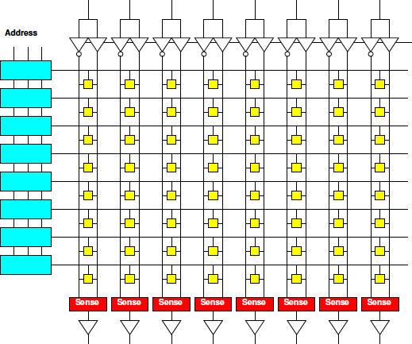
Day 3: Memory Scaling
Small memories are fast
  Large memories are slow
Small memories low energy
  Large memories high energy
Large memories dense
  Small memories cost
  more area per bit
Combining:
  Dense memories
  are slow

Slide 5
Day 3: Lesson
Cheaper to access wide/contiguous blocks memory
  In hardware
  From the architectures typically build
Can achieve higher bandwidth on large block data transfer
  Than random access of small data items

Slide 6
DRAM
Usually the largest memory

Slide 7
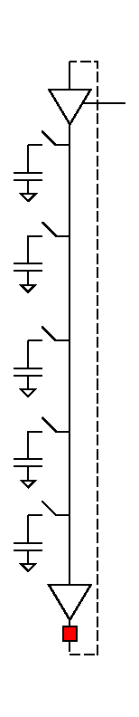
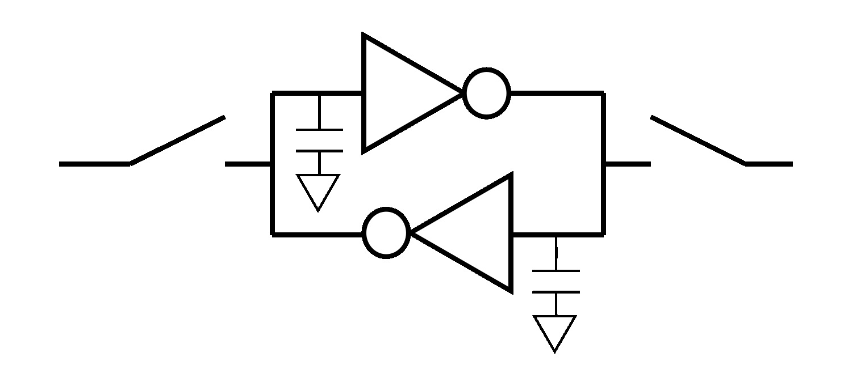
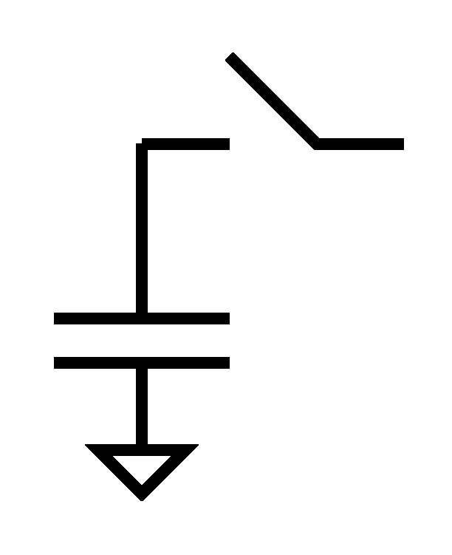
Dynamic RAM
Shares even more logic among bits
Share refresh/restoration logic as well
Minimal storage is a capacitor
“Feature” DRAM process is ability to make capacitors efficiently
Denser, but slower

Slide 8
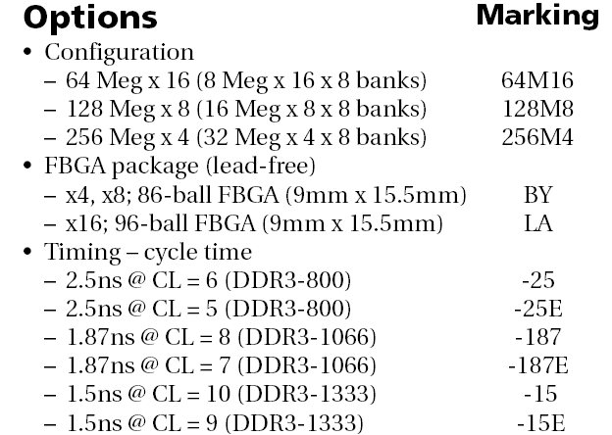
DRAM
1GB DDR3 SDRAM from Micron
  http://www.micron.com/products/dram/ddr3/
  96 pin pakage
  16b datapath IO
  Operate at 500+MHz
  37.5ns random access latency

Slide 9
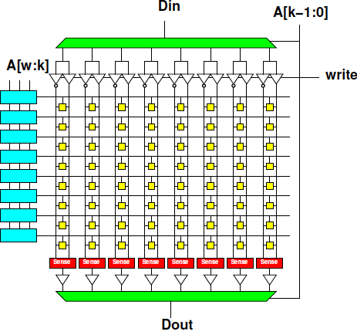
Memory Access Timing
Access:
  Address (RCD)

Slide 10
Memory Access Timing
Access:
  Address (RCD)
  Row fetch (RP)

Slide 11
Memory Access Timing
Access:
  Address (RCD)
  Row fetch (RP)
  Column select (CL)

Slide 12
Memory Access Timing
Access:
  Address (RCD)
  Row fetch (RP)
  Column select (CL)
  writeback/refresh

Slide 13
Dynamic RAM
Shares even more logic among bits
Share refresh/restoration logic as well
Minimal storage is a capacitor
“Feature” DRAM process is ability to make capacitors efficiently
Denser, but slower

Slide 14
Memory Access Timing
Access:
  Address (RCD)
  Row fetch (RP)
  Column select (CL)
  writeback/refresh

Slide 15
Memory Access Timing
Access:
  Address (RCD)
  Row fetch (RP)
  Column select (CL)
  writeback/refresh
Optimization for access within a row

Slide 16
Memory Access Timing
Access
  Address (RCD)
  Row fetch (RP)
  Column select
    CL: Can repeat
  writeback/refresh
Row
1024b—8192b
Faster to access within row

Slide 17
DRAM
1GB DDR3 SDRAM from Micron
  http://www.micron.com/products/dram/ddr3/
  96 pin pakage
  16b datapath IO
  Operate at 500+MHz
  37.5ns random access latency

Slide 18
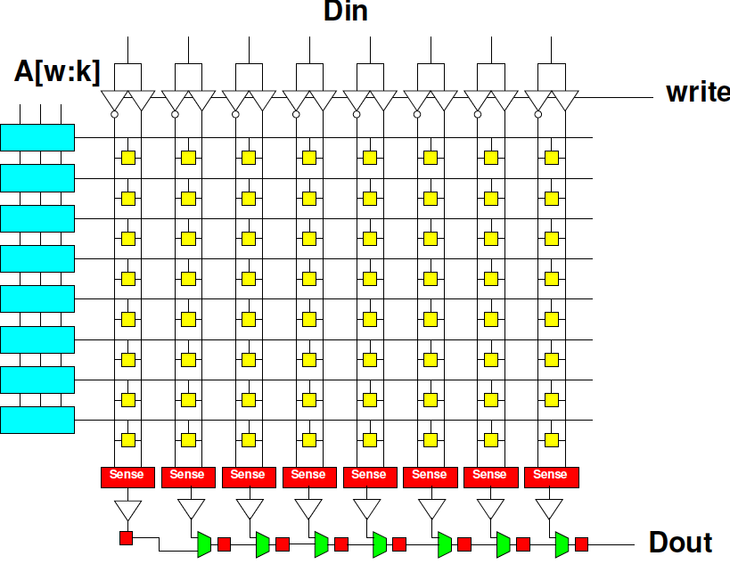
DRAM Streaming
Reading row
is 15ns (12.5ns)
16b @ 500MHz
1024b row
1024/16
  64 words
  per row
How supply 16b/2ns ? (Hint: how long to transfer 64 16b words at 16b/2ns?)

Slide 19
DRAM
1GB DDR3 SDRAM from Micron
  http://www.micron.com/products/dram/ddr3/
  96 pin pakage
  16b datapath IO
  Operate at 500+MHz
  37.5ns random access latency

Slide 20
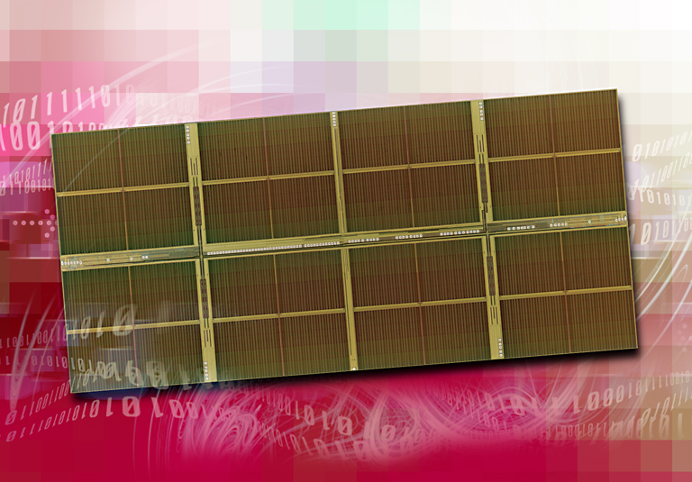
1 Gigabit DDR2 SDRAM
[Source: http://www.elpida.com/en/news/2004/11-18.html]

Slide 21
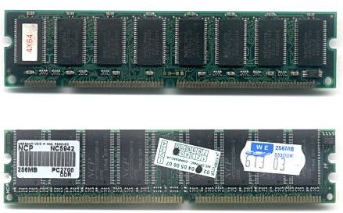
DIMMS multi-DRAM
DIMMs usually pack multiple DRAM chips, c, in parallel
  Can access c*16b per transfer
  Typically 64, 128, 256b wide
    8 chips = 128b wide
https://commons.wikimedia.org/wiki/File:DIMMs.jpg

Slide 22
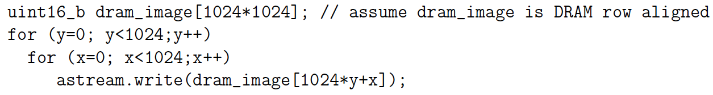
Preclass 1
How many cycles to run loop?
  10 cycle on row change
  3 cycles same row
  128 uint16_b per row (2048b)

Slide 23
Image Row and DRAM Rows
Address | MSB -- DRAM Row Bytes -- LSB
0x027FF0 | [y-1,1023]
0x028000 | [y,127] |  |  |  |  |  |  | [y,0]
0x028100 |  |  |  |  |  |  |  | [y,128]
0x028200
0x028300
0x028400
0x028500
0x028600
0x028700 | [y,1023] |  |  |  |  |  |  | [y,896]
0x028800 |  |  |  |  |  |  |  | [y+1,0]
0x028900
0x028a00

Slide 24
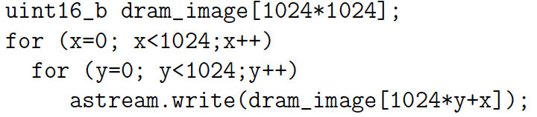
Preclass 2
Note loop
interchange
How many cycles to run loop?
  10 cycle on row change
  3 cycles same row
  128 uint16_b per row (2048b)

Slide 25
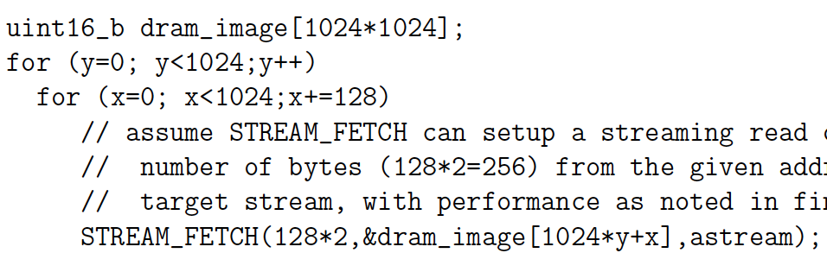
Preclass 3
How many cycles to run loop?
  10+n cycles to fetch n<=256 Bytes on row

Slide 26
DRAM
Latency is large (10s of ns)
Throughput can be high (GB/s)
  If accessed sequentially
  If exploit wide-word block transfers
Throughput low on random accesses
  As we saw for random access on wide-word memory

Slide 27
Maximize Reuse
Minimize need to go to large memory

Slide 28
Data Management
Large, central memory
  Bottleneck
  High energy
Minimize need to return to it

Slide 29
Window Filter
Compute based on neighbors
  F(d[y-1][x-1],d[y-1][x],d[y-1][x+1],
  d[y][x-1],d[y][x],d[y][x+1],
  d[y+1][x-1],d[y+1][x],d[y+1][x+1])
Common idiom
  Image filtering
  Numerical simulation
  Cellular automata
  Search, matching

Slide 30
Window Filter
Compute based on neighbors
  F(d[y-1][x-1],d[y-1][x],d[y-1][x+1],
  d[y][x-1],d[y][x],d[y][x+1],
  d[y+1][x-1],d[y+1][x],d[y+1][x+1])
Generalize for different neighborhood sizes
  for (yoff=YMIN; yoff<YMAX;yoff++)
  for (xoff=XMIN; xoff<XMAX;xoff++)
  res=fun(res,d[y+yoff][x+xoff]);

Slide 31
Window Filter
Compute based on neighbors
for (y=0;y<YMAX;y++)
for (x=0;x<XMAX;x++)
  o[y][x]=F(d[y-1][x-1],d[y-1][x],d[y-1][x+1],
  d[y][x-1],d[y][x],d[y][x+1],
  d[y+1][x-1],d[y+1][x],d[y+1][x+1]);
How work with image in DRAM?
  As written references
  Reads per row

Slide 32
Window Filter
Compute based on neighbors
for (y=0;y<YMAX;y++)
for (x=0;x<XMAX;x++)
  o[y][x]=F(d[y-1][x-1],d[y-1][x],d[y-1][x+1],
  d[y][x-1],d[y][x],d[y][x+1],
  d[y+1][x-1],d[y+1][x],d[y+1][x+1]);
Data reused between inner loop invocations when x increments?

Slide 33
Window Shift x++
 | 23 | 24 | 25 | 26 | 27
17
18 |  | Y-1,X-1 | Y-1,X | Y-1,X+1
19 |  | Y,X-1 | Y,X | Y,X+1
20 |  | Y+1,X-1 | Y+1,X | Y+1,X+1
21
 | 23 | 24 | 25 | 26 | 27
17
18 |  |  | Y-1,X-1 | Y-1,X | Y-1,X+1
19 |  |  | Y,X-1 | Y,X | Y,X+1
20 |  |  | Y+1,X-1 | Y+1,X | Y+1,X+1
21

Slide 34
Window Filter
Compute based on neighbors
for (y=0;y<YMAX;y++)
for (x=0;x<XMAX;x++)
  o[y][x]=F(d[y-1][x-1],d[y-1][x],d[y-1][x+1],
  d[y][x-1],d[y][x],d[y][x+1],
  d[y+1][x-1],d[y+1][x],d[y+1][x+1]);
Data reused between y values in outer loop?
  Reuse distance?

Slide 35
Window Shift y++
 | 23 | 24 | 25 | 26 | 27
17
18 |  | Y-1,X-1 | Y-1,X | Y-1,X+1
19 |  | Y,X-1 | Y,X | Y,X+1
20 |  | Y+1,X-1 | Y+1,X | Y+1,X+1
21
 | 23 | 24 | 25 | 26 | 27
17
18
19 |  | Y-1,X-1 | Y-1,X | Y-1,X+1
20 |  | Y,X-1 | Y,X | Y,X+1
21 |  | Y+1,X-1 | Y+1,X | Y+1,X+1

Slide 36
Window Filter
Compute based on neighbors
for (y=0;y<YMAX;y++)
for (x=0;x<XMAX;x++)
  o[y][x]=F(d[y-1][x-1],d[y-1][x],d[y-1][x+1],
  d[y][x-1],d[y][x],d[y][x+1],
  d[y+1][x-1],d[y+1][x],d[y+1][x+1]);
What need to do to store old y offsets so not need to reread from large memory?

Slide 37
Line Buffers
Only need to save last 2 (window_height-1) rows (d[y][*])
Store in local buffers
  Type dy[XMAX], dym[XMAX];
    dym for dy minus 1
  Stick value there between uses.

Slide 38
Variable Naming
 |  | +xm |  | +xp
dym |  | Y-1,X-1 | Y-1,X | Y-1,X+1
dy |  | Y,X-1 | Y,X | Y,X+1
dyp |  | Y+1,X-1 | Y+1,X | Y+1,X+1
 |  | +xm |  | +xp
dym |  | Y-1,X-1 | Y-1,X | Y-1,X+1
dy |  | Y,X-1 | Y,X | Y,X+1
dyp |  | dypxm | dypx | dnew

Slide 39
Window Filter
With line buffers dy, dym
for (y=0;y<YMAX;y++)
for (x=0;x<XMAX;x++) {
  dypxm=dypx; dypx=dnew; dnew=d[y+1][x+1];
  o[y][x]=F(dym[x-1],dym[x],dym[x+1],
  dy[x-1],dy[x],dy[x+1],
  dypxm,dypx,dnew);
  dym[x-1]=dy[x-1];dy[x-1]=dypxm; }

Slide 40
Lines in Buffers
 |  | +xm |  | +xp
dym |  | Y-1,X-1 | Y-1,X | Y-1,X+1
dy |  | Y,X-1 | Y,X | Y,X+1
dyp |  | Y+1,X-1 | Y+1,X | Y+1,X+1

Slide 41
Window Filter
With line buffers dy, dym
for (y=0;y<YMAX;y++)
for (x=0;x<XMAX;x++) {
  dypxm=dypx; dypx=dnew; dnew=d[y+1][x+1];
  o[y][x]=F(dym[x-1],dym[x],dym[x+1],
  dy[x-1],dy[x],dy[x+1],
  dypxm,dypx,dnew);
  dym[x-1]=dy[x-1];dy[x-1]=dypxm; }
Avoid multiple read dy, dym?
  Save memory ports

Slide 42
Variable Naming
 |  | +xm |  | +xp
dym |  | Y-1,X-1 | Y-1,X | Y-1,X+1
dy |  | Y,X-1 | Y,X | Y,X+1
dyp |  | Y+1,X-1 | Y+1,X | Y+1,X+1
 |  | +xm |  | +xp
dym |  | dymxm | dymx | dymxp
dy |  | dyxm | dyx | dyxp
dyp |  | dypxm | dypx | dnew

Slide 43
Window Filter
Single read and write from dym, dy
for (y=0;y<YMAX;y++)
for (x=0;x<XMAX;x++) {
  dypxm=dypx; dypx=dnew; dnew=d[y+1][x+1];
  dyxm=dyx; dyx=dyxp; dyxp=dy[x+1];
  dymxm=dymx; dymx=dymxp; dymxp=dym[x+1];
  o[y][x]=F(dymxm,dymx,dymxp,
  dyxm,dyx,dyxp,
  dypxm,dypx,dnew);
  dym[x-1]=dyxm;dy[x-1]=dypxm; }

Slide 44
Pipelined Circuit
Single read from big
memory (DRAM)
per result
Shift registers
Line buffers

Slide 45
Window Filter
Convert to stream … use Preclass 3 load
for (y=0;y<YMAX;y++)
for (x=0;x<XMAX;x++) {
  dypxm=dypx; dypx=dnew; astream.read(dnew);
  dyxm=dyx; dyx=dyxp; dyxp=dy[x+1];
  dymxm=dymx; dymx=dymxp; dymxp=dym[x+1];
  o[y][x]=F(dymxm,dymx,dymxp,
  dyxm,dyx,dyxp,
  dypxm,dypx,dnew);
  dym[x-1]=dyxm;dy[x-1]=dypxm; }

Slide 46
Window Filter
Convert to stream … use Preclass 3 load
for (y=0;y<YMAX;y++)
for (x=0;x<XMAX;x++) {
  dypxm=dypx; dypx=dnew; astream.read(dnew);
  dyxm=dyx; dyx=dyxp; dyxp=dy[x+1];
  dymxm=dymx; dymx=dymxp; dymxp=dym[x+1];
  ostream.write(F(dymxm,dymx,dymxp,
  dyxm,dyx,dyxp,
  dypxm,dypx,dnew));
  dym[x-1]=dyxm;dy[x-1]=dypxm; }

Slide 47
Multiple Filters
What if want to run multiple filters?
for (f=0;f<FMAX;f++)
for (y=0;y<YMAX;y++)
for (x=0;x<XMAX;x++)
  o[f][y][x]=fun[f](d[y-1][x-1],d[y-1][x],d[y-1][x+1],
  d[y][x-1],d[y][x],d[y][x+1],
  d[y+1][x-1],d[y+1][x],d[y+1][x+1]);
Forces multiple reads through d
Avoidable?

Slide 48
Take-Away
Can process with a single, streaming read through data in large memory
  Specifically for window filters on images
  General goal to try to achieve
Careful to orchestrate data in small, local buffers
DMA/streaming transfers to achieve near peak DRAM bandwidth

Slide 49
Sort

Slide 50
Sort
Order data
  7 3 4 2 1 9 8 0 → 0 1 2 3 4 7 8 9
Data movement can be challenging
  Last value may become first (vice-versa)
  Especially when not fit in small memories
Many sequential sort solutions access data irregularly
  Want to avoid with DRAM

Slide 51
Observation: Merge
Merging two sorted list is a streaming operation
Int aptr; int bptr;
For (i=0;i<MCNT;i++)
  If ((aptr<ACNT) && (bptr<BCNT))
  If (a[aptr]>b[bptr])
  { o[i]=a[aptr]; aptr++; }
  Else
  { o[i]=b[bptr]; bptr++; }
  Else // copy over remaining from a or b

Slide 52
Merge using Streams
Merging two sorted list is a streaming operation
Int ptr; int bptr;
astream.read(ain); bstream.read(bin)
For (i=0;i<MCNT;i++)
  If ((aptr<ACNT) && (bptr<BCNT))
  If (ain>bin)
  { ostream.write(ain); aptr++; astream.read(ain);}
  Else
  { ostream.write(bin) bptr++; bstream.read(bin);}
  Else // copy over remaining from astream/bstream

Slide 53
Merge and DRAM
How streaming merge work with DRAM row?
For (i=0;i<MCNT;i++)
  If ((aptr<ACNT) && (bptr<BCNT))
  if (ain>bin)
  { ostream.write(ain); aptr++; astream.read(ain);}
  else
  { ostream.write(bin) bptr++; bstream.read(bin);}

Slide 54
Merge and DRAM
First version (repeat below) may alternate between DRAM rows
Int aptr; int bptr;
For (i=0;i<MCNT;i++)
  If ((aptr<ACNT) && (bptr<BCNT))
  If (a[aptr]>b[bptr])
  { o[i]=a[aptr]; aptr++; }
  Else
  { o[i]=b[bptr]; bptr++; }
  Else // copy over remaining from a or b

Slide 55
Merge and DRAM
Want to fetch a as block into local memory, then can do this
Int aptr; int bptr;
For (i=0;i<MCNT;i++)
  If ((aptr<ACNT) && (bptr<BCNT))
  If (a[aptr]>b[bptr])
  { o[i]=a[aptr]; aptr++; }
  Else
  { o[i]=b[bptr]; bptr++; }
  Else // copy over remaining from a or b

Slide 56
Merge using Streams and DRAM
Streaming accomplishes if Streaming is implemented to fetch row into FIFO buffer
Int ptr; int bptr;
astream.read(ain); bstream.read(bin)
For (i=0;i<MCNT;i++)
  If ((aptr<ACNT) && (bptr<BCNT))
  If (ain>bin)
  { ostream.write(ain); aptr++; astream.read(ain);}
  Else
  { ostream.write(bin) bptr++; bstream.read(bin);}
  Else // copy over remaining from astream/bstream

Slide 57
Building from Merge
Know how to get sorted data of length N given two, independently sorted lists of length N/2
If have list of length 1, is it sorted?
Merging two lists of length 1 gives us?
Mergine two lists of length 2 gives us?

Slide 58
Merge Sort
Strategy
  For i=1 to passes
    Pass over data creating merged sequences of length 2^{i} from pairs of length 2^{i-1}
  What is passes?
Can, at least, limit to passes reads through data from large memory.

Slide 59
On-chip Merge
As long as can fit sequence (2^{i}) on chip, can stream merge stages without going back to big memory (DRAM)
2^{i-1}
2^{i}
2^{i}
merge
alternate

Slide 60
On-chip Merge
As long as can fit sequence (2^{i}) on chip, can stream merge stages without going back to big memory (DRAM)
  E.g. with 36Kb BRAMs ~ first 10-12 stages
    Up to ~16 using multiple BRAMs
merge+alt
merge+alt
merge+alt

Slide 61
On-chip Merge
For sorts up to ~100K elements may be able to cover in one read/write stream to/from DRAM
Larger: ~log₂(N)-15 read/writes
merge+alt
merge+alt
merge+alt

Slide 62
Big Ideas
Must pay attention to orchestrate data movement
  How we access and reuse data
Minimize use of large memories
Regular access to large memories higher performance
  Easier to get bandwidth on wide-word reads

Slide 63
Admin
Reading for Wednesday on web
HW6 due Friday
  Does include 8 full FPGA builds
  Plan for that build time
Midterm next Monday
  See Fall 2017, Spring 2017 syllabus for
    Previous semester’s midterm and final
      …with solutions
Feedback sheets

