Slide 1
ESE532: System-on-a-Chip Architecture
Day 14: October 17, 2018
VLIW
(Very Long Instruction Word Processors)

Slide 2
Today
VLIW (Very Large Instruction Word)
Exploiting Instruction-Level Parallelism (ILP)
Demand
Basic Model
Costs
Tuning

Slide 3
Message
VLIW as a Model for
Instruction-Level Parallelism (ILP)
Customizing Datapaths
Area-Time Tradeoffs

Slide 4
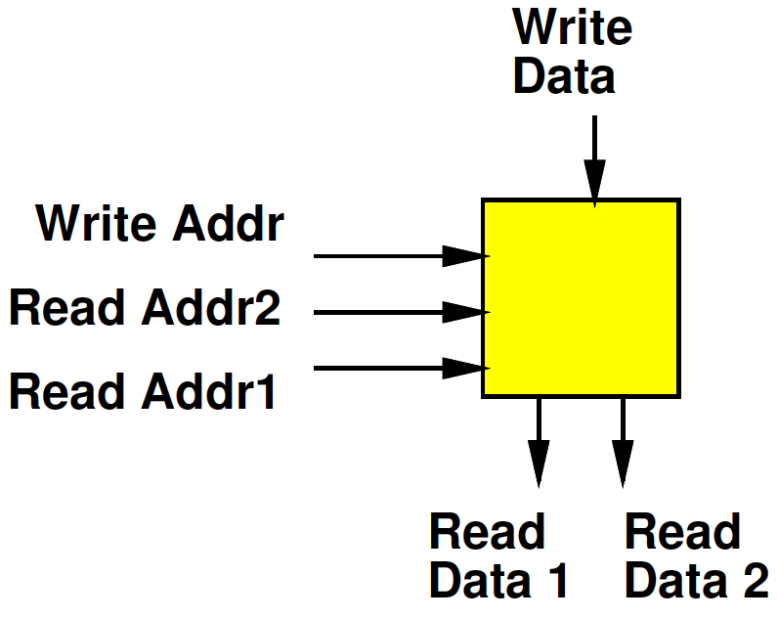
Register File
Day 6
Small Memory
Usually with multiple ports
Ability to perform multiple reads and writes simultaneously
Small
To make it fast (small memories fast)
Multiple ports are expensive

Slide 5
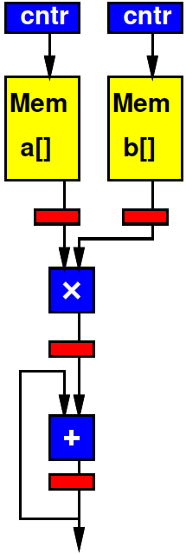
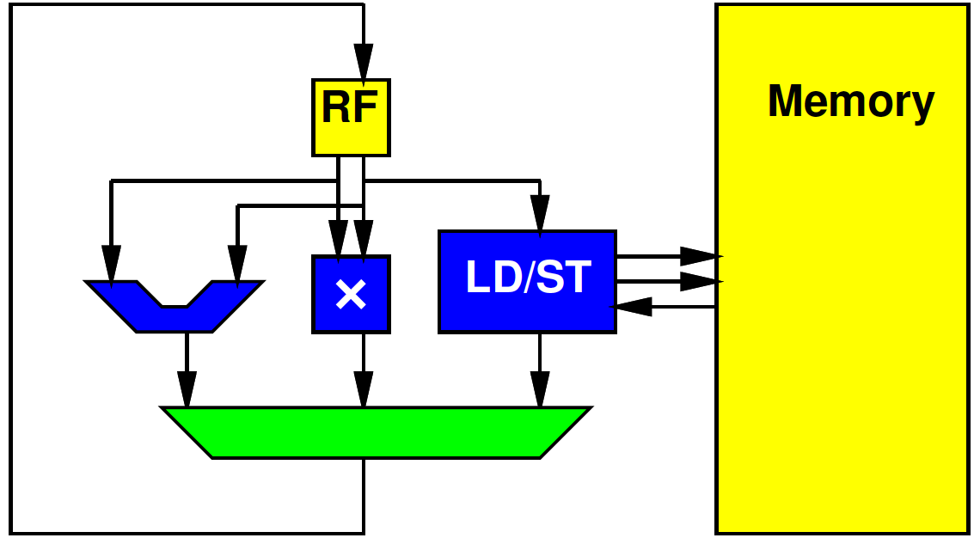
Preclass 1
Cycles per multiply-accumulate
Spatial Pipeline
Processor

Slide 6
Preclass 1
How different?
Resources
Ability to use resources

Slide 7
Computing Forms
Processor – does one thing at a time
Spatial Pipeline – can do many things, but always the same
Vector – can do the same things on many pieces of data

Slide 8
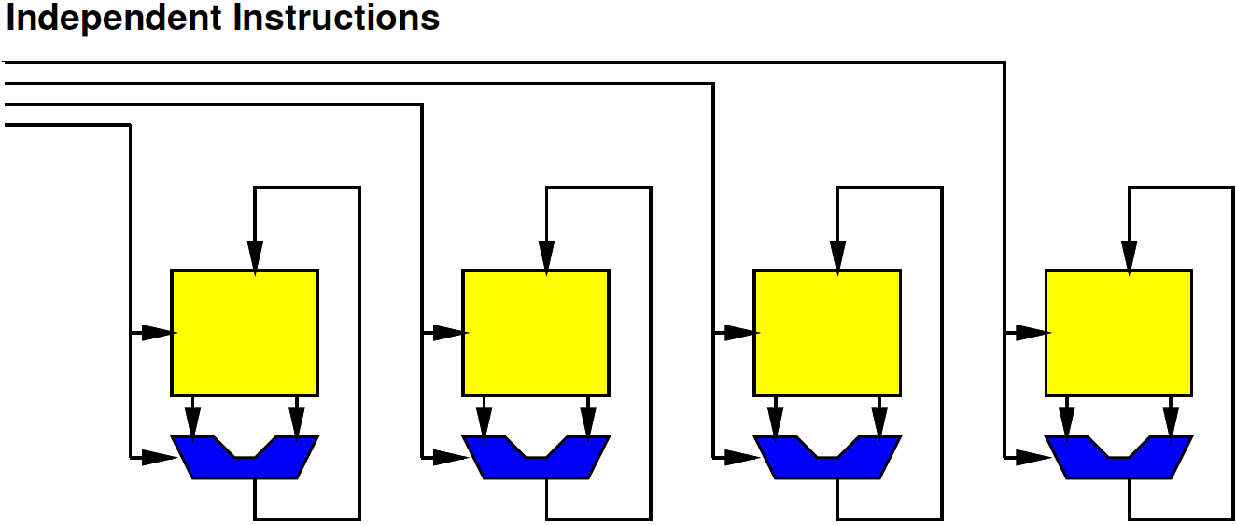
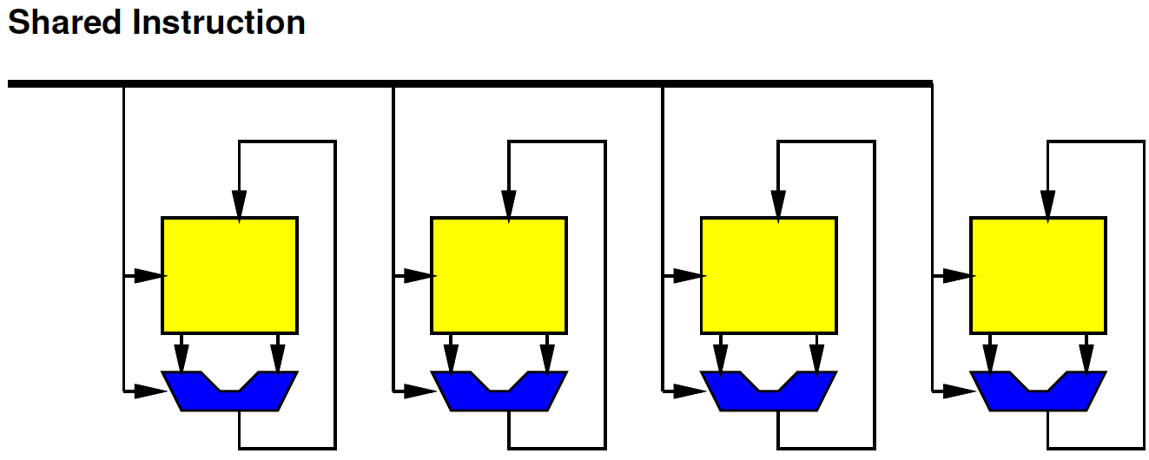
In Between
What if…
Want to
Do many things at a time (ILP)
But not the same (DLP)

Slide 9
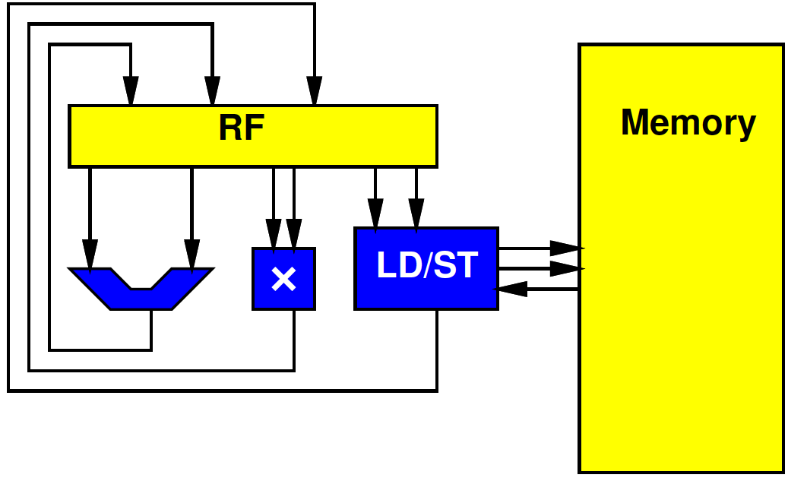
In Between
What if…
Want to
Do many things at a time (ILP)
But not the same (DLP)
Want to use resources concurrently

Slide 10
In Between
What if…
Want to
Do many things at a time (ILP)
But not the same (DLP)
Want to use resources concurrently
Want to
Accelerate specific task
But not go to spatial pipeline extreme

Slide 11
VLIW Feature: Supply Independent Instructions
Provide instruction per ALU (resource)
Instructions more expensive than Vector
But more flexible

Slide 12
Control Heterogeneous Units
Control each unit simultaneously and independently
More expensive than processor
Memory ports and/or interconnect
But more parallelism

Slide 13
VLIW
The “instruction”
The bits controlling the datapath
…becomes long
Hence:
Very Long Instruction Word (VLIW)
long
instruction

Slide 14
VLIW
Very Long Instruction Word
Set of operators
Parameterize number, distribution (X, +, sqrt…)
More operators→ less time, more area
Fewer operators→ more time, less area
Memories for intermediate state
X
X
+

Slide 15
VLIW
Very Long Instruction Word
Set of operators
Parameterize number, distribution (X, +, sqrt…)
More operators→ less time, more area
Fewer operators→ more time, less area
Memories for intermediate state
Memory for “long” instructions
Instruction
Memory
Address
X
X
+

Slide 16
VLIW
Instruction
Memory
Address
X
X
+

Slide 17
VLIW
Very Long Instruction Word
Set of operators
Parameterize number, distribution (X, +, sqrt…)
More operators→ less time, more area
Fewer operators→ more time, less area
Memories for intermediate state
Memory for “long” instructions
General framework for specializing to problem
Wiring, memories get expensive
Opportunity for further optimizations
General way to tradeoff area and time

Slide 18
VLIW
Instruction
Memory
Address
X
X
+

Slide 19
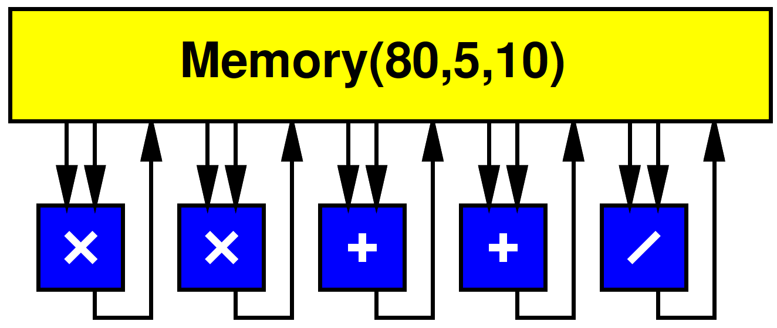
VLIW w/ Multiport RF
Simple, full-featured model use common Register File
Memory(Words, WritePorts, ReadPorts)

Slide 20
Processor Unbound
Can (design to) use all operators at once

Slide 21
Processor Unbound
Implement Preclass 1

Slide 22
Schedule
Cycle | Branch | ALU | Multiply | LD/ST
0 | Bzneq r3,end | Add r4
1 |  | Add r5 |  | Ld r4,r6
2 |  | Sub r2,r1,r3 |  | Ld r5,r7
3 |  | Add r1,#1,r1 | Mpy r7,r8,r8
4 | B top | Add r7,r8,r8

Slide 23
VLIW Operator Knobs
Choose collection of operators and the numbers of each
Match task
Tune resources

Slide 24
Schedule
Choose collection of operators and the numbers of each
Match task
Tune resources
What operator might we add
to accelerate this loop?
Cycle | Branch | ALU | Multiply | LD/ST
0 | Bzneq r3,end | Add r4
1 |  | Add r5 |  | Ld r4,r6
2 |  | Sub r2,r1,r3 |  | Ld r5,r7
3 |  | Add r1,#1,r1 | Mpy r7,r8,r8
4 | B top | Add r7,r8,r8

Slide 25
Preclass 2a
res[i]=sqrt(x[i]*x[i]+y[i]*y[i]+z[i]*z[i]);
II with one operator of each?

Slide 26
Schedule
Cycle | LD | ST | Multiply | Add | incr | sqrt
0 |  |  |  | i<MAX | &X[i]
1 | X[i] |  |  |  | &Y[i]
2 | Y[i] |  | X[i]*X[i] |  | &Z[i]
3 | Z[i] |  | Y[i]*Y[i]
4 |  |  | Z[i]*Z[i] | X²+Y²
5 |  |  |  | (X²+Y²)+Z²
6 |  |  |  |  |  | Sqrt()
7 |  | Res[i] |  |  | i

Slide 27
Preclass 2b
res[i]=sqrt(x[i]*x[i]+y[i]*y[i]+z[i]*z[i]);
Minimum II achievable?
Latency lower bound

Slide 28
Critical Path
Increment pointers / branch
Load
Multiplies
Add
Add
Squareroot
Writeback

Slide 29
Preclass 2c
res[i]=sqrt(x[i]*x[i]+y[i]*y[i]+z[i]*z[i]);
How many operators of each type to achieve minimum II (latency lower bound)?

Slide 30
Schedule w/ 2d Resources
What is disappointing about this schedule?
 | LD | LD | LD | ST | * | * | * | + | i | i | i | sqrt
0 |  |  |  |  |  |  |  | < | &x | &y | &z
1 | X[i] | Y[i] | Z[i]
2 |  |  |  |  | x | y | z
3 |  |  |  |  |  |  |  | X+y
4 |  |  |  |  |  |  |  | +z
5 |  |  |  |  |  |  |  |  |  |  |  | sqrt
6 |  |  |  | Res[i] |  |  |  |  | i

Slide 31
Preclass 2d
res[i]=sqrt(x[i]*x[i]+y[i]*y[i]+z[i]*z[i]);
res[i+1]=sqrt(x[i+1]*x[i+1]+y[i+1]*y[i+1]+z[i+1]*z[i+1]);
res[i+2]=sqrt(x[i+2]*x[i+2]+y[i+2]*y[i+2]+z[i+2]*z[i+2]);
res[i+3]=sqrt(x[i+3]*x[i+3]+y[i+3]*y[i+3]+z[i+3]*z[i+3]);
Schedule

Slide 32
Unroll 4
 | LD | LD | LD | ST | * | * | * | + | + | i | i | i | sqrt
0 |  |  |  |  |  |  |  | < |  | x0 | y0 | z0
1 | x0 | y0 | z0 |  |  |  |  |  |  | x1 | y1 | z1
2 | x1 | y1 | z1 |  | x0 | y0 | z0 |  |  | x2 | y2 | z2
3 | x2 | y2 | z2 |  | x1 | y1 | z1 | xy0 |  | x3 | y2 | z3
4 | x3 | y2 | z3 |  | x2 | y2 | z2 | xy1 | +z0
5 |  |  |  |  | x3 | y2 | z3 | xy2 | +z1 |  |  |  | 0
6 |  |  |  | 0 |  |  |  | xy3 | +z2 |  |  |  | 1
7 |  |  |  | 1 |  |  |  |  | +z3 |  |  |  | 2
8 |  |  |  | 2 |  |  |  |  |  |  |  |  | 3
9 |  |  |  | 3 |  |  |  |  |  | i

Slide 33
Time Points
4 iterations in 10 cycles = 2.5 cycles/iter
Compared to 1 iteration in 7
Compared to 1 iteration in 8

Slide 34
Preclass 2e
res[i]=sqrt(x[i]*x[i]+y[i]*y[i]+z[i]*z[i]);
Area comparison?

Slide 35
Midterm

Slide 36
Midterm
From Code
Forms of Parallelism
Dataflow, SIMD, hardware pipeline, threads
Pipelining/Retiming
Map/schedule task graph to (multiple) target substrates
Memory assignment and movement
Area-time points
Analysis
Bottleneck
Amdhal’s Law Speedup
Computational requirements
Resource Bounds
Critical Path
Latency/throughput/II
Will be calculating/estimating runtimes

Slide 37
Midterm
Closed book, notes, etc.
Calculators allowed (encouraged)
Last two midterms, final online
Both without answers (for practice)
…and with answers (check yourself)
No VLIW on midterm
But memory fair game; II, latency…

Slide 38
Data Storage and Movement

Slide 39
Multiport RF
Multiported memories are expensive
Need input/output lines for each port
Makes large, slow
Simplified preclass model:
Area(Memory(n,w,r))=n*(w+r+1)/2

Slide 40
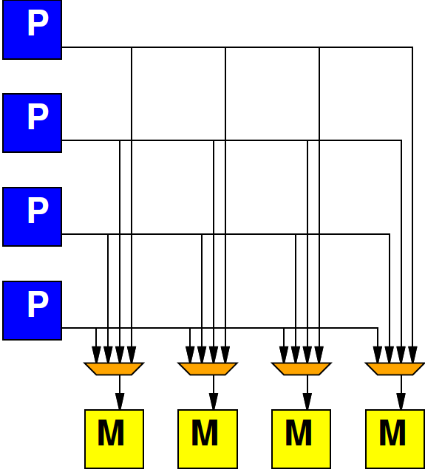
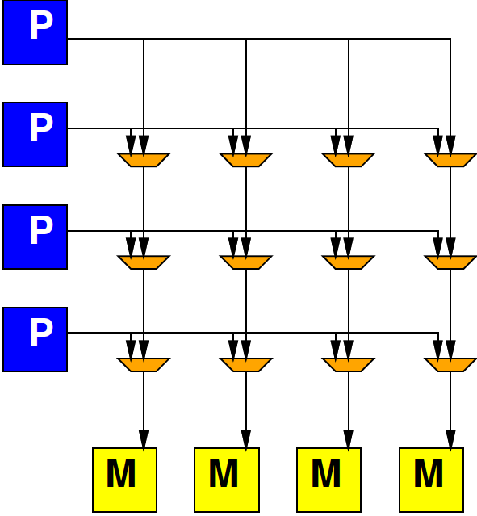
Alternate: Crossbar
Day 12
Provide programmable connection between all sources and destinations
Any destination can be connected to any single source

Slide 41
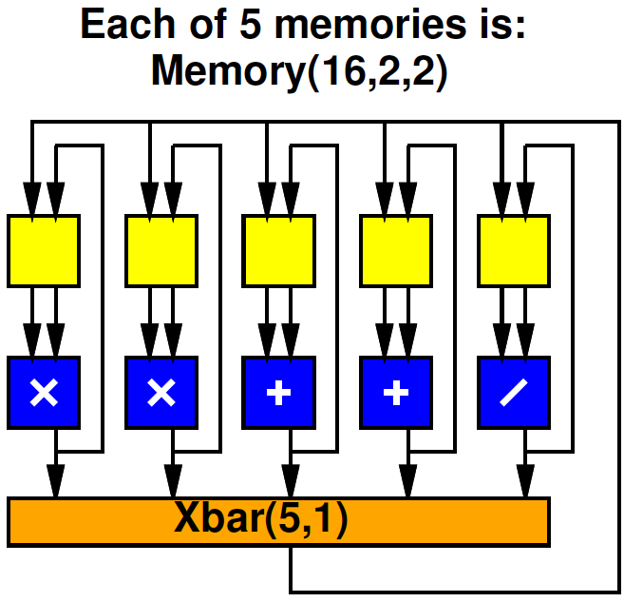
Preclass 3
Operator area?
Xbar(5,1) area
Memory area, each case
Total area
How does area of memories, xbar compare to datapath operators in each case?

Slide 42
Split RF Cheaper
At same capacity, split register file cheaper
2R+1W → 2 per word
5R+10W → 8 per word

Slide 43
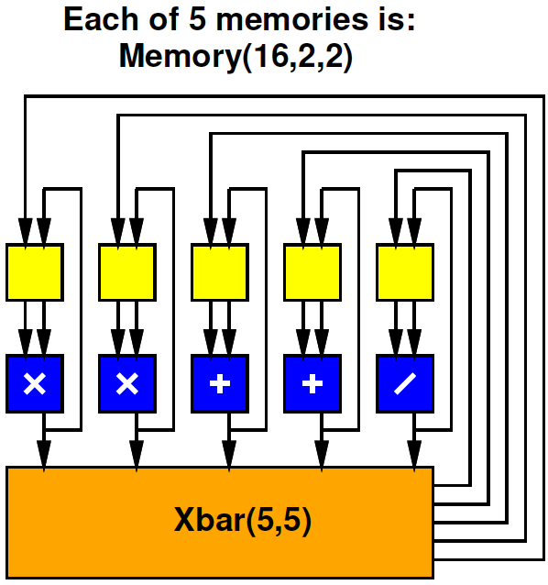
Split RF
Xbar(5,5) cost?
Total Area?

Slide 44
Split RF Full Crossbar
Cycles each for: (A*B+C)/(D*E+F)
Assume A..F start as shown
A,B
D,E
C
F

Slide 45
VLIW Memory Tuning
Can select how much sharing or independence in local memories

Slide 46
Split RF, Limited Crossbar
What limitation does the one crossbar output pose?
Cycles for same task: (A*B+C)/(D*E+F)
A,B
D,E
C
F
A,B
D,E
C
F

Slide 47
VLIW Schedule
Need to schedule Xbar output(s) as well as operators.
cycle | * | * | + | + | / | Xbar
0
1
2
3
4

Slide 48
VLIW vs. Superscalar

Slide 49
VLIW vs. SuperScalar
Modern, high-end proc. (incl. ARM on Zynq)
Do support ILP
Issue multiple instructions per cycle
…but, from a single, sequential instruction stream
SuperScalar – dynamic issue and interlock on data hazards – hide # operators
Must have shared, multiport RF
VLIW – offline scheduled
No interlocks, allow distributed RF
Lower area/operator – need to recompile code

Slide 50
Back to VLIW

Slide 51
Pipelined Operators
Often seen, will have pipelined operators
E.g. 3 cycles multiply
How complicate?

Slide 52
Accommodating Pipeline
Schedule for when data becomes available
Dependencies
Use of resources
cycle | * | * | + | + | / | Xbar
0 | X*X
1 | Y*Y
2 |  |  |  |  |  | X*X
3 |  |  |  |  |  | Y*Y
4 |  |  | X²+Y² |  |  | X²+Y²
5 |  |  |  |  | X²+Y²/Z
6

Slide 53
Accommodating Pipeline
Schedule for when data becomes available
Dependencies
Use of resources
Impossible
schedule;
Conflict on
single Xbar
output
cycle | * | * | + | + | / | Xbar
0 | X*X
1 | Y*Y
2 |  |  |  |  |  | X*X
3 |  |  | Q+R |  |  | Y*Y,Q+R
4 |  |  | X²+Y² |  |  | X²+Y²
5 |  |  |  |  | X²+Y²/Z
6

Slide 54
VLIW Interconnect Tuning
Can decide how rich to make the interconnect
Number of outputs to support
How to depopulate crossbar
Use more restricted network

Slide 55
Commercial: Xilinx AI Engine
6-way superscalar Vector
https://www.xilinx.com/support/documentation/white_papers/wp506-ai-engine.pdf
Xilinx WP506

Slide 56
Big Ideas:
VLIW as a Model for
Instruction-Level Parallelism (ILP)
Customizing Datapaths
Area-Time Tradeoffs
Customize VLIW
Operator selection
Memory/register file setup
Inter-functional unit communication network

Slide 57
Admin
Midterm on Monday
Previous midterms and solutions online
Extra Review Office Hours on Sunday
See Piazza
HW6 due Friday
Remember many slow builds
HW7 out

Slide 58
Loop Overhead
Bonus slides:
not expect to cover in lecture

Slide 59
Loop Overhead
Can handle loop overhead in ILP on VLIW
Increment counters, branches as independent functional units

Slide 60
VLIW Loop Overhead
Can handle loop overhead in ILP on VLIW
…but paying a full issue unit and instruction costs overhead

Slide 61
Zero-Overhead Loops
Specialize the instructions, state, branching for loops
Counter rather than RF
One bit to indicate if counter decrement
Exit loop when decrement to 0

Slide 62
Simplification

Slide 63
Zero-Overhead Loop Simplify
Share port – simplify further

Slide 64
Zero-Overhead Loop Example (preclass 1)
repeat r3:
addi r4,#4,r4;
addi r5,#4,r5; ld r4,r6
ld r5,r7
mul r6,r7,r7
add r7,r8,r8

Slide 65
Zero-Overhead Loop
Potentially generalize to multiple loop nests and counters
Common in highly optimized DSPs, Vector units

