Slide 1
ESE532: System-on-a-Chip Architecture
Day 16: October 24, 2018
Deduplication and Compression Project
Midterm: average 41, std. dev 13

Slide 2
Midterm
Still need to record in canvas (tonight?)
Solution … (next few days…)
Exams back on Monday
Looks time constrained
Biggest role prepare you for final
Know what these exams look like
Don’t Panic – but take as serious diagnostic
10% of grade
Will replace midterm grade with final exam grade if that is higher

Slide 3
Today
Motivation
Project
Content-Defined Chunking
Hashing / Deduplication
LZW Compression

Slide 4
Message
Can reduce data size by identifying and reducing redundancy
Can
spend computation and data storage
to reduce communication traffic

Slide 5
Problem
Always want more
Bandwidth
Storage space
Carry data with me (phone, laptop)
Backup laptop, phone data
Maybe over limited bw links
Never delete data
Download movies, books, datasets
Make most use of space, bw given

Slide 6
Opportunity
Significant redundant content in our raw data streams (data storage)
More formally:
Information content < raw data
Reduce the data we need to send or store by identifying redundancies

Slide 7
Example
Two identical files
Different parts of my file systems
Don’t store separate copies
Store one
And the other says “same as the first file”
e.g. keep a pointer

Slide 8
Why Identical?
Eniac file system (common file server)
Multiple students have copies of assignment(s)
Snapshots (.snapshot)
Has copies of your directory an hour ago, days ago, weeks ago
…but most of that data hasn’t changed

Slide 9
Broadening
History file systems
snapshot, Apple Time Machine
Version Control (git, svn)
Manually keep copies
Download different software release versions
With many common files

Slide 10
Cloud Data Storage
E.g. Drop Box, Google Drive, Apple Cloud
Saves data for large class of people
Want to only store one copy of each
Synchronize with local copy on phone/laptop
Only want to send one copy on update
Only want to send changes
Data not already known on other side
(or, send that data compactly by just naming it)

Slide 11
Functional Placement
At file server
Deduplicate/compress data as stored
In client
Dedup/compress to send to server
In data center network
Dedup/compress data to send between server
Network infrastructure
Dedup/compress from central to regional server

Slide 12
Optimizing the Bottleneck
Saving data (transmitted, stored)
By spending compute cycles
And storage database
When communication (storage) is the bottleneck
We’re willing to spend computation to better utilize the bottleneck resource

Slide 13
Project

Slide 14
Project
Perform deduplication/compression at network speeds (1Gb/s, 10Gb/s)
Use “chunks” instead of files
Turn a raw/uncompressed data stream into one that exploits
Duplicate chunks
Redundancies within chunks

Slide 15
Project Context
File server input link from network
Compress data before sending to disk
Network link in data center or infrastructure
Compress data that goes over network

Slide 16
Project Task

Slide 17
Motivation
Can we afford to simply compare every incoming file with all the files we’ve already sent?

Slide 18
Preclass 1
How many comparisons per input byte?

Slide 19
Requirements?
Can we afford to simply compare every incoming file with all the files we’ve already sent?
Data coming in at 1 GB/s
Processor (or datapath) running at 1GHz
How many operations needed per cycle with preclass 1 solution?

Slide 20
Alternate Strategy
Is there something we can compute on the input file that will let us
Know if a file is definitely not equivalent
So not worth checking every byte
Find the duplicate directly?

Slide 21
Content-Defined Chunking

Slide 22
Files or chunks?
Why files might be wrong granularity?

Slide 23
Blocks
We regularly cut files into fixed-sized blocks
Disk sectors or blocks
inodes in File systems
Why might fixed-sized blocks not be right division for deduplication?

Slide 24
Preclass 2 and 3
How much duplication opportunity in
Preclass 2 blocks?
Preclass 3 chunks?
Why chunks able to do better?

Slide 25
Common Modifications
Add a line of text
Remove a line of text
Fix a typo
Rewrite a paragraph
Trim or compose a video sequence

Slide 26
Content-Define Chunking
Would like to re-align pieces around unchanged/common sequences
Around the content
Break up larger thing (file) into pieces based on features of content

Slide 27
Chunks
Pieces of some larger file (data stream)
Variable size
Over a limited range
Discretion in how formed / divided

Slide 28
Chunk Creation
How do we identify chunks?

Slide 29
Signature or Hash Digest
A short, deterministic value generated from a set of data bytes
A document, chunk, block, or object
Use for
Detecting equality (or likely equality)
Or, at least, detecting equivalence classes
Something must at least have the same signature to possibly be equal
Hash should be short
Cannot be a 1:1 mapping from a large file (or chunk) to a short hash value

Slide 30
Example Hashes
Sum up the bytes (or words) modulo some value
Variant: weighted sum
XOR together the bits in some way
Variant: lots of different ways to shuffle bits for xor

Slide 31
Hashes and Chunk Creation
Compute a hash on a window of values
Window: sequence of N-bytes
Scan window over the input
When hash has some special value (like 0)
Declare separate off a new chunk

Slide 32
Hashes as Chunk Cut Points
What does this do?
Guarantees that each chunk begins (or ends) at some fixed hash
For a particular substring that matches the target hash
Always occurs at beginning (or end) of chunk
If have a large body of repeated text
Will synchronize cuts at the same points based on the content

Slide 33
Chunk Size
Assume hash is uniformly random
The likelihood of each window having a particular value is the same
So, if hash has a range of N, the probability of a particular window having the magic “cut” value is 1/N
…making the average chunk size N
So, we engineer chunk size by selecting the range of the hash we use
E.g. 12b hash for 2¹² = 4KB chunks

Slide 34
Chunking Design
Raises questions
How big should chunks be?
Apply maximum and minimum size beyond content definition?
How big should hash window be?
Discuss
What forces drive larger chunks, smaller?
How do large chunks help compression? Hurt?

Slide 35
Example Text
Consider beginning of repeated block of text.
This stuff has already been seen.
But, we are only matching on something that has a hash of zero.
Maybe this line has a hash of zero.
But, our repeated text is before and after the magic window with the matched hash value.

Slide 36
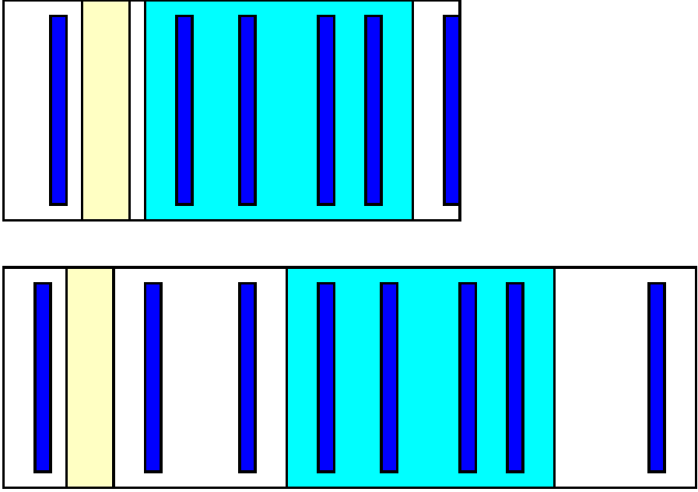
Example Data Stream
Light blue
Identical.
Dark blue
Hash=0.

Slide 37
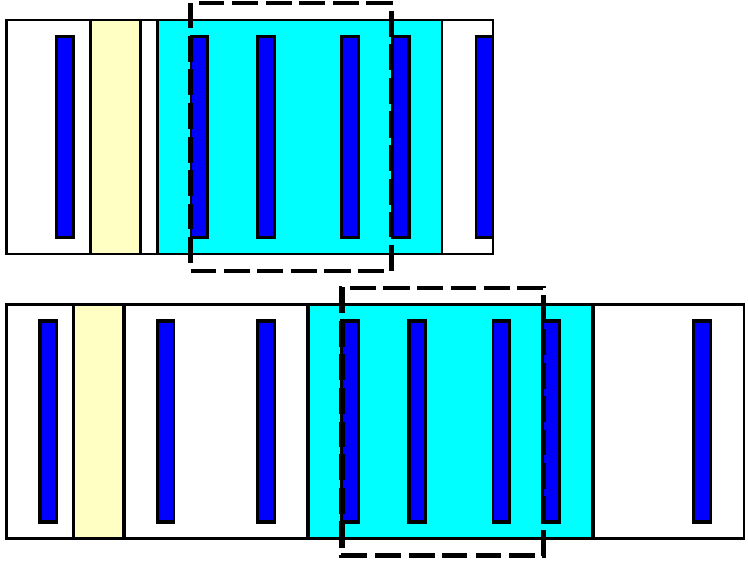
Example Data Stream

Slide 38
Chunk Size
Large chunks
Increase potential compression
ChunkSize/ChunkAddressBits
Decrease
Probability of finding whole chunk
Fraction of repeated content included completely inside chunks

Slide 39
Rolling Hash
A Windowed hash that can be computed incrementally
Hash(a[x+0],a[x+1],…a[x+W-1])=
Hash(a[x-1],a[x+0],…a[x+W-2]) - F(a[x-1])+F(A[x+W-1])
i.e., hash computation is associative
(+,- used abstractly here, could be in some other domain than modulo arithmetic)

Slide 40
Rabin Fingerprinting
Particular scheme for rolling hash due to Michael Rabin based on polynomial over a finite field
Commonly used for this chunking application

Slide 41
Content-Defined Chunking
Compute rolling hash (Rabin Fingerprint) on input stream
At points where hash value goes to 0, create a new chunk

Slide 42
Hashing Deduplication

Slide 43
Hashes for Equality
We can also (separately) take the hash signature of an entire chunk
The longer we make the hash, the lower the likelihood two different chunks will have the same hash
If hash is perfectly uniform,
N-bit hash, two chunks have a 2^{-N} chance of having the same hash.

Slide 44
Deduplicate
Compute chunk hash
Use chunk hash to lookup known chunks
Data already have on disk
Data already sent to destination, so destination will know
If lookup yields a chunk with same hash
Check if actually equal (maybe)
If chunks equal
Send (or save) pointer to existing chunk

Slide 45
Deduplicate
Use chunk hash to lookup known chunks
Data already have or sent
If lookup yields a chunk with same hash
Check if actually equal (maybe)
How reduce work compared to simple comparison to every chunk ?
preclass 1 applied to chunks
What are we computing per input byte?

Slide 46
Deduplicate
Compute chunk hash
Use chunk hash to lookup known chunks
Data already have on disk
Data already sent to destination, so destination will know
If lookup yields a chunk with same hash
Check if actually equal (maybe)
What might be problematic about looking up a 256b hash?

Slide 47
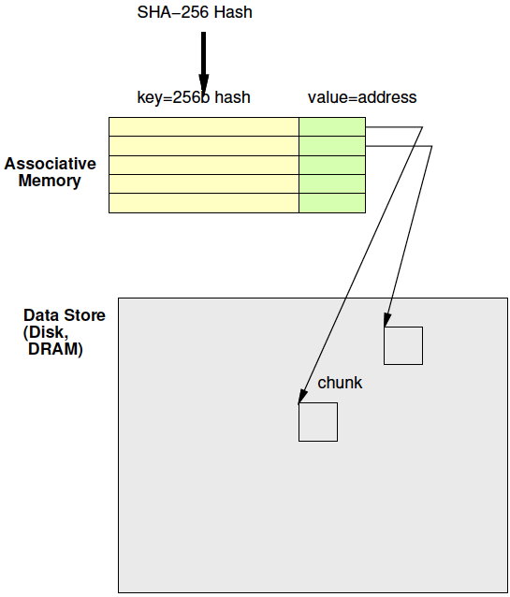
Deduplication Architecture

Slide 48
Associative Memory
Maps from a key to a value
Key not necessarily dense
Contrast simple RAM
Talk about options to implement next week

Slide 49
Secure Hash
We regularly use signatures to identify if a file has been tampered with
Again, hashes are same, mean data might be the same
For security, we would like additional property
not easy to make the anti-tamper signature match

Slide 50
Cryptographic Hash
One-way functions
Easy to compute the hash
Hard to invert
Ideally, only way to get back to input data is by brute force
Key: someone cannot change the content (add a backdoor to code) and then change some further to get hash signature to match original

Slide 51
SHA-256
Standard secure hash with a 256b hash digest signature
Heavily analyzed
Heavily used
TLS, SSL, PGP, Bitcoin, …

Slide 52
LZW Compression

Slide 53
Preclass 4, 5, 6
Message?
Bits in unencoded (decoded) message?
Bits for encoded message?

Slide 54
Idea
Use data already sent as the dictionary
Give short names to things in dictionary
Don’t need to pre-arrange dictionary
Adapt to common phrases/idioms in a particular document

Slide 55
Encoding
Greedy simplification
Encode by successively selecting the longest match between the head of the remaining string to send and the current window

Slide 56
Algorithm Concept
While data to send
Find largest match in window of data sent
If length too small (length=1)
Send character
Else
Send <x,y> = <match-pos,length>
Add data encoded into sent window

Slide 57
Preclass 7
How many comparisons per invocation?

Slide 58
Idea
Avoid O(Dictionary-size) work
Represent all strings as prefix tree
Share prefix among substrings
Follow prefix trees with fixed work per input character

Slide 59
Tree Example
THEN AND THERE, THEY STOOD…
T
H
E
N
R
Y
E

Slide 60
Tree Algorithm
Root for each character
Follow tree according to input until no more match
Send <name of last tree node>
An <x,y> pair
Extend tree with new character
Start over with this character

Slide 61
Tree Example
Label with <lastpos,len> pair
THEN AND THERE, THEY STOOD…
T
T | H | E | N |  | A | N | D |  | T | H | E | R | E | , |  | T | H | E | Y
0 | 1 | 2 | 3 | 4 | 5 | 6 | 7 | 8 | 9 | 10 | 11 | 12 | 13 | 14 | 15 | 16 | 17 | 18 | 19
<0,1>
<1,2>
H
<2,3>
E
<3,4>
N
R
<12,4>
Y
<19,4>
<4,5>
E
<13,5>
<20,5>

Slide 62
Large Memory
int encode[SIZE][256];
Name tree node by position in chunk
lastpos
c is a character
Encode[lastpos][c] holds the next tree node that extends tree node lastpos by c
Or NONE if there is no such tree node

Slide 63
Tree Example
Label with <lastpos,len> pair
THEN AND THERE, THEY STOOD…
T
T | H | E | N |  | A | N | D |  | T | H | E | R | E | , |  | T | H | E | Y
0 | 1 | 2 | 3 | 4 | 5 | 6 | 7 | 8 | 9 | 10 | 11 | 12 | 13 | 14 | 15 | 16 | 17 | 18 | 19
<0,1>
<1,2>
H
encode[2][‘N’]=3
<2,3>
E
encode[2][‘R’]=12
<3,4>
N
R
<12,4>
Y
<19,4>
encode[2][‘Y’]=19
encode[2][‘A’]=NONE
<4,5>
E
<13,5>
<20,5>

Slide 64
Memory Tree Algorithm
curr – pointer into input chunk
// follow tree
y=0; x=0;
while(encode[x][input[curr+y]]!=NONE)
x=encode[x][input[curr+y]]; y++;
If (y>0)
send <x,y>
else
send input[curr+y]
encode[x][input[curr+y]]=curr+y

Slide 65
Complexity
How much work per character to encode?

Slide 66
Compact Memory
int encode[SIZE][256];
How many entries in this table are not NONE?

Slide 67
Compact Memory
int encode[SIZE][256];
Table is very sparse
Store as associative memory
At most SIZE entries
Look at how to implement associative memories next time

Slide 68
Project Task

Slide 69
Big Ideas
Can reduce data size by identifying and reducing redundancy
Can spend computation and data storage to reduce communication traffic

Slide 70
Admin
HW7 due Friday
Project assignment out
Reading for Monday online
First project milestone due next Friday
Including teaming
Teams of 3

