Slide 1
ESE532: System-on-a-Chip Architecture
Day 18: October 31, 2018
Design Space Exploration

Slide 2
Today
Design-Space Exploration
Generic
Concrete example:
Fast Fourier Transform (FFT)

Slide 3
Message
The universe of possible implementations (design space) is large
Many dimensions to explore
Formulate carefully
Approach systematically
Use modeling along the way for guidance

Slide 4
Design-Space Exploration
Generic

Slide 5
Design Space
Have many choices for implementation
Alternatives to try
Parameters to tune
Mapping options
This is our freedom to impact implementation costs
Area, delay, energy

Slide 6
Design Space
Ideally
Each choice orthogonal axis in high-dimensional space
Want to understand points in space
Find one that bests meets constraints and goals
Practice
Seldom completely orthogonal
Requires cleverness to identify dimensions
Messy, cannot fully explore
But…can understand, prioritize, guide

Slide 7
Preclass 1
What choices (design-space axes) can we explore in mapping a task to an SoC?
What showed up in homework so far?

Slide 8
From Homework?
Types of parallelism
Mapping to different fabrics / hardware
How manage memory, move data
DMA, streaming
Data access patterns
Levels of parallelism
Pipelining, unrolling, II, array partitioning
Data size (precision)

Slide 9
Design-Space Choices
Type of parallelism
How decompose / organize parallelism
Area-time points (level exploited)
What resources we provision for what parts of computation
Where to map tasks
How schedule/order computations
How synchronize tasks
How represent data
Where place data; how manage and move
What precision use in computations

Slide 10
Generalize Continuum
Encourage to think about parameters (axes) that capture continuum to explore
Start from an idea
Maybe can compute with 8b values
Maybe can put matrix-mpy computation on FPGA fabric
Move data in 1KB chunks
Identify general knob
Tune intermediate bits for computation
How much of computation go on FPGA fabric
What is optimal data transfer size?

Slide 11
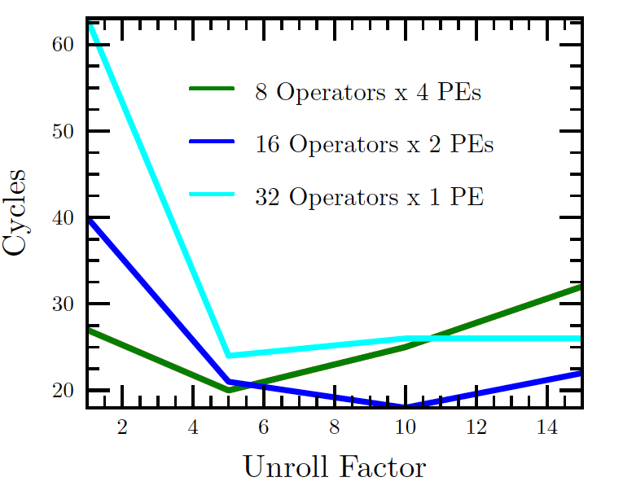
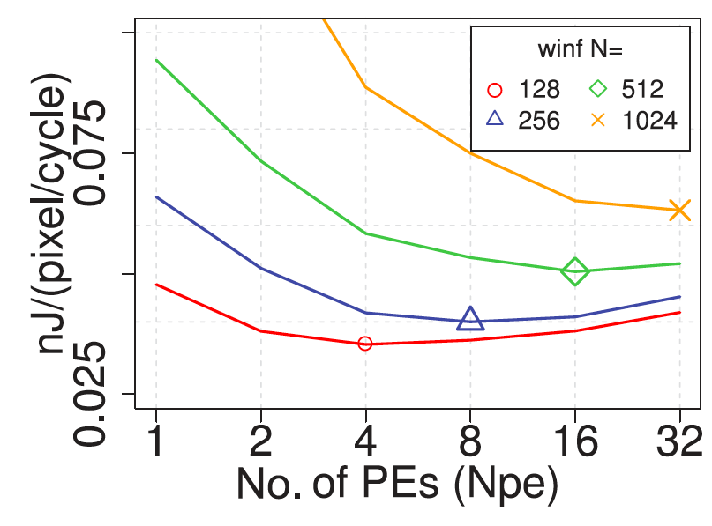
Finding Optima
Kapre, FPL 2009
Kadric, TRETS 2016

Slide 12
Design Space Explore
Think systematically about how might map the application
Avoid overlooking options
Understand tradeoffs
The larger the design space
more opportunities to find good solutions
Reduce bottlenecks

Slide 13
Elaborate Design Space
Refine design space as you go
Ideally identify up front
Practice bottlenecks and challenges
will suggest new options / dimensions
If not initially expect memory bandwidth to be a bottleneck…
Some options only make sense in particular sub-spaces
Bitwidth optimization not a big issue on the 64b processor
More interesting on vector, FPGA

Slide 14
Tools
Sometimes tools will directly help you explore design space
What SDSoC/Vivado HLS support?
Often they will not
What might you want that does not support?

Slide 15
Tools
Sometimes tools will directly help you explore design space
Unrolling, pipelining, II
Array packing and partitioning
Some choices for data movement
Some loop transforms
Granularity to place on FPGA
Often they will not
Need to reshape functions and loops
Data representations and sizes

Slide 16
Code for Exploration
Can you write your code with parameters (#define) can easily change to explore continuum?
Unroll factor?
Number of parallel tasks?
Size of data to move?
Want to make it easy to explore different points in space

Slide 17
Design-Space Exploration
Example FFT

Slide 18
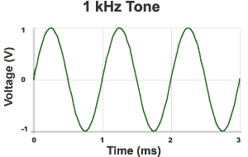
Sound Waves
Hz = 1/s
1kHz = 1000 cycles/s
Source: http://www.mediacollege.com/audio/01/sound-waves.html

Slide 19
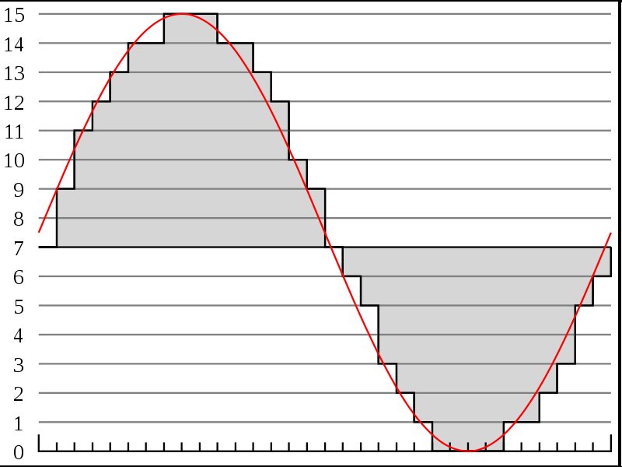
Discrete Sampling
Represent as time sequence
Discretely sample in time
What we can do directly with an Analog-to-Digital (A2D) converter.
http://en.wikipedia.org/wiki/File:Pcm.svg
http://en.wikipedia.org/wiki/File:Pcm.svg

Slide 20
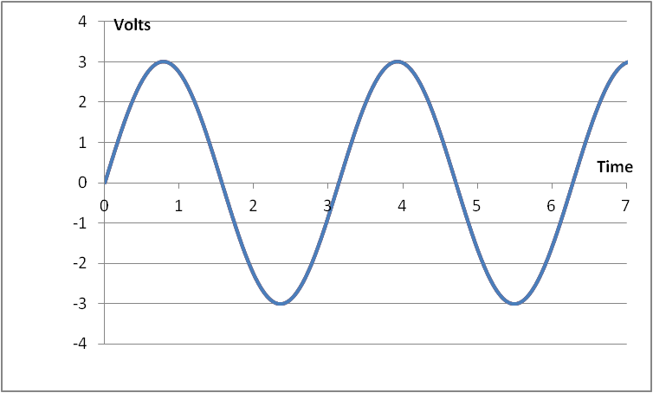
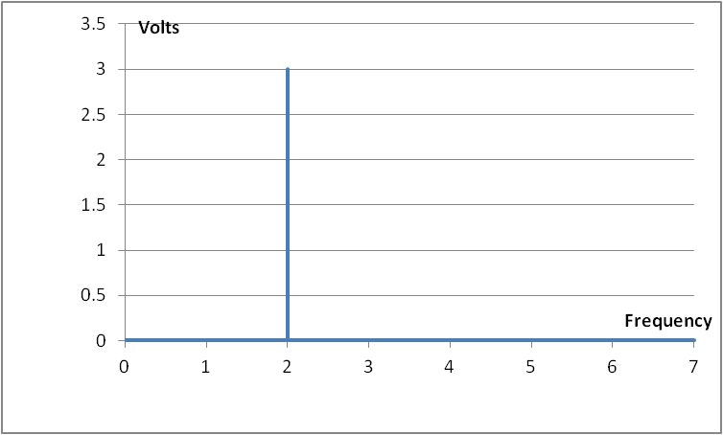
Frequency-domain
T = π, A = 3: s(t) = A*sin(2π*f*t) = 3*sin(2*t)

Slide 21
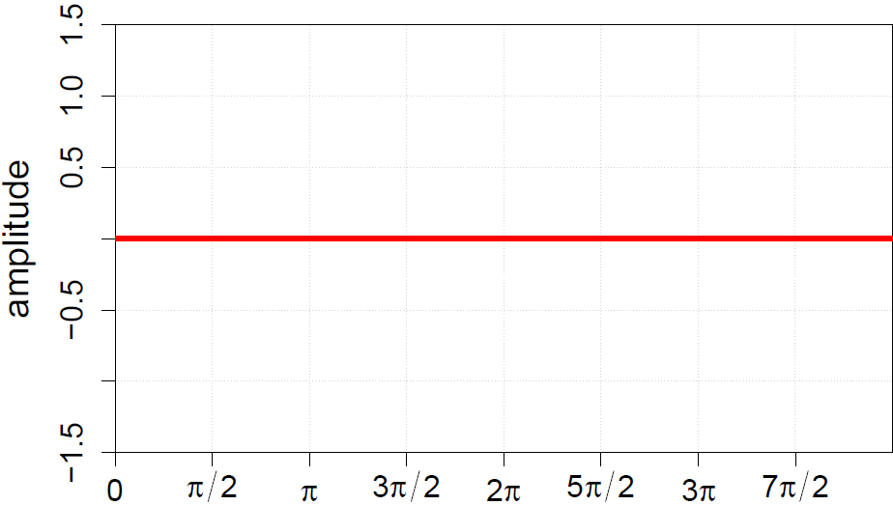
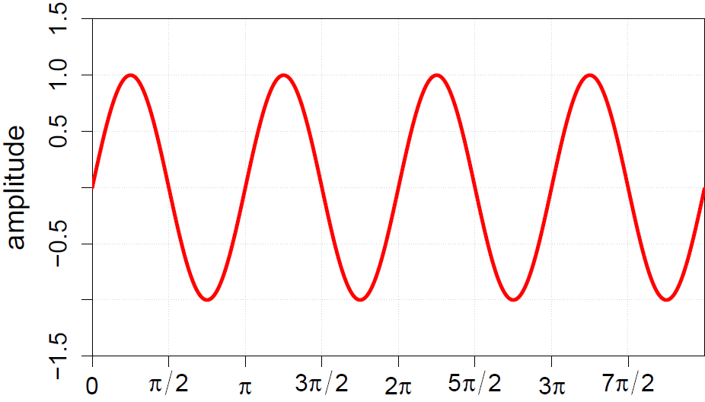
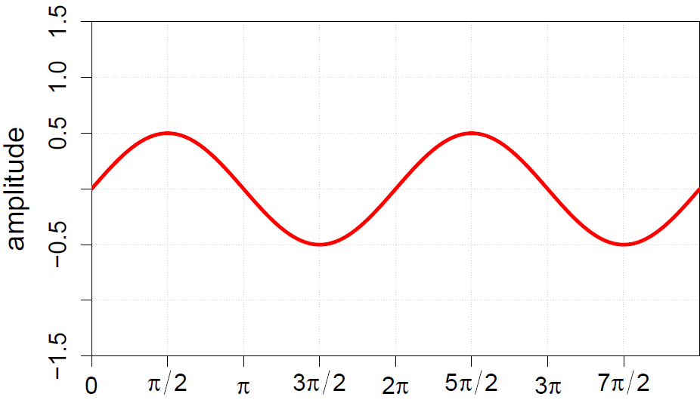
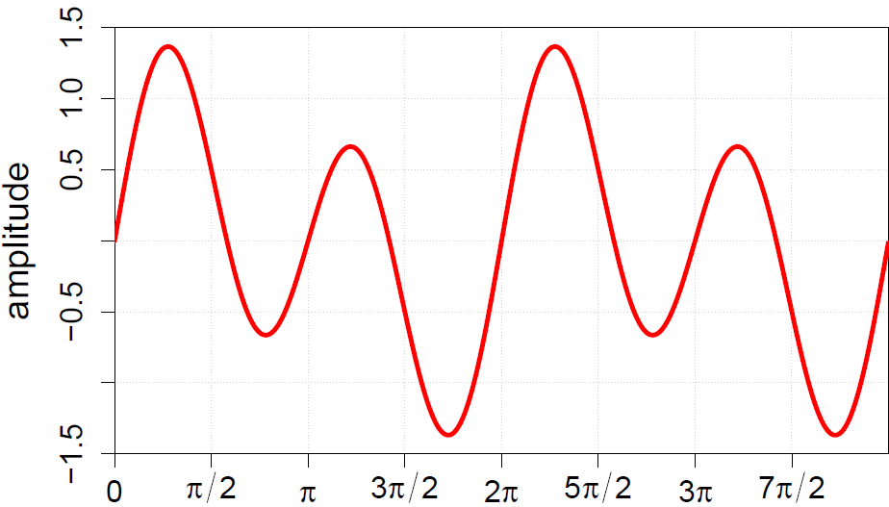
Frequency-domain
Can represent sound wave as linear sum of frequencies

Slide 22
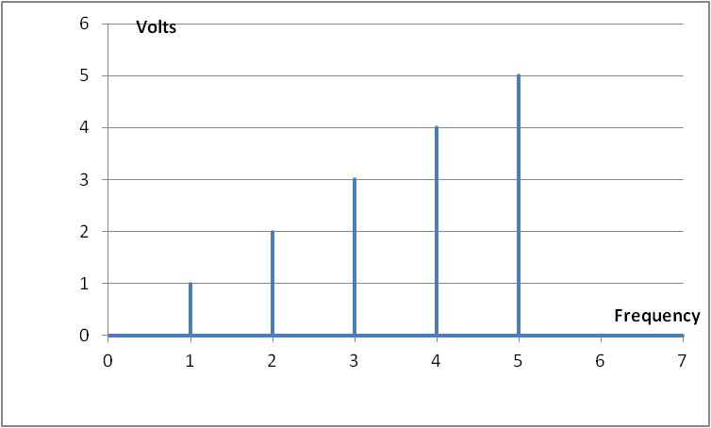
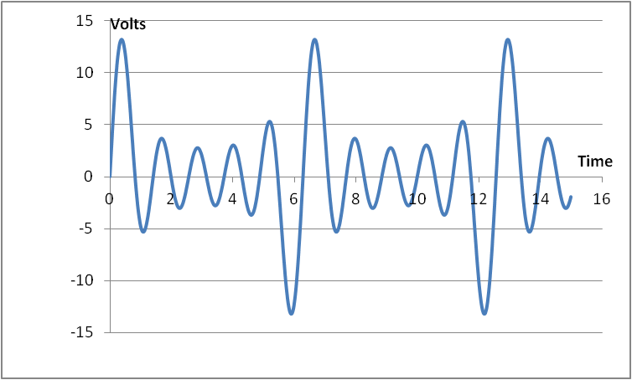
Time vs. Frequency

Slide 23
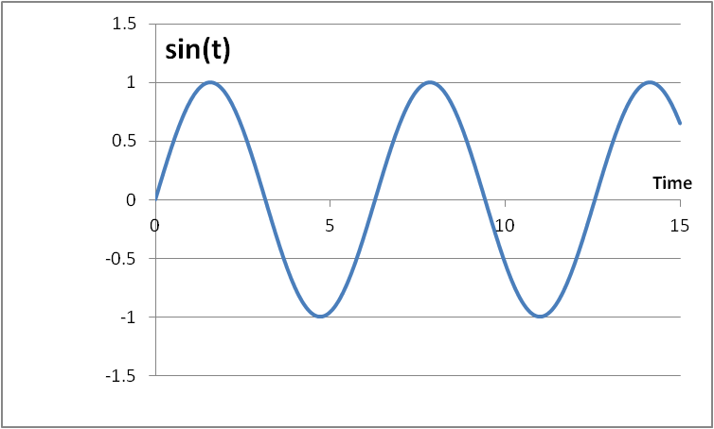
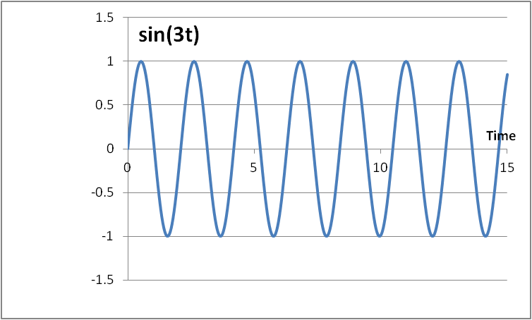
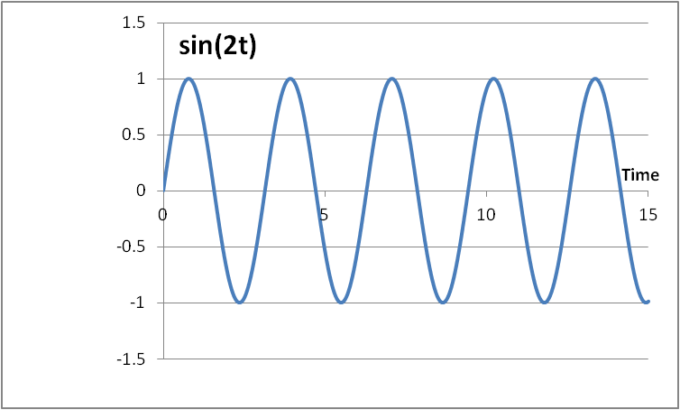
Fourier Series
The cos(nx) and sin(nx) functions form an orthogonal basis: they allow us to represent any periodic signal by taking a linear combination of the basis components without interfering with one another

Slide 24
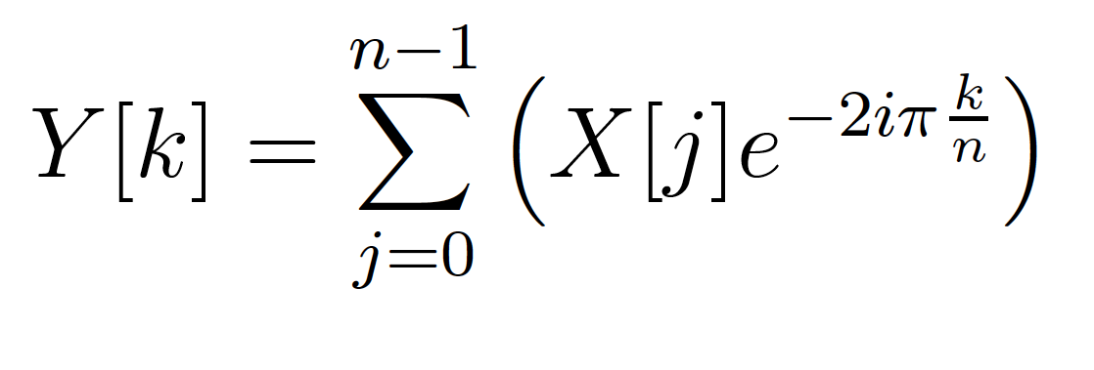
Fourier Transform
Identify spectral components (frequencies)
Convert between Time-domain to Frequency-domain
E.g. tones from data samples
Central to audio coding – e.g. MP3 audio

Slide 25
FT as Matching
Fourier Transform is essentially performing a dot product with a frequency
How much like a sine wave of freq. f is this?

Slide 26
Fast-Fourier Transform (FFT)
Efficient way to compute FT
O(N*log(N)) computation
Contrast N² for direct computation
N dot products
Each dot product has N points (multiply-adds)

Slide 27
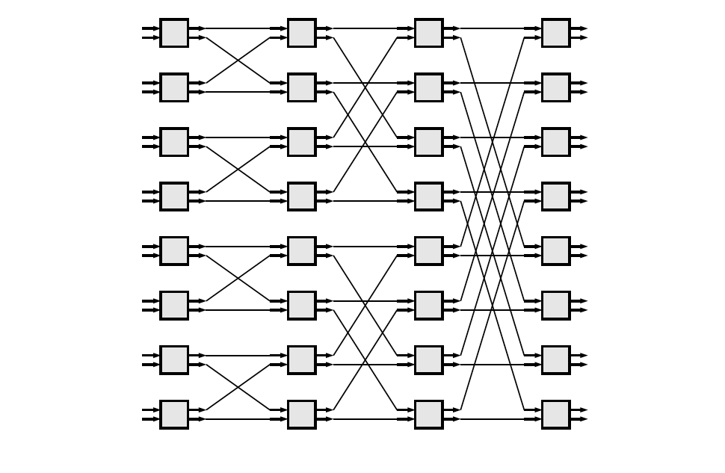
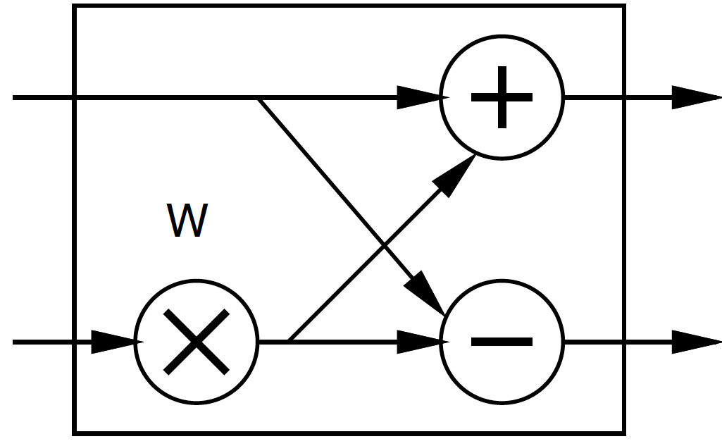
FFT
Large space of FFTs
Radix-2 FFT Butterfly

Slide 28
Basic FFT Butterfly
Y0=X0+W(stage,butterfly)*X1
Y1=X0-W(stage,butterfly)*X1
Common sub expression, compute once: W(stage,butterfly)*X1
X0
Y0
X1
Y1

Slide 29
Preclass 2
What parallelism options exist?
Single FFT
Sequence of FFTs

Slide 30
FFT Parallelism
Spatial
Pipeline
Streaming
By column
Choose how many Butterflies to serialize on a PE
By subgraph
Pipeline subgraphs

Slide 31
Streaming FFT

Slide 32
Preclass 3
How large of a spatial FFT can implement with 220 multipliers?

Slide 33
Bit Serial
Could compute the add/multiply bit serially
One full adder per adder
W full adders per multiply
50,000 LUTs
~= 2500 bit-serial butterflies for W=16?
Maybe 512-point FFT?
Another dimension to design space:
How much serialize word-wide operators
Use LUTs vs. DSPs

Slide 34
Accelerator Building Blocks
What common subgraphs exist in the FFT?

Slide 35
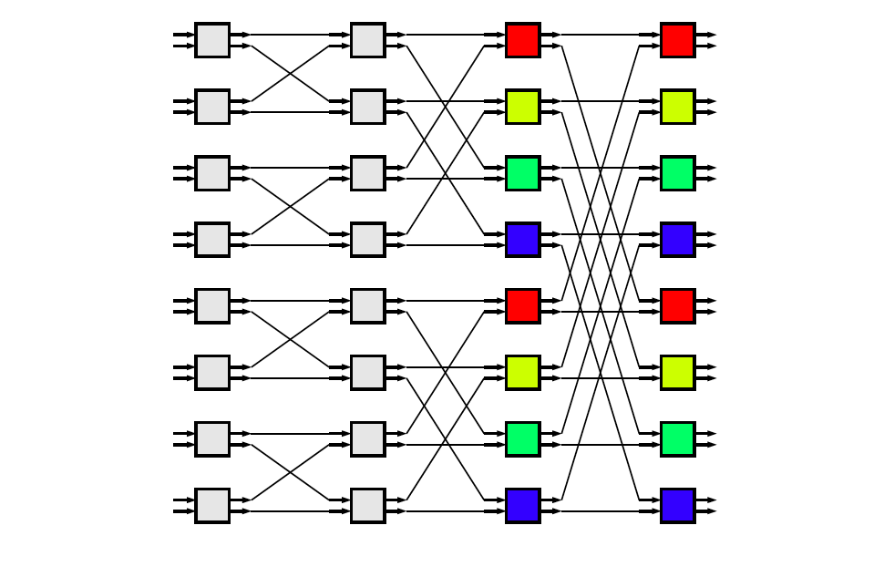
Common Subgraphs

Slide 36
Processor Mapping
How map butterfly operations to processors?
Implications for communications?

Slide 37
Preclass 4a
How large local memory to communicate from stage to stage?

Slide 38
Preclass 4b
How change evaluation order to reduce local storage memory?

Slide 39
Preclass 4b
Evaluation order
1
3
9
2
4
10
5
7
11
6
8
12

Slide 40
Streaming FFT

Slide 41
Communication
How implement the data shuffle between processors or accelerators?
Memories / interconnect ?
How serial / parallel ?
Network?

Slide 42
Data Precision
Input data from A2D likely 12b
Output data, may only want 16b
What should internal precision and representation be?

Slide 43
Number Representation
Floating-Point
IEEE standard single (32b), double (64b)
With mantissa and exponent
…half, quad ….
Fixed-Point
Select total bits and fraction
E.g. 16.8 (16 total bits, 8 of which are fraction)
Represent 1/256 to 256-1/256

Slide 44
Heterogeneous Precision
May not be same in every stage
W factors less than 1
Non-fraction grows at most 1b per stage

Slide 45
W/Twiddle factors
Precompute and store in arrays
Compute as needed
How?
sin/cos hardware?
CORDIC?
Polynominal approximation?
Specialize into computation
Many evaluate to 0, ±1, ±½, ….
Multiplication by 0, 1 not need multiplier…

Slide 46
FFT (partial) Design Space
Parallelism
Decompose
Size/granularity of accelerator
Area-time
Sequence/share
Communicate
Representation/precisions
Twiddle

Slide 47
Big Ideas:
Large design space for implementations
Worth elaborating and formulating systematically
Make sure don’t miss opportunities
Think about continuum for design axes
Model effects for guidance and understanding

Slide 48
Admin
P1 milestone
Due Friday
P2 out
Asks you to identify design space

