Slide 1
ESE532: System-on-a-Chip Architecture
Day 2: September 5, 2018
Analysis, Metrics, and Bottlenecks
Work Preclass
Lecture start 10:35pm

Slide 2
Today: Analysis
How do we quickly estimate what’s possible?
Before (with less effort than) developing a complete solution
How should we attack the problem?
Achieve the performance, energy goals?
When we don’t like the performance we’re getting, how do we understand it?
Where should we spend our time?

Slide 3
Today: Analysis
Throughput
Latency
Bottleneck
Computation as a Graph, Sequence
Critical Path
Resource Bound
90/10 Rule
Amdahl’s Law (time permitting)

Slide 4
Message for Day
Identify the Bottleneck
May be in compute, I/O, memory, data movement
Focus and reduce/remove bottleneck
More efficient use of resources
More resources
Repeat

Slide 5
Latency vs. Throughput
Latency: Delay from inputs to output(s)
Throughput: Rate at which can produce new set of outputs
(alternately, can introduce new set of inputs)

Slide 6
Preclass Washer/Dryer Example
10 shirt capacity
1 Washer Takes 30 minutes
1 Dryer Takes 60 minutes
How long to do one load of wash?
→ Wash latency
Cleaning Throughput?
W
D
W
D
60m

Slide 7
Pipeline Concurrency
W
D
Break up the computation graph into stages
Allowing us to
reuse resources for new inputs (data),
while older data is still working its way through the graph
Before it has exited graph
Throughput > (1/Latency)
Relate liquid in pipe
Doesn’t wait for first drop of liquid to exit far end of pipe before accepting second drop

Slide 8
Escalator
Image Source: https://commons.wikimedia.org/wiki/File:Tanforan_Target_escalator_1.JPG

Slide 9
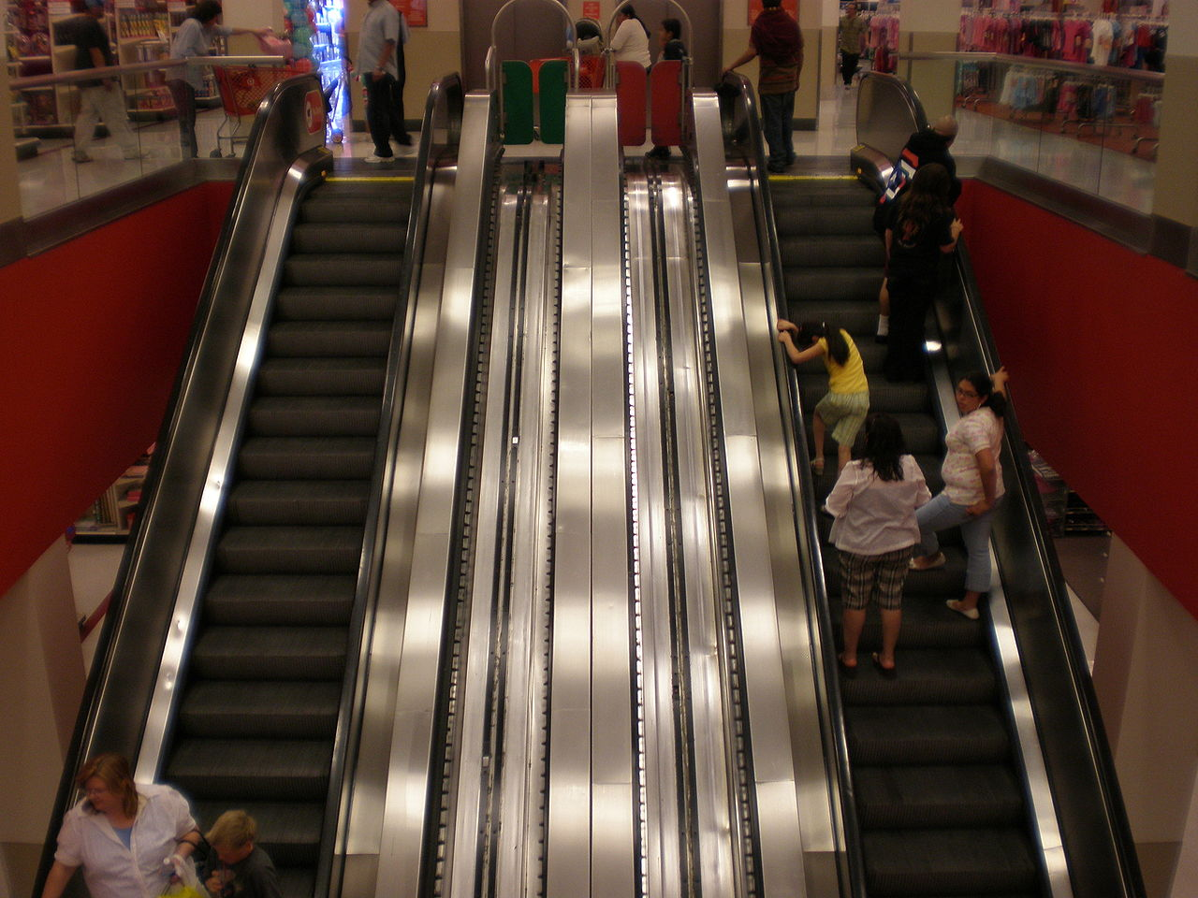
Escalator
Moves 2 ft/second
Assume for simplicity one person can step on escalator each second
Escalator travels 30 feet (vertical and horizontal)
Latency of escalator trip?
Throughput of escalator: people/hour ?

Slide 10
Bottleneck
What is the rate limiting item?
Resource, computation, ….

Slide 11
Preclass Washer/Dryer Example
1 Washer Takes 30 minutes
Isolated throughput 20 shirts/hour
1 Dryer Takes 60 minutes
Isolated throughput 10 shirts/hour
Where is bottleneck in our cleaning system?
W
D
W
D
60m

Slide 12
Preclass Washer/Dryer Example
1 Washer $500
Isolated throughput 20 shirts/hour
1 Dryer $500
Isolated throughput 10 shirts/hour
How do we increase throughput with $500 investment
W
D
W
D
60m

Slide 13
Preclass Washer/Dryer Example
1 Washer $500
Isolated throughput 20 shirts/hour
2 Dryers $500
Isolated single dryer throughput 10 shirts/hour
Latency?
Throughput?
D
W
D

Slide 14
Preclass Washer/Dryer Example
1 Washer $500
Isolated throughput 20 shirts/hour
2 Dryers $500
Isolated single dryer throughput 10 shirts/hour
Able to double the throughput without doubling system cost
D
W
D

Slide 15
Preclass Stain Example
3x
1 Washer Takes 30 minutes
Isolated throughput 20 shirts/hour
1 Dryer Takes 60 minutes
Isolated throughput 10 shirts/hour
Shirt need 3 wash cycles
Latency?
Throughput (assuming share)?
D
W

Slide 16
Beyond Computation

Slide 17
Bottleneck
May be anywhere in path
I/O, compute, memory, data movement

Slide 18
Bottleneck
Where bottleneck?
Ethernet
1Gb/s
(64b in 64ns)
64b every 4ns
64b→64b
In 5ns
64b→32b in 10ns
Serial
1Mb/s
(64b in 64μs)
64b→64b in 2ns
32b→64b in 10ns

Slide 19
Bottleneck
Where bottleneck?
Ethernet
1Gb/s
(64b in 64ns)
64b every 4ns
64b→64b
In 5ns
64b→32b in 10ns
Ethernet
1Gb/s
(64b in 64ns)
64b→64b in 2ns
32b→64b in 200ns

Slide 20
Bottleneck
Where bottleneck?
Ethernet
1Gb/s
(64b in 64ns)
64b every 4ns
64b→64b
In 1000ns
64b→32b in 10ns
Ethernet
1Gb/s
(64b in 64ns)
64b→64b in 2ns
32b→64b in 200ns

Slide 21
Feasibility / Limits
First things to understand
Obvious limits in system?
Impossible?
Which aspects will demand efficient mapping?
Where might there be spare capacity

Slide 22
Generalizing

Slide 23
Computation as Graph
Shown “simple” graphs (pipelines) so far
Y=(A+B)*(C+D)
Z=(C+D)*E

Slide 24
Computation as Graph
Nodes have multiple input/output edges
Edges may fanout
Results go to multiple successors

Slide 25
Computation as Sequence
Shown “simple” graphs (pipelines) so far
Y=(A+B)*(C+D)
Z=(C+D)*E
T1=A+B
T2=C+D
Y=T1*T2
Z=T1*E

Slide 26
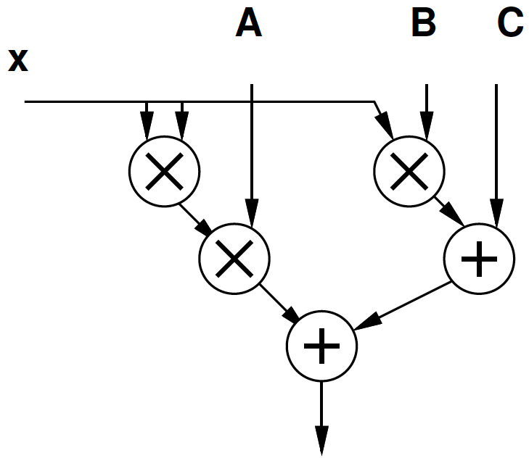
Computation as Graph
Y=Ax²+Bx+C
T1=x*x
T2=A*T1
T3=B*x
T4=T2+T3
Y=C+T4

Slide 27
Computation as Graph
Latency multiply = 3
Latency add = 1
Latency from B to output?
Latency from x to output?
Through Ax² ?
Through Bx ?

Slide 28
Delay in Graphs
There are multiple paths from inputs to outputs
Need to complete all of them to produce outputs
Limited by longest path
Critical path: longest path in the graph

Slide 29
Computation as Graph
Latency multiply = 3
Latency add = 1
Critical Path?

Slide 30
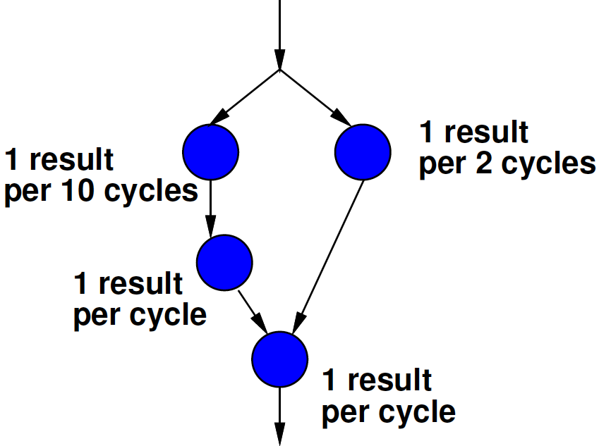
Bottleneck
Where is the bottleneck?
A
B
C
D

Slide 31
Time and Space

Slide 32
Space-Time
In general, we can spend resources to reduce time
Increase throughput
D
W
D
Three wash stain removal case
W
W
W
D

Slide 33
Space Time
Computation
A=x0+x1
B=A+x2
C=B+x3
Adder takes one cycle
Throughput on one adder?
Throughput on 3 adders?
+
+
+

Slide 34
Dependencies and S-T
Dependencies may limit throughput acceleration
Give benefit less than 1/space

Slide 35
Computation as Graph
Latency multiply = 1
Thput mult = 1
Space multiply = 3
Latency add = 1/3
Space add = 1
Thput and Space
3 mul, 2 add

Slide 36
Computation as Graph
Latency multiply = 1
Thput mult = 1
Space multiply = 3
Latency add = 1/3
Space add = 1
Thput and Space
1 mul, 1 add
Where is bottleneck?

Slide 37
Computation as Graph
Latency multiply = 1
Thput mult = 1
Space multiply = 3
Latency add = 1/3
Space add = 1
Thput and Space
2 mul, 1 add
(no algebraic optimizations, iterations may overlap)

Slide 38
Space-Throughput Graph

Slide 39
Two Bounds
(still in Time and Space)

Slide 40
Bounds
Quick lower bounds can estimate
Two:
CP: Critical Path
Sometimes call it “Latency Bound”
RB: Resource Bound
Sometimes call it “Throughput Bound” or “Compute Bound”

Slide 41
Critical Path Lower Bound
Critical path assuming infinite resources
Certainly cannot finish any faster than that

Slide 42
Resource Capacity Lower Bound
Sum up all capacity required per resource
E.g. number of multiplications, additions, memory lookups
Divide by total resource (for type)
E.g., number of multipliers, adders, memory ports
Lower bound on compute
(best can do is pack all use densely)
Ignores data dependency constraints

Slide 43
Example
Critical Path

Slide 44
Example
Total capacity (yellow circle evaluations) needed?
Resource Bound (2 resources)?

Slide 45
Example
D
F
G
Cycle | Resource 1 | Resource 2
0 | A | B
1 | C | D
2 | E | F
3 | G
C
E
B
A
Resource Bound (2 resources)?

Slide 46
Example
Resource Bound (4 resources)?

Slide 47
Example
D
F
G
C
E
B
Cycle | R1 | R2 | R3 | R4
0 | A | B | C | D
1 | E | F | G
A
Legal Schedule?

Slide 48
Resource Capacity Lower Bound
Sum up all capacity required per resource
E.g. number of multiplications, additions, memory lookups
Divide by total resource (for type)
E.g., number of multipliers, adders, memory ports
Lower bound on compute
(best can do is pack all use densely)
Ignores data dependency constraints

Slide 49
Example
Critical Path
3
7/2=4
7/4=2
Resource Bound (2 resources)
Resource Bound (4 resources)

Slide 50
Critical Path
Latency multiply = 3
Thput mult = 1/3
Space multiply = 3
Latency add = 1
Space add = 1
Critical Path?

Slide 51
Resource Bound
Latency multiply = 3
Thput mult = 1/3
Space multiply = 3
Latency add = 1
Space add = 1
Resource Bound
1 mul, 1 add
2 mul, 1 add
3 mul, 2 add

Slide 52
90/10 Rule (of Thumb)
Observation that code is not used uniformly
90% of the time is spent in 10% of the code
Knuth: 50% of the time in 2% of the code
Implications
There will typically be a bottleneck
We don’t need to optimize everything
We don’t need to uniformly replicate space to achieve speedup
Not everything needs to be accelerated

Slide 53
Amdahl’s Law
If you only speedup Y(%) of the code, the most you can accelerate your application is 1/(1-Y)
T_{before} = 1*Y + 1*(1-Y)
Speedup by factor of S
T_{after}=(1/S)*Y+1*(1-Y)
Limit S→infinity T_{before}/T_{after}=1/(1-Y)

Slide 54
Amdahl’s Law
T_{before} = 1*Y + 1*(1-Y)
Speedup by factor of S
T_{after}=(1/S)*Y+1*(1-Y)
Y=70%
Possible speedup (S→infinity) ?
Speedup if S=10?

Slide 55
Amdahl’s Law
If you only speedup Y(%) of the code, the most you can accelerate your application is 1/(1-Y)
Implications
Amdhal: good to have a fast sequential processor
Keep optimizing
T_{after}=(1/S)*Y+1*(1-Y)
For large S, bottleneck now in the 1-Y

Slide 56
Big Ideas
Identify the Bottleneck
May be in compute, I/O, memory ,data movement
Focus and reduce/remove bottleneck
More efficient use of resources
More resources

Slide 57
Admin
Reading for Day 3 on web
HW1 due Friday
HW2 out
Partner assignment and board shuffle (see canvas)
Remember feedback

