Slide 1
ESE532: System-on-a-Chip Architecture
Day 21: November 12, 2018
Energy

Slide 2
Today
Energy
Today’s bottleneck
What drives
Efficiency of
Processors, FPGAs, accelerators
How does parallelism impact energy?

Slide 3
Message
Energy dominates
Including limiting performance
Make memories small and wires short
Small memories cost less energy per read
Accelerators reduce energy
Compared to processors
Can tune parallelism to minimize energy
Typically, the more parallel implementation costs less energy

Slide 4
Energy
Growing domain of portables
Less energy/op → longer battery life
Global Energy Crisis
Power-envelope at key limit
E reduce → increase compute in P-envelope
Scaling
Power density not transistors limit sustained ops/s
Server rooms
Cost-of-ownership not dominated by Silicon
Cooling, Power bill

Slide 5
Preclass 1--4
200K gates/mm²
5*10⁻¹⁵ J/gate switch
Gates on 1cm²
Energy to switch all?
Power at 1GHz?
Fraction can switch with 10W/cm² power budget?

Slide 6
Challenge: Power

Slide 7
Origin of Power Challenge
Limited capacity to remove heat
~100W/cm² force air
1-10W/cm² ambient
Transistors per chip grow at Moore’s Law rate = (1/F)²
Energy/transistor must decrease at this rate to keep constant power density
P/tr ∝ CV²f
E/tr ∝ CV²
…but V scaling more slowly than F

Slide 8
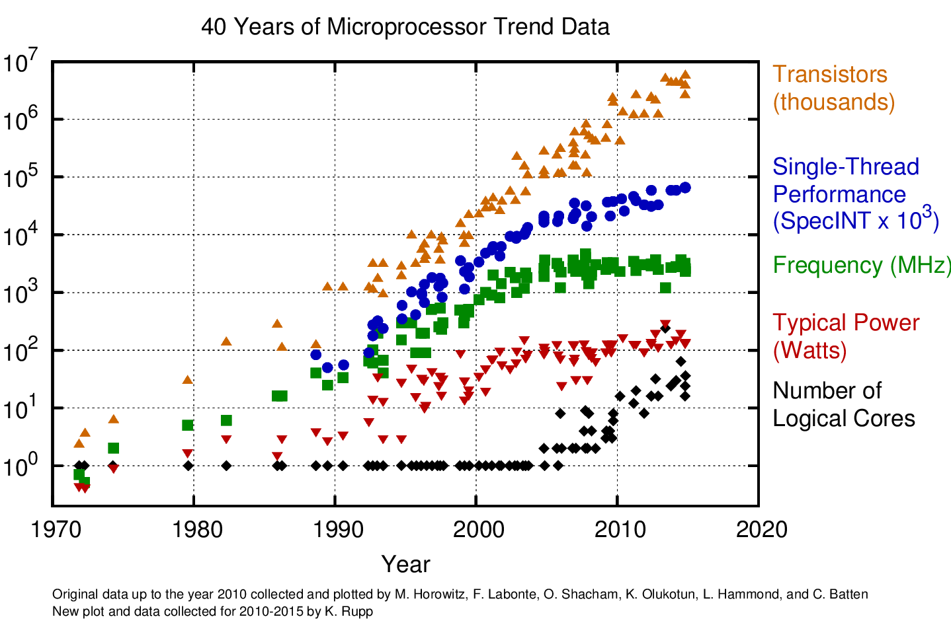

Slide 9
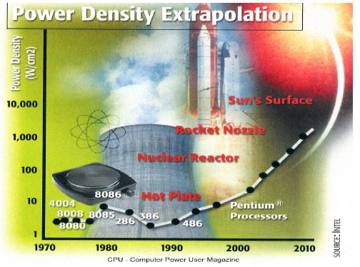
Intel Power Density

Slide 10
Impact
Power Limits Integration
Source: Carter/Intel
10

Slide 11
Impact
Power density is limiting scaling
Can already place more transistors on a chip than we can afford to turn on!
Power is potential challenge/limiter for all future chips.
Only turn on small percentage of transistors?
Operate those transistors at much slower frequency?

Slide 12
Energy

Slide 13
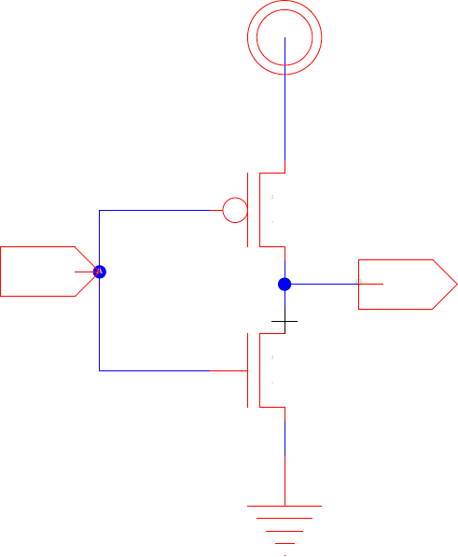
Leakage Energy
I_{leak}
Subthreshold leakage
(possibly) Gate-Drain leakage

Slide 14
Switching Energy
C – driven by architecture
V – today, driven by variation, aging
α – driven by architecture, coding/information

Slide 15
Energy

Slide 16
Voltage
We can set voltage
Reducing voltage
Reduces E_{switch}
Increases delay → cycle time, T
Increases leakage

Slide 17
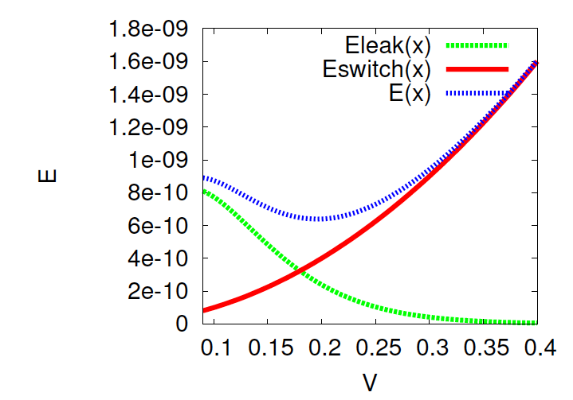
Total Energy vs. Voltage

Slide 18
Switching Energy
C – driven by architecture
Also impacted by variation, aging
V – today, driven by variation, aging
α – driven by architecture, information

Slide 19
Data Dependent Activity
Consider an 8b counter
How often do each of the following switch?
Low bit?
High bit?
Average switching across all 8 output bits?
Assuming random inputs
Activity at output of nand4?
Activity at output of xor4?

Slide 20
Gate Output Switching (random inputs)
Prev.
Next
0
Pswitch=P(0@i)*P(1@i+1)
+P(1@i)*P(0@i+1)
1

Slide 21
Switching Energy
C_{i} == capacitance driven by each gate (including wire)

Slide 22
Switching Rate (α_{i}) Varies
Different logic (low/high bits, gate type)
Different usage
Gate off unused functional units
Data coded
Entropy in data
Average α 5--15% plausible

Slide 23
Switching Energy
C – driven by architecture
V – today, driven by variation, aging
α – driven by architecture, information

Slide 24
Wire Driven
Gates drive
Self
Inputs to other gates
Wire routing between self and other gates
Typically:

Slide 25
Wire Capacitance
How does wire capacitance relate to wire length?

Slide 26
Wire Capacitance
C=εA/d = εW*L_{wire}/d = C_{unit} * L_{wire}
Wire capacitance is linear in wire length
E.g. 1.7pF/cm (preclass)
Remains true if buffer wire
Add buffered segment at fixed lengths

Slide 27
Wire Driven Implications
Care about locality
Long wires are higher energy
Producers near consumers
Memories near compute
Esp. for large α_{i}’s
Care about size/area
Reduce (worst-case) distance must cross
Care about minimizing data movement
Less data, less often, smaller distances
Care about size of memories

Slide 28
Preclass 5
Primary switching capacitance in wires
C: How does energy of a read grow with capacity (N) of a memory bank?
D: Energy per bit?

Slide 29
Memory Implications
Memory energy can be expensive
Small memories cost less energy than large memories
Use data from small memories as much as possible
Cheaper to re-use data item from register than re-reading from memory

Slide 30
Architectural Implications

Slide 31
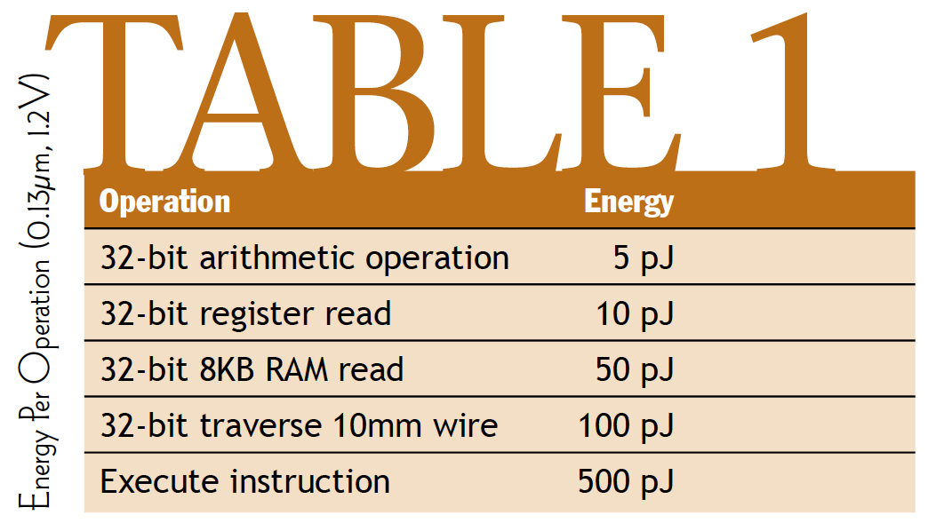
Component Numbers
[Dally, March 2004 ACM Queue]

Slide 32
Component Numbers
Processor instruction 100x more than arithmetic
Register read 2x
RAM read 10x
Why processor instruction > arith operation?
[Dally, March 2004 ACM Queue]

Slide 33
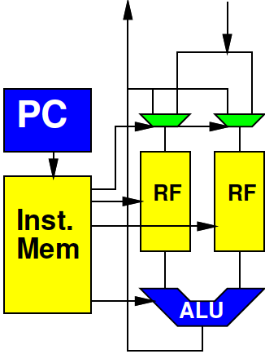
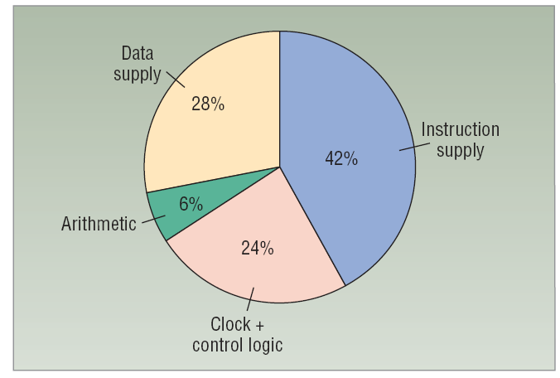
Processors and Energy
Very little into actual computation
Determine and Fetch Instruction
Read and Write data from memories
[Dally et al. /
Computer 2008]

Slide 34
ARM Cortex A9
Estimate find: 0.5W at 800MHz in 40nm
0.5/0.8 x 10⁻⁹ J/instr
~600pJ/instr
Scale to 28nm
maybe 0.7*600—0.5*600
300—400pJ/instr ?
Is superscalar w/ neon, so not as simple a processor as previous example

Slide 35
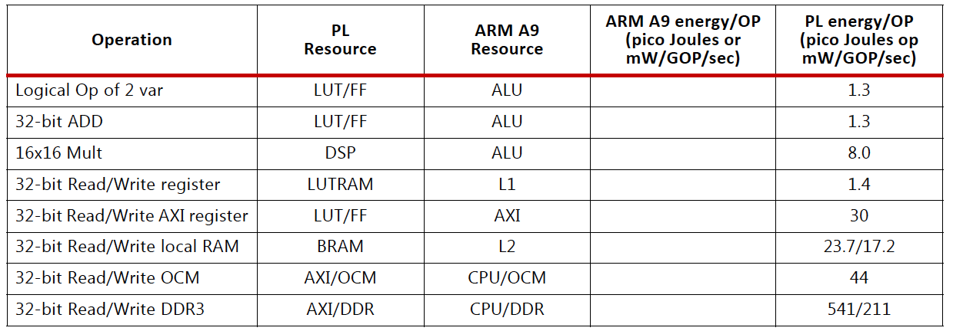
Zynq
ARM A9 instruction 300—400pJ
ARM A9 L1 cache read 23pJ
Xilinx UG585 – Zynq TRM

Slide 36
Compare
Assume ARM Cortex A9 executes 4x32b Neon vector add instruction for 300pJ
Compare to 32b adds on FPGA?

Slide 37
Compare
Assume ARM Cortex A9 executes 8x16b Neon vector multiply instruction for 300pJ
Compare to 16x16 multiplies on FPGA?

Slide 38
Programmable Datapath
Performing an operation in a pipelined datapath can be orders of magnitude less energy than on a processor
ARM 300pJ vs. 1.3pJ 32b add
Even neon 300pJ vs. 4x1.3pJ for 4x32b add
300pJ vs. 8x8pJ for 8 16x16b multiplies

Slide 39
Zynq
Reading from OCM order of magnitude less than from DRAM
…and BRAM half that
Xilinx UG585 – Zynq TRM

Slide 40
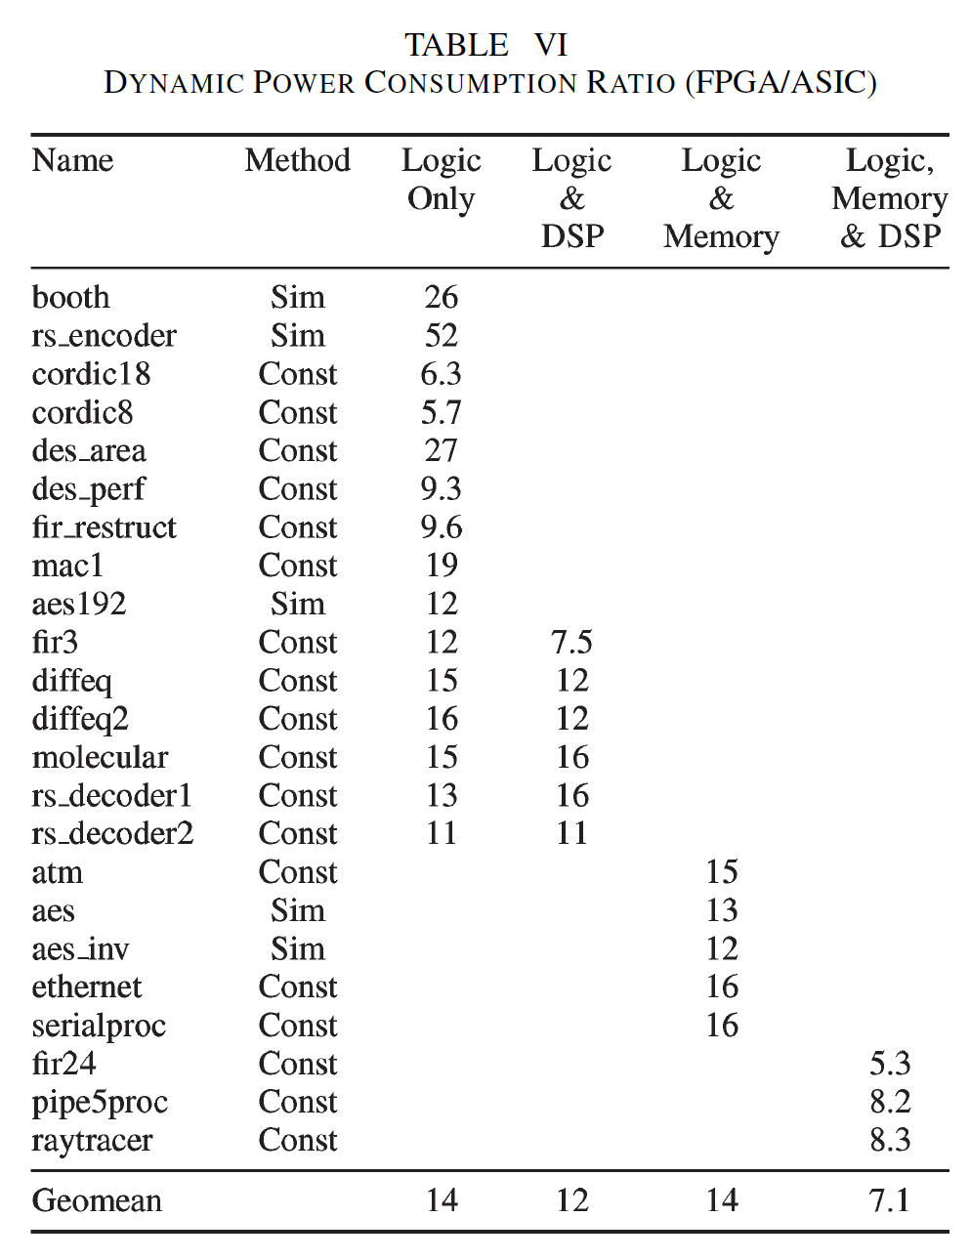
FPGA vs. Std Cell Energy
90nm
FPGA: Stratix II
STMicro CMOS090
[Kuon/Rose TRCADv26n2p203--215 2007]

Slide 41
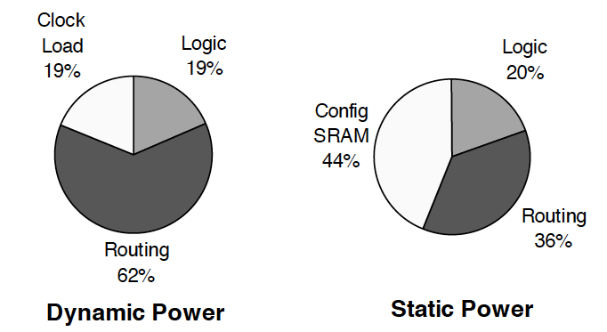
FPGA Disadvantage to Custom
Interconnect Energy
Long wires → more capacitance → more E
Switch Energy is an overhead
[Tuan et al./FPGA 2006]

Slide 42
Simplified Comparison
Processor two orders of magnitude higher energy than custom accelerator
FPGA accelerator in between
Order of magnitude lower than processor
Order of magnitude higher than custom

Slide 43
Parallelism and Energy

Slide 44
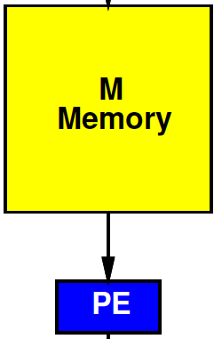
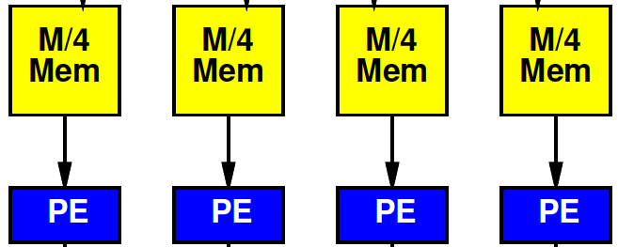
Preclass 6
Energy
Per read from M=10⁶ memory?
Per read from 10⁶/4 memory?

Slide 45
Local Consumption
To exploit, we must consume the data local to the memory.

Slide 46
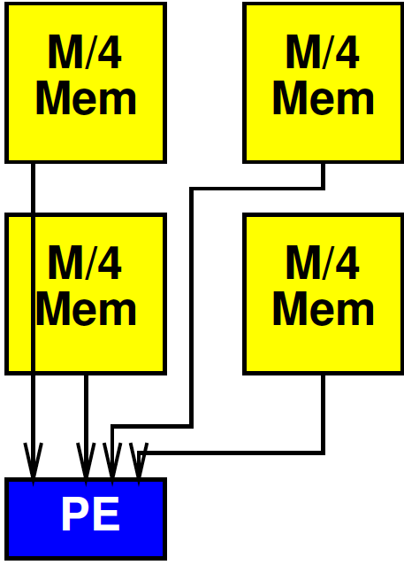
Cheat?
What if we broke the memory into 4 blocks, but still routed to a single processor?
Hint: Interconnect energy reading from top right?

Slide 47
Cheat?
E=Emem(M/4) + 2*sqrt(M/4)*Cwire
(simplify assume 2C_{wire}~= unit)
E=sqrt(M/4) + sqrt(M/4) ≅ sqrt(M)

Slide 48
Cheat?
Near mem = E(M/4)=(1/2) sqrt(M)
Far mem = sqrt(M) [previous slide]
Other two = E(M/4)+sqrt(M/4)*Cwire = (1/2+1/4)sqrt(M)
Average:
Sqrt(M)*(1/4)(1/2+2*3/4+1)
= ¾ sqrt(M)

Slide 49
Exploit Locality
Must consume data near computation

Slide 50
Inter PE Communication
May need to communicate between parallel processing elements [PEs] (and memories)
Must pay for energy to move data between PEs

Slide 51
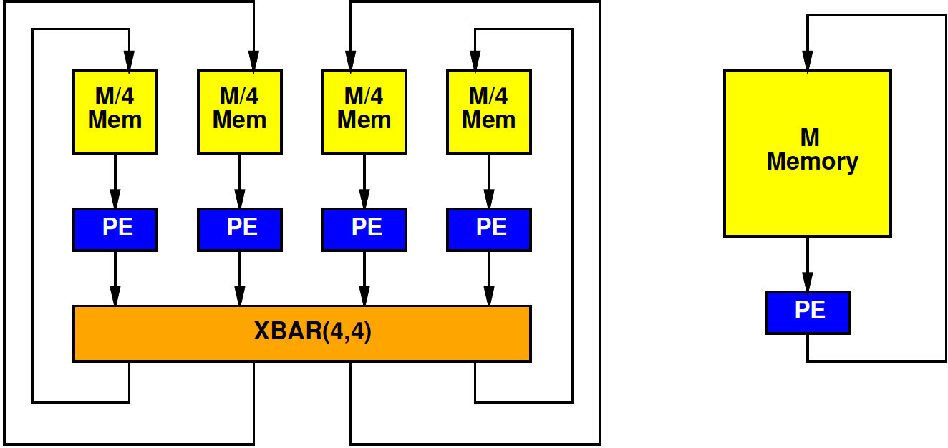
Preclass 7
Energy: Read 4 memories 10⁶/4, route 4x4 crossbar, write 4 10⁶/4 memories?
Energy: 4 reads from 10⁶ memory, 4 writes from 10⁶ memory?

Slide 52
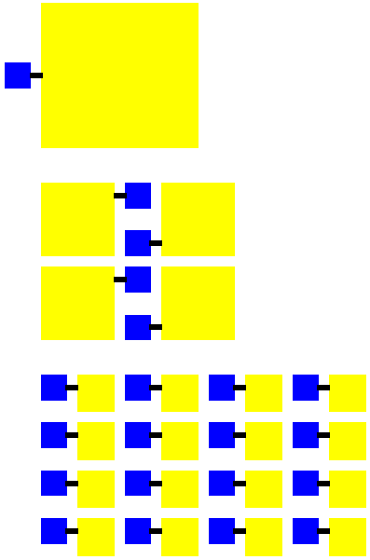
Parallel Larger
More parallel design
Has more PEs
Adds interconnect
Total area > less parallel design
More area → longer wires → more energy in communication between PEs
Could increase energy!

Slide 53
Continuum Question
Where do we minimize total energy?
Both memory and communication
Design axis P – number of PEs
What P minimizes energy?

Slide 54
Simple Model
E_{mem}=sqrt(M)
Communication = E_{xbar}(I,O)=4*I*O
P Processors
N total data
Possibly communicate each result to other PEs

Slide 55
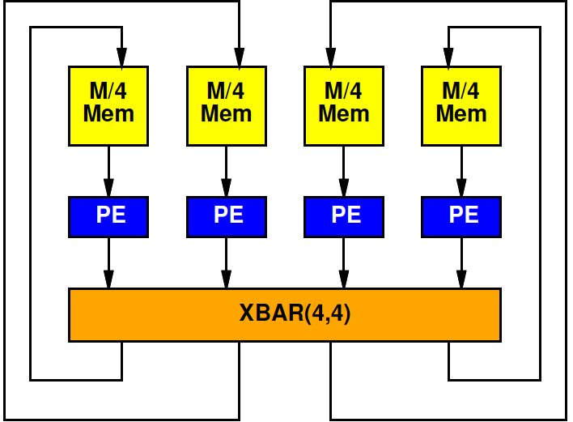
Simple Model: Memory
Divide N data over P memories
E_{mem}=sqrt(N/P)
N total memory operations
Memory energy: N*sqrt(N/P)
Memory energy decrease with P

Slide 56
Simple Model: Communication
Crossbar with P inputs and P outputs
E_{xbar}=4*P*P
Crossbar used N/P times
Crossbar energy: 4*N*P
Communication energy increase with P

Slide 57
Simple Model

Slide 58
Preclass 8
For N=10⁶
Per operation becomes:

Slide 59
Preclass 8
Energy for:
P=1
P=4
P=100
Energy minimizing P?
Energy?

Slide 60
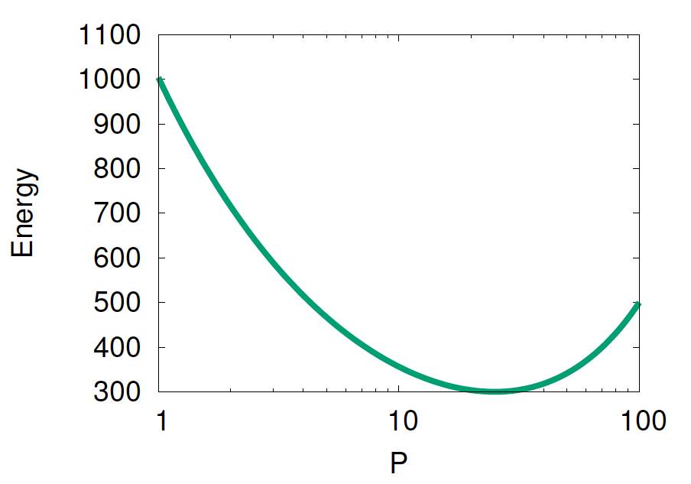
Graph

Slide 61
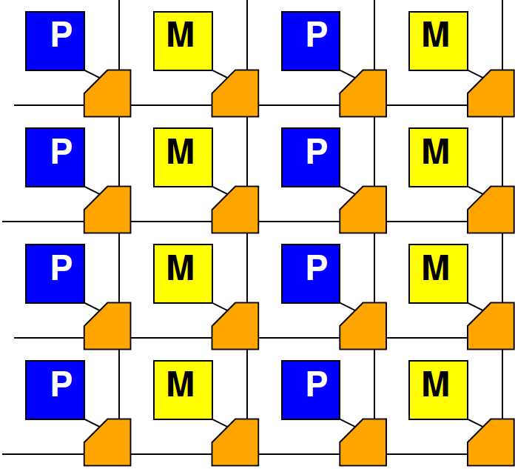
High Locality
If communication is local, don’t need crossbar
Communication energy scales less than P²
Can scale as low as P

Slide 62
Model for High Locality
E_{comm}=constant
E_{comm}=10
Total comm:
N*10

Slide 63
Preclass 9
What is energy minimizing P?

Slide 64
Task Locality Matters
Optimal P depends on communication locality
Very local problems always benefit from parallelism
Highly interconnected problems must balance energies → intermediate parallelism

Slide 65
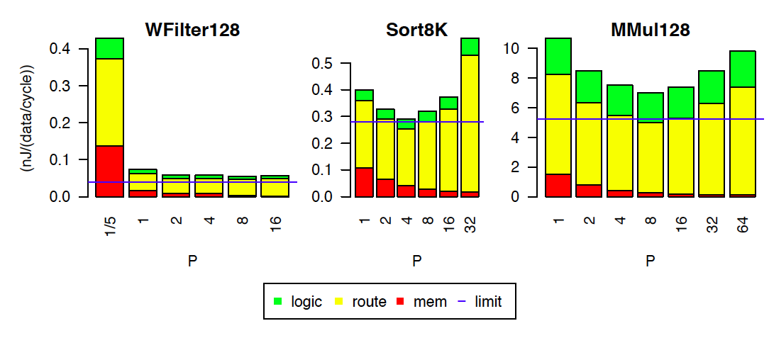
Tune Parallelism: Stratix-IV
[Kadric, FPGA 2015]

Slide 66
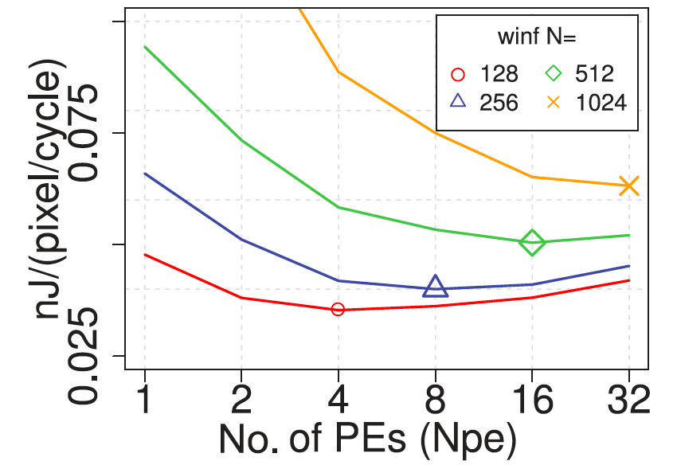
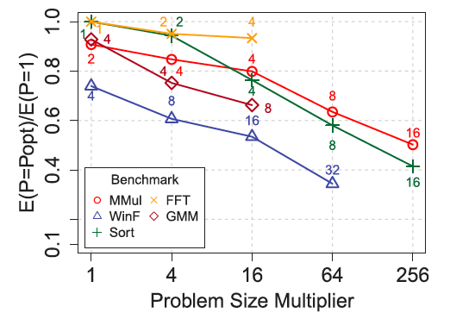
PE Scaling with Problem Size
[Kadric, TRETS 2016]

Slide 67
Big Ideas
Energy dominance
With power-density budget
The most energy efficient architecture delivers the most performance
Make memories small and wires short
SoC, accelerators reduce energy by reducing processor instruction execution overhead
Parallel design exploit locality→reduce energy
Optimal parallelism for problem
Driven by communication structure, size

Slide 68
Admin
P2 design space
Should have feedback on canvas
Back to verification on Wednesday
P3 I/O and Energy Milestone
Due Friday

