Slide 1
ESE532: System-on-a-Chip Architecture
Day 23: November 19, 2018
Estimating Chip Area and Costs

Slide 2
Today
Chip Costs from Area
Chip Area
IO
Interconnect – Rent’s Rule
Infrastructure
Some Areas
CACTI – for modeling memories

Slide 3
Message
First order:
Chip cost proportional to Area
Area = Sum(Area(Components))
But appreciate the simplification:
Yield makes cost superlinear in area
I/O, Interconnect, infrastructure
Can make Area > Sum(Area(Components))

Slide 4
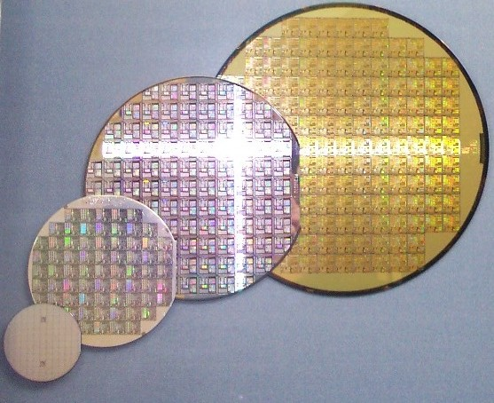
Wafer Cost
Incremental cost of producing a silicon wafer is fixed for a given technology
Independent of the specific design
E.g. $3,500
Can fill wafer with copies of chip
By German Wikipediabiatch, original upload 7.
Okt 2004 by Stahlkocher de:Bild:Wafer 2 Zoll bis 8 Zoll.jpg,
CC BY-SA 3.0, https://commons.wikimedia.org/w/index.php?curid=928106

Slide 5
Preclass 1
Rough cost per mm of silicon?
$3500 for 300mm wafer

Slide 6
Implication
Raw silicon die cost is roughly proportional to area
Larger the die, the fewer we get on the wafer

Slide 7
…but
Limits to how big we can make chips
Manufactures are prepared to create
Can be reliably manufactured
…and how small we can make chips
I/O pads
Cutting/handling/marking

Slide 8
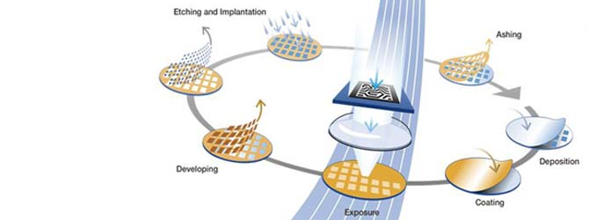
Imaging
Limit to how large optical imaging supports
Reticle – imagable region for photo lithography
Around 600mm²
Source
https://www.asml.com/the-asml-exposure-apparatus-is-the-most-expensive-and-complex-step-in-the-chip-fabrication-process-what-is-involved-in-the-lithography-business/ja/s28145?rid=44709

Slide 9
Yield
Chips won’t be manufactured perfectly
Dust particles can impact imaging
Manufacturing processes are statistical
If chips must be defect-free,
larger chips are more likely to have defects than smaller chips

Slide 10
Simple Yield Model
Probability of a region being perfect
E.g. probability of one sq. mm being defect-free
Chip yields if its entire area is defect free
(look at how to tolerate defects in a couple of weeks)

Slide 11
Chip Yield
P = defect-free probability per sq. mm
What is probability a chip of A sq. mm yields (symbolic) ?

Slide 12
Preclass 2
P=0.99
Probability of yield for
10 mm², 50 mm², 100 mm², 500 mm²

Slide 13
Yielded Die
For a yield rate, Y, how many raw die need to manufacture per yielded die?

Slide 14
Preclass 3
P=0.99
Die cost for:
10 mm², 50 mm², 100 mm², 500 mm²

Slide 15
Yielded Die Cost

Slide 16
Yielded Die Cost
Ultimately exponential in Area
Means
Expensive above knee in exponential curve
Close to linear below knee in curve
E.g.
Below P^{A}=0.5
effect of Yield term is less than 2

Slide 17
Design Dependent Cost
P can be design dependent
More aggressive designs have higher defect rates
Can tune design to ease manufacturing
Contrast with point that wafer manufacture cost independent of design

Slide 18
Slightly Fuller Story
Chip cost = die + test + package

Slide 19
Test
Testing costs proportional to test time
Time on expensive test unit
Depends on complexity of tests need to run
Can motivate spending silicon area on on-chip test structures to reduce
Can dominate on small chips or complex testing

Slide 20
Packaging
Pay for density and performance

Slide 21
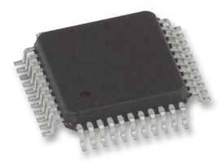
Plastic Packages
Simple plastic packages cheap
Limited number of pins
Limited to perimeter
Limited heat removal (few Watts)
Can be large (due to pins)
Higher inductance on pins
http://wiki.electroons.com/doku.php?id=ic_packages

Slide 22
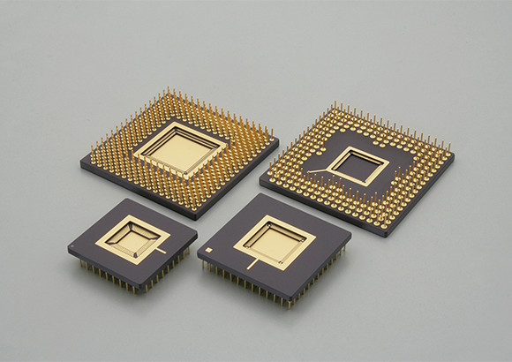
Ceramic Packages
Better thermal characteristics
Add heat-sink, tolerate hotter chips
To 100 W
More pins
More expensive
Source: https://www.ngkntk.co.jp/english/product/semiconductor_packages/htcc.html

Slide 23
Flip Chip Packages
Support Area-IO
More, denser pins
Smaller die if IO limited
Lower inductances
Smaller packaged chip
Source: http://mantravlsi.blogspot.com/2014/10/flip-chip-and-wire-bonding.html

Slide 24
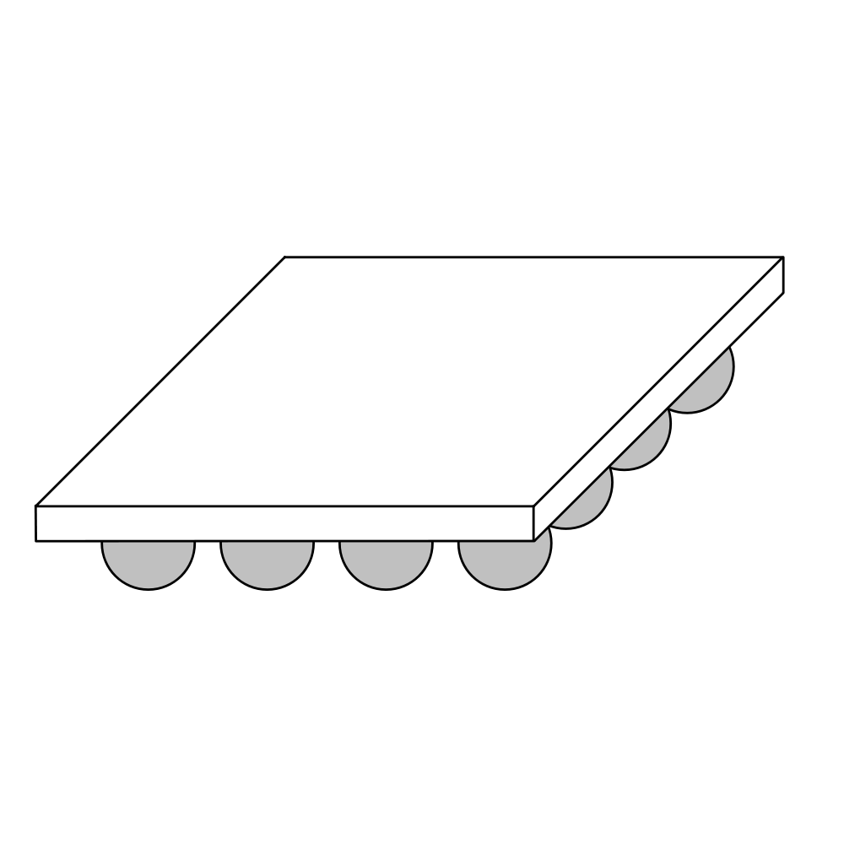
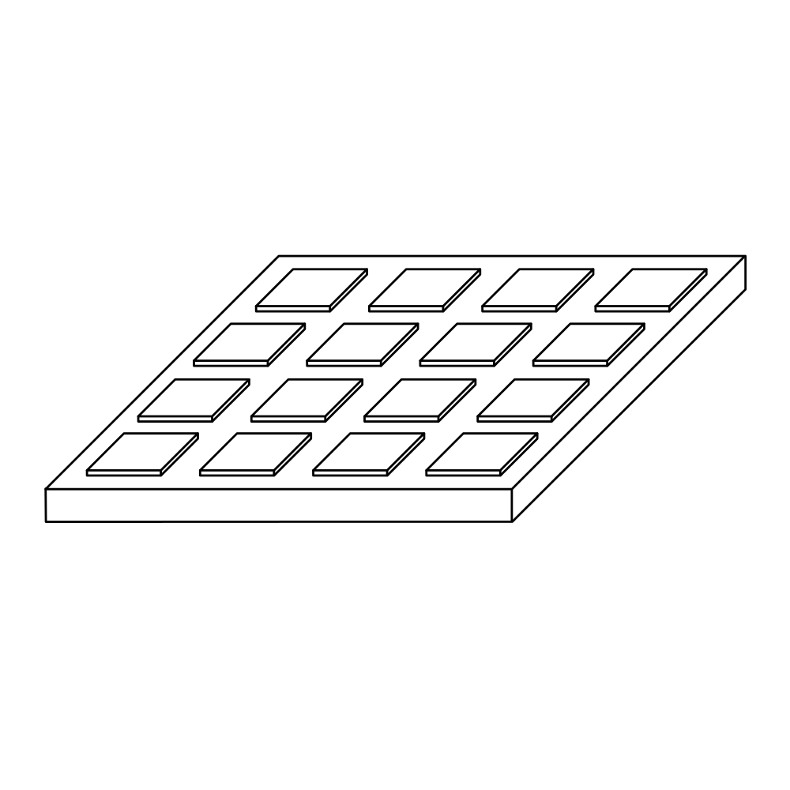
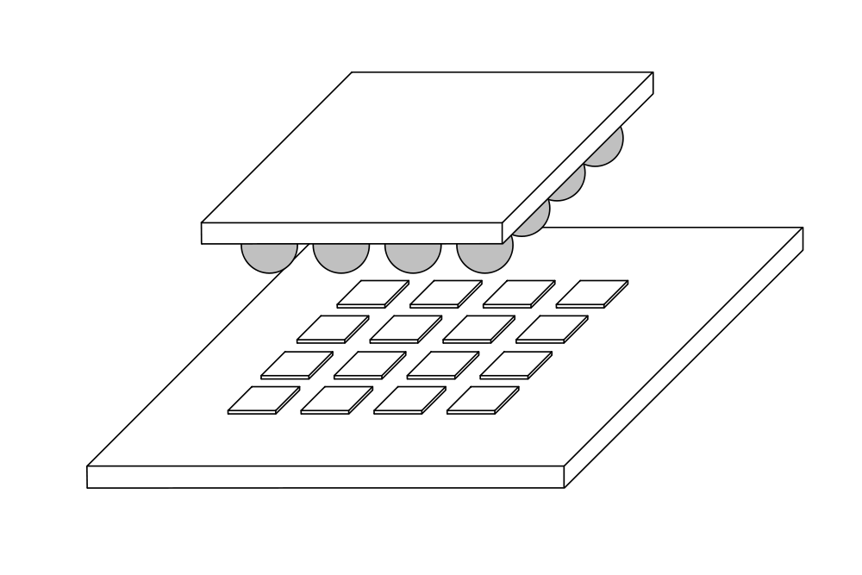
Flip Chip I/O
Source: https://en.wikipedia.org/wiki/Flip_chip

Slide 25
Zynq Land Grid Package

Slide 26
Don’t Forget NRE
This is all about recurring costs
Cost = RecurringCost + (NRE/NumParts)
NRE
Mask costs in millions
Design costs in 10s to 100s of millions

Slide 27
Putting Together
100mm² die -- $5 raw
Maybe $6--13 yielded -- call it $6
NRE $100 M -- $1
Sell 100 M units
Put in $1 packge -- $1
Test -- $1
Total: $9

Slide 28
Price vs. Cost
…and this is all about cost
What it takes to manufacture
Price
What people will pay for it
Profit = Price - Cost

Slide 29
Area

Slide 30
Area
Simple story
Sum up component areas

Slide 31
Too Simplistic
Area may be driven by
I/O
Interconnect
Will need to pay for infrastructure
Clocking, Power

Slide 32
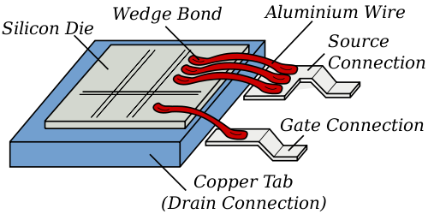
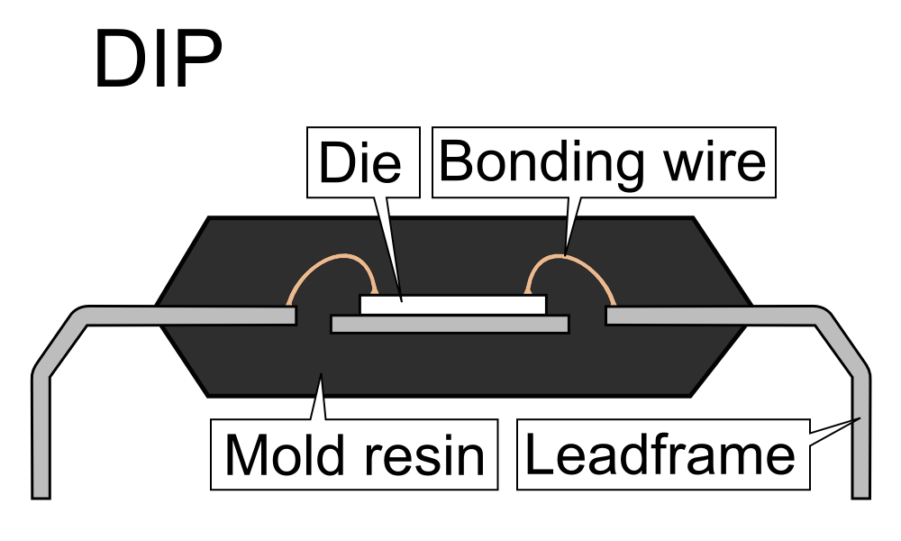
I/O Pads
Must go on edge for wire bonding
Esp. for cheap packages
Src: http://en.wikipedia.org/wiki/File:Wirebonding2.svg
Source: https://commons.wikimedia.org/wiki/File:DIP_package_sideview.PNG

Slide 33
Pad Ring
Pads must go on side of chip
Pad spacing large to permit bonding
I/O pads may set lower bound on chip size

Slide 34
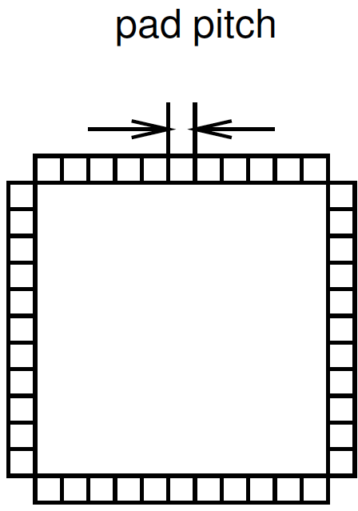
Preclass 4
400 pads
25μm pad spacing
Square chip dimensions?

Slide 35
I/O Limits
Perimeter grows as 4s
Area grows as s²
Area grows (NumIO/4)²
IO may drive chip area

Slide 36
Area I/O
Put I/O in grid over chip
I/O pads still large and take up space
Avoid perimeter scaling
Requires more expensive flip-chip package

Slide 37
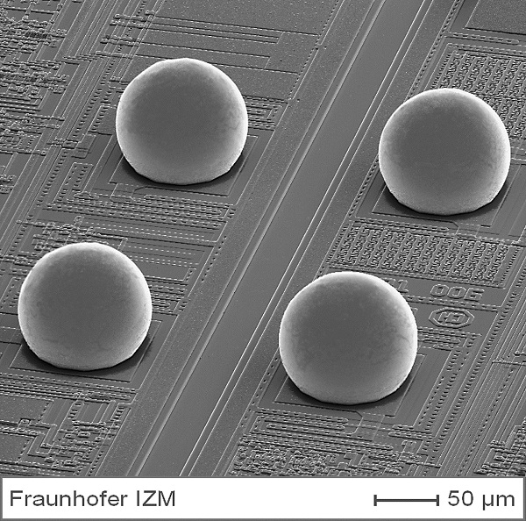
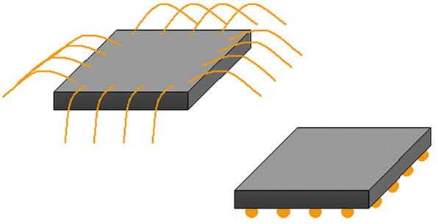
Flip Chip, Area IO
www.microwavejournal.com
http://www.izm.fraunhofer.de/en/abteilungen/high_density_interconnectwaferlevelpackaging/arbeitsgebiete/arbeitsgebiet1.html

Slide 38
Interconnect
Long wires need buffering
Buffers take up space
Weren’t in simple accounting of logic and memory blocks

Slide 39
Interconnect
Wires take up space
Similar issue to pad I/O
Wires crossing into region grow as perimeter
Logic inside grows as area
Region size may be dictated by wires entering/leaving

Slide 40
Wiring Requirements
Wires 50nm pitch
Gates 500nm on side
(500nm x 500nm)
How many gates per row can provide outputs before saturate edge?
(single layer)
What if want more outputs to exit across edge?

Slide 41
Bisection Width
Partition design into two equal size halves
Minimize wires (nets) with ends in both halves
Number of wires crossing is bisection width
Information crossing
lower bw = more locality
N/2
bisection
width
N/2

Slide 42
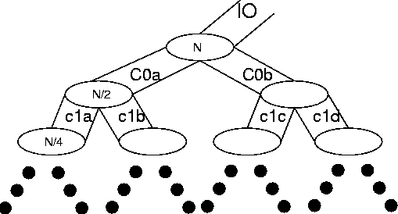
Rent’s Rule
If we recursively bisect a graph, attempting to minimize the cut size, we typically get:
BW=IO = c N^{p}
0≤p≤1
p≤1 means many inputs come from within a partition
[Landman and Russo,
IEEE TR Computers p1469, 1971]

Slide 43
Rent and Locality
Rent and IO quantifying locality
local consumption
local fanout
IO = c N^{p}

Slide 44
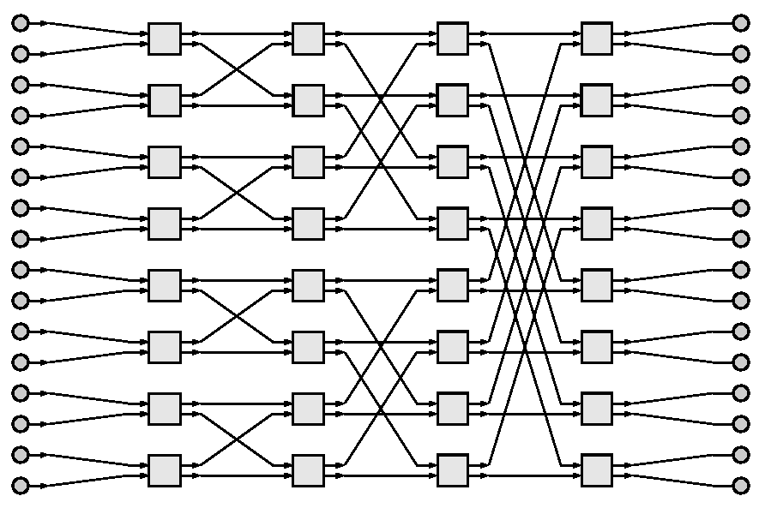
Common Applications
reg
reg
reg
reg
reg
reg
reg
reg
reg
reg
reg
reg
Rent p=0
Shift-register, 1D filter
Rent p=0.5
Array multiplier
2D Window Filter
nearest-neighbor
Rent p=1.0
FFT, Sort
reg
reg
reg
reg
Mpy
bit
Mpy
bit
Mpy
bit
Mpy
bit
Mpy
bit
Mpy
bit
Mpy
bit
Mpy
Bit
Mpy
bit
Mpy
bit
Mpy
bit
Mpy
bit
Mpy
bit
Mpy
bit
Mpy
bit
Mpy
bit

Slide 45
VLSI Interconnect Area
Bisection width is lower-bound on IC width
When wire dominated, may be tight bound
(recursively)
Rent’s Rule tells us how big our chip must be

Slide 46
As a function of Bisection
A_{chip} ≥ N × A_{gate}
A_{chip} ≥ N_{horizontal} W_{wire} × N_{vertical} W_{wire}
N_{horizontal} = N_{vertical} = IO = cN^{p}
A_{chip} ≥ (cN)^{2p}
If p<0.5
A_{chip} ∝ N
If p>0.5
A_{chip} ∝ N^{2p}

Slide 47
In terms of Rent’s Rule
If p<0.5, A_{chip} ∝ N
If p>0.5, A_{chip} ∝ N^{2p}
Typical designs have p>0.5
interconnect dominates
A_{chip} > Σ A_{elements}

Slide 48
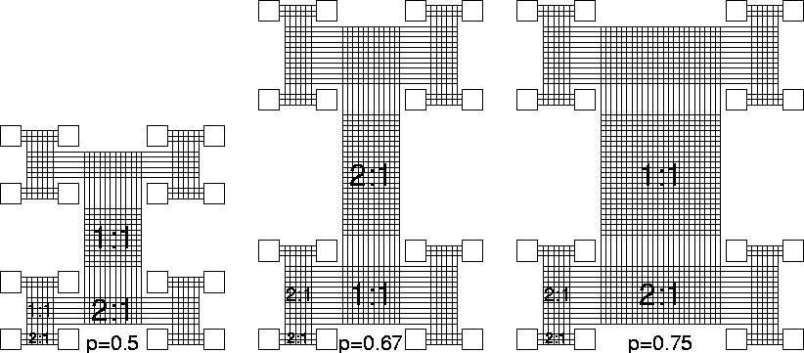
Rent Network Richness

Slide 49
Infrastructure: Clocking
PLL (Phased-Lock-Loop) to generate and synchronize clock
Clock drivers are big (drive big load)
Need buffering all over chip

Slide 50
Infrastructure: Power
Need many I/O Pads
Carry current
Keep inductance low
Wires to distribute over chip
Maybe
Capacitance to stabilize power
Voltage converters

Slide 51
Area
Mostly sum of components, but…
Area may be driven by
I/O
Interconnect A ≥ N^{2p}
Will need to pay for infrastructure
Clocking, Power

Slide 52
Some Areas

Slide 53
Processor Areas
ARM Cortex A9 about 1mm² in 28nm
Zynq processor
SuperScalar core
A5 (scalar) about 0.25mm²
A15 (higher performance) about 3mm²

Slide 54
Zynq Compute Blocks
Crude estimate, including interconnect
2000 6-LUTs per sq. mm
DSP Block ~ 0.1 sq. mm

Slide 55
CACTI
Standard program for modeling memories and caches
More sophisticated version of the simple modeling we’ve been doing
Will ask you to use for custom area estimates (P4 milestone, final report)

Slide 56
CACTI Parameters
Technology
Capacity
Output Width
Ports
Cache ways

Slide 57
Example Output
- Total cache size (bytes): 32768
Number of banks: 1
Associativity: 4
Block size (bytes): 64
Read/write Ports: 1
Read ports: 0
Write ports: 0
Technology size (nm): 32
Access time (ns): 1.09421
Cycle time (ns): 1.25458
Total dynamic read energy per access (nJ): 0.0234295
Total dynamic write energy per access (nJ): 0.018806
Total leakage power of a bank without power gating, including its network outside (mW): 0.00787646
Cache height x width (mm): 0.152304 x 0.523289

Slide 58
CACTI – Memories on Zynq
32nm (closest technology it models to 28nm in Zynq)
36Kb BRAMs 0.025mm
2 port, 72b output
ARM L1 cache 0.08mm
32KB 4-way associative (previous slide)
ARM L2 cache 1.5 mm
512KB 8-way associative

Slide 59
Zynq Component Estimates
6-LUT 0.0005 mm²
DSP Block 0.1 mm²
36Kb BRAMs 0.025mm²
ARM L1 cache 0.08mm²
ARM L2 cache 1.5 mm²
ARM Cortex A9 1.0 mm²

Slide 60
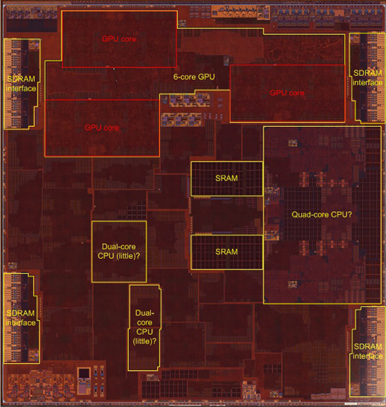
Apple A10
Quad=Dual Dual Core
Dual 64-bit ARM 2.3GHz
Dual 64-bit ARM low energy
3MB L2 cache
6 GPU cores
Custom accelerators
Image Processor?
125mm² 16nm FinFET
3.3B transistors
Chipworks Die Photo

Slide 61
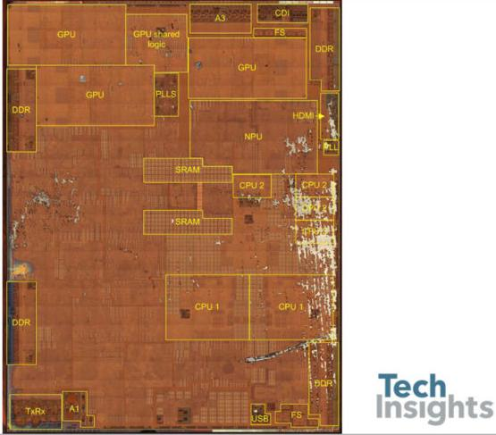
Apple A11
90mm² 10nm FinFET
4.3B transistors
iPhone 8, 8s, X
6 ARM cores
2 fast (2.4GHz)
4 low energy
3 custom GPUs
Neural Engine
600 Bops?
Motion, image accel.
8MB L2 cache
https://wccftech.com/apple-iphone-8-plus-a11-bionic-complete-teardown/

Slide 62
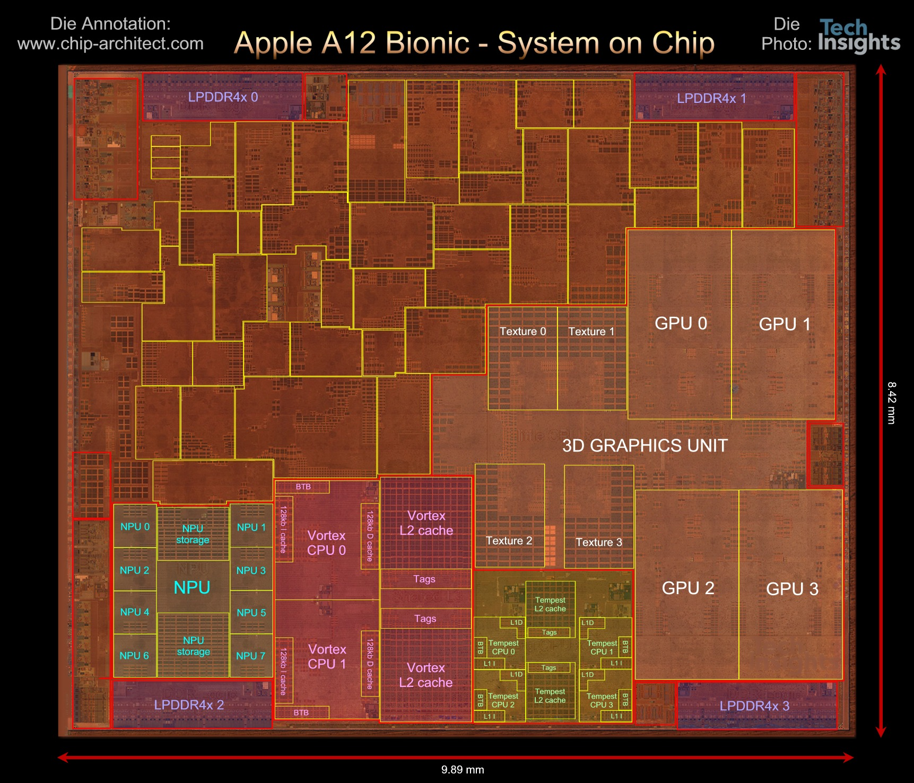

Slide 63
Apple A12
84mm², 7nm
7 Billion Tr.
iPhone XS
6 ARM cores
2 fast
4 low energy
4 custom GPUs
Neural Engine
5 Trillion ops/s?

Slide 64
A12 Die Areas
https://www.anandtech.com/print/13393/techinsights-publishes-apple-a12-die-shot-our-take

Slide 65
Big Ideas
First order:
Chip cost proportional to Area
Area = Sum(Area(Components))
But appreciate the simplification:
Yield makes cost superlinear in area
Limited range over which “linear” accurate
I/O, Interconnect, infrastructure
Can make Area > Sum(Area(Components))

Slide 66
Admin
Tomorrow
Is a virtual Thursday
There are TA office hours
I will have “Tuesday” office hours
But running to airport right at 5:25pm
Wednesday is a virtual “Friday”
No lecture
Friday is a Holiday – no milestone due
P4 due Friday, Nov. 30th
Proj. supplement – additional instructions for turnin and run final proj.

