Slide 1
ESE532: System-on-a-Chip Architecture
Day 24: November 26, 2018
Real Time Scheduling

Slide 2
Today
Real Time
Synchronous Reactive Model
Interrupts
Polling alternative
Timer?
Resource Scheduling Graphs

Slide 3
Message
Scheduling is key to real time
Analysis
Guarantees

Slide 4
Synchronous Circuit Model
A simple synchronous circuit is a good “model” for real-time task
Run at fixed clock rate
Take input every cycle
Produce output every cycle
Complete computation between input and output
Designed to run at fixed-frequency
Critical path meets frequency requirement

Slide 5
Synchronous Reactive Model
Discipline for Real-Time tasks
Embodies “synchronous circuit model”

Slide 6
Synchronous Reactive
There is a rate for interaction with external world (like the clock)
Computation scheduled around these clock ticks (or time-slices)
Continuously running threads
Each thread performs action per tick
Inputs and outputs processed at this rate
Computation can “react” to events
Reactions finite and processed before next tick

Slide 7
Thread Form
while (1) { tick(); }
tick() -- yields after doing its work
May be state machine
May change state and have different behavior based on state
May trigger actions to respond to events (inputs)

Slide 8
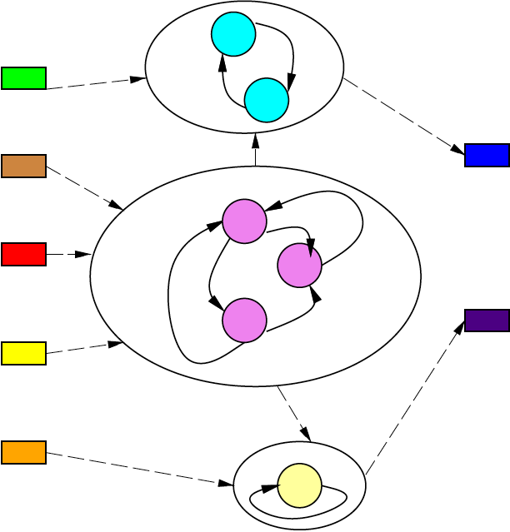
Thread Model

Slide 9
Preclass 1
Typical real-world interaction times?
Video frame output?
Video game input?
Anti-lock brakes, cruise-control?

Slide 10
Tick Rate
Driven by application – demands of external control
Control loop 100 Hz
Robot, airplane, car, manufacturing plant
Video at 33 fps
Game with 20ms response
Router with 1ms packet latency
12μs

Slide 11
Tick Rate
Multiple rates
May need master tick as least-common multiple of set of interaction rates
…and lower freq. events scheduled less frequently
E.g. 100Hz control loop and 33Hz video
Master at 10ms
Schedule video over 3 10ms time-slots
May force decompose into tasks fit into smaller time window since must schedule events at highest frequency

Slide 12
Synchronous Reactive
Ideal model
Per tick reaction (task processing) instantaneous
Separate function from compute time
Separate function from technology
Feature size, processor mapped to
Like synchronous circuit
If logic correct, works when run clock slow enough
Works functionally when change technology
Then focus on reducing critical path
→ making timing work

Slide 13
Timing and Function
Why want to separate function from technology and timing?
What happens when get faster (slower) processor?

Slide 14
Synchronous Reactive Timing
Once functional,
need to guarantee all tasks (in all states)
Can complete in tick time-slot
On particular target architecture
Identify WCET (worst-case execution time)
Like critical path in FSM circuit
Time of task on processor target

Slide 15
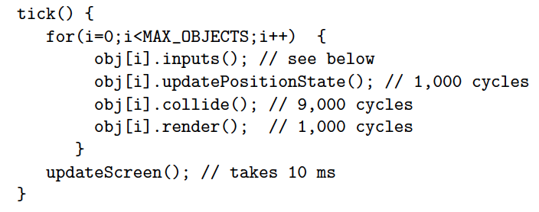
Preclass 2
Time available to process objects?

Slide 16
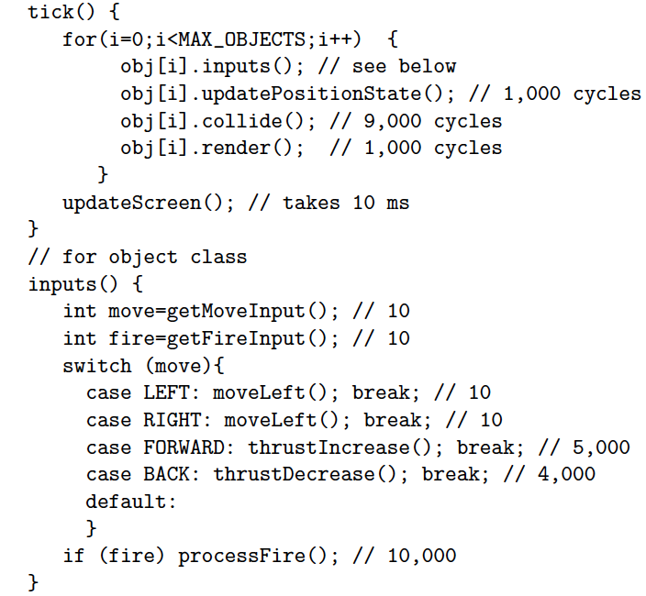
Preclass 2
Worst-case object processing time?

Slide 17
Preclass 2
Maximum number of objects on single GHz processor?

Slide 18
Synchronous Reactive Timing
Once functional,
need to guarantee all tasks (in all states) can complete in tick time-slot
On particular target architecture
Identify WCET
Like critical path in FSM circuit
Time of task on processor target
Schedule onto platform
Threads onto processor(s)

Slide 19
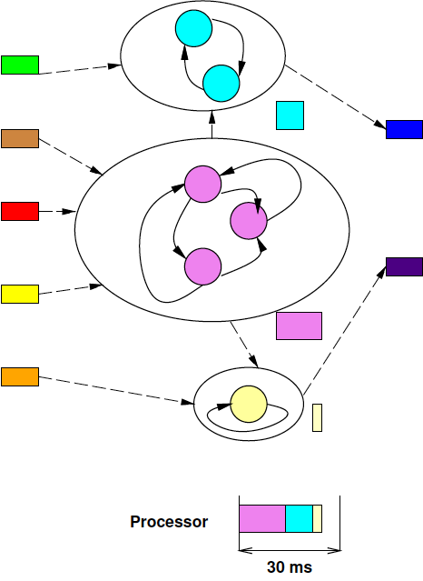
Threads Mapped to Processor

Slide 20
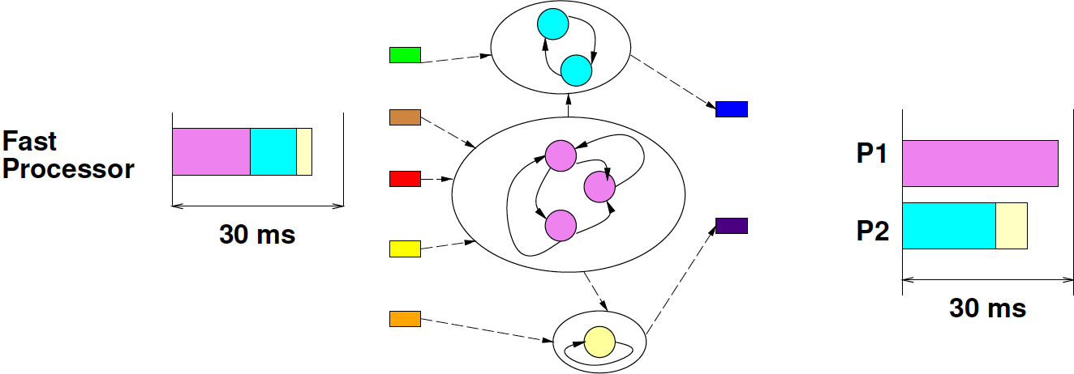
Platforms
Platform 1: fast processor
Platform 2: many slow processors

Slide 21
Synchronous Reactive Model
Discipline for Real-time tasks
Embodies the “synchronous circuit model”
Master clock rate
Computation decomposed per clock
Functionality assuming instantaneous compute
On platform, guarantee runs fast enough to complete critical path at “clock” rate

Slide 22
Interrupts

Slide 23
Interrupt
External event that redirects processor flow of control
Typically forces a thread switch
Common for I/O, Timers
Indicate a need for attention

Slide 24
Interrupts
Why would we use interrupts for I/O?

Slide 25
Interrupts: Good
Allow processor to run some other work
Infrequent, irregular task service with low response service latency
Low latency
Low throughput

Slide 26
Interrupts: Bad
Time predictability
Real-time for computing tasks interrupted
Processor usage
Costs time to switch contexts
Concurrency management
Must deal with tasks executing non-atomically
Interleave of interrupted service tasks
Perhaps interleave of any task

Slide 27
Polling Discipline
Alternate to I/O interrupts
Every I/O task is a thread
Budget time and rate it needs to run
E.g. 10,000 cycles every 5ms
Likely tied to
Buffer sizes
Response latency
Schedule I/O threads as real-time tasks
Some can be DMA channels

Slide 28
IO Thread
while (1) { process_input(); }
Like tick() -- yields after doing its work

Slide 29
Preclass 3
Input at 100KB/s
30ms time-slot window
Size of buffer?
100 cycles/byte, GHz processor – runtime of service routine?
Fraction of processor capacity?

Slide 30
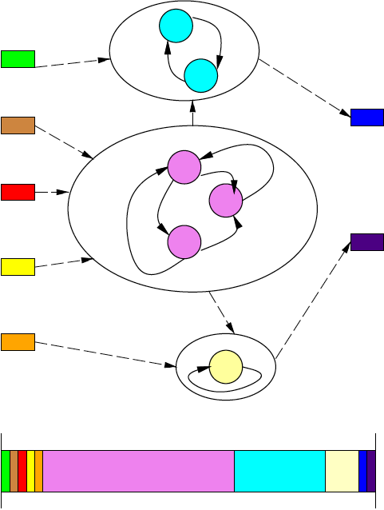
Scheduling I/O Tasks

Slide 31
Timer Interrupts
Why do we have timer interrupts in conventional operating systems?
E.g. in linux?

Slide 32
Timer Interrupts
Best effort tasks (i.e. non-real-time tasks)
Have no guarantee to finish in bounded time
Timer interrupts necessary
to allow other threads to run
fairness
to switch to real-time service tasks
Need timer interrupts if need to share processor with real-time threads
Alternate: Easier to segregate real-time and best-effort threads onto different processors

Slide 33
Timer Interrupts?
Bounded-time tasks
E.g. reactive tasks in real-time
Task has guarantee to release processor within time window
Not need timer interrupts to regain control from task
(Maybe use deadline operations [Day9] for timer)

Slide 34
Greedy Strategy
Schedule real-time tasks
Scheduled based on worst-case, so may not use all time allocated
Run best-effort tasks at end of time-slice after complete real-time tasks
Timer-interrupt to recover processor in time for start of next scheduling time slot
(adds complexity)

Slide 35
Real-Time Tasks
Interrupts less attractive
More disruptive
Scheduled polling better predictability
Fits with Synchronous Reactive Model

Slide 36
Resource Scheduling Graphs

Slide 37
Scheduling
Useful to think about scheduling a processor by task usage
Useful to budget and co-schedule required resources
Bus
Memory port
DMA channel

Slide 38
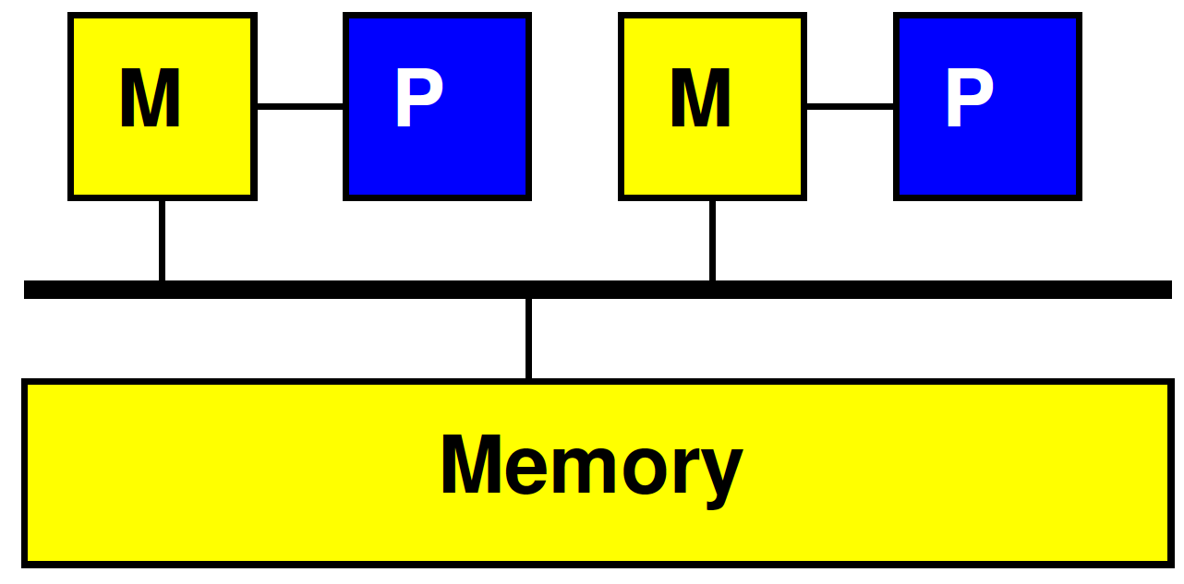
Simple Task Model
Task requires
Data to be transferred
Local storage state
Computational cycles
(Result data to be transferred)
Uses resources
Bus/channel to transfer data
(in and out)
Space in memory on accelerator
Cycles on accelerator

Slide 39
One Task
P1
P2
Bus
Mem

Slide 40
Several Tasks
Resource | 0 | 1 | 2 | 3 | 4 | 5 | 6 | 7 | 8
P1
P2
Bus
Mem

Slide 41
Resource Schedule Graph
Extend as necessary to capture potentially limiting resources and usage
Regions in memories
Memory ports
I/O channels

Slide 42
Extended Details
Resource | 0 | 1 | 2 | 3 | 4 | 5 | 6 | 7 | 8
P1
P1 M0
P1 M1
P2
P2 M0
P2 M1
Bus1
Bus2
OCM
DRAM

Slide 43
Several Tasks
Resource | 0 | 1 | 2 | 3 | 4 | 5 | 6 | 7 | 8
P1
P1 M0
P1 M1
P2
P2 M0
P2 M1
Bus1
Bus2
OCM
DRAM

Slide 44
Approach
Ideal/initial – look at processing requirements
Resource bound on processing
Look for bottlenecks / limits with Resource Bounds independently
Add buses, memories, etc.
Plan/schedule with Resource Schedule Graph

Slide 45
Preclass 4a
Resource Bound
Data movement over bus?
Compute on 2 processors?
Compute on 2 processors when processor must wait while local memory is written?

Slide 46
Preclass 4b Schedule
Processor wait for data load

Slide 47
Double Buffering
Common trick to overlap compute and communication
Reserve two buffers input (output)
Alternate buffer use for input
Producer fills one buffer while consumer working from the other
Swap between tasks
Tradeoff memory for concurrency

Slide 48
Preclass 4c Schedule
Double Buffer
Minimum local memory space required?

Slide 49
Resource Schedule Graphs
Useful to plan/visualize resource sharing and bottlenecks in SoC
Supports scheduling
Necessary for real-time scheduling

Slide 50
Big Ideas:
Scheduling is key to real time
Analysis, Guarantees
Synchronous reactive
Scheduling worst-case tasks “reactions” into master time-slice matching rate
Schedule I/O with polling threads
Avoid interrupts
Schedule dependent resources
Buses, memory ports, memory regions…

Slide 51
Admin
P4 due Friday

