Slide 1
ESE532: System-on-a-Chip Architecture
Day 25: November 28, 2018
Network-on-a-Chip (NoC)

Slide 2
Today
Ring
2D Mesh Networks
Design Issues
Buffering and deflection
Dynamic and static routing

Slide 3
Message
Scalable interconnect for locality
has rich design space
Customize to compute and application
Support real-time with static scheduled communication

Slide 4
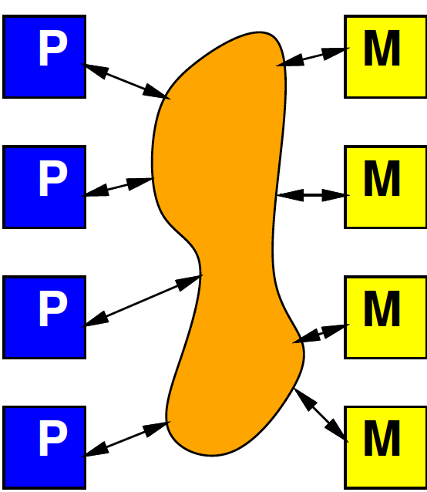
Interconnect
Day 12
Will need an infrastructure for programmable connections
Rich design space to tune area-bandwidth-locality
Will explore more later in course

Slide 5
Interconnect Concerns
Avoid being a bottleneck
Bandwidth
Latency
Competes for area and energy
against compute and memory

Slide 6
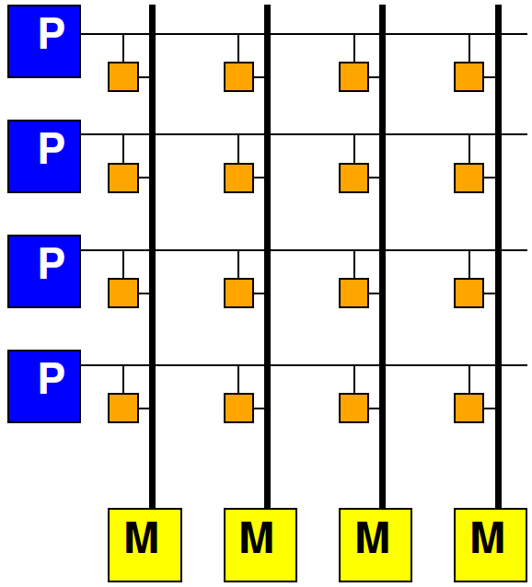
Crossbar
Connect any I inputs, O outputs
Area ~ I×O
For N PEs scale as N²

Slide 7
Today’s SoC Large
At 0.4mm² small core on Apple A12
can put 250 on 1cm² chip
Intel Knight’s Bridge with 76 PEs
120 core MIPS on Stratix V FPGA
FPGA 2017
1680 core RISC-V on Xilinx Ultrascale
http://fpga.org/2017/01/12/grvi-phalanx-joins-the-kilocore-club/
Scaling to 100s and 1000s of processing elements (PEs) that need interconnect

Slide 8
Locality
Delay and energy proportional to distance
Want to keep communications short
Data near compute
From compute block to compute block
How build network?
Scalable (Area ~ N = things connected?)
Supports locality

Slide 9
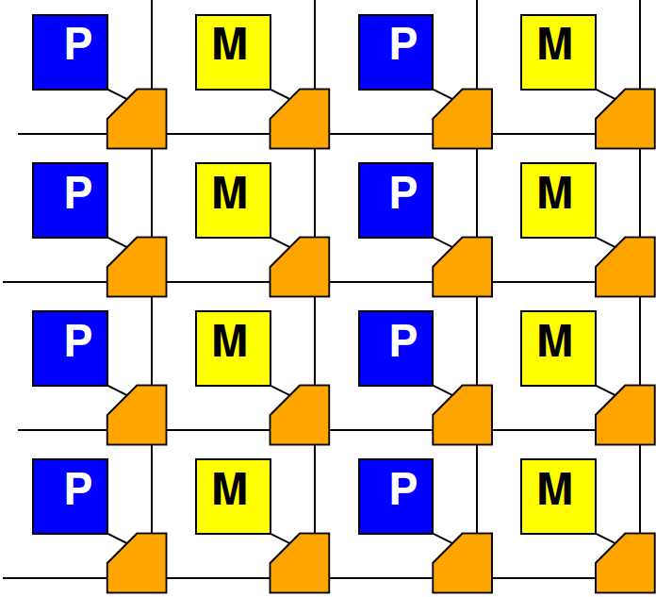
Mesh
Day 12

Slide 10
Bus to Ring

Slide 11
Ring

Slide 12
Preclass 1
Traffic pattern
Similar bandwidth?
One has higher bandwidth?

Slide 13
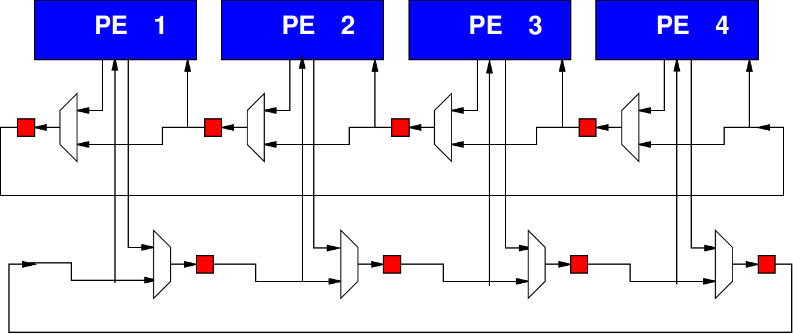
Bidirectional Ring

Slide 14
Interleaved Layout
What problem does the bottom layout solve (compared to top)?

Slide 15
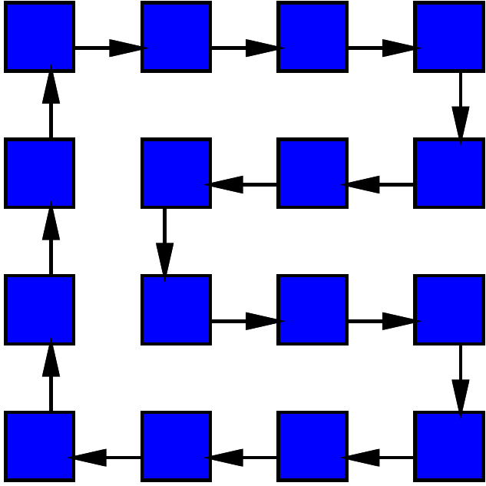
2D Layout

Slide 16
Scaling
How does area scale with N?
How does neighbor distance scale with N?
Unidirectional
bidirectional
How does worst-case distance in ring scale with N?
Unidirectional
bidirectional

Slide 17
1D to 2D

Slide 18
Ring Abstract

Slide 19
Row and Column Rings

Slide 20
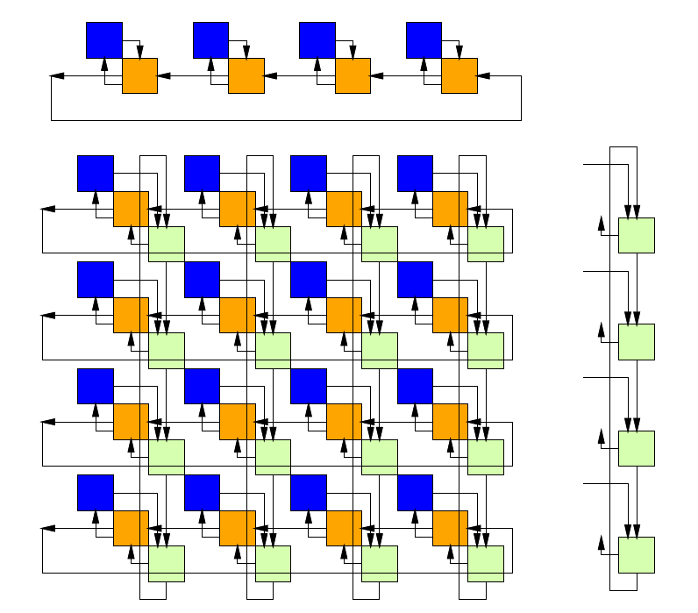
Mesh as Row & Column Rings

Slide 21
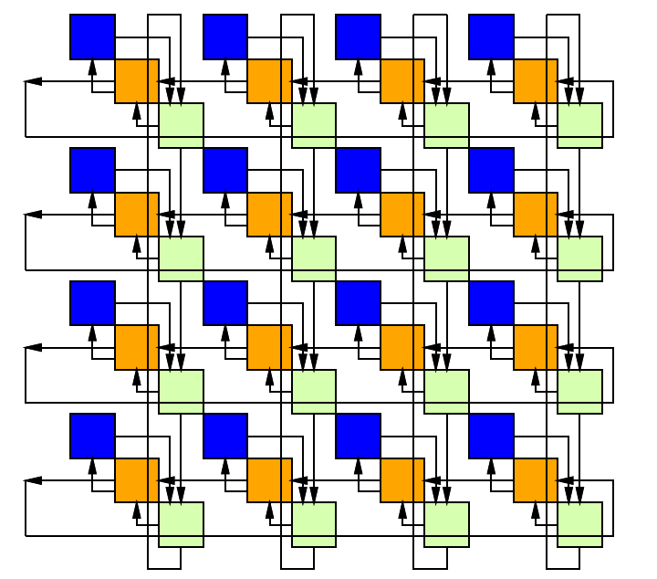
Directional Mesh (Torus)

Slide 22
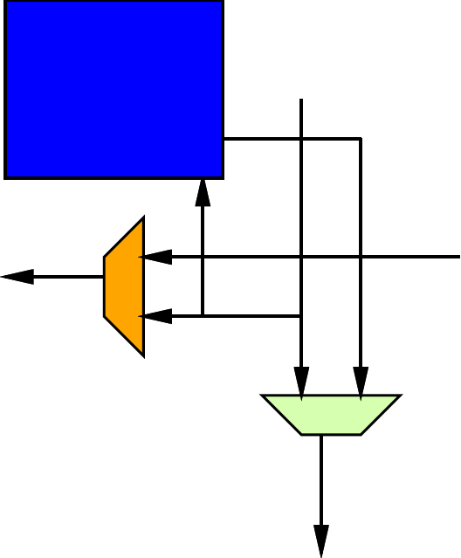
Mesh Datapath

Slide 23
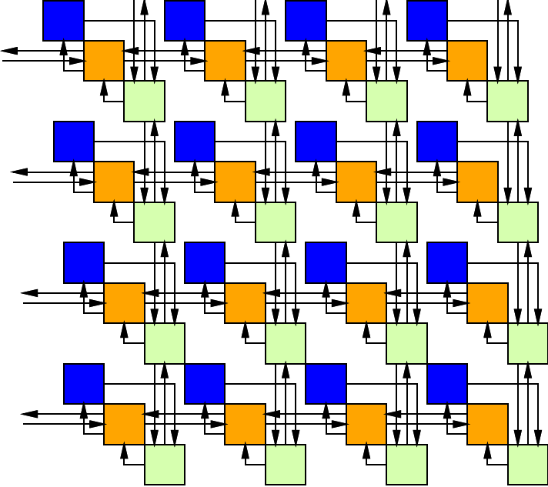
Bidirectional Mesh

Slide 24
2D Mesh Scaling
How does area scale with N?
How does neighbor distance scale with N?
How does worst-case distance in mesh scale with N?

Slide 25
Specifying Destination
Simple: add destination address
Ring or Mesh wires carry:
Valid bit + Address + Payload (Data)

Slide 26
Mesh Routing
Route in Y until reach row
Then route in X until reach column
Consume from PE when arrives

Slide 27
Mesh Routing
Yin
Xin
Xout
Yout
Yout=Yin.valid & row(Yin.address)!=row & Yin + Pin.valid & P
Xout=Xin.valid & column(Xin.address)!=column & Xin + Yin.valid & row(Yin.address==row)
Not deal with congestion

Slide 28
Mesh Routing
Yout=Yin.valid & row(Yin.address)!=row & Yin + Pin.valid & P
Xout=Xin.valid & column(Xin.address)!=column & Xin + Yin.valid & row(Yin.address==row)
Complexity of route function can impact
Area, cycle time, route latency

Slide 29
Mesh Congestion

Slide 30
Mesh Congest
What happens when inputs from 2 sides want to travel out same output?
(here Xin, Yin)

Slide 31
Dealing with Congestion
Don’t let it happen (offline/static)
Schedule to avoid
Online/dynamic
Store in place -- Buffer
Misroute -- Deflect

Slide 32
Congestion 1D
For simplicity, we look at congestion in 1D case (Preclass 2)

Slide 33
Preclass 2ab
Complete table – identify uncongested latencies
Worst-case?

Slide 34
Preclass 2c
Cycles from simulation?

Slide 35
Observe
Did have congestion
Ran slower than the single-link case (2b)
How we make decisions matters
Who gets to route, which is stalled
Best, global decision can be better than local decisions

Slide 36
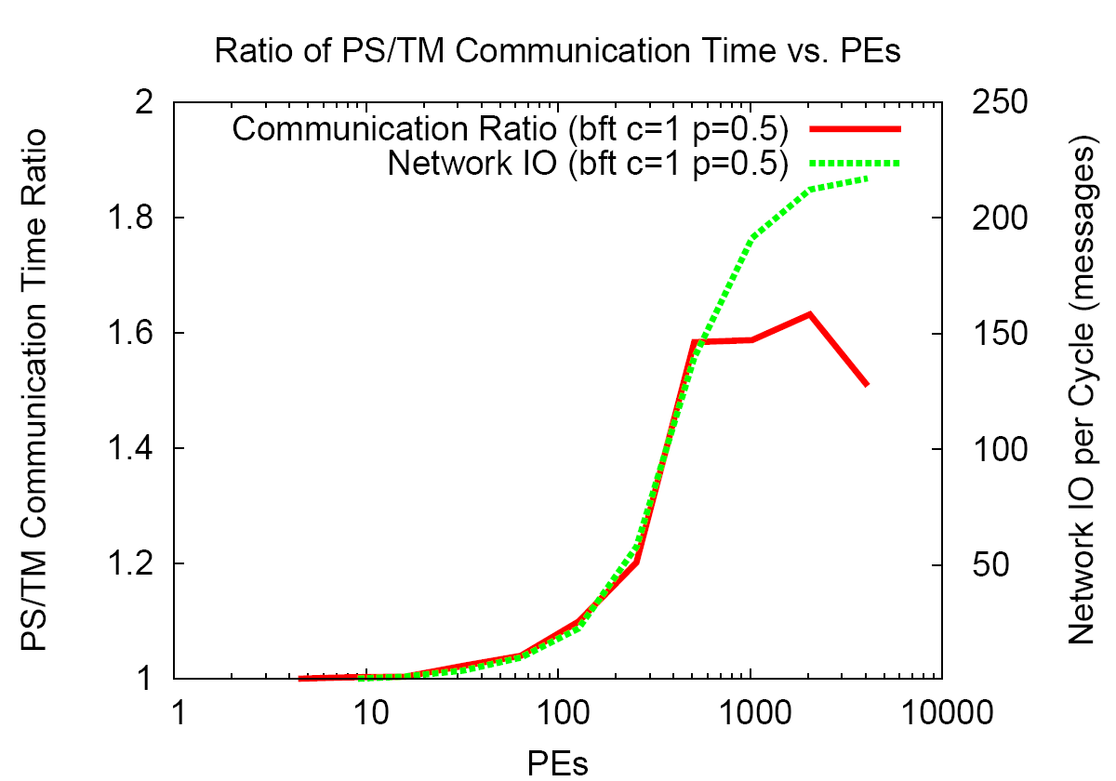
Offline vs. Online
[Kapre et al., FCCM 200]

Slide 37
Dealing with Congestion
Don’t let it happen (offline/static)
Schedule to avoid
Online/dynamic
Store in place -- Buffer
Misroute -- Deflect

Slide 38
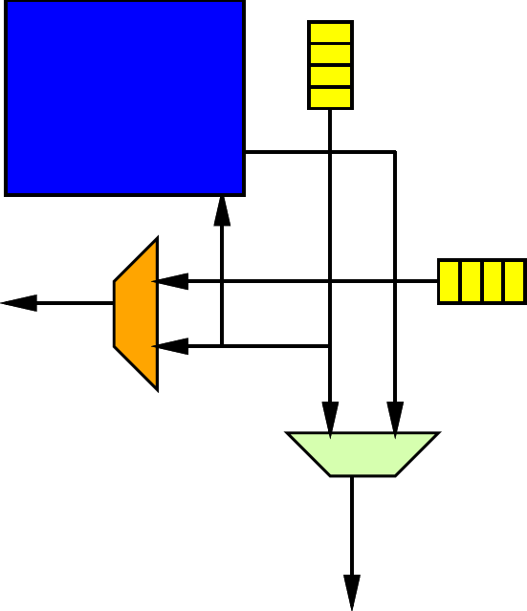
Congestion: Buffer
Store inputs that must wait until path available
Typically store in FIFO buffer
How big do we make the FIFO?
FIFO Buffers cost space
Often more than multiplexers

Slide 39
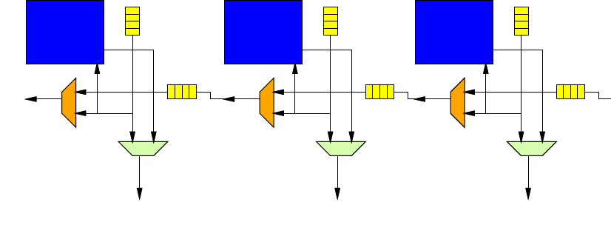
Congestion: Buffer
Store inputs that must wait until path available
Typically store in FIFO buffer
How big do we make the FIFO?
What if FIFO full?

Slide 40
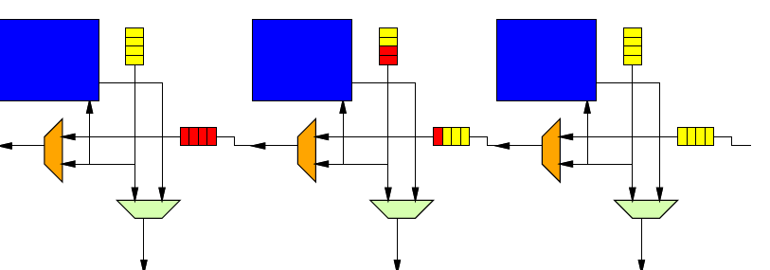
Congestion: Buffer
Store inputs that must wait until path available
Typically store in FIFO buffer
How big do we make the FIFO?
What if FIFO full?

Slide 41
Congestion: Deflect
Misroute: (deflection routing)
Send in to an available (wrong) direction
Avoid Buffer
Requires balance of ins and outs
Can make work on mesh
How much more traffic do we create misrouting?

Slide 42
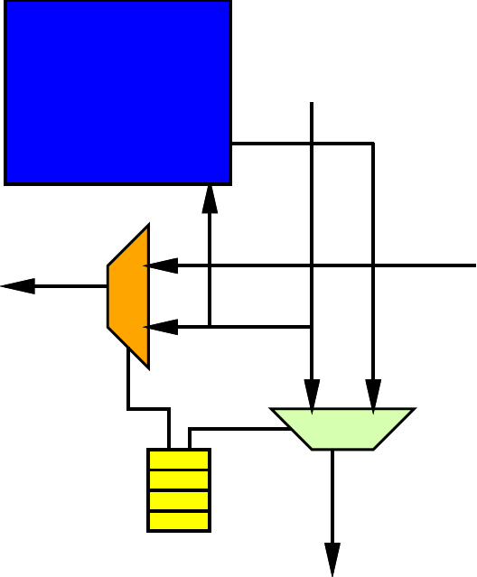
Static Schedule
Store per-cycle instruction for switch
Doesn’t need address header on route
Local memories control destination

Slide 43
Alternate Static Schedule
Control injection cycle from processor so never have conflict
Simple datapath logic to select available data
Needs address header on routed data

Slide 44
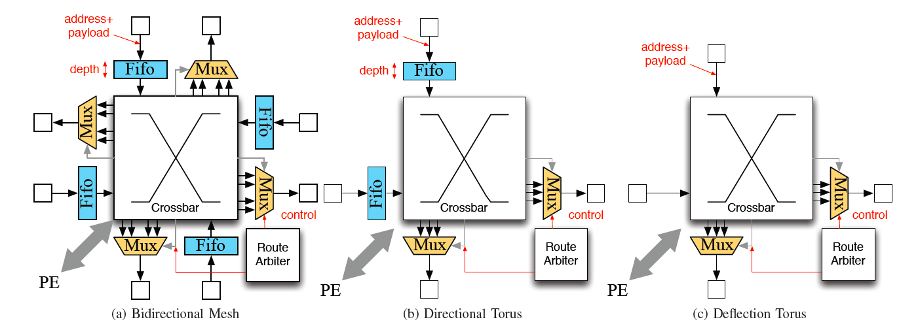
Mesh Packet Switched 32b
Bidirectional FIFO
bidrectional
1800 LUTs
Deflection (bufferless)
undirectional
60 LUTs
Big difference in area costs.
Need to look at area and benefits.
[Kapre+Gray, FPL 2015]

Slide 45
Deflection Route
What concerns might we have about deflection route?

Slide 46
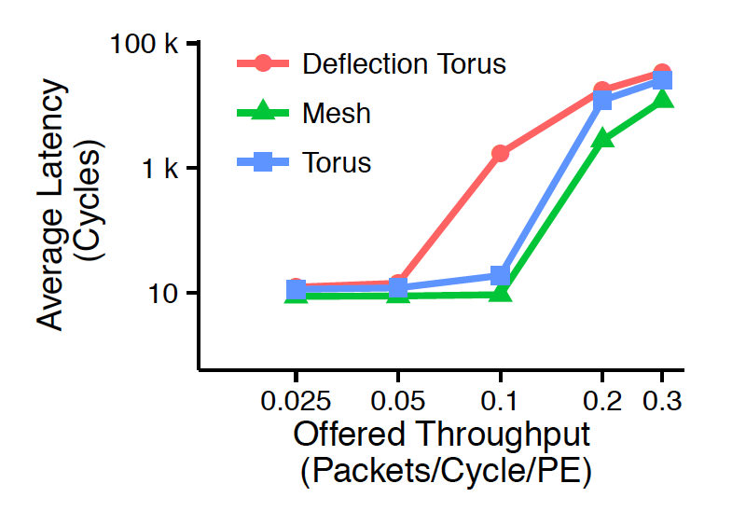
Buffer vs. Deflection
[Kapre+Gray, FPL 2015]

Slide 47
Tuning
How could we increase bandwidth to better handle high throughput?
Especially when the switches are small
Mesh switch 1800
Deflection Torus 60

Slide 48
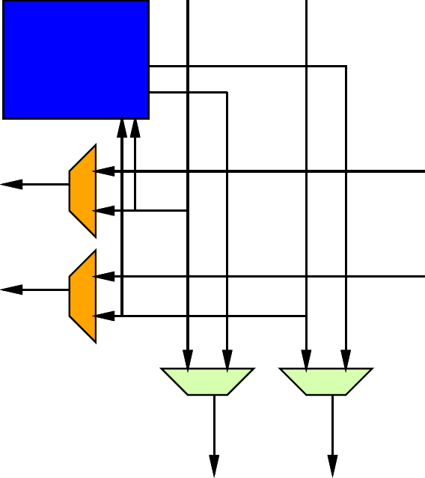
Tune Bandwidth
Add channels to tune bandwidth
Rings per row, column
Single deflection channel ~60
…two around 120 … still << 1800

Slide 49
Take 2, they are small
[Kapre+Gray, FPL 2015]

Slide 50
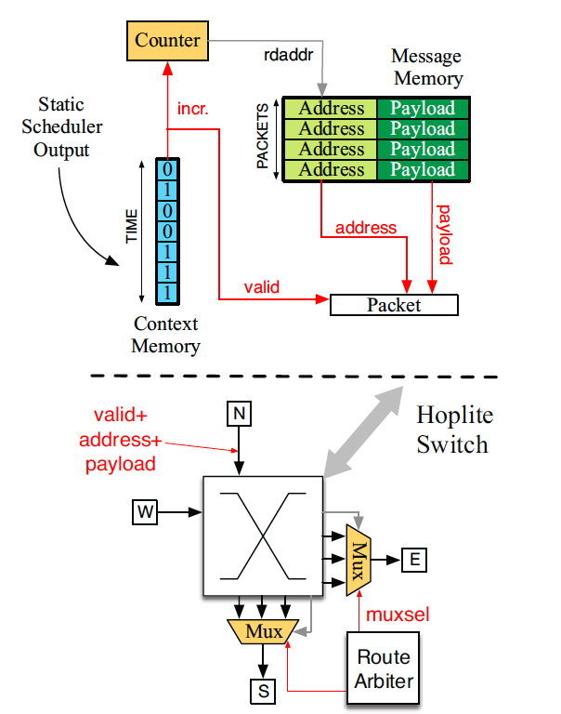
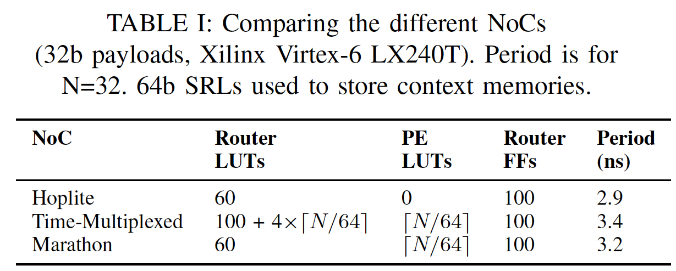
Mesh Area Deflection PS/TM
Hoplite = Deflection
Marathon = Deflection + static schedule at source
[Kapre FCCM 2015]

Slide 51
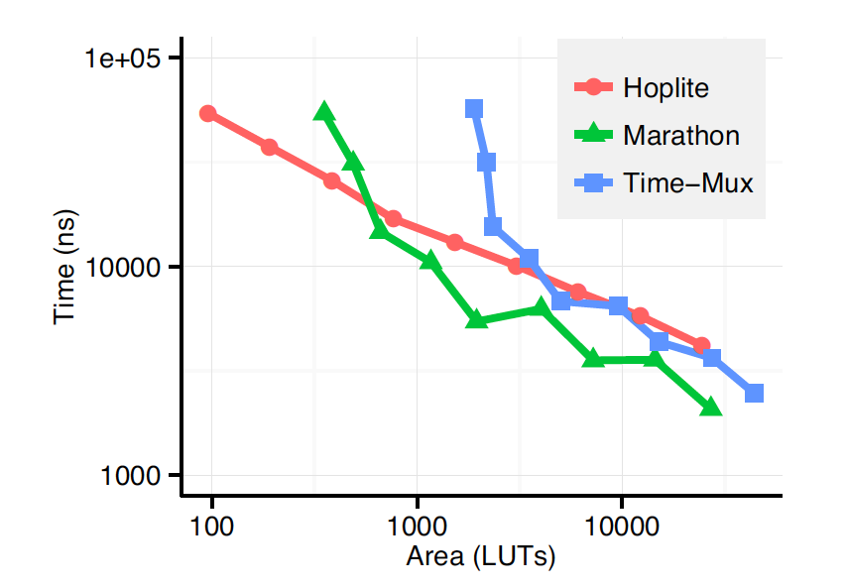
Static Schedule vs. Deflection
Deflection
Scheduled Deflection
[Kapre FCCM 2015]

Slide 52
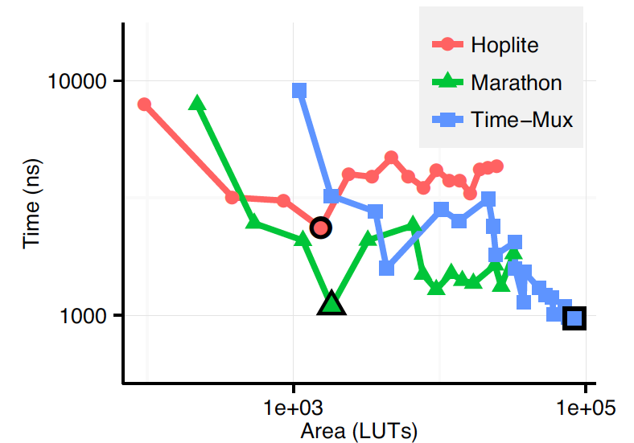
Static Schedule vs. Deflection
Routing 142K message add20 benchmark
Marathon statically schedule PS
Deflection
Scheduled Deflection
[Kapre FCCM 2015]

Slide 53
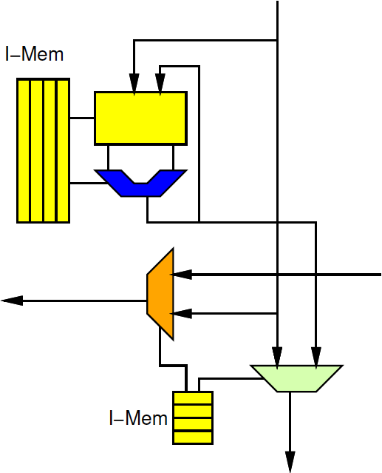
Large VLIW
Natural to use static network with VLIW clusters
Network routing becomes part of long instruction word
Schedule with computation
Extreme one operator per mesh PE
Tune bandwidth by clustering

Slide 54
Mesh Customization

Slide 55
Tuning Down
What could we do to reduce area if we needed less bandwidth?

Slide 56
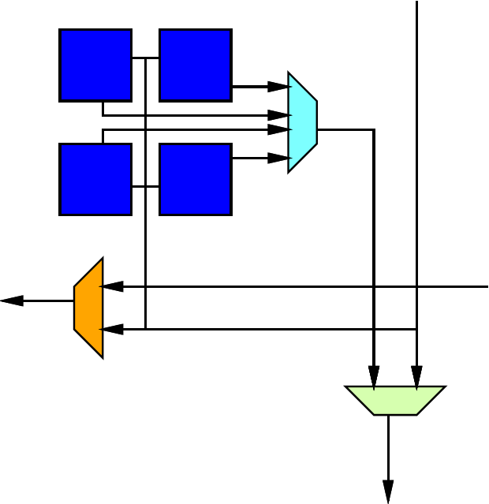
Tuning Down Bandwidth
If need less bandwidth, cluster multiple PEs to share a router.

Slide 57
Simple Bandwidth/Area Control
Width of channels
Like SIMD
All bits going to same destination

Slide 58
Packets
Simple story is, each “word” routed on mesh is: address+payload
Alternately:
Multiword packet with single address
Share “address” across larger payload
Control width of datapath separate from size of payload
Additional control issues to route packet together and buffer

Slide 59
Customization
Bandwidth
Width, clustering, channels
Directional/Bidirectional
Online dynamic/offline static
Buffer/deflect
Buffer depth
Route function sophistication

Slide 60
Big Ideas
Scalable interconnect for locality
Has rich design space
Customize to compute and application
Support real-time with static scheduled communication

Slide 61
Admin
P4 Due Friday

