Slide 1

ESE532:
System-on-a-Chip Architecture
Day 26: December 3, 2018
Defect Tolerance

Slide 2
Today
Reliability Challenges
Defect Tolerance
  Memories
  Interconnect
  FPGA
FPGA Variation and Energy
  (time permitting)

Slide 3
Message
At small feature sizes, not viable to demand perfect fabrication of billions of transistors on a chip
Modern ICs are like snowflakes
  Everyone is different, changes over time
Reconfiguration allows repair
  Finer grain → higher defect rates
  Tolerate variation → lower energy

Slide 4
Intel Xeon Phi Offerings
Part # | Cores
7290F | 72
7250F | 68
7230F | 64
http://www.intel.com/content/www/us/en/products/processors/xeon-phi/xeon-phi-processors.html

Slide 5
Intel Xeon Phi Offerings
Part # | Cores
7290F | 72
7250F | 68
7230F | 64
Is Intel producing 3 separate chips?

Slide 6
Preclass 1 and
Intel Xeon Phi Offerings
Part # | Cores
7290F | 72
7250F | 68
7230F | 64
Cost ratio between 72 and 64 processor
assuming fixed mm² per core?

Slide 7

Intel Xeon Phi Pricing

Slide 8
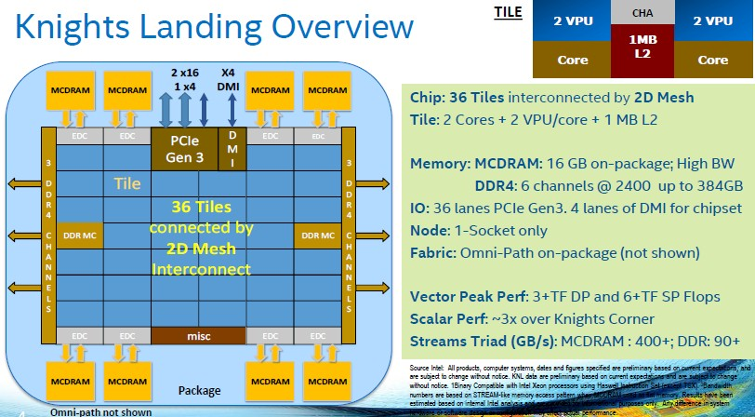
Intel Knights Landing
https://www.nextplatform.com/2016/06/20/intel-knights-landing-yields-big-bang-buck-jump/
[Intel, Micro 2016]

Slide 9
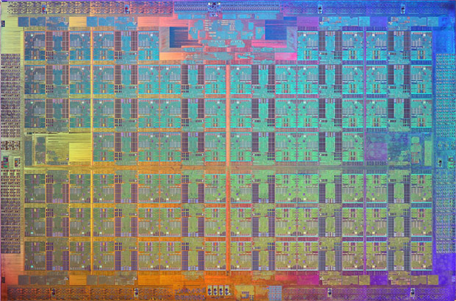
Knights Landing Xeon Phi
[Intel, Micro 2016]

Slide 10
What’s happening?
Fabricated chip has 76 cores
Not expect all to work
Selling based on functional cores
  72, 68, 64
Charge premium for high core counts
  Don’t yield as often, people pay more
Do see design to accommodate defects
https://www.nextplatform.com/2016/08/22/intel-tweaking-xeon-phi-deep-learning/
[Intel, Micro 2016]

Slide 11
Warmup Discussion
Where else do we guard against defects today?
  Where do we accept imperfection today?

Slide 12
Motivation: Probabilities
Given:
  N objects
  P_{g} yield probability
What’s the probability for yield of composite system of N items? [Preclass 2]
  Assume iid (independent, identically distributed) faults
  P(N items good) = (P_{g})^{N}

Slide 13
Probabilities
  P_{all_good}(N)= (P_{g})^{N}
P=0.999999
N | P_{all_good}(N)
10⁴
10⁵
10⁶
10⁷

Slide 14
Probabilities
  P_{all_good}(N)= (P_{g})^{N}
P=0.999999
N | P_{all_good}(N)
10⁴ | 0.99
10⁵ | 0.90
10⁶ | 0.37
10⁷ | 0.000045

Slide 15
Simple Implications
As N gets large
  must either increase reliability
  …or start tolerating failures
N
  memory bits
  disk sectors
  wires
  transmitted data bits
  processors
  transistors
  molecules
As devices get smaller, failure rates increase
chemists think P=0.95 is good
As devices get faster, failure rate increases

Slide 16
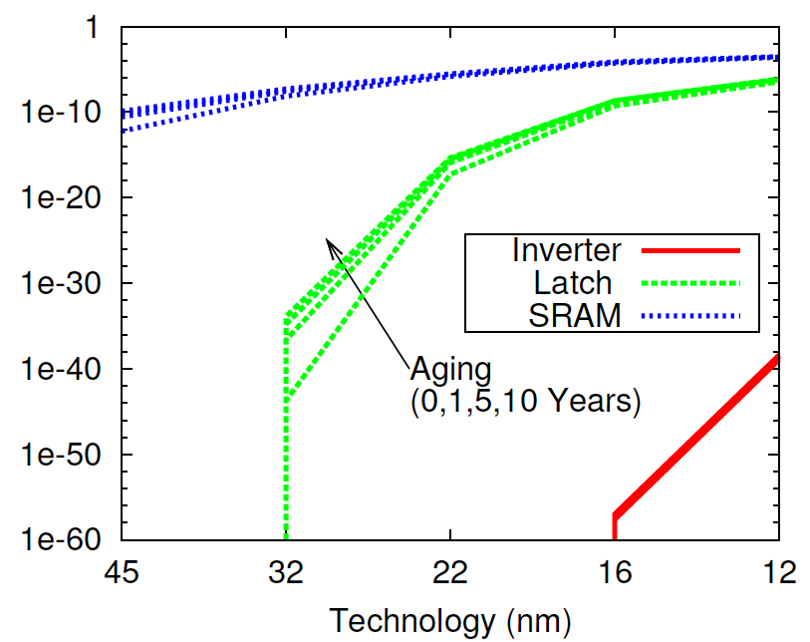
Failure Rate Increases
[Nassif / DATE 2010]

Slide 17
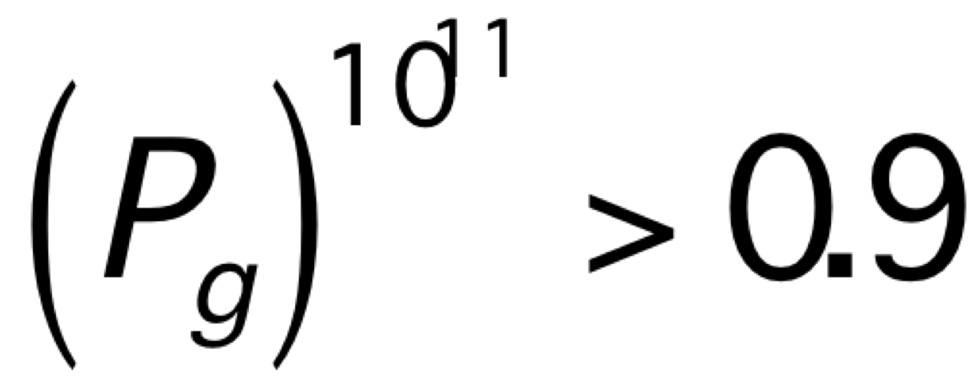
Quality Required for Perfection?
How high must P_{g} be to achieve 90% yield on a collection of 10¹¹ devices?
[preclass 4]
P_{g}>1-10⁻¹²

Slide 18
Failure Rate Increases
[Nassif / DATE 2010]

Slide 19
Challenge
Feature size scales down (S)
Capacity (area) → increases (1/S²)
  N increase
Reliability per device goes down
  P_{g} decrease
  P(N items good) = (P_{g})^{N}

Slide 20
Defining Problems

Slide 21
Three Problems
Defects: Manufacturing imperfection
  Occur before operation; persistent
    Shorts, breaks, bad contact
Transient Faults:
  Occur during operation; transient
    node X value flips: crosstalk, ionizing particles, bad timing, tunneling, thermal noise
Lifetime “wear” defects
  Parts become bad during operational lifetime
    Fatigue, electromigration, burnout….
  …slower
    NBTI, Hot Carrier Injection

Slide 22
Shekhar Bokar
Intel Fellow
Micro37 (Dec.2004)

Slide 23
Defect Rate
Device with 10¹¹ elements (100BT)
3 year lifetime = 10⁸ seconds
Accumulating up to 10% defects
10¹⁰ defects in 10⁸ seconds
  1 new defect every 10ms
At 10GHz operation:
  One new defect every 10⁸ cycles
  P_{newdefect}=10⁻¹⁹

Slide 24
First Step to Recover
Admit you have a problem
(observe that there is a failure)

Slide 25
Detection
How do we determine if something wrong?
  Some things easy
    ….won’t start
  Others tricky
    …one and gate computes False & True→True
Observability
  can see effect of problem
  some way of telling if defect/fault present

Slide 26
Detection
Coding
  space of legal values << space of all values
  should only see legal
  e.g. parity, ECC (Error Correcting Codes)
Explicit test (defects, recurring faults)
  ATPG = Automatic Test Pattern Generation
  Signature/BIST=Built-In Self-Test
  POST = Power On Self-Test
Direct/special access
  test ports, scan paths

Slide 27
Coping with defects/faults?
Key idea: redundancy
Detection:
  Use redundancy to detect error
Mitigating: use redundant hardware
  Use spare elements in place of faulty elements (defects)
  Compute multiple times so can discard faulty result (faults)

Slide 28
Defect Tolerance

Slide 29
Three Problems
Defects: Manufacturing imperfection
  Occur before operation; persistent
    Shorts, breaks, bad contact
Transient Faults:
  Occur during operation; transient
    node X value flips: crosstalk, ionizing particles, bad timing, tunneling, thermal noise
Lifetime “wear” defects
  Parts become bad during operational lifetime
    Fatigue, electromigration, burnout….
  …slower
    NBTI, Hot Carrier Injection

Slide 30
Two Models
Disk Drives (defect map)
Memory Chips (perfect chip)

Slide 31
Disk Drives
Expose defects to software
  software model expects defects
    Create table of good (bad) sectors
  manages by masking out in software
    (at the OS level)
    Never allocate a bad sector to a task or file
  yielded capacity varies

Slide 32
Memory Chips
Provide model in hardware of perfect chip
Model of perfect memory at capacity X
Use redundancy in hardware to provide perfect model
Yielded capacity fixed
  discard part if not achieve

Slide 33
Example: Memory
Correct memory:
  N slots
  each slot reliably stores last value written
Millions, billions, etc. of bits…
  have to get them all right?

Slide 34
Failure Rate Increases
[Nassif / DATE 2010]

Slide 35
Memory Defect Tolerance
Idea:
  few bits may fail
  provide more raw bits
  configure so yield what looks like a perfect memory of specified size

Slide 36
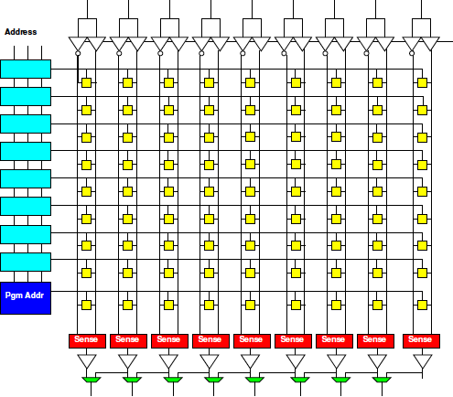
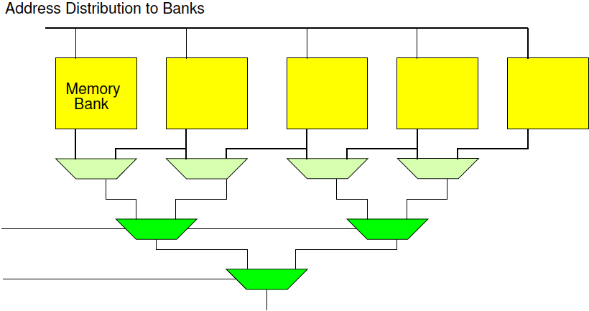
Memory Techniques
Row Redundancy
Column Redundancy
Bank Redundancy

Slide 37
Yield M of N
Preclass 5: Probability of yielding 3 of 5 things?
  Symbolic?
  Numerical for P_{g}=0.9?

Slide 38
Yield M of N
P(M of N) = P(yield N)
  (N choose N-1) P(exactly N-1)
  (N choose N-2) P(exactly N-2)…
  (N choose N-M) P(exactly N-M)…
  [think binomial coefficients]

Slide 39
M of 5 example
1*P⁵ + 5*P⁴(1-P)¹+10P³(1-P)²+10P²(1-P)³+5P¹(1-P)⁴ + 1*(1-P)⁵
Consider P=0.9
  1*P⁵ 0.59 M=5 P(sys)=0.59
  5*P⁴(1-P)¹ 0.33 M=4 P(sys)=0.92
  10P³(1-P)² 0.07 M=3 P(sys)=0.99
  10P²(1-P)³ 0.008
  5P¹(1-P)⁴ 0.00045
  1*(1-P)⁵ 0.00001
Can achieve higher
system yield than
individual components!

Slide 40
Possible Yield of 76 cores@ P=0.9
Processors Yield | Prob Exact | Prob at least
76 | 0.001 | 0.001
75 | 0.004 | 0.005
74 | 0.016 | 0.020
73 | 0.041 | 0.061
72 | 0.079 | 0.140
71 | 0.119 | 0.259
70 | 0.148 | 0.407
69 | 0.156 | 0.562
68 | 0.141 | 0.704
67 | 0.112 | 0.816
66 | 0.079 | 0.895
65 | 0.050 | 0.945
64 | 0.028 | 0.973

Slide 41
Possible Yield of 76 cores@ P=0.9
Processors Yield | Prob at least
76 | 0.001
75 | 0.005
74 | 0.020
73 | 0.061
72 | 0.140
71 | 0.259
70 | 0.407
69 | 0.562
68 | 0.704
67 | 0.816
66 | 0.895
65 | 0.945
64 | 0.973
Out of 100 chips,
how many?
Sell with 72:
Sell with 68:
Sell with 64:
Discard:

Slide 42
Intel Xeon Phi Pricing

Slide 43
Repairable Area
Not all area in a RAM is repairable
  memory bits spare-able
  io, power, ground, control not redundant

Slide 44
Repairable Area
P(yield) = P(non-repair) * P(repair)
P(non-repair) = P^{Nnr}
  N_{nr}<<N_{total}
  P > P_{repair}
    e.g. use coarser feature size
    Differential reliability
P(repair) ~ P(yield M of N)

Slide 45
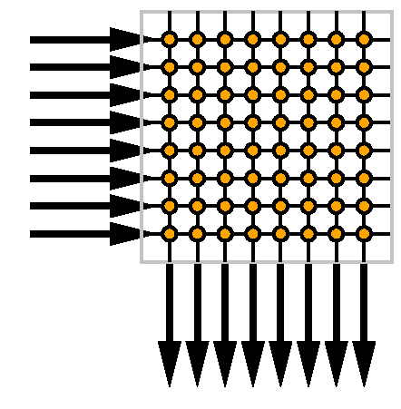
Consider a Crossbar
Allows us to connect any of N things to each other
  E.g.
    N processors
    N memories
    N/2 processors
    N/2 memories

Slide 46
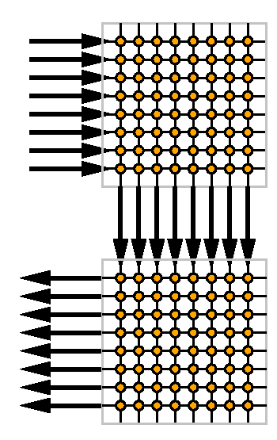
Crossbar Buses and Defects
Two crossbar multibus
Wires may fail
Switches may fail
How tolerate
  Wire failures between
  crossbars?
  Switch failures?

Slide 47
Crossbar Buses and Defects
Two crossbars
Wires may fail
Switches may fail
Provide more wires
  Any wire fault avoidable
    M choose N

Slide 48
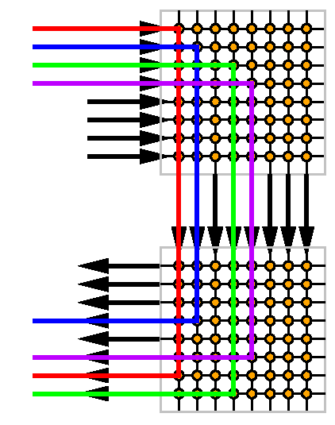
Crossbar Buses and Defects
Two crossbars
Wires may fail
Switches may fail
Provide more wires
  Any wire fault avoidable
    M choose N

Slide 49
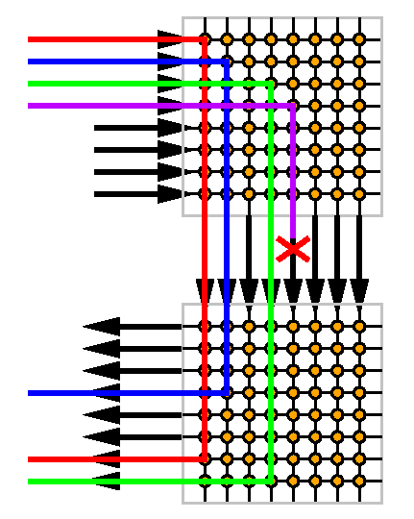
Crossbar Buses and Faults
Two crossbars
Wires may fail
Switches may fail
Provide more wires
  Any wire fault avoidable
    M choose N

Slide 50
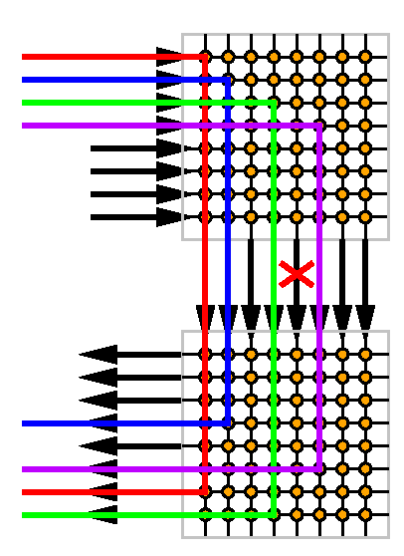
Crossbar Buses and Faults
Two crossbars
Wires may fail
Switches may fail
Provide more wires
  Any wire fault avoidable
    M choose N
  Same idea

Slide 51
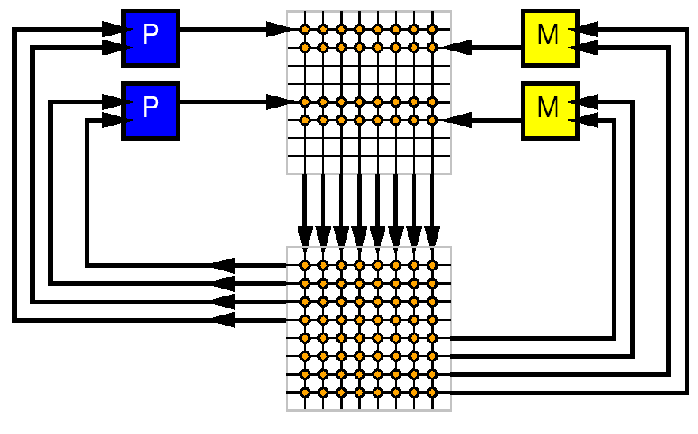
Simple System
P Processors
M Memories
Wires
Memory, Compute, Interconnect

Slide 52
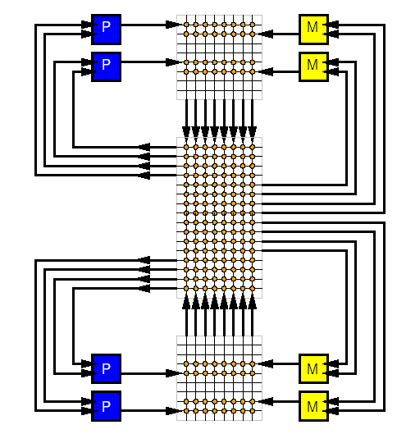
Simple System w/ Spares
P Processors
M Memories
Wires
Provide spare
  Processors
  Memories
  Wires

Slide 53
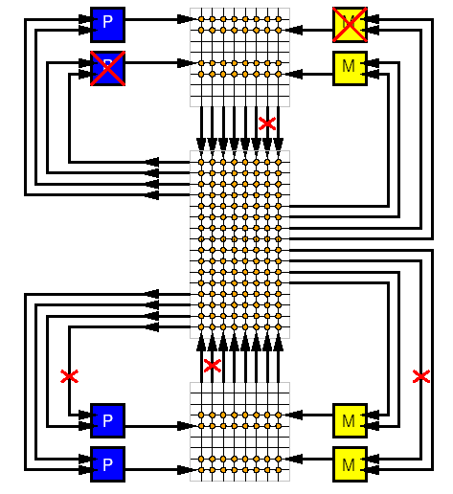
Simple System w/ Defects
P Processors
M Memories
Wires
Provide spare
  Processors
  Memories
  Wires
...and defects

Slide 54
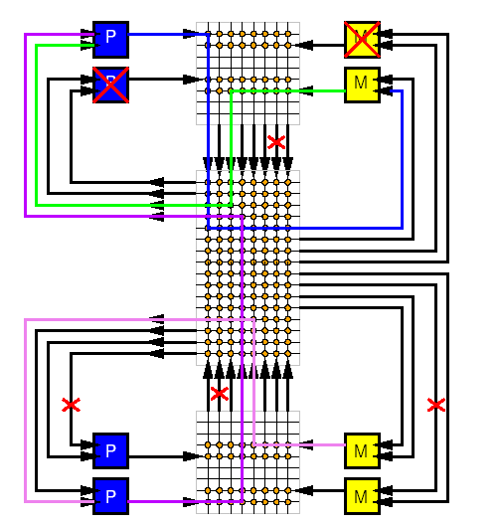
Simple System Repaired
P Processors
M Memories
Wires
Provide spare
  Processors
  Memories
  Wires
Use crossbar to switch together good processors and memories

Slide 55
Simple System Repaired
What are the costs?
  Area
  Energy
  Delay

Slide 56
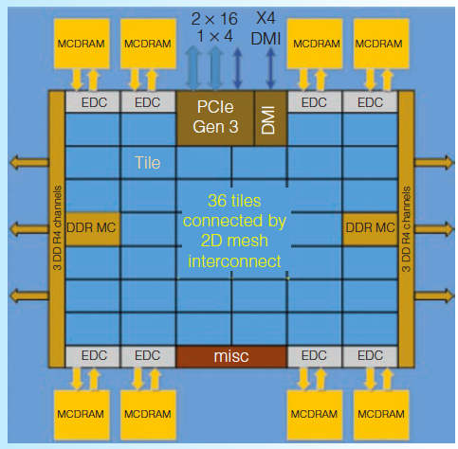
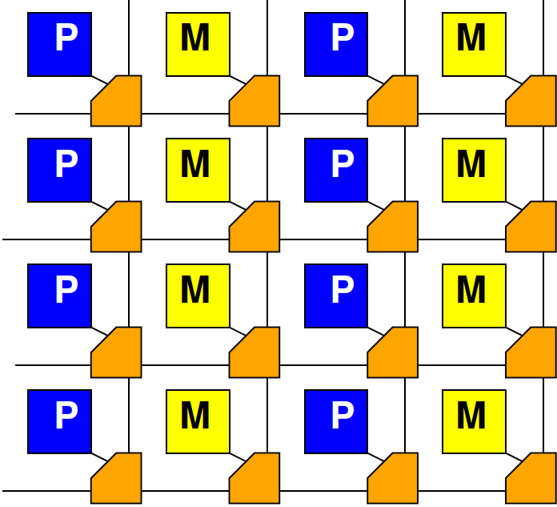
In Practice
Crossbars are inefficient
Use switching networks with
  Locality
  Segmentation
…but basic idea for sparing
is the same

Slide 57
FPGAs

Slide 58
Modern FPGA
Has 10,000 to millions of LUTs
Hundreds to thousands of
  Memory banks
  Multipliers
Reconfigurable interconnect

Slide 59
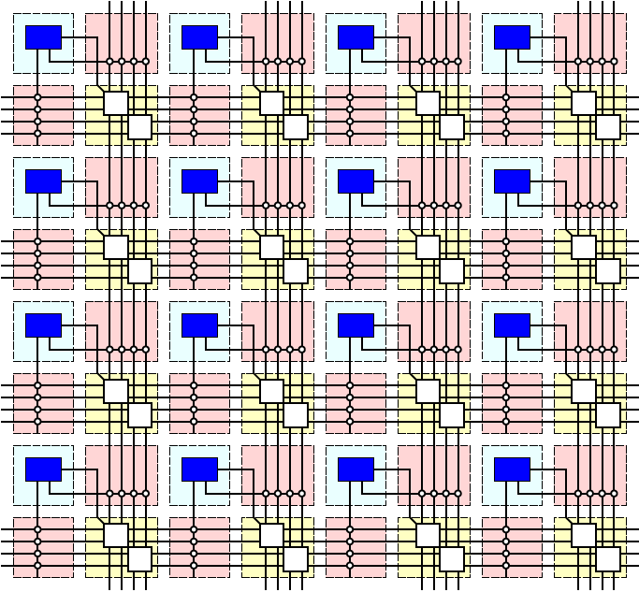
XC7Z020
6-LUTs: 53,200
DSP Blocks: 220
  18x25 multiply,
  48b accumulate
Block RAMs: 140
  36Kb
  Dual port
  Up to 72b wide

Slide 60
Modern FPGA
Has 10,000 to millions of gates
Hundreds to thousands of
  Memory banks
  Multipliers
Reconfigurable interconnect
If a few resources don’t work
  avoid them

Slide 61
Granularity
How do transistors compare between
6-LUT and 64b processor core?
  [qualitative or ballpark]

Slide 62
Granularity
Consider two cases
  Knight’s Bridge with 76 64b processors
  FPGA with 1 Million 6-LUTs
10 defects (bad transistors)
How much capacity lost?
  Knight’s Bridge?
  1M 6-LUT FPGA?

Slide 63
Observe
Finer granularity sparing
  Lose fewer resources per defect
    Losing processor vs. losing 6-LUT
    Losing memory row vs. losing entire memory bank
  Pay more for reconfiguration
Finer grained designs
  Tolerate higher defect rates

Slide 64
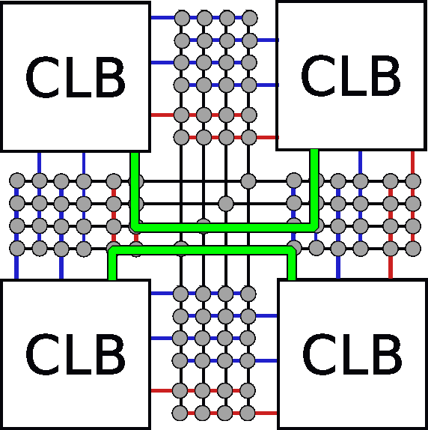
Interconnect Defects
Route around interconnect defects

Slide 65
Defect-Level Viable with FPGAs
Fine-grained repair
Avoiding routing defects
  Tolerates >20% switch defects
[Rubin/unpublished]

Slide 66
FPGAs
Variation and Energy
(if time permits)

Slide 67
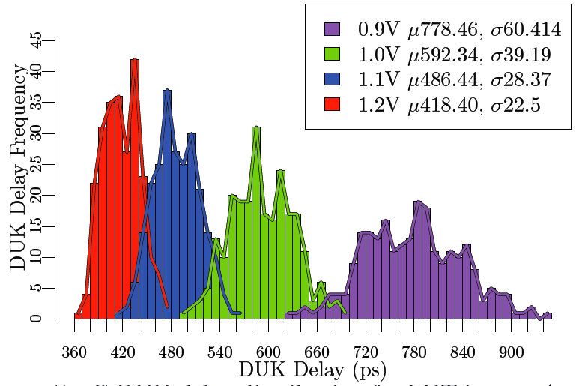
Variation
Modern ICs are like Snowflakes
  Each one is different
[Gojman, FPGA2013]

Slide 68
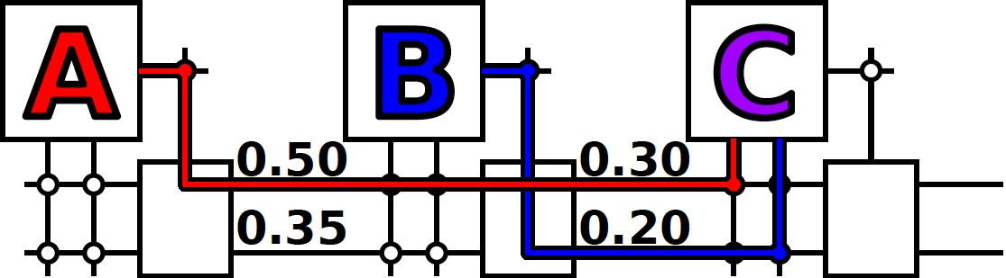
Variation Challenge
Use of high V_{th} resource forces high supply voltage (V_{dd}) to meet timing requirement
Delay: CV/I and I goes as (V_{dd}-V_{th})²

Slide 69
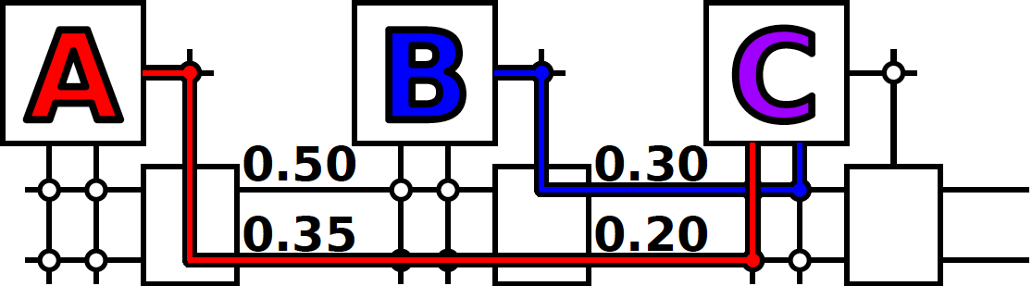
Component-Specific
Use defect idea to avoid high V_{th} resource
Allow lower supply voltage (V_{dd}) to meet timing requirement
Delay: CV/I and I goes as (V_{dd}-V_{th})²

Slide 70
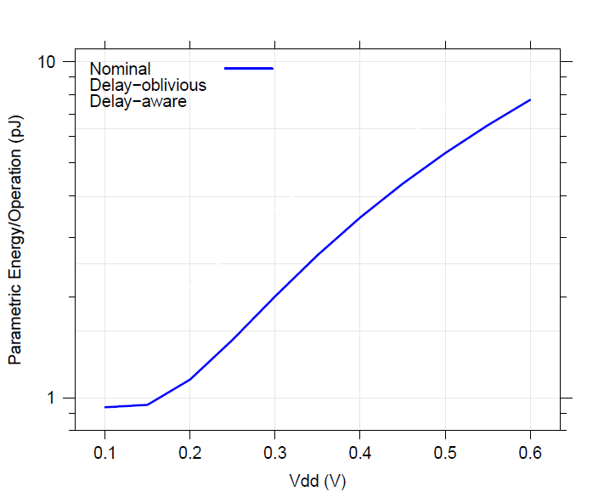
Energy vs V_{dd} (des)
Nominal uses minimum size
[Mehta, FPGA 2012]

Slide 71
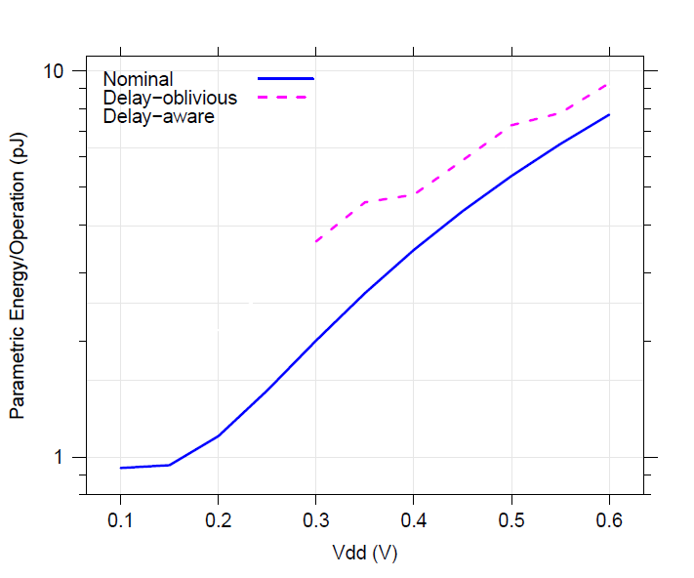
Energy vs V_{dd} (des)
Nominal uses minimum size
Energy
Margin
[Mehta, FPGA 2012]

Slide 72
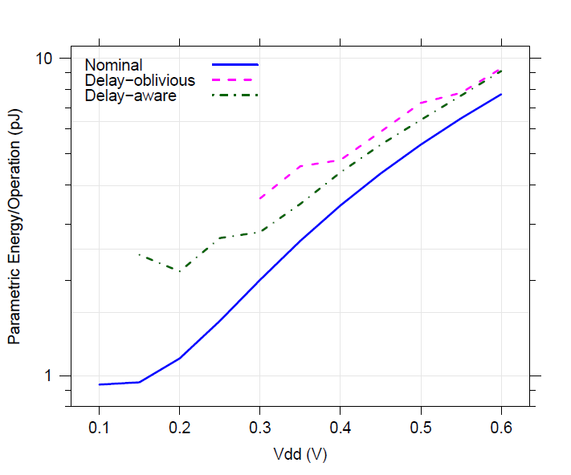
Energy vs V_{dd} (des)
Nominal uses minimum size
Delay-aware routing reduces energy margins
  Smaller sizes
Energy
Savings
(Sizing)
[Mehta, FPGA 2012]

Slide 73
Energy vs V_{dd} (des)
Nominal uses minimum size
Delay-aware routing reduces energy margins
  Smaller sizes
  Lower voltages
Energy
Savings
(Vdd)
[Mehta, FPGA 2012]

Slide 74
Energy vs V_{dd} (des)
Nominal uses minimum size
Delay-aware routing reduces energy margins
  Smaller sizes
  Lower voltages
  Less Leakage
Energy
Savings
(Total)
[Mehta, FPGA 2012]

Slide 75
Big Ideas
At small feature sizes, not viable to demand perfect fabrication of billions of transistors on a chip
Modern ICs are like snowflakes
  Everyone is different, changes over time
Reconfiguration allows repair
  Finer grain → higher defect rates
  Tolerate variation → lower energy

Slide 76
Admin
Project due Friday
  Reminder turin
    Report
    Code
    Bitstsream, elf, decoder (see supplement)
  Current sender will send largest files

