Slide 1
ESE532: System-on-a-Chip Architecture
Day 27: December 5, 2018
Representation and Precision

Slide 2
Today
Fixed Point
Errors from Limited Precision
Precision Analysis / Interval Arithmetic
Floating Point
If time permits

Slide 3
Message
We must always calculate with limited precision
Precision costs area (and energy)
Can economize area (and energy) by judiciously using just the precision we need
Something can do when building customized accelerator
Precision-cost tradeoff → design-space axis
Can perform analysis on precision

Slide 4
Fixed Point
Integer which interpret as a fraction
Fixed-Point N.F
N bits
F bits below fraction (typically N>F)
Equivalently: meaning is Integer-value/2^{F}
F=0 → Integer

Slide 5
Operator Sizes
Operator | LUTs | LUTs + DSPs
Double FP Add | 712 | 681+3 DSPs
Single FP Add | 370 | 219+2 DSPs
Fixed-Point Add (32) | 16
Fixed-Point Add (n) | n/2
Double FP Multiply | 2229 | 223+10 DSPs
Single FP Multiply | 511 | 461+3 DSPs
Fixed Multiply (32x32) | 1099
Fixed Multiply (16x16) | 283 | 1 DSP
Fixed Multiply (18x25) |  | 1 DSP
Fixed Multiply (n) | ~ n²
FP (Floating Point) sizes from:
https://www.xilinx.com/support/documentation/ip_documentation/ru/floating-point.html

Slide 6
Observe
Floating-Point operators are large compared to Fixed-Point
For similar precision
712 vs. 32 for addition
Double-precision Floating point operators are large
2229 Multiply, 712 Add
Can quickly fill 50,000 LUT programmable logic

Slide 7
Fixed-Point Economy
Can fit more logic (more parallelism) using modest fixed-point
At 16b: Multiply 283, Add 16
Vs. Double: 2229, 712
But
How much precision do we need?
How do we determine?

Slide 8
Perfect Representation
Start with Fixed-Point 16.8
What do we need to
represent the result of an addition? (1a)
represent the result of a multiplication? (1b)

Slide 9
Sequence
Across a sequence of operations
A, B, C start Fixed-Point 16.8
Y=(A+B)*C
Perfect representation for partial results up to Y?

Slide 10
Looping: Bound loop
res=0;
for(i=0;i<3;i++)
res=res*x+a[i]
Assume a[i], x start Fixed-Point 16.8
Final precision needed for res?

Slide 11
Looping: Unbound
res=0;
for(i=0;i<len;i++)
res=res*x+a[i]
Assume a[i], x start Fixed-Point 16.8, len starts Integer 16
Final precision needed for res?

Slide 12
Perfect Representation
Start with Fixed-Point 16.8
What do we need to
represent the result of a division? (1c)
E.g. 00000001.00000000/00000011.00000000

Slide 13
Conclude
Cannot generally keep perfect precision
Will typically need to decide how much precision we need and where

Slide 14
Errors from Limited Precision
Accept errors necessary.
How big are they?
How design to manage them?

Slide 15
What error introduce?
Absolute Error – what level of error do we have in approximated value or a result
Might be all we care about
Get answer to 1mV accuracy
…or 1 pixel accuracy
4.13742 – assume full
4.1374 – 0.00002
10⁻⁵
4.137 – 0.00042
10⁻⁴
4.14 – 0.00256
10⁻³
4.1 – 0.03742
10⁻²

Slide 16
What error introduce?
4.13742 – 0.0003
Ideal: 4.13712
2 decimal frac: 4.14-0.00
4.14
(4.14-4.13712)/4.13712
0.07% error
4.13742-4.13628
Ideal: 0.00114
2 decimal fac: 4.14-4.14
0.00
(0.00114-0)/0.00114
100% error
Relative Error – error as percentage of intended result
May be more relevant, particularly if trying to identify small values

Slide 17
Preclass 2
Complete Table

Slide 18
Observe
Add/Multiply relatively well behaved
Must be very careful when
Division involved
Divisors can be small
Get approximated near zero

Slide 19
Precision Allocation
Full precision can be too expensive
Non-sensical
Limited precision introduces errors
May be smaller than we care about
Determine minimal precision needed
…or where to spend precision…

Slide 20
Empirical Analysis
Make guess at precisions
Set precisions in calculation
Simulate on data
Evaluate results (absolute, relative error) compared to gold standard
Unlimited precision…or, at least, higher precision
Often standard is double-precision float
…but, as we’ll, even that’s a compromise
Update precision guess and repeat

Slide 21
Empirical Analysis
Make guess at precisions
Set precisions in calculation
Simulate on data
Evaluate results compared to gold standard
Demands Care
Test coverage
Adequate set of test data to trigger worst-case errors?
Requires some understanding of calculation
Shouldn’t be entirely black box

Slide 22
Vivado HLS Support
Has libraries to support
Arbitrary precision integers
Arbitrary precision fixed point
For
Simulation
Synthesis
UG902 – Vivado HLS User Guide
Chapter 2: Abritrary Precision Data Type Library

Slide 23
Precision Analysis

Slide 24
Precision Analysis
Can analyze worst-case error impacts from limited precision
Give results not sensitive to test set
Give guidance on where to allocate precision
…can be automated

Slide 25
Limit Precision Inputs
Typically start with limited precision
A/D only sample to 12b
Real-world had more precise value, but didn’t capture
Quantized data stored in representation
Sound samples, DCT frequency coefficients
We start with error
What does that mean about values we calculate?

Slide 26
Interval Analysis
Treat every value as an interval arrange
Model effects of operations on range of results
A=(A.H, A.L) e.g. read 37 (37.49,37.51)
A+B=(A.H+B.H,A.L+B.L)
Assuming Positive A, B and interval not cross 0, what is range for:
A*B
A/B

Slide 27
Interval Analysis
Treat every value as an interval arrange
Model effects of operations on range of results
A=(A.H, A.L)
A+B=(A.H+B.H,A.L+B.L)
Positive A, B and B interval not cross 0
A*B=(A.H*B.H,A.L*B.L)
A/B=(A.H/B.L,A.L/B.H)

Slide 28
Interval Analysis
With ranges that may cross zero…
A*B=(max(A.H*B.H,A.H*B.L,A.L*B.H,A.L*B.L), min(A.H*B.H,A.H*B.L,A.L*B.H,A.L*B.L))
A/B … more complicated
If B.H positive, B.L negative, can become infinity

Slide 29
Limited Precision
A=(A.H,A.L)=(A+ε,A-ε)=A±ε
E.g. if rounded to Fixed Point 16.8
ε may be 2⁻⁹

Slide 30
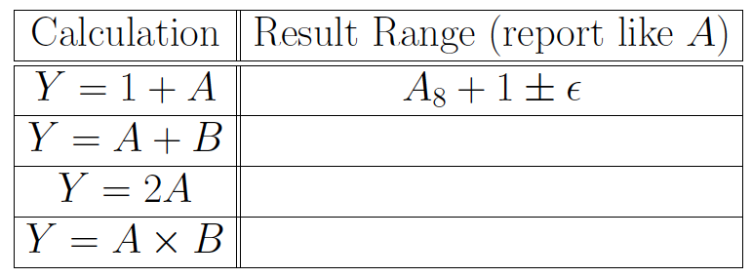
Preclass 2
Complete Table

Slide 31
Multiplication
(A±ε)(B±ε)
A*B ± ( (A+B) ε + ε² )
A and B can be MAXVAL, MINVAL
Assume symmetric (MAXVAL=-MINVAL)
A*B ± ( 2*MAXVAL* ε + ε² )
Probably reasonable to drop ε²
A*B ± 2*MAXVAL* ε

Slide 32
Multiply Range Example
Recall: Fixed-Point 16.8 multiply
Full precision result: 32.16 (preclass 1b)
What is error interval for result of 16.8 multiply?

Slide 33
Range Example
Error Interval for 16.8 fixed-point multiply
For 16.8, ε₀=1/512, maxval=256
From preclass 3 symbolic answer
A*B ± 2*MAXVAL* ε
A*B ± 2*256*(1/512)
Or A*B±1

Slide 34
Observe
Full precision may keep bits well below the error in the calculation
E.g. 32.16 result, keeping 16b below 2⁰ term
Entire fraction is below the error in the calculation
A*B±1

Slide 35
Rounding
Rounding introduces an error
Round Nearest A to Fixed-Point N.8
ε=2⁻⁹
As does truncation, floor, ceil…
But asymetric interval

Slide 36
Compute and Round Error
Error range if round 32.16 result to 18.2?
(from 16.8 multiply)
Hint:
How much from calculation?
How much additional from rounding?

Slide 37
Compute and Round Error
Rounding 32.16 to 18.2 introduces a quantization error of 2⁻³
Our 32.16 multiply result was ±1
Add an addition ±1/8
Total error: ±9/8

Slide 38
Result
Dropping (rounding) bits may not increase error range (much)

Slide 39
Symbolic
If work through computation symbolically, can generate equation for error
Each rounding (precision drop) adds some ε_{i} precision

Slide 40
Approach
At each step compute interval
Keep track of
maxval
ε

Slide 41
Symbolic Example
Start A, B, C with maxval₀, ε₀
Y=(A+B)*C;
A+B maxval₁=2maxval₀ , ε₂=2ε₀+ε₁
ε₁ for round after this operation
(A+B)*C
maxval₂=maxval₁*maxval₀
ε₄=ε₂*maxval₀+ε₀*maxval₁+ε₃
ε₃ for round at this operation

Slide 42
Result Precision
After series of operations, may have expression like:
Y±(ε₃+(ε₁+4 *ε₀) *maxval₀)
If looking for result with precision ±ε_{res}
ε_{res}≥ (ε₃+(ε₁+4 *ε₀ )*maxval₀)

Slide 43
Result Precision
Fixed Precision12.0 = Round(val)
E.g. A/D output
Only need to know val to ε=1/2
Fixed Precision 12.0 = Round(val/4)
E.g. Quantized value stored in file
Only need to know val to ε=2
Start 13.8, maxval₀=32
ε_{res}≥ (ε₃+(ε₁+4 *ε₀ )*maxval₀)=(ε₃+(ε₁+4 *ε₀ )*32)
What epsilons might solve?
Hint: try budget half unit for each ε₃, ε₁ term

Slide 44
Optimize Precision Allocation
ε_{res}≥ (ε₃+ε₁+4 *ε₀ *32)
Maybe: ε₀=1/256, ε₁=1/2, ε₃=1/64
1/256 – 7 bit fraction, 1/64 – 5 bit, ½ -- no fraction
More generally
Combine with area model and look at expense of providing each ε_{i}
Round to 12.7, Fixed 12.7 add, round to 11.5, Fixed 11.5 multiply, round to 12.0
12/2 add, 12/2 round, 11*11 for multiply ~ 133 LUTs
Try pick ε_{i} to meet ε_{res} while minimizing area

Slide 45
Tools
Tools can automate interval calculations to verify precision
E.g. Gappa++
https://bitbucket.org/mlinderm/gappa

Slide 46
Floating Point
(time permit)
Robert Tinney
(Byte circa 1980)

Slide 47
Floating-Point vs. Fixed-Point
Floating-Point (esp. double-precision) is a big hammer solution
Trades hardware/energy for programmer attention to needs
Standards have been well thought out so works over wide range
One size fits all (…almost)
Most cases it is more than needed
Cost/energy sensitive designs will ask what’s necessary and tune accordingly

Slide 48
Floating Point
Leading 0s aren’t that useful
Can represent more compactly by counting them
Only need log bits to count the zeros
Represent value as v=1.m * 2^{(exp-offset)}
Mantissa (m)
Exponent (exp)
Like Scientific Notation

Slide 49
Floating Point
Floating Point means
Move the datapath to the interesting/significant part of computation
Don’t represent leading zeros
Don’t represent less significant bits
Even if they are well above 1
In the integer portion

Slide 50
Standard Floating Point
Double Precision (64b)
1 bit sign
11 bit exponent
Offset 1023 represents 1023 to -1022
53 bit mantissa (52b + implicit 1)
Single Precision (32b)
1 bit sign
8 bit exponent (offset 127)
24 bit mantissa (23b + implicit 1)

Slide 51
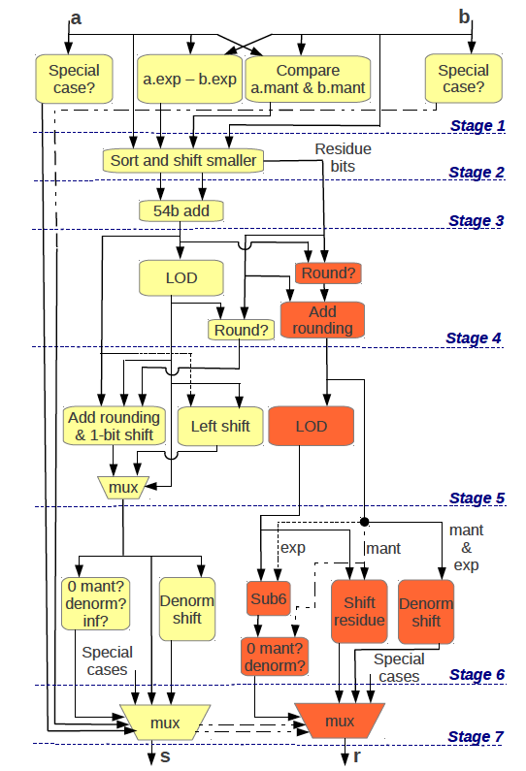
Expensive FP Add
Recall
712 LUTs double
370 single
Double:
54b add one stage of 7 in pipeline
Done in 27 6-LUTs
[Kadric, Arith 2013]

Slide 52
Floating Point Multiply
Double 2229, Single 461
Don’t need to sort, pre-shift
m=A.m*B.m (53x53 multiply dominates)
e=A.e+B.e
Still have shifting, rounding at end

Slide 53
Dynamic Range
Floating Point has very wide dynamic range
Can deal with significant piece being anywhere in 1023 to -1022
For fixed-point to cover same range
Fixed Point 2046.1022
Add 1024 LUTs
Multiply ~ 4M LUTs
When need dynamic range, FP economical

Slide 54
Customization
Can customize Floating Point on FPGA or custom silicon
Mantissa bits
Exponent bits
Fewer bits when need less precision or range to save area
More bits if need greater precision or range

Slide 55
Floating Point
Not free of precision problems
((1+2¹⁰⁰)-2⁹⁹)-2⁹⁹=0
1+(2¹⁰⁰+(-2⁹⁹-2⁹⁹))=1

Slide 56
Floating-Point Analysis
Can do similar analysis on floating point
…and there are tools to help
Including Gappa++

Slide 57
Big Ideas
We must always calculate with limited precision
Precision costs area (and energy)
Can economize area (and energy) by judiciously using just the precision we need
Precision-cost tradeoff
Design-space axes
Can perform analysis on precision

Slide 58
Admin
Project Due Friday
Report individual
Elf, bitstream, decoder – one per group
Code – everyone turn in, but same across group
Return boards Monday in Class
Exam following Friday (12/14)
Towne 303 (here), 9am

