Slide 1
ESE532: System-on-a-Chip Architecture
Day 3: September 10, 2018
Memory

Slide 2
Today
Memory
Memory Bottleneck
Memory Scaling
Latency Engineering
Scheduling
Data Reuse: Scratchpad and cache
Bandwidth Engineering
Wide word
Banking (form of parallelism for data)

Slide 3
Message
Memory bandwidth (throughput) and latency can be bottlenecks
Minimize data movement
Exploit small, local memories
Exploit data reuse

Slide 4
Memory Scaling

Slide 5
On-Chip Delay
Delay is proportional to distance travelled
Make a wire twice the length
Takes twice the latency to traverse
(can pipeline)
Modern chips
Run at 100s of MHz to GHz
Take 10s of ns to cross the chip
Takes 100s of ns to reference off-chip data
What does this say about placement of computations and memories?

Slide 6
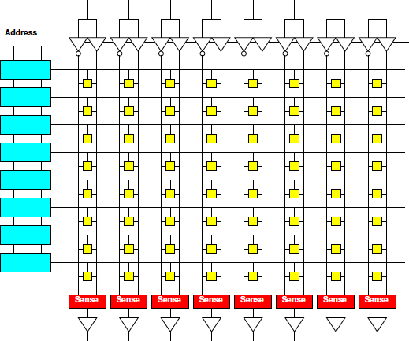
Memory Block
Linear wire delay with distance
Assume constant area/memory bit
N-bit memory, arranged in square
4x capacity delay change?
width
depth

Slide 7
Memory Block
Linear wire delay with distance
Assume constant area/memory bit
N-bit memory, arranged in square
Width relate to N?
Depth?
Delay scale N?
width
depth

Slide 8
Memory Block Bandwidth
N-bit memory, arranged in square
Bits/cycle scale with N?

Slide 9
Memory Block Energy
Assume read full width,
Energy scales with N
Activate sqrt(N) wires
Each wire sqrt(N) long
Or, energy/bit scales as sqrt(N)
Larger memories cost more energy

Slide 10
Memory Block Density
Address, sense amplifies are large
Scale slower than bit area
Bits scale N
Address sqrt(N)*log(N)
Sense amps sqrt(N)
Large memories pay less per bit
denser

Slide 11
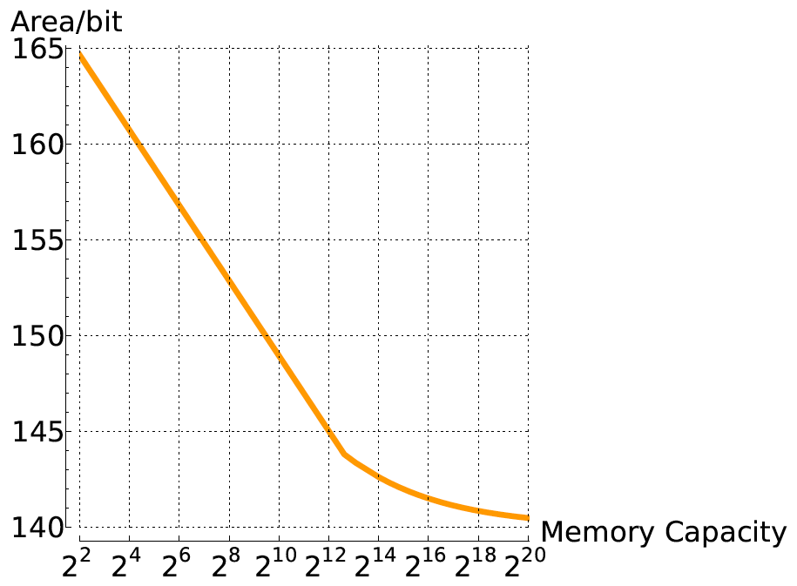
Compactness vs. Memory Size

Slide 12
Memory Scaling
Small memories are fast
Large memories are slow
Small memories low energy
Large memories high energy
Large memories dense
Small memories cost more area per bit
Combining:
Dense memories are slow

Slide 13
Latency Engineering Scheduling

Slide 14
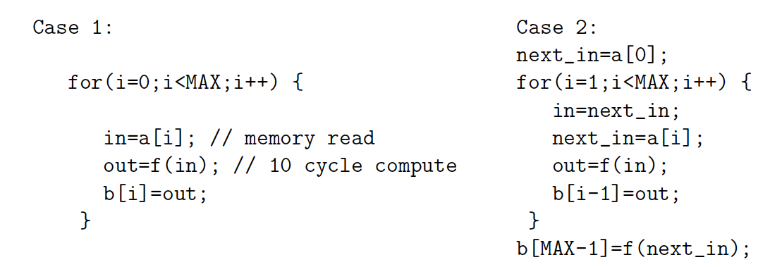
Preclass 2
10 cycle latency to memory
Throughput in each case?

Slide 15
Lesson
Long memory latency can impact throughput
When must wait on it
When part of a cyclic dependency
Overlap memory access with computations when possible
exploit parallelism between compute and memory access

Slide 16
Latency Engineering Data Reuse

Slide 17
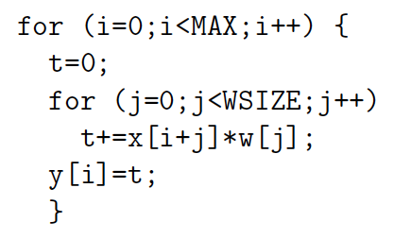
Preclass 3abc
MAX=10⁶ WSIZE=5
How many times execute t+=x[]*w[] ?
How many reads to x[] and w[]?
Runtime read x,w 20 t+=… 5

Slide 18
Preclass 3c
T=MAX*WSIZE(T_{comp}+T_{x}+T_{w})
T=10⁶*5*(5+20+20)
T=2.25*10⁸

Slide 19
Preclass 3d
How many distinct x[], w[] read?

Slide 20
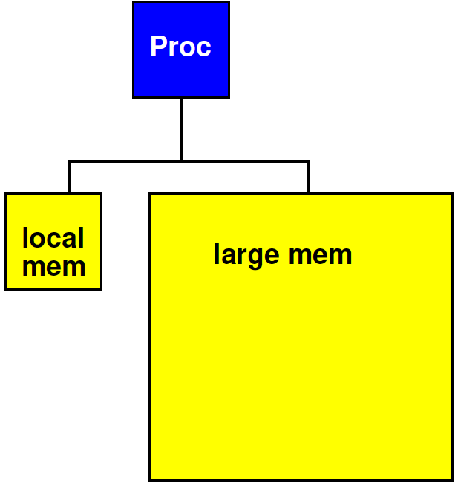
Strategy
Add small, local memory bank
Small memories are faster

Slide 21
Preclass 3e
How use local memory to reduce large memory reads to 3d?
How much local memory need?
How much faster might small memory be?

Slide 22
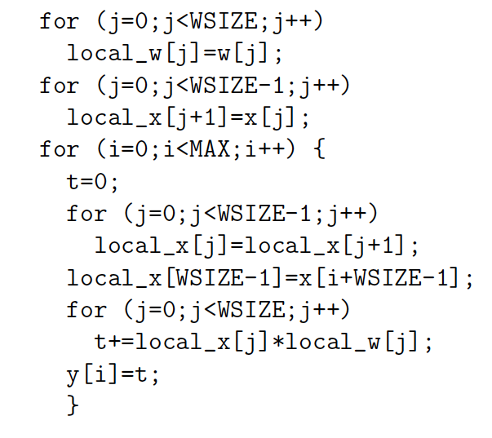
Preclass 3

Slide 23
Preclass 3
WSIZE*T_{w}
WSIZE*T_{x}
WSIZE*MAX*T_{local}
MAX*T_{x}
WSIZE*MAX*T_{comp}
WSIZE*MAX*2*T_{local}

Slide 24
Preclass 3
WSIZE*MAX*(T_{comp}+3*T_{local})
+WSIZE*(T_{w}+T_{x})
+MAX*T_{x}
5*10⁶*(5+3)
+5*(20+20)
+10⁶*20
6*10⁷

Slide 25
Preclass 3
2.25*10⁸ 6*10⁷
3.75x

Slide 26
Lesson
Data can often be reused
Keep data needed for computation in
Closer, smaller (faster, less energy) memories
Reduces latency costs
Reduces bandwidth required from large memories
Reuse hint: value used multiple times
Or value produced/consumed

Slide 27
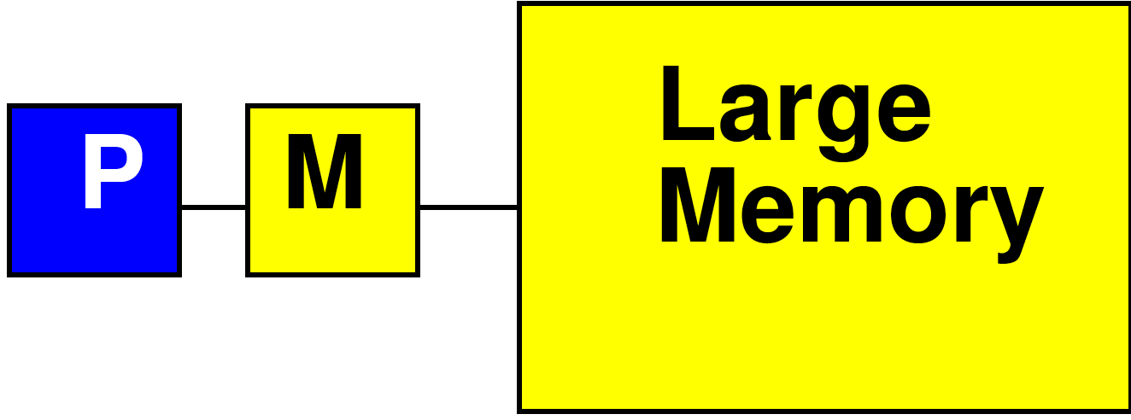
Processor Data Caches
Traditional Processor Data Caches are a heuristic instance of this
Add a small memory local to the processor
It is fast, low latency
Store anything fetched from large/remote memory in local memory
Hoping for reuse in near future
On every fetch, check local memory before go to large memory

Slide 28
Cache
Goal: performance of small memory with density of large memory

Slide 29
Processor Data Caches
Demands more than a small memory
Need to sparsely store address/data mappings from large memory
Makes more area/delay/energy expensive than just a simple memory of capacity
Don’t need explicit data movement
Cannot control when data moved/saved
Bad for determinism
Limited ability to control what stays in small memory simultaneously

Slide 30
Terminology
Cache
Hardware-managed small memory in front of larger memory
Scratchpad
Small memory
Software (or logic) managed
Explicit reference to scratchpad vs. large (other) memories
Explicit movement of data

Slide 31
Terminology: Unroll Loop
Replace loop with instantiations of body
For WSIZE=5

Slide 32
Terminology: Unroll Loop
Replace loop with instantiations of body
For WSIZE=5

Slide 33
Terminology: Unroll Loop
Can unroll partially
For WSIZE even

Slide 34
Amdahl’s Law

Slide 35
Amdahl’s Law
If you only speedup Y(%) of the code, the most you can accelerate your application is 1/(1-Y)
T_{before} = 1*Y + 1*(1-Y)
Speedup by factor of S
T_{after}=(1/S)*Y+1*(1-Y)
Limit S→infinity T_{before}/T_{after}=1/(1-Y)

Slide 36
Amdahl’s Law
T_{before} = 1*Y + 1*(1-Y)
Speedup by factor of S
T_{after}=(1/S)*Y+1*(1-Y)
Y=70%
Possible speedup (S→infinity) ?
Speedup if S=10?

Slide 37
Amdahl’s Law
If you only speedup Y(%) of the code, the most you can accelerate your application is 1/(1-Y)
Implications
Amdhal: good to have a fast sequential processor
Keep optimizing
T_{after}=(1/S)*Y+1*(1-Y)
For large S, bottleneck now in the 1-Y

Slide 38
Bandwidth Engineering

Slide 39
Bandwidth Engineering
High bandwidth is easier to engineer than low latency
Wide-word
Banking
Decompose memory into independent banks
Route requests to appropriate bank

Slide 40
Wide Memory
Relatively easy to have a wide memory
As long as we share the address
One address to select wide word or bits
Efficient if all read together

Slide 41
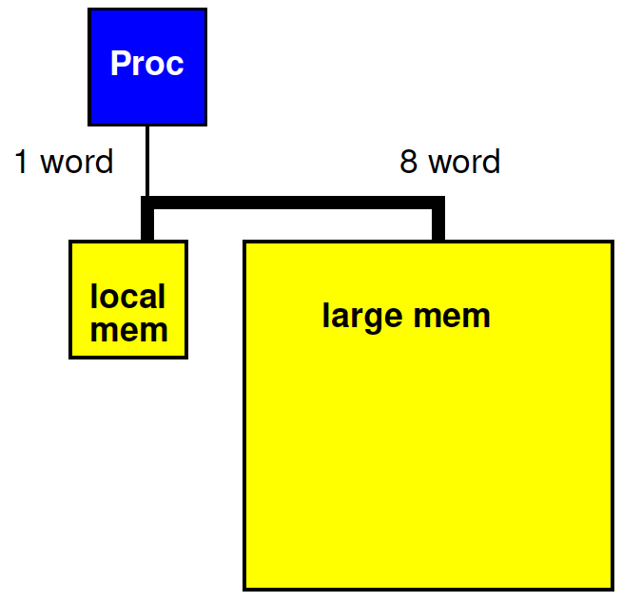
Revisit Preclass 3
Use wide memory access to move 8 words (x[]) between large and small memory in a single cycle

Slide 42
Preclass 3 + wide
Impact of 8 word datapath between large and local memory?
WSIZE*MAX*(T_{comp}+3*T_{local})
+WSIZE*(T_{w}+T_{x})
+MAX*T_{x}
5*10⁶*(5+3)
+5*(20+20)
+10⁶*20
6*10⁷
What term most impacted?

Slide 43
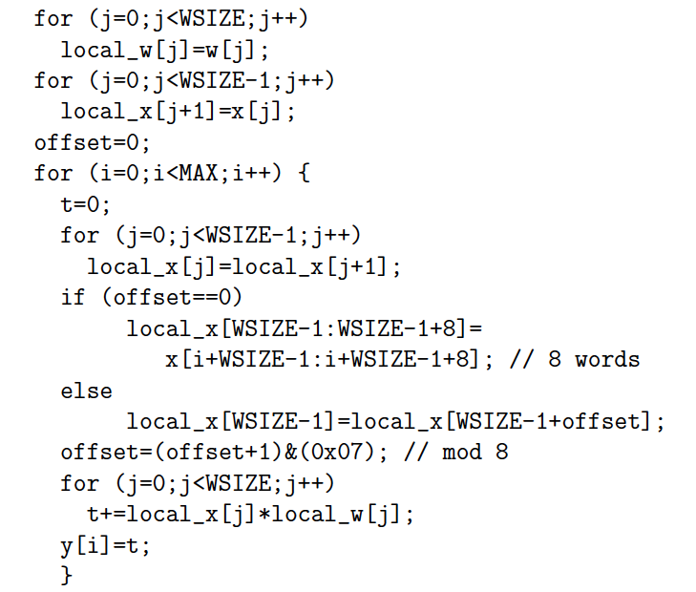
Preclass 3 + wide
WSIZE*MAX*(T_{comp}+3*T_{local})
+WSIZE*(T_{w}+T_{x})
+MAX/8*T_{x}
+MAX*(T_{local}+2)
5*10⁶*(5+3)
+5*(20+20)
+10⁶*20/8
+10⁶*3
4.55*10⁷

Slide 44
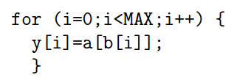
Preclass 4
Cycles reading from large memory for a, b
Cycles reading a, b from large memory.
20 cycle read latency; MAX=10⁶
 | a[i]*b[i] | a[b[i]]
1-word wide
8-word wide

Slide 45
Lesson
Cheaper to access wide/contiguous blocks memory
In hardware
From the architectures typically build
Can achieve higher bandwidth on large block data transfer
Than random access of small data items

Slide 46
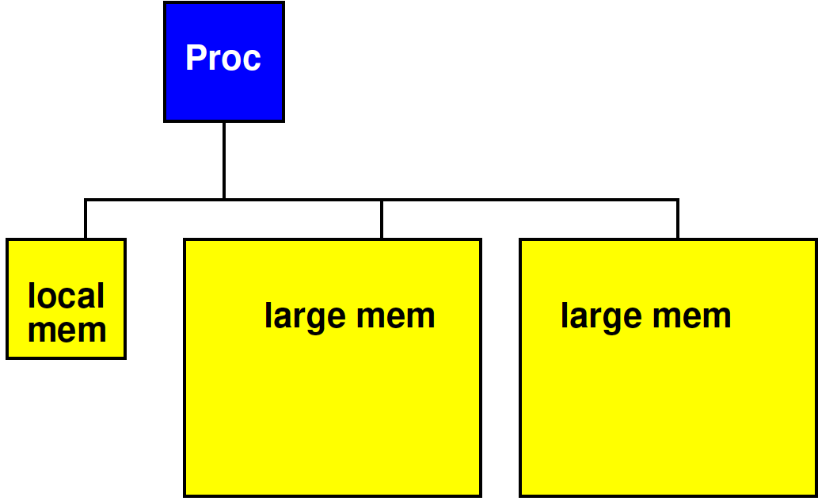
Bank Memory
Break memory into independent banks
Allow banks to operate concurrently

Slide 47
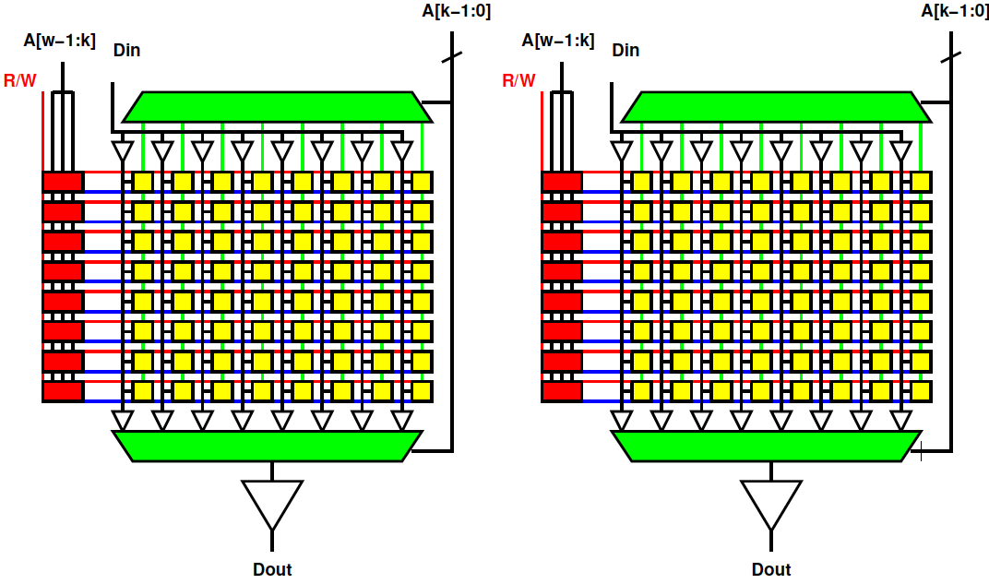
Bank Memory
Break memory into independent banks
Allow banks to operate concurrently

Slide 48
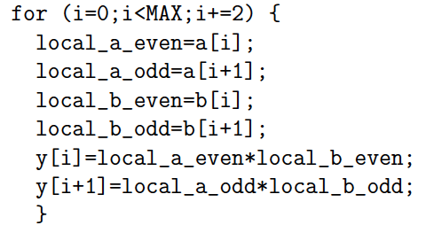
Preclass 4 Banked
20 cycle read latency; MAX=10⁶
Put odd a, b in one bank, even in other.
Cycles reading a, b from large memory?

Slide 49
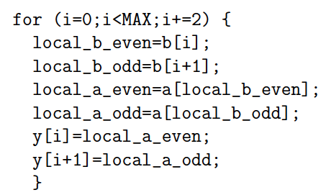
Preclass 4 Banked
20 cycle read latency; MAX=10⁶
Put odd a, b in one bank, even in other.
Cycles reading a, b from large memory?

Slide 50
Banking Costs
Area compare
One memory bank
Depth 1024, width 64
Two memory banks
Depth 1024, width 32

Slide 51
Memory Organization
Architecture contains
Large memories
For density, necessary sharing
Small memories local to compute
For high bandwidth, low latency, low energy
Need to move data
Among memories
Large to small and back
Among small

Slide 52
Big Ideas
Memory bandwidth and latency can be bottlenecks
Exploit small, local memories
Easy bandwidth, low latency, energy
Exploit data reuse
Keep in small memories
Minimize data movement
Small, local memories keep distance short
Minimally move into small memories

Slide 53
Admin
Reading for Wednesday on canvas
HW2 due Friday

