Slide 1
ESE532: System-on-a-Chip Architecture
Day 4: September 12, 2018
Parallelism Overview

Slide 2
Today
Types of Parallelism
How can we slice up and think about parallelism?
Compute Models
How do we express and reason about parallel execution freedom

Slide 3
Message
Many useful models for parallelism
Help conceptualize
One-size does not fill all
Match to problem

Slide 4
Types of Parallelism

Slide 5
Types of Parallelism
Data Level – Perform same computation on different data items
Thread or Task Level – Perform separable (perhaps heterogeneous) tasks independently
Instruction Level – Within a single sequential thread, perform multiple operations on each cycle.

Slide 6
Pipeline Parallelism
Pipeline – organize computation as a spatial sequence of concurrent operations
Can introduce new inputs before finishing
Instruction- or thread-level
Use for data-level parallelism
Can be directed graph

Slide 7
Sequential
Build 1
Single person build E
Latency?
Throughput?

Slide 8
Data Parallel
Build 2
Everyone in class build own E
Latency?
Throughput?
Ideal speedup?
Resource Bound?
100 Es, 12 people
When useful?

Slide 9
Data-Level Parallelism
Data Level – Perform same computation on different data items
Ideal: T_{dp} = T_{seq}/P
(independent problems, match our resource bound computation)

Slide 10
Thread Parallel
Build 3
Each person build indicated letter
Latency?
Throughput?
Speedup over sequential build of 6 letters?

Slide 11
Thread-Level Parallelism
Thread or Task Level – Perform separable (perhaps heterogeneous) tasks independently
Ideal: T_{tp} = T_{seq}/P
T_{tp}=max(T_{t1},T_{t2},T_{t4},…)
Less speedup than ideal if not balanced
Can produce a diversity of calculations
Useful if have limited need for the same calculation

Slide 12
Instruction-Level Parallelism
Build 4
Build single letter in lock step
Groups of 3
Resource Bound for 3 people building 9-brick letter?
Announce steps from slide
Stay in step with slides

Slide 13
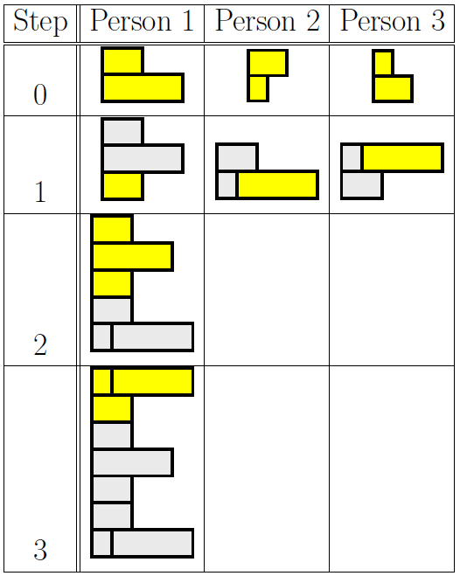
Group Communication
Groups of 3
Note who was person 1 task
2, 3 will need to pass completed substructures

Slide 14
Step 0

Slide 15
Step 1

Slide 16
Step 2

Slide 17
Step 3

Slide 18
Instruction-Level Parallelism
Latency?
Throughput?
Can reduce latency for single letter
Ideal: T_{latency} = T_{seqlatency}/P
…but critical path bound applies, dependencies may limit

Slide 19
Instruction-Level Pipeline
Build 5
Each person adds one brick to build
Run pipeline once alone
Latency?
Then run pipeline with 5 inputs
Throughput?

Slide 20
Thread Graph
How would we build with task level parallelism?
Tasks?
Dependencies?

Slide 21
Types of Parallelism
Data Level – Perform same computation on different data items
Thread or Task Level – Perform separable (perhaps heterogeneous) tasks independently
Instruction Level – Within a single sequential thread, perform multiple operations on each cycle.

Slide 22
Parallel Compute Models

Slide 23
Sequential Control Flow
Control flow
Program is a sequence of operations
Operation reads inputs and writes outputs into common store (memory)
One operation runs at a time
defines successor
Model of correctness is sequential execution
Examples
C (Java, …)
Finite-State Machine (FSM) / Finite Automata (FA)

Slide 24
Parallelism can be explicit
ILP Build example
Coordinate data parallel operations
Multiply, add for quadratic equation
Coordinate ILP
cycle | mpy | add
1 | B,x
2 | x,x | (Bx)+C
3 | A,x²
4 |  | Ax²+(Bx+C)

Slide 25
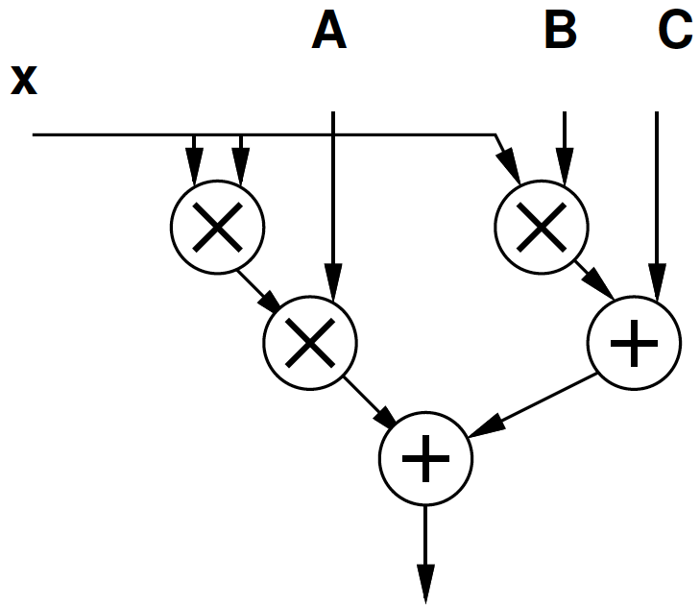
Parallelism can be implicit
Sequential expression
Infer data dependencies
T1=x*x
T2=A*T1
T3=B*x
T4=T2+T3
Y=C+T4
Or
Y=A*x*x+B*x+C

Slide 26
Implicit Parallelism
d=(x1-x2)*(x1-x2) + (y1-y2)*(y1-y2)
What parallelism exists here?

Slide 27
Parallelism can be implicit
Sequential expression
Infer data dependencies
for (i=0;i<100;i++)
y[i]=A*x[i]*x[i]+B*x[i]+C
Why can these operations be performed in parallel?

Slide 28
Term: Operation
Operation – logic computation to be performed

Slide 29
Dataflow / Control Flow
Dataflow
Program is a graph of operations
Operation consumes tokens and produces tokens
All operations run concurrently
Control flow (e.g. C)
Program is a sequence of operations
Operation reads inputs and writes outputs into common store
One operation runs at a time
defines successor

Slide 30
Token
Data value with presence indication
May be conceptual
Only exist in high-level model
Not kept around at runtime
Or may be physically represented
One bit represents presence/absence of data

Slide 31
Token Examples?
What are familiar cases where data may come with presence tokens?
Network packets
Memory references from processor
Variable latency depending on cache presence
Start bit on serial communication

Slide 32
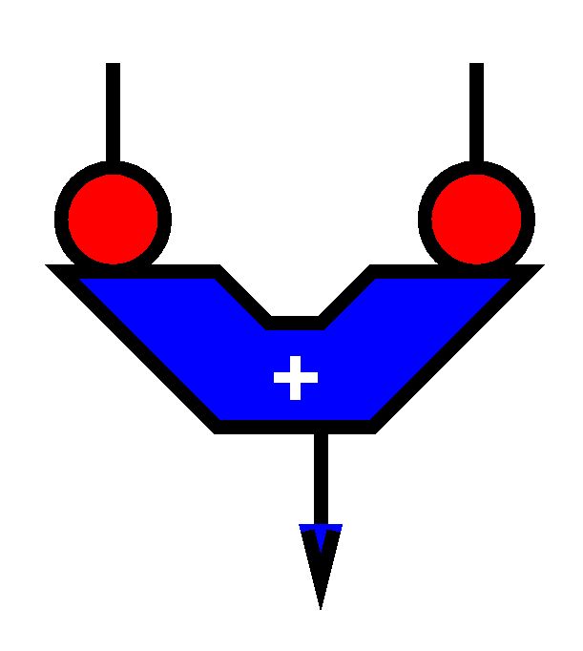
Operation
Takes in one or more inputs
Computes on the inputs
Produces results
Logically self-timed
“Fires” only when input set present
Signals availability of output

Slide 33
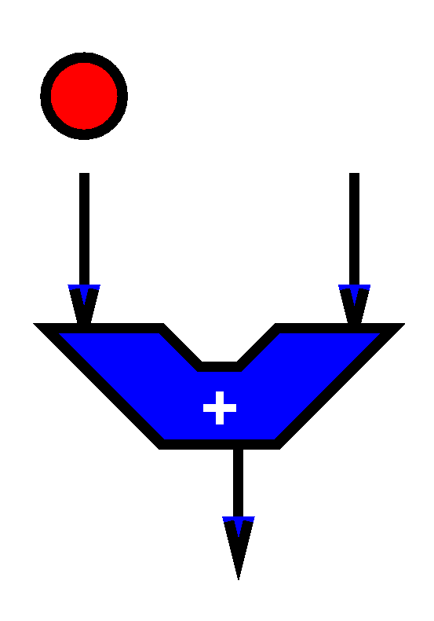
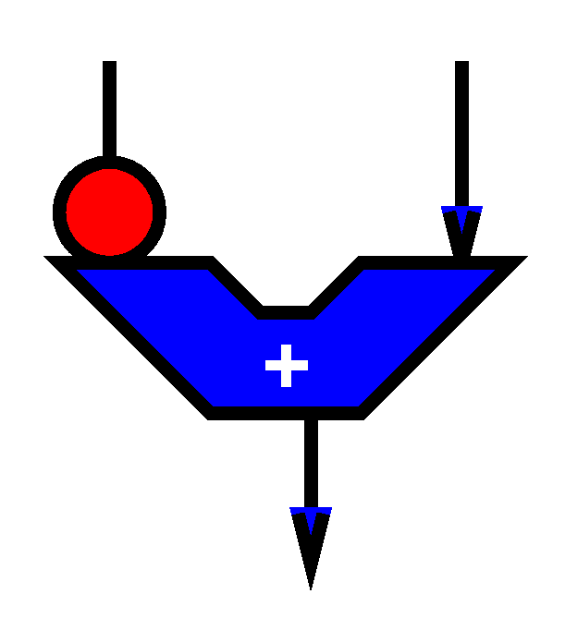
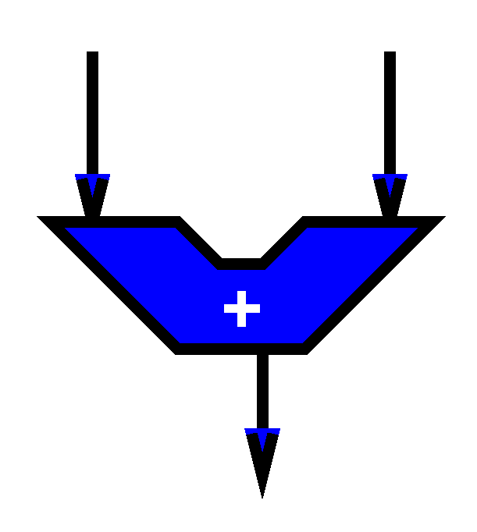
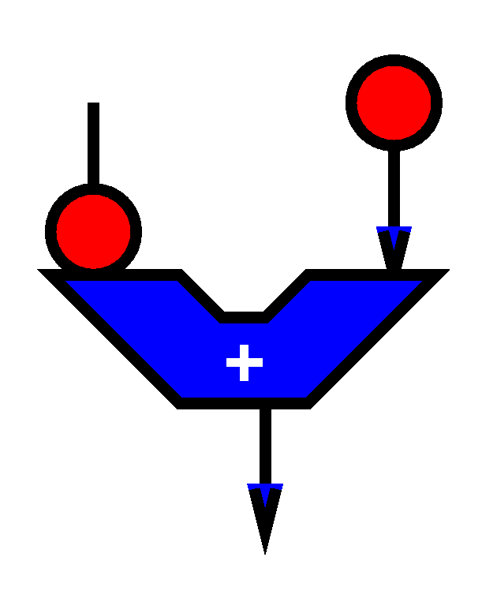
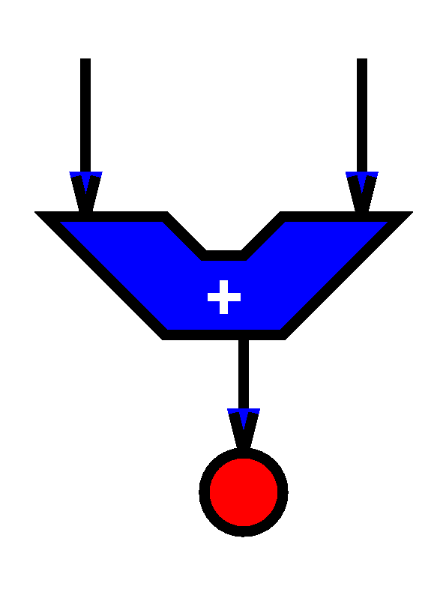

Slide 34
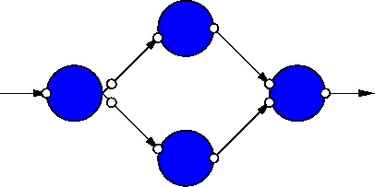
Dataflow Graph
Represents
computation sub-blocks
linkage
Abstractly
controlled by data presence

Slide 35
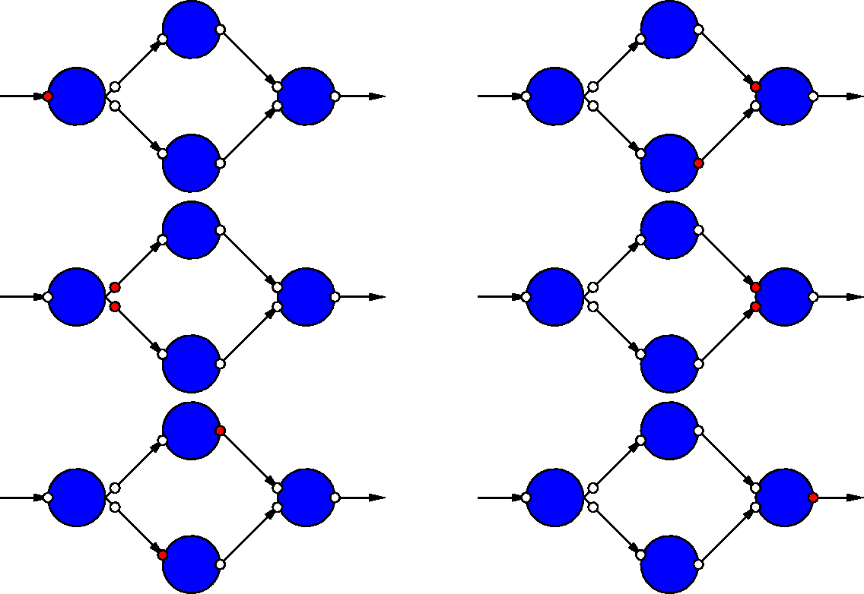
Dataflow Graph Example

Slide 36
Sequential / FSM
FSM is degenerate dataflow graph where there is exactly one token
S1
x not
present?
cycle | mpy | add | next
S1 | B,x |  | x-->S2, else S1
S2 | x,x | (Bx)+C | S3
S3 | A,x² |  | S4
S4 |  | Ax²+(Bx+C) | S1
S2
S3
S4

Slide 37
Sequential / FSM
FSM is degenerate dataflow graph where there is exactly one token
S1
cycle | mpy | add | next
S1 | B,x |  | x-->S2, else S1
S2 | x,x | (Bx)+C | S3
S3 | A,x² |  | S4
S4 |  | Ax²+(Bx+C) | S1
S2
S3
S4

Slide 38
Communicating Threads
Computation is a collection of sequential/control-flow “threads”
Threads may communicate
Through dataflow I/O
(Through shared variables)
View as hybrid or generalization
CSP – Communicating Sequential Processes → canonical model example

Slide 39
Video Decode
Audio
Sync to HDMI
Parse
Video
Why might need to synchronize to send to HDMI?

Slide 40
Compute Models

Slide 41
Value of Multiple Models
When you have a big enough hammer, everything looks like a nail.
Many stuck on single model
Try to make all problems look like their nail
Value to diversity / heterogeneity
One size does not fit all

Slide 42
Big Ideas
Many parallel compute models
Sequential, Dataflow, CSP
Find natural parallelism in problem
Mix-and-match

Slide 43
Admin
Reading Day 5 on web
HW2 due Friday
HW3 out
Return Legos ☺
Recitation in here at noon
Will take questions after class in hall

