Slide 1
ESE532: System-on-a-Chip Architecture
Day 5: September 17, 2018
Dataflow Process Model

Slide 2
Today
Dataflow Process Model
Terms
Issues
Abstraction
Performance Prospects
Basic Approach
Dataflow variants
Motivations/demands for variants
If time permits

Slide 3
Message
Parallelism can be natural
Expression can be agnostic to substrate
Abstract out implementation details
Tolerate variable delays may arise in implementation
Divide-and-conquer
Start with coarse-grain streaming dataflow
Basis for performance optimization and parallelism exploitation

Slide 4
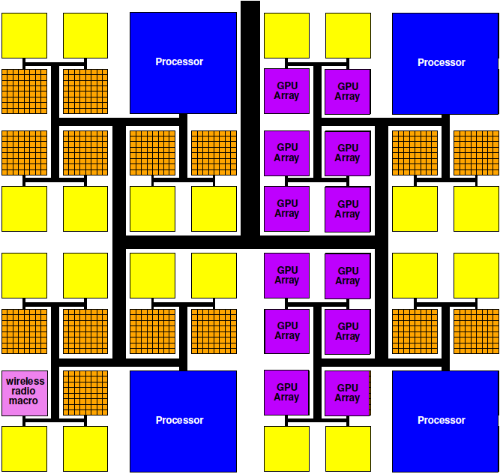
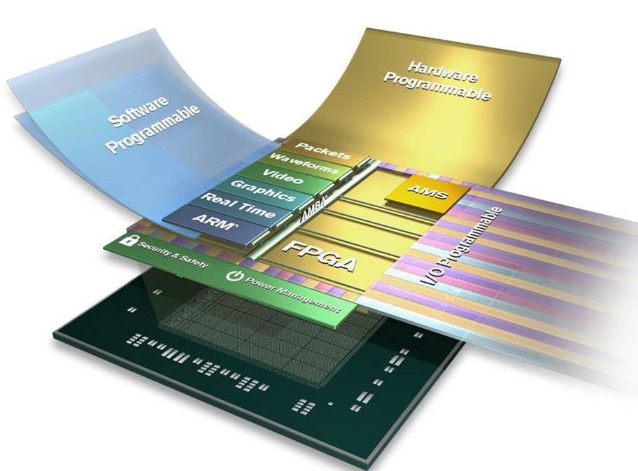
Programmable SoC
Implementation Platform for innovation
This is what you target (avoid NRE)
Implementation vehicle

Slide 5
Reminder
Goal: exploit parallelism on heterogeneous PSoC to achieve desired performance (energy)

Slide 6
Term: Process
Abstraction of a processor
Looks like each process is running on a separate processor
Has own state, including
Program Counter (PC)
Memory
Input/output
May not actually run on processor
Could be specialized hardware block
May share a processor

Slide 7
Thread
Has a separate locus of control (PC)
May share memory (contrast process)
Run in common address space with other threads

Slide 8
Model (from Day 3) Communicating Threads
Computation is a collection of sequential/control-flow “threads”
Threads may communicate
Through dataflow I/O
(Through shared variables)
View as hybrid or generalization
CSP – Communicating Sequential Processes → canonical model example

Slide 9
Process
Processes allow expression of independent control
Convenient for things that advance independently
Process (thread) is the easiest way to express some behaviors
Easier than trying to describe as a single process
Can be used for performance optimization to improve resource utilization

Slide 10
FIFO
First In First Out
Delivers inputs to outputs in order
Data presence
Consumer knows when data available
Back Pressure
Producer knows when at capacity
Typically stalls
Decouples producer and consumer processes
Hardware: maybe even different clocks

Slide 11
Issues
Communication – how move data between processes?
What latency does this add?
Throughput achievable?
Synchronization – how define how processes advance relative to each other?
Determinism – for the same inputs, do we get the same outputs?

Slide 12
Today’s Stand
Communication – FIFO-like channels
Synchronization – dataflow with FIFOs
Determinism – how to achieve
…until you must give it up.

Slide 13
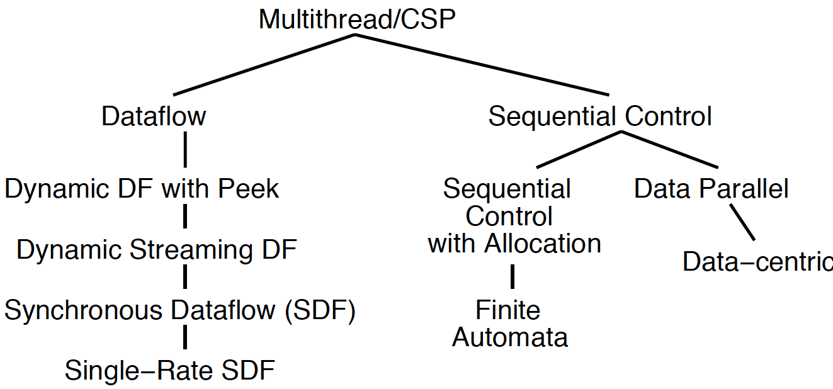
Dataflow Process Model

Slide 14
Operation/Operator
Operation – logic computation to be performed
A process that communicates through dataflow inputs and outputs
Operator – physical block that performs an Operation
E.g. processor, hardware block

Slide 15
Dataflow / Control Flow
Day 4
Dataflow
Program is a graph of operations
Operation consumes tokens and produces tokens
All operations run concurrently
All processes
Control flow (e.g. C)
Program is a sequence of operations
Operation reads inputs and writes outputs into common store
One operation runs at a time
defines successor

Slide 16
Token
Data value with presence indication
May be conceptual
Only exist in high-level model
Not kept around at runtime
Or may be physically represented
One bit represents presence/absence of data

Slide 17
Stream
Logical abstraction of a persistent point-to-point communication link between operators
Has a (single) source and sink
Carries data presence / flow control
Provides in-order (FIFO) delivery of data from source to sink
stream

Slide 18
Streams
Captures communications structure
Explicit producer→consumer link up
Abstract communications
Physical resources or implementation
Delay from source to sink
Contrast
C: producer->consumer implicit through memory
Verilog/VHDL: cycles visible in implementation
(can add on top of either C or Verilog)

Slide 19
Streams
Stream: logical communication link
How might we implement:
Two threads running on a single processor (sharing common memory)?
Two processes running on different processors on the same die?
Two processes running on different hosts
E.g. one at Penn, one on Amazon cloud

Slide 20
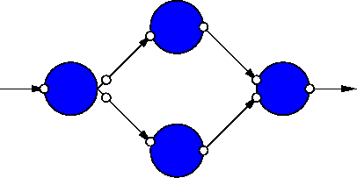
Dataflow Process Network
Collection of Operators
Connected by Streams
Communicating with Data Tokens
(CSP restricted to stream communication)

Slide 21
Dataflow Abstracts Timing
Doesn’t say
on which cycle calculation occurs
Does say
What order operations occur in
How data interacts
i.e. which inputs get mixed together
Permits
Scheduling on different # and types of resources
Operators with variable delay
Variable delay in interconnect

Slide 22
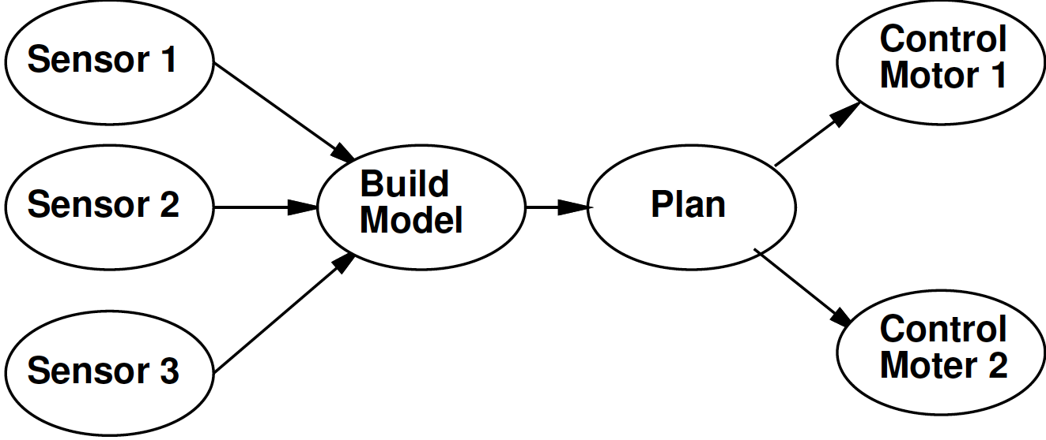
Some Task Graphs

Slide 23
Synchronous Dataflow (SDF) with fixed operators
Particular, restricted form of dataflow
Each operation
Consumes a fixed number of input tokens
Produces a fixed number of output tokens
Operator performs fixed number of operations (in fixed time)
When full set of inputs are available
Can produce output
Can fire any (all) operations with inputs available at any point in time

Slide 24
SDF Operator
FFT
1024 inputs
1024 outputs
10,240 multiplies
20,480 adds
(or 30,720 primitive operations)
1024
1024
30,720

Slide 25
Processor Model
Simple (for today’s lecture)
Assume one primitive operation per cycle
Could embelish
Different time per operation type
E.g. adds: 1 cycle, multiply: 3 cycles
Multiple memories with different timings

Slide 26
Time for Graph Iteration on Processors
Single processor
One processor per Operator
General
c(x,y) – 1 if Processor x runs task y

Slide 27
Intel Xeon Phi Pricing

Slide 28
Intel Knights Landing
https://www.nextplatform.com/2016/06/20/intel-knights-landing-yields-big-bang-buck-jump/
[Intel, Micro 2016]

Slide 29
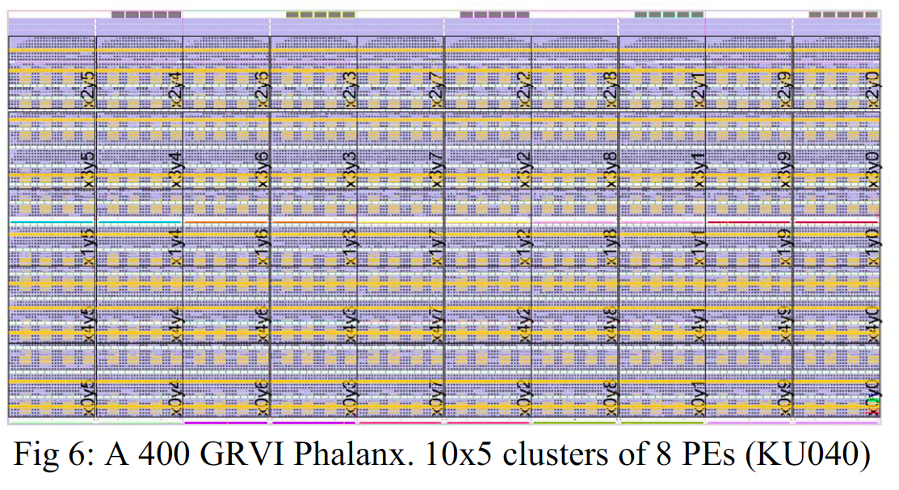
GRVI/Phallanx
Puts 1680 RISC-V32b Integer cores
On XCVU9P FPGA
http://fpga.org/2017/01/12/grvi-phalanx-joins-the-kilocore-club/
[Gray, FCCM 2016]

Slide 30
Map to different processors
30,000
15,000
3,000
2,000
Map to (preclass 1)
One processor performance?
One process per processor performance?
Two processors
How?
Performance?
Bottleneck?

Slide 31
Refine Data Parallel
If component is data parallel, can split out parallel tasks

Slide 32
Refine Pipeline
If operation internally pipelineable, break out pipeline into separate tasks
6,000
6,000
6,000
6,000
6,000
2,000
7,500
3,000
Performance with one processor per operator?
Achieve same performance with how many processors?

Slide 33
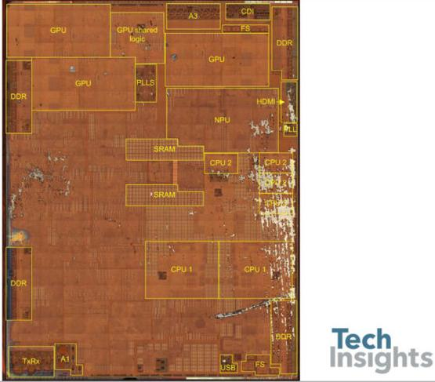
Apple A11 Bionic
90mm² 10nm FinFET
4.3B transistors
iPhone 8, 8s, X
6 ARM cores (64b)
2 fast (2.4GHz)
4 low energy
3 custom GPUs
Neural Engine
600 Bops?
Motion, image accel.
8MB L2 cache
https://wccftech.com/apple-iphone-8-plus-a11-bionic-complete-teardown/

Slide 35
Heterogeneous Processor
30,000
15,000
3,000
2,000
GPU perform 10 primitive FFT Ops per cycle
Fast CPU can perform 2 ops/cycle
Slow CPU 1 op/cycle
Map: FFT to GPU, Select to 2 Fast CPUs, quantize and Entropy each to own Slow CPU
Cycles/graph iteration?

Slide 36
Custom Accelerator
Dataflow Process doesn’t need to be mapped to a processor
Map FFT to custom datapath on FPGA logic
Read and produce one element per cycle
1024 cycles to process 1024-point FFT
1024
15,000
3,000
2,000

Slide 37
Operations
Can be implemented on different operators with different characteristics
Small or large processor
Hardware unit
Different levels of internal
Data-level parallelism
Instruction-level parallelism
Pipeline parallelism
May itself be described as
Dataflow process network, sequential, hardware register transfer language

Slide 38
Add Delay
What do to computation if add an operation that copies inputs to outputs with some latency?
Impact on function?
Througput impact if Identity operation has
Latency 10, throughput 1 value per cycle?
(reminder 1024 values between FFT and Select Freq.)
30,000
1024
15,000
3,000
2,000

Slide 39
Communication Latency
Once map to multiple processors
Need to move data between processors
That costs time

Slide 40
On-Chip Delay
Day 3
Delay is proportional to distance travelled
Make a wire twice the length
Takes twice the latency to traverse
(can pipeline)
Modern chips
Run at 100s of MHz to GHz
Take 10s of ns to cross the chip

Slide 41
Dataflow gives Clock Independent Semantics
Interconnect
Takes n-clocks
Latency

Slide 42
Semantics
Need to implement semantics
i.e. get same result as if computed as indicated
But can implement any way we want
That preserves the semantics
Exploit freedom of implementation

Slide 43
Basic Approach

Slide 44
Approach (1)
Identify natural parallelism
Convert to streaming flow
Initially leave operations in software
Focus on correctness
Identify flow rates, computation per operator, parallelism needed
Refine operations
Decompose further parallelism?
E.g. data parallel split, ILP implementations
model potential hardware

Slide 45
Approach (2)
Refine coordination as necessary for implementation
Map operations and streams to resources
Provision hardware
Scheduling: Map operations to operators
Memories, interconnect
Profile and tune
Refine

Slide 46
Dataflow Variants

Slide 47
Turing Complete
Can implement any computation describable with a Turing Machine
(theoretical model of computing by Alan Turing)
Turing Machine – captures our notion of what is computable
If it cannot be computed by a Turing Machine, we don’t know how to compute it

Slide 48
Process Network Roundup
Model | Deterministic Result | Deterministic Timing | Turing Complete
SDF+fixed-delay operators | Y | Y | N
SDF+variable delay operators | Y | N | N
DDF blocking | Y | N | Y
DDF non-blocking | N | N | Y

Slide 49
Synchronous Dataflow (SDF) with fixed operators
Particular, restricted form of dataflow
Each operation
Consumes a fixed number of input tokens
Produces a fixed number of output tokens
Operator performs fixed number of operations (in fixed time)
When full set of inputs are available
Can produce output
Can fire any (all) operations with inputs available at any point in time

Slide 50
Synchronous Dataflow (SDF)
Particular, restricted form of dataflow
Each operation
Consumes a fixed number of input tokens
Produces a fixed number of output tokens
(can take variable computation for operator)
When full set of inputs are available
Can produce output
Can fire any (all) operations with inputs available at any point in time

Slide 51
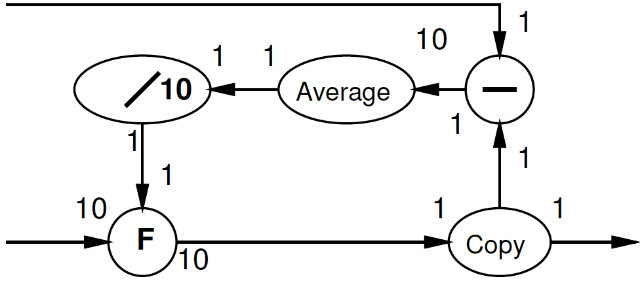
Multirate Synchronous Dataflow
Rates can be different
Allow lower frequency operations
Communicates rates to tools
Use in scheduling, provisioning
Rates must be constant
Data independent
2
decimate
1

Slide 52
Dynamic Dataflow
(Less) restricted form of dataflow
Each operation
Conditionally consume input based on data value
Conditionally produce output based on data value
When full set of inputs are available
Can (optionally) produce output
Can fire any (all) operations with data-specified necessary inputs available at any point in time

Slide 53
Blocking
Key to determinism: behavior doesn’t depend on timing
Cannot ask if a token is present
If (not_empty(in))
Out.put(3);
Else
Out.put(2);

Slide 54
Process Network Roundup
Model | Deterministic Result | Deterministic Timing | Turing Complete
SDF+fixed-delay operators | Y | Y | N
SDF+variable delay operators | Y | N | N
DDF blocking | Y | N | Y
DDF non-blocking | N | N | Y

Slide 55
Motivations and Demands for Options
Time Permitting

Slide 56
Variable Delay Operators
What are example of variable delay operators we might have?

Slide 57
Variable Delay Operators
Operators with Variable Delay
Cached memory or computation
Shift-and-add multiply
Iterative divide or square-root

Slide 58
GCD (Preclass 2)
What is delay of GCD computation?
while(a!=b)
t=max(a,b)-min(a,b)
a=min(a,b)
b=t
return(a);

Slide 59
Preclass 3
How long to process each input?
(for concrete example on preclass)
Correlation in delays?
What benefit from FIFO and processes?

Slide 60
Preclass 3
Independent probability of miss
P_{f}, P_{g}
Concretely
1 cycle in map
100 run function and put in map
If each runs independently (in isolation)
T~= 1*(1-P)+P*100
If run together in lock step
Either can stall: P=P_{f}+P_{g}-P_{f}P_{g}
T~= 1*(1-P)+(P)*100

Slide 61
Dynamic Rates?
When might static rates be limiting? (prevent useful optimizations?)

Slide 62
Dynamic Rates?
Static Rates limiting
Compress/decompress
Lossless
Even Run-Length-Encoding
Filtering
Discard all packets from spamRus
Anything data dependent

Slide 63
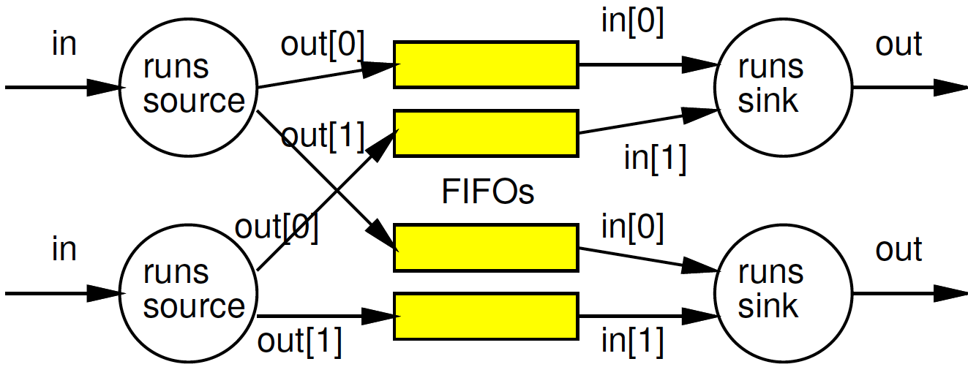
When non-blocking necessary?
What are cases where we need the ability to ask if a data item is present?
Consider an IP packet router:

Slide 64
Non-Blocking
Removed model restriction
Can ask if token present
Gained expressive power
Can grab data as shows up
Weaken our guarantees
Possible to get non-deterministic behavior

Slide 65
Process Network Roundup
Model | Deterministic Result | Deterministic Timing | Turing Complete
SDF+fixed-delay operators | Y | Y | N
SDF+variable delay operators | Y | N | N
DDF blocking | Y | N | Y
DDF non-blocking | N | N | Y

Slide 66
Big Ideas
Capture gross parallel structure with Process Network
Use dataflow synchronization for determinism
Abstract out timing of implementations
Give freedom of implementation
Exploit freedom to refine mapping to optimize performance
Minimally use non-determinism as necessary

Slide 67
Admin
Reading for Day 6 on web
HW3 due Friday
Boards

