Slide 1

ESE532:
System-on-a-Chip Architecture
Day 7: September 24, 2018
Pipelining

Slide 2
Previously
Pipelining in the large
  Not just for gate-level circuits
Throughput and Latency
Form of parallelism

Slide 3
Today
Pipelining details (for gates, primitive ops)
Systematic Approach
Justify Operator and Interconnect Pipelining
Loop Bodies
Cycles if the Dataflow Graph
C-slow [bonus if have time]

Slide 4
Message
Pipelining is an efficient way to reuse hardware to perform the same set of operations at high throughput

Slide 5
Synchronous Circuit Discipline
Registers that sample inputs at clock edge and hold value throughout clock period
Compute from registers-to-registers
Cycle time large enough for longest logic path between registers
Min cycle = Max path delay between registers
Comb
logic

Slide 6
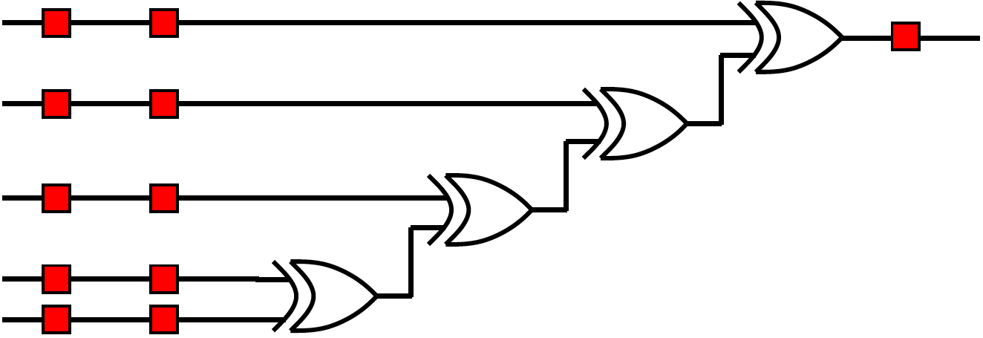
Preclass 1
Delay between registers as shown?

Slide 7
Preclass 1
Move registers so can clock at 2-xor-delays?

Slide 8
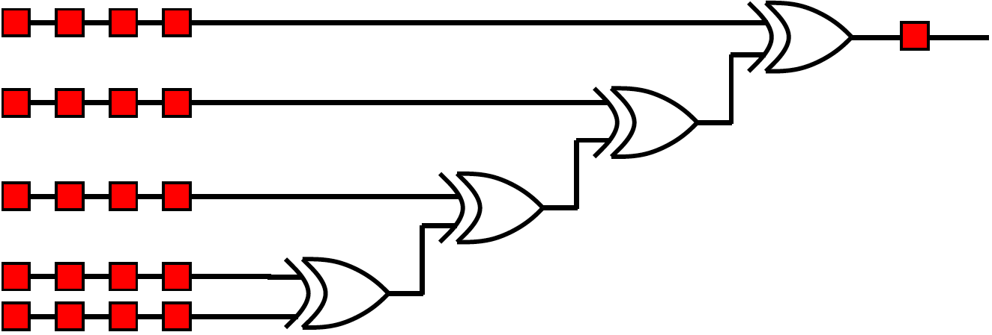
Preclass 2
Move registers so can clock at xor-delays?

Slide 9
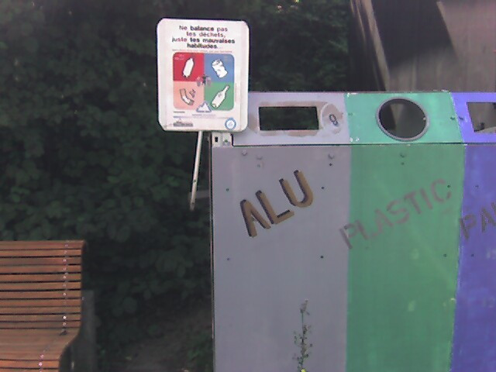
Pipeline Reuse
Lower delay between clocks
  Higher clock rate
  Higher potential throughput
  Faster we reuse our logic
  More capacity get out of design
    Assuming registers cheap in area and time overhead

Slide 10
Levelize-and-Cut Pipelining
Assuming willing to pipeline into as many cycles as necessary
Draw circuit in levels by delay from input
  Level=max(level of inputs)+delay operator
Given cycle time target
Count forward to target
Bisect circuit adding register on every cut link
Repeat count-and-bisect until done

Slide 11
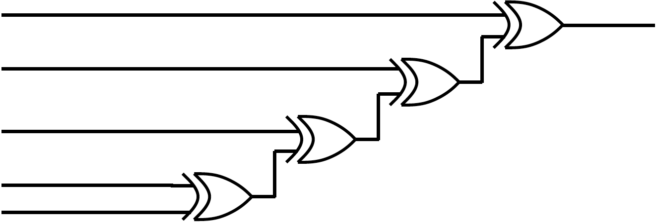
Apply to xor-chain
Levelize
Cut for 2 unit cycle target
  … for 1 unit

Slide 12
Note Registers on Links
Some links end up with multiple registers.
Why?

Slide 13
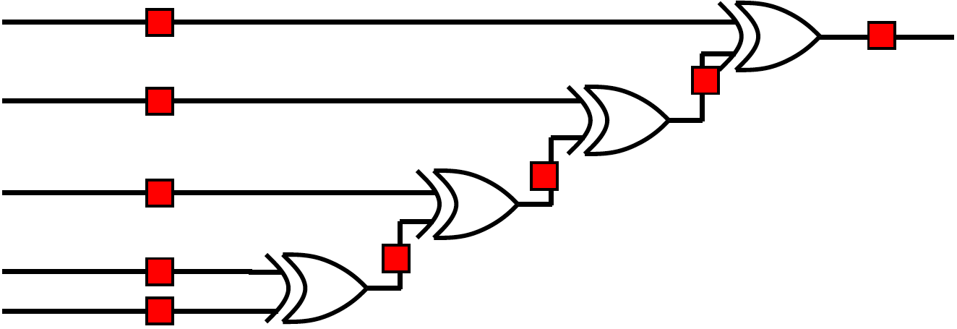
What Happens?
What would be wrong with this pipelining?

Slide 14
Consistent Pipelining
Levelize-and-cut guarantees path from input to any gate input passes through the same number of registers
Makes sure a consistent input set arrives at each gate/operator
  Don’t get mixing between input sets

Slide 15
Add Registers and Move
If we’re willing to add pipeline delay
  Add any number of pipeline registers at input
  Move registers into circuit to reduce cycle time
    Reduce max delay between registers

Slide 16
Add Registers at Input

Slide 17
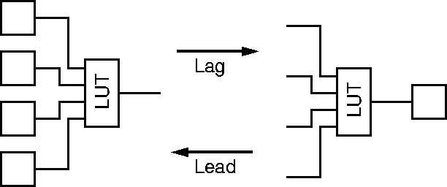
Legal Register Moves
Retiming Lag/Lead

Slide 18
Add Register and Retime
Add chain of registers on every input
Retime registers into circuit
  Minimizing delay between registers

Slide 19
Preclass 1
Retime

Slide 20
Add Registers and Retime
Lets us think about behavior
  What the pipelining is doing to cycles of delay
Separate from details of how redistribute registers
Behavioral equivalence between the registers-at-front and properly retimed version of circuit

Slide 21
Justify Pipelining
(or composing pipelined operators)

Slide 22
Handling Pipelined Operators
Given a pipelined operator
  (or a pipelined interconnect)
Discipline of picking a frequency target and designing everything for that
  May be necessary to pipeline operator since its delay is too high
Due to hierarchy
  Pipelined this operator and now want to use it as a building block

Slide 23
Examples
Run at 500MHz
Floating-point unit that takes 9ns
  Can pipeline into 5, 2ns stages
Multiplier that takes 6ns
Memory can access in 2ns
  Only if registers on address/inputs and output
  i.e. exist in own clock stage

Slide 24
Interconnect Delay
Chips >> Clock Cycles
May have chip 100s of Operators wide
May only be able to reach across 10 operators in a 2ns cycle
Must pipeline long interconnect links

Slide 25
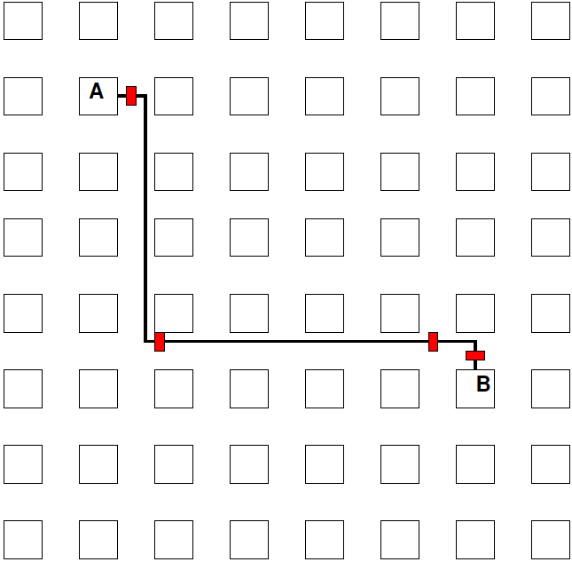
Interconnect Example

Slide 26
Methodology:
Pipelined Operator Graph
Start with logical, unpipelined graph
Treat each pipelined operator as a set of unit-delay operators of mandatory depth
Treat each interconnect pipeline stage as a unit-delay buffer
Add registers at input
Retime into graph

Slide 27
Model
3-stage Multiplier
Interconnect Delay
A
I1
M1
I2
M2
I3
M3
B

Slide 28
Pipeline Loop
(and use for justify pipeline example)

Slide 29
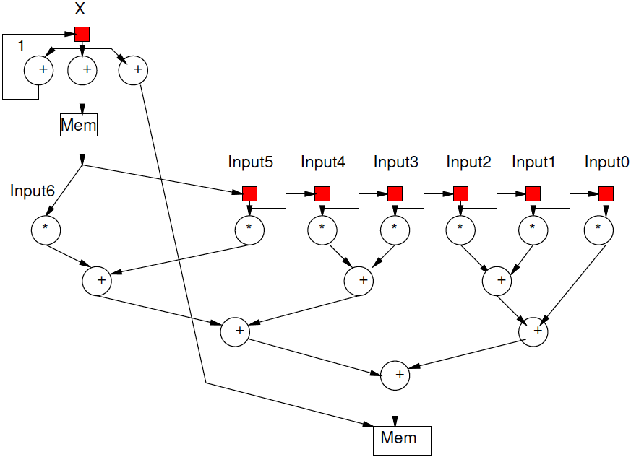
Preclass 4
Logical (unpipelined) dataflow graph for loop body

Slide 30
Example Operators
Operator and Interconnect delays
  Multiplier 3 cycles
  Reading from Input array
    Memory op is cycle after computing address
    Takes one cycle delay bring data back to multiplier

Slide 31
Illustrate Need
What happens if just use graph as is (with operators pipelined as required)?

Slide 32
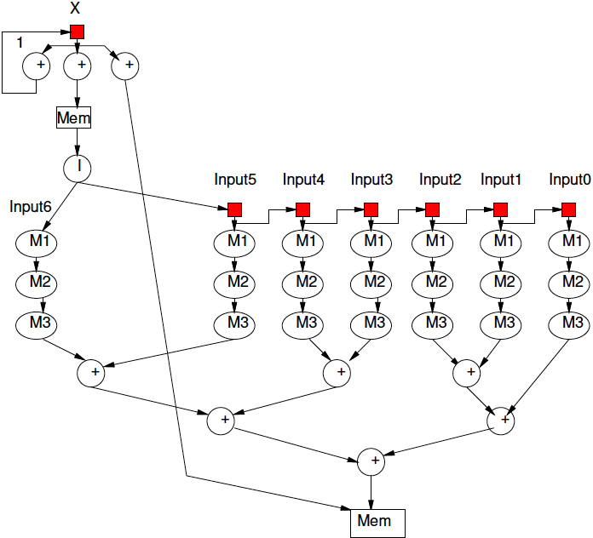
Model Graph
Revised graph for modeling

Slide 33
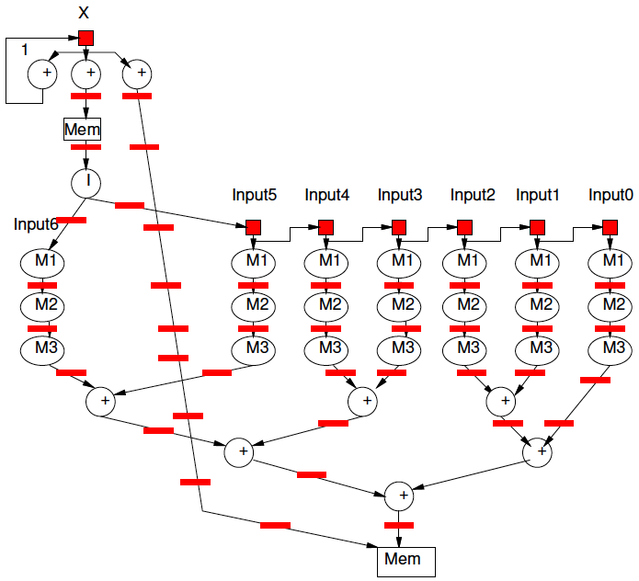
Pipeline Graph
Result after pipelining?

Slide 34
Pipelining Lesson
Can always pipeline an acyclic graph to fixed frequency target
  fixed pipelining of primitive operators
  Pipeline interconnect delays
Need to keep track of registers to balance paths
  So see consistent delays to operators

Slide 35
Graph Cycles

Slide 36
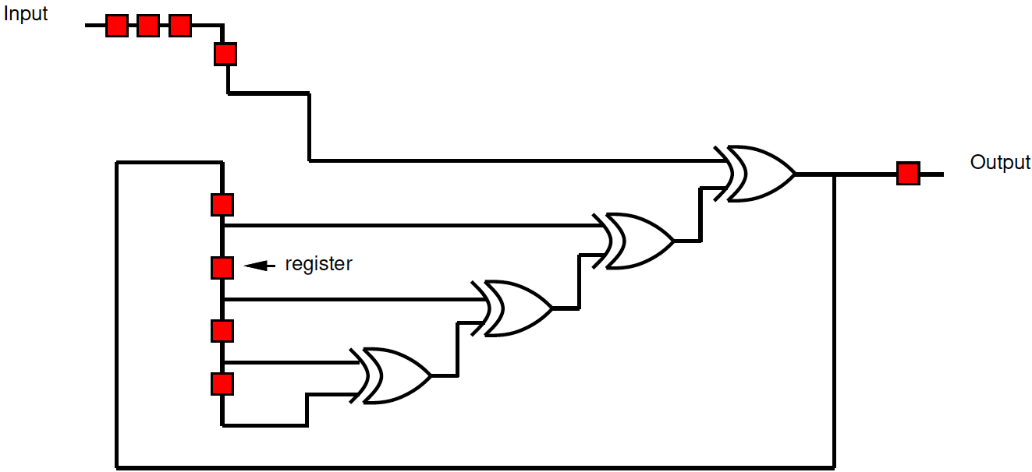
Preclass 3
What cycle time can we achieve?
How retime?

Slide 37
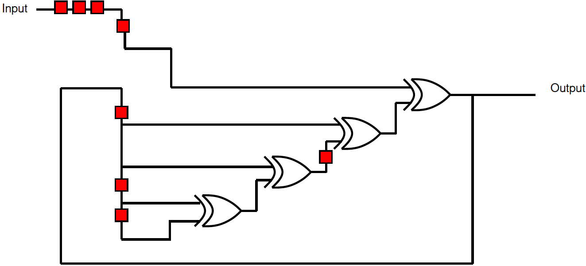
Retimed Preclass 3

Slide 38
Retiming Limits?
What prevents us from further retiming?

Slide 39
Cycle Observation
Retiming does not allow us to change the number of registers inside a cycle.
Limit to cycle time
  Max delay in cycle / Registers in cycle
Pipelining doesn’t help inside cycle
  Cannot push registers into cycle

Slide 40
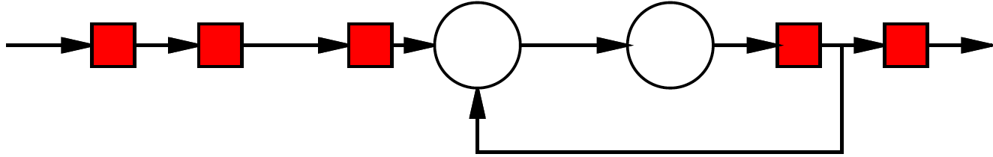
Simple Cycle
Delay of cycle?
Registers in cycle?
What happens to cycle if try to apply lead/lag?

Slide 41
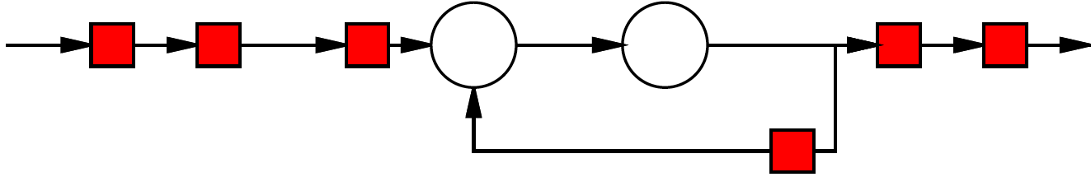
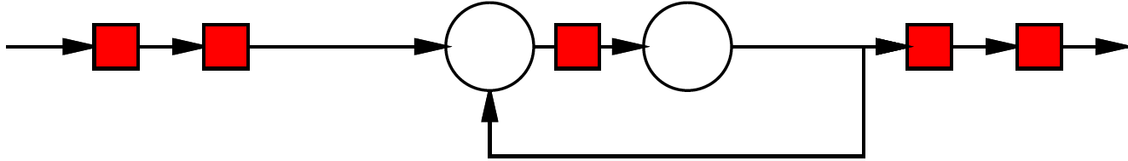
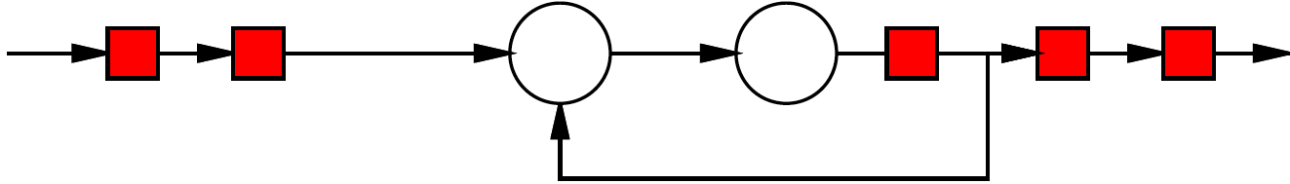
Retiming

Slide 42
Loop
What does graph look like for this loop body?
[multiply and mod each take 3 cycles]
For (i=0;i<N;i++)
  C[i]=(C[i-1]*A[i])%N;

Slide 43
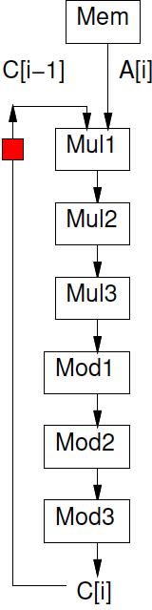
Loop
For (i=0;i<N;i++)
  C[i]=(C[i-1]*A[i])%N;

Slide 44
Initiation Interval (II)
Cyclic dependencies can limit throughput
Due to dependent cycles,
  May not be able to initiate a new computation on every cycle
II – cycles (delay) before can initiate
Throughput = 1/II

Slide 45
Loop
For (i=0;i<N;i++)
  C[i]=(C[i-1]*A[i])%N;
Initiation Interval?

Slide 46
C-Slow
(if time permits)

Slide 47
Problem
Pipelining cannot push registers into cycle
Graph cycles can prevent running at full pipeline target (maximum frequency)
If not reusing operators at full pipeline target are underutilizing resources
Can we use the resources for something?

Slide 48
C-Slow
Observation: if we have data-level parallelism, can use to solve independent problems on same hardware
Transformation: make C copies of each register
Guarantee: C computations operate independently
  Do not interact with each other

Slide 49
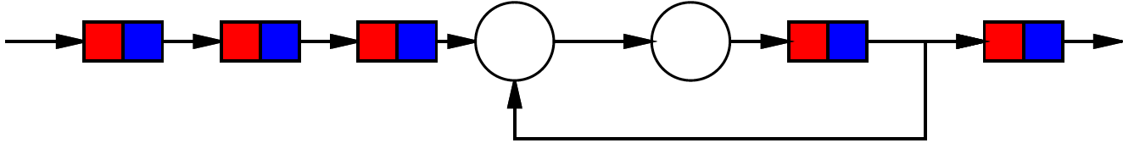
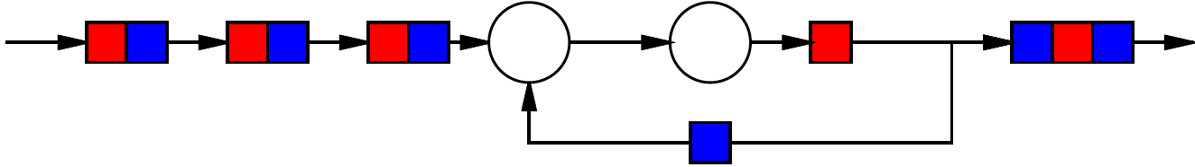
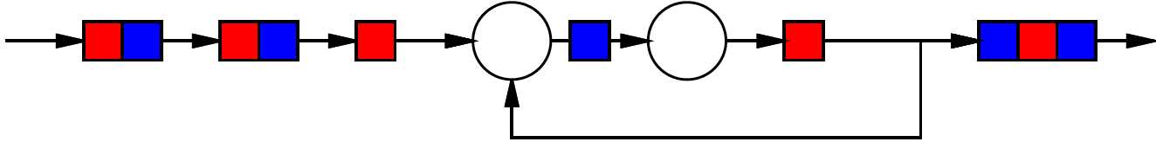
2-Slow Simple Cycle
Replace register with pair
Retime

Slide 50
2-Slow Simple Cycle
Replace register with pair
Retime
Observe independence of red/blue computations

Slide 51
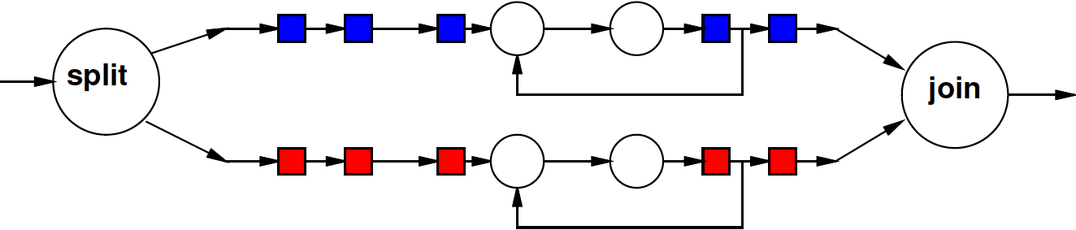
Equivalence
The 2-slow operator is equivalent to two data parallel operators running at half the speed

Slide 52
Automation
No mainstream tool today will perform C-slow transformation for you automatically
Synthesis tools will retime registers

Slide 53
Lesson
Cyclic dependencies limit throughput on single task or data stream
  Cycle-length / registers-in-cycle
Can use on C independent (data parallel) tasks

Slide 54
Big Ideas
Pipeline computations to reuse hardware and maximize computational capacity
Can compose pipelined operators and accommodate fixed-frequency target
  Be careful with data retiming
Cycles limit pipelining on single stream
C-slow to share hardware among multiple, data-parallel streams

Slide 55
Admin
Reading for Day 8 on web
HW4 due Friday

