Slide 1

ESE532:
System-on-a-Chip Architecture
Day 7: September 24, 2018
Pipelining -- Supplement

Slide 2
Register
On each cycle, the output of the register is the value of the input of the register on the previous cycle.

Slide 3
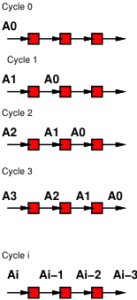
Shift Register
Illustrate operation
Data moves through
registers
Shifts to right with each cycle
Steady state, output at right is value input 3 cycles prior

Slide 4

Addition
Combinational Addition
Two Adders
Output is sum of 3 values

Slide 5
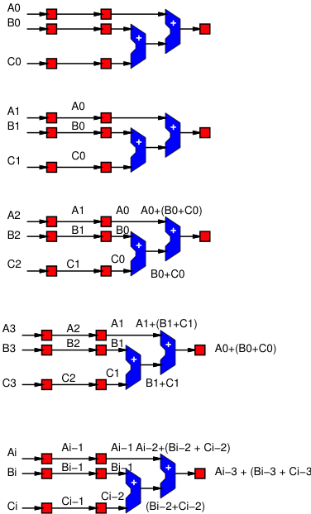
Pipelined
Addition
Here we add registers to compute the addition in part of a pipeline
Like the shift register values move through the registers over cycles
The output is the sum of the inputs 3 cycles prior

Slide 6
Pipelined
Addition
Note that the output is all inputs from the same cycle
All the subscripts to A, B, C are the same.

Slide 7

Retimed Add
Now, we retime the add by applying a lag to the first adder
  Move registers from its inputs to outputs

Slide 8
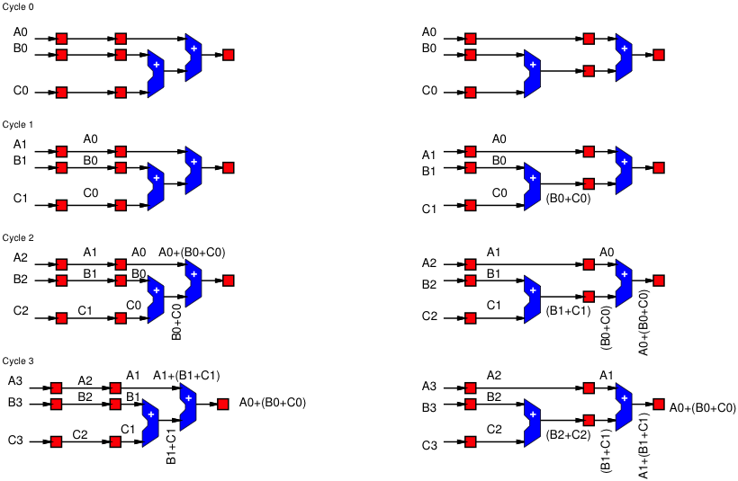
Compare Behavior

Slide 9
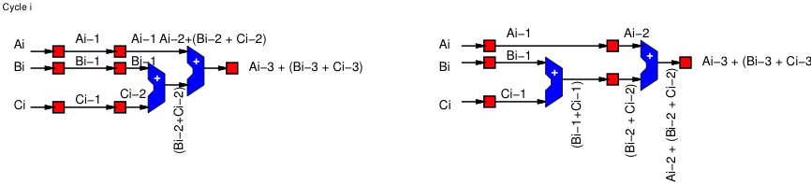
Retimed Behavior
To external behavior, the output is unchanged after the lag
  Circuits behave identically

Slide 10

Retimed Circuit Cycle Time
Original circuit had two adder delays between registers
  Minimum cycle time = 2*Tadd
  Throughput = 1/(2*Tadd)
Retimed circuit has one adder delay between registers
  Minimum cycle time = Tadd
  Throughput = 1/Tadd
By performing the retiming, we doubled the throughput

Slide 11
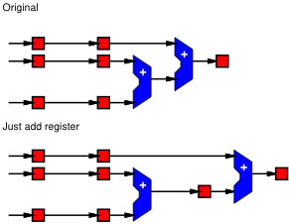
What-if just added a register?
Rather than lag, what if we just added a register?

Slide 12
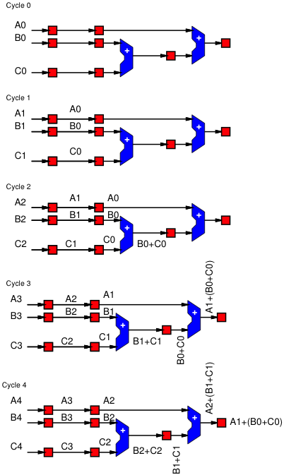
Just Add Register
Behavior
Note how this is different
from the original
(and from the retimed)
Here, final output mixes
A1 with B0 and C0

Slide 13
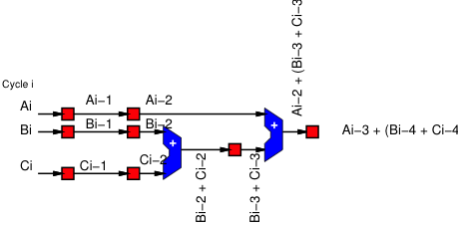
Just Add Register Function
Output takes the B and C from one
input and adds it to the A that enters
one cycle later.

