Slide 1
ESE532: System-on-a-Chip Architecture
Day 8: September 26, 2018
Spatial Computations

Slide 2
Today
Graph Cycles (from Day 7)
Accelerator Pipelines
FPGAs
Zynq Computational Capacity

Slide 3
Message
Custom accelerators efficient for large computations
Exploit Instruction-level parallelism
Run many low-level operations in parallel
Field Programmable Gate Arrays (FPGAs)
Allow post-fabrication configuration of custom accelerator pipelines
Can offer high computational capacity

Slide 4
Graph Cycles

Slide 5
Reminder
Able to pipeline and retime to reduce cycle time on acyclic dataflow graphs

Slide 6
Preclass 1
Can we retime to reduce cycle

Slide 7
Retiming Limits?
What prevents us from retiming?

Slide 8
Cycle Observation
Retiming does not allow us to change the number of registers inside a cycle.
Limit to cycle time
Max delay in cycle / Registers in cycle
Pipelining doesn’t help inside cycle
Cannot push registers into cycle

Slide 9
Simple Cycle
Delay of cycle?
Registers in cycle?
What happens to cycle if try to apply lead/lag?

Slide 10
Retiming

Slide 11
Loop
What does graph look like for this loop body?
[multiply and mod each take 3 cycles]
For (i=0;i<N;i++)
C[i]=(C[i-1]*A[i])%N;

Slide 12
Loop
For (i=0;i<N;i++)
C[i]=(C[i-1]*A[i])%N;

Slide 13
Initiation Interval (II)
Cyclic dependencies can limit throughput
Due to dependent cycles,
May not be able to initiate a new computation on every cycle
II – cycles (delay) before can initiate
Throughput = 1/II

Slide 14
Loop
For (i=0;i<N;i++)
C[i]=(C[i-1]*A[i])%N;
Initiation Interval?

Slide 15
Accelerator Datapaths

Slide 16
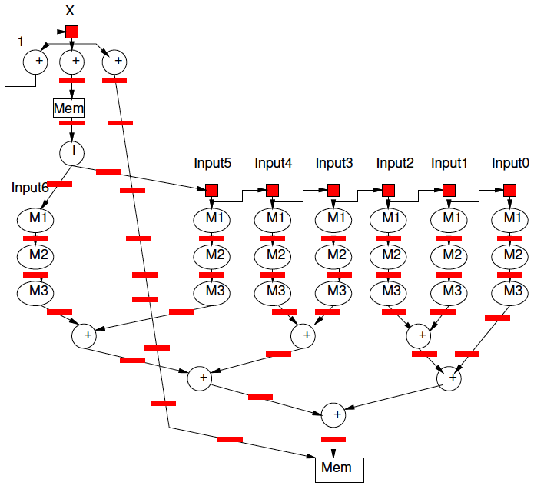
Pipeline for Unrolled Loop

Slide 17
Preclass 1
For fully unrolled loop shown, how many instructions per pipeline cycle?
Add
Mpy
Load
Store

Slide 18
Spatial Pipeline
Can compute equivalent of tens of “instructions” in a cycle
Wire up primitive operators
No indirection through register file, memory
Pipeline for operator latencies
Any dataflow graph of computational operations

Slide 19
Operators
Can assemble any custom operators
Ones may not have in generic processor
Processor
Add, bitwise-xor/and/or, multiply
Maybe: floating-point add, multiply
Less likely
Square-root, exponent, cosine, encryption (AES) step, polynomial evaluate, log-number-system

Slide 20
Accelerators
Compression/decompression
Encryption/decryption
Encoding (ECC, Checksum)
Discrete Cosine Transform (DCT)
Sorter
Taylor Series Approximation of function
Transistor evaluator
Tensor or Neural Network evaluator

Slide 21
Streaming Dataflow
Replace operator with custom accelerator
Stream data to/from it

Slide 22
Streaming Dataflow Example

Slide 23
Application-Specific SoCs
For dedicated applications may build custom hardware for accelerators
Layout VLSI, fab unique chips
ESE370, 570
Video-encoder – include custom DCT, motion-estimation engines

Slide 24
Customizable Accelerators
With post-fabrication configurability can exploit without unique fabrication
Need programmable substrate that allows us to wire-up computations

Slide 25
Field-Programmable Gate Arrays
FPGAs

Slide 26
FPGA
Idea: Can wire up programmable gates in the “field”
After fabrication
At your desk
When part “boots”
Like a “Gate Array”
But not hardwired

Slide 27
Gate Array
Idea: Provide a collection of uncommitted gates
Create your “custom” logic by wiring together the gates
Less layout, fewer masks than full custom
Since only wiring together pre-fab gates
→ lower cost (fewer masks)
→ lower manufacturing delay

Slide 28
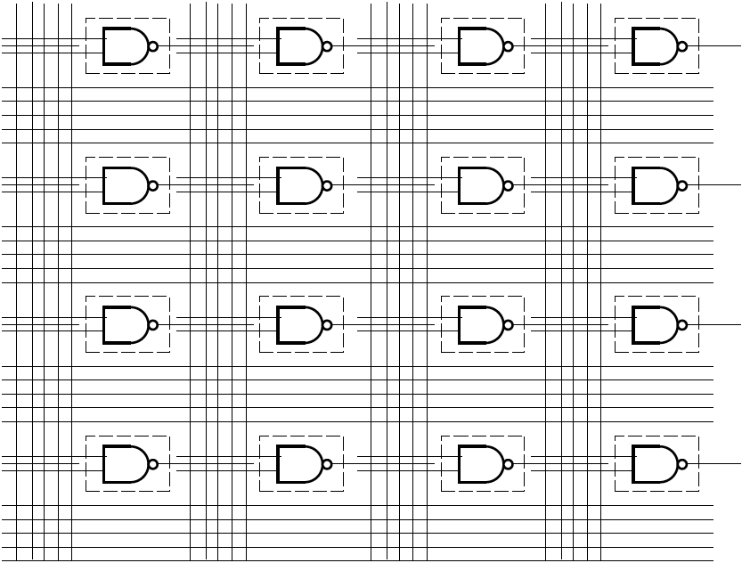
Gate Array

Slide 29
GA→FPGA
Remove the need to even fabricate the wiring mask
Make “customization” soft
Key trick:
Use reprogrammable configuration bits
Typically: static-RAM bits
Like SRAM cells or latches in memory
Hold a configuration value

Slide 30
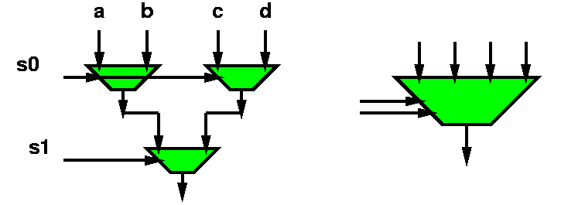
Mux with configuration bits = programmable gate

Slide 31
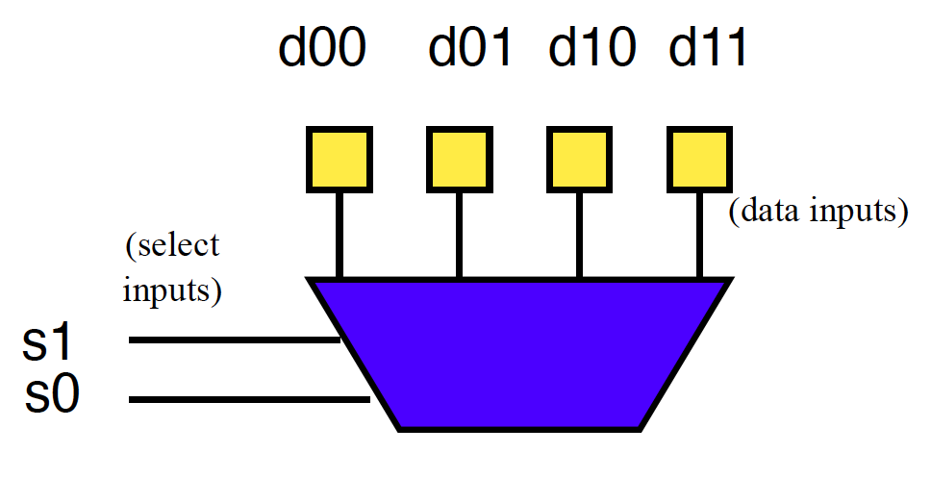
Preclass 2a
How do we program to behave as and2?

Slide 32
Preclass 2b
How do we program to behave as xor2?

Slide 33
Mux as Logic
Just by “configuring” data into this mux4,
Can select any two input function

Slide 34
LUT – LookUp Table
When use a mux as programmable gate
Call it a LookUp Table (LUT)
Implementing the Truth Table for small # of inputs
# of inputs =k (need mux-2^{k})
Just lookup the output result in the table

Slide 35
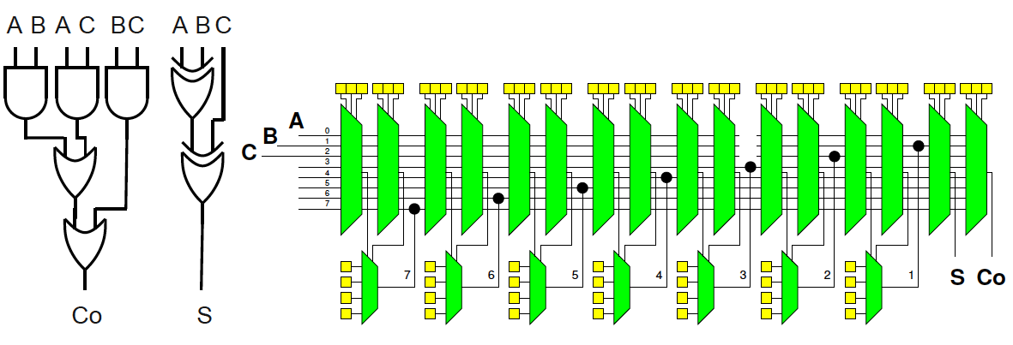
Preclass 3
How do we program full adder?

Slide 36
FPGA
Programmable gates + wiring
(both built from muxes w/ config. bits)
Can wire up any collection of gates
Like a gate array

Slide 37
Simplistic FPGA (illustrate possibility)
Every LUT input has a mux
Every such mux has m=(N+I) inputs
An input for each LUT output (N 2-LUTs)
An input for each Circuit Input (I Circuit inputs)
Each Circuit Output has an m-input mux

Slide 38
Simplistic FPGA (illustrate possibility)
N 2-LUTs, I Circuit Inputs, O Circuit Outputs
2N+O muxes to connect
Can build any combinational logic circuit that doesn’t need more than N 2-input gates, I inputs, O outputs

Slide 39
How big is an m-input mux?
In terms of 2-input muxes?
m inputs – what we are selecting from
log₂(m) bits
to select
which input
routed to
output

Slide 40
Simplistic FPGA (illustrate possibility…and expense)
2N+O m-input muxs; m=N+I
Each m-input mux is m-1 2-input muxes
Requires: (2N+O)*(N+I-1) 2-input muxes
Mux area grows as ~N²
when gate (LUT) area grows as N

Slide 41
Interconnect
Fully connected mux input too expensive
…and not necessary
Want
To be able to wire up gates
Economical with wires and muxes
…and configuration bits
Exploit locality (keep wires short)

Slide 42
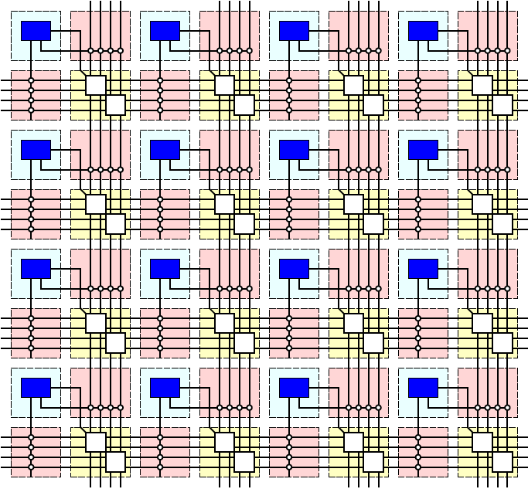
Simple FPGA

Slide 43
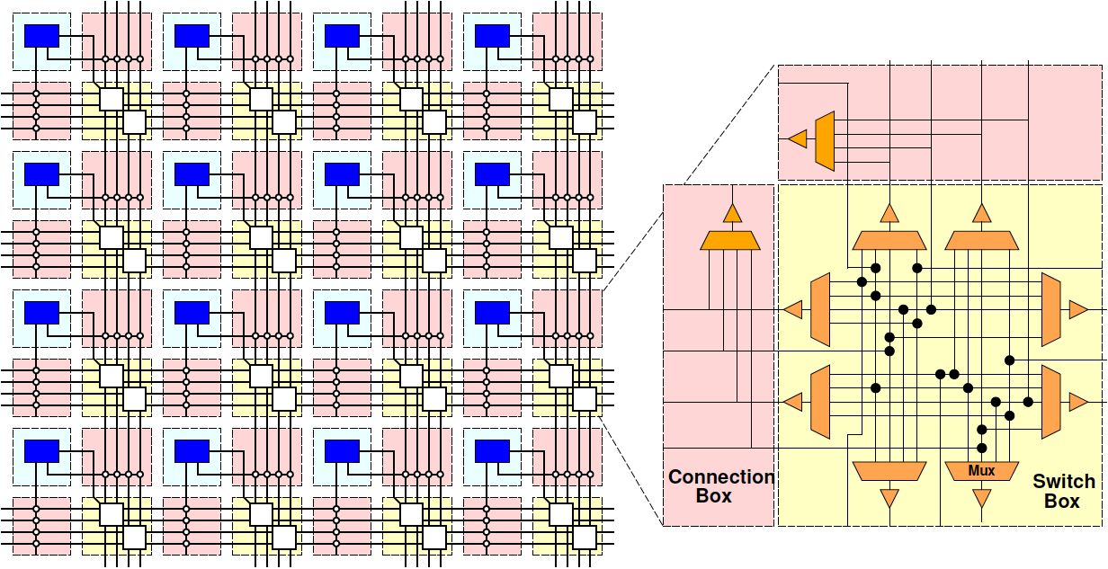
Simple FPGA

Slide 44
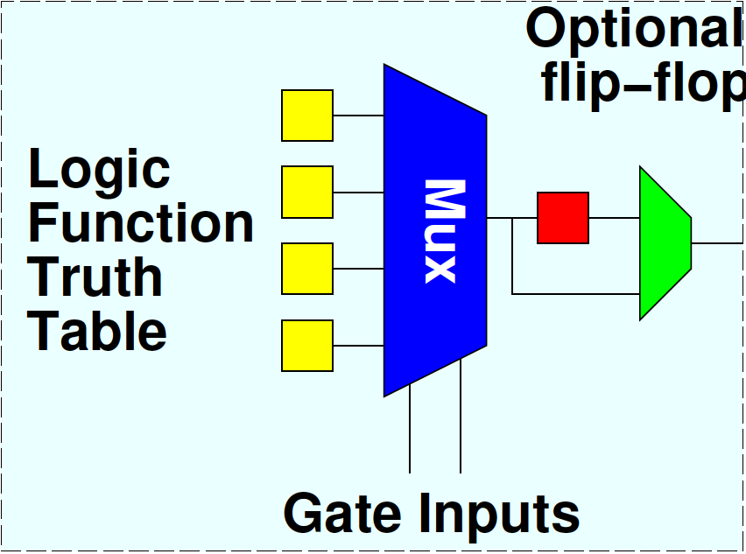
Flip-Flops
Want to be able to pipeline logic
…and generally hold state
E.g. implement hold Input-N in preclass 2
Add optional flip-flop on each gate

Slide 45
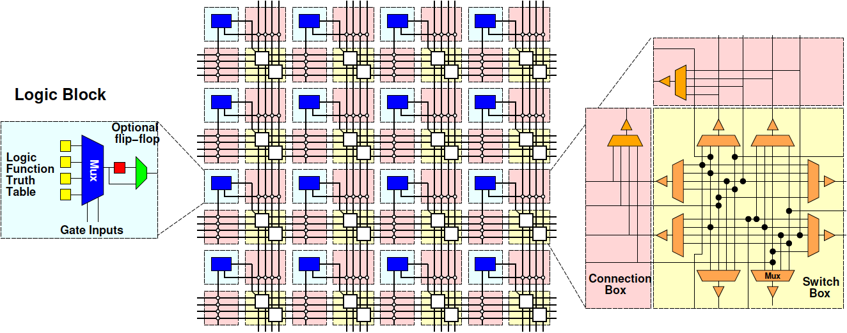
Simple FPGA

Slide 46
FPGA Design
Raises many architectural design questions
How big (many inputs) should the gates have?
Are LUTs really the right thing…
How rich is the interconnect?
Wires/channel
Wire length
Switching options

Slide 47
Modern FPGAs
Logic Blocks
hardwired fast-carry logic
Can implement adder bit in single “LUT”
Speed optimized: 6-LUTs
Energy, Cost optimization: 4-LUTs
Clusters many LUTs into a tile
Interconnect
Mesh, segments of length 4 and longer

Slide 48
More than LUTs
Should there be more than LUTs in the “array” fabric?
What else might we want?

Slide 49
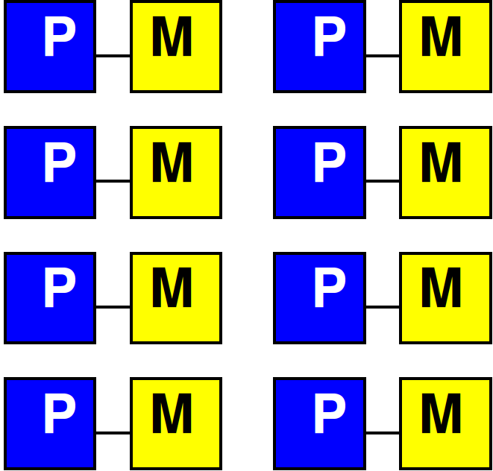
Embedded Memory
One flip-flop per LUT doesn’t store state densely
Want memory close to logic

Slide 50
Embed Memory in Array
Replace logic clusters
Convenient to replace columns
Since area of memory may not match area of logic cluster

Slide 51
Embedded Memory in FPGA
Logic
Cluster
Memory
Bank
Memory
Frequency
Memory banks on Xilinx called BRAMs (Block RAMs)

Slide 52
Hardwired Multipliers
Can build multipliers out of LUTs
Just as can implement multiplies on processor out of adds
But, custom multiplier is smaller than LUT-configured multiplier
…and multipliers common in signal processing, scientific/engineering compute

Slide 53
Multiplier Integration
Integrate like memories
Replace columns

Slide 54
More FPGA Architecture Design Questions
Size of Memories? Multipliers?
Mix of LUTs, Memories, Multipliers?
Add processors? Floating-point?
Other hardwired blocks?
How manage configuration?

Slide 55
Zynq

Slide 56
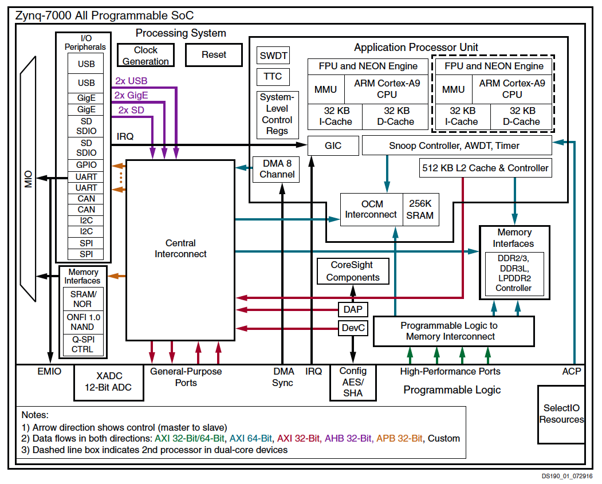

Slide 57
XC7Z020
6-LUTs: 53,200
DSP Blocks: 220
18x25 multiply, 48b accumulate
Block RAMs (BRAMs): 140
36Kb
Dual port
Up to 72b wide (512x72)

Slide 58
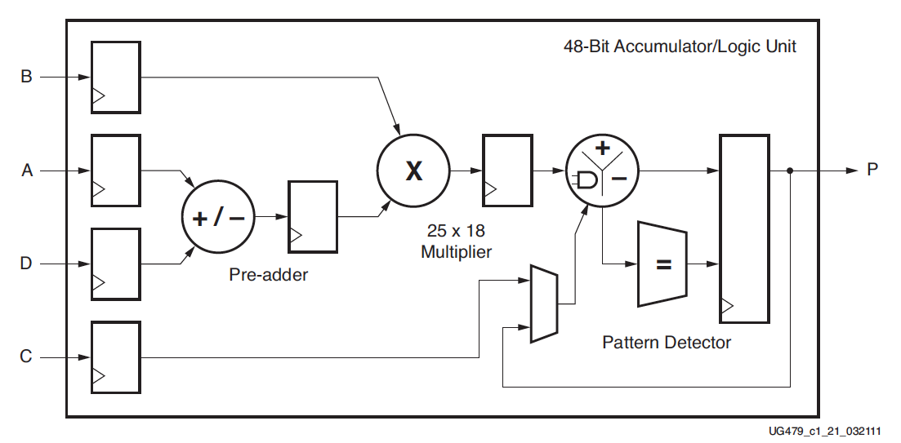
DSP48
Xilinx UG479 DSP48E1 User’s Guide

Slide 59
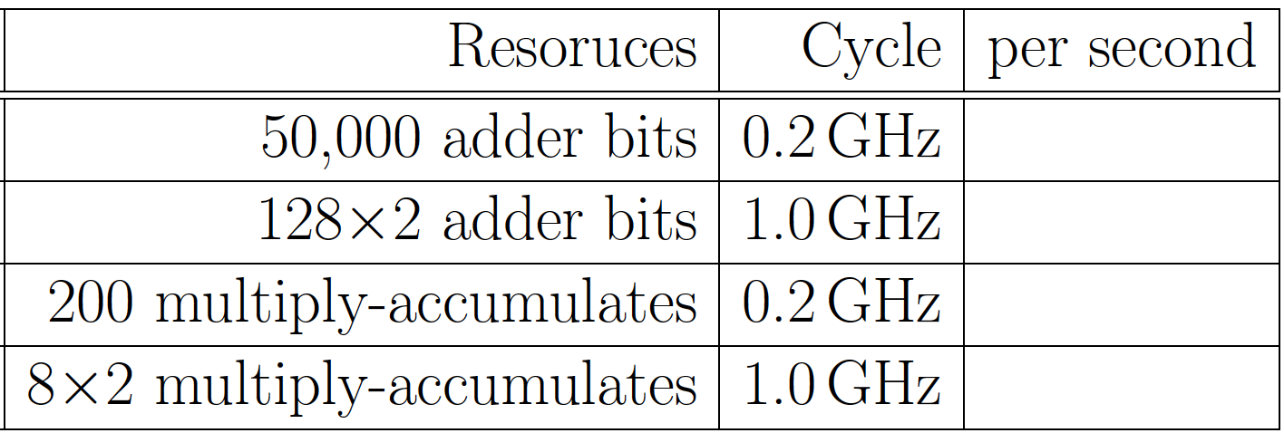
Preclass 4

Slide 60
Compute Capacity
How compare between ARM/NEON and FPGA array?
Adder-bits/second?
Multiply-accumulators/second?

Slide 61
Capacity → Density
Says Zynq has high computational capacity in FPGA
More broadly
FPGA can have more compute/area than processor
E.g., more adder bits in some fixed area
SIMD can have more compute/area than processor
How wide SIMD can you exploit?

Slide 62
FPGA Potential
FPGA Array has high raw capacity
Exploitable when computation has high regularity
Uses the same computation over-and-over
High throughput on a computation
Build customized accelerator pipeline to match the computation
Low-hanging fruit
Operator/function takes most of the compute time

Slide 63
90/10 Rule (of Thumb)
Observation that code is not used uniformly
90% of the time is spent in 10% of the code
Knuth: 50% of the time in 2% of the code
Opportunity
Build custom datapath in FPGA (hardware) for that 10% (or 2%) of the code

Slide 64
Big Ideas
Custom accelerators efficient for large computations
Exploit Instruction-level parallelism
Run many low-level operations in parallel
Field Programmable Gate Arrays (FPGAs)
Allow post-fabrication configuration of custom accelerator pipelines
Can offer high computational capacity

Slide 65
Admin
Reading for Day 9 on canvas
HW4 due Friday
No homework due 10/5 (Fall Break)
HW5 out
Due 10/12
SDSoC synthesis slow (plan for it)
May need to run Vivado HLS on linux

