Slide 1
ESE532: System-on-a-Chip Architecture
Day 9: October 1, 2018
Real Time

Slide 2
Today
Real Time
Demands
Challenges
Algorithms
Architecture
Disciplines to achieve

Slide 3
Message
Real-Time applications demand different discipline from best-effort tasks
Look more like synchronous circuits
Can sequentialize, like processor
But must avoid/rethink typical general-purpose processor common-case optimizations

Slide 4
Real Time
“Real” – refers to physical time
Connection to Real or Physical World
Contrast with “virtual” or “variable” time
Handles events with absolute guarantees on timing

Slide 5
Real-Time Tasks
What timing guarantees might you like for the following tasks?
Push a fire button on a video game
Delay to recognize and shoots bullet
Turn steering wheel on a drive-by-wire car
Delay to recognized and car turns
Self-driving car detects an object in its path
Delay from object appearing to detection
Pacemaker stimulates your heart
Video playback (frame to frame delay)

Slide 6
Real-Time Guarantees
Attention/processing within fixed interval
Sample new value every XX ms
Produce new frame every 30 ms
Both: schedule to act and complete action
Bounded response time
Respond to keypress within 20 ms
Detect object within 100 ms
Return search results within 200 ms

Slide 7
Computer Response
What do these things indicate?
When will the computer complete the task?
https://en.wikipedia.org/wiki/File:Windows_8_%2B_10_wait_cursor.gif
https://en.wikipedia.org/wiki/File:WaitCursor-300p.gif

Slide 8
Real-Time Reponse
What if your car gave you a spinning wait wheel for 5 seconds when you
Turned the wheel?
Stepped on the brakes?

Slide 9
Synchronous Circuit Model
A simple synchronous circuit is a good “model” for real-time task
Run at fixed clock rate
Take input every “cycle”
Produce output every “cycle”
Complete computation between input and output
Designed to run at fixed-frequency
Critical path meets frequency requirement

Slide 10
Preclass 2
Worst-case delay from (L)eft press to change in heading?
Cycle rate could operate?

Slide 11
Historically
Real-Time concerns grew up in EE
Because an analog circuit was the only way could meet frequency demands
…later a dedicated digital circuit…
Applications
Signal processing, video, control, …

Slide 12
Technological Change
Why not be satisfied with this answer today?
That is, for real-time task need dedicated synchronous circuit?
Hint: What does preclass 2b suggest?

Slide 13
Performance Scaling
As circuit speeds increased
Can meet real-time performance demands with heavy sequentialization
Circuit and processor clocks
from MHz to GHz
Many real-time task rates unchanged
44KHz audio, 33 frames/second video
Even 100MHz processor
Can implement audio in a small fraction of its computational throughput capacity

Slide 14
HW/SW Co-Design
Computer Engineers – know can implement anything as hardware or software
Want freedom to move between hardware and software to meet requirements
Performance, costs, energy

Slide 15
Real-Time Challenge
Meet real-time demands / guarantees
Economically using programmable architectures
Sequentialize and share resources with deterministic, guaranteed timing

Slide 16
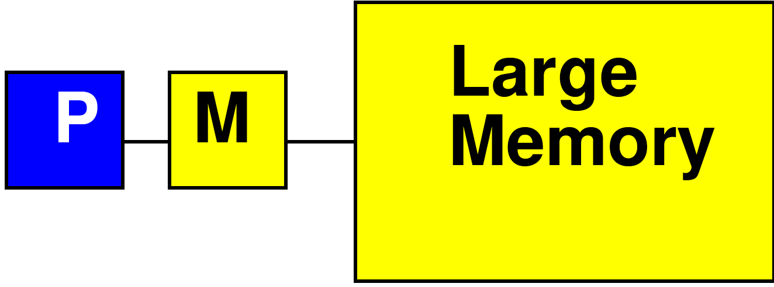
Processor Data Caches
Day 3
Traditional Processor Data Caches are a heuristic instance of this
Add a small memory local to the processor
It is fast, low latency
Store anything fetched from large/remote memory in local memory
Hoping for reuse in near future
On every fetch, check local memory before go to large memory

Slide 17
Processor Data Caches
Day 3
Demands more than a small memory
Need to sparsely store address/data mappings from large memory
Makes more area/delay/energy expensive than just a simple memory of capacity
Don’t need explicit data movement
Cannot control when data moved/saved
Bad for determinism
Limited ability to control what stays in small memory simultaneously

Slide 18
Processor Data Caches
Traditional Processor Data Caches are a heuristic instance of this
Store anything fetched from large/remote memory in local memory
Hoping for reuse in near future
On every fetch, check local memory before go to large memory
Stall processor while waiting for data

Slide 19
Preclass 3: Processor Cache Timing
Assume
cache miss (go to large memory) takes 10 cycles
Cache hit (small memory) takes 1
Start with empty cache
Due to memory delay, how long to execute:
b=a[0]+a[1];
c=a[1]+a[2];
d=a[2]+a[0];
b=a[i]+a[j];
c=a[k]+a[l];
d=a[m]+a[n];

Slide 20
Observe
Instructions on “General Purpose” processors take variable number of cycles

Slide 21
Preclass 4
How many cycles?
sin, cos 100 cycles each
Assignments 1
old_sh=sh; old_ch=ch;
if (!left || !right)
{sh=old_sh;ch=old_ch;}
else
{sh=sine(heading);
ch=cosine(heading);}

Slide 22
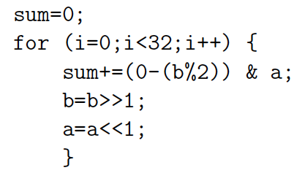
Preclass 5
How many cycles?

Slide 23
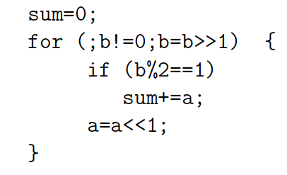
Preclass 5
How many cycles?

Slide 24
Observe
Data-dependent branching, looping
Means variable time for operations

Slide 25
Two Challenges
Architecture – Hardware have variable (data-dependent) delay
Esp. for General-Purpose processors
Instructions take different number of cycles
Algorithm – computational specification have variable (data-dependent) operations
Different number of instructions

Slide 26
Algorithm
What programming constructs are data-dependent (variable delay)?

Slide 27
Programming Constructs
Conditionals: if/then/else
Loops without compile-time determined bounds
While with termination expressions
For with data-dependent bounds
Data-dependent recursion
Interrupts
I/O events, time-slice

Slide 28
Programming Constructs
Dynamic Dataflow (from Day 5)
Variable rates
Switch/select operators

Slide 29
Architecture
What processor constructs are variable delay?

Slide 30
Processor Variable Delay
Caches
Dynamic arbitration for shared resources
Bus, I/O, Crossbar output, memory, …
Data hazards
Data-dependent branching / branch delays
Speculative issue
Out-of-Order, branch prediction

Slide 31
Hardware Architecture
Some typical (371, 501) processor “optimizations” can cause variable delay
Caches
Common-case optimizations
Pipeline stalls

Slide 32
What can we do to make architecture more deterministic?
Explicitly managed memory
Eliminate Branching (too severe?)
Unpipelined processors
Fixed-delay pipelines
Offline-scheduled resource sharing
Multi-threaded
Deadlines

Slide 33
Explicitly Managed Memory
Make memory hierarchy visible
Use Scratchpad memories instead of caches
Explicitly move data between memories
E.g. movement into local memory
Already do for Register File in Processor
Load/store between memory and RF slot
…but don’t do for memory hierarchy

Slide 34
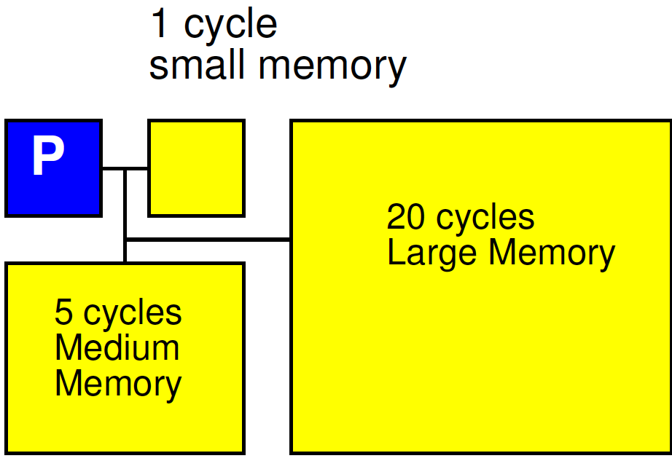
Explicitly Managed Memory

Slide 35
Offline Schedule Resource Sharing
Don’t arbitrate
Decide up-front when each shared resource can be used by each thread or processor
Simple fixed schedule
Detailed Schedule
What
Memory bank, bus, I/O, network link, …

Slide 36
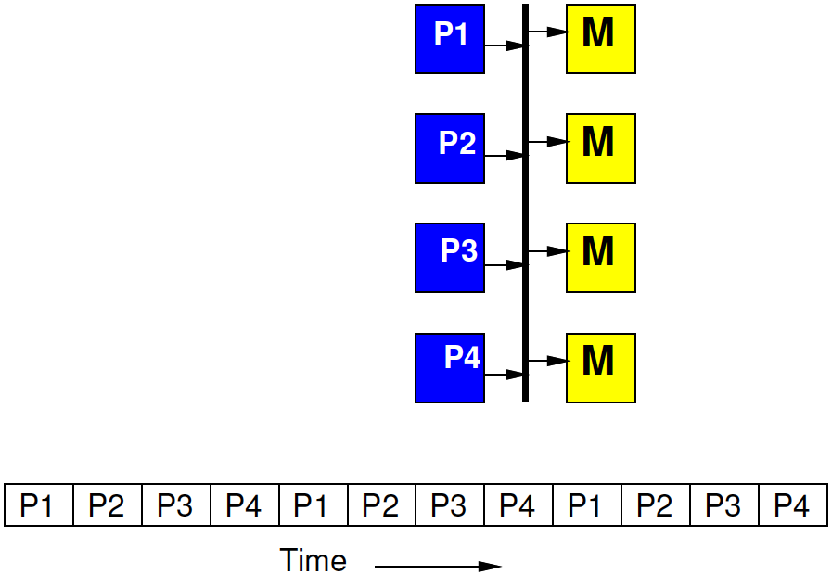
Time-Multiplexed Bus
Fixed by hardware master
4 masters share a bus
Each master gets to make a request on the bus every 4th cycle
If doesn’t use it, goes idle

Slide 37
Time-Multiplexed Bus
Regular schedule
Fixed bus slot schedule of length N > masters
(probably a multiple)
Assign owner for each slot
Can assign more slots to one
E.g. N=8, for 4 masters
Schedule (1 2 1 3 1 2 1 4)

Slide 38
Fully Scheduled
At extreme, fully schedule which tasks gets resource on each cycle

Slide 39
Simple Deterministic Processor
No branching
Unpipelined
Every operation completes in fixed time
Cycle time?

Slide 40
Simple Deterministic Processor with Multiplier
No branching
Unpipelined
Every operation completes in fixed time
Cycle time?
What’s unfortunate about this?

Slide 41
Simple Deterministic Processor with some Pipelining
No branching
Every operation completes in fixed time
Retimed cycle time?
How pipelines added change behavior?

Slide 42
Simple Deterministic Pipelined Processor
No branching
Every operation completes in fixed time
Retimed cycle time?
How pipelines added change behavior?
Hint R1 value

Slide 43
Multithreaded Processor
No branching
Every operation completes in fixed time
Retimed cycle time
Each PC (color) is a separate thread
How interact?
What does this act like?
Compare unpipe?

Slide 44
Branching?
Could add branching
Architecture deterministic
Need to reason about variable timing from branching

Slide 45
Multithreaded Pipeline
Non-real-time threads can share
Timing of threads not impact each other
Non-real-time threads take variable time
Not interfere with real-time thread slots

Slide 46
Deadline Instruction
Deal with algorithmic (branching) variability
Set a hardware counter for thread
Demand counter reach 0 before thread allowed to continue at deadline instruction
Model: fixed rate of attention
Stall if get there early
Similar to flip-flop on a logic path
Wait for clock edge to change or sample value
Model: fixed execution time

Slide 47
WCET
WCET – Worst-Case Execution Time
Analysis when working with algorithms and architectures with data-dependent delay
Need to meet real time
Calculate the worst-case runtime of a task
Like calculating the critical path (but harder)
Worst-case delay of instructions
Worst-case path through code
Worst-case # loop iterations
Rationale for setting Deadlines
(like a cycle time)

Slide 48
Deterministic Pipelines
Not how ARM, Intel (371, 501) processor are piplined
Those include operations that make timing variable
dynamic data hazards, branch speculation
Here, data becomes available after a predictable time
Branches take effect at a fixed time
Likely delayed
Schedule to delays to get correct data

Slide 49
Different Goals
General Purpose/Best Effort
ISA fixed
Want to run same assembly on different implementations
Tolerate different delays for different hardware
Run faster on newer, larger implementations
Real-Time
Willing to recompile to new hardware
Want time on hardware predictable
Willing to schedule for delays in particular hardware

Slide 50
SoC Opportunity
Can choose which resources are shared
Can dedicate resources to tasks
Isolate real-time tasks/portions of tasks from best-effort
Separate hardware/processors
Separate memories, network

Slide 51
Big Ideas:
Real-Time applications demand different discipline from best-effort tasks
Look more like synchronous circuits and hardware discipline
Avoid or use care with variable delay programming constructs
Can sequentialize, like processor
But must avoid/rethink typical processor common-case optimizations
Offline calculate static schedule for computation and sharing
Instead of dynamic arbitration, interlocks

Slide 52
Admin
Wednesday/Day 10 reading on Canvas + Zynq Book
We are here Wednesday
Do have office hours Monday, Tuesday
Fall Break – Thursday and Friday
No Office Hours Thursday (10/4)
No HW due this Friday (10/5)
HW5 due 10/12
Will involve some long Vivado HLS/SDSoC tool times

