Slide 1
ESE532: System-on-a-Chip Architecture
Day 9: October 1, 2018
Real Time
Preclass 6d Retiming Solution

Slide 2
Simple Deterministic Pipelined Processor
No branching
Every operation completes in fixed time
Retimed cycle time?

Slide 3
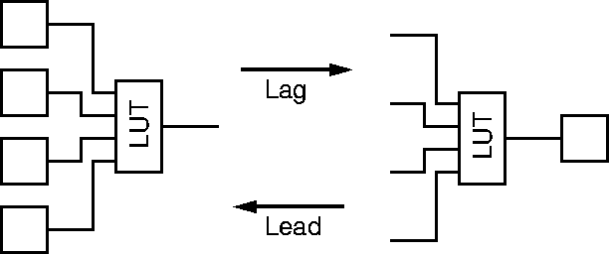
Legal Register Moves
Day 7
Retiming Lag/Lead

Slide 4
Reminder
Day 8
Able to pipeline and retime to reduce cycle time on acyclic dataflow graphs

Slide 5
Step 1: lead Mux

Slide 6
Step 2: lead M3

Slide 7
Step 3: lead M2

Slide 8
Step 4: lead M1

Slide 9
Step 5: Lead ALU

Slide 10
Step 6: Lead Data Mem

Slide 11
Step 7: Lag Instr. Mem

Slide 12
Step 8: Lead Mux

Slide 13
Step 9: Lead M3

Slide 14
Step 10: Lead M2

Slide 15
Step 11: Lead Mux

Slide 16
Step 12: Lead M3

Slide 17
Step 13: Lead Mux

Slide 18
Retimed
Max delay between
registers 1ns

