Slide 1

ESE532:
System-on-a-Chip Architecture
Day 14: October 16, 2019
Real Time

Slide 2
Today
Real Time
Demands
Challenges
  Algorithms
  Architecture
Disciplines to achieve

Slide 3
Message
Real-Time applications demand different discipline from best-effort tasks
Look more like synchronous circuits
Can sequentialize, like processor
  But must avoid/rethink typical general-purpose processor common-case optimizations

Slide 4
Real Time
“Real” – refers to physical time
  Connection to Real or Physical World
Contrast with “virtual” or “variable” time
Handles events with absolute guarantees on timing

Slide 5
Real-Time Tasks
What timing guarantees might you like for the following tasks?
  Turn steering wheel on a drive-by-wire car
    Delay to recognized and car turns
  Self-driving car detects an object in its path
    Delay from object appearing to detection
  Pacemaker stimulates your heart
  Video playback (frame to frame delay)

Slide 6
Real-Time Guarantees
Attention/processing within fixed interval
  Sample new value every XX ms
  Produce new frame every 30 ms
  Both: schedule to act and complete action
Bounded response time
  Respond to keypress within 20 ms
  Detect object within 100 ms
  Return search results within 200 ms

Slide 7


Computer Response
What do these things indicate?
  When will the computer complete the task?
https://en.wikipedia.org/wiki/File:Windows_8_%2B_10_wait_cursor.gif
https://en.wikipedia.org/wiki/File:WaitCursor-300p.gif

Slide 8
Real-Time Reponse
What if your car gave you a spinning wait wheel for 5 seconds when you
  Turned the wheel?
  Stepped on the brakes?

Slide 9
Synchronous Circuit Model
A simple synchronous circuit is a good “model” for real-time task
  Run at fixed clock rate
  Take input every “cycle”
  Produce output every “cycle”
  Complete computation between input and output
  Designed to run at fixed-frequency
    Critical path meets frequency requirement

Slide 10
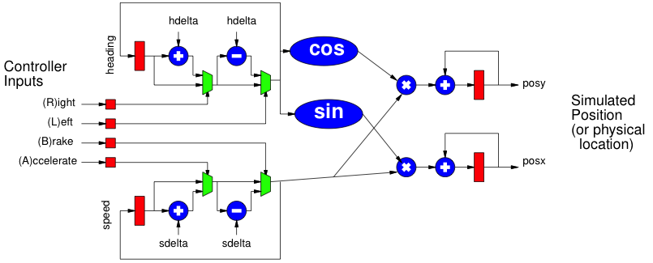
Preclass 2
Assume clocked at 100Hz
Worst-case delay from (L)eft press to change in heading?
Cycle rate could operate?

Slide 11
Historically
Real-Time concerns grew up in EE
  Because an analog circuit was the only way could meet frequency demands
  …later a dedicated digital circuit…
Applications
  Signal processing, video, control, …

Slide 12
Technological Change
Why not be satisfied with this answer today?
  That is, for real-time task need dedicated synchronous circuit?
  Hint: What does preclass 2c suggest?

Slide 13
Performance Scaling
As circuit speeds increased
  Can meet real-time performance demands with heavy sequentialization
Circuit and processor clocks
  from MHz to GHz
Many real-time task rates unchanged
  44KHz audio, 33 frames/second video
Even 100MHz processor
  Can implement audio in a small fraction of its computational throughput capacity

Slide 14
HW/SW Co-Design
Computer Engineers – know can implement anything as hardware or software
Want freedom to move between hardware and software to meet requirements
  Performance, costs, energy

Slide 15
Real-Time Challenge
Meet real-time demands / guarantees
  Economically using programmable architectures
Sequentialize and share resources with deterministic, guaranteed timing

Slide 16
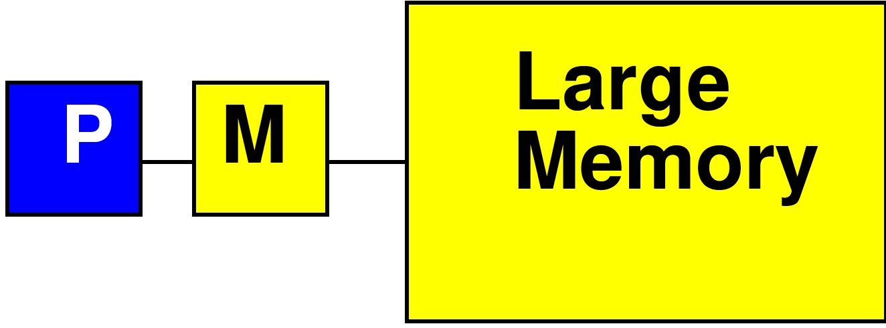
Processor Data Caches
Day 3
Traditional Processor Data Caches are a heuristic instance of this
  Add a small memory local to the processor
    It is fast, low latency
  Store anything fetched from large/remote memory in local memory
    Hoping for reuse in near future
  On every fetch, check local memory before go to large memory

Slide 17
Processor Data Caches
Day 3
Demands more than a small memory
  Need to sparsely store address/data mappings from large memory
  Makes more area/delay/energy expensive than just a simple memory of capacity
Don’t need explicit data movement
Cannot control when data moved/saved
  Bad for determinism
Limited ability to control what stays in small memory simultaneously

Slide 18
Processor Data Caches
Traditional Processor Data Caches are a heuristic instance of this
  Store anything fetched from large/remote memory in local memory
    Hoping for reuse in near future
  On every fetch, check local memory before go to large memory
  Stall processor while waiting for data

Slide 19
Preclass 3:
Processor Cache Timing
Assume
  cache miss (go to large memory) takes 10 cycles
  Cache hit (small memory) takes 1
  Start with empty cache
Due to memory delay, how long to execute:
b=a[0]+a[1];
c=a[1]+a[2];
d=a[2]+a[0];
b=a[i]+a[j];
c=a[k]+a[l];
d=a[m]+a[n];

Slide 20
Observe
Instructions on “General Purpose” processors take variable number of cycles

Slide 21
Preclass 4
How many cycles?
  sin, cos 100 cycles each
  Assignments take 1 cycle
old_sh=sh; old_ch=ch;
if (!left || !right)
{sh=old_sh;ch=old_ch;}
else
{sh=sin(heading);
ch=cos(heading);}

Slide 22
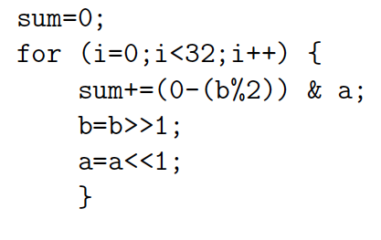
Preclass 5
How many cycles?

Slide 23
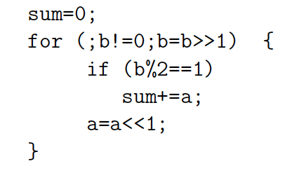
Preclass 5
How many cycles?

Slide 24
Observe
Data-dependent branching, looping
  Means variable time for operations

Slide 25
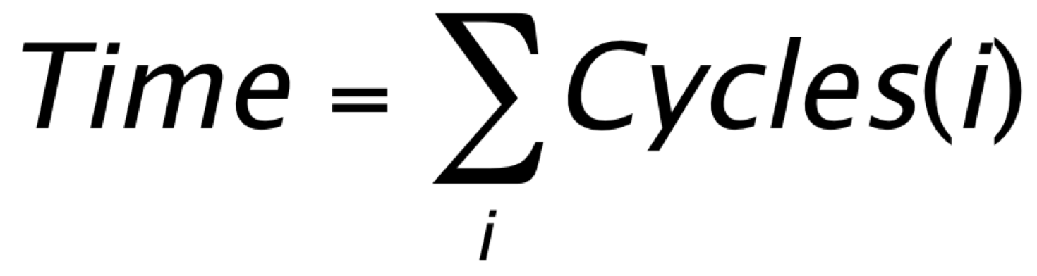
Two Challenges
Architecture – Hardware have variable (data-dependent) delay
  Esp. for General-Purpose processors
    Instructions take different number of cycles
Algorithm – computational specification have variable (data-dependent) operations
  Different number of instructions

Slide 26
Algorithm
What programming constructs are data-dependent (variable delay)?

Slide 27
Programming Constructs
Conditionals: if/then/else
Loops without compile-time determined bounds
  While with termination expressions
  For with data-dependent bounds
Data-dependent recursion
Interrupts
  I/O events, time-slice
Note: 1st three were issue for HLS
  For same reason – how did we address?

Slide 28
Programming Constructs
Dynamic Dataflow (from Day 5)
  Variable rates
  Switch/select operators

Slide 29
Architecture
What processor constructs are variable delay?

Slide 30
Processor Variable Delay
Caches
Dynamic arbitration for shared resources
  Bus, I/O, Crossbar output, memory, …
Data hazards
Data-dependent branching / branch delays
Speculative issue
  Out-of-Order, branch prediction

Slide 31
Hardware Architecture
Some typical (371, 501) processor “optimizations” can cause variable delay
  Caches
  Common-case optimizations
  Pipeline stalls

Slide 32
What can we do to make architecture more deterministic?
Explicitly managed memory
Eliminate Branching (too severe?)
Unpipelined processors
Fixed-delay pipelines
  Offline-scheduled resource sharing
  Multi-threaded
Deadlines

Slide 33
Explicitly Managed Memory
Make memory hierarchy visible
  Use Scratchpad memories instead of caches
Explicitly move data between memories
  E.g. movement into local memory
Already do for Register File in Processor
  Load/store between memory and RF slot
  …but don’t do for memory hierarchy

Slide 34
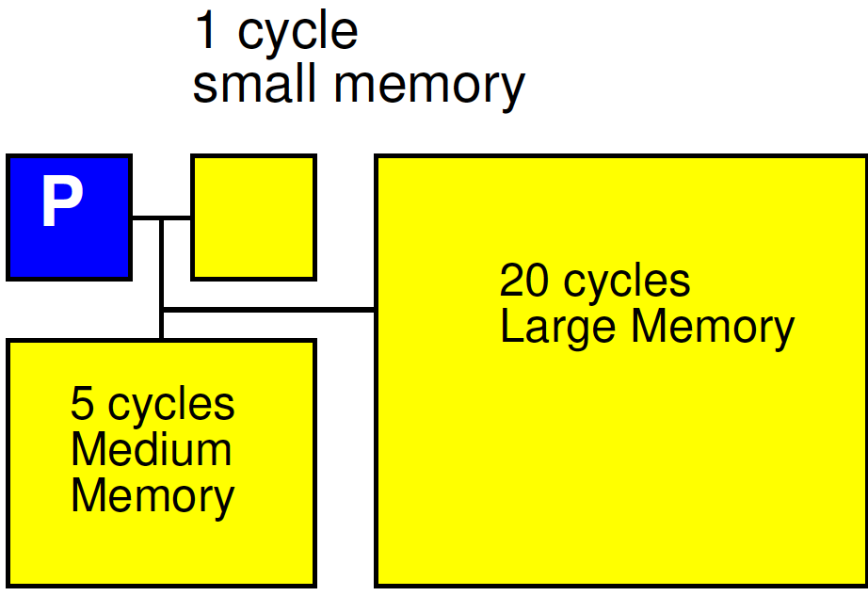
Explicitly Managed Memory

Slide 35
Offline Schedule Resource Sharing
Don’t arbitrate
Decide up-front when each shared resource can be used by each thread or processor
  Simple fixed schedule
  Detailed Schedule
What
  Memory bank, bus, I/O, network link, …

Slide 36
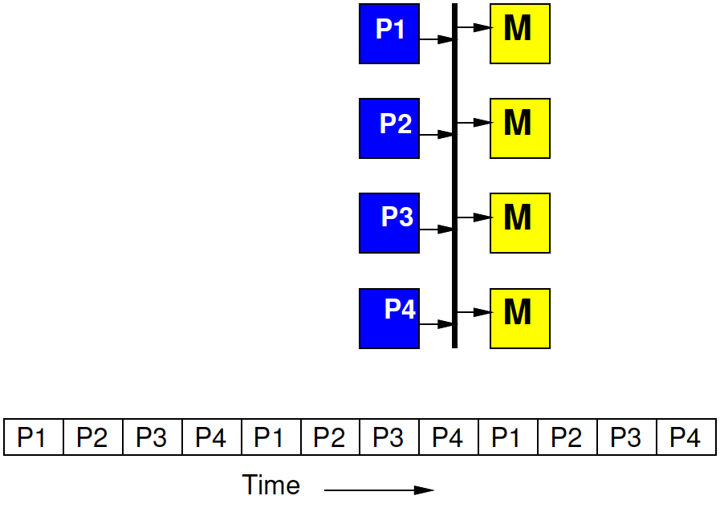
Time-Multiplexed Bus
Fixed by hardware master
4 masters share a bus
Each master gets to make a request on the bus every 4th cycle
  If doesn’t use it, goes idle

Slide 37
Time-Multiplexed Bus
Regular schedule
Fixed bus slot schedule of length N > masters
  (probably a multiple)
Assign owner for each slot
  Can assign more slots to one
E.g. N=8, for 4 masters
  Schedule (1 2 1 3 1 2 1 4)

Slide 38
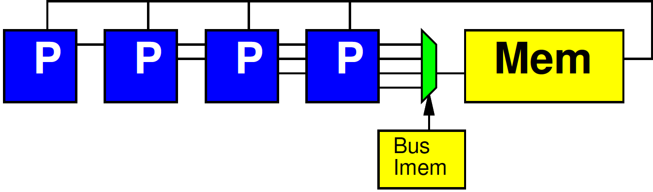
Fully Scheduled
At extreme, fully schedule which tasks gets resource on each cycle

Slide 39
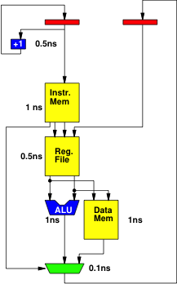
Simple Deterministic Processor
No branching
Unpipelined
Every operation completes in fixed time
Cycle time?

Slide 40
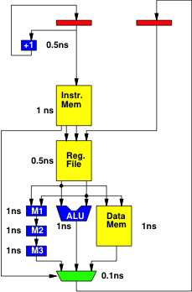
Simple Deterministic Processor with Multiplier
No branching
Unpipelined
Every operation completes in fixed time
Cycle time?
What’s unfortunate about this?

Slide 41
Simple Deterministic Processor with some Pipelining
No branching
Every operation completes in fixed time
Retimed cycle time?
How pipelines added change behavior?
  Hint: what is sequence of addresses into Instr. Mem?

Slide 42
Simple Deterministic
Pipelined Processor
No branching
Every operation completes in fixed time
How pipelines added change behavior?
  Hint R1 value

Slide 43
Simple Deterministic
Pipelined Processor
No branching
Every operation completes in fixed time
Retimed cycle time?

Slide 44
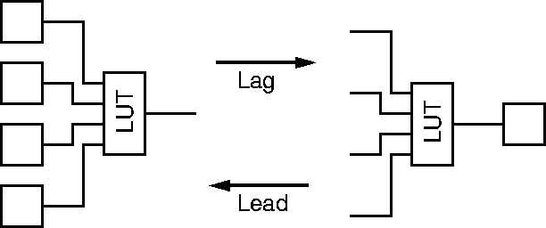
Legal Register Moves
Day 7
Retiming Lag/Lead

Slide 45

Reminder
Day 8
Able to pipeline and retime to reduce cycle time on acyclic dataflow graphs

Slide 46
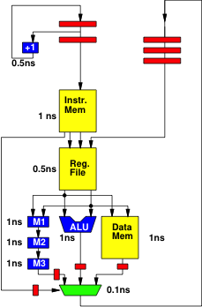
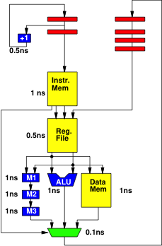
Step 1: lead Mux

Slide 47

Step 2: lead M3

Slide 48

Step 3: lead M2

Slide 49
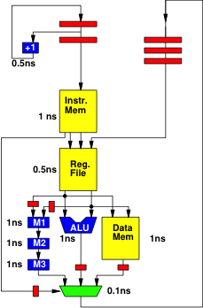
Step 4: lead M1

Slide 50
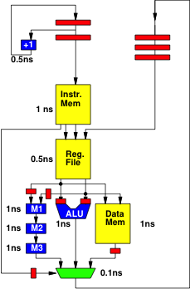
Step 5: Lead ALU

Slide 51
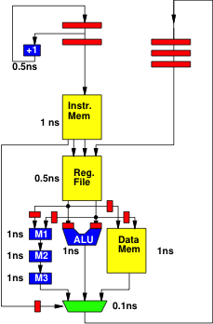
Step 6: Lead Data Mem

Slide 52
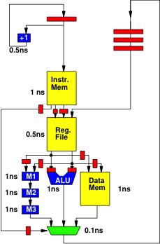
Step 7: Lag Instr. Mem

Slide 53
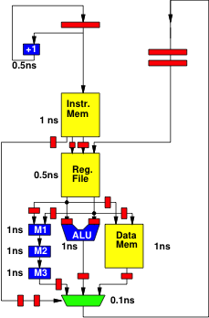
Step 8: Lead Mux

Slide 54
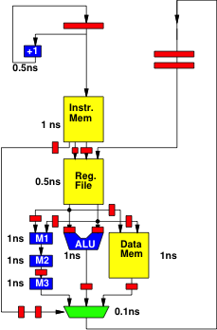
Step 9: Lead M3

Slide 55

Step 10: Lead M2

Slide 56

Step 11: Lead Mux

Slide 57
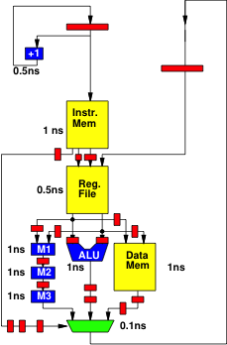
Step 12: Lead M3

Slide 58
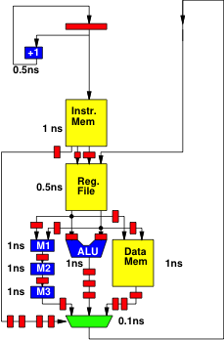
Step 13: Lead Mux

Slide 59
Retimed
Max delay between
registers 1ns

Slide 60
Deadline Instruction
Deal with algorithmic (branching) variability
Set a hardware counter for thread
Decrement counter on each cycle
Demand counter reach 0 before thread allowed to continue at deadline instruction
Model: fixed rate of attention
  Stall if get there early
  Similar to flip-flop on a logic path
    Wait for clock edge to change or sample value
Model: fixed execution time

Slide 61
WCET
WCET – Worst-Case Execution Time
Analysis when working with algorithms and architectures with data-dependent delay
  Need to meet real time
  Calculate the worst-case runtime of a task
    Like calculating the critical path (but harder)
    Worst-case delay of instructions
    Worst-case path through code
    Worst-case # loop iterations
  Rationale for setting Deadlines
    (like a cycle time)

Slide 62
Deterministic Pipelines
Not how ARM, Intel (371, 501) processor are piplined
Those include operations that make timing variable
  dynamic data hazards, branch speculation
Here, data becomes available after a predictable time
Branches take effect at a fixed time
  Likely delayed
Schedule to delays to get correct data

Slide 63
Different Goals
General Purpose/Best Effort
ISA fixed
Want to run same assembly on different implementations
Tolerate different delays for different hardware
Run faster on newer, larger implementations
Real-Time
Willing to recompile to new hardware
Want time on hardware predictable
Willing to schedule for delays in particular hardware

Slide 64
SoC Opportunity
Can choose which resources are shared
Can dedicate resources to tasks
Isolate real-time tasks/portions of tasks from best-effort
  Separate hardware/processors
  Separate memories, network

Slide 65
UltraScale+ Zynq
Has 2x “Real-Time Processor”
  ARM Cortex-R5
    32b (vs. 64b for A53 APU processor)
    ARMv7-R (vs. ARMv8)
    Single ALU, dual issue
    Branch prediction
Explicitly managed scratchpads
    Tightly-Coupled Memories
    On-Chip Memory (OCM)

Slide 66
Programmable SoC
UG1085
Xilinx
UltraScale
Zynq
TRM
(p27)

Slide 67
RPU Subsystem
UG1085
Xilinx
UltraScale
Zynq
TRM
(p65)

Slide 68
Multithreaded Processor
(Bonus, time permitting)

Slide 69
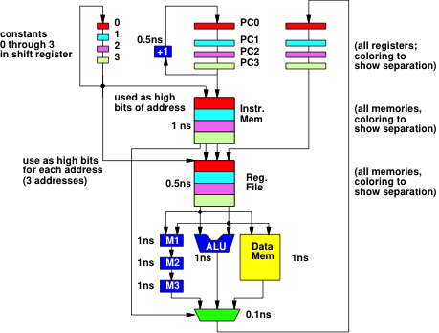
Multithreaded Processor
No branching
Every operation completes in fixed time
Retimed cycle time
Each PC (color) is a separate thread
How interact?
What does this act like?
Compare unpipe?

Slide 70
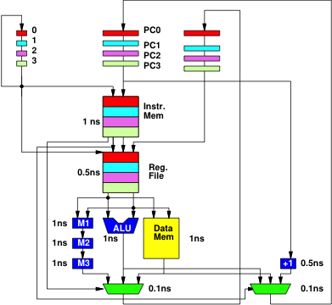
Branching?
Could add branching
Architecture deterministic
Need to reason about variable timing from branching
  Use deadline

Slide 71
Multithreaded Pipeline
Non-real-time threads can share
Timing of threads not impact each other
Non-real-time threads take variable time
  Not interfere with real-time thread slots

Slide 72
Big Ideas:
Real-Time applications demand different discipline from best-effort tasks
Look more like synchronous circuits and hardware discipline
Avoid or use care with variable delay programming constructs
Can sequentialize, like processor
  But must avoid/rethink typical processor common-case optimizations
  Offline calculate static schedule for computation and sharing
    Instead of dynamic arbitration, interlocks

Slide 73
Admin
HW6 due Friday
Emulation tutorial
  Thursday 6pm – Yuanlong office hours
HW7 out

