Slide 1

ESE532:
System-on-a-Chip Architecture
Day 16: October 23, 2019
Deduplication and Compression Project

Slide 2
Today
Motivation
Project
Content-Defined Chunking
Hashing / Deduplication
LZW Compression

Slide 3
Message
Can reduce data size by identifying and reducing redundancy
Can
  spend computation and data storage
  to reduce communication traffic

Slide 4
Problem
Always want more
  Bandwidth
  Storage space
Carry data with me (phone, laptop)
Backup laptop, phone data
  Maybe over limited bandwidth links
Never delete data
Download movies, books, datasets
Make most use of space, bw given

Slide 5
Opportunity
Significant redundant content in our raw data streams (data storage)
More formally:
  Information content < raw data
Reduce the data we need to send or store by identifying redundancies

Slide 6
Example
Two identical files
  Different parts of my file systems
Don’t store separate copies
  Store one
  And the other says “same as the first file”
    e.g. keep a pointer

Slide 7
Why Identical?
Eniac file system (common file server)
  Multiple students have copies of assignment(s)
  Snapshots (.snapshot)
    Has copies of your directory an hour ago, days ago, weeks ago
      …but most of that data hasn’t changed

Slide 8
Broadening
History file systems
  snapshot, Apple Time Machine
Version Control (git, svn)
Manually keep copies
Download different software release versions
  With many common files

Slide 9
Cloud Data Storage
E.g. Drop Box, Google Drive, Apple Cloud
Saves data for large class of people
  Want to only store one copy of each
Synchronize with local copy on phone/laptop
  Only want to send one copy on update
  Only want to send changes
    Data not already known on other side
    (or, send that data compactly by just naming it)

Slide 10
Functional Placement
At file server or USB drive
  Deduplicate/compress data as stored
In client
  Dedup/compress to send to server
In data center network
  Dedup/compress data to send between server
Network infrastructure
  Dedup/compress from central to regional server

Slide 11
Optimizing the Bottleneck
Saving data (transmitted, stored)
By spending compute cycles
  And storage database
When communication (storage) is the bottleneck
  We’re willing to spend computation to better utilize the bottleneck resource

Slide 12
Project

Slide 13
Project
Perform deduplication/compression at network speeds (1Gb/s, 10Gb/s)
Use “chunks” instead of files
Turn a raw/uncompressed data stream into one that exploits
  Duplicate chunks
  Redundancies within chunks

Slide 14
Project Context
File server input link from network
  Compress data before sending to disk
  (or USB link from computer, compress before store to flash)
Network link in data center or infrastructure
  Compress data that goes over network

Slide 15
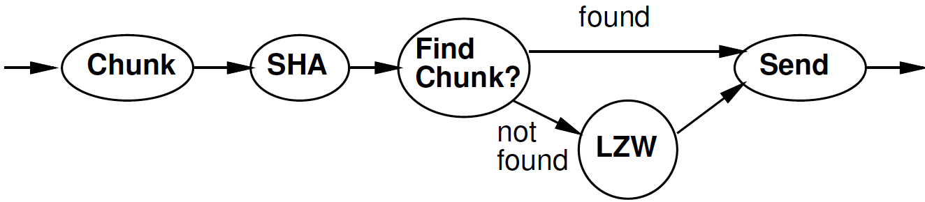
Project Task

Slide 16
Motivation
Can we afford to simply compare every incoming file with all the files we’ve already sent?

Slide 17
Preclass 1
How many comparisons per input byte?

Slide 18
Requirements?
Can we afford to simply compare every incoming file with all the files we’ve already sent?
Data coming in at 1 GB/s
Processor (or datapath) running at 1GHz
How many comparisons needed per cycle with preclass 1 solution?

Slide 19
Alternate Strategy
Is there something we can compute on the input file that will let us
  Know if a file is definitely not equivalent
    So not worth checking every byte
  Find the duplicate directly?

Slide 20
Alternatives
How about
  Look at size of file?
  Look at 10 characters at fixed spots in the files?
Could do better?
  Could do something where changing any single character might be detected?

Slide 21
Exploring Alternatives
What if we xor’ed together every byte in the file?
What if we took sum of every word (group of 4 bytes) in the file?

Slide 22
Fingerprint, checksum, digest
Compute a function on all the bytes in the file → digest
Bins files into separate classes by the digest
  Only need to check those
As increase bits in digest
  Make likelihood of two files having same digest smaller
If can arrange for digests to essentially be unique – like a fingerprint

Slide 23
Hash
A finite digest (fixed number of bits) computed on a potentially large collection of data (like a file)
Ideally uniformly random digests
  each hash value equally likely
Use as building block for grouping and matching

Slide 24
Refined Strategy
Keep a map of hash digests to files on the system
On new file,
  Compute hash digest on file
  Only compare file contents against files with the same hash
If hash is perfect with 20b, how does this reduce the number of files need to compare?

Slide 25
Content-Defined Chunking

Slide 26
Files or chunks?
Why might files be the wrong granularity for identifying duplicates?

Slide 27
Blocks
We regularly cut files into fixed-sized blocks
  Disk sectors or blocks
  inodes in File systems
We could look for duplicates in blocks
Why might fixed-sized blocks not be right division for deduplication?

Slide 28
Preclass 2 and 3
How much duplication opportunity in
  Preclass 2 blocks?
  Preclass 3 chunks?
Why chunks able to do better?

Slide 29
Common File Modifications
Add a line of text
Remove a line of text
Fix a typo
Rewrite a paragraph
Trim or compose a video sequence

Slide 30
Content-Define Chunking
Would like to re-align pieces around unchanged/common sequences
  Around the content
Break up larger thing (file) into pieces based on features of content
  Hence ”content-defined”

Slide 31
Chunks
Pieces of some larger file (data stream)
Variable size
  Over a limited range
Discretion in how formed / divided

Slide 32
Chunk Creation
How do we identify chunks?

Slide 33
Hashes and Chunk Creation
Compute a hash on a window of values
  Window: sequence of N-bytes
  Like window filter

Slide 34
Hashes and Chunk Creation
Compute a hash on a window of values
  Window: sequence of N-bytes
  Like window filter
Scan window over the input

Slide 35
Hashes and Chunk Creation
Compute a hash on a window of values
  Window: sequence of N-bytes
  Like window filter
Scan window over the input
When hash has some special value
(like 0 or 0x11)
  Declare a chunk boundary

Slide 36
Hashes as Chunk Cut Points
What does this do?
Guarantees that each chunk begins (or ends) at some fixed hash
For a particular substring that matches the target hash
  Always occurs at beginning (or end) of chunk
If have a large body of repeated text
  Will synchronize cuts at the same points based on the content

Slide 37
Chunk Size
Assume hash is uniformly random
The likelihood of each window having a particular value is the same
So, if hash has a range of N,
the probability of a particular window having the magic “cut” value is 1/N
…making the average chunk size N
So, we engineer chunk size by selecting the range of the hash we use
  E.g. 12b hash for 2¹² = 4KB chunks

Slide 38
Chunking Design
Raises questions
  How big should chunks be?
    Apply maximum and minimum size beyond content definition?
  How big should hash window be?
Discuss
  What forces drive larger chunks, smaller?
    How do large chunks help compression? Hurt?

Slide 39
Example Text
Consider beginning of repeated block of text.
This stuff has already been seen.
But, we are only matching on something that has a hash of zero.
Maybe this line has a hash of zero.
But, our repeated text is before and after the magic window with the matched hash value.

Slide 40
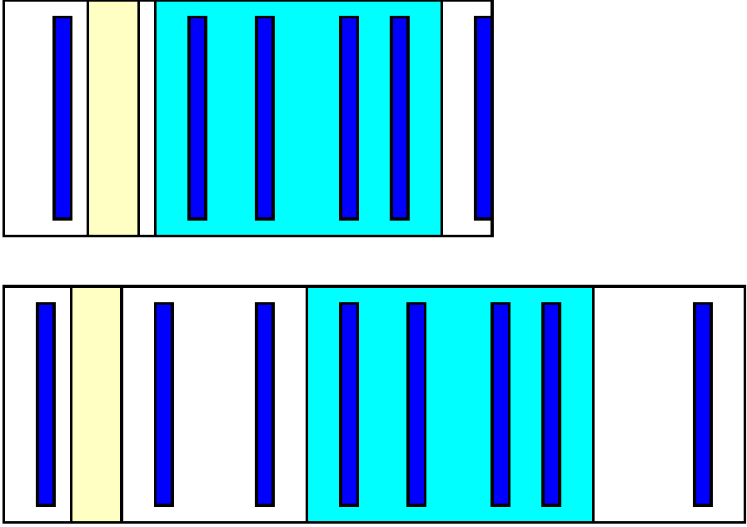
Example Data Stream
Light blue
Identical.
Dark blue
Hash=0.

Slide 41
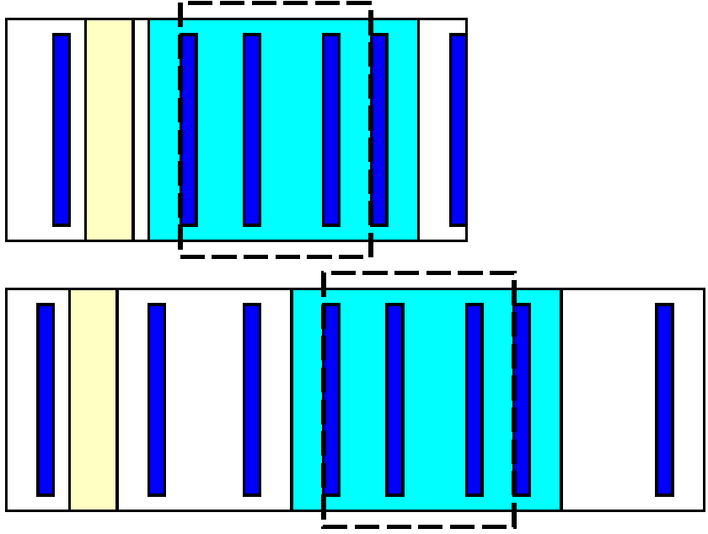
Example Data Stream

Slide 42
Chunk Size
Large chunks
  Increase potential compression
    ChunkSize/ChunkAddressBits
  Decrease
    Probability of finding whole chunk
    Fraction of repeated content included completely inside chunks

Slide 43
Rolling Hash
A Windowed hash that can be computed incrementally
Hash(a[x+0],a[x+1],…a[x+W-1])=
G(Hash(a[x-1],a[x+0],…a[x+W-2]))
- F(a[x-1])+F(A[x+W-1])
i.e., hash computation is associative
(+,- used abstractly here, could be in some other domain than modulo arithmetic)

Slide 44
Rolling Hash
hash ( gree) = 0x20+0x67+0x72+0x65+0x65
hash (green) = 0x67+0x72+0x65+0x65+0x6e
hash(green) = hash( gree)-0x20+0x6e

Slide 45
Rabin Fingerprinting
Particular scheme for rolling hash due to Michael Rabin based on polynomial over a finite field
Commonly used for this chunking application

Slide 46
Content-Defined Chunking
Compute rolling hash (Rabin Fingerprint) on input stream
At points where hash value goes to 0,
create a new chunk

Slide 47
Hashing Deduplication

Slide 48
Hashes for Equality
We can also (separately) take the hash signature of an entire chunk
The longer we make the hash,
the lower the likelihood two different chunks will have the same hash
If hash is perfectly uniform,
  N-bit hash, two chunks have a 2^{-N} chance of having the same hash.

Slide 49
Deduplicate
Compute chunk hash
Use chunk hash to lookup known chunks
  Data already have on disk
  Data already sent to destination, so destination will know
If lookup yields a chunk with same hash
  Check if actually equal (maybe)
If chunks equal
  Send (or save) pointer to existing chunk

Slide 50
Engineering Hash
How much DRAM on Ultra96?
How many 1KB chunks on a 1TB file system?
Potential hash values for 256b hash?

Slide 51
Deduplicate
Compute chunk hash
Use chunk hash to lookup known chunks
  Data already have on disk
  Data already sent to destination, so destination will know
If lookup yields a chunk with same hash
  Check if actually equal (maybe)
How large of a memory do you need to hold the table of all 256b hash results?
How relate to Ultra96 DRAM capacity?

Slide 52
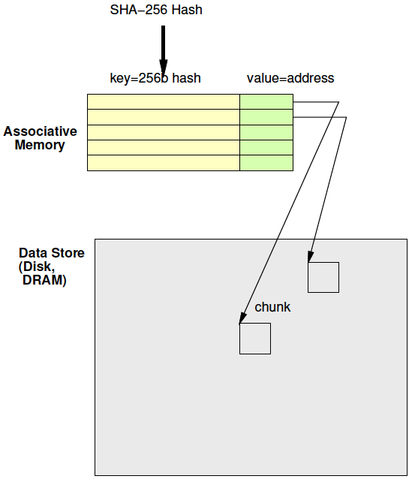
Deduplication Architecture

Slide 53
Associative Memory
Maps from a key to a value
Key not necessarily dense
  Contrast simple RAM
Talk about options to implement next week

Slide 54
Secure Hash
We regularly use digest signatures to identify if a file has been tampered with
Again, hashes are same, mean data might be the same
For security, we would like additional property
  not easy to make the anti-tamper signature match

Slide 55
Cryptographic Hash
One-way functions
Easy to compute the hash
Hard to invert
  Ideally, only way to get back to input data is by brute force – try all possible inputs
Key: someone cannot change the content (add a backdoor to code) and then change some further to get hash signature to match original

Slide 56
SHA-256
Standard secure hash with a 256b hash digest signature
Heavily analyzed
Heavily used
  TLS, SSL, PGP, Bitcoin, …

Slide 57
LZW Compression

Slide 58
Preclass 4, 5, 6
Message?
Bits in unencoded (decoded) message?
Bits for encoded message?

Slide 59
Idea
Use data already sent as the dictionary
  Give short names to things in dictionary
  Don’t need to pre-arrange dictionary
  Adapt to common phrases/idioms in a particular document

Slide 60
Encoding
Greedy simplification
  Encode by successively selecting the longest match between the head of the remaining string to send and the current window

Slide 61
Algorithm Concept
While data to send
  Find largest match in window of data sent
  If length too small (length=1)
    Send character
  Else
    Send <x,y> = <match-pos,length>
  Add data encoded into sent window

Slide 62
Preclass 7
How many comparisons per invocation?

Slide 63
Idea
Avoid O(Dictionary-size) work
  Only need to match against positions that start with the character(s) in string to encode
    Separate dictionary for each?
If prefix same, why check redundantly?
  Store things with common prefix together
  Share prefix among substrings
  Represent all strings as prefix tree
Follow prefix trees with fixed work per input character

Slide 64
Tree Example
THEN AND THERE, THEY STOOD…
T
H
E
N
R
Y
E

Slide 65
Tree Algorithm
Tree Root for each character
Follow tree according to input until no more match
Send <name of last tree node>
  An <x,y> pair
Extend tree with new character
Start over with this character

Slide 66
Tree Example
Label with <lastpos,len> pair
THEN AND THERE, THEY STOOD…
T
T | H | E | N |  | A | N | D |  | T | H | E | R | E | , |  | T | H | E | Y
0 | 1 | 2 | 3 | 4 | 5 | 6 | 7 | 8 | 9 | 10 | 11 | 12 | 13 | 14 | 15 | 16 | 17 | 18 | 19
<0,1>
<1,2>
H
<2,3>
E
(only showing
Root for ’T’)
<3,4>
N
R
<12,4>
Y
<19,4>
<4,5>
E
<13,5>
<20,5>

Slide 67
Large Memory Implementation
int encode[SIZE][256];
Name tree node by position in chunk
  lastpos
c is a character
Encode[lastpos][c] holds the next tree node that extends tree node lastpos by c
  Or NONE if there is no such tree node

Slide 68
Tree Example
(only showing
Root for ’T’)
Label with <lastpos,len> pair
THEN AND THERE, THEY STOOD…
T
T | H | E | N |  | A | N | D |  | T | H | E | R | E | , |  | T | H | E | Y
0 | 1 | 2 | 3 | 4 | 5 | 6 | 7 | 8 | 9 | 10 | 11 | 12 | 13 | 14 | 15 | 16 | 17 | 18 | 19
<0,1>
<1,2>
H
encode[2][‘N’]=3
<2,3>
E
encode[2][‘R’]=12
<3,4>
N
R
<12,4>
Y
<19,4>
encode[2][‘Y’]=19
encode[2][‘A’]=NONE
<4,5>
E
<13,5>
<20,5>

Slide 69
Memory Tree Algorithm
curr – pointer into input chunk
// follow tree
y=0; x=0;
while(encode[x][input[curr+y]]!=NONE)
x=encode[x][input[curr+y]]; y++;
If (y>0)
send <x,y>
else
send input[curr+y]
encode[x][input[curr+y]]=curr+y
curr=curr+y

Slide 70
Complexity
How much work per character to encode?

Slide 71
Compact Memory
int encode[SIZE][256];
How many entries in this table are not NONE?

Slide 72
Compact Memory
int encode[SIZE][256];
Table is very sparse
Store as associative memory
  At most SIZE entries
Look at how to implement associative memories next time

Slide 73
Project Task

Slide 74
Big Ideas
Can reduce data size by identifying and reducing redundancy
Can spend computation and data storage to reduce communication traffic

Slide 75
Admin
HW7 due Friday
Project assignment out
Reading for Monday online
First project milestone due next Friday
  Including teaming
  Teams of 3

