Slide 1

ESE532:
System-on-a-Chip Architecture
Day 17: October 28, 2019
Associative Maps, Hash Tables

Slide 2
Today
Motivation/Reminder
LZW – tree
Associative Memory
  Custom
  FPGA
Software Maps
  Tree
  Hash Tables
Hardware (FPGA) Hash Maps

Slide 3
Message
Rich design space for Maps
Hash tables are useful tools

Slide 4
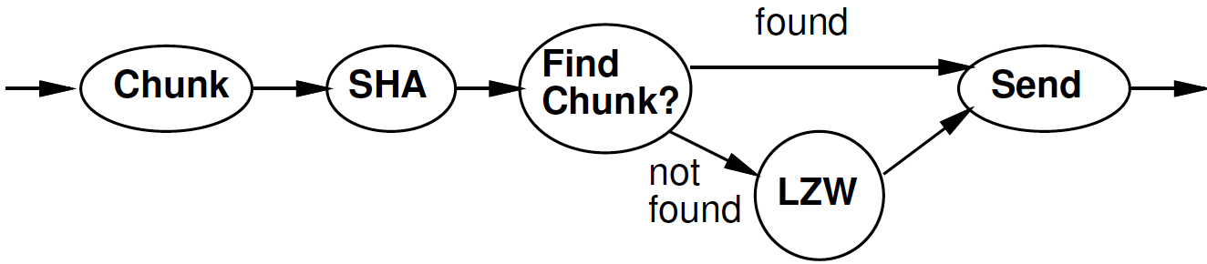
LZW Compression

Slide 5
Idea
Day 16 Review
Use data already sent as the dictionary
  Give short names to things in dictionary
  Don’t need to pre-arrange dictionary
  Adapt to common phrases/idioms in a particular document
<2,3> short name for “AM ’’
<0,4> short name for “I AM”

Slide 6
Algorithm Concept
Day 16 Review
While data to send
  Find largest match in window of data sent
  If length too small (length=1)
    Send character
  Else
    Send <x,y> = <match-pos,length>
  Add data encoded into sent window

Slide 7
Preclass 7
Day 16 Review
DICT_SIZE comparisons per input character

Slide 8
Idea
Avoid O(Dictionary-size) work
  Only need to match against positions that start with the character(s) in string to encode
    Separate dictionary for each?
Only check position 0 for “starts with I”

Slide 9
Idea
Avoid O(Dictionary-size) work
  Only need to match against positions that start with the character(s) in string to encode
    Separate dictionary for each?
If prefix same, why check redundantly?
  Store things with common prefix together
  Share prefix among substrings
  Represent all strings as prefix tree
Follow prefix trees with fixed work per input character

Slide 10
Tree Example
THEN AND THERE, THEY STOOD…
T
H
E
N
R
Y
E

Slide 11
Tree Algorithm
Tree Root for each character
Follow tree according to input until no more match
Send <name of last tree node>
  An <x,y> pair
Extend tree with new character
Start over with this character

Slide 12
Tree Example
Label with <lastpos,len> pair
THEN AND THERE, THEY STOOD…
T
T | H | E | N |  | A | N | D |  | T | H | E | R | E | , |  | T | H | E | Y
0 | 1 | 2 | 3 | 4 | 5 | 6 | 7 | 8 | 9 | 10 | 11 | 12 | 13 | 14 | 15 | 16 | 17 | 18 | 19
<0,1>
<1,2>
H
<2,3>
E
(only showing
Root for ’T’)
<3,4>
N
R
<12,4>
Y
<19,4>
<4,5>
E
<13,5>
<20,5>

Slide 13
Large Memory Implementation
int encode[SIZE][256];
Name tree node by position in chunk
  lastpos
c is a character
Encode[lastpos][c] holds the next tree node that extends tree node lastpos by c
  Or NONE if there is no such tree node

Slide 14
Tree Example
(only showing
Root for ’T’)
Label with <lastpos,len> pair
THEN AND THERE, THEY STOOD…
T
T | H | E | N |  | A | N | D |  | T | H | E | R | E | , |  | T | H | E | Y
0 | 1 | 2 | 3 | 4 | 5 | 6 | 7 | 8 | 9 | 10 | 11 | 12 | 13 | 14 | 15 | 16 | 17 | 18 | 19
<0,1>
<1,2>
H
encode[2][‘N’]=3
<2,3>
E
encode[2][‘R’]=12
<3,4>
N
R
<12,4>
Y
<19,4>
encode[2][‘Y’]=19
encode[2][‘A’]=NONE
<4,5>
E
<13,5>
<20,5>

Slide 15
Memory Tree Algorithm
curr – pointer into input chunk
// follow tree
y=0; x=0;
while(encode[x][input[curr+y]]!=NONE)
x=encode[x][input[curr+y]]; y++;
If (y>0)
send <x,y>
else
send input[curr+y]
encode[x][input[curr+y]]=curr+y
curr=curr+y

Slide 16
Complexity
How much work per character to encode?

Slide 17
Compact Memory
int encode[SIZE][256];
How many entries in this table are not NONE?

Slide 18
Compact Memory
int encode[SIZE][256];
Table is very sparse
Store as associative memory
  At most SIZE entries
Look at how to implement associative memories next

Slide 19
LZW So Far – 4KB chunks
Brute Force
  Needs one byte per byte = 4KB = 1 BRAM
  DICT_SIZE=4096 comparisons per byte
Dense memory encode[SIZE][256]
  Need 2*256B per byte = 512*4KB
  = 512 BRAMs
  1 comparison and lookup per byte

Slide 20
Reminder from Last Time

Slide 21
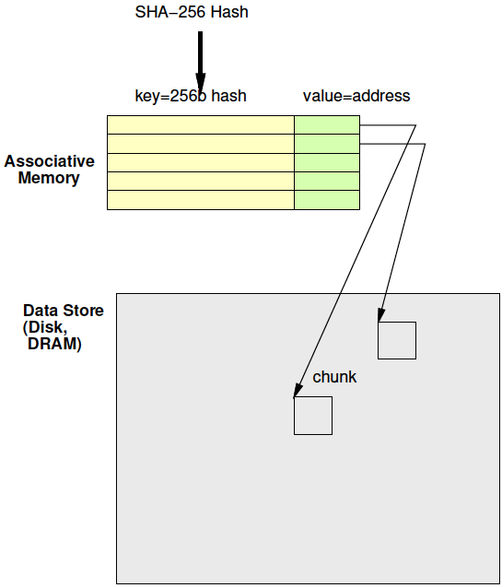
Associative Memory
Day 16 Review
Maps from a key to a value
Key not necessarily dense
  Contrast simple RAM
  Cannot afford 2²⁵⁶ word memory

Slide 22
Deduplicate
Day 16 Review
Compute chunk hash
Use chunk hash to lookup known chunks
  Data already have on disk
  Data already sent to destination, so destination will know
If lookup yields a chunk with same hash
  Check if actually equal (maybe)
If chunks equal
  Send (or save) pointer to existing chunk

Slide 23
Deduplication Architecture
Day 16 Review

Slide 24
Custom Hardware
Associative Memory

Slide 25
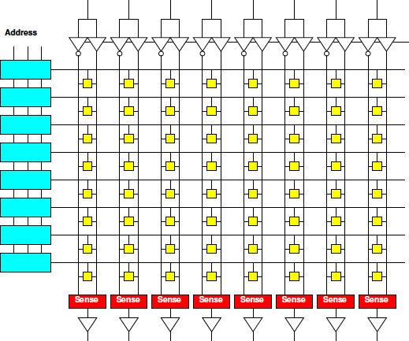
Memory Block Review
Match on address
Select wordline for a row
Reads out a word
Address dense
and hardwired
One row for
each 2^{Abits}
values
width
depth

Slide 26
Address Blocks
Each address match is AND
width
/A2&/A1&/A0
/A2&/A1&A0
depth

Slide 27
Address Blocks

Slide 28
Memory Block Associative
Want address as key
Word is value
Key sparse
Rows<2^{keybits}
Entries<2^{keybits}
Key
programmable
width
depth

Slide 29
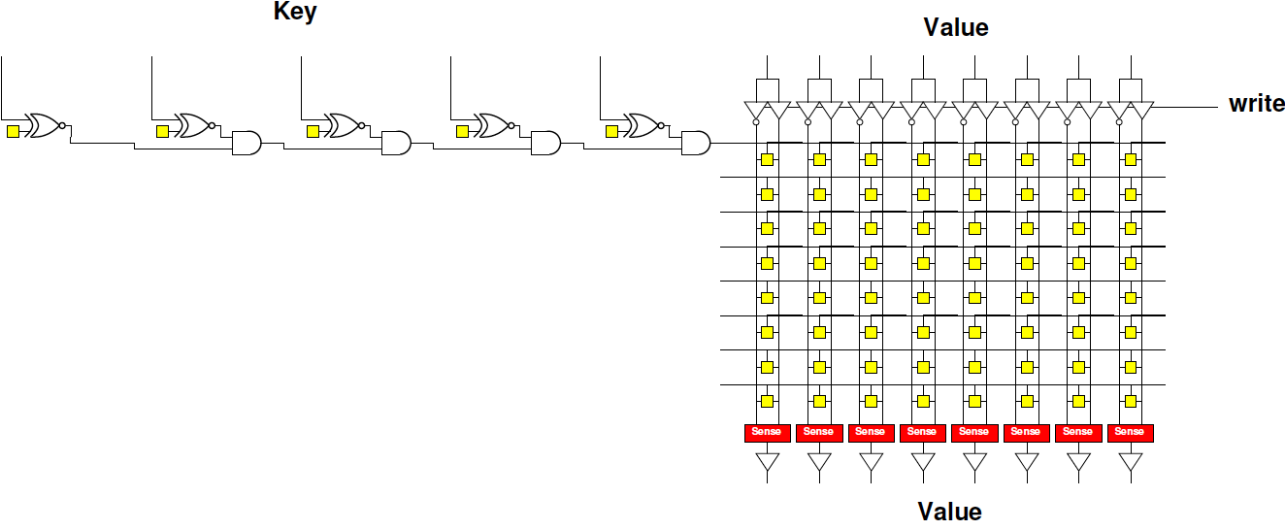
Programmable Key
Make row select programmable

Slide 30
Contrast
Assoc. and Dense Memory

Slide 31
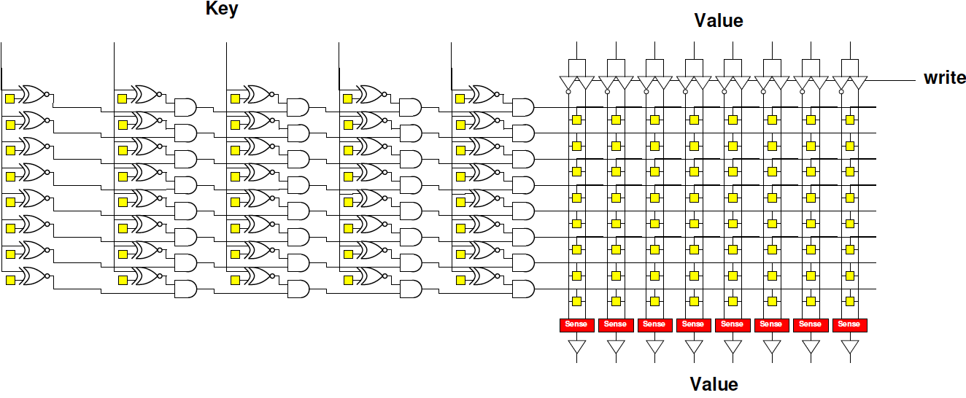
Associative Memory Bank

Slide 32
Programmable Key
Assoc: 5b key, 8 entries, 8b value
How many memory bits?
Direct: 8 entries, 8b value
How many memory bits?

Slide 33
Associative Memory Bank
Memory cells = entries*(keybits+valuebits)

Slide 34
Associative Memory Bank
Will need to be able to write into key
  Another “fixed” decoder to generate
  key-word line for programming

Slide 35
Associate Memory Cost
More expensive than equal capacity SRAM memory bank
  Memory cells in decoder
  Need to support write into key

Slide 36
Associate Memory Cost
Physical associative memory for 4KB LZW Chunk tree encode
  4K entries
  12b output
  12b+8b=20b key
Memory cells assoc.?
Compare direct 4Kx12 memory (cells)?
  How much larger is assoc. for same capacity?
Compare 4096*256 with 12b result for dense LZW case (cells)?
  How much larger to solve same problem

Slide 37
FPGA
Has BRAMs – normal memories, not associative
36Kb BRAM
  512x72
Can be 9b key → 72b value assoc.
  Just using the memory sparsely
Or interpret as programmable decoder with 72 match lines

Slide 38
Assoc. Mem from BRAM
For wider match
Cover 9b of key with each BRAM
Use 72 output bits to indicate if one of 72 entries match
AND together corresponding entries
Get 72 match bits
Re-encode match
bits to lookup value

Slide 39
BRAM Associative Memory
Previous slide expands match width
How would we expand capacity?

Slide 40
BRAM Associative Memory

Slide 41
Associative Memory Cost
Match unit
  Requires 1 BRAM per 9b of key per 72 entries
  (keylen/9b) * (entries/72)
  Asymptotically optimal (keylen*entries)
    But large
    constants
  LZW
    4K entries
    20b key
    How many BRAMs for match?

Slide 42
How are these values stored?
Key[17:9] | Key[8:0] | Value
0x001 | 0x014 | 0x01
0x001 | 0x01 | 0x34
0x0F0 | 0x014 | 0xE3
0x0C8 | 0x113 | 0xCC

Slide 43
Step 1: Assign each a match bit
match | Key[17:9] | Key[8:0] | Value
0 | 0x001 | 0x014 | 0x01
1 | 0x001 | 0x01 | 0x34
2 | 0x0F0 | 0x014 | 0xE3
3 | 0x0C8 | 0x113 | 0xCC
Memory contents
of each BRAM?

Slide 44
How Lookup Work?
Key[17:9] | Key[8:0] | Value
0x001 | 0x014 | 0x01
0x001 | 0x01 | 0x34
0x0F0 | 0x014 | 0xE3
0x0C8 | 0x113 | 0xCC
Lookup 0x214 = 0x001 0x014

Slide 45
Code Snippet
ap_uint<216> key_low[512];
ap_uint<216> key_high[512];
int value[216];
match_low=key_low[key%512];
match_high=key_high[(key>>9)%512];
match=match_low & match_high;
addr=binary_encode(match);
res=value[addr];

Slide 46
Software Map

Slide 47
Software Map
Map abstraction
  void insert(key,value);
  value lookup(key);
Will typically have many different implementations

Slide 48
Preclass 1
For a capacity of 4096
How many memory accesses needed
  When lookup fail?
  When lookup succeed (on average)?

Slide 49
Tree Map (Preclass 2)
Build search tree
Walk down tree
For a capacity of 4096,
assume balanced…
How many tree nodes visited
  When lookup fail?
  When lookup succeed (on average)?

Slide 50
Tree Map LZW
Each character requires log₂(dict) lookups
  12 for 4096
Each internal tree node hold
  Key (20b for LZW), value (12b), and 2 pointers (12b)
  7B
Total nodes 4K*2
Need 14 BRAMs for 4K chunk

Slide 51
Tree Insert
Need to maintain balance
Doable with O(log(N)) insert
  Tricky
  See Red-Black Tree
    https://en.wikipedia.org/wiki/Red–black_tree
    https://www.geeksforgeeks.org/red-black-tree-set-1-introduction-2/

Slide 52
High Performance Map
Would prefer not to search
Want to do better than log₂(N) time
Direct lookup in arrays (memory)
is good…

Slide 53
Hash Table
key
Attempt to turn into direct lookup
Compute some function of key
  A hash
Perform lookup at that point
If hash maps a single entry
(or no entry)
  Great, got direct lookup
    Like sparse table case
hash
Mem
value

Slide 54
Preclass 3a
Average number of entries per hash when N > HASH_CAPACITY?
  Concrete example
    N= 4096
    HASH_CAPACITY=256

Slide 55
Hash Table
key
Attempt to turn into direct lookup
Compute some function of key
  A hash
Perform lookup at that point
Typically, prepared for several keys to map to same hash → call it a bucket
  Keep list or tree of things in each bucket
hash
Mem
value

Slide 56
Hash Table
key
Compute some function of key
  A hash
Perform lookup at that point
Find bucket with small number of entries
  Searching that bucket easier
  …but no absolute guarantee on
  maximum bucket size
hash
Mem
value

Slide 57
Preclass 3b
Probability of conflict if N<<HASH_CAPACITY ?
  Concrete example
    N=4096
    HASH_CAPACITY=409600
Impact of HASH_CAPACITY on average bucket size?

Slide 58
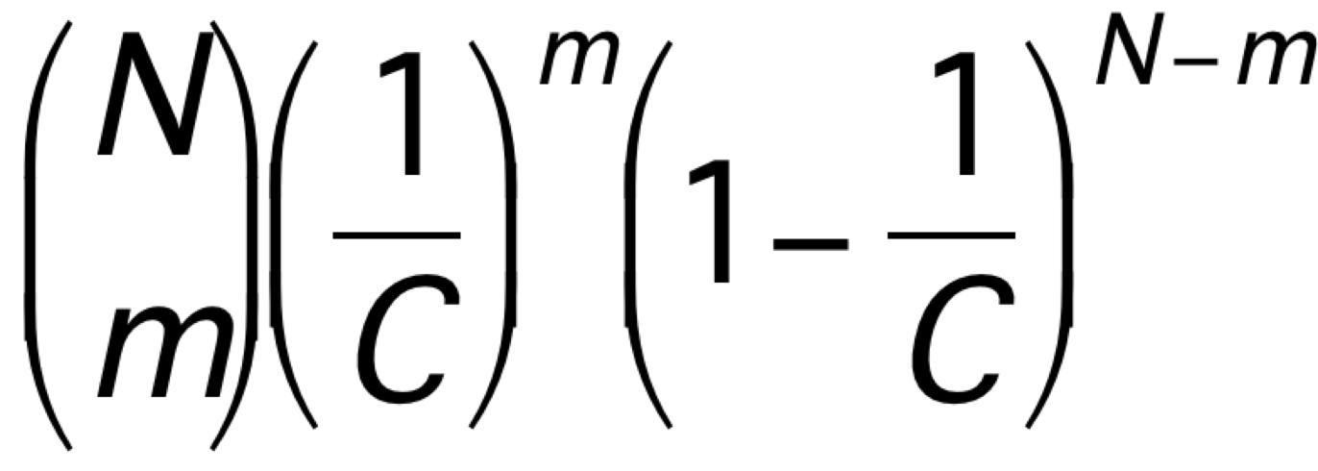
Preclass 4
N=1024
m→ | 0 | 1 | 2 | 3 | 4+
C=1024 | 0.37
C=2048
C=4096

Slide 59
Preclass 4
N=1024
m→ | 0 | 1 | 2 | 3 | 4+
C=1024 | 0.37 | 0.37 | 0.18 | 0.061 | 0.019
C=2048 | 0.60 | 0.30 | 0.076 | 0.013 | 0.0017
C=4096 | 0.78 | 0.19 | 0.024 | 0.0020 | 0.00013

Slide 60
Hash
Can tune hash parameters to control distribution
Spend more memory → smaller buckets → less work finding things in buckets
  Memory-Time tradeoff
Still have possibility of large buckets
…but probability is low

Slide 61
Idea
Hash mostly works
Engineer hash to hold most cases
  Combination of
    sparcity (entries>N)
    Hold multiple entries per hash value
Few cases that overflow
  Store in small fully associative memory

Slide 62
Hybrid Hash+Assoc.

Slide 63
LZW 4K Chunk Hybrid
72 entry assoc. matcn
  needs 3 match BRAMs + 1 data BRAM
  Associative match 20b key
  72 entries (72/4096=1.7% for 4096)
So, can hold ~1% conflicts in 4K hash
Hash N=4096, C=16384, m=2, store 3
  Prob 3+: <1% (see table 1024, 4096)
  20b key+12b value=4B per entry
  16384*3*4B=4*3*4 BRAMs
48+4=52 BRAMs

Slide 64
Further Optimization
Previous example illustrative
  Not necessarily optimal (explore parameters)
May be able to do better with multiple hashes
  See Dhawan reading paper
  May need to use that design in hybrid configuration with assoc. memory like previous example

Slide 65
4K Chunk LZW Search
 | BRAMs | Operations
Brute Search | 1 | 4K
Tree with Dense RAM | 512 | 1
Tree with Full Assoc | 175 | 1
Tree with Tree | 14 | 12
Tree with Hybrid | 52 | 1
36Kb BRAMs on ZU3EG = 216

Slide 66
Big Ideas
Sparse, near O(1) Map access → Hash Table
Rich design space for engineering associative map solutions

Slide 67
Admin
First project milestone due Friday
  Including teaming

