Slide 1

ESE532:
System-on-a-Chip Architecture
Day 19: November 4, 2019
Verification 1

Slide 2
Today
Motivation
Challenge and Coverage
Golden Model / Reference Specification
Automation and Regression

Slide 3
Message
If you don’t test it, it doesn’t work.
Verification is important and challenging
Demands careful thought
  Tractable and adequate coverage
Value to a simple functional reference
Must be automated and rerun with changes
  Often throughout lifecycle of design

Slide 4
Goal
Assure design works correctly
  Not fail and lose consumer confidence.
    …or lose them money, privacy, service availability….
  Not kill anyone
    Ethical issue
  Not lose points on your grade ☺

Slide 5
Challenge
Designs are complex
  Many ways things can go wrong
  Many subtle ways things can go wrong
  Many tricky interactions
Designs are often poorly specified
  Complex to completely specify

Slide 6
Verification
Often dominant cost in product
  Requires most manpower (cost)
  Takes up most of schedule

Slide 7
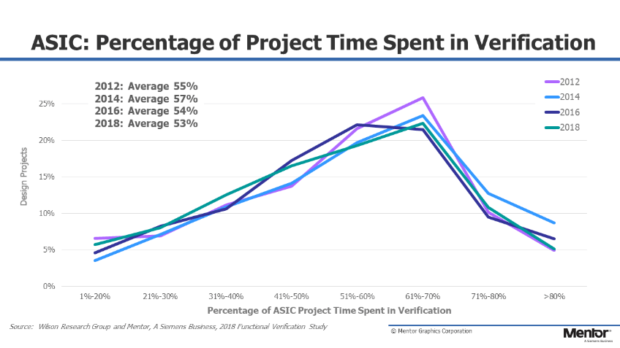
https://semiengineering.com/the-weather-report-2018-study-on-ic-asic-verification-trends/

Slide 8
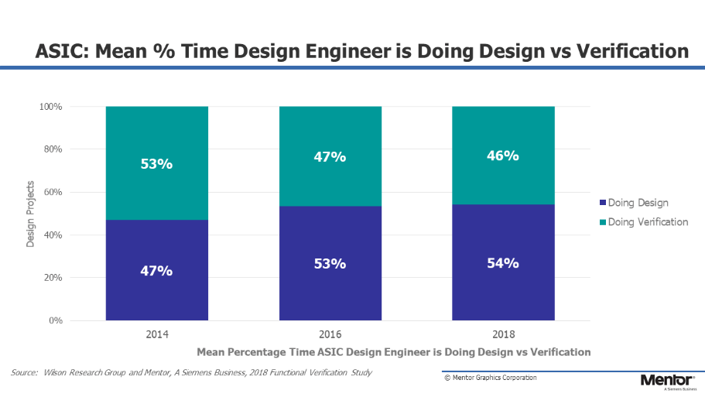
https://semiengineering.com/the-weather-report-2018-study-on-ic-asic-verification-trends/

Slide 9
Correctness?
How do we define correctness for a design?
How do we know the design is correct?
How do we know the design remains correct when?
  Add a some feature
  Perform an optimization
  Fix a bug

Slide 10
Life Cycle
Design
  specify what means to be correct
Development
  Implement and refine
  Fix bugs
  Optimize
Operation and Maintenance
  Discover bugs, new uses and interaction
  Fix and provide updates
Upgrade/revision

Slide 11
Testing and Coverage

Slide 12
Strawman Testing
Validate the design by testing it:
Create a set of test inputs
Apply test inputs
Collect response outputs
Check if outputs match expectations

Slide 13
Strawman: Inputs and Outputs
Validate the design by testing it:
Create a set of test inputs
  How do we generate an adequate set of inputs? (know if a set is adequate?)
Apply test inputs
Collect response outputs
Check if outputs match expectations
  How do we know if outputs are correct?

Slide 14
Try 1: Inputs and Outputs
Create a set of test inputs
  How do we generate an adequate set of inputs? (know if a set is adequate?)
    All possible inputs
Check if outputs match expectations
  How do we know if outputs are correct?
    Manually identify correct output

Slide 15
How many input cases?
Combinational:
10-input AND gate?
Any N-input combinational function?

Slide 16
Add Pipelining
The output doesn’t correspond to the input on a single cycle
Need to think about inputs sequences to output sequences
How many input cases?

Slide 17
Add Pipelining
The output doesn’t correspond to the input on a single cycle
Need to think about inputs sequences to output sequences
How many input cases for a generic acyclic circuit?
  Depth d
  Inputs n

Slide 18
Add Feedback State
When have state
  Different inputs can produce different outputs
Behavior depends on state
Need to reason about all states the design can be in

Slide 19
How many input cases?
Process 1000 Byte packet
  No state kept between packets
Process 1000 Byte packets
  Keep 32b of state between packets

Slide 20
Observation
Cannot afford
  Exhaustively generate input cases
  Manual write output expectations
Will need to be smarter about test case selection

Slide 21
Structural Simplifications
How many cases if treat as 7-input function?
How many useful cases
  If hold s at 0?
  If hold s at 1?
  Together total cases?
s

Slide 22
Useful Test Cases
int fun(int s,a,b,c,d) {
if (s>20)
if (s>100)
return(a+b); else return(b+c);
else
if (s<0)
return(c+d); else return(a+d);
}
What values of s
will be interesting?
When s=10,
what values of a, b, c, d
interesting?

Slide 23
Finite State Machine
What input cases should we try to exercise for an FSM? (goal for test cases)
int state;
while (true) {
switch (state) {
case (ST1): out=1; state=ST2; break;
case (ST2): if (in>0) {out=2; state=ST3;}
else {out=0; state=ST2;} break;
case (ST3): ….

Slide 24
Coverage
Do our tests execute every line of code?
  What percentage of the code is exercised?
Gate-level designs
  Can we toggle every gate output?
Necessary but not sufficient
  Not exercised or not toggled, definitely not testing some functionality
    Remember: If you don’t test it, it doesn’t work.
Measurable

Slide 25
So far…
Identifying test stimulus important and tricky
  Cannot generally afford exhaustive
  Need understand/exploit structure
Coverage metrics a start
  Not complete answer

Slide 26
Reference Specification
(Golden Model)

Slide 27
Strawman: Inputs and Outputs
Validate the design by testing it:
Create a set of test inputs
  How do we generate an adequate set of inputs? (know if a set is adequate?)
Apply test inputs
Collect response outputs
Check if outputs match expectations
  How do we know if outputs are correct?

Slide 28
Problem
Manually writing down results for all input cases
  Tedious
  Error prone
  …simple not viable for large number cases need to cover
    Definitely not viable exhaustive
    …and still not viable when select intelligently

Slide 29
Specification Model
Ideally, have a function that can
  compute the correct output
  for any input sequence
``Gold Standard” – an oracle
  Whatever the function says is truth
Could be another program
  Written in a different language? Same language?

Slide 30
Testing with Reference Specification
Validate the design by testing it:
Create a set of test inputs
Apply test inputs
  To implementation under test
  To reference specification
Collect response outputs
Check if outputs match

Slide 31
Test against Specification
Relieved ourselves of writing outputs
Still have to select input cases
  Can freely use larger set since not responsible for manually generating output match

Slide 32
Random Inputs
Can use random inputs
  Since can generate expected output for any case
Use coverage metric to see how well random inputs are exercising the code
Can be particularly good to identify interactions and corner cases didn’t think of manually
Still unlikely to generate very obscure cases

Slide 33
Random inputs
Combinational:
Expected number inputs
to cause output to toggle?
10-input AND gate?
Any N-input combinational function?

Slide 34
Random Inputs
Expected number of tests to exercise both cases?
  Compare exhaustive
What would we
like to happen
to reduce?
  What would we
  select manually?

Slide 35
Random Testing
Completely random may be just as bad as exhaustive
  Expected time to exercise interesting piece of code
  Expected time to produce a legal input
    E.g. – random packets will almost always have erroneous checksums
  E.g. random bytes won’t generate duplicate chunks, or much opportunity for LZW compression

Slide 36
Biased Random
Non-uniform random generation of inputs
  Compute checksums correctly most of the time
    Control rate and distribution of checksum errors
Randomize properties of input, E.g.
  Lengths of repeated sequences
  Distance between repeated sequences
  Edit sequence applied to differentiate files

Slide 37
Testing with Reference Specification
Validate the design by testing it:
Create a set of test inputs
Apply test inputs
  To implementation under test
  To reference specification
Collect response outputs
Check if outputs match

Slide 38
Specification
Where would we get a reference specification?
  and why should we trust it?
  Isn’t this just another design that can be equally buggy?

Slide 39
Standard
Many standards includes a reference implementation.

Slide 40
Existing Product
Many times there’s an existing product or open-source implementation…

Slide 41
Develop Specification
Maybe develop a simple, functional implementation as part of early design

Slide 42
Specification Correct?
How would we know the specification is correct? -- why should we trust it?
  Simpler/smaller
    Less opportunity for bugs
    Written for function/clarity not performance
  Different
    Ok as long as reference and implementation don’t have same bugs
      Debug and test them against each other

Slide 43
Common Bugs
Combinational (for simplicity)
10 input function
Assume two specifications have 1% error rate (1% of input cases wrong)
Assume independent
  (key assumption – weaker to extent wrong)
Probability of both giving same wrong result?
  For a particular input case?
  Across all input cases?

Slide 44
Window Filter
Day 13
Compute based on neighbors
for (y=0;y<YMAX;y++)
for (x=0;x<XMAX;x++)
  o[y][x]=F(d[y-1][x-1],d[y-1][x],d[y-1][x+1],
  d[y][x-1],d[y][x],d[y][x+1],
  d[y+1][x-1],d[y+1][x],d[y+1][x+1]);

Slide 45
Window Filter
Day 13
Single read and write from dym, dy
for (y=0;y<YMAX;y++)
for (x=0;x<XMAX;x++) {
  dypxm=dypx; dypx=dnew; dnew=d[y+1][x+1];
  dyxm=dyx; dyx=dyxp; dyxp=dy[x+1];
  dymxm=dymx; dymx=dymxp; dymxp=dym[x+1];
  o[y][x]=F(dymxm,dymx,dymxp,
  dyxm,dyx,dyxp,
  dypxm,dypx,dnew);
  dym[x-1]=dyxm;dy[x-1]=dypxm; }

Slide 46
Simpler Functional
Other examples of functional specification being simpler than implementation?

Slide 47
Simpler Functional
Sequential vs. parallel
Unpipelined vs. pipelined
Simple algorithm
  Brute force?
No data movement optimizations
Use robust, mature (well-tested) building blocks

Slide 48
Testing with Reference Specification
Validate the design by testing it:
Create a set of test inputs
Apply test inputs
  To implementation under test
  To reference specification
Collect response outputs
Check if outputs match

Slide 49
Coverage
Of specification or implementation?
  Almost certainly both
Specification may have a case split that implementation doesn’t have
  E.g. handle exceptional case
Implementation typically have many more cases to handle in general

Slide 50
Automation and Regression

Slide 51
Automated
Testing suite must be automated
  Single script or make build to run
  Just start the script
  Runs through all testing and comparison without manual interaction
  Including scoring and reporting a single pass/fail result
    Maybe a count of failing cases

Slide 52
Regression Test
Regression Test -- Suite of tests to run and validate functionality

Slide 53
Regression Tests
One big test or many small tests?
Benefit of many small tests?
Benefit of big test(s)?

Slide 54
Automation Mandatory
Will run regression suite repeatedly during Life Cycle
  Every change
  As optimize
  Every bug fix

Slide 55
Life Cycle
Design
  specify what means to be correct
Development
  Implement and refine
  Fix bugs
  optimize
Operation and Maintenance
  Discover bugs, new uses and interaction
  Fix and provide updates
Upgrade/revision

Slide 56
Automation Value
Engineer time is bottleneck
  Expensive, limited resource
  Esp. the engineer(s) that understand what the design should do
Cannot spend that time evaluating/running tests
Reserve it for debug, design, creating tests
Capture knowledge in tools and tests

Slide 57
When find a bug
If regression suite didn’t originally find it
  Add a test (expand regression suite) so will have a test to cover
Make sure won’t miss it again
Test suite monotonically improving

Slide 58
When add a feature
Add a test to validate that feature
  And interaction with existing functionality
Maybe add the test first…
  See test identifies lack of feature before add functionality
  …then see (correctly added) feature satisfies test

Slide 59
Continuous Integration
When commit code to shared repo (git, svn)
  Build and run regression suite
  Perhaps before allow commit
  Guarantee not break good version
    Or, at least, know how functional/broken the current version is
Alternately, nightly regression
  Automation to check out, build, run tests

Slide 60
Regression Test Size
Want to be comprehensive
  More tests better….
Want to run in tractable time
  Few minutes once make change or when checkin
  Cannot run for weeks or months
  Might want to at least run overnight
Sometimes forced to subset
  Small, focused subset for immediate test
  Comprehensive test for full validation

Slide 61
Unit Tests
Regression for individual components
Good to validate independently
Lower complexity
  Fewer tests
  Complete quickly
Make sure component(s) working before run top-level design tests
  One strategy for long top-level regression

Slide 62
Functional Scaffolding
If functional decomposed into components like implementation
Replace individual components with implementation
  Use reference/functional spec for rest

Slide 63
Functional Scaffolding
If functional decomposed into components like implementation
Replace individual components with implementation
  Use reference/functional spec for rest
Independent test of integration for that module

Slide 64
Functional Scaffolding
If functional decomposed into components like implementation
Run reference component and implementation together and check outputs

Slide 65
Decompose Specification
Should specification decompose like implementation?
  ultimate golden reference
    Only if that decomposition is simplest
But, worth refining
  Golden reference simplest
  Intermediate functional decomposed
    Validate it versus golden
    Still simpler than final implementation
    Then use with implementation

Slide 66
Big Ideas
Testing
  Designs are complicated, need extensive validation – If you don’t test it, it doesn’t work.
  Exhaustive testing not tractable
  Demands care
  Coverage one tool for helping identify
Reference specification as “gold” standard
  Simple, functional
Must automate regression
  Use regularly throughout life cycle

Slide 67
Admin
P2 due Friday

