Slide 1

ESE532:
System-on-a-Chip Architecture
Day 2: September 4, 2019
Analysis, Metrics, and Bottlenecks
Work Preclass
Lecture start 10:35am

Slide 2
Today: Analysis
How do we quickly estimate what’s possible?
  Before (with less effort than) developing a complete solution
How should we attack the problem?
  Achieve the performance, energy goals?
When we don’t like the performance we’re getting, how do we understand it?
Where should we spend our time?

Slide 3
Today: Analysis
Throughput
Latency
Bottleneck
Computation as a Graph, Sequence
Critical Path
Resource Bound
90/10 Rule (time permitting)

Slide 4
Message for Day
Identify the Bottleneck
  May be in compute, I/O, memory, data movement
Focus and reduce/remove bottleneck
  More efficient use of resources
  More resources
Repeat

Slide 5
Latency vs. Throughput
Latency: Delay from inputs to output(s)
Throughput: Rate at which can produce new set of outputs
  (alternately, can introduce new set of inputs)

Slide 6
Preclass
Washer/Dryer Example
10 shirt capacity
1 Washer Takes 30 minutes
1 Dryer Takes 60 minutes
How long to do one load of wash?
  → Wash latency
Cleaning Throughput?
W
D
W
D
60m

Slide 7
Pipeline Concurrency
W
D
Break up the computation graph into stages
  Allowing us to
    reuse resources for new inputs (data),
    while older data is still working its way through the graph
      Before it has exited graph
  Throughput > (1/Latency)
Relate liquid in pipe
  Doesn’t wait for first drop of liquid to exit far end of pipe before accepting second drop

Slide 8
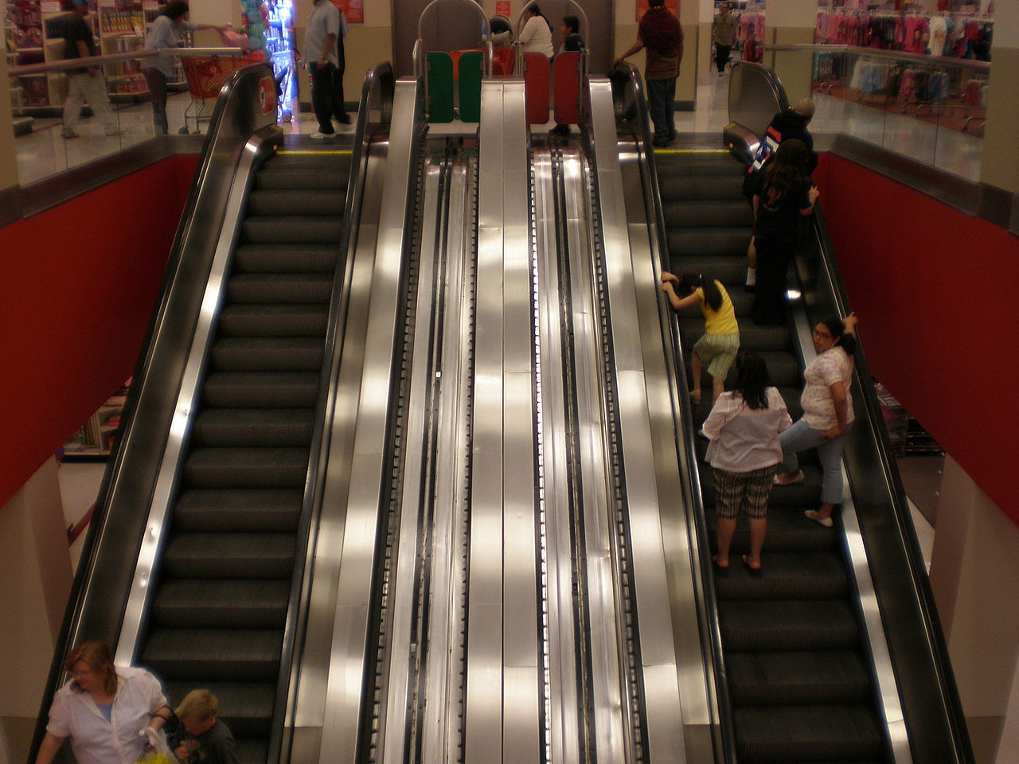
Escalator
Image Source: https://commons.wikimedia.org/wiki/File:Tanforan_Target_escalator_1.JPG

Slide 9
Escalator
Moves 2 ft/second
Assume for simplicity one person can step on escalator each second
Escalator travels 30 feet (vertical and horizontal)
Latency of escalator trip?
Throughput of escalator: people/hour ?

Slide 10
Bottleneck
What is the rate limiting item?
  Resource, computation, ….

Slide 11
Preclass
Washer/Dryer Example
1 Washer Takes 30 minutes
  Isolated throughput 20 shirts/hour
1 Dryer Takes 60 minutes
  Isolated throughput 10 shirts/hour
Where is bottleneck in our cleaning system?
W
D
W
D
60m

Slide 12
Preclass
Washer/Dryer Example
1 Washer $500
  Isolated throughput 20 shirts/hour
1 Dryer $500
  Isolated throughput 10 shirts/hour
How do we increase throughput with $500 investment
W
D
W
D
60m

Slide 13
Preclass
Washer/Dryer Example
1 Washer $500
  Isolated throughput 20 shirts/hour
2 Dryers $500
  Isolated single dryer throughput 10 shirts/hour
Latency?
Throughput?
D
W
D

Slide 14
Preclass
Washer/Dryer Example
1 Washer $500
  Isolated throughput 20 shirts/hour
2 Dryers $500
  Isolated single dryer throughput 10 shirts/hour
Able to double the
throughput without doubling system cost
D
W
D

Slide 15
Preclass
Stain Example
3x
1 Washer Takes 30 minutes
  Isolated throughput 20 shirts/hour
1 Dryer Takes 60 minutes
  Isolated throughput 10 shirts/hour
Shirt need 3 wash cycles
Latency?
Throughput?
  (assuming reuse single washer)
D
W

Slide 16
Beyond Computation

Slide 17
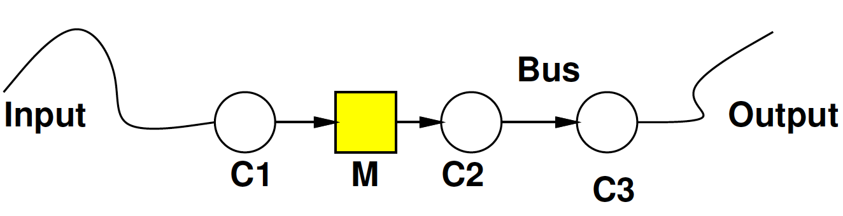
Bottleneck
May be anywhere in path
  I/O, compute, memory, data movement

Slide 18
Bottleneck
Where bottleneck?
Ethernet
1Gb/s
(64b in 64ns)
64b every 4ns
64b→64b
In 5ns
64b→32b in 10ns
Serial
1Mb/s
(64b in 64μs)
64b→64b in 2ns
32b→64b in 10ns

Slide 19
Bottleneck
Where bottleneck?
Ethernet
1Gb/s
(64b in 64ns)
64b every 4ns
64b→64b
In 5ns
64b→32b in 10ns
Ethernet
1Gb/s
(64b in 64ns)
64b→64b in 2ns
32b→64b in 200ns

Slide 20
Bottleneck
Where bottleneck?
Ethernet
1Gb/s
(64b in 64ns)
64b every 4ns
64b→64b
In 1000ns
64b→32b in 10ns
Ethernet
1Gb/s
(64b in 64ns)
64b→64b in 2ns
32b→64b in 200ns

Slide 21
Feasibility / Limits
First things to understand
  Obvious limits in system?
Impossible?
Which aspects will demand efficient mapping?
Where might there be spare capacity

Slide 22
Generalizing
(to more general task graphs)

Slide 23
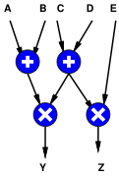
Computation as Graph
Shown “simple” graphs (pipelines) so far
Y=(A+B)*(C+D)
Z=(C+D)*E
Note: HW2 ask you to draw a
dataflow graph.
Here’s an example…more to come.

Slide 24
Computation as Graph
Nodes have multiple input/output edges
Edges may fanout
  Results go to multiple successors

Slide 25
Computation as Sequence
Shown “simple” graphs (pipelines) so far
Y=(A+B)*(C+D)
Z=(C+D)*E
T1=A+B
T2=C+D
Y=T1*T2
Z=T1*E

Slide 26
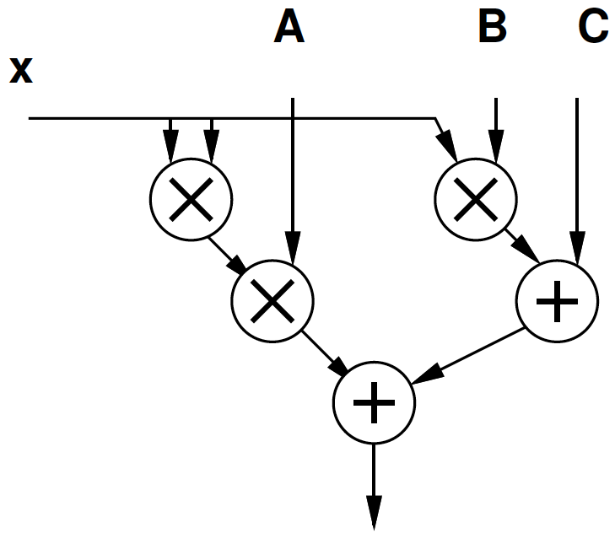
Computation as Graph
Y=Ax²+Bx+C
T1=x*x
T2=A*T1
T3=B*x
T4=T2+T3
Y=C+T4

Slide 27
Computation as Graph
Latency multiply = 1
Latency add = 1/3
Latency from B to output?
Latency from x to output?
  Through Ax² ?
  Through Bx ?

Slide 28
Delay in Graphs
Observe: There are multiple paths from inputs to outputs
Need to complete all of them to produce outputs
Limited by longest path
Critical path: longest path in the graph

Slide 29
Computation as Graph
Latency multiply = 1
Latency add = 1/3
Critical Path?

Slide 30
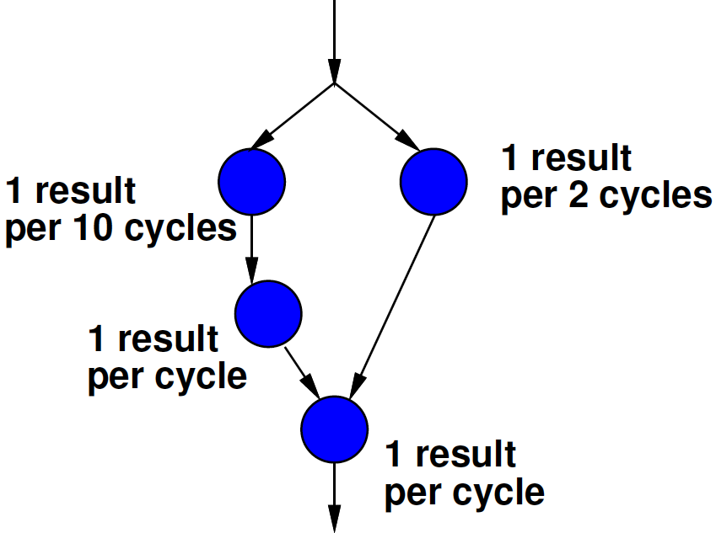
Bottleneck
Where is the bottleneck?
A
B
C
D

Slide 31
Time and Space

Slide 32
Space
“Space” is an abstract term for physical resources
  On VLSI chip: Area – mm² of silicon
  On our FPGA: # of LUTs used
  More abstractly: # of Adders, multipliers
  Laundry example
    $$ to spend on laundry equipment
    Physical space (sq. ft) in laundry room

Slide 33
Space-Time
In general, we can spend resources to reduce time
  Increase throughput
D
W
D
Three wash stain removal case
W
W
W
D

Slide 34
Space Time
Computation
  A=x0+x1
  B=x2+x3
  C=A+B
Adder takes one cycle
Latency on one adder?
Latency on 3 adders?
+
+
+

Slide 35
Computation as Graph
Latency multiply = 1
Space multiply = 3
Latency add = 1
Space add = 1
Latency and Space
  3 mul, 2 add

Slide 36
Schedule 3 mul, 2 add
Cycle | Mul | Mul | Mul | Add | Add
0 | A*B | C*D | E*F
1 |  |  |  | A*B+C*D | E*F+G
2 |  |  |  | (A*B+C*)D+(E*F+G)

Slide 37
Computation as Graph
Latency multiply = 1
Space multiply = 3
Latency add = 1
Space add = 1
Latency and Space
  2 mul, 1 add

Slide 38
Schedule 2 mul, 1 add
Cycle | Mul | Mul | Add
0 | A*B | C*D
1 | E*F |  | (A*B+C*D)
2 |  |  | E*F+G
3 |  |  | (A*B+C*D)+ (E*F+G)

Slide 39
Computation as Graph
Latency multiply = 1
Space multiply = 3
Latency add = 1
Space add = 1
Latency and Space
  1 mul, 1 add

Slide 40
Schedule 1 mul, 1 add
Cycle | Mul | Add
0 | A*B
1 | C*D
2 | E*F | A*B+C*D
3 |  | E*F+G
4 |  | (A*B+C*D)+(E*F+G)

Slide 41
Space-Time Graph
(corrected after lecture)

Slide 42
Two Bounds
(still in Time and Space)

Slide 43
Problem
Coming up with an exact time count can be hard (human/computer time consuming)
  Technically a hard problem
    NP-Complete: no known non-exponential solution
Requires reasoning about structure of graph
Would be nice to have a quick (easy) answer on what is feasible
  …and what is not feasible → impossible.

Slide 44
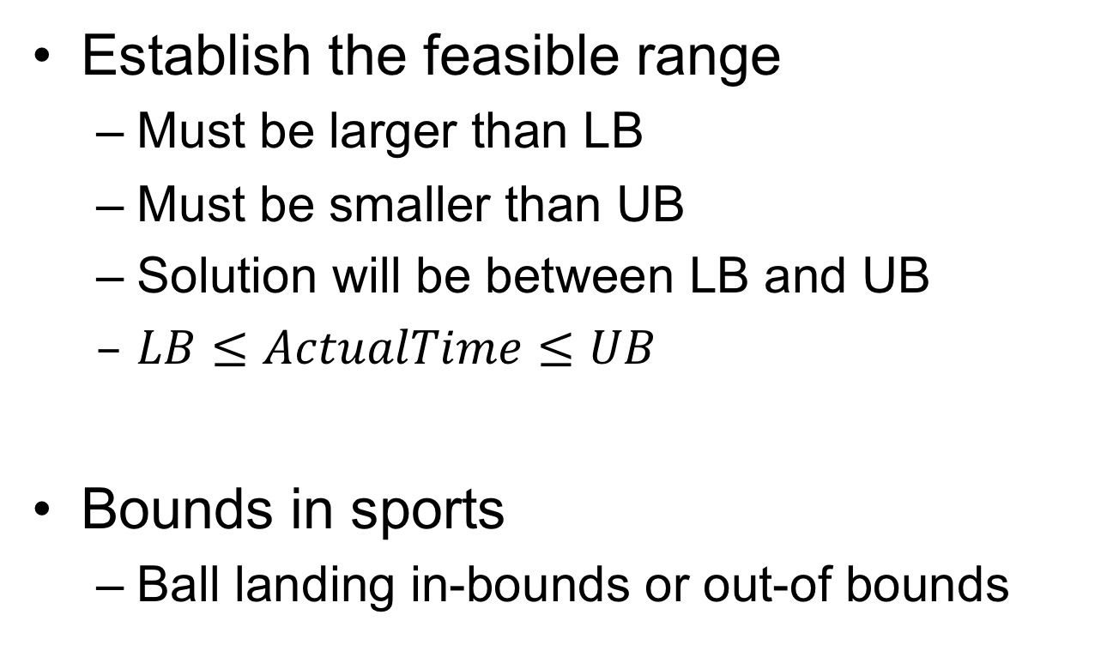
Bounds
Establish the feasible range
  Must be larger than LB
  Must be smaller than UB
  Solution will be between LB and UB
  $LB≤ActualTime≤UB$
Bounds in sports
  Ball landing in-bounds or out-of bounds

Slide 45
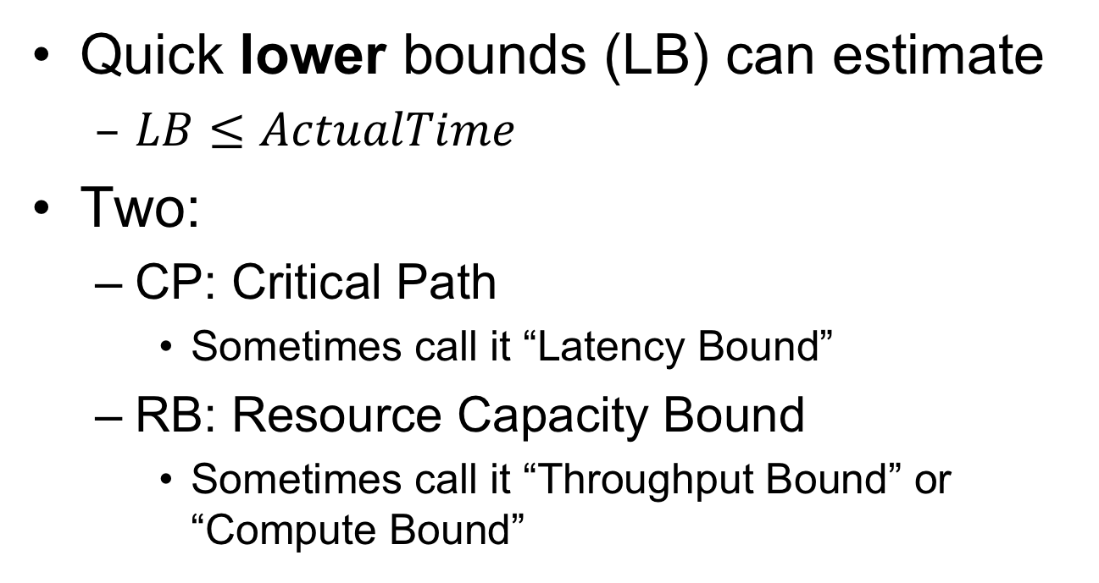
Bounds
Quick lower bounds (LB) can estimate
  $LB≤ActualTime$
Two:
  CP: Critical Path
    Sometimes call it “Latency Bound”
  RB: Resource Capacity Bound
    Sometimes call it “Throughput Bound” or “Compute Bound”

Slide 46
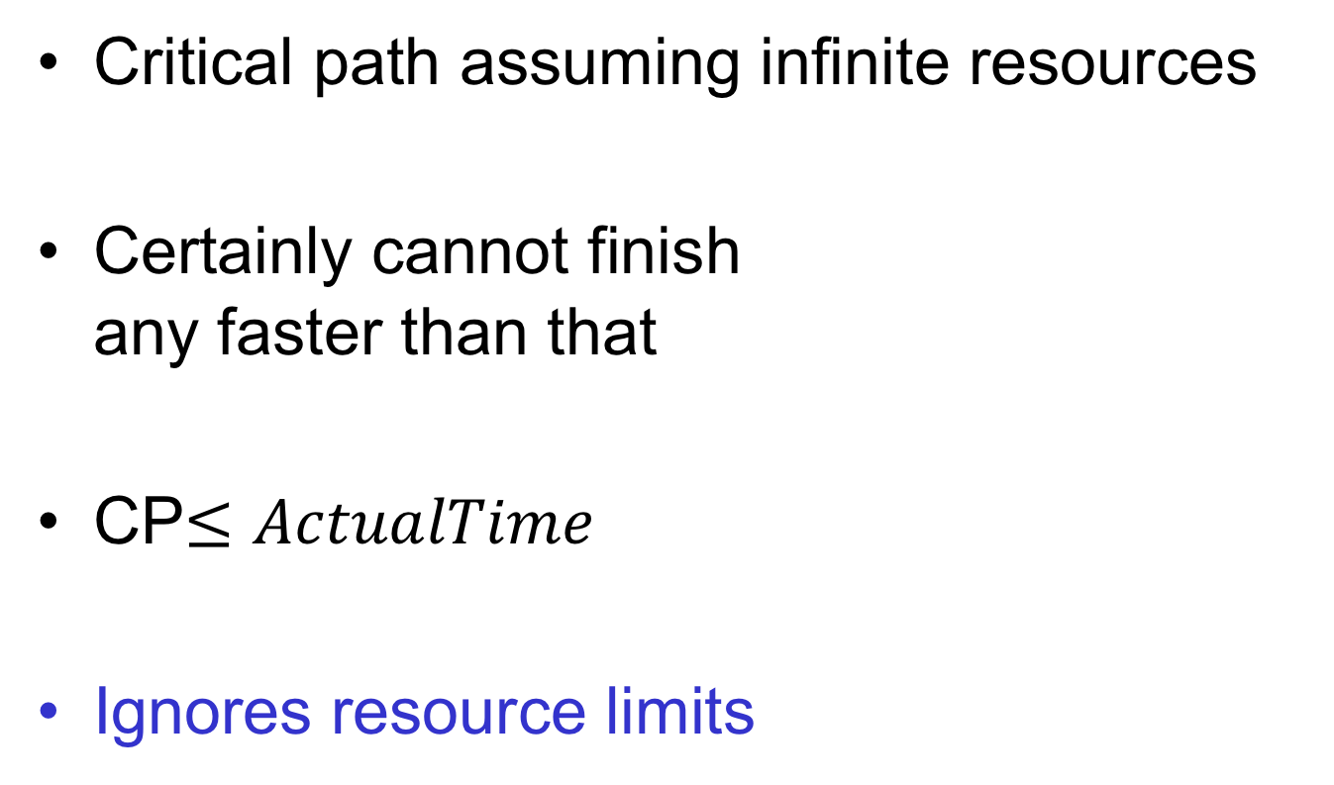
Critical Path Lower Bound
Critical path assuming infinite resources
Certainly cannot finish
any faster than that
CP$≤ActualTime$
Ignores resource limits

Slide 47
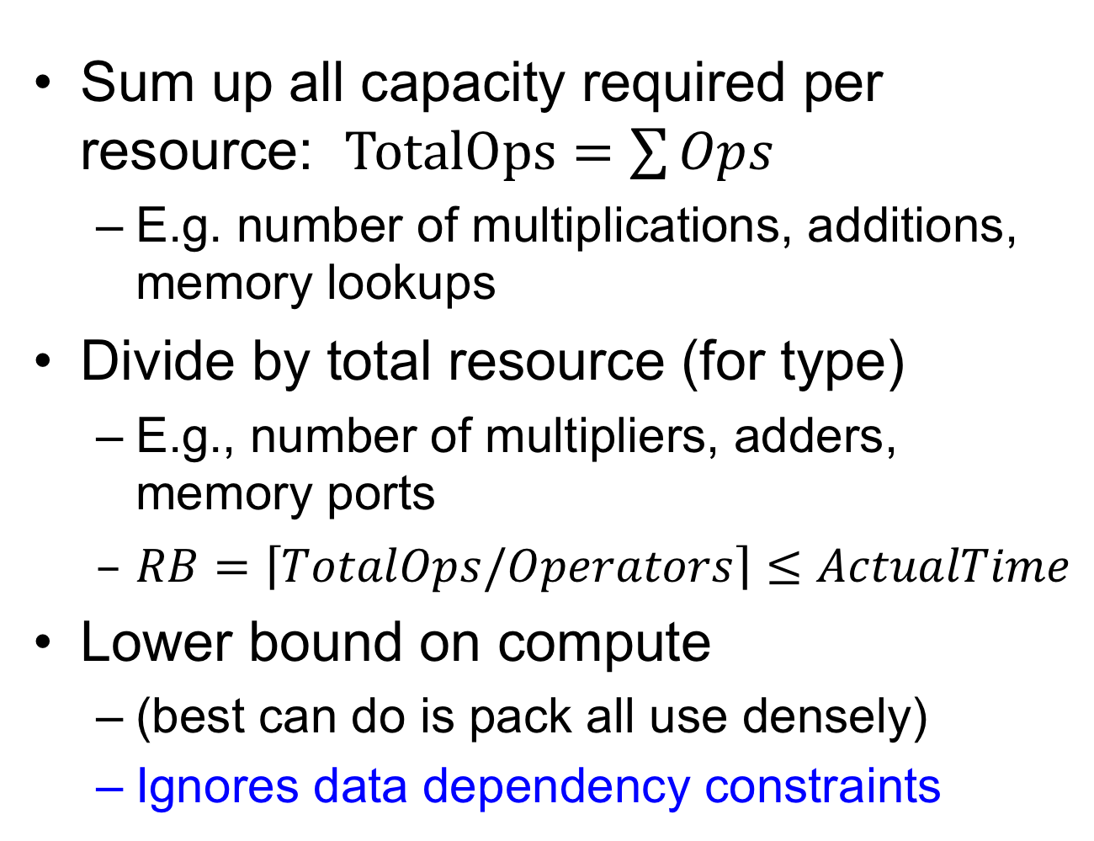
Resource Capacity Lower Bound
Sum up all capacity required per resource: $TotalOps=\sum{Ops}$
  E.g. number of multiplications, additions, memory lookups
Divide by total resource (for type)
  E.g., number of multipliers, adders, memory ports
  $RB=\left\lceil TotalOps/Operators\right\rceil ≤ActualTime$
Lower bound on compute
  (best can do is pack all use densely)
  Ignores data dependency constraints

Slide 48
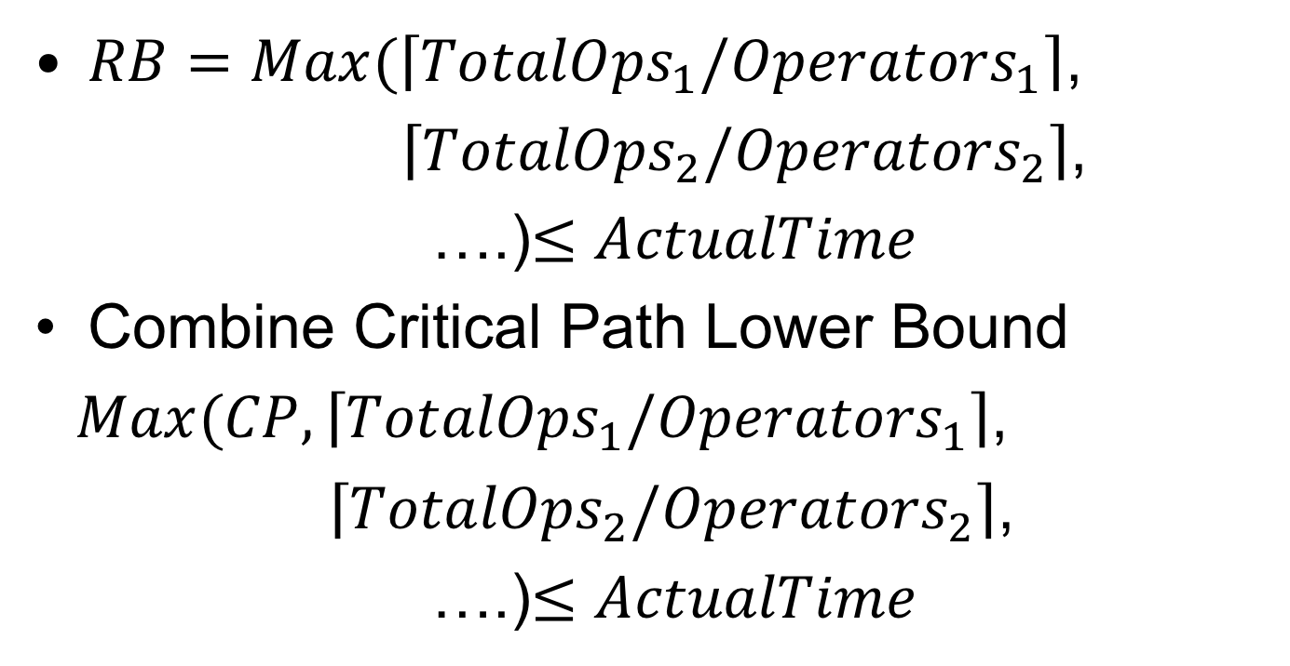
Multiple Resource Types
$RB=Max(\left\lceil {TotalOps}_{1}/{Operators}_{1}\right\rceil$,
$\left\lceil {TotalOps}_{2}/{Operators}_{2}\right\rceil$,
….)$≤ActualTime$
Combine Critical Path Lower Bound
$Max(CP,\left\lceil {TotalOps}_{1}/{Operators}_{1}\right\rceil$,
$\left\lceil {TotalOps}_{2}/{Operators}_{2}\right\rceil$,
….)$≤ActualTime$

Slide 49
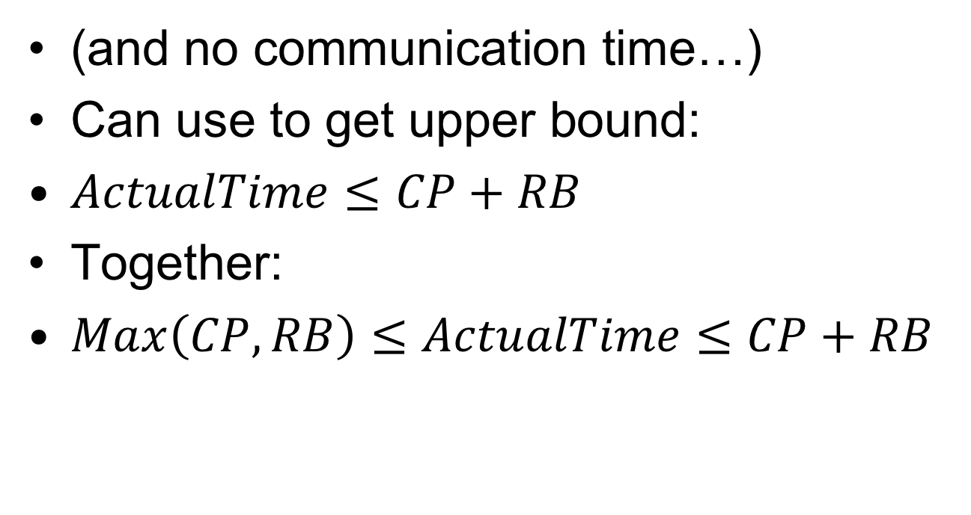
For Single Resource Type
(and no communication time…)
Can use to get upper bound:
$ActualTime≤CP+RB$
Together:
$Max\left(CP,RB\right)≤ActualTime≤CP+RB$

Slide 50
Washer-Dryer Bounds
Task: wash & dry 30 shirts
Washer: 10 shirts/30 min.
Dryer: 10 shirts/60 min.
2 Washers, 2 Dryers
W-->D CP=90 minutes

Slide 51
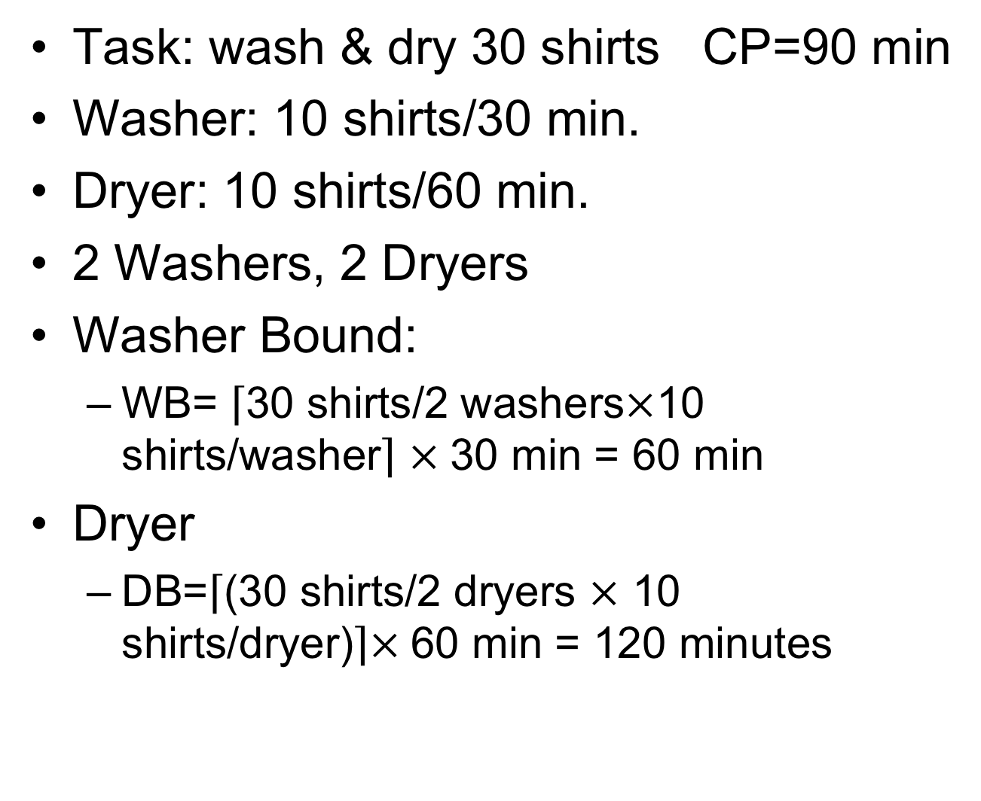
Washer-Dryer Bounds
Task: wash & dry 30 shirts CP=90 min
Washer: 10 shirts/30 min.
Dryer: 10 shirts/60 min.
2 Washers, 2 Dryers
Washer Bound:
  WB= $\left\lceil \text{30 }\text{shirts}\text{/2 }\text{washers}×\text{10 }\text{shirts}\text{/}\text{washer}\right\rceil$ $×$30 min = 60 min
Dryer
  DB=$\left\lceil \text{(30 }\text{shirts}\text{/2 }\text{dryers} ×\text{ 10 }\text{shirts}\text{/}\text{dryer}\text{)}\right\rceil ×$60 min = 120 minutes

Slide 52
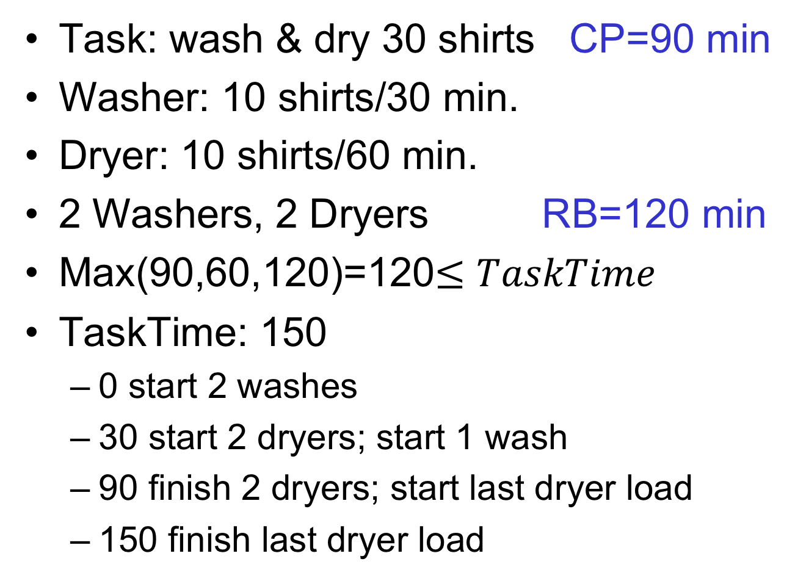
Washer-Dryer Bounds
Task: wash & dry 30 shirts CP=90 min
Washer: 10 shirts/30 min.
Dryer: 10 shirts/60 min.
2 Washers, 2 Dryers RB=120 min
Max(90,60,120)=120$≤TaskTime$
TaskTime: 150
  0 start 2 washes
  30 start 2 dryers; start 1 wash
  90 finish 2 dryers; start last dryer load
  150 finish last dryer load

Slide 53
Example
Critical Path

Slide 54
Example
Total capacity (yellow circle evaluations) needed?
Resource Bound (2 resources)?

Slide 55
Example
D
F
G
Cycle | Resource 1 | Resource 2
0 | A | B
1 | C | D
2 | E | F
3 | G
C
E
B
A
Resource Bound (2 resources)?

Slide 56
Example
Resource Bound (4 resources)?

Slide 57
Example
D
F
G
C
E
B
Cycle | R1 | R2 | R3 | R4
0 | A | B | C | D
1 | E | F | G
A
Legal Schedule?

Slide 58
Resource Capacity Lower Bound
Sum up all capacity required per resource: $TotalOps=\sum{Ops}$
  E.g. number of multiplications, additions, memory lookups
Divide by total resource (for type)
  E.g., number of multipliers, adders, memory ports
  $RB=\left\lceil TotalOps/Operators\right\rceil ≤ActualTime$
Lower bound on compute
  (best can do is pack all use densely)
  Ignores data dependency constraints

Slide 59
Example
Critical Path
3
7/2=4
7/4=2
Resource Bound (2 resources)
Resource Bound (4 resources)

Slide 60
90/10 Rule (of Thumb)
Observation that code is not used uniformly
90% of the time is spent in 10% of the code
Knuth: 50% of the time in 2% of the code
Implications
  There will typically be a bottleneck
  We don’t need to optimize everything
  We don’t need to uniformly replicate space to achieve speedup
  Not everything needs to be accelerated

Slide 61
Big Ideas
Identify the Bottleneck
  May be in compute, I/O, memory ,data movement
Focus and reduce/remove bottleneck
  More efficient use of resources
  More resources

Slide 62
Admin
Reading for Day 3 on web
HW1 due Friday
HW2 out
  Partner assignment
  (see canvas)
Remember feedback

