Slide 1

ESE532:
System-on-a-Chip Architecture
Day 23: November 18, 2019
Estimating Chip Area and Costs

Slide 2
Today
Chip Costs from Area
Chip Area
  IO
  Interconnect – Rent’s Rule
  Infrastructure
Some Areas
  CACTI – for modeling memories

Slide 3
Message
First order:
  Chip cost proportional to Area
  Area = Sum(Area(Components))
But appreciate the simplification:
  Yield makes cost superlinear in area
  I/O, Interconnect, infrastructure
    Can make Area > Sum(Area(Components))

Slide 4
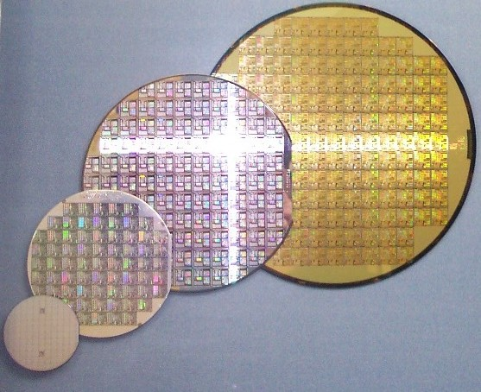
Wafer Cost
Incremental cost of producing a silicon wafer is fixed for a given technology
  Independent of the specific design
  E.g. $4,000
Can fill wafer with
copies of chip
By German Wikipediabiatch, original upload 7.
Okt 2004 by Stahlkocher de:Bild:Wafer 2 Zoll bis 8 Zoll.jpg,
CC BY-SA 3.0, https://commons.wikimedia.org/w/index.php?curid=928106

Slide 5
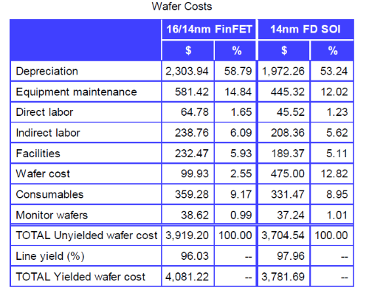
16nm Wafer Costs
Source: https://www.eetimes.com/author.asp?section_id=36&doc_id=1329887

Slide 6
Preclass 1
Rough cost per mm of silicon?
  $4000 for 300mm wafer

Slide 7
Implication
Raw silicon die cost is roughly proportional to area
  Larger the die, the fewer we get on the wafer

Slide 8
…but
Limits to how big we can make chips
  Manufactures are prepared to create
  Can be reliably manufactured
…and how small we can make chips
  I/O pads
  Cutting/handling/marking

Slide 9
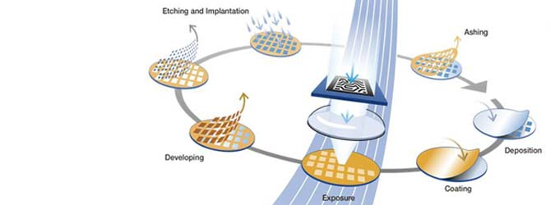
Imaging
Limit to how large optical imaging supports
Reticle – imagable region for photo lithography
  Around 600mm²
Source
https://www.asml.com/the-asml-exposure-apparatus-is-the-most-expensive-and-complex-step-in-the-chip-fabrication-process-what-is-involved-in-the-lithography-business/ja/s28145?rid=44709

Slide 10
Yield
Chips won’t be manufactured perfectly
  Dust particles can impact imaging
  Manufacturing processes are statistical
If chips must be defect-free,
  larger chips are more likely to have defects than smaller chips

Slide 11
Simple Yield Model
Probability of a region being perfect
  E.g. probability of one sq. mm being defect-free
Chip yields if its entire area is defect free
(look at how to tolerate defects in a couple of weeks)

Slide 12
Chip Yield
P = defect-free probability per sq. mm
What is probability a chip of A sq. mm yields (symbolic) ?

Slide 13
Preclass 2
P=0.99
Probability of yield for
  10 mm², 50 mm², 100 mm², 500 mm²

Slide 14
Yielded Die
For a yield rate, Y, how many raw die need to manufacture per yielded die?

Slide 15
Preclass 3
P=0.99
Die cost for:
  10 mm², 50 mm², 100 mm², 500 mm²

Slide 16
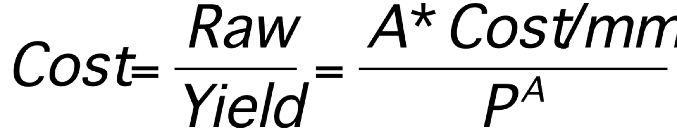
Yielded Die Cost

Slide 17
Yielded Die Cost
Ultimately exponential in Area
Means
  Expensive above knee in exponential curve
  Close to linear below knee in curve
E.g.
  Below P^{A}=0.5
    effect of Yield term is less than 2

Slide 18
Design Dependent Cost
P can be design dependent
  More aggressive designs have higher defect rates
  Can tune design to ease manufacturing
Contrast with point that wafer manufacture cost independent of design

Slide 19
Slightly Fuller Story
Chip cost = die + test + package

Slide 20
Test
Testing costs proportional to test time
  Time on expensive test unit
  Depends on complexity of tests need to run
    Can motivate spending silicon area on on-chip test structures to reduce
Can dominate on small chips or complex testing

Slide 21
Packaging
Pay for density and performance

Slide 22
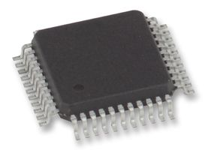
Plastic Packages
Simple plastic packages cheap
  Limited number of pins
    Limited to perimeter
  Limited heat removal (few Watts)
  Can be large (due to pins)
  Higher inductance on pins
http://wiki.electroons.com/doku.php?id=ic_packages

Slide 23
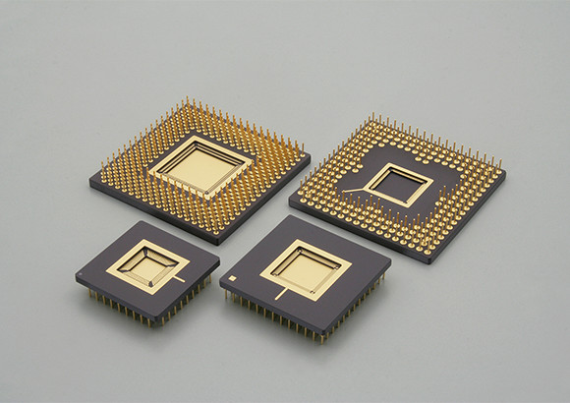
Ceramic Packages
Better thermal characteristics
  Add heat-sink, tolerate hotter chips
    To 100 W
  More pins
  More expensive
Source: https://www.ngkntk.co.jp/english/product/semiconductor_packages/htcc.html

Slide 24
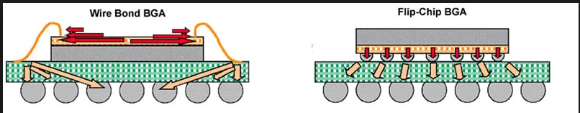
Flip Chip Packages
Support Area-IO
  More, denser pins
  Smaller die if IO limited
  Lower inductances
  Smaller packaged chip
Source: http://mantravlsi.blogspot.com/2014/10/flip-chip-and-wire-bonding.html

Slide 25
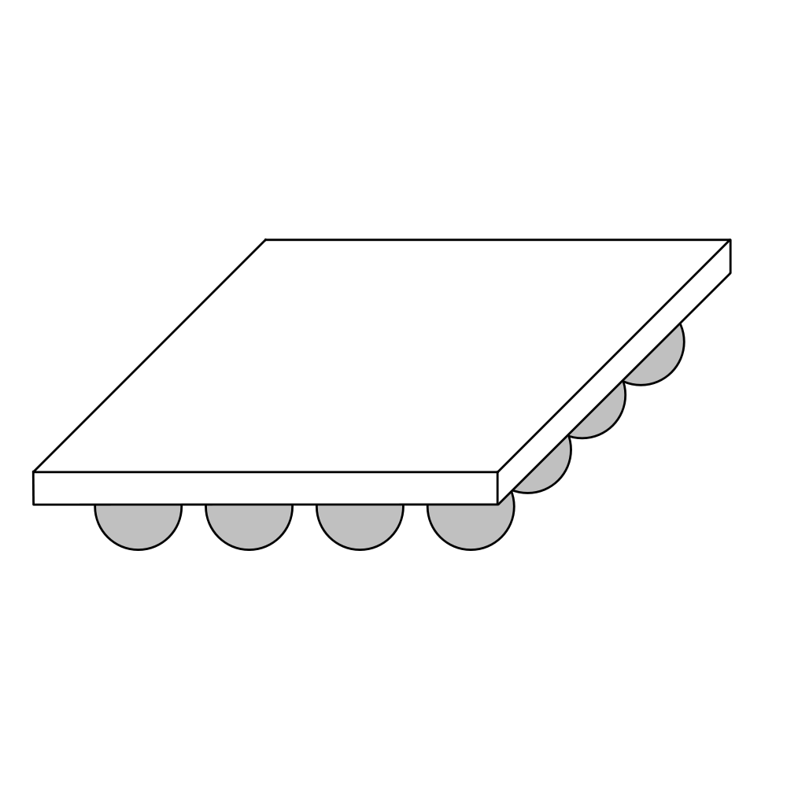
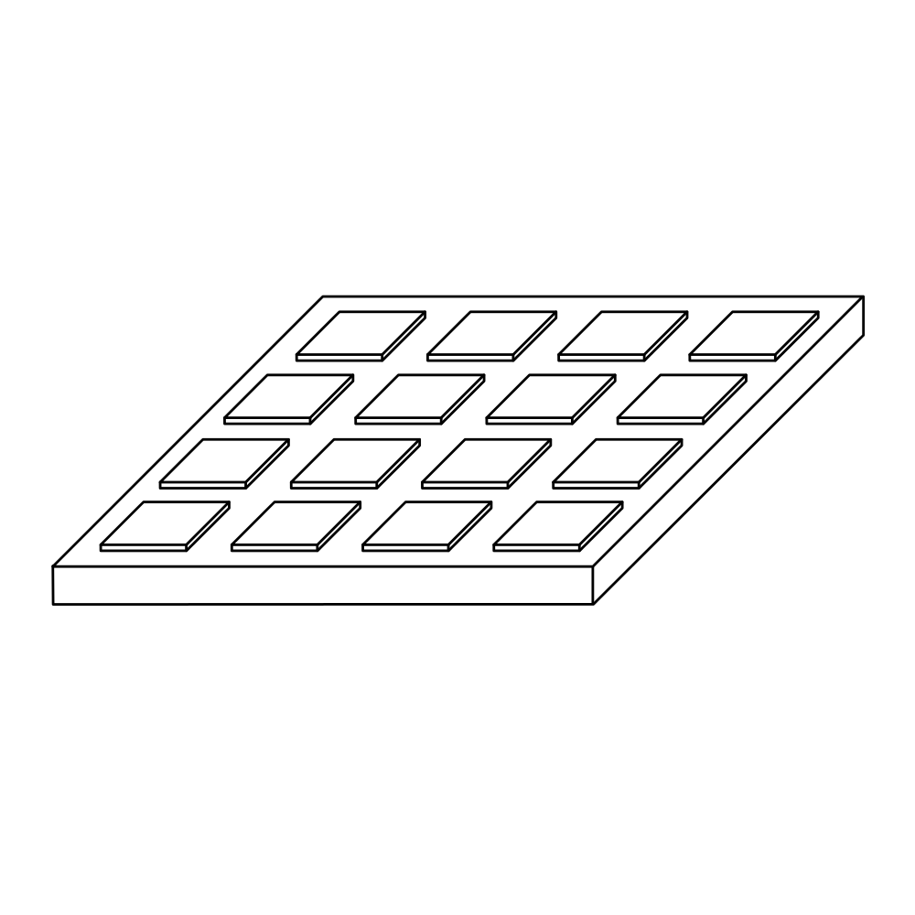
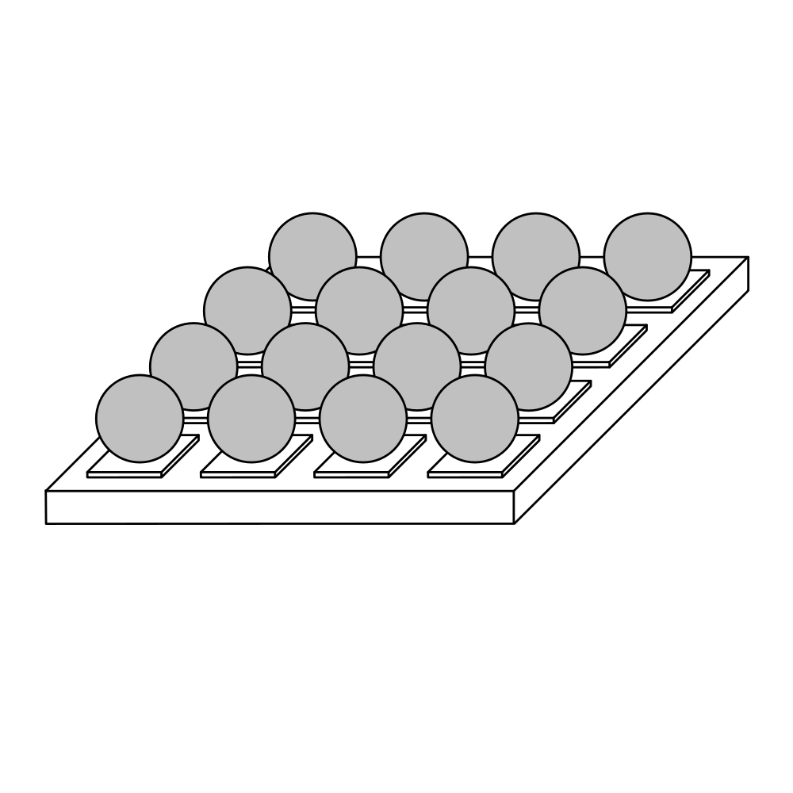
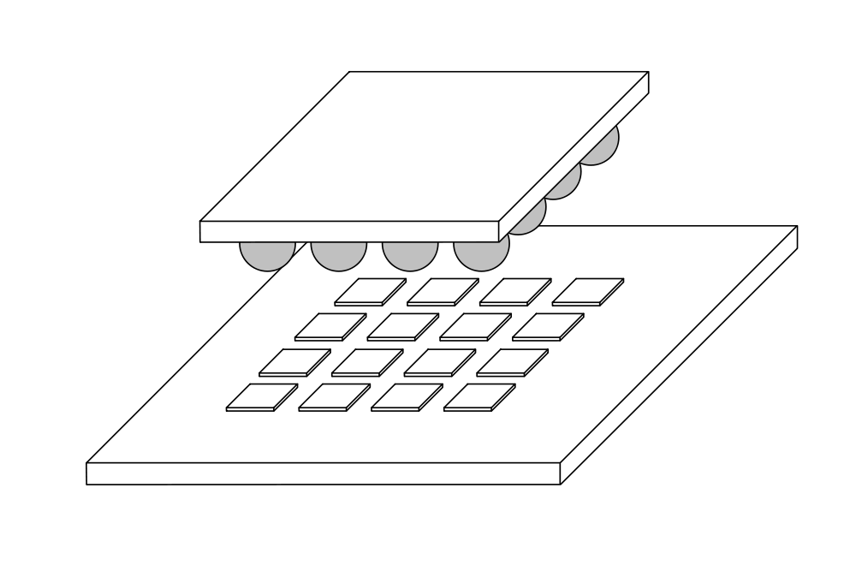
Flip Chip I/O
Source: https://en.wikipedia.org/wiki/Flip_chip

Slide 26
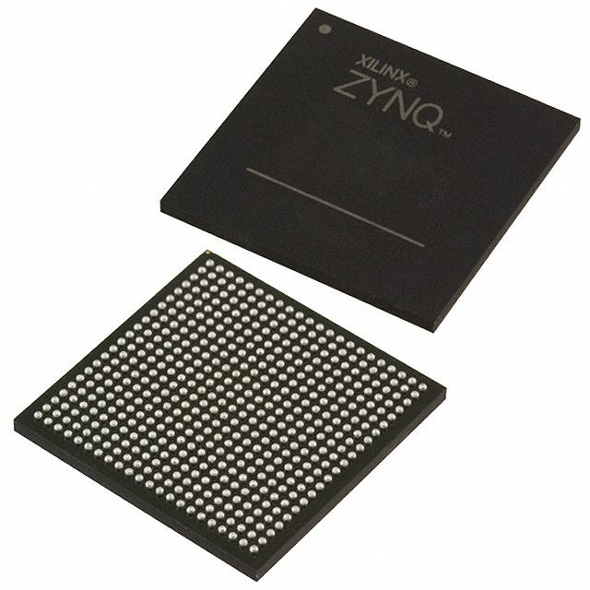
Zynq Land Grid Package
SBVA 484 – flip chip, Ball-Grid Array (UG 1075)

Slide 27
Don’t Forget NRE
This is all about recurring costs
Cost = RecurringCost + (NRE/NumParts)
NRE
  Mask costs in millions
  Design costs in 10s to 100s of millions

Slide 28
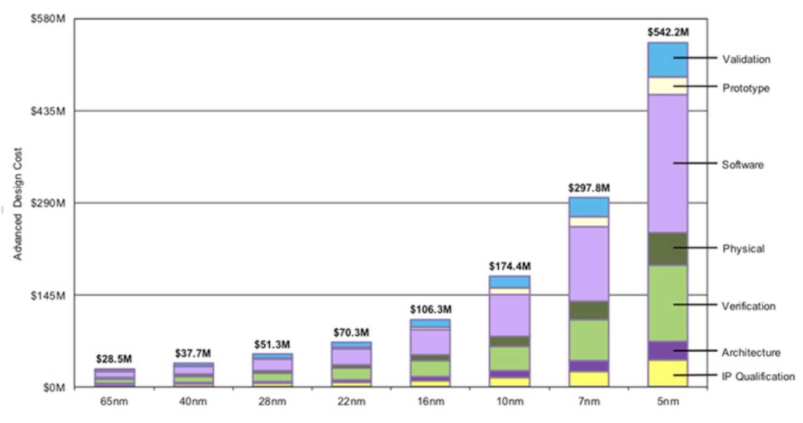
Bonus: Chip Design Costs
https://wccftech.com/apple-5nm-3nm-cost-transistors/

Slide 29
Putting Together
100mm² die -- $5.6 raw
  Maybe $6--16 yielded -- call it $7
NRE $100 M -- $1
  Sell 100 M units
Put in $1 packge -- $1
Test -- $1
Total: $10

Slide 30
Price vs. Cost
…and this is all about cost
  What it takes to manufacture
Price
  What people will pay for it
Profit = Price - Cost

Slide 31
Area

Slide 32
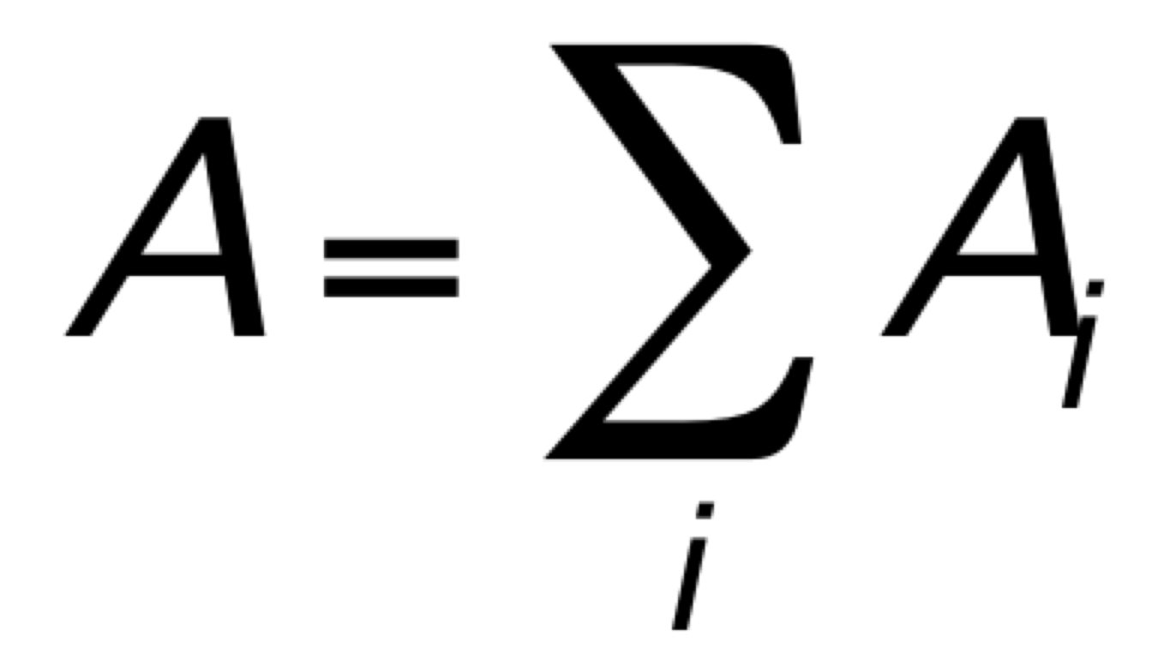
Area
Simple story
  Sum up component areas

Slide 33
Too Simplistic
Area may be driven by
  I/O
  Interconnect
Will need to pay for infrastructure
  Clocking, Power

Slide 34
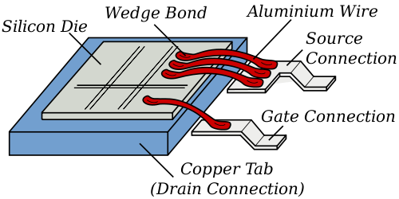
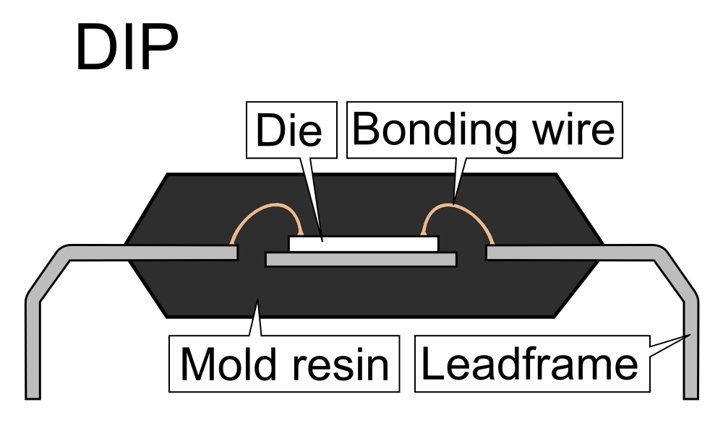
I/O Pads
Must go on edge for wire bonding
  Esp. for cheap packages
Src: http://en.wikipedia.org/wiki/File:Wirebonding2.svg
Source: https://commons.wikimedia.org/wiki/File:DIP_package_sideview.PNG

Slide 35
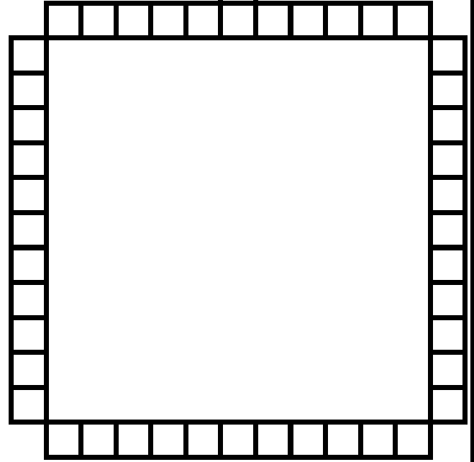
Pad Ring
Pads must go on side of chip
Pad spacing large to
permit bonding
I/O pads may set
lower bound on chip size

Slide 36
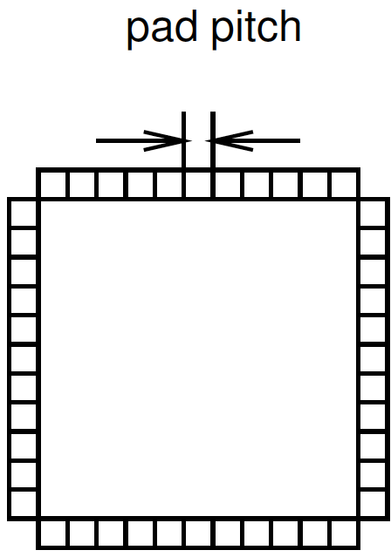
Preclass 4
400 pads
25μm pad spacing
Square chip
dimensions?

Slide 37
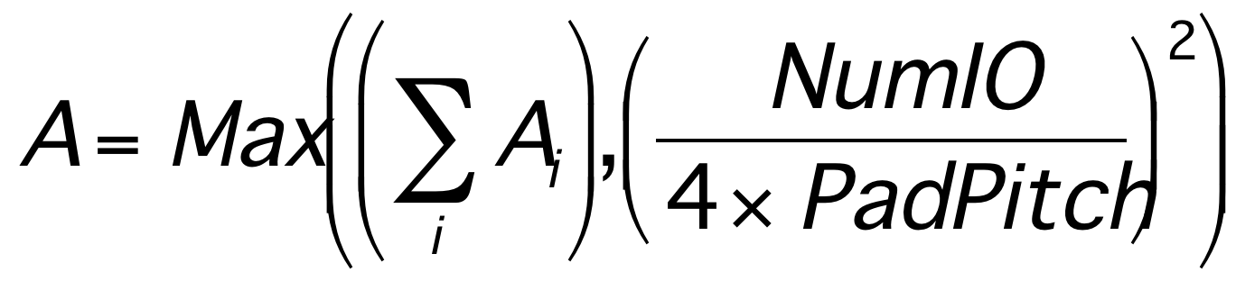
I/O Limits
Perimeter grows as 4s
Area grows as s²
Area grows (NumIO/4)²
IO may drive chip area

Slide 38
Area I/O
Put I/O in grid over chip
I/O pads still large and take up space
Avoid perimeter scaling
Requires more expensive flip-chip package

Slide 39
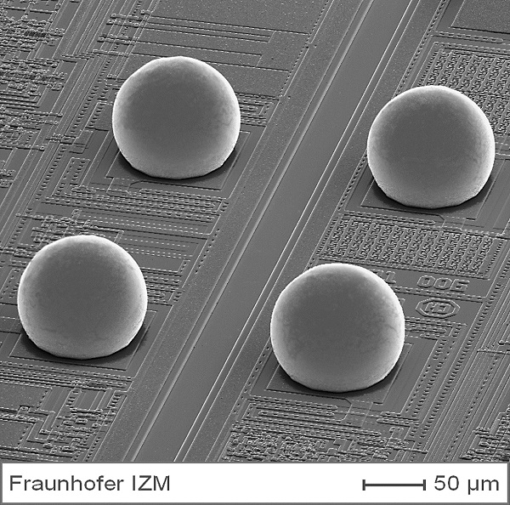
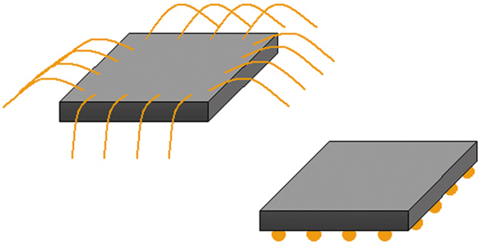
Flip Chip, Area IO
www.microwavejournal.com
http://www.izm.fraunhofer.de/en/abteilungen/high_density_interconnectwaferlevelpackaging/arbeitsgebiete/arbeitsgebiet1.html

Slide 40

Interconnect
Long wires need buffering
Buffers take up space
  Weren’t in simple accounting of logic and memory blocks

Slide 41
Interconnect
Wires take up space
Similar issue to pad I/O
  Wires crossing into region grow as perimeter
  Logic inside grows as area
Region size may be dictated by wires entering/leaving

Slide 42
Wiring Requirements
Wires 50nm pitch
Gates 500nm on side
  (500nm x 500nm)
How many wires fit across the side of one gate?

Slide 43
Wiring Requirements
Wires 50nm pitch
Gates 500nm on side
  (500nm x 500nm)
Wires/gate side (prev slide)
If have SxS gate on left,
how many wires can cross over the line of S gates at the right?
What if need more wires to cross to right?

Slide 44
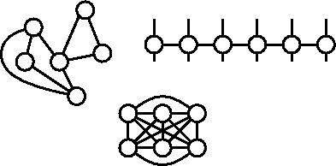
Bisection Width
Partition design into two equal size halves
  Minimize wires (nets) with ends in both halves
Number of wires crossing is bisection width
  Information crossing
lower bw = more locality
N/2
bisection
width
N/2

Slide 45
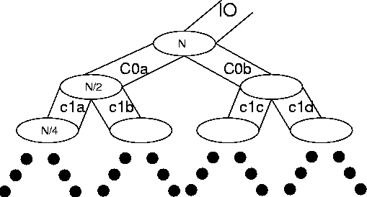
Rent’s Rule
If we recursively bisect a graph, attempting to minimize the cut size,
we typically get:
BW=IO = c N^{p}
  0≤p≤1
  p≤1 means many
  inputs come from
  within a partition
[Landman and Russo,
IEEE TR Computers p1469, 1971]

Slide 46
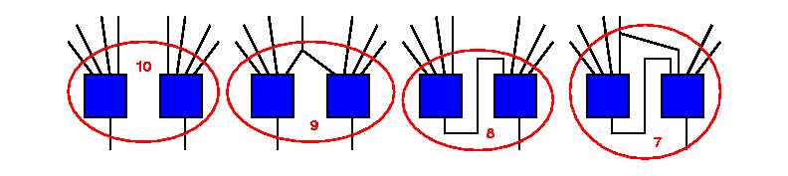
Rent and Locality
Rent and IO quantifying locality
  local consumption
  local fanout
IO = c N^{p}

Slide 47
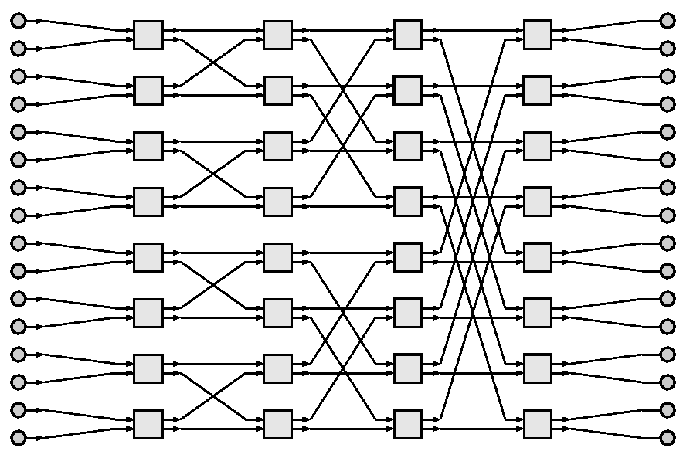
Common
Applications
reg
reg
reg
reg
reg
reg
reg
reg
reg
reg
reg
reg
Rent p=0
  Shift-register, 1D filter
Rent p=0.5
  Array multiplier
  2D Window Filter
  nearest-neighbor
Rent p=1.0
  FFT, Sort
reg
reg
reg
reg
Mpy
bit
Mpy
bit
Mpy
bit
Mpy
bit
Mpy
bit
Mpy
bit
Mpy
bit
Mpy
Bit
Mpy
bit
Mpy
bit
Mpy
bit
Mpy
bit
Mpy
bit
Mpy
bit
Mpy
bit
Mpy
bit

Slide 48
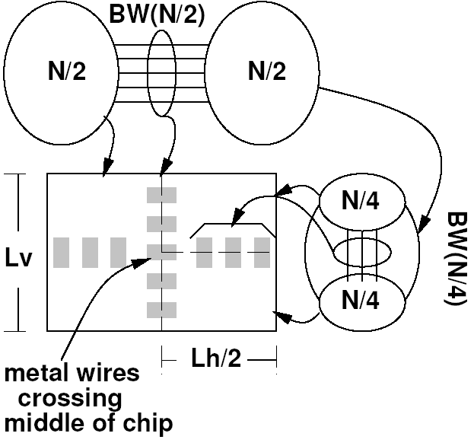
VLSI Interconnect Area
Bisection width is lower-bound on IC width
  When wire dominated, may be tight bound
(recursively)
Rent’s Rule tells us how big our chip must be

Slide 49
As a function of Bisection
A_{chip} ≥ N × A_{gate}
A_{chip} ≥ N_{horizontal} W_{wire} × N_{vertical} W_{wire}
N_{horizontal} = N_{vertical} = IO = cN^{p}
A_{chip} ≥ (cN)^{2p}
If p<0.5
  A_{chip} ∝ N
If p>0.5
  A_{chip} ∝ N^{2p}

Slide 50
In terms of Rent’s Rule
If p<0.5, A_{chip} ∝ N
If p>0.5, A_{chip} ∝ N^{2p}
Typical designs have p>0.5
  interconnect dominates
  A_{chip} > Σ A_{elements}

Slide 51
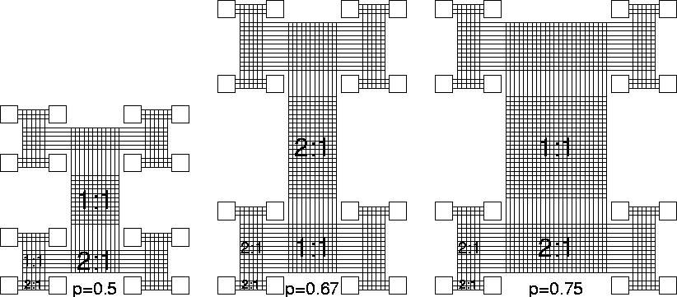
Rent Network Richness

Slide 52
Infrastructure: Clocking
PLL (Phased-Lock-Loop) to generate and synchronize clock
Clock drivers are big (drive big load)
Need buffering all over chip

Slide 53
Infrastructure: Power
Need many I/O Pads
  Carry current
  Keep inductance low
Wires to distribute over chip
Maybe
  Capacitance to stabilize power
  Voltage converters

Slide 54
Area
Mostly sum of components, but…
Area may be driven by
  I/O
  Interconnect A ≥ N^{2p}
Will need to pay for infrastructure
  Clocking, Power

Slide 55
Some Areas

Slide 56
Processor Areas
ARM Cortex A53 about 2mm² in 28nm
  Zynq UltraScale+ processor
  SuperScalar core
A5 (scalar) about 0.25mm²
A9 (superscalar) about 1mm²
A15 (higher performance) about 3mm²
A57 (big core to A53 little) about 3mm²

Slide 57
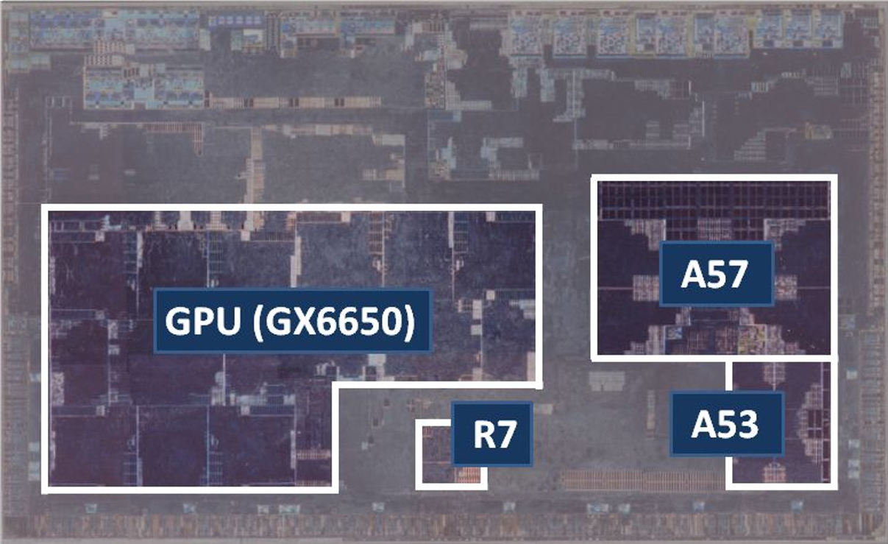
R-Car H3 from Rensas
Quad A57, Quad A53
https://en.wikichip.org/wiki/arm_holdings/microarchitectures/cortex-a53

Slide 58
Zynq Compute Blocks
Crude estimate, including interconnect
2000 6-LUTs per sq. mm
DSP Block ~ 0.1 sq. mm

Slide 59
CACTI
Standard program for modeling memories and caches
  More sophisticated version of the simple modeling we’ve been doing
Will ask you to use for custom area estimates (P4 milestone, final report)

Slide 60
CACTI Parameters
Technology
Capacity
Output Width
Ports
Cache ways

Slide 61
Example Output
- Total cache size (bytes): 32768
Number of banks: 1
Associativity: 4
Block size (bytes): 64
Read/write Ports: 1
Read ports: 0
Write ports: 0
Technology size (nm): 32
Access time (ns): 1.09421
Cycle time (ns): 1.25458
Total dynamic read energy per access (nJ): 0.0234295
Total dynamic write energy per access (nJ): 0.018806
Total leakage power of a bank without power gating, including its network outside (mW): 0.00787646
Cache height x width (mm): 0.152304 x 0.523289

Slide 62
CACTI – Memories on Zynq
32nm (closest technology it models to 28nm in Zynq)
36Kb BRAMs 0.025mm
  2 port, 72b output
ARM L1 cache 0.08mm
  32KB 4-way associative (previous slide)
ARM L2 cache 1.5 mm
  512KB 8-way associative
  (older, not yours)

Slide 63
Zynq Component Estimates
6-LUT 0.0005 mm²
DSP Block 0.1 mm²
36Kb BRAMs 0.025mm²
ARM L1 cache 0.08mm²
ARM L2 cache (512KB, 8-way)1.5 mm²
ARM Cortex A53 2.0 mm²

Slide 64
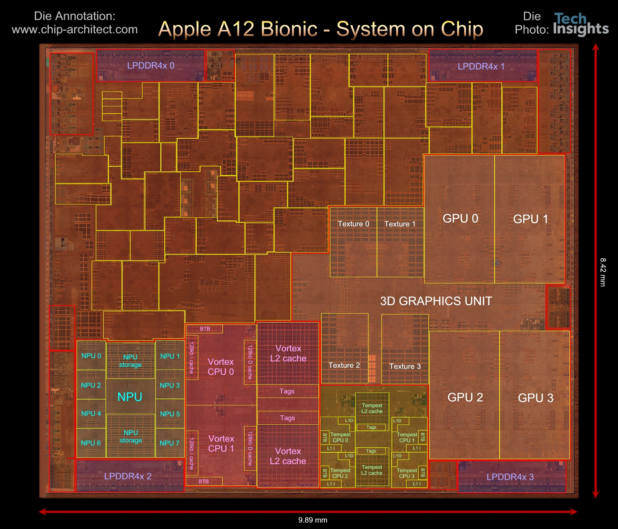

Slide 65
Apple A12
84mm², 7nm
7 Billion Tr.
iPhone XS
6 ARM cores
  2 fast
  4 low energy
4 custom GPUs
Neural Engine
  5 Trillion ops/s?

Slide 66
A12 Die Areas
https://www.anandtech.com/print/13393/techinsights-publishes-apple-a12-die-shot-our-take

Slide 67
A13 Die Areas
https://en.wikipedia.org/wiki/Apple_A13
SoC | A13 (7 nm) | A12 (7 nm)
Process Node | TSMC N7P | TSMC N7
Total Die | 98.48 | 83.27
Big Core | 2.61 | 2.07
Small Core | 0.58 | 0.43
CPU Complex (incl. cores) | 13.47 | 11.16
GPU Core | 3.25 | 3.23
GPU Total | 15.28 | 14.88
NPU | 2.09 | 1.23

Slide 68
Big Ideas
First order:
  Chip cost proportional to Area
  Area = Sum(Area(Components))
But appreciate the simplification:
  Yield makes cost superlinear in area
    Limited range over which “linear” accurate
  I/O, Interconnect, infrastructure
    Can make Area > Sum(Area(Components))

Slide 69
Admin
P4 due Friday

