Slide 1

ESE532:
System-on-a-Chip Architecture
Day 25: November 25, 2019
Reduce

Slide 2
Today
Reduce
Associative Operations
Model
Latency Bound Implications
and Implementations
Parallel Prefix
Broad Application

Slide 3
Message
Aggregation is a common need that is not strictly data parallel
…but admits to parallel computation

Slide 4
Reduce
Reduce – combining a collection of data into a single value
  Converting a vector into a scalar

Slide 5
Sum Reduce
Simplest and most common
  Add up all the values in a vector or array
  int sum=0;
  for (int i=0;i<N; i++)
  sum+=a[i];

Slide 6
Sum Reduce
What’s II?
  int sum=0;
  for (int i=0;i<N; i++)
  sum+=a[i];

Slide 7
Sum Reduce
What’s latency bound?
  Assuming associativity holds for addition
  int sum=0;
  for (int i=0;i<N; i++)
  sum+=a[i];

Slide 8
Associative Operations
Associativity means can group together operations in any way
Normal sequential:
  (((a[0]+a[1])+a[2])+a[4])+…
Associative regroup:
  (a[0]+((((a[1]+(a[2]+a[3]))+a[4])+(…)))

Slide 9
Associative Operations
Associativity means can group together operations in any way
Normal sequential:
  (((a[0]+a[1])+a[2])+a[4])+…
Regroup parallelism:
  (((a[0]+a[1])+(a[2]+a[3]))+((a[4]+a[5])+(a[6]+a[7])))

Slide 10
Associative Tree Reduce
Add pairs – cut numbers in half
Repeat adding pairs until single value
How deep?

Slide 11
Latency Bounds
Associative reduces typically contribute log terms to latency bounds
  …as you’ve seen on many previous midterms and finals

Slide 12
Sum Reduce
Data Parallel?
  int sum=0;
  for (int i=0;i<N; i++)
  sum+=a[i];

Slide 13
Sum Reduce
How exploit 4 cores to compute?
  (assume a very large, like 1 million)
  int sum=0;
  for (int i=0;i<N; i++)
  sum+=a[i];

Slide 14
Model: Data Parallel+Reduce
Data Parallel + Reduce
  Very common to perform a data parallel operation then a reduce on results
Example: dot product
  int sum=0;
  for (int i=0;i<N; i++)
  sum+=a[i]*b[i];

Slide 15
Dot Product
Latency bound for dot product
  Assume 1 cycle add, 3 cycle multiply
Example: dot product
  int sum=0;
  for (int i=0;i<N; i++)
  sum+=a[i]*b[i];

Slide 16
Model: Data Parallel+Reduce
Data Parallel + Reduce
  Very common to perform a data parallel operation then a reduce on results
General form
  int res=0;
  for (int i=0;i<N; i++)
  res=assoc_op(res,f(a[i],b[i], …))

Slide 17
What else Associative?
Beyond addition, what other associative operations do we often see as reductions?

Slide 18
Associative Operations
Add
Multiply
Max
Min
AND
OR
Max/min
  And keep associated values
Find First

Slide 19
Optimization Loop
int minval=f(0);
int min=0;
for (i=1;i<N;i++) {
int val=f(i);
if (val<minval) {
minval=val; min=i;
}
}

Slide 20
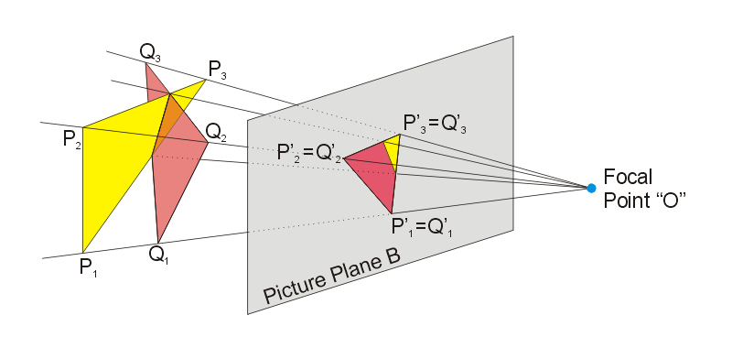

Rendering Decomposed
Day 15
Pipeline of
  Projection
    Where do the points of
    this triangle end up in the viewed image?
    Matrix-multiplication to translate points
  Rasterization
    Turn into pixels
    Fill pixels for triangle
  Z-buffer
    Keep only the ones on top (not hidden)
      2D image + Z-depth – keep smallest
Figures from: https://commons.wikimedia.org/wiki/File:Perspective_Projection_Principle.jpg
https://en.wikipedia.org/wiki/Rasterisation#/media/File:Raster_graphic_fish_20x23squares_sdtv-example.png

Slide 21
Z-Buffering
Storing into Z–buffer is an associative reduce operation
  Min reduce (keep nearest pixel) on depth with an associated value
Parallel strategy
  Split triangles into sets
  Project, rasterize, Z-buffer in parallel
  Assoc. reduce Z-buffer pixels across parallel Z-buffers

Slide 22
Implementations
Data Parallel+Preduce

Slide 23
Threaded:
Data Parallel+Reduce
Break into P threads
  0 to N/P-1, N/P to 2N/P-1, …
Run fraction of data and reduce on each
Then bring results together to sum
  P small, on one processor
  P large, as tree

Slide 24
Model: Data Parallel+Reduce
What’s cycle → what’s II?
General form
  int res=0;
  for (int i=0;i<N; i++)
  res=assoc_op(res,f(a[i],b[i], …))

Slide 25
Pipeline:
Data Parallel + Reduce
Pipeline f
Cycle on assoc_op

Slide 26
Pipeline:
Data Parallel + Reduce
Pipeline f
Cycle on assoc_op
Avoid cycle, II=1 for commutative
  Run interleaved
    C-slow (C=II)
  Combine at end
Commutative operation
  Can reorder operands

Slide 27
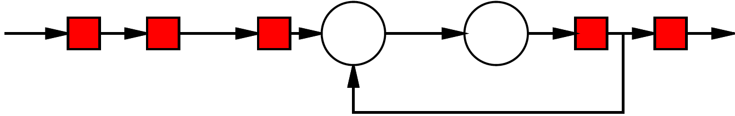
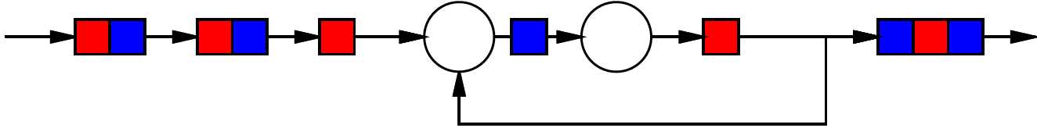
2-Slow Simple Cycle
Day 7
Replace register with pair
Retime
Observe independence of red/blue computations

Slide 28
II=2 Commutative Pipelined Reduce
2-slow transformation
Combine independent (red, blue) reduces

Slide 29
Pipeline:
Data Parallel + Reduce
Pipeline f
Cycle on assoc_op
Avoid cycle, II=1 for associative
  Gather up II values
  Run through pipelined assoc. reduce tree
  Drop into assoc_op cycle every II cycles

Slide 30
Model: Data Parallel+Reduce
Conclude: associative reduce can achieve II of 1
General form
  int res=0;
  for (int i=0;i<N; i++)
  res=assoc_op(res,f(a[i],b[i], …))

Slide 31
Vector:
Data Parallel + Reduce
Some vector/SIMD machines will have dedicated reduce hardware
E.g. vector-add operator
NEON
  Not have vector reduce
  Does have VPADAL
Use VL adds for course-grained reduce
for (i=0;i<N;i+=VL) {
avl=a[i]…a[i+VL-1]
VADD(res,avl, res);
}
Use VPADAL to complete

Slide 32
Unrolled Pipeline:
Data Parallel + Reduce
Unroll computation
Perform f ops in parallel pipelines
Pipelined tree reduce

Slide 33
Parallel Prefix

Slide 34
What if want Prefix?
Sum Reduce
  int sum=0;
  for (int i=0;i<N; i++)
  sum+=a[i];
Sum Prefix
  int sum[N];
  sum[0]=a[0];
  for (int i=1;i<N; i++)
  sum[i]=a[i]+sum[i-1];

Slide 35
Prefix
Aggregate (vector) output
where item i is the reduce of the input vector 0 through i
  prefix[0]=a[0];
  for (int i=1;i<N; i++)
  prefix[i]=op(prefix[i-1],f(a[i]…));

Slide 36
Latency Bound
What’s the latency bound for the prefix when op is associative?
  Assume op is 1 cycle
  How cylces(op)>1 change?
  prefix[0]=a[0];
  for (int i=1;i<N; i++)
  prefix[i]=op(prefix[i-1],f(a[i]…));

Slide 37
Resources?
How much hardware to achieve latency bound?
  prefix[0]=a[0];
  for (int i=1;i<N; i++)
  prefix[i]=op(prefix[i-1],f(a[i]…));

Slide 38
Latency Bound?
What’s the latency bound for this operation?
boolean a[i],b[i],s[i]
for (i=0;i<N;i++) {
  cn=(a[i]&&b[i])||
  (a[i]&&c)||
  (b[i]&&c);
  s[i]=a[i] ^ b[i] ^ c;
  c=cn;
  }

Slide 39
Associative
Is the carry operation in addition an associative operation?
Operation:
  MAJ=majority = A&&B || B&&C || A&&B

Slide 40
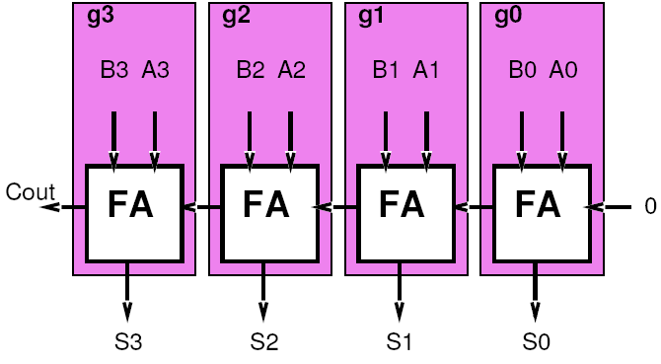
Carry Computation
Think about each adder bit as a computing a function on the carry in
  C[i]=g(c[i-1])
  Particular function f will depend on a[i], b[i]
  g=f(a,b)

Slide 41
Functions
What are the functions g(c[i-1])?
  g(c)=carry(a=0,b=0,c)
  g(c)=carry(a=1,b=0,c)
  g(c)=carry(a=0,b=1,c)
  g(c)=carry(a=1,b=1,c)

Slide 42
Functions
What are the functions g(c[i-1])?
  g(x)=1 Generate
    a[i]=b[i]=1
  g(x)=x Propagate
    a[i] xor b[i]=1
  g(x)=0 Squash
    a[i]=b[i]=0

Slide 43
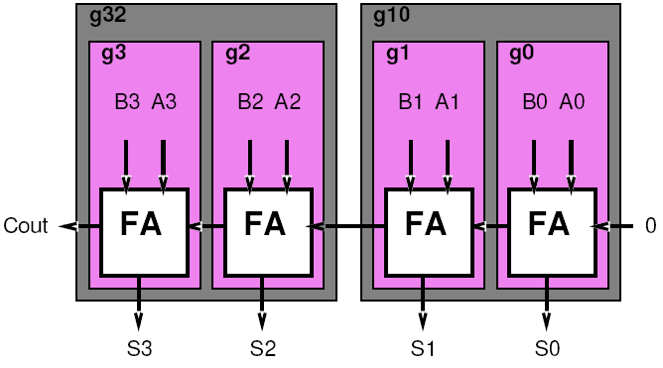
Combining
Want to combine functions
  Compute c[i]=g_{i}(g_{i-1}(c[i-2]))
  Compute compose of two functions
What functions will the compose of two of these functions be?
  Same as before
    Propagate, generate, squash

Slide 44
Compose Rules
(LSB MSB)
GG
GP
GS
PG
PP
PS
SG
SP
SS
[work on board]

Slide 45
Compose Rules
(LSB MSB)
GG = G
GP = G
GS = S
PG = G
PP = P
PS = S
SG = G
SP = S
SS = S

Slide 46
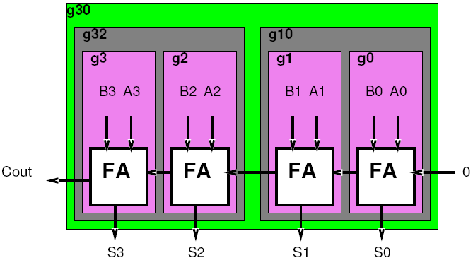
Combining
Do it again…
Combine g[i-3,i-2] and g[i-1,i]
What do we get?

Slide 47
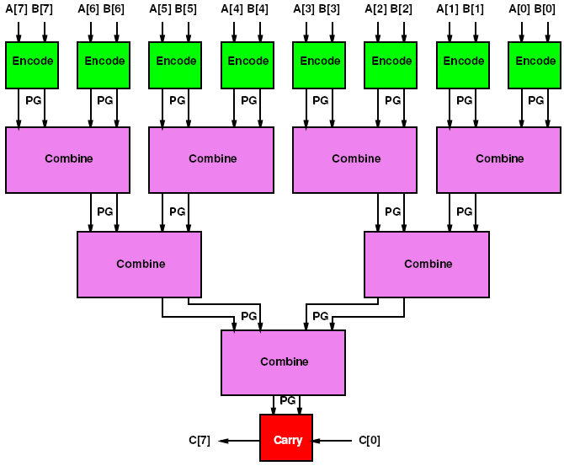
Associative Reduce Tree

Slide 48
Reduce Tree
Sq=/A*/B
Gen=A*B
Sq_{out}=Sq₁+/Gen₁*Sq₀
Gen_{out}=Gen₁+/Sq₁*Gen₀

Slide 49
Reduce Tree
Sq=/A*/B
Gen=A*B
Sq_{out}=Sq₁+/Gen₁*Sq₀
Gen_{out}=Gen₁+/Sq₁*Gen₀
Delay and Area? (work next few slides)

Slide 50
Reduce Tree
A(Encode)=2
D(Encode)=1
A(Combine)=4
D(Combine)=2
A(Carry)=2
D(Carry)=1
Sq=/A*/B
Gen=A*B
Sq_{out}=Sq₁+/Gen₁*Sq₀
Gen_{out}=Gen₁+/Sq₁*Gen₀

Slide 51
Reduce Tree: Delay?
D(Encode)=1
D(Combine)=2
D(Carry)=1
Delay = 1+2log₂(N)+1

Slide 52
Reduce Tree: Area?
A(Encode)=2
A(Combine)=4
A(Carry)=2
Area= 2N+4(N-1)+2

Slide 53
Reduce Tree: Area & Delay
Area(N) = 6N-2
Delay(N) = 2log₂(N)+2

Slide 54
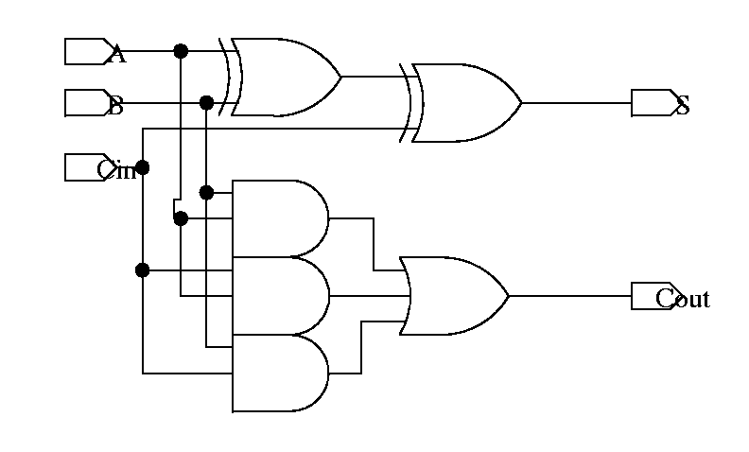
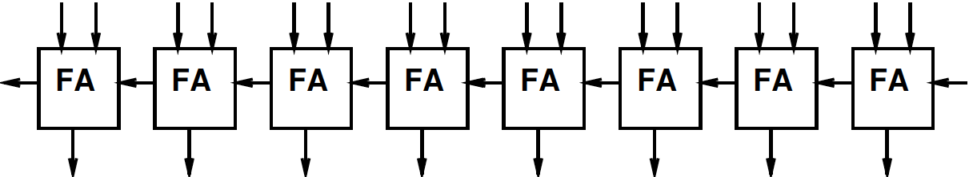
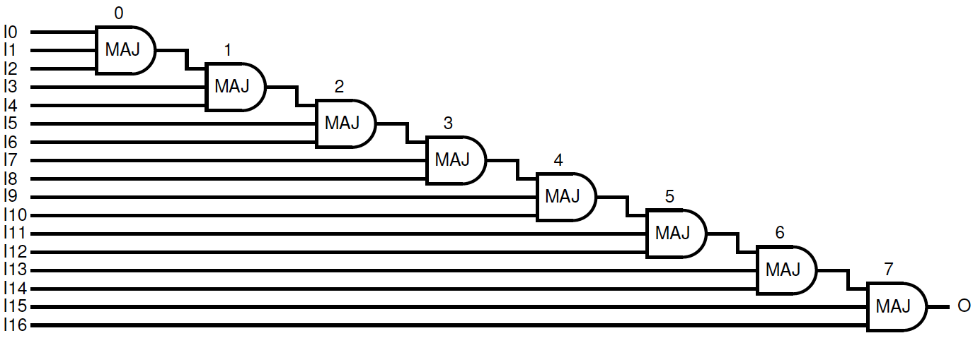
Compute Carry[N]

Slide 55
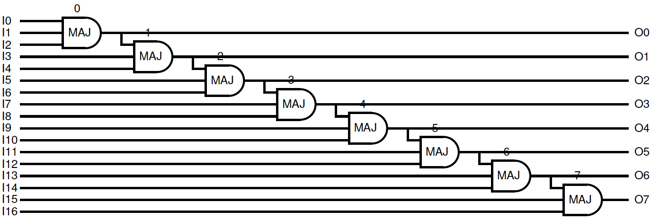
Need Prefix
Need PG[i:0] forall i

Slide 56
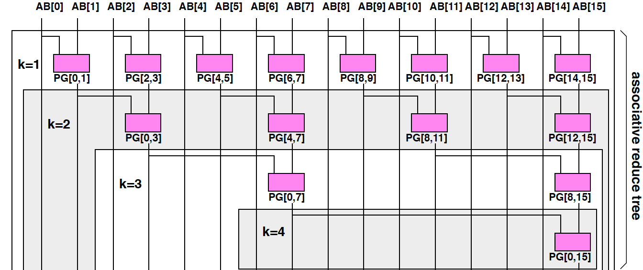
Reduce Tree
While computing PG[0,N]
compute many PG[0,j]’s
  PG[1,0], PG[0,3], PG[0,7] ….

Slide 57
Prefix Tree
While computing PG[0,N] only get
  PG[0,2^{n}-1]
How fillin holes?
– e.g. how get PG[0,11]?

Slide 58
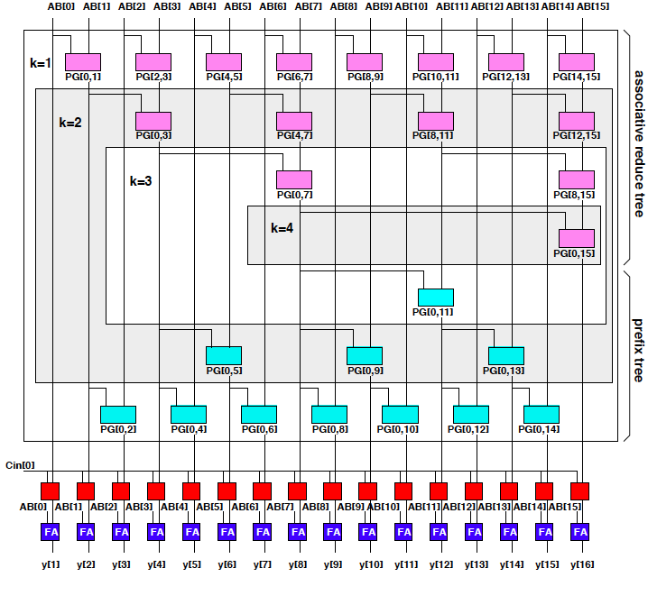
Prefix Tree
Look at Symmetric stage (with respect to middle=PG[0N] stage) and combine to fillin

Slide 59
Prefix Tree

Slide 60
Prefix Tree

Slide 61
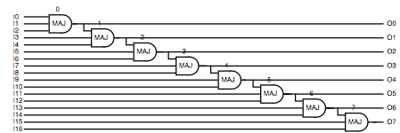
Prefix Tree
Bring in Carry and compute each intermediate carry-in

Slide 62
Prefix Tree
Note: prefix-tree is same size as reduce tree
  Always matched same number of elements in symmetric stage

Slide 63
Parallel Prefix
Area and Delay?
Roughly twice the area/delay
Area= 2N+4N+4N+2N
= 12N
Delay = 4log₂(N)+2
Conclude:
can add in log time
with linear area.

Slide 64
Parallel Prefix
Important Pattern
Applicable any time operation is associative
  Or can be made assoc. as in MAJ case
Function Composition is always associative
Logarithmic delay
Linear area
Notes:
Non-associative example: nor2 ? (strictly if start with nors…but of course nor-n is associative in terms of the Ors)

Slide 65
Parallel Prefix Sum
  prefix[0]=a[0];
  for (int i=1;i<N; i++)
  prefix[i]=op(prefix[i-1],f(a[i]…));

Slide 66
Broader Application

Slide 67
Cast Associative
If you can cast it into an associative operation, you can apply
  Associative Reduce
  Parallel Prefix

Slide 68
Examples
Saturated Addition
  Not associative
Floating-Point Addition
Finite Automata Evaluation
(papers in supplemental reading)

Slide 69
Big Ideas:
Reduce from aggregate to scalar
  is a common operation
  not strictly data parallel
  Associative reduce admits to parallelism
    log(N) latency bound
    II=1
    Linear area
Prefix when want reduce of all prefixes
  Also log(N) latency bound
  Linear area

Slide 70
Admin
Wednesday is a virtual Friday
  Will not meet
  Happy Thankgiving
  Nothing due Friday (virtual or real)
Project due following Friday (12/6)

