Slide 1
ESE532: System-on-a-Chip Architecture
Day 4: September 11, 2019
Parallelism Overview
Pickup:
1 Preclass
1 Lego instructions
1 feecback
1 bag of Legos

Slide 2
Today
Compute Models
How do we express and reason about parallel execution freedom
Types of Parallelism
How can we slice up and think about parallelism?

Slide 3
Message
Many useful models for parallelism
Help conceptualize
One-size does not fill all
Match to problem

Slide 4
Parallel Compute Models

Slide 5
Sequential Control Flow
Control flow
Program is a sequence of operations
Operation reads inputs and writes outputs into common store (memory)
One operation runs at a time
defines successor
Model of correctness is sequential execution
Examples
C (Java, …)
Finite-State Machine (FSM) / Finite Automata (FA)

Slide 6
Parallelism can be explicit
State which operations occur on a cycle
Multiply, add for quadratic equation
cycle | mpy | add
1 | B,x
2 | x,x | (Bx)+C
3 | A,x²
4 |  | Ax²+(Bx+C)

Slide 7
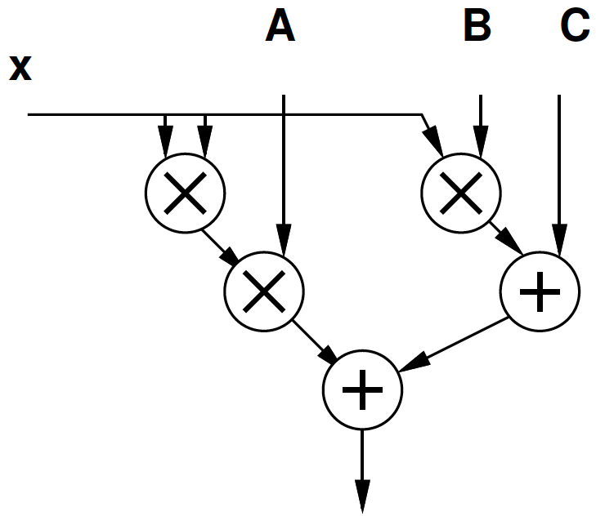
Parallelism can be implicit
Sequential expression
Infer data dependencies
T1=x*x
T2=A*T1
T3=B*x
T4=T2+T3
Y=C+T4
Or
Y=A*x*x+B*x+C

Slide 8
Implicit Parallelism
d=(x1-x2)*(x1-x2) + (y1-y2)*(y1-y2)
What parallelism exists here?

Slide 9
Parallelism can be implicit
Sequential expression
Infer data dependencies
for (i=0;i<100;i++)
y[i]=A*x[i]*x[i]+B*x[i]+C
Why can these operations be performed in parallel?

Slide 10
Term: Operation
Operation – logic computation to be performed

Slide 11
Dataflow / Control Flow
Dataflow
Program is a graph of operations
Operation consumes tokens and produces tokens
All operations run concurrently
Control flow (e.g. C)
Program is a sequence of operations
Operation reads inputs and writes outputs into common store
One operation runs at a time
defines successor

Slide 12
Token
Data value with presence indication
May be conceptual
Only exist in high-level model
Not kept around at runtime
Or may be physically represented
One bit represents presence/absence of data

Slide 13
Token Examples?
How ethernet know when a packet shows up?
Versus when no packets are arriving?
How serial link know character present?
How signal miss in processor data cache and processor needs to wait for data?

Slide 14
Operation
Takes in one or more inputs
Computes on the inputs
Produces results
Logically self-timed
“Fires” only when input set present
Signals availability of output

Slide 15
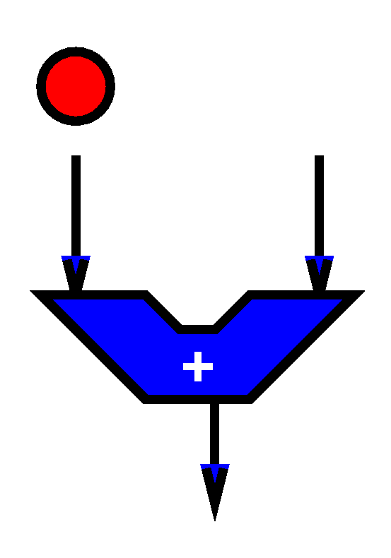
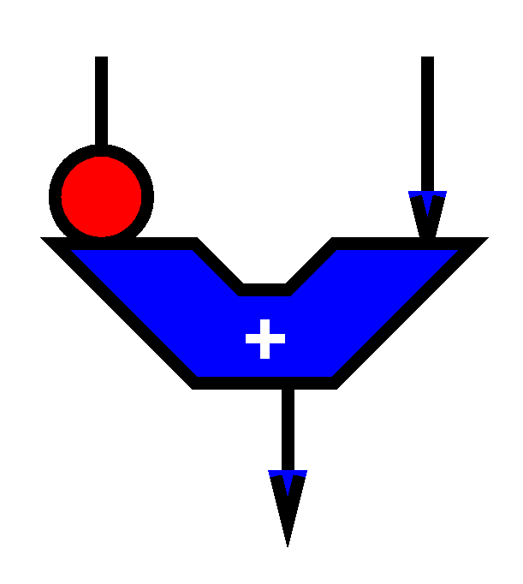
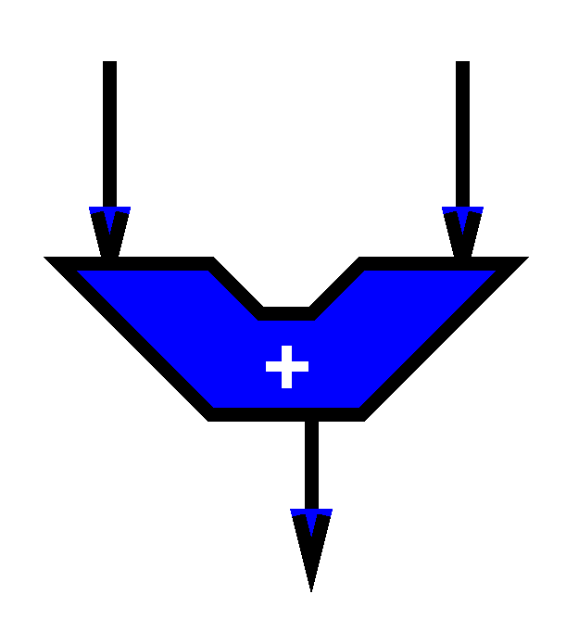
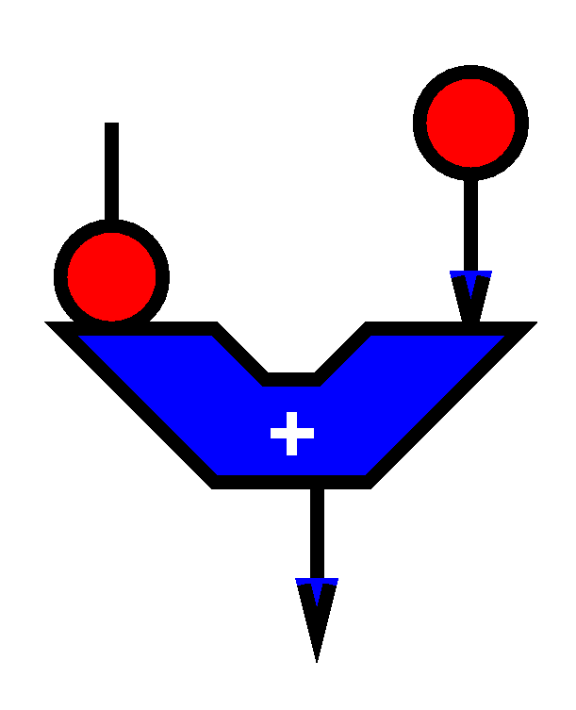
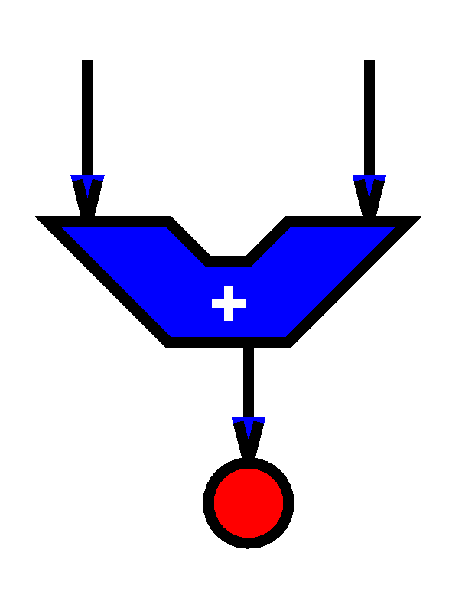

Slide 16
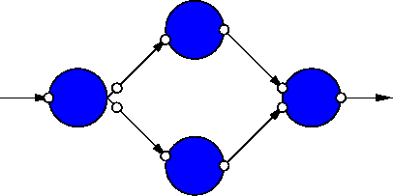
Dataflow Graph
Represents
computation sub-blocks
linkage
Abstractly
controlled by data presence

Slide 17
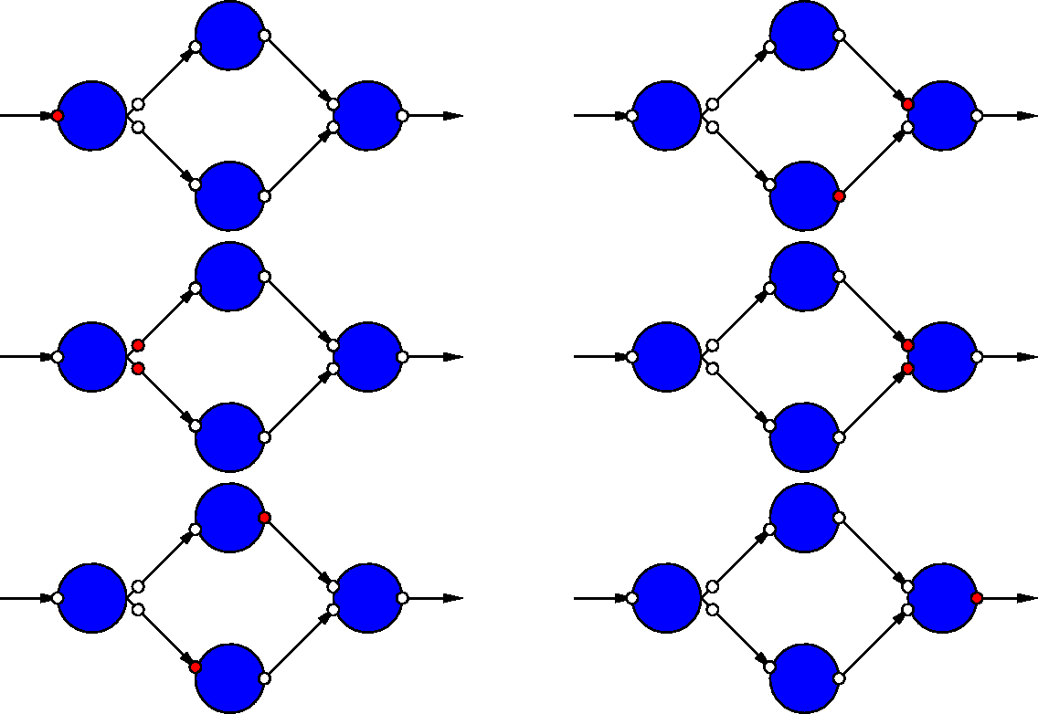
Dataflow Graph Example

Slide 18
Sequential / FSM
FSM is degenerate dataflow graph where there is exactly one token
S1
x not
present?
cycle | mpy | add | next
S1 | B,x |  | x-->S2, else S1
S2 | x,x | (Bx)+C | S3
S3 | A,x² |  | S4
S4 |  | Ax²+(Bx+C) | S1
S2
S3
S4

Slide 19
Sequential / FSM
FSM is degenerate dataflow graph where there is exactly one token
S1
cycle | mpy | add | next
S1 | B,x |  | x-->S2, else S1
S2 | x,x | (Bx)+C | S3
S3 | A,x² |  | S4
S4 |  | Ax²+(Bx+C) | S1
S2
S3
S4

Slide 20
Communicating Threads
Computation is a collection of sequential/control-flow “threads”
Threads may communicate
Through dataflow I/O
(Through shared variables)
View as hybrid or generalization
CSP – Communicating Sequential Processes → canonical model example

Slide 21
Video Decode
Audio
Sync to HDMI
Parse
Video
Why might need to synchronize to send to HDMI?

Slide 22
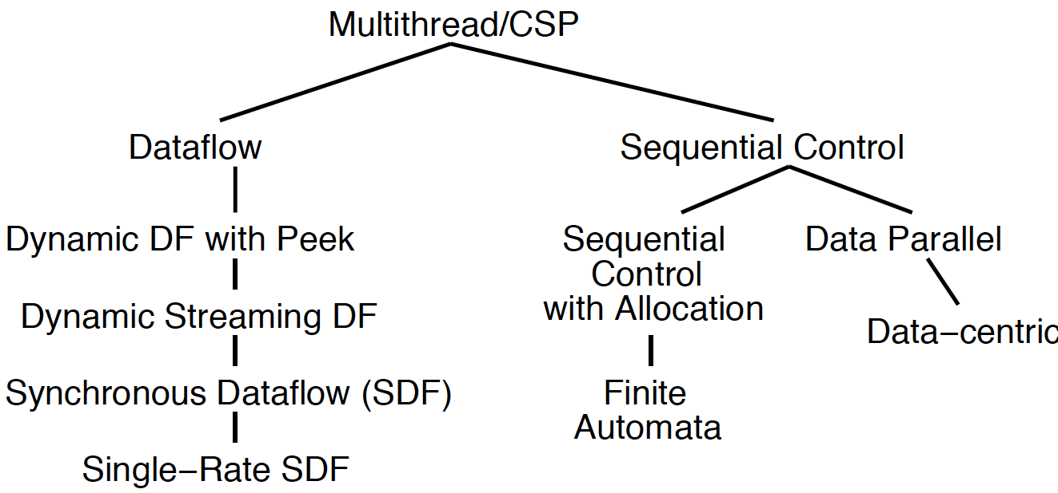
Compute Models

Slide 23
Value of Multiple Models
When you have a big enough hammer, everything looks like a nail.
Many stuck on single model
Try to make all problems look like their nail
Value to diversity / heterogeneity
One size does not fit all

Slide 24
Types of Parallelism

Slide 25
Types of Parallelism
Data Level – Perform same computation on different data items
Thread or Task Level – Perform separable (perhaps heterogeneous) tasks independently
Instruction Level – Within a single sequential thread, perform multiple operations on each cycle.

Slide 26
Pipeline Parallelism
Pipeline – organize computation as a spatial sequence of concurrent operations
Can introduce new inputs before finishing
Instruction- or thread-level
Use for data-level parallelism
Can be directed graph

Slide 27
Sequential
Build 1
Single person build E
Latency?
Throughput?

Slide 28
Data Parallel
Everyone in class build own E
Latency?
Throughput?
Ideal speedup?
Resource Bound?
100 Es, 12 people
When useful?

Slide 29
Data-Level Parallelism
Data Level – Perform same computation on different data items
Ideal: T_{dp} = T_{seq}/P
(with enough independent problems, match our resource bound computation)

Slide 30
Thread Parallel
Build 2
Each person build indicated letter
Latency?
Throughput?
Speedup over sequential build of 6 letters?

Slide 31
Thread-Level Parallelism
Thread or Task Level – Perform separable (perhaps heterogeneous) tasks independently
Ideal: T_{tp} = T_{seq}/P
T_{tp}=max(T_{t1},T_{t2},T_{t3},…)
Less speedup than ideal if not balanced
Can produce a diversity of calculations
Useful if have limited need for the same calculation

Slide 32
Instruction-Level Parallelism
Build 3
Build single letter in lock step
Groups of 3
Resource Bound for 3 people building 9-brick letter?
Announce steps from slide
Stay in step with slides

Slide 33
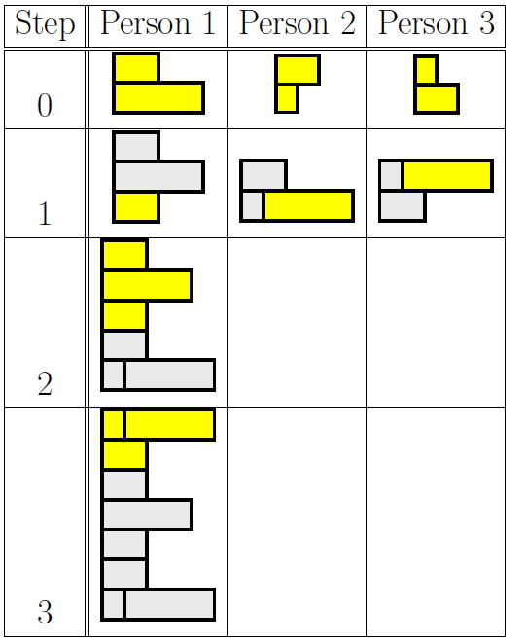
Group Communication
Groups of 3
Note who was person 1 task
2, 3 will need to pass completed substructures

Slide 34
Step 0

Slide 35
Step 1

Slide 36
Step 2

Slide 37
Step 3

Slide 38
Instruction-Level Parallelism (ILP)
Latency?
Throughput?
Can reduce latency for single letter
Ideal: T_{latency} = T_{seqlatency}/P
…but critical path bound applies, dependencies may limit

Slide 39
Bonus (time permit): Instruction-Level Pipeline
Build 4
Each person adds one brick to build
Resources? (people in pipeline?)
Run pipeline once alone
Latency? (brick-adds to build letter)
Then run pipeline with 5 inputs
Throughput? (letters/brick-add-time)

Slide 40
Thread Graph
How would we build with task level parallelism?
Tasks?
Dependencies?

Slide 41
Types of Parallelism
Data Level – Perform same computation on different data items
Thread or Task Level – Perform separable (perhaps heterogeneous) tasks independently
Instruction Level – Within a single sequential thread, perform multiple operations on each cycle.

Slide 42
Pipeline Parallelism
Pipeline – organize computation as a spatial sequence of concurrent operations
Can introduce new inputs before finishing
Instruction- or thread-level
Use for data-level parallelism
Can be directed graph

Slide 43
Big Ideas
Many parallel compute models
Sequential, Dataflow, CSP
Find natural parallelism in problem
Mix-and-match

Slide 44
Admin
Reading Day 5 on web
HW2 due Friday
HW3 out
Return Legos ☺
Recitation in here at noon
Will take questions after class in hall

