Slide 1

ESE532:
System-on-a-Chip Architecture
Day 6: September 18, 2019
Data-Level Parallelism

Slide 2
Today
Data-level Parallelism
For Parallel Decomposition
Architectures
Concepts
NEON

Slide 3
Message
Data Parallelism easy basis for decomposition
Data Parallel architectures can be compact
  pack more computations onto a fixed-size IC die
  OR perform computation in less area

Slide 4
Preclass 1
400 news articles
Count total occurrences of a string
How can we exploit data-level parallelism on task?
How much parallelism can we exploit?

Slide 5
Parallel Decomposition

Slide 6
Data Parallel
Data-level parallelism can serve as an organizing principle for parallel task decomposition
Run computation on independent data in parallel

Slide 7
Exploit
Can exploit with
  Threads
  Pipeline Parallelism
  Instruction-level Parallelism
  Fine-grained Data-Level Parallelism

Slide 8
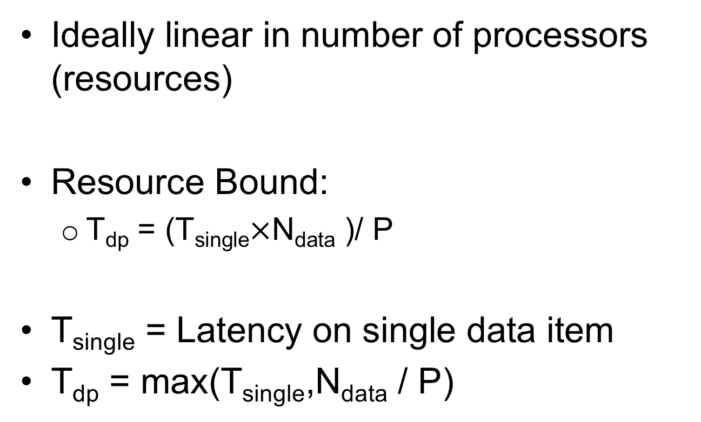
Performance Benefit
Ideally linear in number of processors (resources)
Resource Bound:
  T_{dp} = (T_{single}$×$N_{data} )/ P
T_{single} = Latency on single data item
T_{dp} = max(T_{single},N_{data} / P)

Slide 9
SPMD
Single Program Multiple Data
Only need to write code once
Get to use many times

Slide 10
Preclass 2
Common Examples
What are common examples of DLP?
  Simulation
  Numerical Linear Algebra
  Signal or Image Processing
  Image Processing
  Optimization

Slide 11
Hardware Architectures

Slide 12
Idea
If we’re going to perform the same operations on different data,
exploit that to reduce area, energy
Reduced area means can have more computation on a fixed-size die.

Slide 13
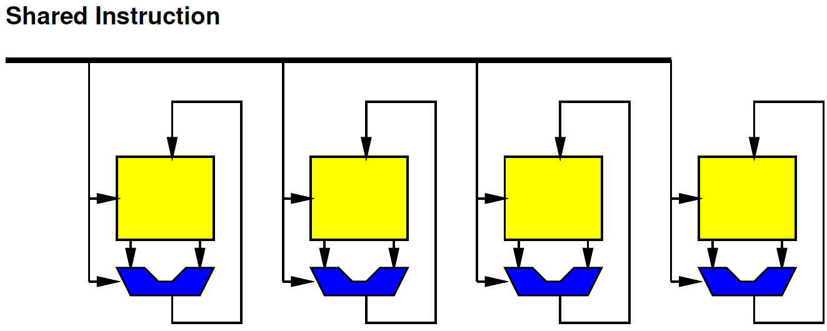
SIMD
Single Instruction Multiple Data

Slide 14
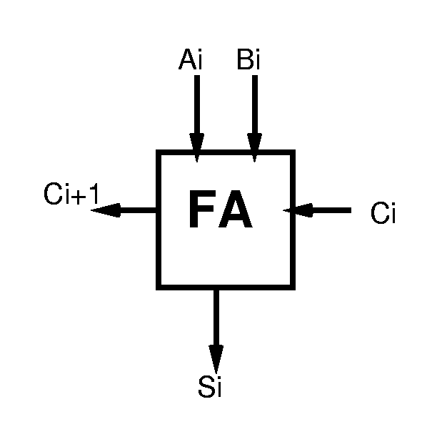
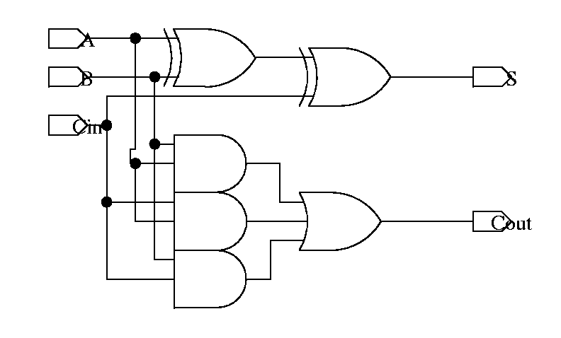
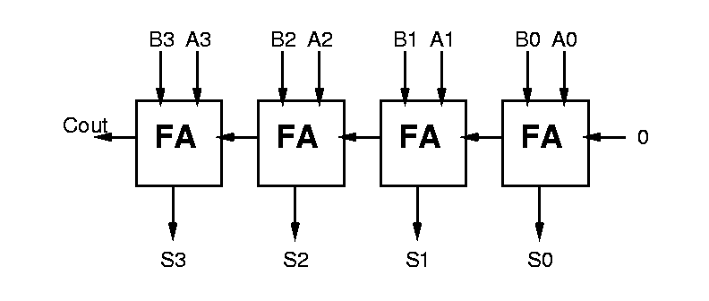
Ripple Carry Addition
Can define logic for each bit, then assemble:
  bit slice

Slide 15
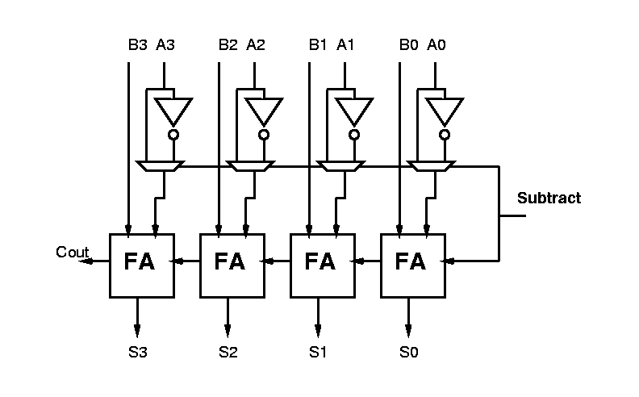
Arithmetic Logic Unit (ALU)
Observe:
  with small tweaks can get many functions with basic adder components

Slide 16

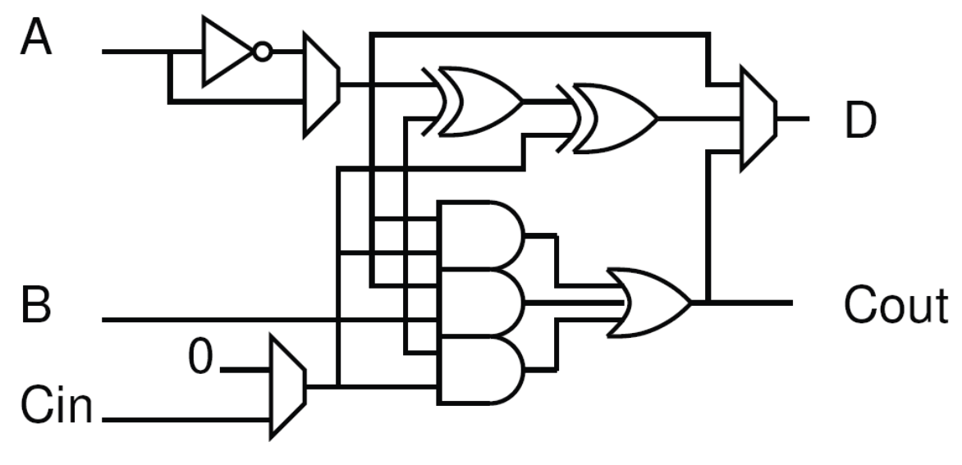
Arithmetic and Logic Unit

Slide 17
ALU Functions
A+B w/ Carry
B-A
A xor B (squash carry)
A*B (squash carry)
/A
Key observation: every ALU bit does the same thing
on different bits of the data word(s).

Slide 18
ARM v7 Core
ALU is Key compute operator in a processor

Slide 19
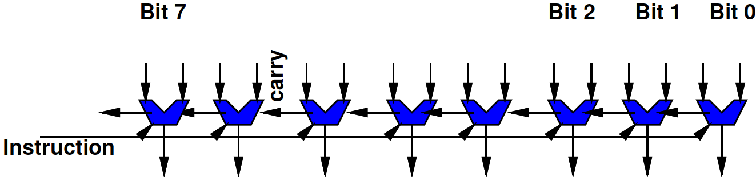
W-bit ALU as SIMD
Familiar idea
A W-bit ALU (W=8, 16, 32, 64, …) is SIMD
Each bit of ALU works on separate bits
  Performing the same operation on it
    Trivial to see bitwise AND, OR, XOR
    Also true for ADD (each bit performing Full Adder)
Share one instruction across all ALU bits

Slide 20
ALU Bit Slice

Slide 21
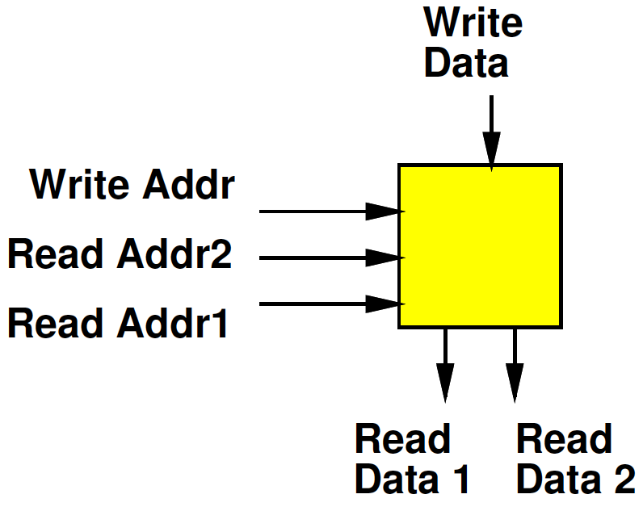
Register File
Small Memory
Usually with multiple ports
  Ability to perform multiple reads and writes simultaneously
Small
  To make it fast (small memories fast)
  Multiple ports are expensive

Slide 22
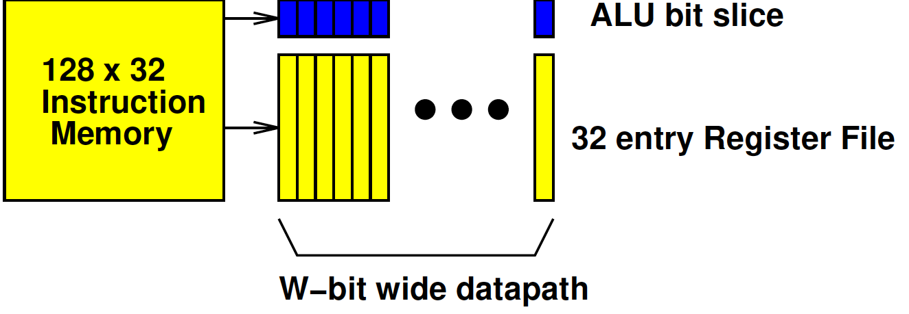
Preclass 4
Number in 10⁸
  W=16
  W=128
Perfect Pack Ratio?
Why?
Area W=16?
Area W=128?

Slide 23

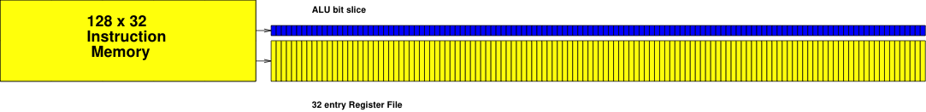
To Scale Comparison

Slide 24
Preclass 4
W for single datapath in 10⁸?
Perfect 16b pack ratio?
Compare W=128 perfect pack ratio?

Slide 25
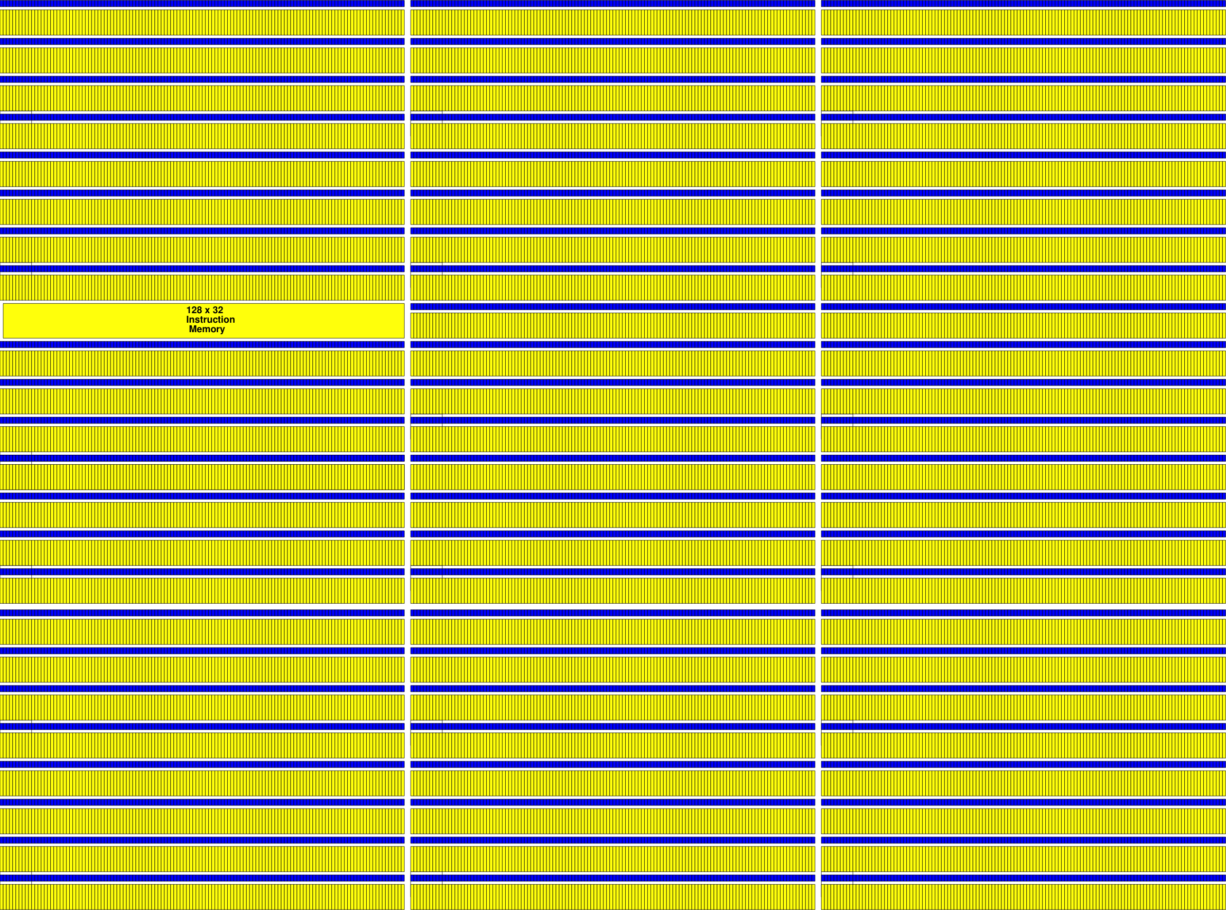
To Scale W=9088

Slide 26
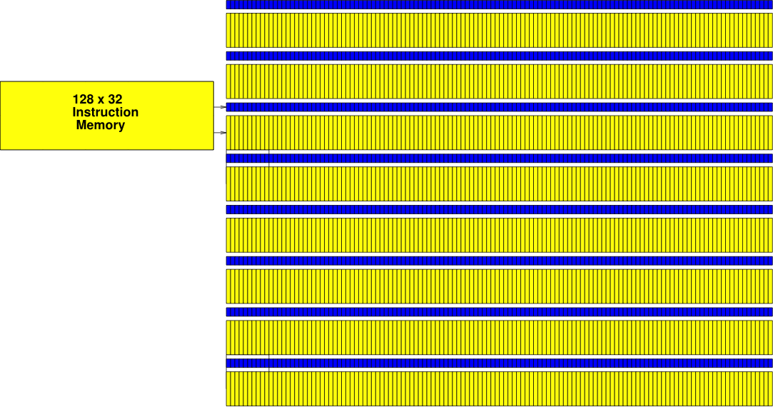
To Scale W=1024

Slide 27
Preclass 6
What do we get when add 65280 to 257
  32b unsigned add?
  16b unsigned add?

Slide 28
ALU vs. SIMD ?
What’s different between
  128b wide ALU
  SIMD datapath supporting eight 16b ALU operations

Slide 29
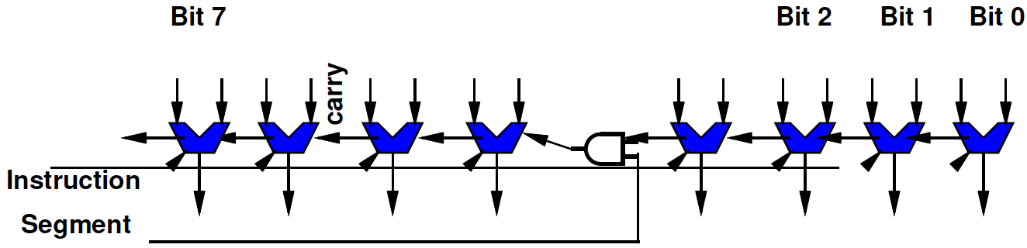
Segmented Datapath
Relatively easy (few additional gates) to convert a wide datapath into one supporting a set of smaller operations
  Just need to squash the carry at points

Slide 30
Segmented Datapath
Relatively easy (few additional gates) to convert a wide datapath into one supporting a set of smaller operations
  Just need to squash the carry at points
But need to keep instructions (description) small
  So typically have limited, homogeneous widths supported

Slide 31
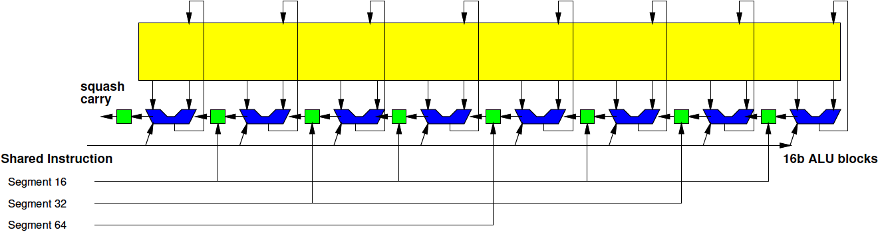
Segmented 128b Datapath
1x128b, 2x64b, 4x32b, 8x16b

Slide 32
Terminology: Vector Lane
Each of the separate segments called a Vector Lane
For 16b data, this provides 8 vector lanes

Slide 33
Performance
Ideally, pack into vector lanes
Resource Bound: T_{vector} = N_{op}/VL

Slide 34
Preclass 5:
Vector Length
May not match physical hardware length
What happens when
  Vector length > Vector Lanes?
  Vector length < Vector Lanes?
  Vector length % (Vector Lanes) !=0
    E.g. vector length 20, for 8 hdw operators

Slide 35
Performance
Resource Bound
  T_{vector} = ceil(N_{op}/VL)*T_{cycle}

Slide 36
Preclass 3:
Opportunity
Don’t need 64b variables for lots of things
Natural data sizes?
  Audio samples?
  Input from A/D?
  Video Pixels?
  X, Y coordinates for 4K x 4K image?

Slide 37
Vector Computation
Easy to map to SIMD flow if can express computation as operation on vectors
  Vector Add
  Vector Multiply
  Dot Product

Slide 38
Concepts

Slide 39
Terminology: Scalar
Simple: non-vector
When we have a vector unit controlled by a normal (non-vector) processor core often need to distinguish:
  Vector operations that are performed on the vector unit
  Normal=non-vector=scalar operations performed on the base processor core

Slide 40
Vector Register File
Need to be able to feed the SIMD compute units
  Not be bottlenecked on data movement to the SIMD ALU
Wide RF to supply
With wide path to memory

Slide 41
Point-wise Vector Operations
Easy – just like wide-word operations
(now with segmentation)

Slide 42
Point-wise Vector Operations
…but alignment matters.
If not aligned, need to perform data movement operations to get aligned

Slide 43
Ideal
for (i=0;i<64;i=i++)
  c[i]=a[i]+b[i]
No data dependencies
Access every element
Number of operations is a
multiple of number of vector lanes

Slide 44
Skipping Elements?
How does this work with datapath?
  Assume loaded a[0], a[1], …a[63] and b[0], b[1], …b[63] into vector register file
for (i=0;i<64;i=i+2)
  c[i/2]=a[i]+b[i]

Slide 45
Stride
Stride: the distance between vector elements used
for (i=0;i<64;i=i+2)
  c[i/2]=a[i]+b[i]
Accessing data with stride=2

Slide 46
Load/Store
Strided load/stores
  Some architectures will provide strided memory access that compact when read into register file
Scatter/gather
  Some architectures will provide memory operations to grab data from different places to construct a dense vector

Slide 47
Neon
ARM Vector Accelerator on Zynq

Slide 48
Programmable SoC
UG1085
Xilinx
UltraScale
Zynq
TRM
(p27)

Slide 49
APU MPcore
UG1085
Xilinx
UltraScale
Zynq
TRM
(p53)

Slide 50
Neon Vector
128b wide register file, 16 registers
Support
  2x64b
  4x32b (also Single-Precision Float)
  8x16b
  16x8b

Slide 51
Sample Instructions
VADD – basic vector
VCEQ – compare equal
  Sets to all 0s or 1s, useful for masking
VMIN – avoid using if’s
VMLA – accumulating multiply
VPADAL – maybe useful for reduce
  Vector pair-wise add
VEXT – for “shifting” vector alignment
VLDn – deinterleaving load

Slide 52
Neon Notes
Didn’t see
  Vector-wide reduce operation
Do need to think about operations being pipelined within lanes

Slide 53
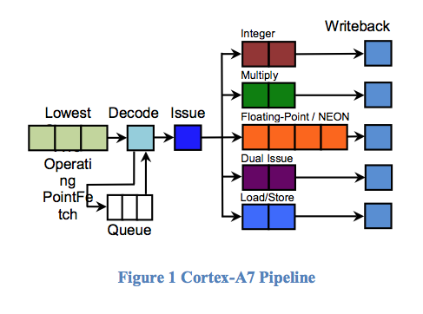
ARM Cortex A53
(similar to A-7 Pipeline)
2-issue
In-order
8-stage pipe
https://www.anandtech.com/show/8718/the-samsung-galaxy-note-4-exynos-review/3
https://arstechnica.com/gadgets/2011/10/arms-new-cortex-a7-is-tailor-made-for-android-superphones/

Slide 54
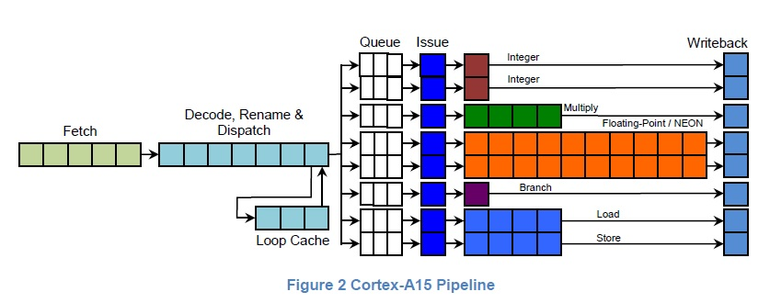
ARM Cortex A-15 Pipeline
https://community.arm.com/processors/f/discussions/4271/out-of-order-for-cortex-a15

Slide 55
Big Ideas
Data Parallelism easy basis for decomposition
Data Parallel architectures can be compact – pack more computations onto a chip
  SIMD, Pipelined
  Benefit by sharing (instructions)
  Performance can be brittle
    Drop from peak as mismatch

Slide 56
Admin
SDSoC available on Linux machines
  See piazza
Reading for Day 7 online
HW3 due Friday
HW4 out

