Slide 1

ESE532:
System-on-a-Chip Architecture
Day 7: September 23, 2019
Pipelining

Slide 2
Previously
Pipelining in the large
  Not just for gate-level circuits
Throughput and Latency
Form of parallelism

Slide 3
Today
Pipelining details (for gates, primitive ops)
Systematic Approach
Justify Operator and Interconnect Pipelining
Loop Bodies
Cycles in the Dataflow Graph
C-slow [bonus if have time]

Slide 4
Message
Pipelining is an efficient way to reuse hardware to perform the same set of operations at high throughput

Slide 5
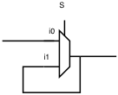

Latch
Element that can hold a
previous value of an input

Slide 6
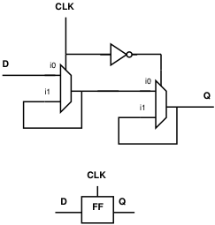
Register
Use a pair to create a flip-flop
  Also call register
What happens when
  CLK is low (0) ?
  CLK is high (1) ?
  CLK transitions from 0 to 1?

Slide 7
Register
Use a pair to create a flip-flop
  Also call register
Sample D input on 0→1
transition of clock (CLK)
Never an open path from
D→Q
  One of the mux latches always
  in hold state

Slide 8
Synchronous Circuit Discipline
Registers that sample inputs at clock edge and hold value throughout clock period
Compute from registers-to-registers
Cycle time large enough for longest logic path between registers
Min cycle = Max path delay between registers
Comb
logic

Slide 9
Preclass 1
Delay between registers as shown?

Slide 10
Preclass 1
Move registers so can clock at adder delay?

Slide 11
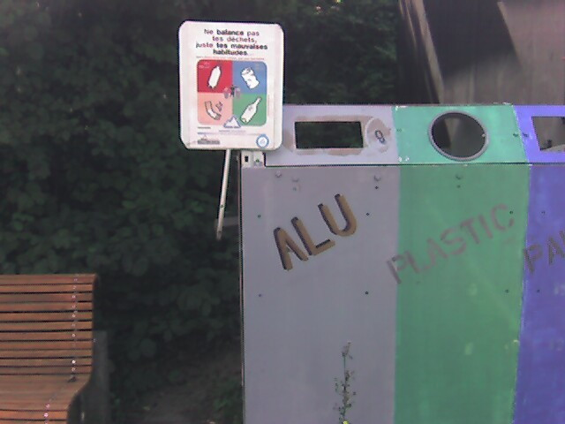
Pipeline Reuse
Lower delay between clocks
  Higher clock rate
  Higher potential throughput
  Faster we reuse our logic
  More capacity get out of design
    Assuming registers cheap in area and time overhead
      T_{setup}, T_{clk->q} ~ 20ps, T_{add} ~ 500ps
      Registers ~ 10 transistors/bit
      Adder ~ 40—50 transistors/bit

Slide 12
Note Registers on Links
Some links end up with multiple registers.
Why?

Slide 13
Preclass 2: What Happens?
What would be wrong with this pipelining?
For this initial design:

Slide 14
Behavior

Slide 15
Equations

Slide 16
Behavior
Add Register

Slide 17
Equations

Slide 18
Consistent Pipelining
Makes sure a consistent input set arrives at each gate/operator
  Don’t get mixing between input sets

Slide 19
Legal Register Moves
Retiming Lag/Lead
Lag: remove register every input
add register every output
Lead: remove register every output
add register every input

Slide 20
Preclass 1
Retime using Lead/Lag

Slide 21
Preclass 1 (revisited)

Slide 22
Add Registers and Move
If we’re willing to add pipeline delay
  Add any number of pipeline registers at input
  Move registers into circuit to reduce cycle time
    Reduce max delay between registers

Slide 23
Add Registers at Input

Slide 24
Add Register and Retime
Add chain of registers on every input
Retime registers into circuit
  Minimizing delay between registers

Slide 25
Add Registers and Retime
Lets us think about behavior
  What the pipelining is doing to cycles of delay
Separate from details of how redistribute registers
Behavioral equivalence between the registers-at-front and properly retimed version of circuit

Slide 26
Justify Pipelining
(or composing pipelined operators)

Slide 27
Handling Pipelined Operators
Given a pipelined operator
  (or a pipelined interconnect)
Discipline of picking a frequency target and designing everything for that
  May be necessary to pipeline operator since its delay is too high
Due to hierarchy
  Pipelined this operator and now want to use it as a building block

Slide 28
Examples
Run at 500MHz
Floating-point unit that takes 9ns
  Can pipeline into 5, 2ns stages
Multiplier that takes 6ns
Memory can access in 2ns
  Only if registers on address/inputs and output
  i.e. exist in own clock stage

Slide 29
Interconnect Delay
Chips >> Clock Cycles
May have chip 100s of Operators wide
May only be able to reach across 10 operators in a 2ns cycle
Must pipeline long interconnect links

Slide 30
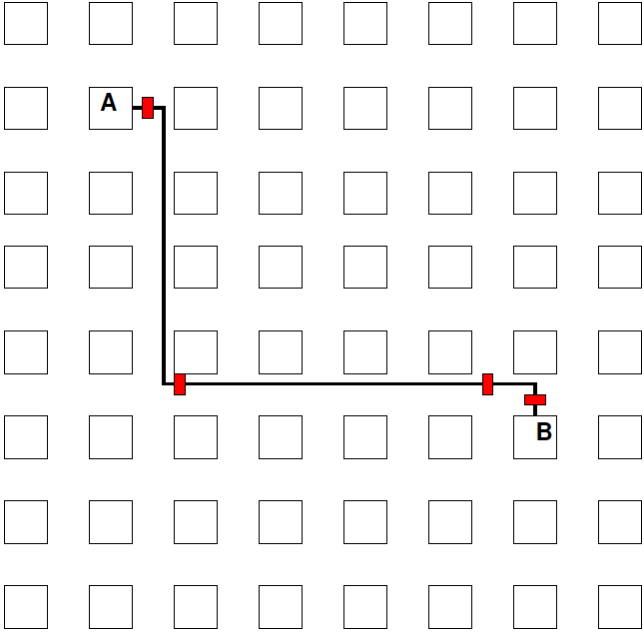
Interconnect Example

Slide 31
Methodology:
Pipelined Operator Graph
Start with logical, unpipelined graph
Treat each pipelined operator as a set of unit-delay operators of mandatory depth
Treat each interconnect pipeline stage as a unit-delay buffer
Add registers at input
Retime into graph

Slide 32
Model
3-stage Multiplier
Interconnect Delay
A
I1
M1
I2
M2
I3
M3
B

Slide 33
Pipeline Loop
(and use for justify pipeline example)

Slide 34
Preclass 4
Logical (unpipelined) dataflow graph for loop body

Slide 35
Example Operators
Operator and Interconnect delays
  Multiplier 3 cycles
  Reading from Input array
    Memory op is cycle after computing address
    Takes one cycle delay bring data back to multiplier

Slide 36
Illustrate Need
What happens if just use graph as is (with operators pipelined as required)?

Slide 37
Model Graph
Revised graph for modeling

Slide 38
Pipeline Graph
Result after pipelining?

Slide 39
Pipelining Lesson
Can always pipeline an acyclic graph to fixed frequency target
  fixed pipelining of primitive operators
  Pipeline interconnect delays
Need to keep track of registers to balance paths
  So see consistent delays to operators

Slide 40
Graph Cycles
Watch: Clock cycle
Cycle time
Cycle in Graph

Slide 41
Preclass 3
Can we retime to reduce cycle time

Slide 42
Retiming Limits?
What prevents us from retiming?

Slide 43
(Graph) Cycle Observation
Retiming does not allow us to change the number of registers inside a cycle.
Limit to cycle time
  Max delay in cycle / Registers in cycle
Pipelining doesn’t help inside cycle
  Cannot push registers into cycle

Slide 44
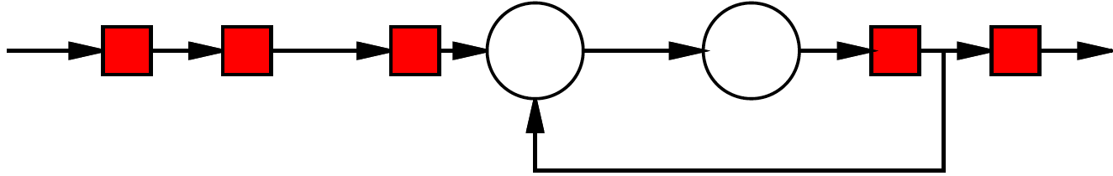
Simple Cycle
Delay of cycle?
Registers in cycle?
What happens to cycle if try to apply lead/lag?

Slide 45
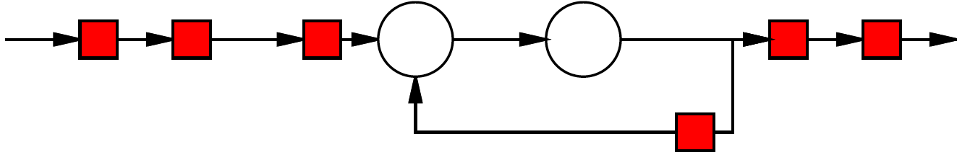
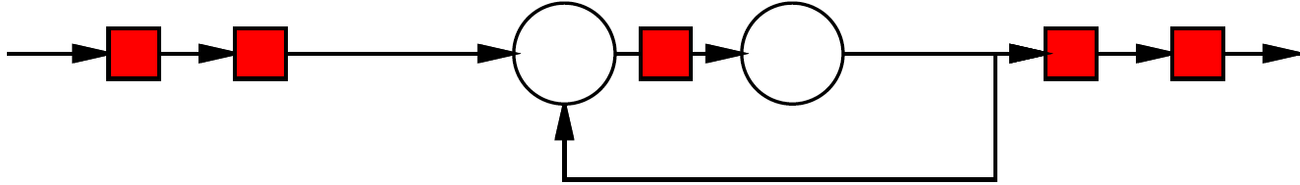
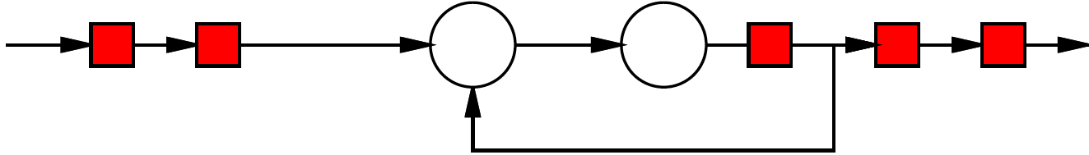
Retiming

Slide 46
Loop
Consider
  [multiply and mod each take 3 cycles]
For (i=0;i<N;i++)
  C[i]=(C[i-1]*A[i])%N;

Slide 47
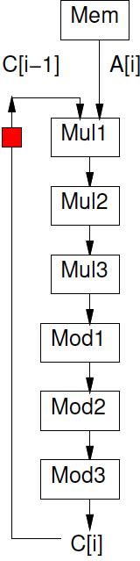
Loop
For (i=0;i<N;i++)
  C[i]=(C[i-1]*A[i])%N;

Slide 48
Initiation Interval (II)
Cyclic dependencies can limit throughput
Due to data dependent cycles in graph,
  May not be able to initiate a new computation on every clock cycle
II – clock cycles (delay) before can initiate
Throughput = 1/II

Slide 49
Loop
For (i=0;i<N;i++)
  C[i]=(C[i-1]*A[i])%N;
Initiation Interval?

Slide 50
Initial Interval
Delay Around graph cycle?
  Assume multiply 3, add 1
Registers in graph cycle?
Retiming clock cycle bound = II ?
Achievable?

Slide 51
II and Latency
Actually is a cycle
  II?
  Latency?

Slide 52
II and Latency
II? (assume willing to pipeline inputs)
Latency?

Slide 53
C-Slow
(if time permits)

Slide 54
Problem
Pipelining cannot push registers into cycle
Graph cycles can prevent running at full pipeline target (maximum frequency)
If not reusing operators at full pipeline target are underutilizing resources
Can we use the resources for something?

Slide 55
C-Slow
Observation: if we have data-level parallelism, can use to solve independent problems on same hardware
Transformation: make C copies of each register
Guarantee: C computations operate independently
  Do not interact with each other

Slide 56
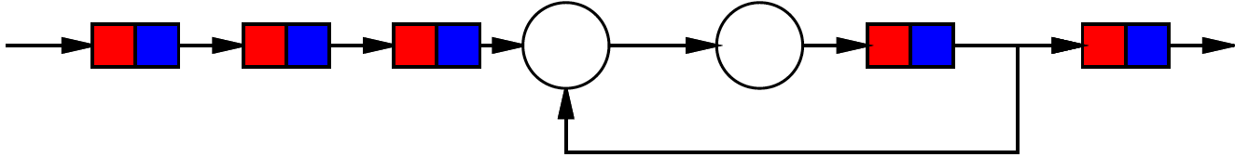
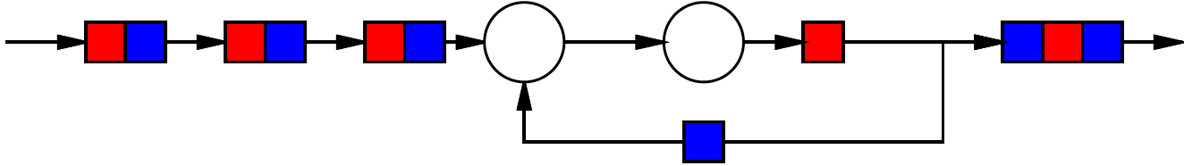
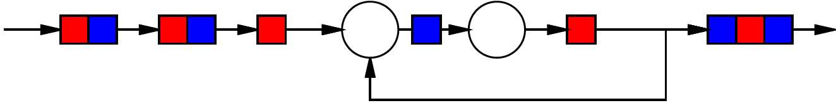
2-Slow Simple Cycle
Replace register with pair
Retime

Slide 57
2-Slow Simple Cycle
Replace register with pair
Retime
Observe independence of red/blue computations

Slide 58
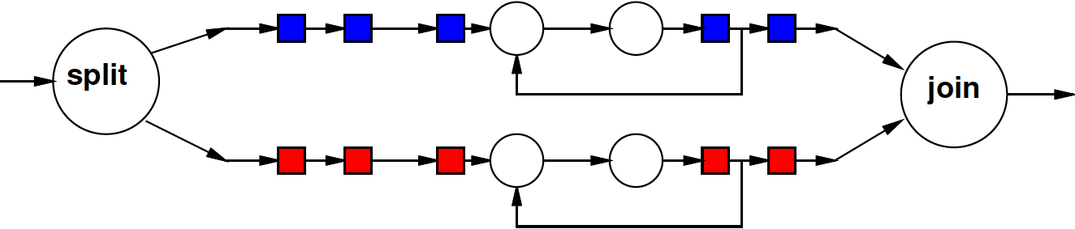
Equivalence
The 2-slow operator is equivalent to two data parallel operators running at half the speed

Slide 59
Automation
No mainstream tool today will perform C-slow transformation for you automatically
Synthesis tools will retime registers

Slide 60
Lesson
Cyclic dependencies limit throughput on single task or data stream
  Cycle-length / registers-in-cycle
Can use on C independent (data parallel) tasks

Slide 61
Big Ideas
Pipeline computations to reuse hardware and maximize computational capacity
Can compose pipelined operators and accommodate fixed-frequency target
  Be careful with data retiming
Cycles limit pipelining on single stream
C-slow to share hardware among multiple, data-parallel streams

Slide 62
Admin
Reading for Day 8 on web
HW4 due Friday
  HW4 lighter, HW5 heavier
  Suggest planning to get early start on HW5

