Slide 1
ESE532: System-on-a-Chip Architecture
Day 9: September 30, 2019
High Level Synthesis (HLS)
C-to-gates
Maybe: C-for-gates

Slide 2
Today
Motivation
Spatial Computations from C specification
Variables and expression (skip?)
Simple Conditionals
Loops
Functions
Arrays
Memory
Complexities from C semantics

Slide 3
Message
C (or any programming language) specifies a computation
Can describe spatial computation
A dataflow graph with physical operators for each operation
Underlying semantics is sequential
Watch for unintended sequentialization
Write C for spatial differently than you write C for processors

Slide 4
Coding Accelerators
Want to exploit FPGA logic on Zynq to accelerate computations
Traditionally has meant develop accelerators in
Hardware Description Language (HDL)
E.g. Verilog → see in CIS371, CIS501
Directly in schematics
Generator language (constructs logic)

Slide 5
Course “Hypothesis”
C-to-gates synthesis mature enough to use to specify hardware
Leverage fact everyone knows C
(must, at least, know C to develop embedded code)
Avoid taking time to teach Verilog or VHDL
Or making Verilog a pre-req.
Focus on teaching how to craft hardware
Using the C already know
…may require thinking about the C differently

Slide 6
Discussion [open]
Is it obvious we can write C to describe hardware?
What parts of C translate naturally to hardware?
What parts of C might be problematic?
What parts of hardware design might be hard to describe in C?

Slide 7
Three Perspectives
How express spatial/hardware computations in C
May want to avoid some constructs in C
How express computations
Hopefully, equally accessible to spatial and sequential implementations
Given C code: how could we implement in spatial hardware
Some corner cases and technicalities make tricky
[copy to board]

Slide 8
Advantage
Use C for hardware and software
Test out functionality entirely in software
Debug code before put on hardware
where harder to observe what’s happening
…without spending time in place and route
…which you are beginning to see now…
Explore hardware/software tradeoffs by targeting same code to either hardware or software

Slide 9
Context
C most useful for describing behavior of leaf operators
C alone doesn’t naturally capture task parallelism

Slide 10
Preclass F
Ready for preclass f?
Skip to preclass f

Slide 11
C Primitives Arithmetic Operators
Unary Minus (Negation) -a
Addition (Sum) a + b
Subtraction (Difference) a - b
Multiplication (Product) a * b
Division (Quotient) a / b
Modulus (Remainder) a % b
Things might have a hardware operator for…

Slide 12
C Primitives Bitwise Operators
Bitwise Left Shift a << b
Bitwise Right Shift a >> b
Bitwise One's Complement ~a
Bitwise AND a & b
Bitwise OR a | b
Bitwise XOR a ^ b
Things might have a hardware operator for…

Slide 13
C Primitives Comparison Operators
Less Than a < b
Less Than or Equal To a <= b
Greater Than a > b
Greater Than or Equal To a >= b
Not Equal To a != b
Equal To a == b
Logical Negation !a
Logical AND a && b
Logical OR a || b
Things might have a hardware operator for…

Slide 14
Expressions: combine operators
a*x+b
a
x
b
*
+
A connected set of operators
→ Graph of operators

Slide 15
Expressions: combine operators
a*x+b
a*x*x+b*x+c
a*(x+b)*x+c
((a+10)*b < 100)
A connected set of operators
→ Graph of operators

Slide 16
C Assignment
Basic assignment statement is:
Location = expression
f=a*x+b
a
x
b
*
+
f

Slide 17
Straight-line code
a sequence of assignments
What does this mean?
g=a*x;
h=b+g;
i=h*x;
j=i+c;
a
x
b
c
*
g
+
h
*
i
+
j

Slide 18
Variable Reuse
Variables (locations) define flow between computations
Locations (variables) are reusable
t=a*x;
r=t*x;
t=b*x;
r=r+t;
r=r+c;

Slide 19
Variable Reuse
Variables (locations) define flow between computations
Locations (variables) are reusable
t=a*x; t=a*x;
r=t*x; r=t*x;
t=b*x; t=b*x;
r=r+t; r=r+t;
r=r+c; r=r+c;
Sequential assignment semantics tell us which definition goes with which use.
Use gets most recent preceding definition.

Slide 20
Dataflow
Can turn sequential assignments into dataflow graph through def→use connections
t=a*x; t=a*x;
r=t*x; r=t*x;
t=b*x; t=b*x;
r=r+t; r=r+t;
r=r+c; r=r+c;
a
x
b
c
*
*
*
+
+

Slide 21
Dataflow Height
t=a*x; t=a*x;
r=t*x; r=t*x;
t=b*x; t=b*x;
r=r+t; r=r+t;
r=r+c; r=r+c;
Height (delay) of DF graph may be less than # sequential instructions.
a
x
b
c
*
*
*
+
+

Slide 22
Lecture Checkpoint
Happy with ?
Straight-line code
Variables
Graph for preclass f

Slide 23
Straight Line Code
C is fine for expressing straight-line code and variables
Has limited data types
Address with tricks like masking
Address with user-defined types

Slide 24
Optimizations can probably expect compiler to do
Constant propagation: a=10; b=c[a];
Copy propagation: a=b; c=a+d; → c=b+d;
Constant folding: c[10*10+4]; → c[104];
Identity Simplification: c=1*a+0; → c=a;
Strength Reduction: c=b*2; → c=b<<1;
Dead code elimination
Common Subexpression Elimination:
C[x*100+y]=A[x*100+y]+B[x*100+y]
t=x*100+y; C[t]=A[t]+B[t];
Operator sizing: for (i=0; i<100; i++) b[i]=(a&0xff+i);

Slide 25
Conditionals
What can we do for simple conditionals?
if (a<b)
res=b-a
Else
res=a-b

Slide 26
Simple Control Flow
If (cond) { … } else { …}
Assignments become conditional
In simplest cases (no memory ops), can treat as dataflow node
cond
then
else
choose

Slide 27
Simple Conditionals
if (a>b)
c=b*c;
else
c=a*c;
a>b
b*c
a*c
c

Slide 28
Simple Conditionals
v=a;
if (b>a)
v=b;
If not assigned, value flows from before assignment
b>a
b
a
v

Slide 29
Simple Conditionals
a
max=a;
min=a;
if (a>b)
{min=b;
c=1;}
else
{max=b;
c=0;}
May (re)define many values on each branch.
a>b
b
1
0
min
max
c

Slide 30
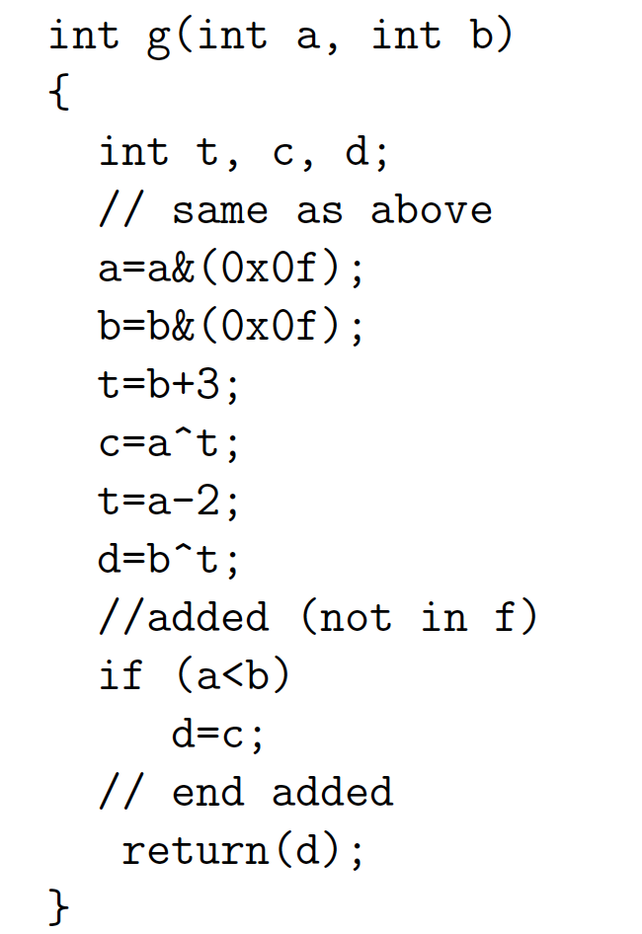
Preclass G
Graph for preclass g as mux-conversion?

Slide 31
Function Call
What computation is this describing?
What role does the function call play?
int f(int a, int b)
return(sqrt(a*a+b*b));
for(i=0;i<MAX;i++)
D[i]=f(A[i],B[i]);

Slide 32
Inline Transformation
Inline a function
Copy the body of function
Into the point of call
Replacing the function arguments
With the arguments supplied in the call
int f(int a, int b)
return(sqrt(a*a+b*b));
for(i=0;i<MAX;i++)
D[i]=f(A[i],B[i]);
for(i=0;i<MAX;i++)
D[i]=sqrt(A[i]*A[i] +B[i]*B[i]);

Slide 33
Inline
int p(int a)
return(a*a+2*a-1);
for(i=0;i<MAX;i++)
D[i]=p(A[i])-p(B[i]);
for(i=0;i<MAX;i++)
D[i]=A[i]*A[i]+2*A[i]-1
- (B[i]*B[i]+2*B[i]-1);
Functions provide descriptive convenience and compactness.
…but don’t need to force implementation.

Slide 34
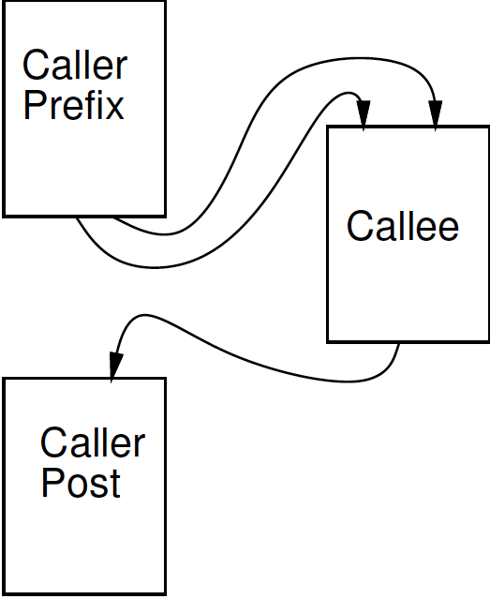
Treat as data flow
Implement function as an operation
Send arguments as input tokens
Get result back as token
Functions provide potential division between substrates?

Slide 35
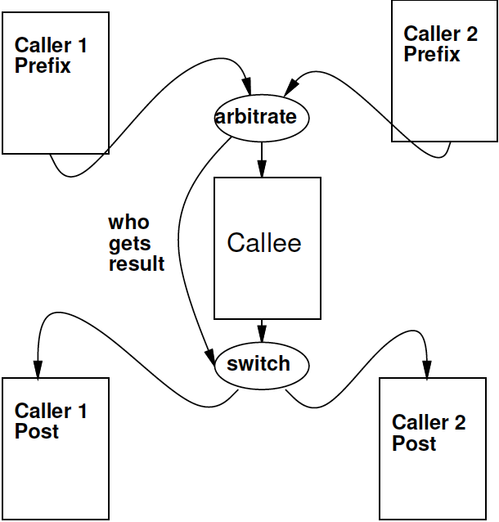
Shared Function
Functions express shared operators.

Slide 36
Recursion?
int fib(int x) {
if ((x==0) || (x==1)) return(1);
else
return(
fib(x-1) + fib(x-2));
}
In general won’t work.
Problem?
Smart compiler might be able to turn some cases into iterative loop.
…but don’t count on it.
VivadoHLS will not

Slide 37
Global Variables
int a=0;
int f1(int *A) {
for (int i=0;i<a;i++)
sum+=A[i];
return(sum); }
void f2(int *A) {
while (A[a]!=0);
a++;
}
f2(input);
isum=f1(input);
Variables not declared in a function resolve to outer context

Slide 38
Treat as data flow
Functions provide potential division between substrates.
Impact on global variables?
Run on ARM
Run on FPGA
int a=0;
int f1(int *A) {
for (int i=0;i<a;i++)
sum+=A[i];
return(sum); }
void f2(int *A) {
while (A[a]!=0);
a++; }
f2(input);
isum=f1(input);

Slide 39
Treat as data flow
Functions provide potential division between substrates.
Impact on global variables?
Correct thing
Reflect change in variable between substrates
Evidence Vivado HLS
Does not do that
Run on ARM
Run on FPGA

Slide 40
Global Variables
int a=0;
int f1(int *A) {
for (int i=0;i<a;i++)
sum+=A[i];
return(sum); }
void f2(int *A) {
while (A[a]!=0);
a++;
}
f2(input);
isum=f1(input);
Globals generally considered bad coding practice
Obfuscate flow of data even for human
Avoid Gobals
With hardware, have extra reason avoid

Slide 41
Global Variables
Bad
Better
int a=0;
int f1(int *A) {
for (int i=0;i<a;i++)
sum+=A[i];
return(sum); }
void f2(int *A) {
while (A[a]!=0);
a++;
}
f2(input);
isum=f1(input);
int f1(int *A, int len) {
for (int i=0;i<len;i++)
sum+=A[i];
return(sum); }
int f2(int *A) {
while (A[a]!=0);
len++;
return(len)
}
len=f2(input);
isum=f1(input,len);

Slide 42
Loops…
From an express computation standpoint, have several roles
Compact code
Unbounded computation
From describe hardware
Compact expression of parallel hardware
Express pipelines
Express area-time tradeoff

Slide 43
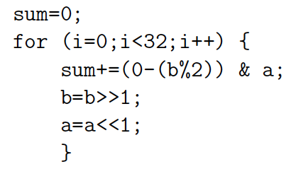
Loop Compact Expression
What express?
Sequential, fully unrolled, partially unrolled?

Slide 44
Sequential

Slide 45
Spatial = fully unrolled

Slide 46
Stream
Day 5
Logical abstraction of a persistent point-to-point communication link between operators
Has a (single) source and sink
Carries data presence / flow control
Provides in-order (FIFO) delivery of data from source to sink
stream

Slide 47
Stream
For the moment assume way to read and write to streams:
stream.read() – return next value on stream
stream.write(val); put val onto stream
stream

Slide 48
Unbounded, Pipelined Operator
What C code describe?

Slide 49
Unbounded, Pipelined Operator
What describe?
int c=12;
while(true)
{
int aval=astream.read();
int bval=bstream.read();
int res=a*b+c;
resstream.write(res);
}

Slide 50
With function call, loop in function
int c=12;
while(true)
{
int aval=astream.read();
int bval=bstream.read();
int res=multiply(a,b)+c;
resstream.write(res);
}

Slide 51
Compact Expression: Arrays
Useful to be able to refer to different values (a large number of values) with the same code.
Arrays + Loops: give us a way to do that
Useful:
general expression
hardware description

Slide 52
Compact Expression: Arrays+Logic
Vector sum:
c3=a3+b3; c2=a2+b2; c1=a1+b1; c0=a0+b0;
for(i=0;i<3;i++) c[i]=a[i]+b[i];
Chose small length to fit non-array on slide
#define K 16
for(i=0;i<K;i++) c[i]=a[i]+b[i];

Slide 53
Compact Expression: Arrays+Logic
Dot Product:
Y=a3*b3+a2*b2+a1*b1+a0*b0;
Y=0; for(i=0;i<3;i++) Y+=a[i]*b[i];

Slide 54
Compact Expression: Arrays+Logic
Vector sum:
c3=a3+b3; c2=a2+b2; c1=a1+b1; c0=a0+b0;
for(i=0;i<3;i++) c[i]=a[i]+b[i];
These array elements may be nodes in dataflow graph, just like the variables we saw for function f
Express large dataflow graphs
Make area-time choices for implementation

Slide 55
Foreshadowing: C Array Challenge
C programmers think of arrays as memory (or memory as arrays)
…and sometimes we will want to
Be careful understanding (and expressing) arrays that don’t have to be memories
…and treated with memory semantics

Slide 56
Loop Interpretations
What does a loop describe?
Sequential behavior [when to execute]
Spatial construction [when create HW]
Data Parallelism [sameness of compute]
We will want to use for all 3
Sometimes need to help the compiler understand which we want

Slide 57
Loop Bounds
Loops without constant bounds
while (sum+a[i]<100) {
sum+=a[i];
b[i]=a[i]>>2;
i++; }
How many times loop execute?
Typically forces sequentialization
Cannot unroll into hardware

Slide 58
Loop Increment
Loops with variable increment also force sequentialization
for (i=0;i<100;i+=f(i))
{ b[i]=a[i]; sum+=a[i]; }
What are values of i for which evaluate body?

Slide 59
Loop Interpretations
What does a loop describe?
Sequential behavior [when execute]
Spatial construction [when create HW]
Data Parallelism [sameness of compute]
We will want to use for all 3
C allows expressive loops
Some expressiveness
Not compatible with spatial hardware construction

Slide 60
Unroll
Vivado HLS has pragmas for unrolling
UG901: Vivado HLS User’s Guide
P180—229 for optimization and directives
#pragma HLS UNROLL factor=…
Use to control area-time points
Use of loop for spatial vs. temporal description

Slide 61
Arrays as Memory Banks
Hardware expression: Sometimes we will want to describe computations with separate memory banks
int a[1024], b[1024], c[1024];
for(i=0;i<1024;i++)
a[i]=bigmem[offset+i];
for (i=0;i<1024;i++)
c[i]=a[i]*b[i];

Slide 62
Arrays as Memory Banks
If single memory has only one port
Can perform only one memory operation per cycle
What II if a, b, c all in bigmem?
for (i=0;i<1024;i++)
c[i]=a[i]*b[i];

Slide 63
Physical Memory Port as Limited Shared Resource
Typically single memory port
Must sequentialize on use of memory port
Reason for banking
Put in separate memories, so operations can occur simultaneously
Ultra96 DRAM 1 port
Virtex BRAM 2 ports

Slide 64
Arrays as things to put in Memory Banks
Computational expression:
sometimes it is useful to express computation
then decide how to pack array state into memory banks for different
Hardware availability
Area-Time tradeoffs

Slide 65
Arrays as Inputs and Outputs
Computational Expression: arrays are often a natural way of expression set of inputs and outputs
int c=12;
while(true)
{
int aval=astream.read();
int bval=bstream.read();
int res=a*b+c;
resstream.write(res);
}
void op(int a[BLOCK], int b[BLOCK], int out[BLOCK]) {
for (i=0;i<BLOCK;i++)
{
out[i]=a[i]*b[i]+c;
}
}

Slide 66
Arrays as Local Memory
Hardware/Computational expression: natural way of describing local state
hist(int a[SIZE], out[EVENTS]) {
int local[EVENTS];
for(i=0;i<EVENTS;i++)
local[i]=0;
for(i=0;i<SIZE;i++)
local[a[i]]++;
for(i=0;i<EVENTS;i++)
out[i]=local[i];
}

Slide 67
Array Interpretations
What does an array describe?
Compact expression [write less code]
Memory banks [where place data]
Things put in separate memory banks
Local memory [not need to be shared]
I/O [source and sink of data]
We will want to use for all 5
C allows expressive use of arrays/memories
Some expressiveness will inhibit efficient hardware

Slide 68
C Memory Model
One big linear address space of locations
Most recent definition to location is value
Sequential flow of statements
New value
000
001
Addr
002
004
005
006
007
008
009
010
011
Current value

Slide 69
Challenge: C Memory Model
One big linear address space of locations
Assumes all arrays live in same memory
Assumes arrays may overlap?
New value
000
001
Addr
002
004
005
006
007
008
009
010
011
Current value

Slide 70
Example
Assume a, b live in same memory
Placed in sequence as shown
What happens when
int a[16];
int b[16];
Read from a[17]
Read from b[-2]
Can inhibit separation into memory banks, parallelism

Slide 71
Memory Operation Challenge
Memory is just a set of location
But memory expressions in C can refer to variable locations
Does A[i], B[j] refer to same location?
A[f(i)], B[g(j)] ?
Can inhibit banking, parallelism
Or add expensive interconnect

Slide 72
C Memory/Pointer Sequentialization
Must preserve ordering of memory operations
A read cannot be moved before write to memory which may redefine the location of the read
Conservative: any write to memory
Sophisticated analysis may allow us to prove independence of read and write
Writes which may redefine the same location cannot be reordered

Slide 73
C Memory/Pointer Sequentialization
Must preserve ordering of memory operations
A read cannot be moved before write to memory which may redefine the location of the read
Writes which may redefine the same location cannot be reordered
True for read/write to single array even if know arrays isolated
Does A[B[i]] refer to same location as A[C[i]]?
So expression issue broader than C

Slide 74
Consequence
Expressions and operations through variables (whose address is never taken) can be executed at any time
Just preserve the dataflow
Memory assignments must execute in strict order
Ideally: partial order
Conservatively: strict sequential order of C

Slide 75
More on Wednesday
If time permits on Wednesday, more on Sequentialization and Dependencies

Slide 76
Big Ideas:
C (any prog lang) specifies a computation
Can describe spatial computation
Has some capabilities that don’t make sense in hardware
Shared memory pool, globals, recursion
Watch for unintended sequentialization
C for spatial is coded differently from C for processor
…but can still run on processor
Good for leaf functions (operations)
Limiting for full task

Slide 77
Admin
Reading for Wednesday on Web
Xilinx HLS documents
HW5 due Friday
Remember several long compiles
Get started early

