Slide 1

ESE532:
System-on-a-Chip Architecture
Day 1: September 2, 2020
Introduction and Overview
(lecture start 10:35am)
Note: both linked to web (also slides)
www.seas.upenn.edu/~ese532/fall2020/fall2020.html
Preclass
Feedback form

Slide 2
Today
Case for Programmable SoC
Course Goals
Outcomes
Evovling Course, Risks, Tools
Sample Optimization
This course (incl. policies, logistics)

Slide 3
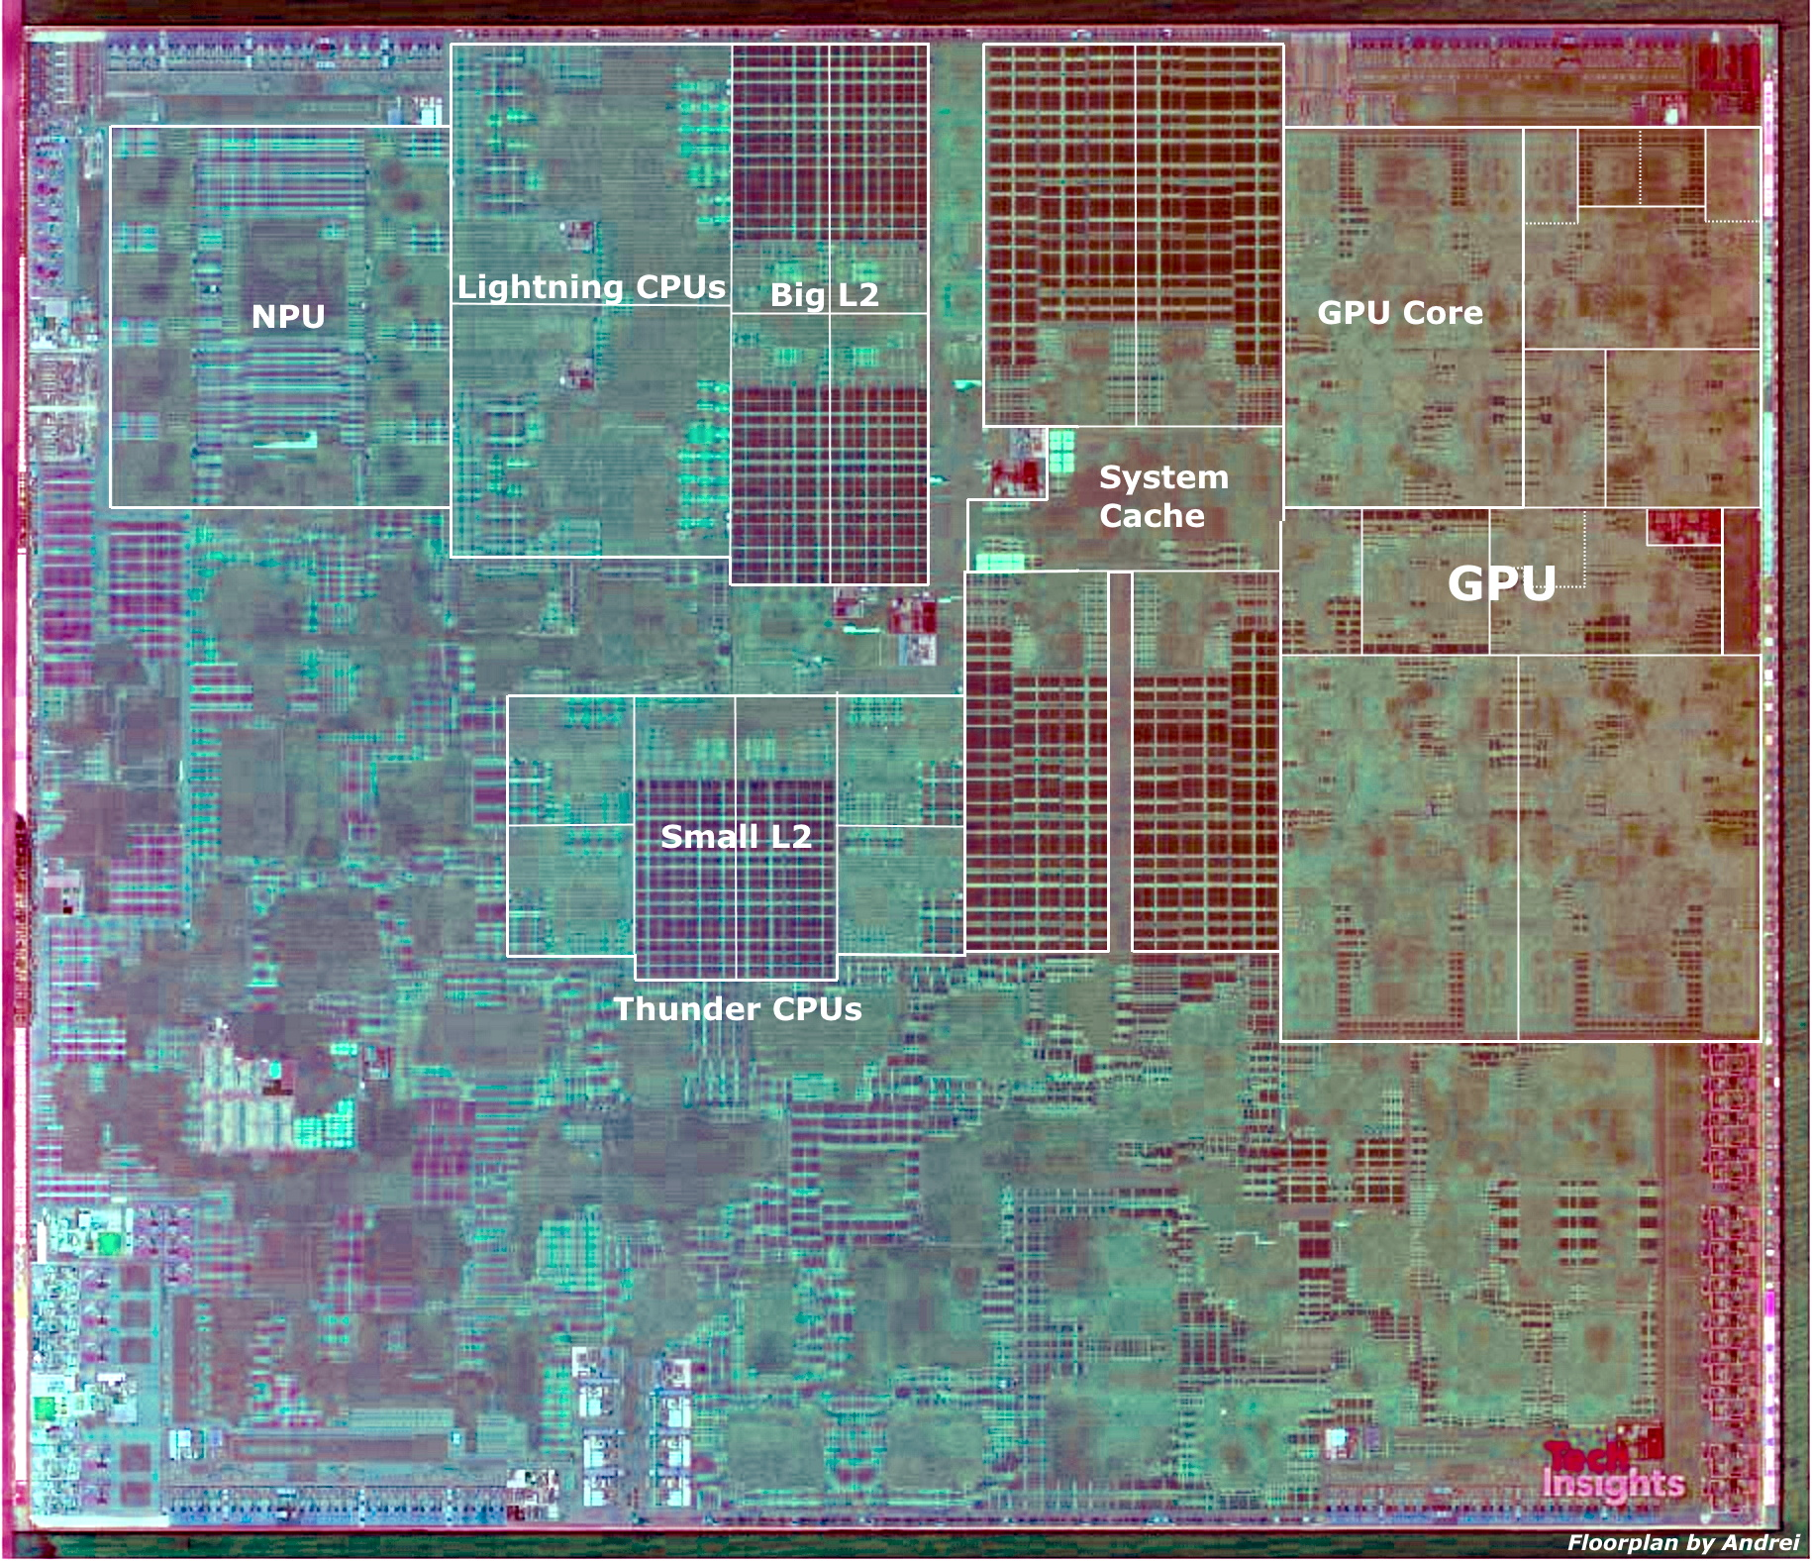
Apple A13 Bionic
98mm², 7nm
8.5 Billion Tr.
iPhone 11 +
6 ARM cores
  2 fast (2.6GHz)
  4 low energy
4 custom GPUs
Neural Engine
  5 Trillion ops/s?

Slide 4
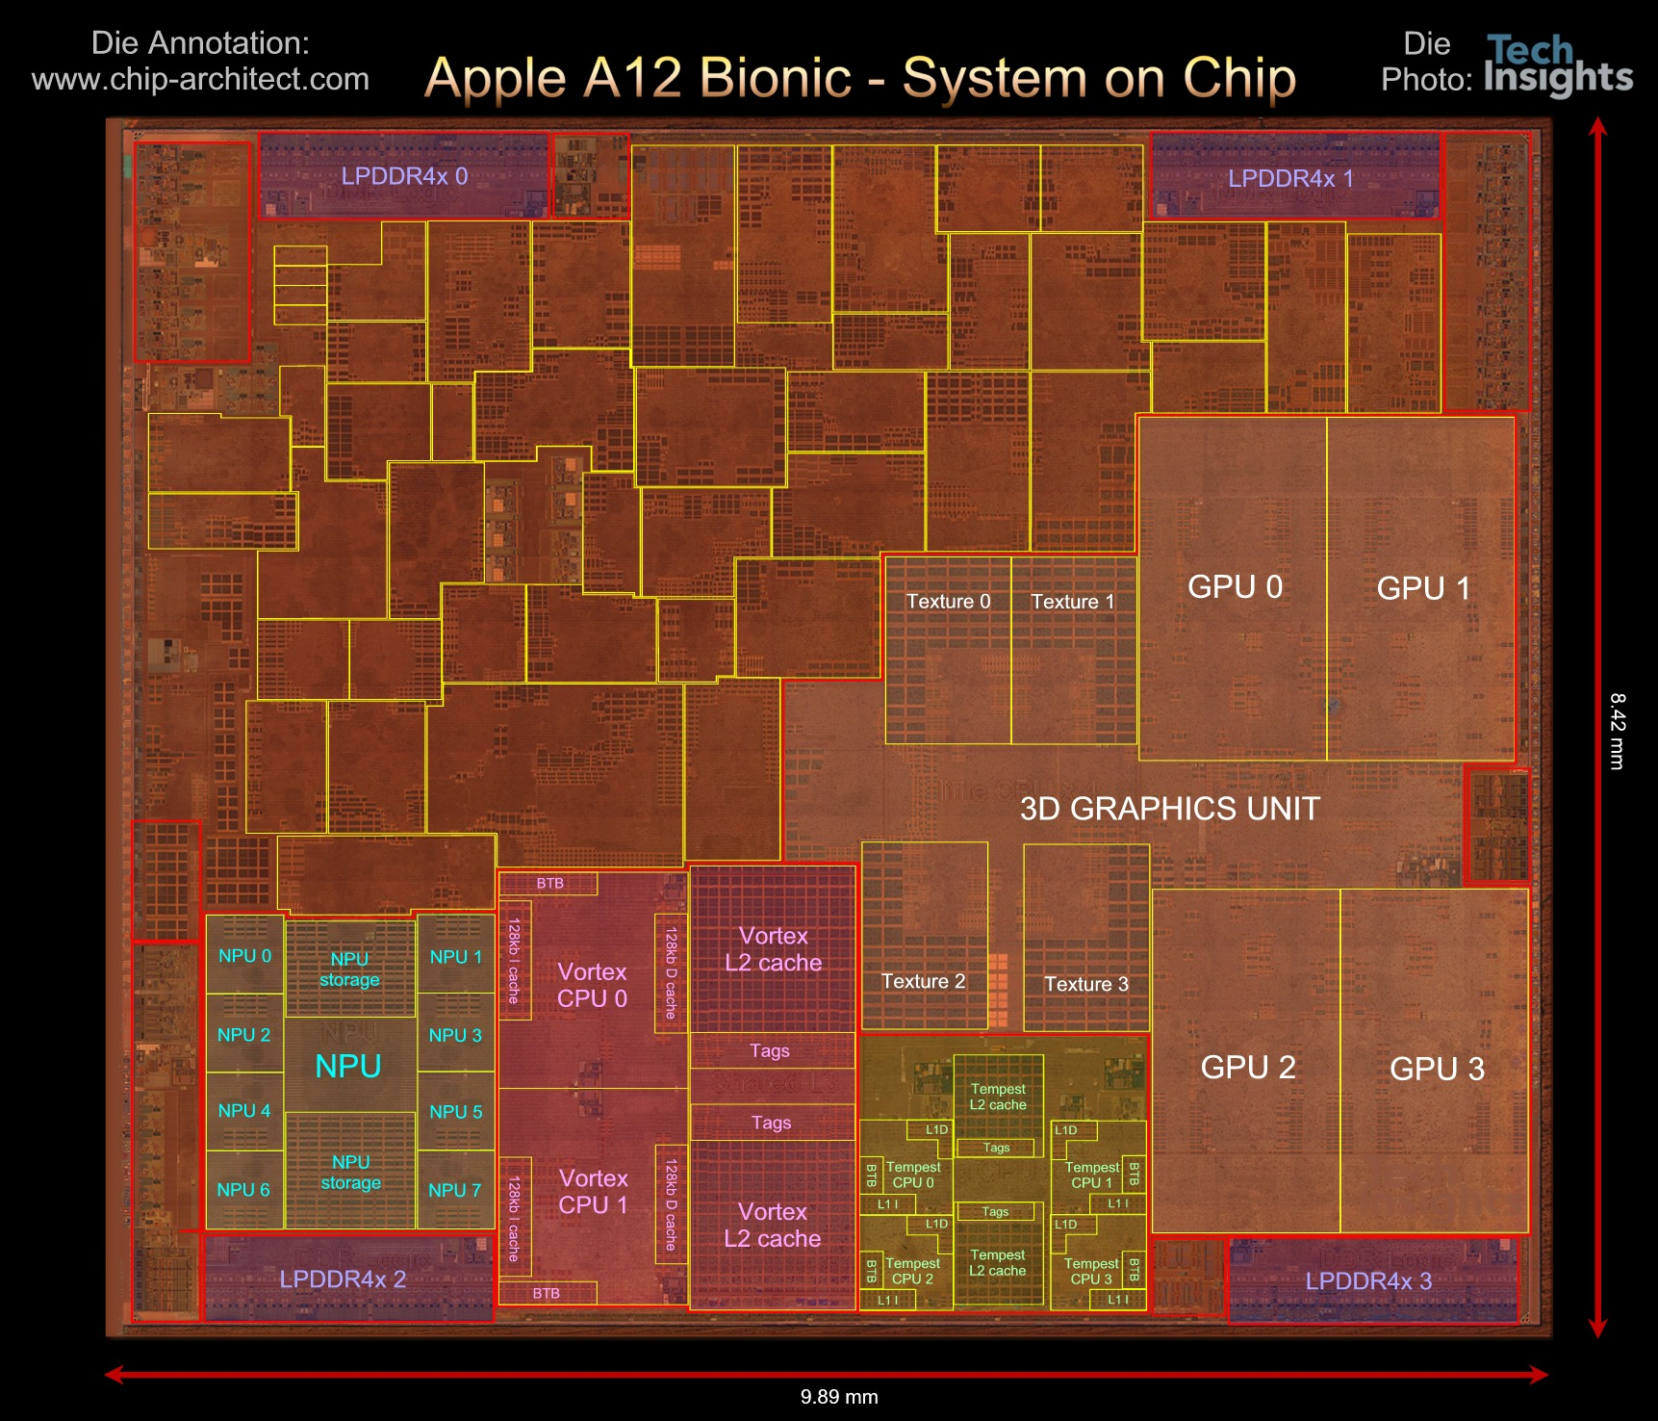
Questions
Why do today’s SoC look like they do?
How approach programming modern SoCs?
How design a custom SoC?
When building a System-on-a-Chip (SoC)
  How much area should go into:
    Processor cores, GPUs,
    FPGA logic, memory,
    interconnect,
    custom functions (which) …. ?

Slide 5
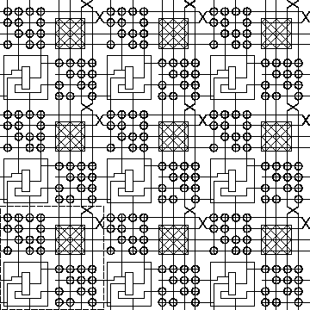
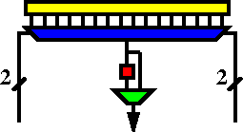
FPGA
Field-Programmable Gate Array
K-LUT (typical k=4 or 6)
Compute block
w/ optional
output Flip-Flop
ESE171, ESE150, CIS371

Slide 6
Case for Programmable SoC

Slide 7
End of uProcessor Scaling
Old
Moore’s Law scaling delivered faster transistors
Processors rode Moore’s Law
  Turning transistors into performance
Could wait and ride technology curve
Now
Dennard’s Law kicked in
uP were burning more power
Lost ability to scale down voltage
Processor performance stalled

Slide 8
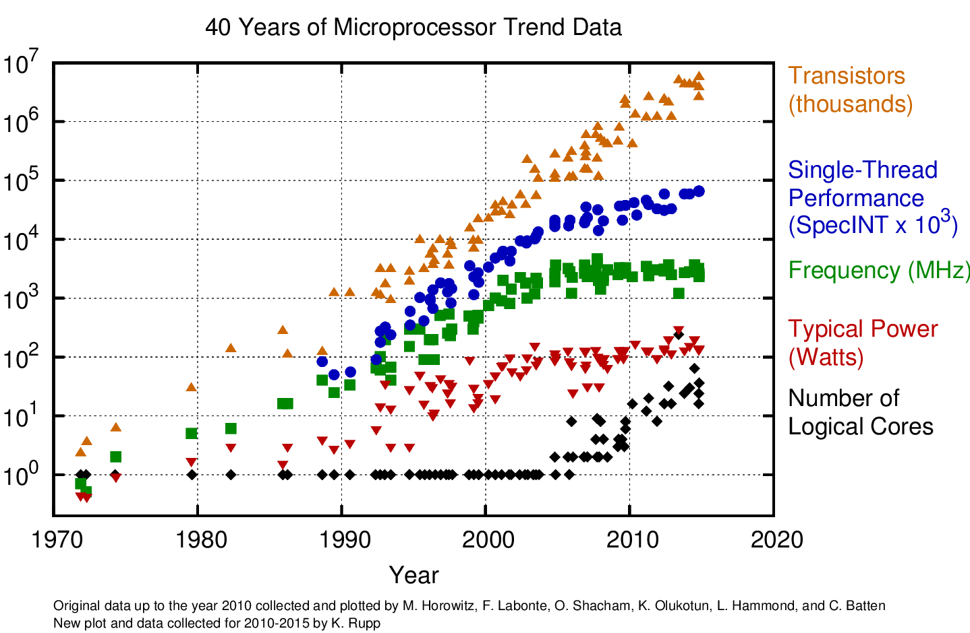

Slide 9
The Way things Were
30 years ago
Wanted programmability
  used a processor
Wanted it a little faster
  Next year’s processor would run faster…
Wanted high-throughput
  used a custom IC
Wanted product differentiation
  Got it at the board level
  Select which ICs and how wired
Build a custom IC
  It was about gates and logic

Slide 10
Today
Microprocessor may not be fast enough
  (but often it is)
  Or low enough energy
Single core processor scaling has ended
Time and Cost of a custom IC is too high
  $100M’s of dollars for development, Years
FPGAs promising
  But build everything from prog. gates?
Premium for small part count
  And avoid chip crossing
  ICs with Billions of Transistors

Slide 11
Non-Recurring Engineering (NRE) Costs
Costs spent up front on development
  Engineering Design Time
  Prototypes
  Mask costs
Recurring Engineering
  Costs to produce each chip

Slide 12
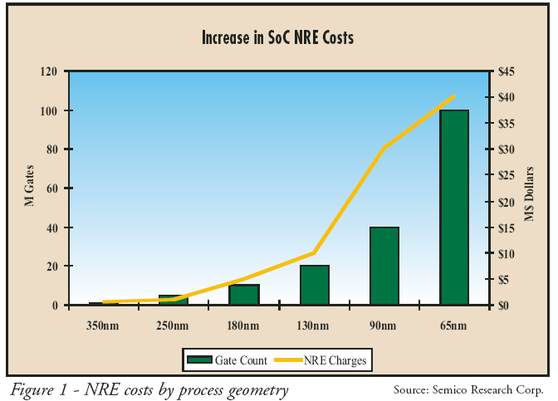
NRE Costs

Slide 13
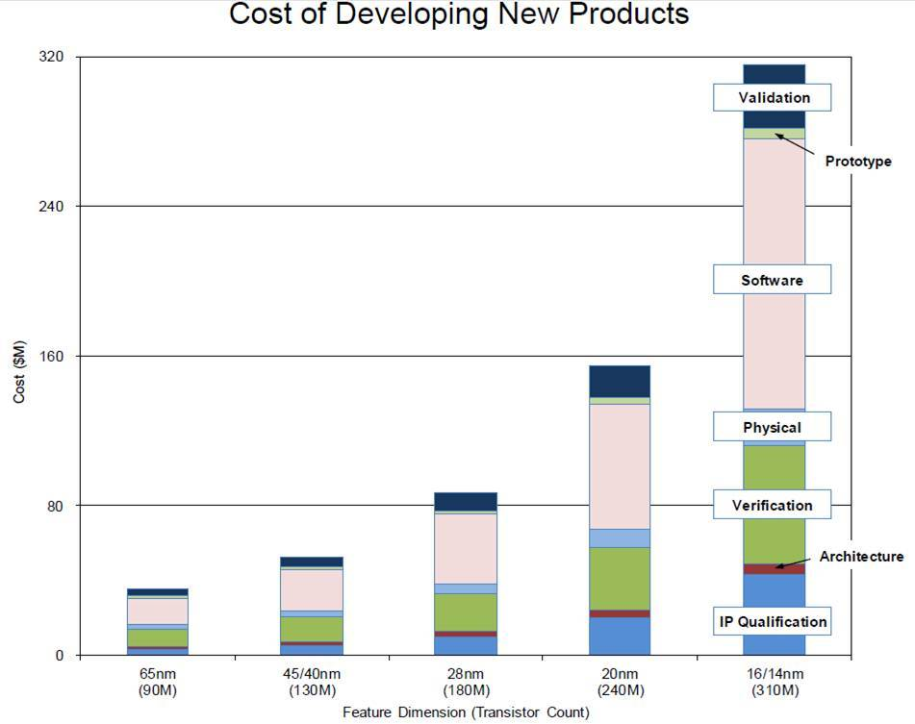
NRE Cost (continued)
https://semiengineering.com/how-much-will-that-chip-cost/

Slide 14
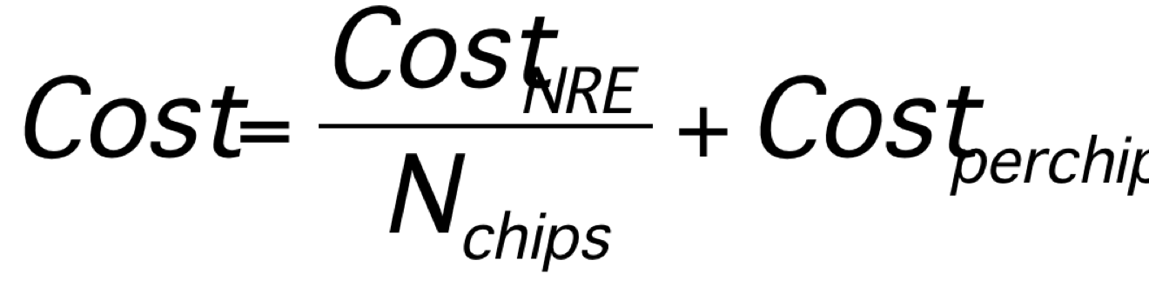
Amortize NRE with Volume

Slide 15
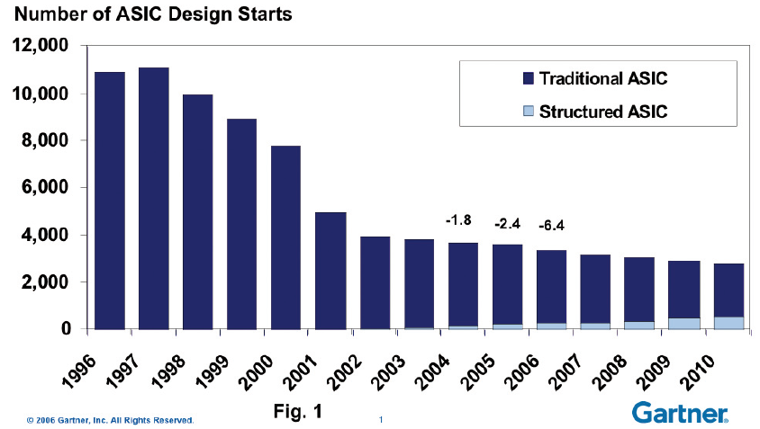
Economics
Forcing fewer,
more
customizable
chips
Economics force fewer, more customizable chips
  Mask costs in the millions of dollars
  Custom IC design NRE 10s—100s of millions of dollars
    Need market of billions of dollars to recoup investment
    With fixed or slowly growing total IC industry revenues
    ➔ Number of unique chips must decrease
    Chips must be programmable

Slide 16
Large ICs
Now contain significant software
  Almost all have embedded processors
Must co-design SW and HW
Must solve complete computing task
  Tasks has components with variety of needs
  Some don’t need custom circuit
  90/10 Rule

Slide 17
Given Demand for Programmable
How do we get higher performance than a processor, while retaining programmability?

Slide 18
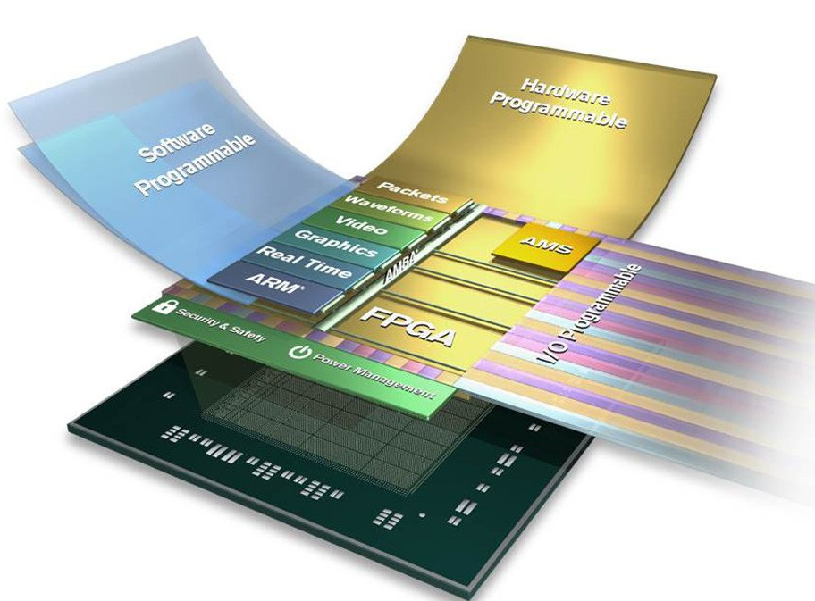
Programmable SoC
Implementation Platform for innovation
  This is what you target (avoid NRE)
  Implementation
  vehicle

Slide 19
Programmable SoC
UG1085
Xilinx
UltraScale
Zynq
TRM
(p27)

Slide 20
Then and Now
30 years ago
Programmability?
  use a processor
Faster
  Processors scaled
High-throughput
  used a custom IC
Wanted product differentiation
  board level
  Select & wired IC
Build a custom IC
  It was about gates and logic
Today
Programmability?
  uP, FPGA, GPU, PSoC
Faster
  Can’t get with single core
High-throughput
  FPGA, GPU, PSoC, custom
Wanted product differentiation
  Program FPGAs, PSoC
Build a custom IC
  System and software

Slide 21
Course
Goals, Outcomes

Slide 22
Goals
Create Computer Engineers
  SW/HW divide is wrong, outdated
  Computer engineers understand computation
    HW and SW are just tools and design options
  Parallelism, data movement, resource management, abstractions
  Cannot build a chip without software
SoC user – know how to exploit
SoC designer – architecture space,
hw/sw codesign
Project experience – design and optimization

Slide 23
Roles
PhD Qualifier
  One broad Computer Engineering
CMPE Concurrency
Hands-on Project course

Slide 24
Outcomes
Design, optimize, and program a modern System-on-a-Chip.
Analyze, identify bottlenecks, design-space
  Modeling → write equations to estimate
Decompose into parallel components
Characterize and develop real-time solutions
Implement both hardware and software solutions
Formulate hardware/software tradeoffs, and perform hardware/software codesign

Slide 25
Outcomes
Understand the system on a chip from gates to application software, including:
  on-chip memories and communication networks, I/O interfacing, design of accelerators, processors, firmware and OS/infrastructure software.
Understand and estimate key design metrics and requirements including:
  area, latency, throughput, energy, power, predictability, and reliability.

Slide 26
Evolving Course
Spring 2017 – first offering
  Raw, all assignments new, buggy, too tedious, long
Fall 2017 – second offering
  Refine assignments, project; increased explicit modeling emphasis
  Hard, not insane
Fall 2018 – third offering (similar 2017)
  Added real-time ethernet data handling; project groups of 3
  Many students challenged with C and software engineering
  Stream debug and performance challenging
Fall 2019 – fourth (structure same)
  Try front-load more C, better introduce Stream optimization and debug
  Group writeup on projects
Fall 2020 – now
  Move to Vitis (from SDSoC)
  Use Amazon cloud for first half; F1 instance for FPGA access HW
  Then transition to Ultra96 (SoC FPGA) for projects

Slide 27
Tools
Are complex
Will be challenging, but good for you to build confidence can understand and master
Tool runtimes can be long
Learning and sharing experience will be part of assignments

Slide 28
Distinction
CIS240, 371, 471, 571
ESE532
Best Effort Computing
  Run as fast as you can
Binary compatible
ISA separation
Shared memory parallelism
Hardware-Software codesign
  Willing to recompile, maybe rewrite code
  Define/refine hardware
Real-Time
  Guarantee meet deadline
Non shared-memory parallelism models

Slide 29
Distinction
ESE532:
ESE680: Hardware/Software Co-Design for Machine Learning
Deep computer engineering
Broad application
Program in C
Suitable followup if want to dig deeper
5th offering
Deep on Application (ML)
More accessible to CS
  Less previous experience with circuits and architecture
Won’t be as deep on understanding HW and optimization
Program in Pytorch, OpenCL
First offering

Slide 30
Abstraction Stack
Software
ESE680 HW/SW ML
Embedded Sys:
ESE350/519
Systems
SoC Arch:
ESE 532
Processors
Processor Arch:
CIS 371/501
(CIS240)
Mixed Signal:
ESE 568
ADC, DAC
Switched Capacitors
Gates, Memories
Digital:
ESE370/570
Analog:
ESE419/572
Amplifier, Compare
Voltage/Current Ref.
Circuits/VLSI
Devices: ESE521
(ESE218)
Transistors

Slide 31
Approach -- Example

Slide 32
Abstract Approach
Identify requirements, bottlenecks
Decompose Parallel Opportunities
  At extreme, how parallel could make it?
  What forms of parallelism exist?
    Thread-level, data parallel, instruction-level
Design space of mapping
  Choices of where to map, area-time tradeoffs
Map, analyze, refine
  Write equations to understand, predict

Slide 33
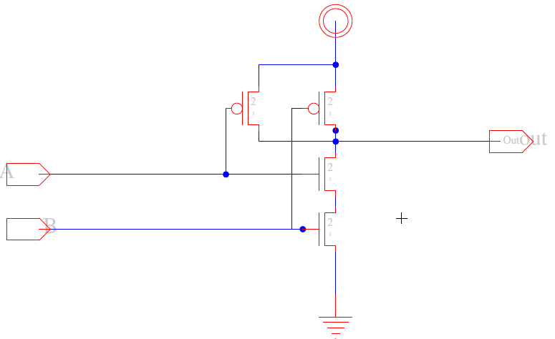
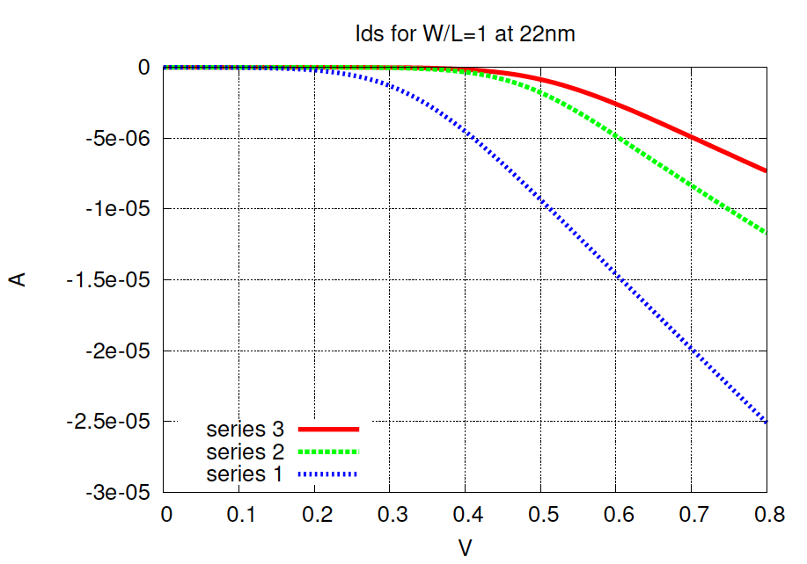
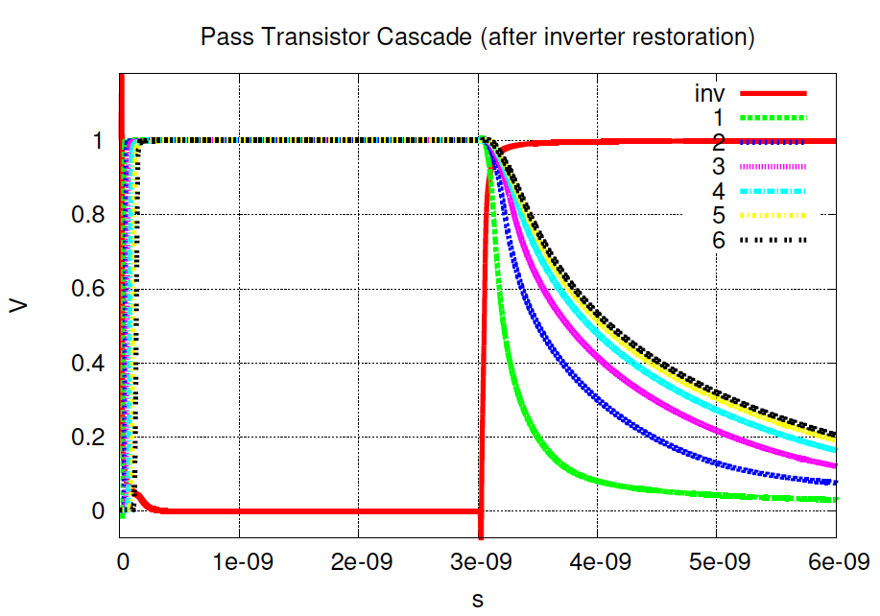
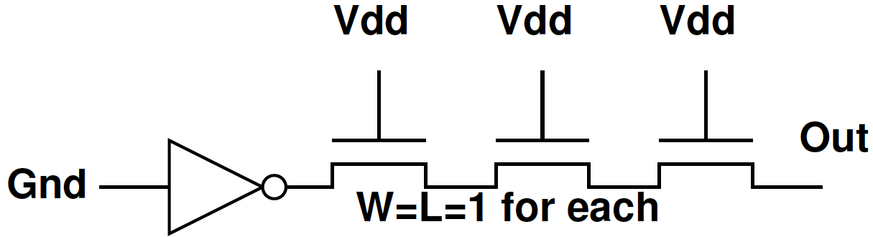
Example SPICE Circuit Simulator

Slide 34
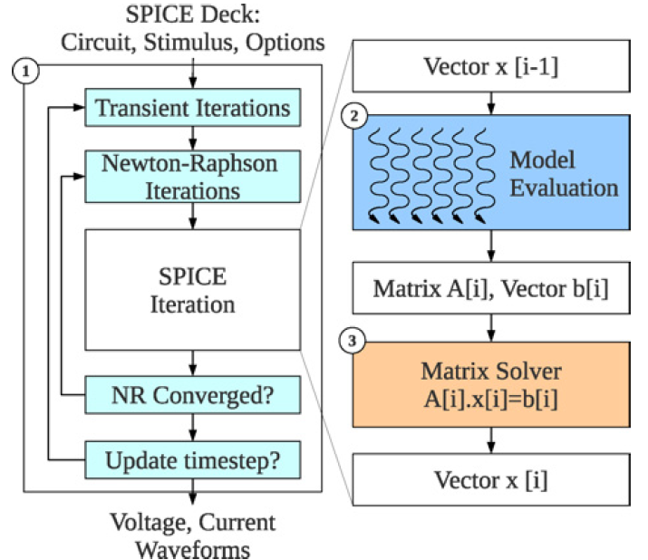
Example: SPICE Circuit Simulator
Matrix Solve
Ax=B
A matrix
B vector
x unknown vector
Solve for x
= KCL, KVL *
Linear Algebra
solving n eqns
in n unknowns.
Example: Kapre+DeHon, TRCAD 2012
* Kirchhoff {Current,Voltage} Laws

Slide 35
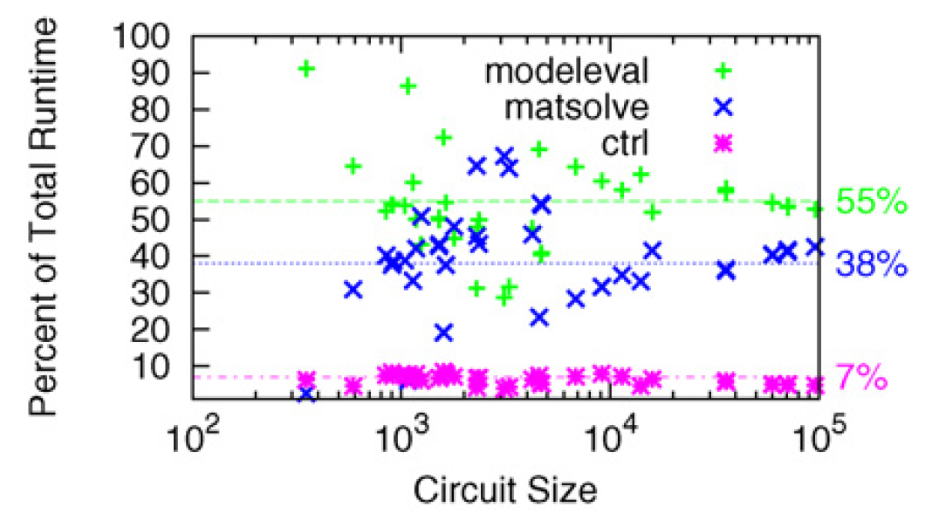
Analyze

Slide 36
Analyze
T=T_{modeleval}+T_{matsolve}+T_{ctrl}

Slide 37
Speedup
T=T_{modeleval}+T_{matsolve}+T_{ctrl}
What should we speedup first?
What happens if only speedup modeleval?
  T=T_{matsolve}+(T_{modeleval})/S+T_{ctrl}

Slide 38
Analyze
If only accelerated model evaluation
only about 2x speedup
If want better than 14x speed,
must also attack control

Slide 39
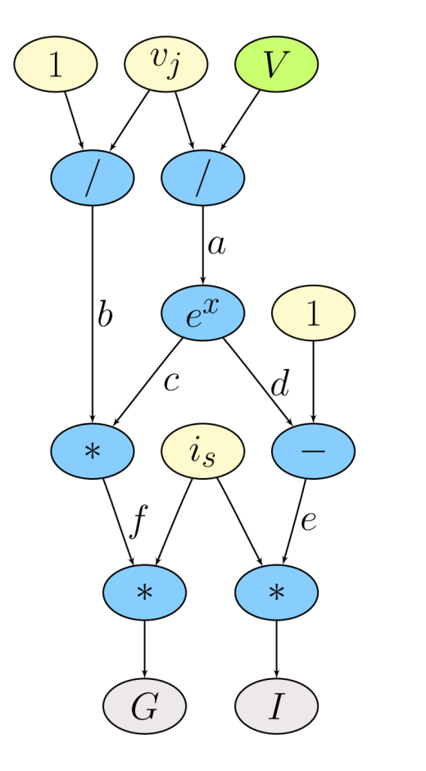
Model Evaluation: Trivial Hardware Implementation
*
*
÷
e
f
b
-
*
÷
d
c
a
e^{x}
Verilog-AMS as Domain-Specific Language

Slide 40
Spatial Parallelism
Every operation (*, + /) gets dedicated hardware.
Implement task in space → use additional area for each operator.
Parallel – all operations occur simultaneously.
*
*
÷
e
f
b
-
*
÷
d
c
a
e^{x}

Slide 41
Parallelism: Model Evaluation
Data Parallel
Every device independent
Many of each type of device
Can evaluate in parallel
  T=T_{seq}/N_{proc}
Build pipelined circuit for model
  T_{seq}=N_{comp}*T_{cycle}
  vs. T_{pipe}=T_{cycle}

Slide 42
Spatial Too Big?
Fully spatial circuit
Custom VLIW
*
÷
*
*
÷
b
e
f
-
*
÷
+
d
c
a
e^{x}
e^{x}
~100x Speedup
Multiple FPGAs
~10x Speedup
1 FPGA
VLIW=Very Long Instruction Word
exploits Instruction-Level Parallelism

Slide 43
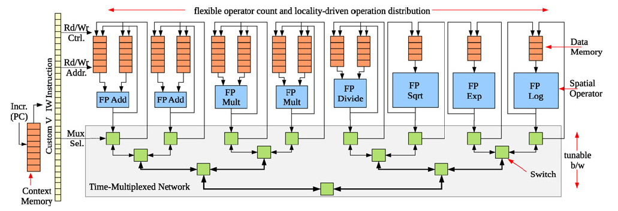
Parallelism: Model Evaluation
Spatial end up bottlenecked by other components
Use custom evaluation engines
…or GPUs

Slide 44
Parallelism: Matrix Solve
Needed direct solver?
E.g. Gaussian elimination
Data dependence on previous reduce
  Limited data parallelism
Parallelism in subtracts
Some row independence

Slide 45
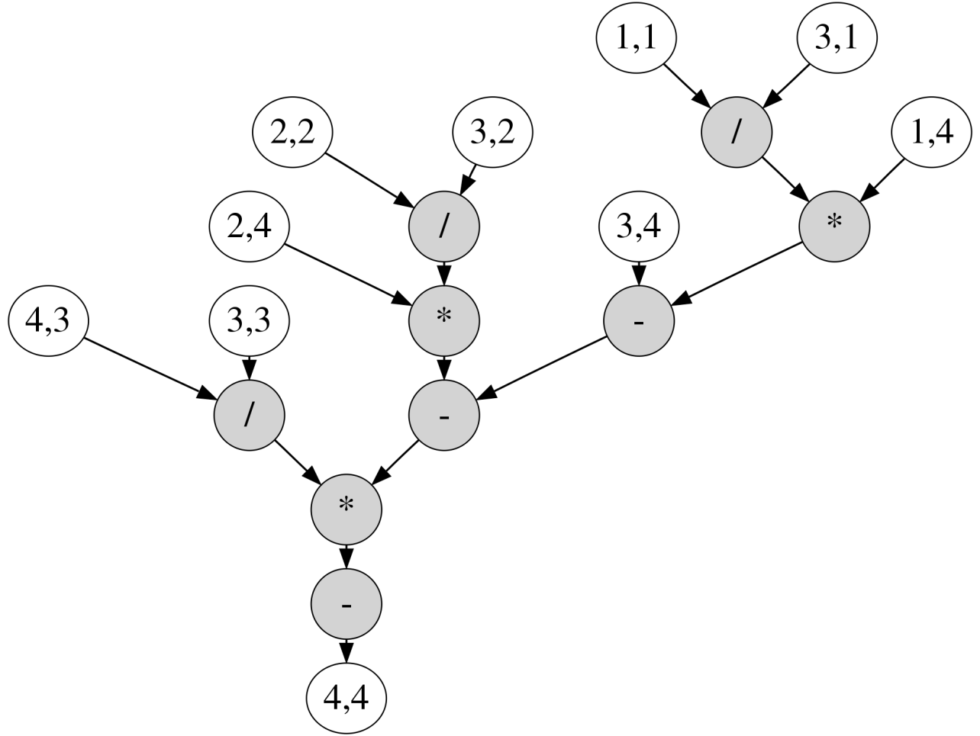
Example Matrix

Slide 46
Example Matrix

Slide 47
Example Matrix
Reduce to critical path:
from 9 sequential operations
to path of 5 operations.

Slide 48
Dataflow Processing Element (PE)
Graph
Nodes
Incoming Messages
Dataflow trigger
*
+
÷
Graph
Fanout
Outgoing Messages

Slide 49
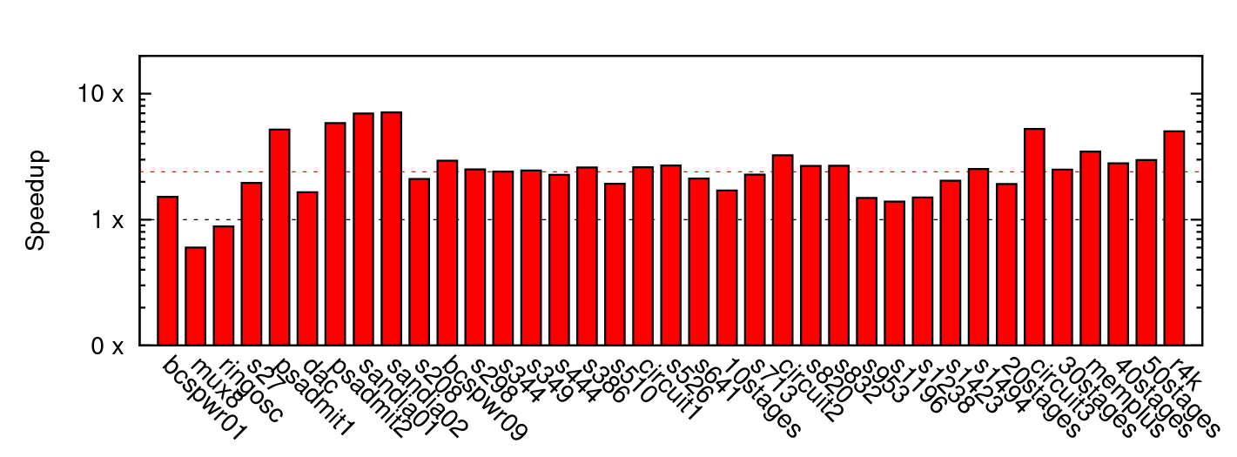
Matrix Solve Only
~2.4x mean

Slide 50
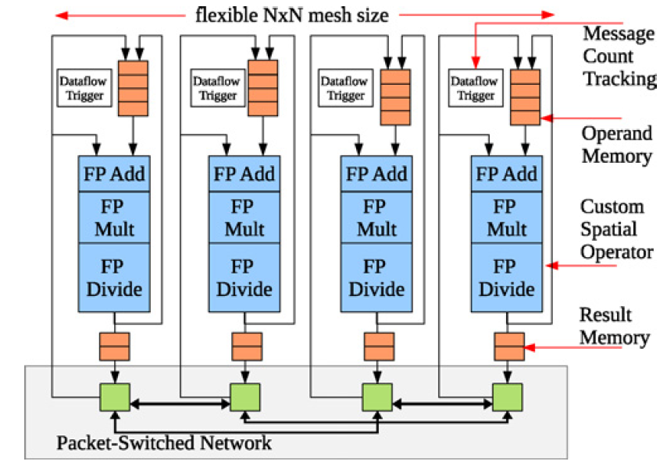
Parallelism: Matrix Solve
Settled on constructing dataflow graph
Graph can be iteration independent
  Statically scheduled
  (cheaper)
This is bottleneck to further acceleration

Slide 51
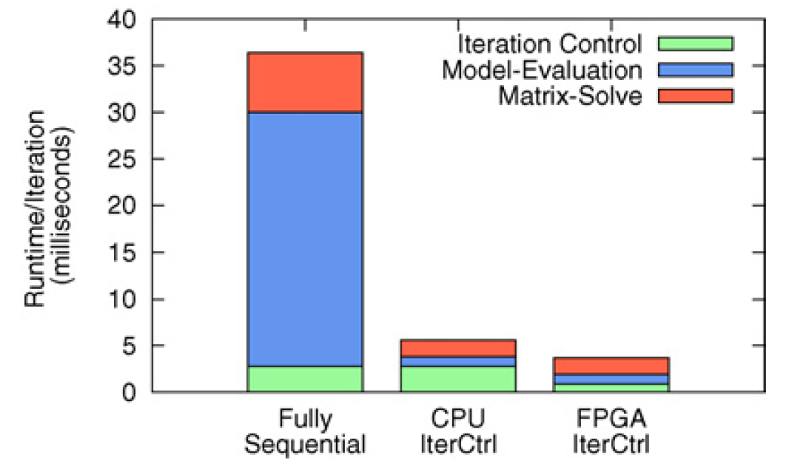
Parallelism Controller?
Could leave sequential
For some designs, becomes the bottleneck once others accelerated
Has internal parallelism in condition evaluation
  T=T_{modeleval}/S₁+(T_{matsolve})/S₂+T_{ctrl}

Slide 52
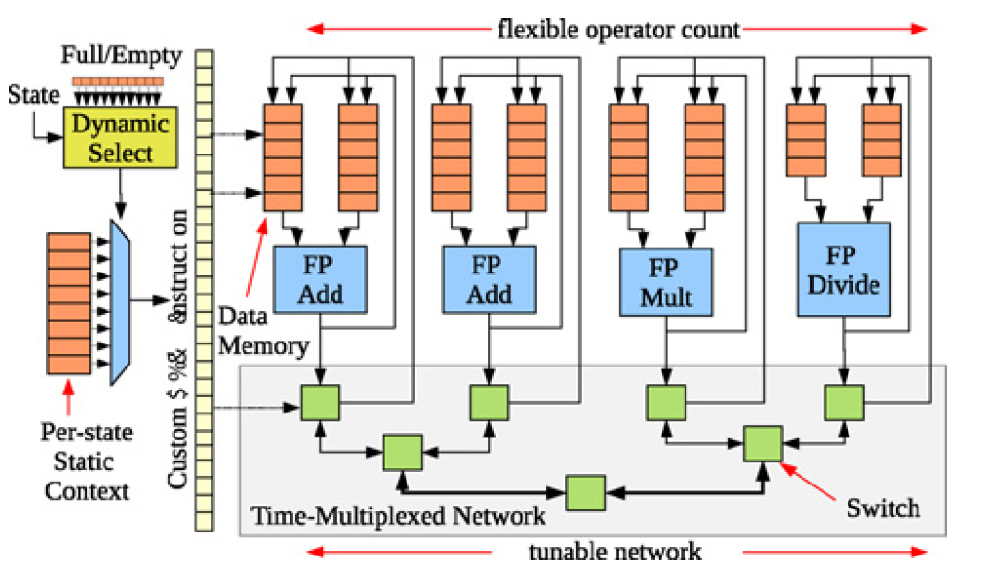
Parallelism Controller
Customized datapath controller
T_{seqctrl}=N_{add}+N_{mul}+10*N_{divide}
T_{vliwctrl}=Max(N_{add}/2,N_{mul},10*N_{divide})

Slide 53
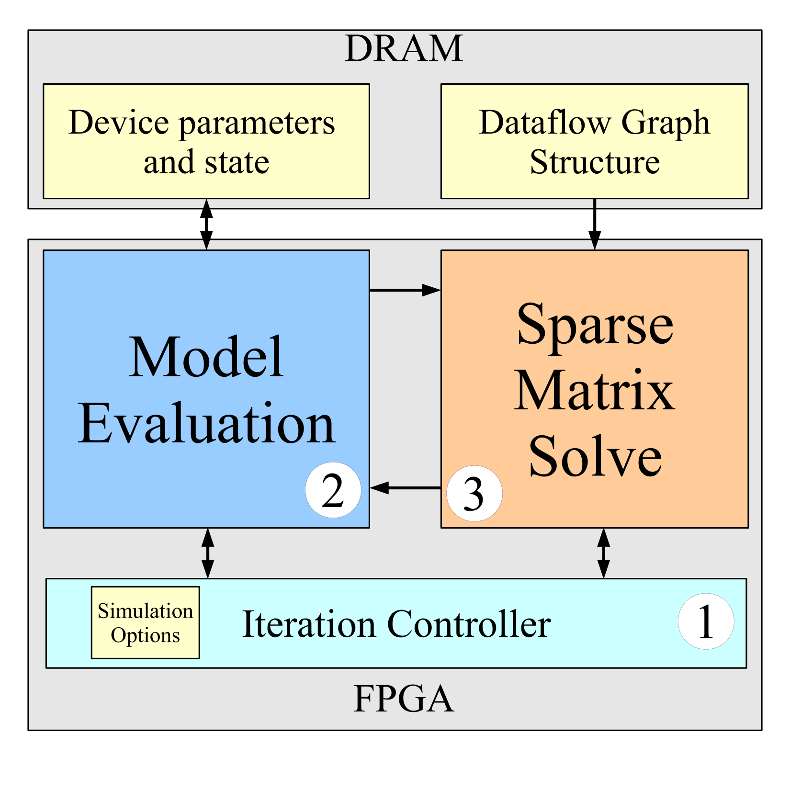
Single-Chip Solution

Slide 54
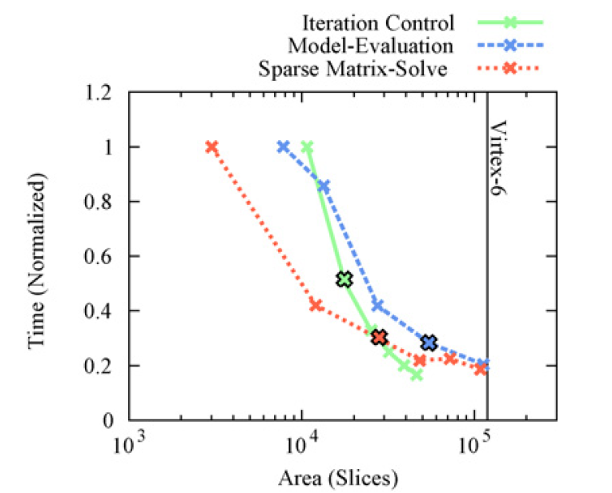
Area-Time for Each
[1 Slice = 4 LUTs]

Slide 55
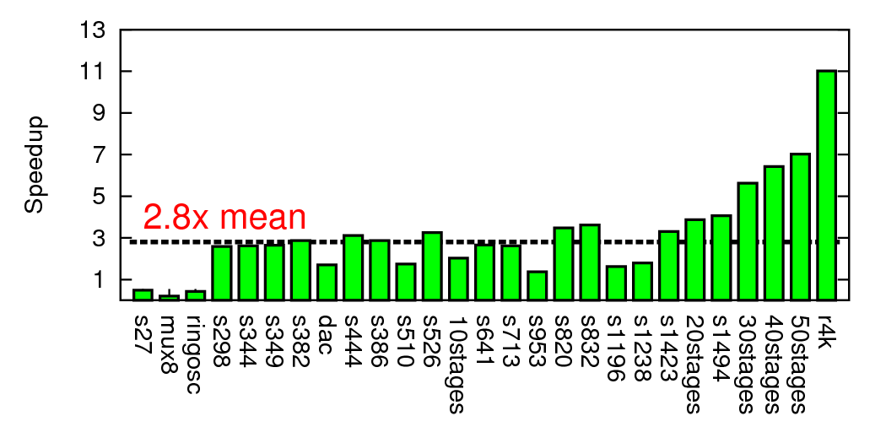
Composite Speedup

Slide 56
Modern SoC

Slide 57
Class Components

Slide 58
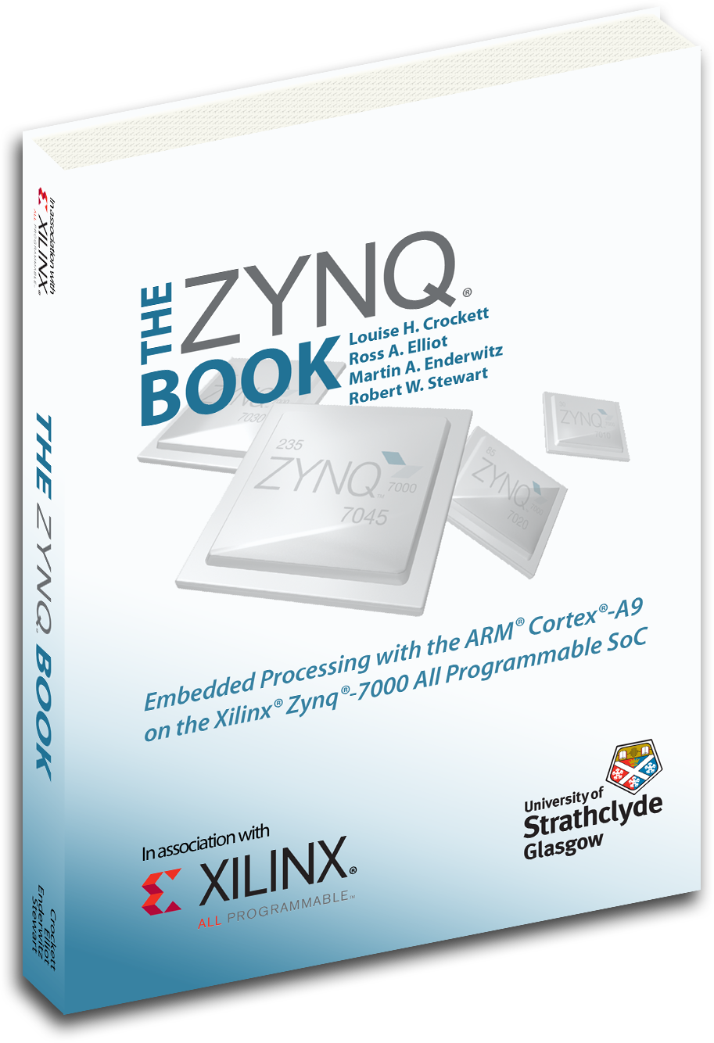
Class Components
Lecture (incl. preclass exercise)
  Slides on web before class
    (you can print if want a follow-along copy)
  N.B. I encourage class participation
    Attend Synch recording; Questions (“warm” calls)
Reading [~1 required paper/lecture]
  online: Canvas, IEEE, ACM, also ZynqBook,
  Parallel Programming for FPGAs
Homework
  (1 per week due F5pm Eastern)
Project – open-ended (~6 weeks)
Note syllabus, course admin online

Slide 59
First Half
Quickly cover breadth
Metrics, bottlenecks
Memory
Parallel models
SIMD/Data Parallel
Thread-level parallelism
Spatial, C-to-gates
Line up with homeworks

Slide 60
Second Half
Use everything on project
Schedule more tentative
  Adjust as experience and project demands
Going deeper
Real-time
Reactive
Memory
Networking
Energy
Scaling
Chip Cost
Verification

Slide 61
Teaming
HW in Groups of 2
HW: we assign
Individual assignment writeup
Project in Groups of 3
Project: you propose, we review
  Most portions group writeup
  Few components individual writeup

Slide 62
Office & Lab Hours
Andre: T 4:15pm—5:30pm Zoom
  See canvas
Syed:
  First: Thursday (tomorrow) 10am
  Make sure learning-from up to date
  Make sure on piazza will poll

Slide 63
C Review
Course will rely heavily on C
  Program both hardware and software in C
HW1 has some C warmup problems
Syed will hold C review
  on Sept. 8th, 5:30pm
  (before our next class meeting since Monday 9/7 is Labor day)

Slide 64
Preclass Exercise
Motivate the topic of the day
  Introduce a problem
  Introduce a design space, tradeoff, transform
Available before lecture
  (only available for 24-48 hours; download)
  Should work before lecture starts
Do use calculator
  Will be numerical examples

Slide 65
Synchronous Recording Timeline
Start Zoom before 10:30am
Start lecture at 10:35am
Lecture until 11:55am
(most days) stay for remaining questions
Post lecture to canvas later in day

Slide 66
Feedback
Will have anonymous feedback google forms for each lecture
  Clarity?
  Speed?
  Vocabulary?
  General comments
Linked on syllabus
Todays: https://forms.gle/qMuup5pLkwtp187x5

Slide 67
Policies
Canvas turn-in of assignments
No handwritten work
Due on time
  Individual assignments only
    3 free late days total
Collaboration
  Tools – allowed
  Designs – limited to project teams as specified on assignments
See web page

Slide 68
Admin
Your action:
  Find course web page
    Read it, including the policies
    Find Syllabus
      Find homework 1
      Find lecture slides
        Will try to post before lecture
      Find reading assignments
  Find reading for lecture 2 on canvas and web
    …for this lecture if you haven’t already
  Find/join piazza group for course

Slide 69
Logistics
Will need SD Card writer for HW7+
  (can get $<10 on amazon.com)

Slide 70
Big Ideas
Programmable Platforms
  Key delivery vehicle for innovative computing applications
  Reduce TTM (Time-to-Market), risk
  More than a microprocessor
  Heterogeneous, parallel
Demand hardware-software codesign
  Soft view of hardware
  Resource-aware view of parallelism

Slide 71
Questions?

