Slide 1

ESE532:
System-on-a-Chip Architecture
Day 12: October 14, 2020
Data Movement
(Interconnect, DMA)

Slide 2
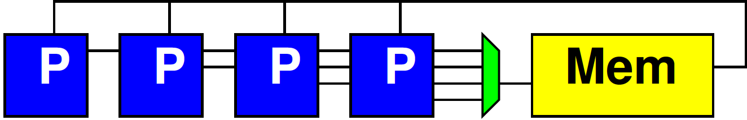
Preclass 1
N processors
Each: 1 read, 10 cycle compute, 1 write
Memory: 1 read or write per cycle
How many processors can support before saturate memory capacity?

Slide 3
Schedule Memory Port
12 | 13 | 14 | 15 | 16 | 17 | 18 | 19 | 20 | 21 | 22 | 23 | 24 | 25
P1.1 write | P1.2 read | P2.1 write | P2.2 read | P3.1 write | P3.2 read | P4.1 write | P4.2 read | P5.1 write | P5.2 read | P6.1 write | P6.2 read | P1.2 write | P1.3 read
 |  | P1 compute f on 2nd iteration
 |  |  |  | P2 compute f on 2nd iteration

Slide 4
Bottleneck
Sequential access to a common memory can become the bottleneck

Slide 5
Previously
Want data in small memories
  Low latency, high bandwidth
FPGA has many memories all over fabric

Slide 6
Embedded Memory in FPGA
Logic
Cluster
Memory
Bank
Memory
Frequency
ZU3EG (Ultra96) has 216 36Kb BRAMs

Slide 7
Previously
Want data in small memories
  Low latency, high bandwidth
FPGA has many memories all over fabric
Want C arrays in small memories
  Partitioned so can perform enough reads (writes) in a cycle to avoid memory bottleneck

Slide 8
Today
Interconnect Infrastructure
Peripherals (Part 2)
Data Movement Threads (Part 3)
DMA -- Direct Memory Access (Part 4)

Slide 9
Message
Need to move data
Shared interconnect to make physical connections
Useful to move data as separate thread of control
  Dedicating a processor is inefficient
  Useful to have dedicated data-movement hardware: Direct Memory Access (DMA)

Slide 10
Memory and I/O Organization
Architecture contains
  Large memories
    For density, necessary sharing
  Small memories local to compute
    For high bandwidth, low latency, low energy
  Peripherals for I/O
Need to move data
  Among memories and I/O
    Large to small and back
    Among small
    From Inputs, To Outputs

Slide 11
Term: Peripheral
“On the edge (or perhiphery) of something”
Peripheral device – device used to put information onto or get information off of a computer
  E.g.
    Keyboard, mouse, modem, USB flash drive, …

Slide 12
Programmable SoC
UG1085
Xilinx
UltraScale
Zynq
TRM
(p27)

Slide 13
Memory and I/O Organization
Architecture contains
  Large memories
    For density, necessary sharing
  Small memories local to compute
    For high bandwidth, low latency, low energy
  Peripherals for I/O
Need to move data
  Among memories and I/O
    Large to small and back
    Among small
    From Inputs, To Outputs

Slide 14
How move data?
Abstractly, using stream links.
Connect stream between producer and consumer.
Ideally: dedicated wires

Slide 15
Dedicated Wires?
What might prevent us from having dedicated wires between all communicating units?

Slide 16
Making Connections
Cannot always be dedicated wires
  Programmable
  Wires take up area
  Don’t always have enough traffic to consume the bandwidth of point-to-point wire
  May need to serialize use of resource
    E.g. one memory read per cycle
  Source or destination may be sequentialized on hardware

Slide 17
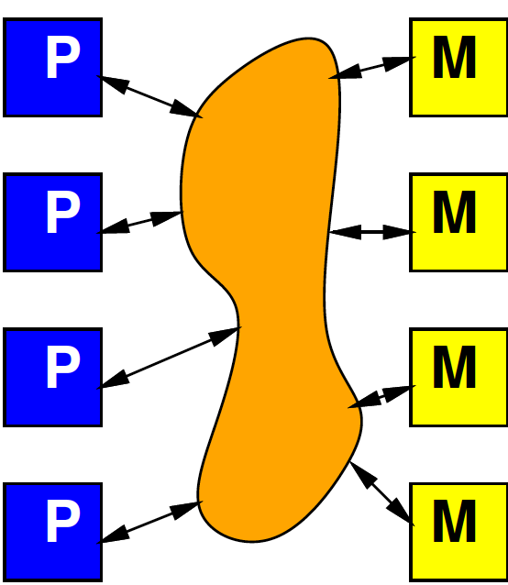
Model
Programmable, possibly shared interconnect

Slide 18
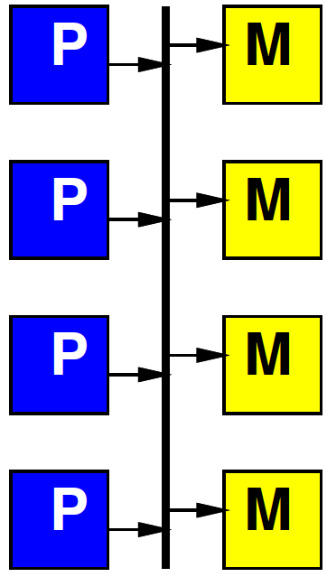
Simple Realization
Shared Bus
Write to bus with
address of destination
When address match,
take value off bus
Pros?
Cons?

Slide 19
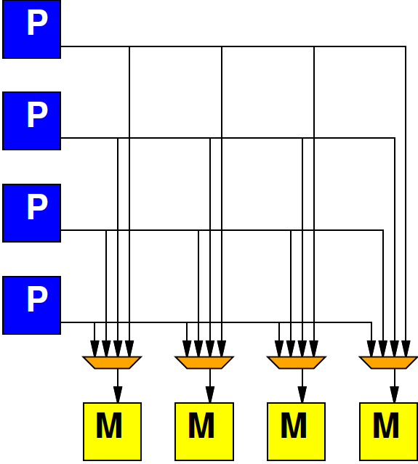
Alternate: Crossbar
Provide programmable connection between all sources and destinations
Any destination can be connected to any single source

Slide 20
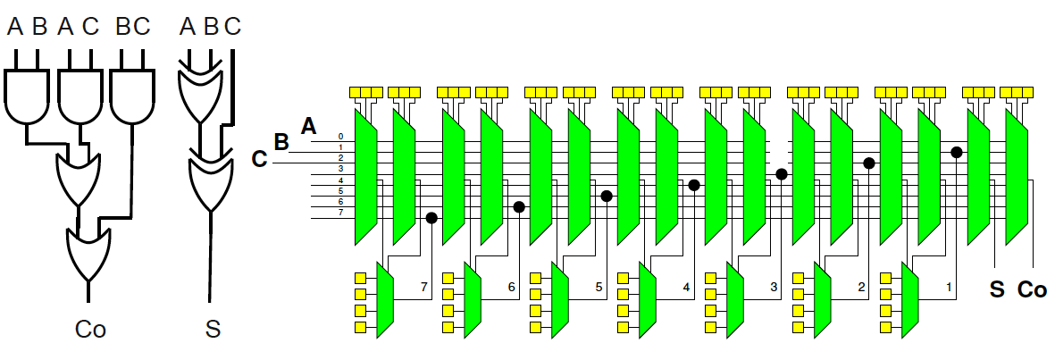
Simplistic FPGA
(illustrate possibility)
Day 8
Every LUT input has a mux
Every such mux has m=(N+I) inputs
  An input for each LUT output (N 2-LUTs)
  An input for each Circuit Input (I Circuit inputs)
Each Circuit Output has an m-input mux

Slide 21
Alternate: Crossbar
Provide programmable connection between all sources and destinations
Any destination can be connected to any single source

Slide 22
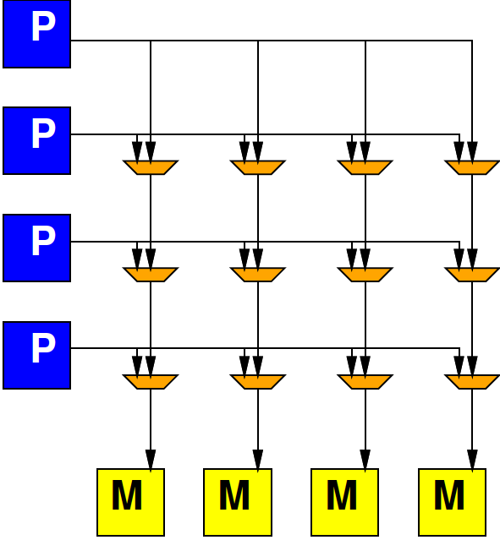
Crossbar

Slide 23
Preclass 2
K-input, O-output Crossbar
How many 2-input muxes?

Slide 24
Crossbar
Provides high bandwidth
  Minimal blocking
Costs large amounts of area
  Grows fast with inputs, outputs

Slide 25
General Interconnect
Generally, want to be able to parameterize designs
Here: tune area-bandwidth
  Control how much bandwidth provide

Slide 26
Mux-based Bus

Slide 27
Multiple Busses
Think of crossbar as one bus per output
Simple bus is one bus total

Slide 28
Interconnect
How might get design points between bus and crossbar?
How could reduce number
  Inputs to crossbar?
  Outputs from crossbar?

Slide 29
Share Crossbar Outputs
Group set of outputs together on a bus

Slide 30
Share Crossbar Inputs
  Group number of inputs together on an input port to crossbar

Slide 31
Delay
Delay proportional to distance
Pipeline bus to keep cycle time down
  Take many cycles to travel long distance
  …but fewer cycles when distance small
Sometimes call this a ”Ring”

Slide 32
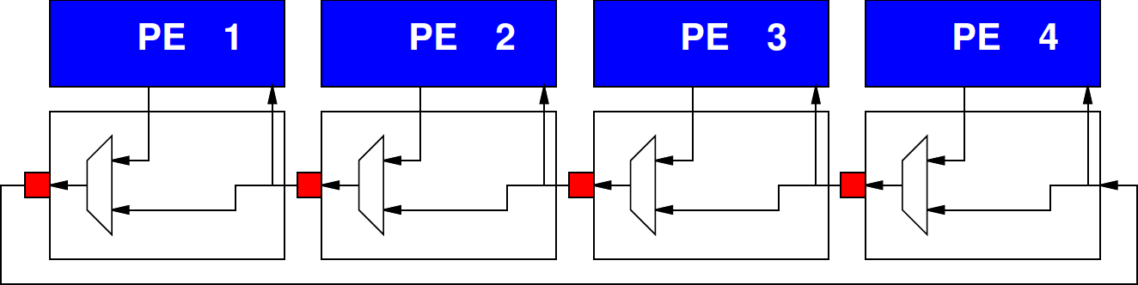
Local Interconnect
How many cycles from:
  PE3 to PE2
  PE3 to PE1
  PE3 to PE4

Slide 33
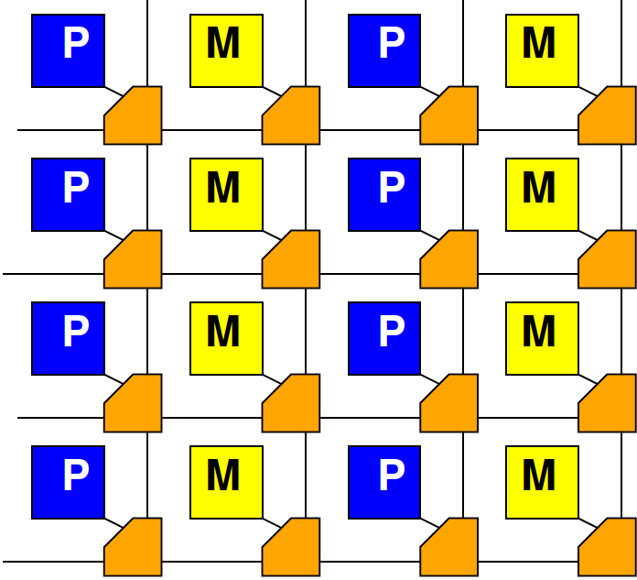
Mesh
Mesh is a set
Of Horizontal
And Vertical
Rings with
Option to switch
H to V

Slide 34
Mesh
Delay Proportional to distance in 2D

Slide 35
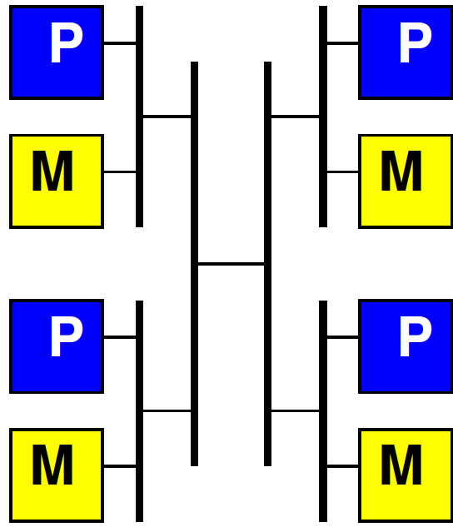
Hierarchical Busses

Slide 36
Interconnect
Will need an infrastructure for programmable connections
Rich design space to tune
area-bandwidth-locality
  Will explore more
  later in course

Slide 37
Peripherals
Part 2

Slide 38
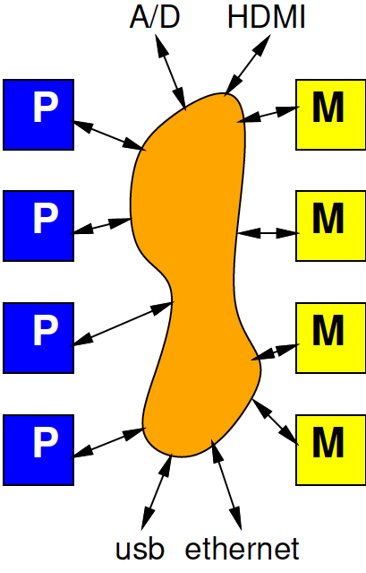
Input and Output
Typical SoC has I/O with external world
  Sensors
  Actuators
  Keyboard/mouse, display
  Communications
Also accessible from interconnect

Slide 39
Programmable SoC
UG1085
Xilinx
UltraScale
Zynq
TRM
(p27)

Slide 40
High Speed I/O
UG1085
Xilinx
UltraScale
Zynq
TRM
(p27)

Slide 41
Masters and Slaves
Two kinds of entities on interconnect
Master – can initiate requests
  E.g. processor that can perform a read or write
Slaves – can only respond to requests
  E.g. memory that can return the read data from a read request

Slide 42
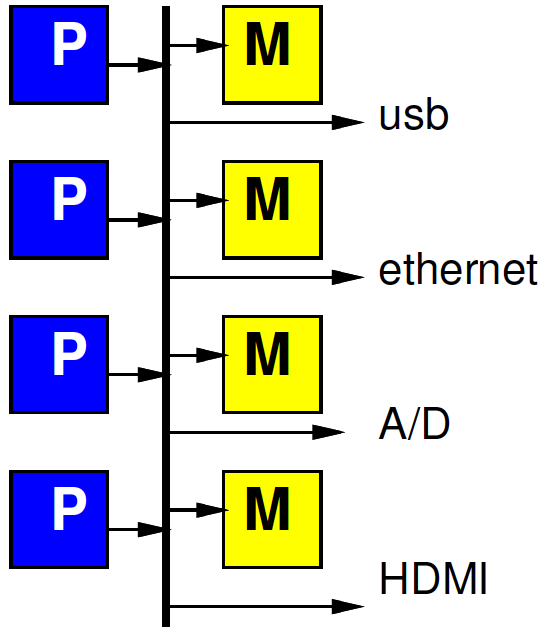
Simple Peripheral Model
Peripherals are slave devices
  Masters can read input data
  Masters can write output data
  To move data, master (e.g. processor) initiates

Slide 43
Simple Peripheral Model
Peripherals are slave devices
  Masters can read input data
  Masters can write output data
  To move data, master (e.g. processor) initiates
Demanding processor touch every data item has some negative consequences

Slide 44
Timing Demands
Must read each input before overwritten
Must write each output within real-time window
Must guarantee processor scheduled to service each I/O at appropriate frequency
How many cycles between 32b input words for 1Gb/s network and 32b, 1GHz processor?
  Consider input data shifted into register 1b per ns
  Must read out 32b register before overwritten

Slide 45
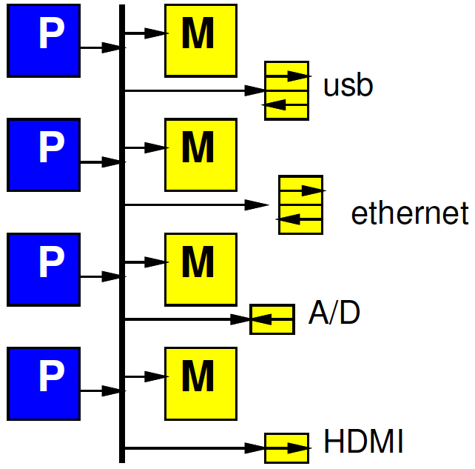
Refine Model
Give each peripheral local FIFO
Processor must still move data
How does this change requirements and impact?

Slide 46
Long Latency Memory Operations
Part 3

Slide 47
Day 3
Large memories are slow
  Latency increases with memory size
Distant memories are high latency
  Multiple clock-cycles to cross chip
  Off-chip memories even higher latency

Slide 48
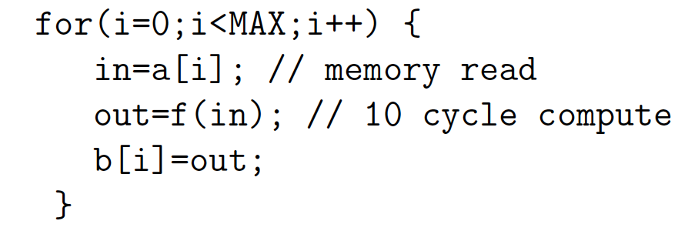
Day 3, Preclass 2
10 cycle latency to memory
If must wait for data return, latency can degrade throughput
10 cycle latency + 10 op + (assorted)
  More than 20 cycles / result

Slide 49
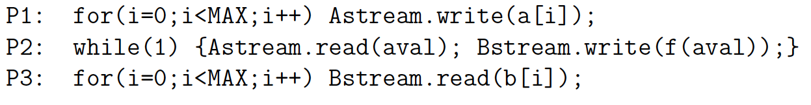
Preclass 3
Throughput using 3 threads on 3 processors: P1, P2, P3?

Slide 50
Fetch (Write) Threads
Potentially useful to move data in separate thread
Especially when
  Long (potentially variable) latency to data source (memory)
Useful to split request/response

Slide 51
DMA
Part 4
Direct Memory Access

Slide 52
Preclass 4a

Slide 53
Preclass 4
How much hardware?
  Counter bits?
  Registers?
  Comparators?
  Control Logic gates? (4cd)
Compare to MicroBlaze
  small RISC Processor optimized for Xilinx
  minimum config 630 6-LUTs

Slide 54
Observe
Modest hardware can serve as data movement thread
  Much less hardware than a processor
  Offload work from processors
Small hardware allow peripherals to be master devices on interconnect

Slide 55

DMA
Direct Memory Access (DMA)
“Direct” – inputs (and outputs) don’t have to be indirectly handled by the processor between memory and I/O
I/O unit directly reads/write memory

Slide 56
DMA
Direct Memory Access (DMA)
Peripheral as Master
  Can write directly into (read from) memory
  Saves processor from copying
  Reduces demand to schedule processor
  to service

Slide 57
DMA Engine
Data Movement Thread
  Specialized Processor that moves data
Act independently
Implement data movement
Can build to move data between memories (Slave devices)
E.g., Implement P1, P3 in Preclass 3

Slide 58
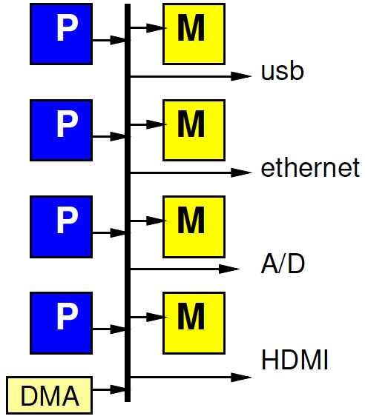
DMA Engine

Slide 59
Programmable DMA Engine
What copy from?
How much?
Where copy to?
Stride?
What size data?
Loop?
Transfer Rate?

Slide 60
Multithreaded DMA Engine
One copy task not necessarily saturate bandwidth of DMA Engine
Share engine performing many transfers (channels)
Separate transfer state for each
  Hence thread (or channel)
Swap among threads
  Simplest: round-robin:
    1, 2, 3, .. K, 1, 2, 3, .. K, 1, ….

Slide 61
Programmable SoC
UG1085
Xilinx
UltraScale
Zynq
TRM
(p27)

Slide 62
Hardwired and Programmable
Zynq has hardwired DMA engine
  8 channels
Also build data movement engines (Data Movers) in FPGA fabric
UG1085
Xilinx
UltraScale
Zynq
TRM
Ch. 10
(p519)

Slide 63
Example
Networking Application
Header on processor
Payload (encrypt, checksum) on FPGA
DMA from ethernet→main memory
DMA main memory→BRAM
Stream between payload components
DMA from chksum to ethernet out
header
Payload encrypt
chksum
ethernet
ethernet

Slide 64
AXI
Advanced eXtensible Interface
  Originally developed by ARM
  On-chip communication bus standard
  Particular communication protocol
Full AXI
  Read/write operations with bursts
    Burst = single address + length
  Separate send/receive data channels
AXI-S – for streaming connections
AXI-lite – simpler, not burst

Slide 65
Programmable SoC
UG1085
Xilinx
UltraScale
Zynq
TRM
(p27)

Slide 66
Programmable SoC
AXI Channels
128b wide
@ 333 MHz
=5.3GB/s
Separate
Data in
Data out
Paths
5.3GB/s
Each way

Slide 67
Programmable SoC
AXI Channels
128b wide
@ 333 MHz
=5.3GB/s
Per direction
Per channel
S_ act as
master for PL
(connects to
slave ports
in PS)
M_ as slave
for PL

Slide 68
DMA in Vitis
Vitis/OpenCL demands that we write code to perform DMA of data to and from accelerators in FPGA fabric
We will see specifics on Monday
Have some options to control
  With pragmas
  With choice of data and burst sizes
  Explore HW6

Slide 69
Big Ideas
Need to move data
Shared Interconnect to make physical connections – can tune area/bw/locality
Useful to
  move data as separate thread of control
  Have dedicated data-movement hardware: DMA

Slide 70
Admin
Feedback
Hardware distribution
  Thursday (for those not pick up yesterday)
HW5
  Due Friday, long build
HW6
  Out soon
  Assign so at least one partner has Ultra96

