Slide 1

ESE532:
System-on-a-Chip Architecture
Day 23: November 23, 2020
Energy

Slide 2
Today
Energy
Part 1
  Today’s bottleneck
  What drives
Part 2: Architecture and Energy
  Processors, FPGAs, accelerators
Part 3:
  How does parallelism impact energy?

Slide 3
Message
Energy dominates
  Including limiting performance
Make memories small and wires short
  Small memories cost less energy per read
Accelerators reduce energy
  Compared to processors
Can tune parallelism to minimize energy
  Typically, the more parallel implementation costs less energy

Slide 4

Energy
Growing domain of portables
  Less energy/op → longer battery life
Global Energy Crisis
Limit to the power our computers/devices can dissipate (we can provide)
  Reduce E/op
    → increase compute when power limited
  Scaling
    Power density not transistors limit sustained ops/s
  Server rooms
    Cost-of-ownership not dominated by Silicon
      Cooling, Power bill

Slide 5
Preclass 1--4
200K gates/mm²
5*10⁻¹⁵ J/gate switch
Gates on 1cm²
Energy to switch all?
Power at 1GHz?
Fraction can switch with 10W/cm² power budget?

Slide 6
Challenge: Power

Slide 7
Origin of Power Challenge
Limited capacity to remove heat
  ~100W/cm² force air
  1-10W/cm² ambient
Transistors per chip grow at Moore’s Law rate = (1/F)²
Energy/transistor must decrease at this rate to keep constant power density
P/tr ∝ CV²f
E/tr ∝ CV²
  …but V scaling more slowly than F

Slide 8
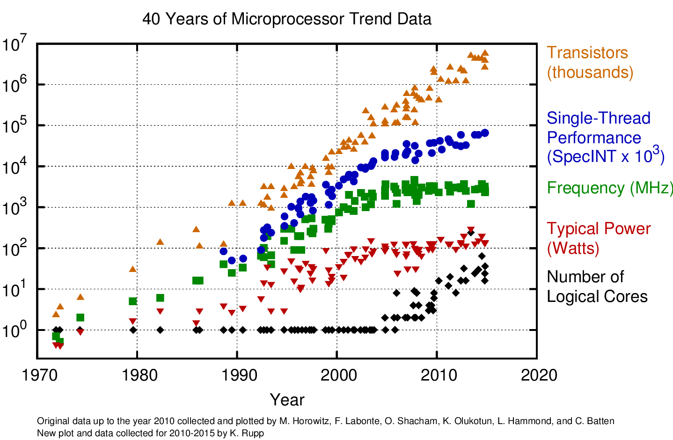

Slide 9
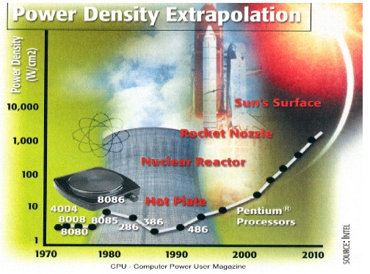
Intel Power Density

Slide 10
Impact
Power Limits Integration
Source: Carter/Intel
10

Slide 11
Impact
Power density is limiting scaling
  Can already place more transistors on a chip than we can afford to turn on!
Power is potential challenge/limiter for all future chips.
  Only turn on small percentage of transistors?
  Operate those transistors at much slower frequency?

Slide 12
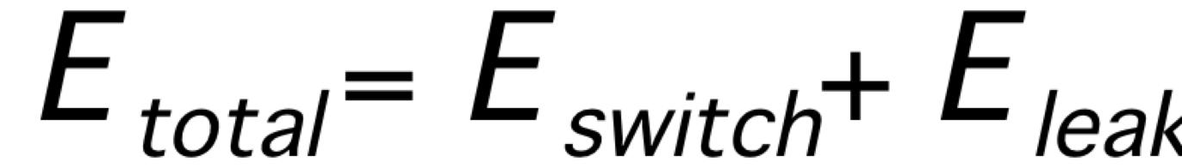
Energy
Dynamic – Switching Energy (Power)
Static – Leakage Energy (Power)

Slide 13
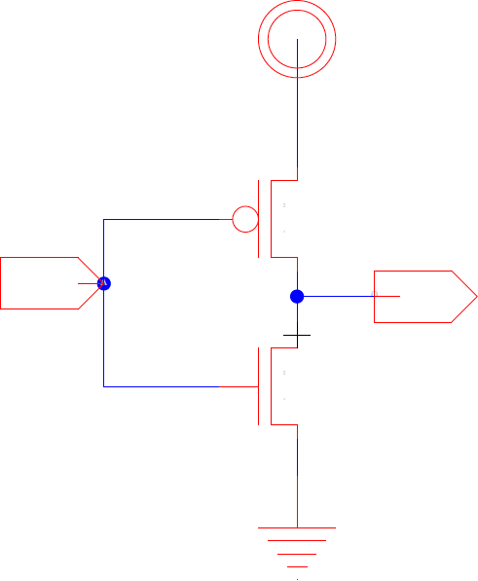
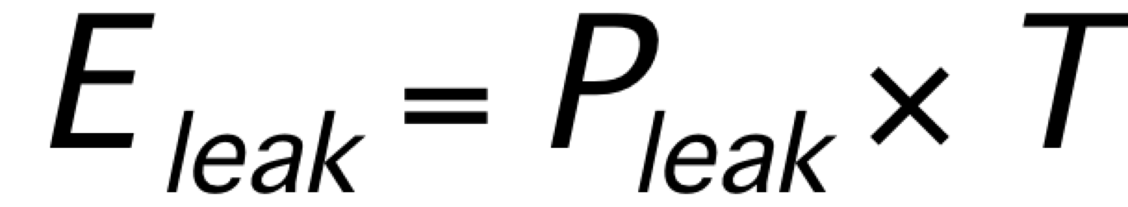
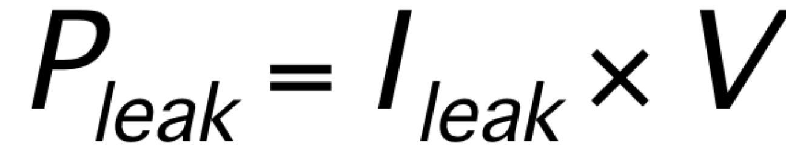
Leakage Energy
(Static Energy, Power)
I_{leak}
  Subthreshold leakage
  (possibly) Gate-Drain leakage

Slide 14
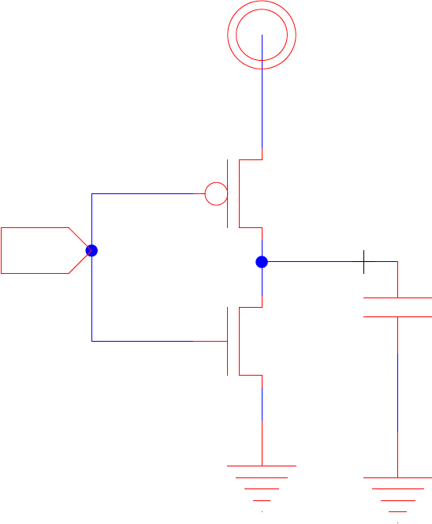
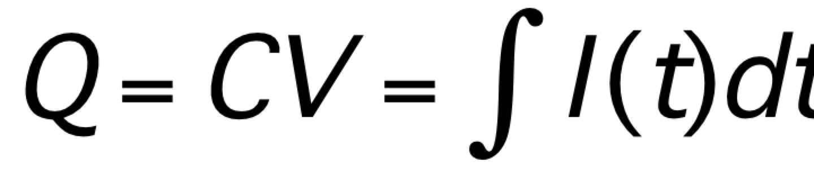
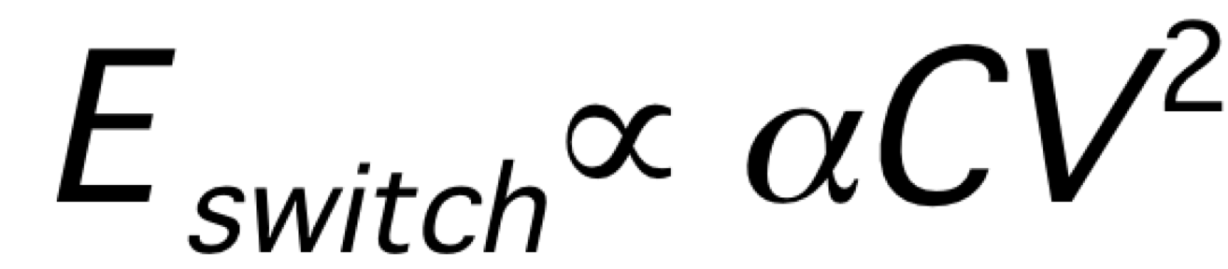
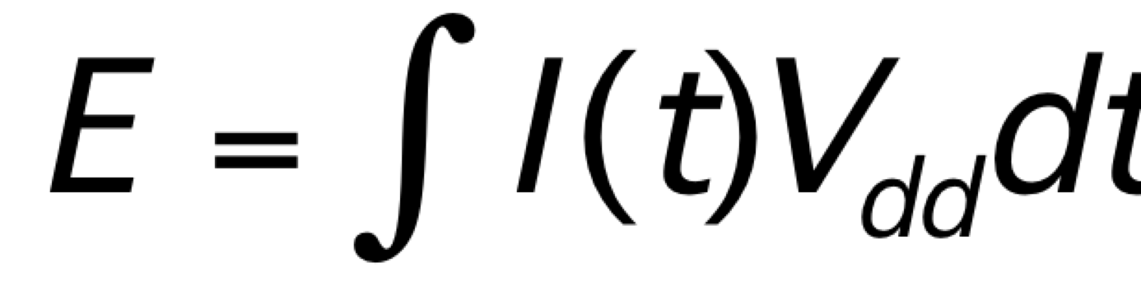
Switching Energy
(Dynamic Energy, Power)
Charge/discharging gate and load
C – driven by architecture
V – today, driven by variation, aging
α – probability will switch;
driven by architecture, coding/information

Slide 15
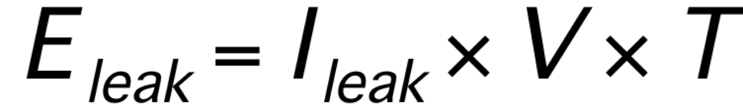
Energy

Slide 16
Voltage
We can set voltage
Reducing voltage
  Reduces E_{switch}
  Increases delay → cycle time, T
  Increases leakage

Slide 17
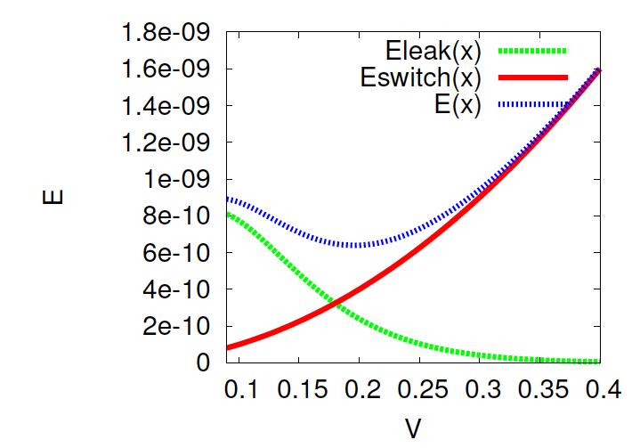
Total Energy vs. Voltage

Slide 18
Switching Energy
C – driven by architecture
  Also impacted by variation, aging
V – today, driven by variation, aging
α – probably a node will switch;
driven by architecture, information

Slide 19
Data Dependent Activity
Consider an 8b counter
  How often do each of the following switch?
    Low bit?
    High bit?
  Average switching across all 8 output bits?
Assuming random inputs
  Activity at output of xor4?
    Hint: probability of output of xor4 being 0? 1?
  Activity at output of nand4?

Slide 20
Gate Output Switching
(random inputs)
Prev.
Next
0
Pswitch=P(0@i)*P(1@i+1)
+P(1@i)*P(0@i+1)
1

Slide 21
Conclude
Not all gates (output nodes) switch at same rate

Slide 22
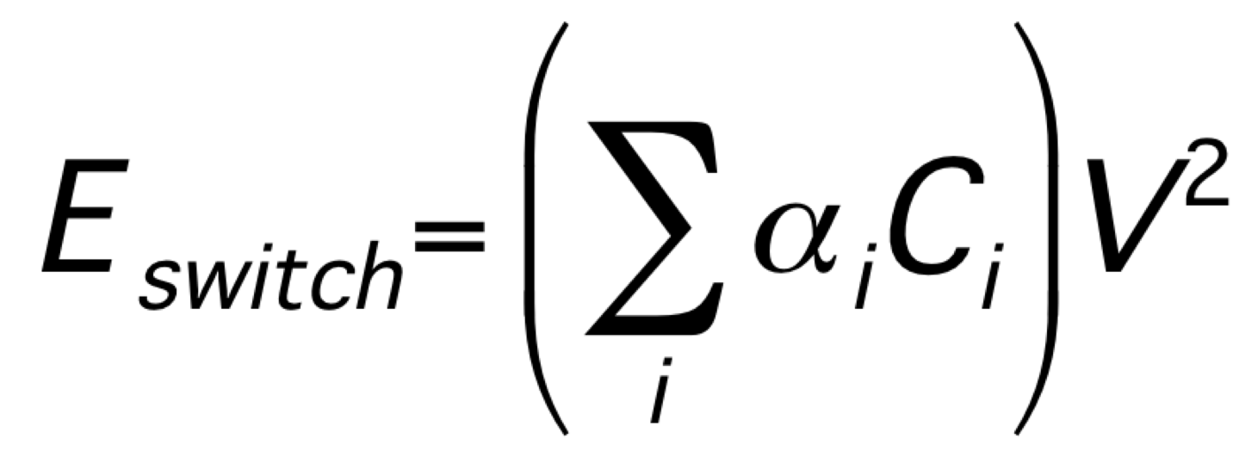
Switching Energy
C_{i} == capacitance driven by each gate (including wire)

Slide 23
Switching Rate (α_{i}) Varies
Different logic (low/high bits, gate type)
Different usage
  Gate off unused functional units
Data coded
Entropy in data
Average α 5--15% plausible

Slide 24
Switching Energy
C – driven by architecture
V – today, driven by variation, aging
α – driven by architecture, information

Slide 25
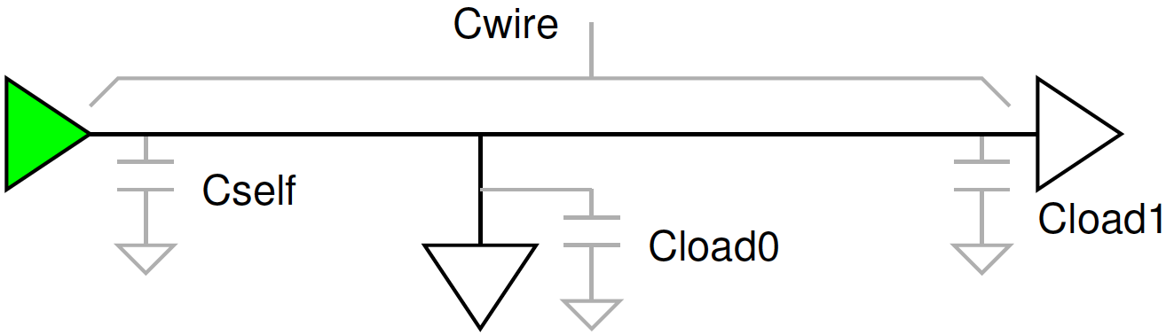

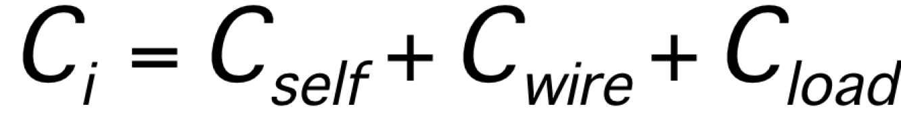
Wire Driven
Gates drive
  Self
  Inputs to other gates
  Wire routing between self and other gates
Typically:

Slide 26
Wire Capacitance
How does wire capacitance relate to wire length?

Slide 27
Wire Capacitance
C=εA/d = εW*L_{wire}/d = C_{unit} * L_{wire}
Wire capacitance is linear in wire length
E.g. 1.7pF/cm (preclass)
Remains true if buffer wire
  Add buffered segment at fixed lengths
  [different use of word buffer than normal in this class – here we’re talking about adding a repeater to perform electrical signal restoration]

Slide 28
Wire Driven Implications
Care about locality
  Long wires are higher energy
  Producers near consumers
  Memories near compute
  Esp. for large α_{i}’s
Care about size/area
  Reduce (worst-case) distance must cross
Care about minimizing data movement
  Less data, less often, smaller distances
Care about size of memories

Slide 29
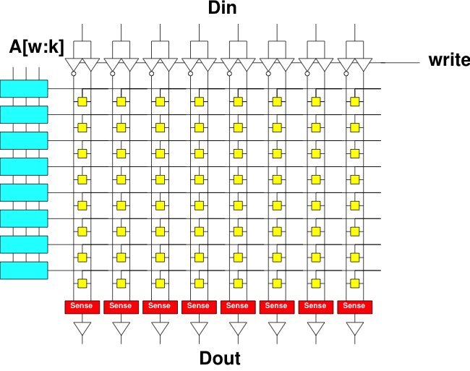
Preclass 5
Primary switching capacitance in wires
C: How does energy of a read grow with capacity (N) of a memory bank?
D: Energy per bit?

Slide 30
Memory Implications
Memory energy can be expensive
Small memories cost less energy than large memories
  Use data from small memories as much as possible
Cheaper to re-use data item from register than re-reading from memory

Slide 31
Architectural Implications
Part 2

Slide 32
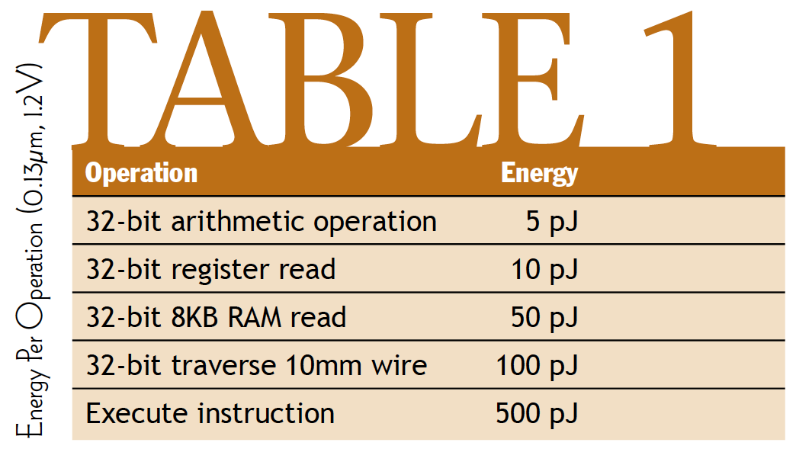
Component Numbers
[Dally, March 2004 ACM Queue]

Slide 33
Component Numbers
Processor instruction 100x more than arithmetic
Register read 2x
RAM read 10x
Why processor instruction > arith operation?
[Dally, March 2004 ACM Queue]

Slide 34
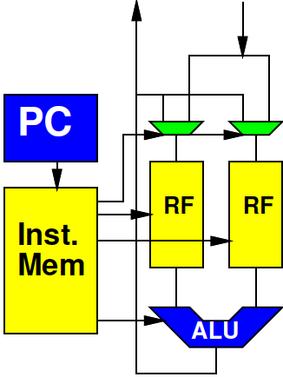
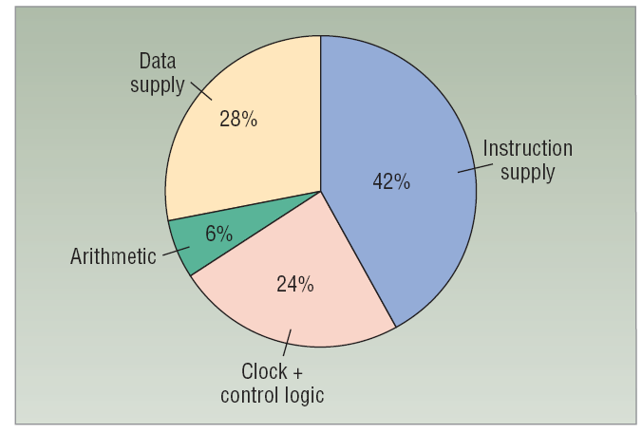
Processors and Energy
Very little into actual computation
Determine and Fetch Instruction
Read and Write data from memories
[Dally et al. /
Computer 2008]

Slide 35
ARM Cortex A9
Estimate find: 0.5W at 800MHz in 40nm
0.5/0.8 x 10⁻⁹ J/instr
~600pJ/instr
Scale to 28nm
  maybe 0.7*600—0.5*600
  300—400pJ/instr ?
Is superscalar w/ Neon, so not as simple a processor as previous example

Slide 36
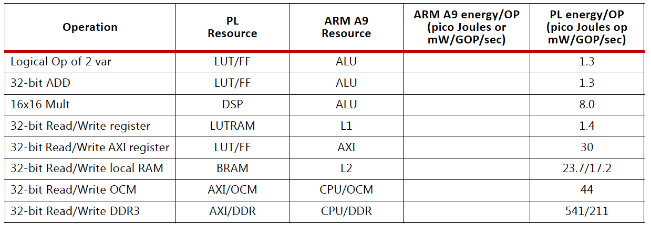
Zynq (7-series, 28nm)
ARM A9 instruction 300—400pJ
ARM A9 L1 cache read 23pJ
Xilinx UG585 – Zynq TRM

Slide 37
Compare
Assume ARM Cortex A9 executes 4x32b Neon vector add instruction for 300pJ
Compare to 32b adds on FPGA?

Slide 38
Compare
Assume ARM Cortex A9 executes 4x16b Neon vector multiply instruction for 300pJ
Compare to 16x16 multiplies on FPGA?

Slide 39
Programmable Datapath
Performing an operation in a pipelined datapath can be orders of magnitude less energy than on a processor
  ARM 300pJ vs. 1.3pJ 32b add
  Even neon 300pJ vs. 4x1.3pJ for 4x32b add
  300pJ vs. 4x8pJ for 4 16x16b multiplies

Slide 40
Zynq
Reading from OCM order of magnitude less than from DRAM
…and BRAM half that
Xilinx UG585 – Zynq TRM

Slide 41
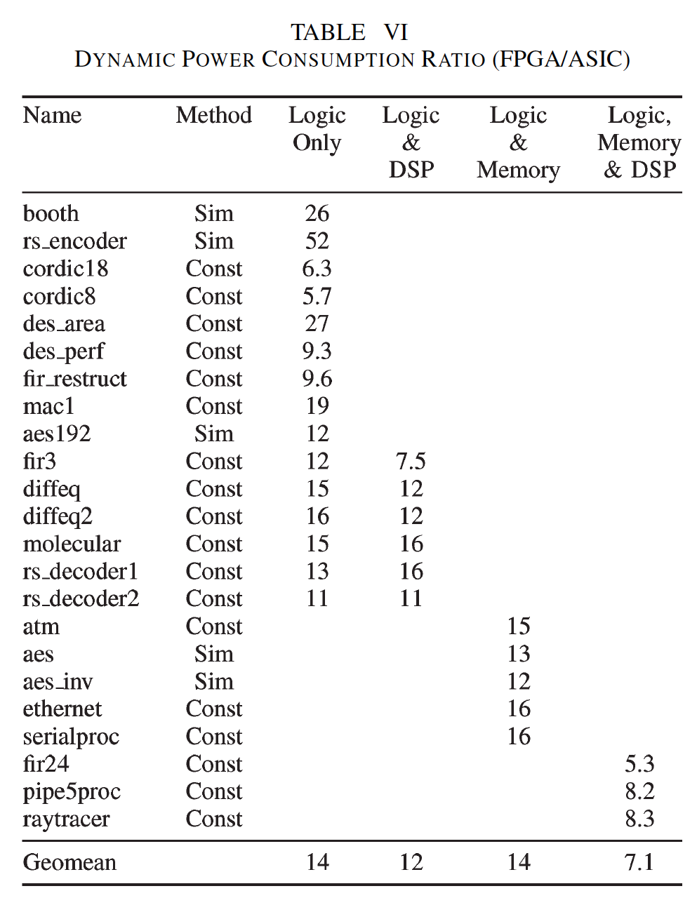
FPGA vs. Std Cell
Energy
90nm
FPGA: Stratix II
STMicro CMOS090
[Kuon/Rose TRCADv26n2p203--215 2007]

Slide 42
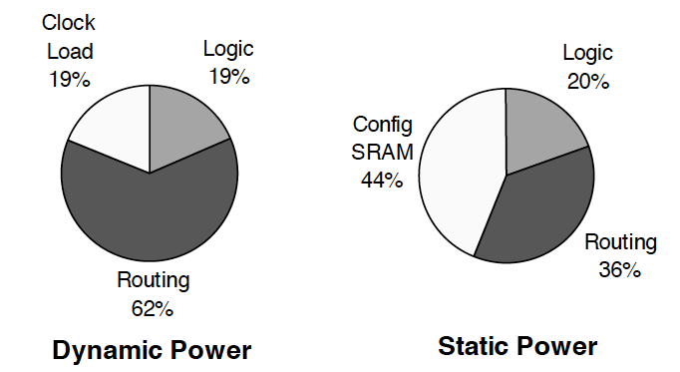
FPGA Disadvantage to Custom
Interconnect Energy
  Long wires → more capacitance → more E
  Switch Energy is an overhead
[Tuan et al./FPGA 2006]

Slide 43
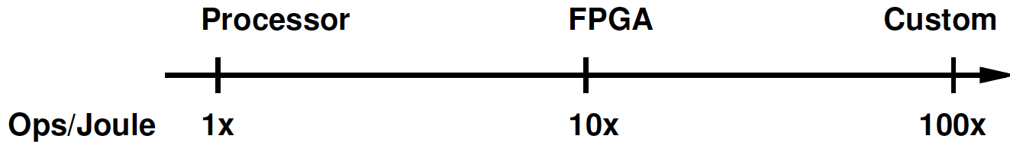
Simplified Comparison
Processor two orders of magnitude higher energy than custom accelerator
FPGA accelerator in between
  Order of magnitude lower than processor
  Order of magnitude higher than custom

Slide 44
Accelerators save Energy
Customized accelerators save energy
  Even when built on FPGA
Recall: can put more transistors on chip than can afford to turn on
Opportunity to spend extra transistors to save energy and increase performance
  Even if don’t use accelerator continuously
Opportunity: Area-energy tradeoff

Slide 45
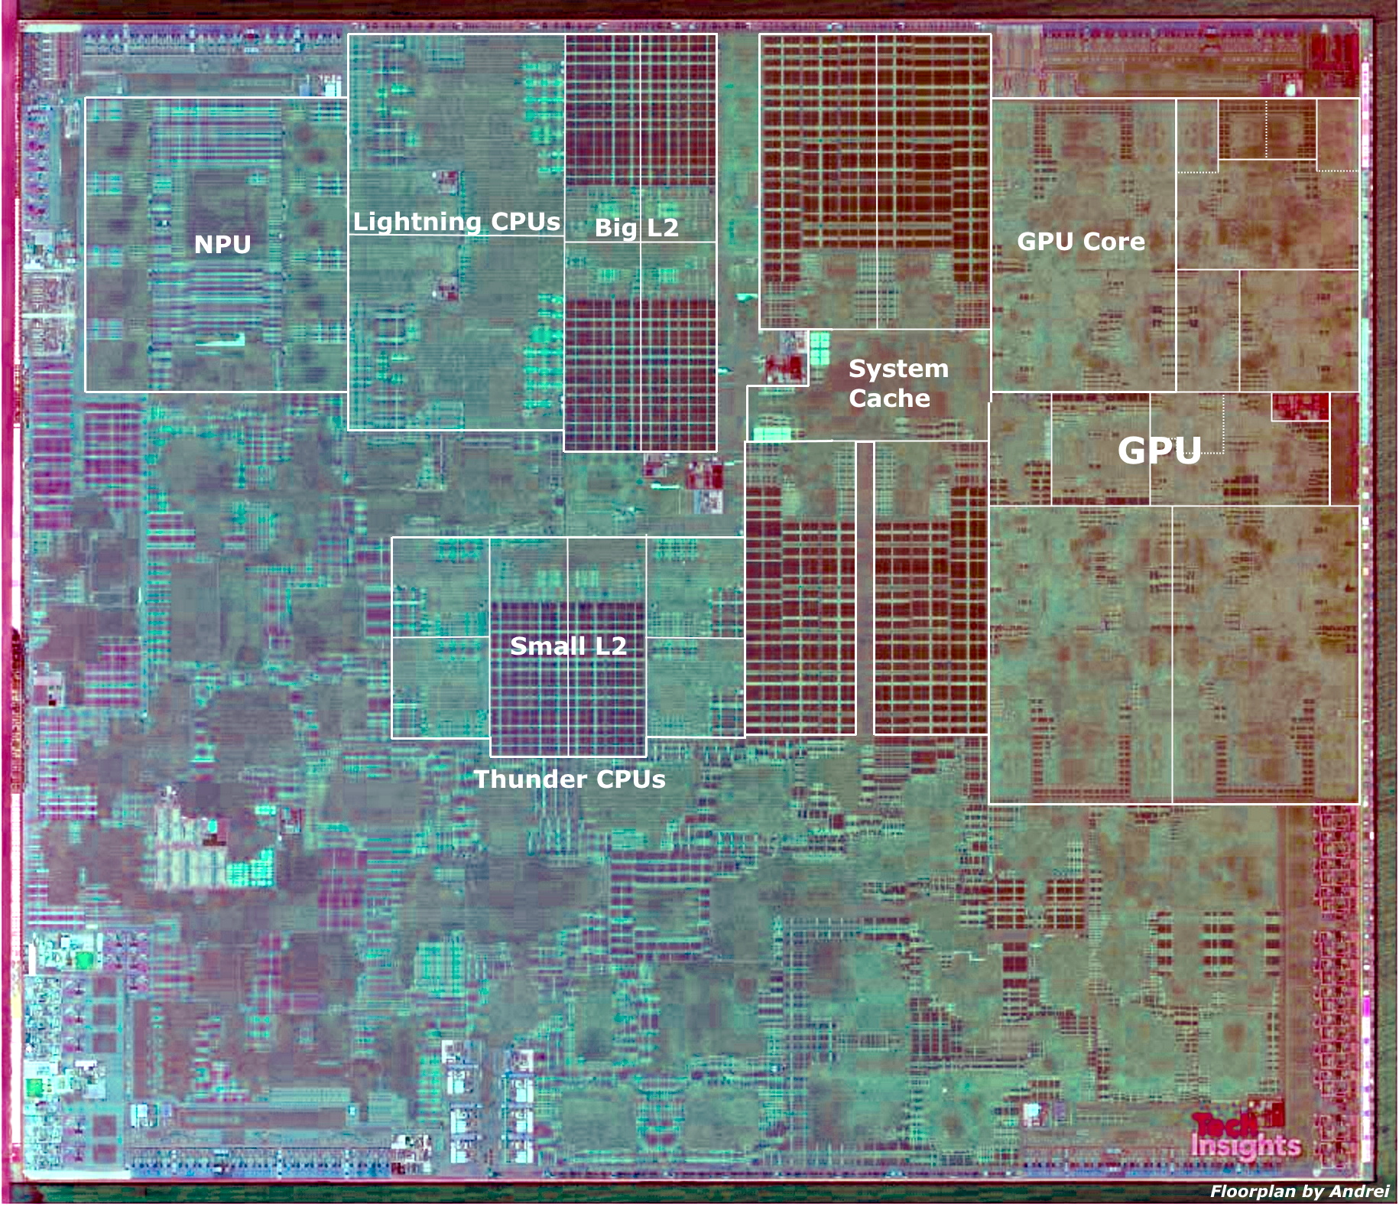
Apple A13 Bionic
98mm², 7nm
8.5 Billion Tr.
iPhone 11 +
6 ARM cores
  2 fast (2.6GHz)
  4 low energy
4 custom GPUs
Neural Engine
  5 Trillion ops/s?

Slide 46
Parallelism and Energy
Part 3

Slide 47
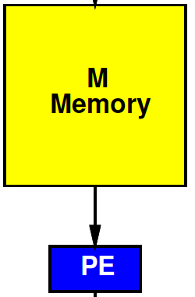
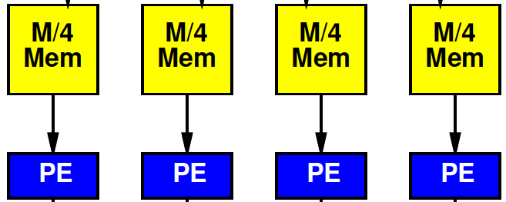
Preclass 6
Energy
  Per read from M=10⁶ memory?
  Per read from 10⁶/4 memory?

Slide 48
Local Consumption
To exploit, we must consume the data local to the memory.

Slide 49
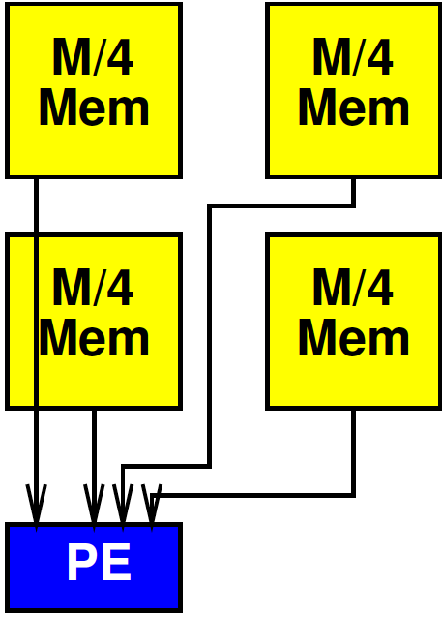
Cheat?
What if we broke the memory into 4 blocks, but still routed to a single processor?
  Hint: Interconnect energy
  reading from top right?

Slide 50
Cheat?
E=Emem(M/4) + 2*sqrt(M/4)*Cwire
(simplify assume 2C_{wire}~= unit)
E=sqrt(M/4) + sqrt(M/4) ≅ sqrt(M)

Slide 51
Cheat?
Near mem = E(M/4)=(1/2) sqrt(M)
Far mem = sqrt(M) [previous slide]
Other two = E(M/4)+sqrt(M/4)*Cwire
= (1/2+1/4)sqrt(M)
Average:
  Sqrt(M)*(1/4)(1/2+2*3/4+1)
  = ¾ sqrt(M)

Slide 52
Exploit Locality
Must consume data near computation

Slide 53
Inter PE Communication
May need to communicate between parallel processing elements [PEs]
(and memories)
Must pay for energy to move data between PEs

Slide 54
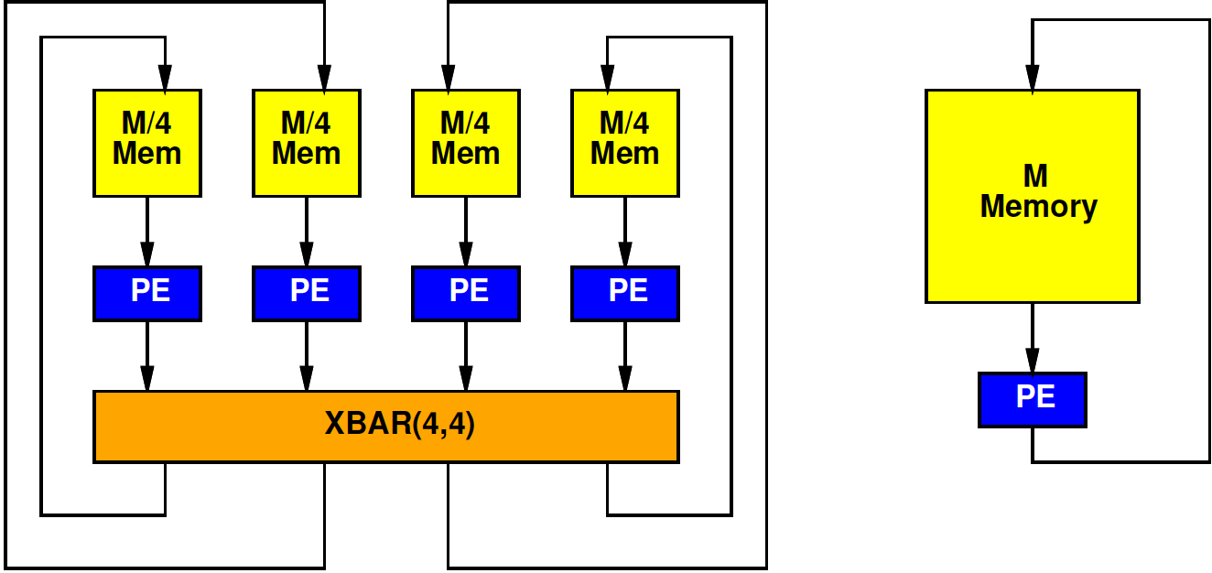
Preclass 7
Energy: Read 4 memories 10⁶/4, route 4x4 crossbar, write 4 10⁶/4 memories?
Energy: 4 reads from 10⁶ memory, 4 writes from 10⁶ memory?

Slide 55
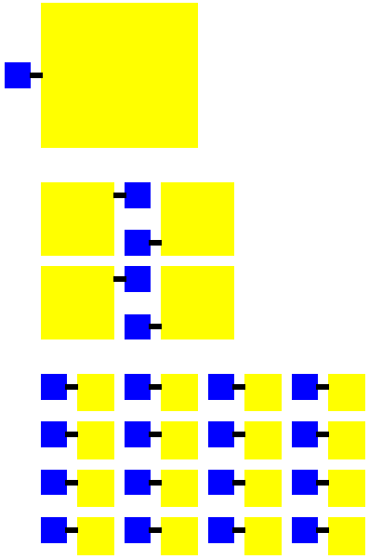
Parallel Larger
More parallel design
  Has more PEs
  Adds interconnect
Total area > less parallel design
  More area → longer wires → more energy in communication between PEs
Could increase energy!

Slide 56
Continuum Question
Where do we minimize total energy?
  Both memory and communication
Design axis P – number of PEs
  What P minimizes energy?

Slide 57
Simple Model
E_{mem}=sqrt(M)
Communication = E_{xbar}(I,O)=4*I*O
P Processors
N total data
Possibly communicate each result to other PEs

Slide 58
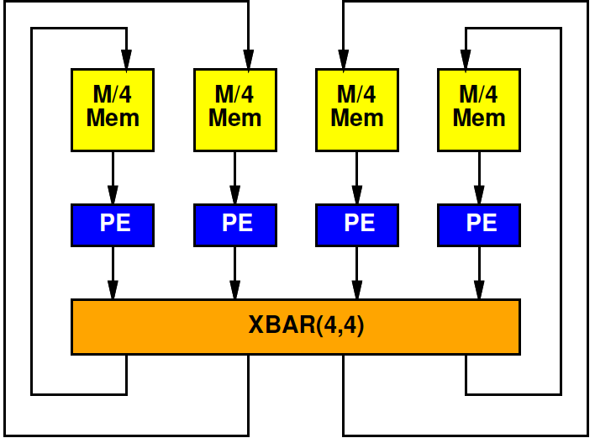
Simple Model: Memory
Divide N data over P memories
E_{mem}=sqrt(N/P)
N total memory operations
Memory energy: N*sqrt(N/P)
Memory energy decrease with P

Slide 59
Simple Model: Communication
Crossbar with P inputs and P outputs
E_{xbar}=4*P*P
Crossbar used N/P times
Crossbar energy: 4*N*P
Communication energy increase with P

Slide 60
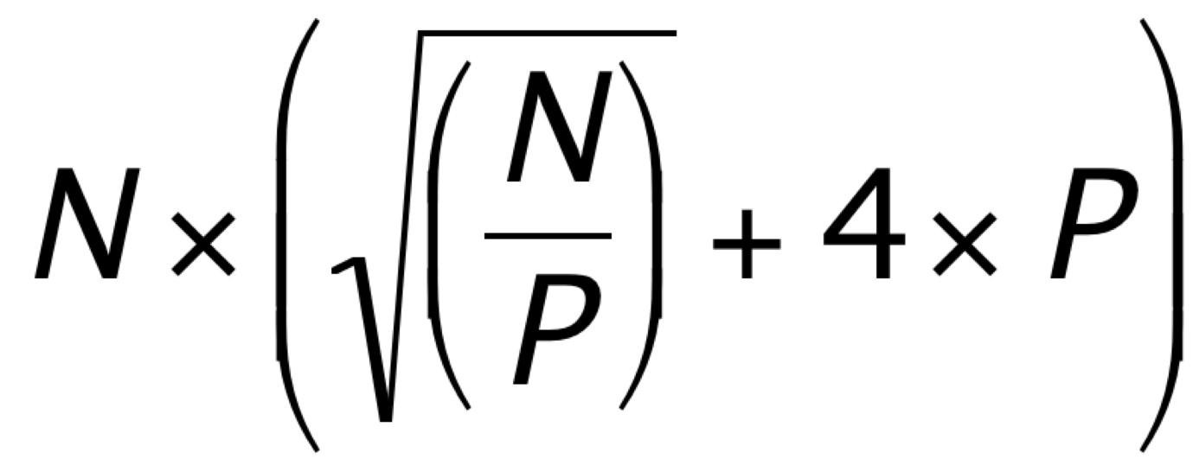
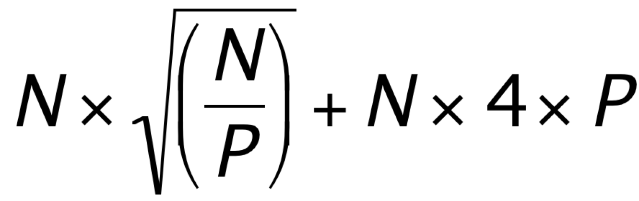
Simple Model

Slide 61
Preclass 8
For N=10⁶
Per operation becomes:

Slide 62
Preclass 8
Energy for:
  P=1
  P=4
  P=100
Energy minimizing P?
  Energy?

Slide 63
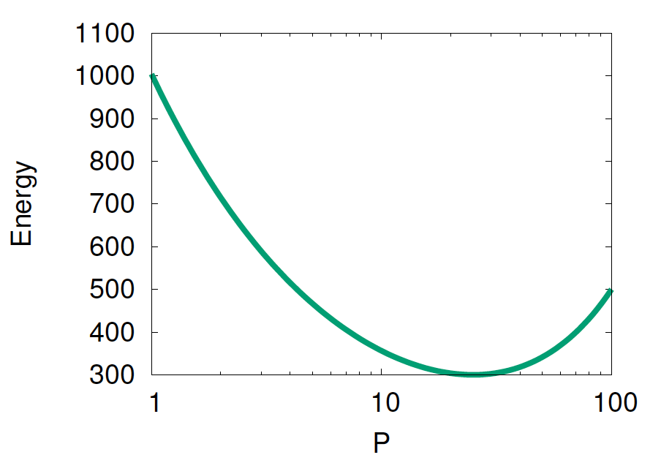
Graph

Slide 64
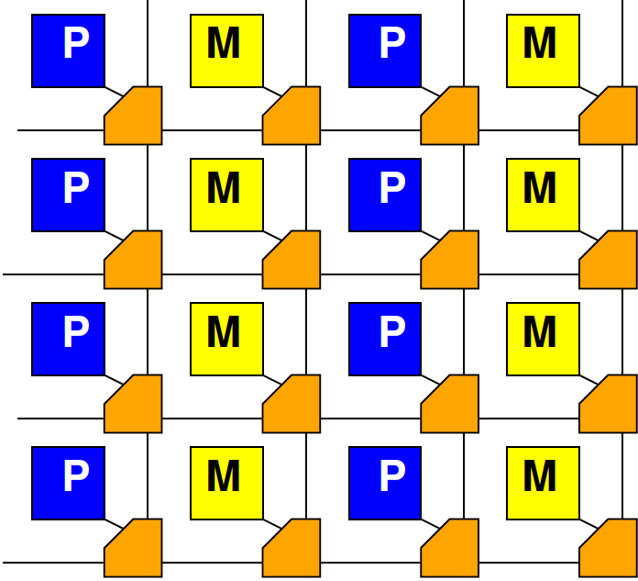
High Locality
If communication is local, don’t need crossbar
  Remember Rent’s Rule
Communication energy scales less than P²
Can scale as low as P

Slide 65
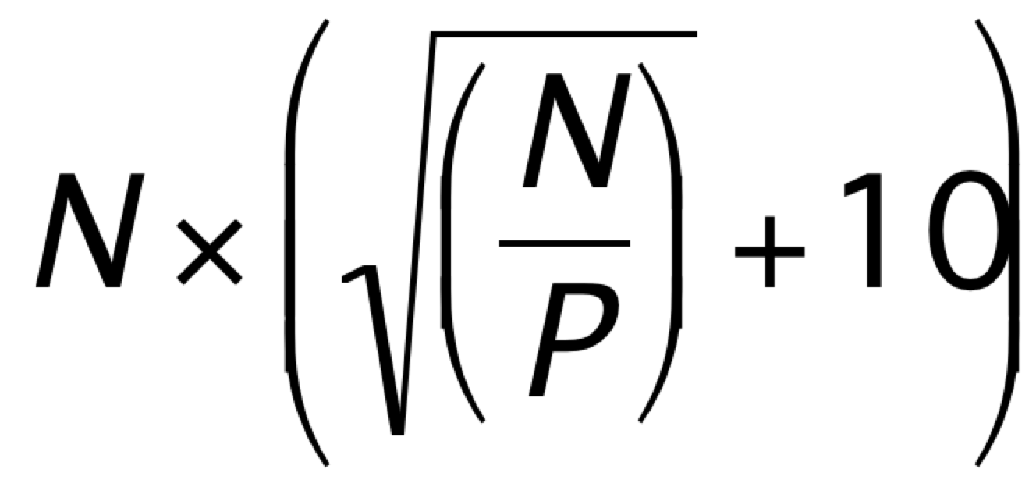
Model for High Locality
E_{comm}=constant
E_{comm}=10
Total comm:
  N*10

Slide 66
Preclass 9
What is energy minimizing P?

Slide 67
Task Locality Matters
Optimal P depends on communication locality (Rent Expontent p)
  Very local problems (p<0.5) always benefit from parallelism
  Highly interconnected problems (p>0.5) must balance energies → intermediate parallelism

Slide 68
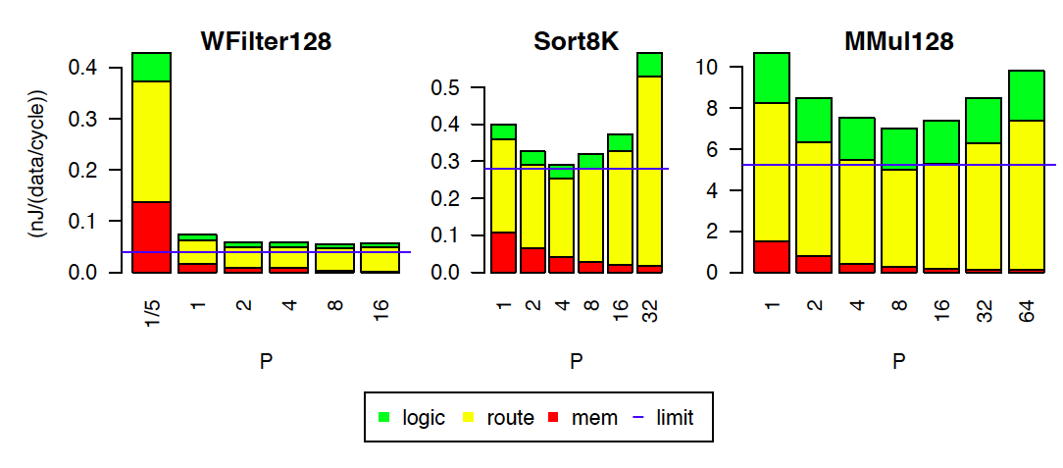
Tune Parallelism: Stratix-IV
[Kadric, FPGA 2015]

Slide 69
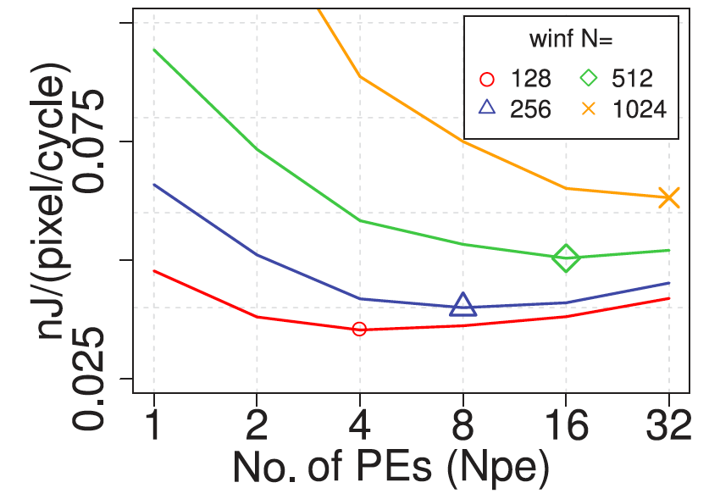
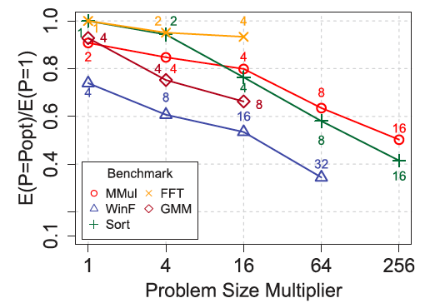
PE Scaling with Problem Size
[Kadric, TRETS 2016]

Slide 70
Power vs. Energy
Notice: main comparisons are energy for operation
  Not power
Power is rate of energy use
  Can slow down clock to reduce power
  Power alone doesn’t tell us energy requirement or energy efficiency
    Need to also know time

Slide 71
Big Ideas
Energy dominance
With power-density budget
  The most energy efficient architecture delivers the most performance
Make memories small and wires short
SoC, accelerators reduce energy by reducing processor instruction execution overhead
Parallel design exploit locality→reduce energy
Optimal parallelism for problem
  Driven by communication structure, size

Slide 72
Admin
Feedback (including P3)
No class on Wed.
  This Wed. is a Virtual Friday
P4 due next Friday
Happy Thanksgiving!
Reading for Monday on web

