Slide 1
ESE532: System-on-a-Chip Architecture
Day 28: December 10, 2020
Wrapup

Slide 2
Today
Part 1:
What was course about
Final
Part 2: Review w/ Simple Models
Part 3
Other Courses
Questions/Discussion

Slide 3
Goal
How to design/select/map to SoC to reduce Energy/Area/Delay.

Slide 4
Outcomes
Day 1
Design, optimize, and program a modern System-on-a-Chip.
Analyze, identify bottlenecks, design-space
Decompose into parallel components
Characterize and develop real-time solutions
Implement both hardware and software solutions
Formulate hardware/software tradeoffs, and perform hardware/software codesign

Slide 5
Outcomes
Day 1
Understand the system on a chip from gates to application software, including:
on-chip memories and communication networks, I/O interfacing, RTL design of accelerators, processors, firmware and OS/infrastructure software.
Understand and estimate key design metrics and requirements including:
area, latency, throughput, energy, power, predictability, and reliability.

Slide 6
Message for Day
Day 2
Identify the Bottleneck
May be in compute, I/O, memory, data movement
Focus and reduce/remove bottleneck
More efficient use of resources
More resources
Repeat

Slide 7
Abstract Approach
Day 1
Identify requirements, bottlenecks
Decompose Parallel Opportunities
At extreme, how parallel could make it?
What forms of parallelism exist?
Thread-level, data parallel, instruction-level
Design space of mapping
Choices of where to map, area-time tradeoffs
Map, analyze, refine

Slide 8
SoC Designer Hardware Building Blocks
Communication blocks
Busses
Multiplexers, Crossbars
DMA Engines
Processors
I/O blocks
Ethernet, USB, PCI, DDR, Gigabit serial links
Computational blocks
Adders, multipliers, dividers, ALUs
Data Storage
Registers
Memory blocks

Slide 9
Final

Slide 10
Final
From Code
Forms of Parallelism
Dataflow, SIMD, VLIW, hardware pipeline, threads, reduce
Map/schedule task graph to (multiple) target substrates
Memory assignment and movement
Area-time points
Real Time
Analysis
Bottleneck
Amdhal’s Law Speedup
Computational requirements
Resource Bounds
Critical Path
Latency/throughput/II
Model/estimate speedup, area, energy, yield

Slide 11
Final
Like midterm
Content
Style
Open book, notes
Calculators allowed (encouraged)
Previous years final and solutions
Linked to Fall 2019, Fall 2018, Fall 2017 syllabus (Spring 2017)
Friday, December 18
Any time in 24 hour window
2 hours (standard final exam period)

Slide 12
Review
Part 2

Slide 13
Sequential Computation
Computation requires a collection of operations
Arithmetic
Logical
Data storage/retrieval

Slide 14
Computations in C
Express computations in a programming language, such as C
Can execute computation in many different ways
Sequential, parallel, spatial hardware
while(true) {
for (i=0;i<16;i++)
y[i]=a[i]*b[i];
z[0]=y[0];
for (i=1;i<16;i++)
z[i]=z[i-1]+y[i];
}

Slide 15
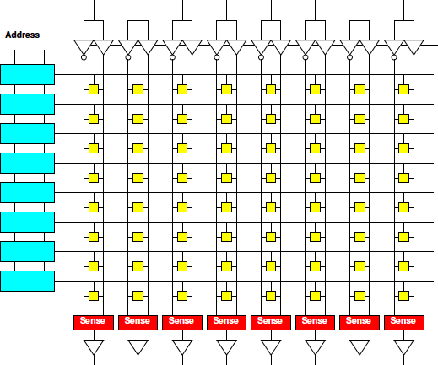
Memory Characteristics
Small memories
Fast
Low energy
Not dense
(high area per bit)
Large memories
Slow
High energy
Dense (less area per bit)

Slide 16
Memory and Compute
Computation involves both arith/logical ops and memory ops

Slide 17
Memory and Compute
Computation involves both arith/logical ops and memory ops
Either can dominate
Be bottleneck

Slide 18
Memory and Compute
Timing
T_{mem}=10
T_{alu}=1
N_{mpy}=
N_{add}=
N_{mem}=
Total Time, T?
while(true) {
for (i=0;i<16;i++)
y[i]=a[i]*b[i];
z[0]=y[0];
for (i=1;i<16;i++)
z[i]=z[i-1]+y[i];
}
(not count loop, indexing costs in this sequence)

Slide 19
Memory and Compute
Where bottleneck?
T_{mem}=10
T_{alu}=1
N_{mpy}=16
N_{add}=15
N_{mem}=95
while(true) {
for (i=0;i<16;i++)
y[i]=a[i]*b[i];
z[0]=y[0];
for (i=1;i<16;i++)
z[i]=z[i-1]+y[i];
}

Slide 20
Data Reuse
Reduce memory operations to large memory by storing in
Registers
Small memories
T_{lmem}>T_{smem}

Slide 21
Memory and Compute
a,b in large mem
y,z in small mem
T_{lmem}=10
T_{smem}=1
T_{alu}=1
N_{mpy}=16
N_{add}=15
N_{lmem}=?
N_{smem}=?
while(true) {
for (i=0;i<16;i++)
y[i]=a[i]*b[i];
z[0]=y[0];
for (i=1;i<16;i++)
z[i]=z[i-1]+y[i];
}

Slide 22
Memory and Compute
a,b in large mem
y,z in small mem
T_{lem}=10
T_{sem}=1
T_{alu}=1
N_{mpy}=16
N_{add}=15
N_{lmem}=32
N_{smem}=63
while(true) {
for (i=0;i<16;i++)
y[i]=a[i]*b[i];
z[0]=y[0];
for (i=1;i<16;i++)
z[i]=z[i-1]+y[i];
}
Performance impact?

Slide 23
Task Parallel
Can run unrelated tasks concurrently
Ideal: T(p) = T(1)/p

Slide 24
Data Parallel
Can run same task on independent data in parallel
Ideal: T(p) = T(1)/p

Slide 25
Data Parallel
Where reduce?
What’s data parallel?
while(true) {
for (i=0;i<16;i++)
y[i]=a[i]*b[i];
z[0]=y[0];
for (i=1;i<16;i++)
z[i]=z[i-1]+y[i];
}

Slide 26
Vector/SIMD
Can perform same operation on a set of data items
Ideal: T(VL) = T(1)/VL
(Vector Length)

Slide 27
Vector/SIMD
Can perform same operation on a set of data items
Not everything vectorizable

Slide 28
Vector/SIMD
What’s vectorizable?
Speedup vector piece VL=4
(assume both memory and compute speedup)
Overall speedup
Amdahl’s Law speedup for VL→infintiy?
while(true) {
for (i=0;i<16;i++)
y[i]=a[i]*b[i];
z[0]=y[0];
for (i=1;i<16;i++)
z[i]=z[i-1]+y[i];
}

Slide 29
Dataflow Pipeline
Prod
Consume
With no cycles in flowgraph
(no feedback)
(no loop carried dependencies)
Producer and consumer can operate concurrently

Slide 30
Data Flow Pipeline
Producer/consumer here?
Time each
Assuming T_{mem}=1
Granularity of dataflow pipeline
Size of buffer needed to allow concurrent operation?
while(true) {
for (i=0;i<16;i++)
y[i]=a[i]*b[i];
z[0]=y[0];
for (i=1;i<16;i++)
z[i]=z[i-1]+y[i];
}

Slide 31
Data Flow Pipeline
(note changed second loop)
Granularity of dataflow pipeline
Size of buffer needed to allow concurrent operation?
while(true) {
for (i=0;i<16;i++)
y[i]=a[i]*b[i];
z[15]=y[15];
for (i=14;i>=0;i--)
z[i]=z[i+1]+y[i];
}

Slide 32
Spatial Pipeline
Can build spatial pipeline of hardware operators to compute a dataflow graph
With no feedback: T=1
With feedback limit II: T=II

Slide 33
Initiation Interval
What’s II?
a, b still Tmem=1
while(true) {
for (i=0;i<16;i++)
y[i]=a[i]*b[i];
z[0]=y[0];
for (i=1;i<16;i++)
z[i]=z[i-1]+y[i];
}

Slide 34
Initiation Interval
What’s II?
a, b, c Tmem=1
while(true) {
for (i=0;i<16;i++)
y[i]=a[i]*b[i]+c[i];
z[0]=y[0];
for (i=1;i<16;i++)
z[i]=z[i-1]+y[i];
}

Slide 35
Initiation Interval
First loop (Tmem=1)
Latency of loop body?
II?
while(true) {
g=0;
for (i=0;i<16;i++) {
t=a[i]*b[i]+c[g];
y[i]=t;
g=t%16; }
z[0]=y[0];
for (i=1;i<16;i++)
z[i]=z[i-1]+y[i];
}

Slide 36
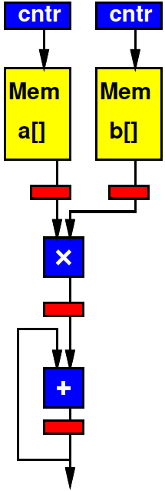
Spatial Pipeline
Back to original code
Pipeline taking one a[i], b[i] per cycle?
Tmem=1
while(true) {
for (i=0;i<16;i++)
y[i]=a[i]*b[i];
z[0]=y[0];
for (i=1;i<16;i++)
z[i]=z[i-1]+y[i];
}

Slide 37
Reduce
(note slightly different second loop)
Common pattern is a reduce operation
Combine a set of data into a single value
Latency bound for second loop?
while(true) {
for (i=0;i<16;i++)
y[i]=a[i]*b[i];
z=0;
for (i=0;i<16;i++)
z+=y[i];
}

Slide 38
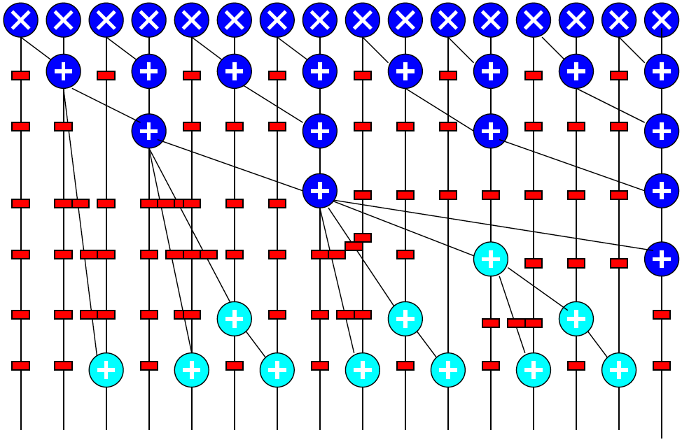
Log-Depth Associative Reduce

Slide 39
VLIW
Can control datapath to perform multiple, heterogeneous operations per cycle
Tune parallelism
Op types: A, B, C
Ops N_{A}, N_{B}, N_{C}
Number of Hardware Units H_{A}, H_{B}, H_{C}
T_{RB}=max(N_{A}/H_{A}, N_{B}/H_{B}, N_{C}/H_{C},…)≤T_{VLIW}
T_{CP}≤T_{VLIW}

Slide 40
VLIW
VLIW
1 load/store (a,b,z)
Assume single cycle
1 mpy
1 add
(ignoring increment for simplicity/consistent)
RB
CP
while(true) {
for (i=0;i<16;i++)
y[i]=a[i]*b[i];
z[0]=y[0];
for (i=1;i<16;i++)
z[i]=z[i-1]+y[i];
}

Slide 41
VLIW
VLIW
1 load/store (a,b,z)
Assume single cycle
1 mpy
1 add
1 incr
while(true) {
for (i=0;i<16;i++)
y[i]=a[i]*b[i];
z[0]=y[0];
for (i=1;i<16;i++)
z[i]=z[i-1]+y[i];
}
Cycle | mpy | add | Ld/st
0 | a*b 0 |  | a1
1 |  | +y[i] 0 | b1
2 |  |  | Z0

Slide 42
VLIW
VLIW
4 load/store (a,b,z)
Assume single cycle
2 mpy
2 add
RB
CP
while(true) {
for (i=0;i<16;i++)
y[i]=a[i]*b[i];
z[0]=y[0];
for (i=1;i<16;i++)
z[i]=z[i-1]+y[i];
}

Slide 43
Memory Bottleneck
Memory can end up being bottleneck
Ideal: T(p) = T_{comp}(1)/p+T_{mem}

Slide 44
Memory Bottleneck
Pipeline to perform one multiply per cycle
Memory supplies one data item from large memory (a,b) every 10 cycles
Performance?
(number of cycles)
while(true) {
for (i=0;i<16;i++)
y[i]=a[i]*b[i];
z[0]=y[0];
for (i=1;i<16;i++)
z[i]=z[i-1]+y[i];
}

Slide 45
Memory Bottleneck
Memory can end up being bottleneck
Ideal: T(p) = T_{comp}(1)/p+T_{mem}/Membw

Slide 46
Memory Bottleneck
Invest in higher bandwidth
Wider memory
More memory banks
Exploit data reuse
Smaller memories may have more bandwidth
Smaller memories are additional banks
More bandwidth

Slide 47
Communication
Once parallel, communication may be bottleneck
Ideal (like VLIW):
T≤max(T_{comp}/p,T_{mem}/membw,T_{comm}/netbw)

Slide 48
Area
Can model area of various solutions
Sum of component areas
(watch interconnect)
Cost proportional A/P_{chip}
Without sparing
P_{chip} = (P_{mm})^{A}
Sparing (did not cover this year)
Pmofn

Slide 49
Multi-Objective Optimization
Many forms of parallelism
Given fixed area (resources, energy)
Maximize performance
Select best architecture
Given fixed performance goal (Real Time)
Find architecture that achieves
With minimum area (energy, cost)

Slide 50
Final
From Code
Forms of Parallelism
Dataflow, SIMD, VLIW, hardware pipeline, threads, reduce
Map/schedule task graph to (multiple) target substrates
Memory assignment and movement
Area-time points
Real Time
Analysis
Bottleneck
Amdhal’s Law Speedup
Computational requirements
Resource Bounds
Critical Path
Latency/throughput/II
Model/estimate speedup, area, energy, yield

Slide 51
Other Courses Wrapup, Questions
Part 3

Slide 52
Distinction
CIS240, 571(471)
ESE532
Best Effort Computing
Run as fast as you can
Binary compatible
ISA separation
Shared memory parallelism
Caching – automatic memory management
Superscalar
Pipelined processor
Hardware-Software codesign
Willing to recompile, maybe rewrite code
Define/refine hardware
Real-Time
Guarantee meet deadline
Non shared-memory models
Explicit memory management
VLIW

Slide 53
Abstraction Stack
Software
ESE539 HW/SW ML
Embedded Sys:
ESE350/519
Systems
SoC Arch:
ESE 532
Processors
Processor Arch:
CIS 471/571
(CIS240)
Mixed Signal:
ESE 568
ADC, DAC
Switched Capacitors
Gates, Memories
Digital:
ESE370/570
Analog:
ESE419/572
Amplifier, Compare
Voltage/Current Ref.
Circuits/VLSI
Devices: ESE521
(ESE218)
Transistors

Slide 54
Circuits and Computer Engineering
ESE350
Embedded Systems
μ-controller architectures, Interfacing, ADC, sensor and actuator control, ROS, network protocols
ESE370
Circuit Level Modeling & Optimization of Dig. Systems
Transistor models, CMOS logic, delay, scaling, energy, interconnects, flip-flops, noise, T-lines, RAM design
ESE319
Electronics
Diode & Transistor Circuits, Single Stage & Diff. Amplifiers, Filters, Oscillators
ESE519
Real-Time &
Embedded Systems
μ-controller architectures, Interfacing, ADC, sensor and actuator control, ROS, network protocols
or
ESE419 (572)
Analog Integrated Circuits
MOSFET circuits, Ampl. Stages, I-Mirrors, Op-Amps, Feedback, Stability, Root Locus, Cascode Ampl.
ESE532
SoC Architecture
Hardware/Software
Codesign,
Parallelism, Analysis, Real-Time
ESE570
Digital Integrated Circuits
MOSFET Trans Models, Inverter switching, MOS Logic, Memories, Implementation methods, Layout.
or
or
ESE568 (Fall)
Mixed-Signal Circuits
A/D, D/A, sampling…
CIS541
Embedded Cyber Physical Systems
Life-Critical, Real-Time,
Analysis,
Implementations
Validation/verification
ESE578
RF Integrated
Circuits Design
μ-wave Eng overview, T-line, Smith-chart, S-parameters, matching, passive devices, small signal amplifier, LNA and PA, mixed signal on chip
ESE672
Integrated Communication Circuits
Receivers, Low-noise amplifiers, mixers, oscillators, phase lock loops, power amplifiers
Digital
Embedded
(uP/uC)
Analog
Notes:
Simple Story

Slide 55
Other Courses
Security: CIS331, CIS551
Networking: ESE407, CIS553
GPGPU (graphics focus): CIS565
Machine Learning: ESE539
(was 680 this term)

Slide 56
Message
Any interesting, challenging computation will require both hardware and software
SoC powerful implementation platform
Target pre-existing
Design customized for problem
Exploit heterogeneous parallelism
Understand and systematically remove bottlenecks
Compute, memory, communicate, I/O

Slide 57
Admin
Feedback
Project Report due Today
Final: Friday, Dec. 18

Slide 58
Question/Discussion

