Slide 1

ESE532:
System-on-a-Chip Architecture
Day 5: September 21, 2020
Dataflow Process Model

Slide 2
Today
Dataflow Process Model
Terms (part 1)
Issues
Abstraction
Performance Prospects (part 2)
Basic Approach
As time permits (part 3)
  Dataflow variants
  Motivations/demands for variants

Slide 3
Message
Parallelism can be natural
Expression can be agnostic to substrate
  Abstract out implementation details
  Tolerate variable delays may arise in implementation
Divide-and-conquer
  Start with coarse-grain streaming dataflow
Basis for performance optimization and parallelism exploitation

Slide 4
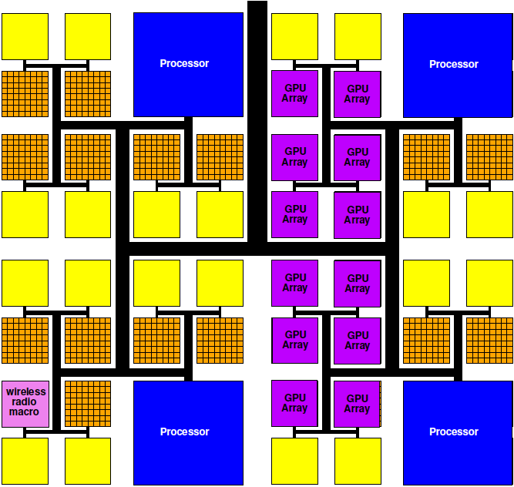
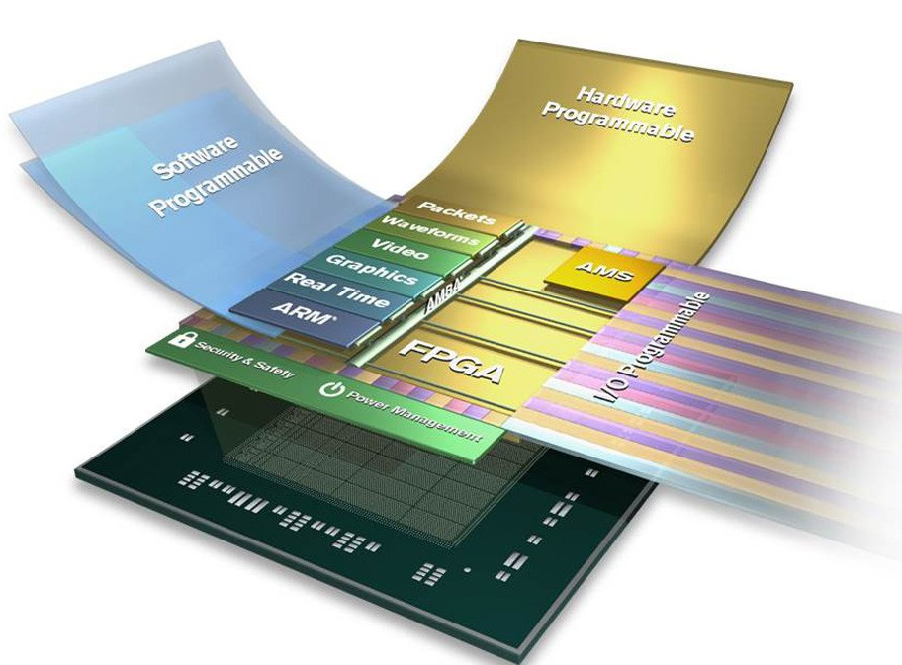
Programmable SoC
Implementation Platform for innovation
  This is what you target (avoid NRE)
  Implementation
  vehicle

Slide 5
Reminder
Goal:
exploit parallelism on heterogeneous PSoC to achieve desired performance (energy)

Slide 6
Term: Process
Abstraction of a processor
Looks like each process is running on a separate processor
Has own state, including
  Program Counter (PC)
  Memory
  Input/output
May not actually run on processor
  Could be specialized hardware block
  May share a processor

Slide 7
Thread
Has a separate locus of control (PC)
May share memory (contrast process)
  Run in common address space with other threads
May not actually run on processor
  Could be specialized hardware block
  May share a processor

Slide 8
FIFO
Day 4
Hardware Block
Outputs data in order received
  First-In, First-Out
Tell it when you are providing data
  Write
  May choose not to insert on a cycle
    Need to signal
Tell it when you are consuming data
  Read
Tells you when it’s empty and has no data to provide
Tells you when it’s full and can hold nothing else

Slide 9
Process
Processes (threads) allow expression of independent control
Convenient for things that advance independently
Process (thread) is the easiest way to express some behaviors
  Easier than trying to describe as a single process
Can be used for performance optimization to improve resource utilization

Slide 10
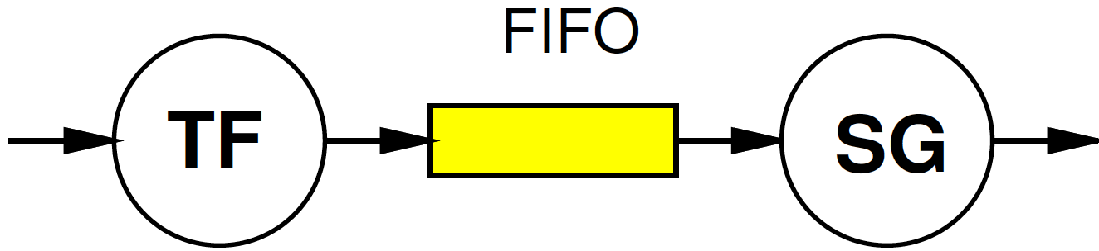
Preclass 2
Average time for TF, SG?
  1 cycle 99% of time, 100 cycles 1% of time
Throughput no FIFO?
  Hint: what must wait on TF miss? SG miss?
Throughput with FIFO?
  How is FIFO changing?
What benefit from FIFO and processes?

Slide 11
Preclass 2
Independent probability of miss
  P_{f}, P_{g}
Concretely
  1 cycle in map
  100 run function and put in map
If each runs independently (in isolation)
  T~= 1*(1-P)+P*100
If run together in lock step
  Either can stall: P=P_{f}+P_{g}-P_{f}P_{g}
  T~= 1*(1-P)+(P)*100

Slide 12
Model (from Day 4) Communicating Threads
Computation is a collection of sequential/control-flow “threads”
Threads may communicate
  Through dataflow I/O
  (Through shared variables)
View as hybrid or generalization
CSP – Communicating Sequential Processes → canonical model example

Slide 13
Issues
Communication – how move data between processes?
  What latency does this add?
  Throughput achievable?
Synchronization – how define how processes advance relative to each other?
Determinism – for the same inputs, do we get the same outputs?

Slide 14
Today’s Stand
Communication – FIFO-like channels
Synchronization – dataflow with FIFOs
Determinism – how to achieve
  …until you must give it up.

Slide 15
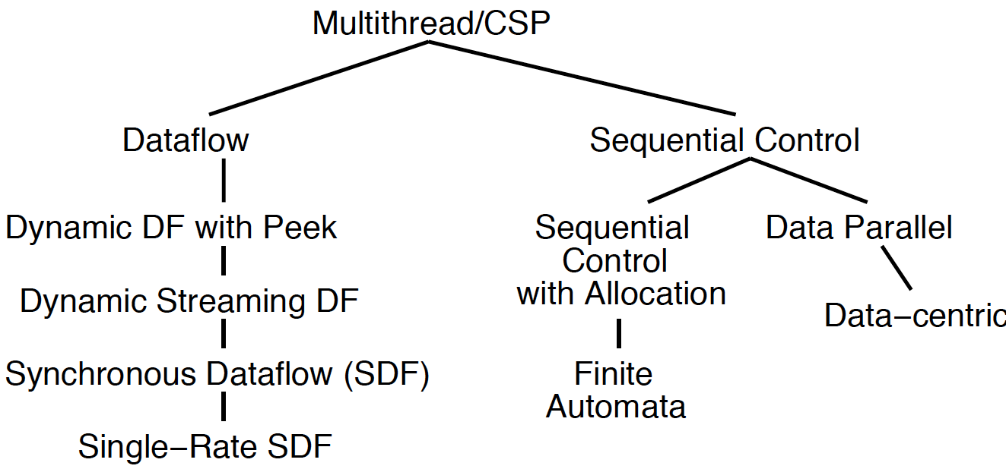
Dataflow Process Model

Slide 16
Operation/Operator
Operation – logical computation to be performed
  A process that communicates through dataflow inputs and outputs
Operator – physical block that performs an Operation
  E.g. processor, hardware block

Slide 17
Dataflow / Control Flow
Day 4
Dataflow
Program is a graph of operations
Operation consumes tokens and produces tokens
All operations run concurrently
  All processes
Control flow (e.g. C)
Program is a sequence of operations
Operation reads inputs and writes outputs into common store
One operation runs at a time
  defines successor

Slide 18
Token
Day 4
Data value with presence indication
  May be conceptual
    Only exist in high-level model
    Not kept around at runtime
  Or may be physically represented
    One bit represents presence/absence of data

Slide 19
Stream
Logical abstraction of a persistent point-to-point communication link between operations (processes)
  Has a (single) source and sink
  Carries data presence / flow control
  Provides in-order (FIFO) delivery of data from source to sink (producer to consumer)
stream

Slide 20
Streams
Captures communications structure
  Explicit producer→consumer link up
Abstract communications
  Physical resources or implementation
  Delay from source to sink
Contrast
  C: producer->consumer implicit through memory
  Verilog/VHDL: cycles visible in implementation
  (can add on top of either C or Verilog)

Slide 21
Variable Delay Source to Sink
How would placement of source and sink operator impact delay?
How could sharing of interconnect between source and sink impact delay?

Slide 22
Communication Latency
Once map to multiple processors
Need to move data between processors
That costs time

Slide 23
On-Chip Delay
Day 3
Delay is proportional to distance travelled
Make a wire twice the length
  Takes twice the latency to traverse
  (can pipeline)
Modern chips
  Run at 100s of MHz to GHz
  Take 10s of ns to cross the chip

Slide 24
Dataflow gives
Clock Independent Semantics
Interconnect
Takes n-clocks
Latency

Slide 25
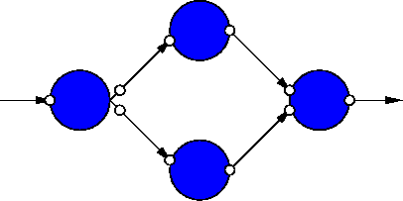
Dataflow Process Network
Collection of Operations
Connected by Streams
Communicating with Data Tokens
(CSP restricted to stream communication)

Slide 26
Dataflow Abstracts Timing
Doesn’t say
  on which cycle calculation occurs
Does say
  What order operations occur in
  How data interacts
    i.e. which inputs get mixed together
Permits
  Scheduling on different # and types of resources
  Operators with variable delay
  Variable delay in interconnect

Slide 27
Dataflow Graphs
Parallel Performance Prospect
Part 2

Slide 28
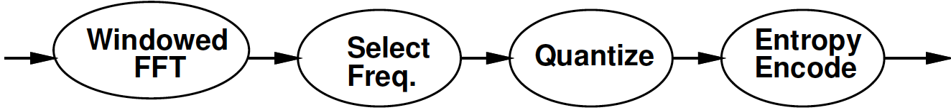
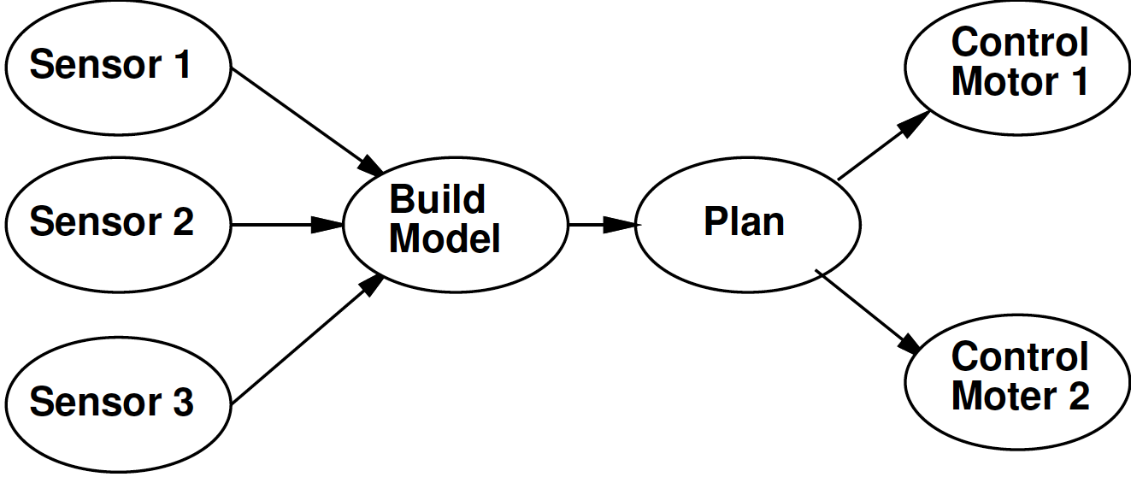
Some Task Graphs

Slide 29
Synchronous Dataflow (SDF) with fixed operators
Particular, restricted form of dataflow
Each operation
  Consumes a fixed number of input tokens
  Produces a fixed number of output tokens
  Operator performs fixed number of operations (in fixed time)
  When full set of inputs are available
    Can produce output
  Can fire any (all) operations with inputs available at any point in time

Slide 30
SDF Operator
FFT
1024 inputs
1024 outputs
10,240 multiplies
20,480 adds
(or 30,720 primitive operations)
1024
1024
30,720

Slide 31
Processor Model
Simple (for today’s lecture)
  Assume one primitive operation per cycle
Could embelish
  Different time per operation type
    E.g. adds: 1 cycle, multiply: 3 cycles
  Multiple memories with different timings

Slide 32
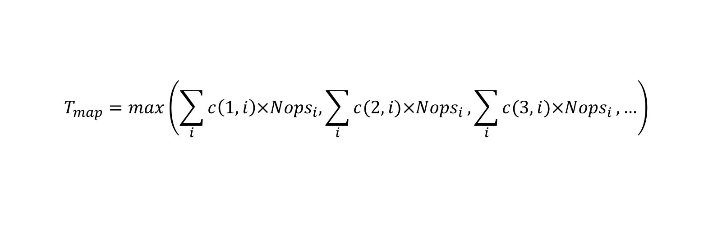
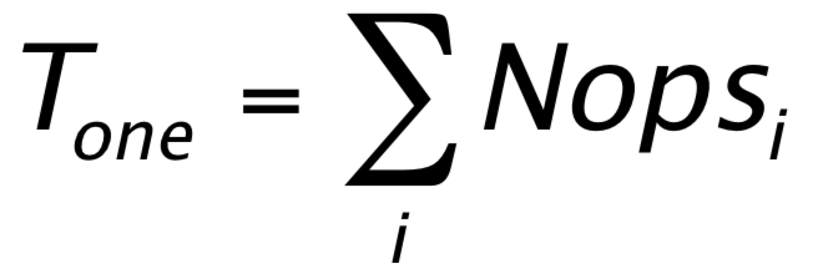
Time for Graph Iteration on Processors
Single processor
One processor per Operation (process)
  T_{each} = max(Nop₁,Nop₂,Nop₃,…)
General
$$T_{map}=max\left(\sum_{i}{c\left(1,i\right)×{Nops}_{i},\sum_{i}{c(2,i)×{Nops}_{i}},\sum_{i}{c(3,i)×{Nops}_{i}},…}\right)$$
c(x,y) – 1 if Processor x runs task y

Slide 33
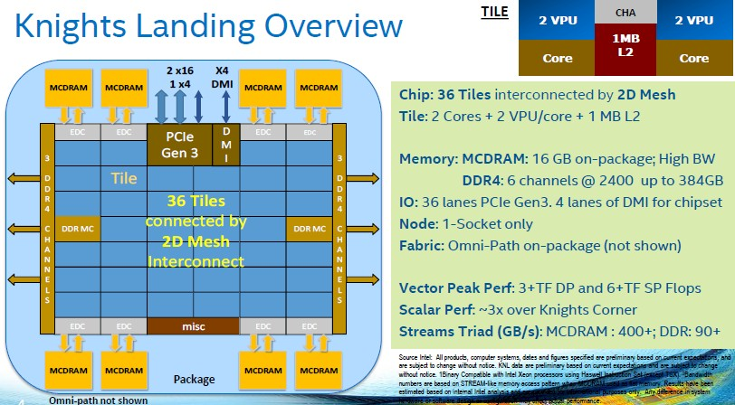
Intel Knights Landing
https://www.nextplatform.com/2016/06/20/intel-knights-landing-yields-big-bang-buck-jump/
[Intel, Micro 2016]

Slide 34
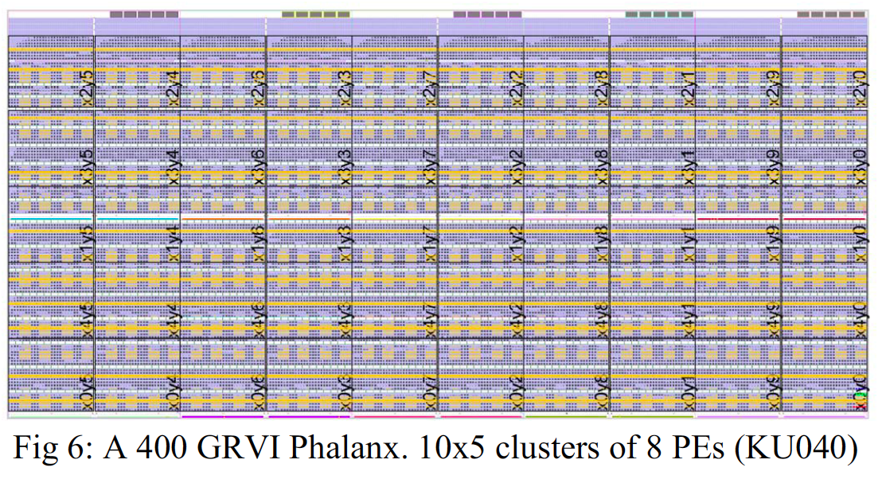
GRVI/Phallanx
Puts 1680 RISC-V32b Integer cores
On XCVU9P FPGA
http://fpga.org/2017/01/12/grvi-phalanx-joins-the-kilocore-club/
[Gray, FCCM 2016]

Slide 35
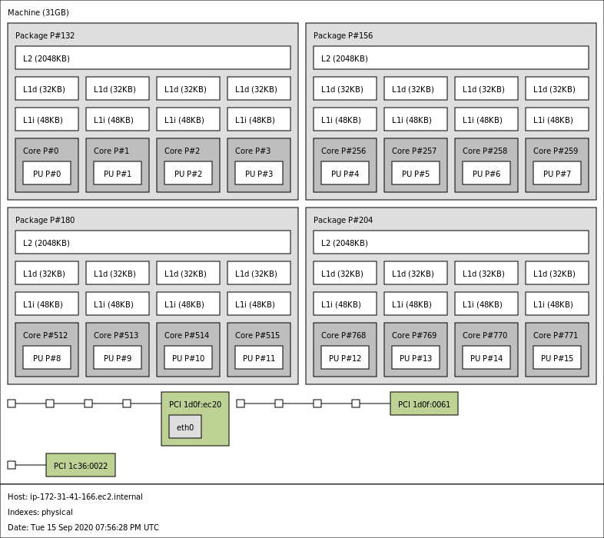
AWS a1-metal

Slide 36
Map to different processors
30,000
15,000
3,000
2,000
Map to (preclass 1)
  One processor performance?
  One process per processor performance?
  Two processors
    How?
    Performance?
  Bottleneck?

Slide 37
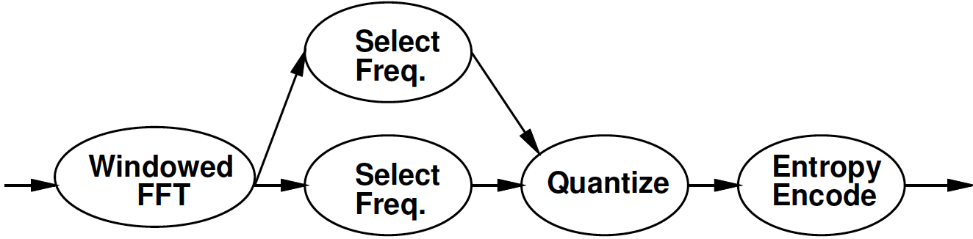
Refine Data Parallel
If component is data parallel, can split out parallel tasks

Slide 38
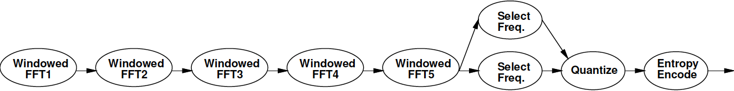
Refine Pipeline
If operation internally pipelineable,
break out pipeline into separate tasks
6,000
6,000
6,000
6,000
6,000
2,000
7,500
3,000
Performance with one processor per operation?
Achieve same performance with how many processors?

Slide 39
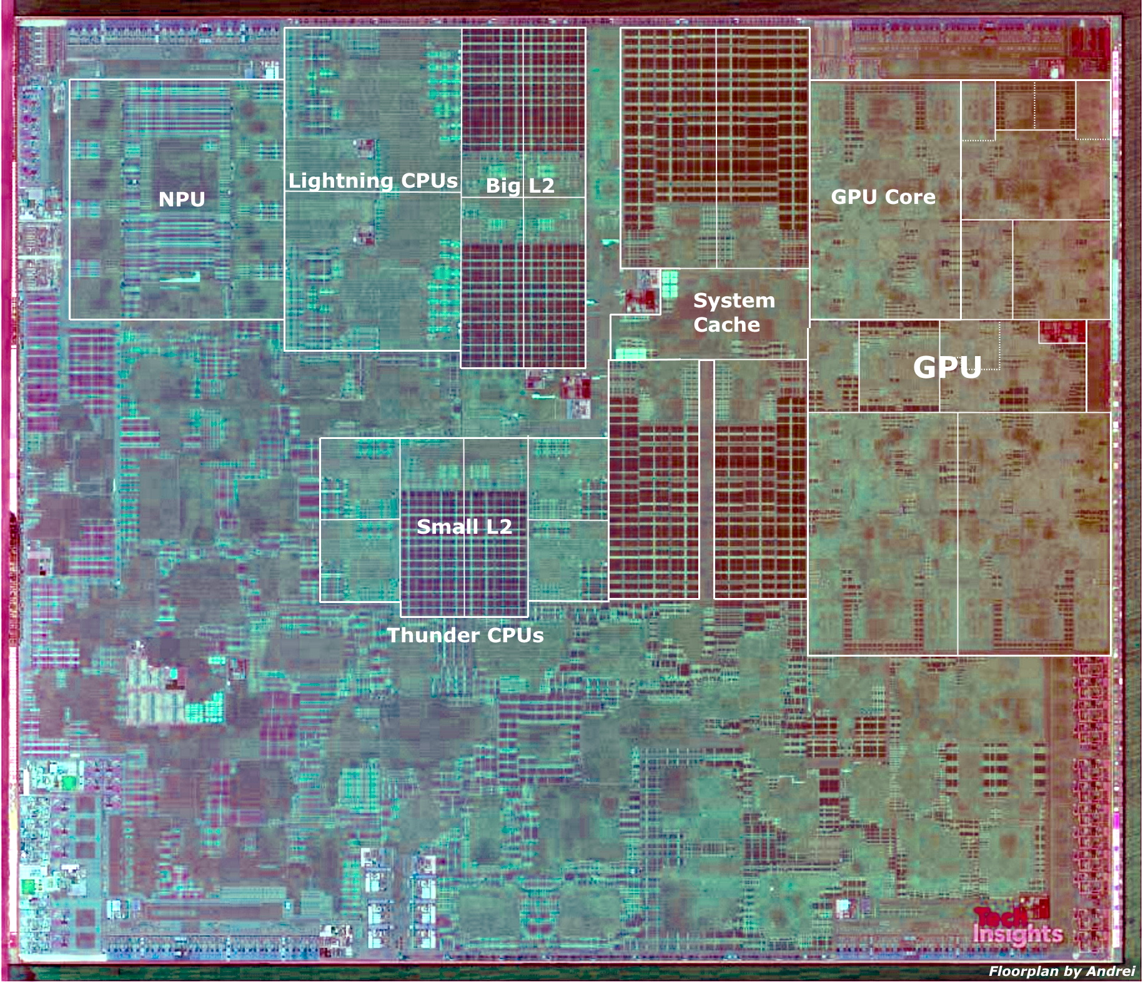
Apple A13 Bionic
98mm², 7nm
8.5 Billion Tr.
iPhone 11 +
6 ARM cores
  2 fast (2.6GHz)
  4 low energy
4 custom GPUs
Neural Engine
  5 Trillion ops/s?

Slide 40
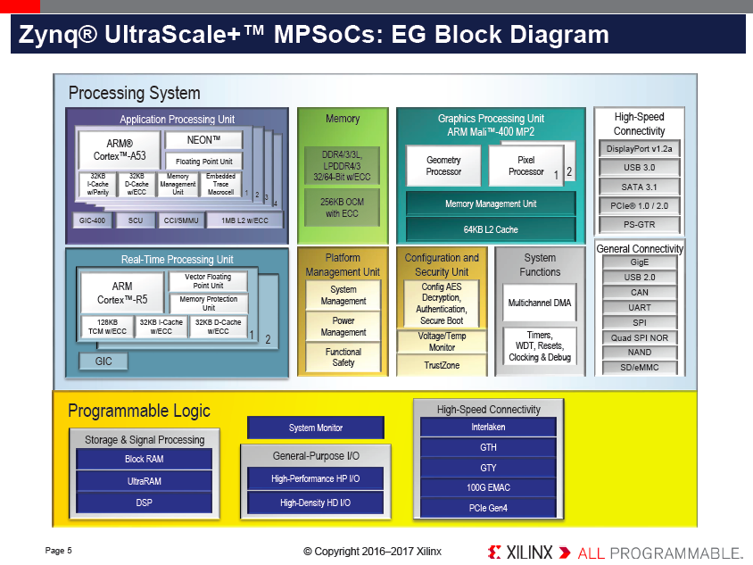

Slide 41
Heterogeneous Processor
GPU perform 10 primitive FFT Ops per cycle
Fast CPU can perform 2 ops/cycle
Slow CPU 1 op/cycle
Map: FFT to GPU, Select to 2 Fast CPUs, quantize and Entropy each to own Slow CPU
Cycles/graph iteration?

Slide 42
Heterogeneous Processor
 | GPU | Fast CPU | Slow CPU
Windowed FFT | 3,000 | 15,000 | 30,000
Select Freq. 1 |  | 3,750 | 7,500
Select Freq. 2 |  | 3,750 | 7,500
Quantize |  | 1,500 | 3,000
Entropy Encode |  | 1,000 | 2,000

Slide 43
Heterogeneous Processor
This marking
Is for one
Slow processor
Not the 2 mentioned before.
 | GPU | Fast CPU | Slow CPU
Windowed FFT | 3,000 | 15,000 | 30,000
Select Freq. 1 |  | 3,750 | 7,500
Select Freq. 2 |  | 3,750 | 7,500
Quantize |  | 1,500 | 3,000
Entropy Encode |  | 1,000 | 2,000
Max(3000,3750,5000) = 5000

Slide 44
Heterogeneous Processor
This marking
Is for one
Slow processor
Not the 2 mentioned before.
 | GPU | Fast CPU | Slow CPU
Windowed FFT | 3,000 | 15,000 | 30,000
Select Freq. 1 |  | 3,750 | 7,500
Select Freq. 2 |  | 3,750 | 7,500
Entropy Encode |  | 1,000 | 2,000
Quantize |  | 1,500 | 3,000
Max(3000,3750,4750,3000) = 4750

Slide 45
Heterogeneous Processor
 | GPU | Fast CPU | Slow CPU
Windowed FFT | 3,000 | 15,000 | 30,000
Select Freq. 1 |  | 3,750 | 7,500
Select Freq. 2 |  | 3,750 | 7,500
Quantize |  | 1,500 | 3,000
Entropy Encode |  | 1,000 | 2,000
General case – find assignment with optimal timing

Slide 46
Custom Accelerator
Dataflow Process doesn’t need to be mapped to a processor
Map FFT to custom datapath on FPGA logic
  Read and produce one element per cycle
  1024 cycles to process 1024-point FFT
1024
15,000
3,000
2,000

Slide 47
Operations
Can be implemented on different operators with different characteristics
  Small or large processor
  Hardware unit
  Different levels of internal
    Data-level parallelism
    Instruction-level parallelism
    Pipeline parallelism
May itself be described as
  Dataflow process network, sequential, hardware register transfer language

Slide 48
Streams
Stream: logical communication link
How might we implement:
  Two threads running on a single processor (sharing common memory)?
  Two processes running on different processors on the same chip?
  Two processes running on different hosts
    E.g. one at Penn, one on Amazon cloud

Slide 49
Add Delay
What does it do to computation
if add an operation that copies inputs to outputs with some latency?
  Impact on function?
  What is throughput impact when Identity operation has
    Latency 10, throughput 1 value per cycle?
    (reminder 1024 values between FFT and Select Freq.)
30,000
1024
15,000
3,000
2,000

Slide 50
Semantics (meaning)
Need to implement semantics
  i.e. get same result as if computed as indicated
But can implement any way we want
  That preserves the semantics
  Exploit freedom of implementation

Slide 51
Basic
Approach

Slide 52
Approach (1)
Identify natural parallelism
Convert to streaming flow
  Initially leave operations in software
  Focus on correctness
Identify flow rates, computation per operator, parallelism needed
Refine operations
  Decompose further parallelism?
  E.g. data parallel split, ILP implementations
  model potential hardware

Slide 53
Approach (2)
Refine coordination as necessary for implementation
Map operations and streams to resources
  Provision hardware
  Scheduling: Map operations to operators
  Memories, interconnect
Profile and tune
Refine

Slide 54
Dataflow Variants
Part 3:
(coverage here depends on time available)

Slide 55
Turing Complete
Can implement any computation describable with a Turing Machine
  (theoretical model of computing by Alan Turing)
Turing Machine – captures our notion of what is computable
  If it cannot be computed by a Turing Machine, we don’t know how to compute it

Slide 56
DataFlow (DF) Process Network Roundup
Model | Deterministic Result | Deterministic Timing | Turing Complete
SDF+fixed-delay operators | Y | Y | N
SDF+variable delay operators | Y | N | N
DDF blocking | Y | N | Y
DDF non-blocking | N | N | Y

Slide 57
Synchronous Dataflow (SDF) with fixed operators
Particular, restricted form of dataflow
Each operation
  Consumes a fixed number of input tokens
  Produces a fixed number of output tokens
  Operator performs fixed number of operations (in fixed time)
  When full set of inputs are available
    Can produce output
  Can fire any (all) operations with inputs available at any point in time

Slide 58
Synchronous Dataflow (SDF)
Particular, restricted form of dataflow
Each operation
  Consumes a fixed number of input tokens
  Produces a fixed number of output tokens
  (can take variable computation for operator)
  When full set of inputs are available
    Can produce output
  Can fire any (all) operations with inputs available at any point in time

Slide 59
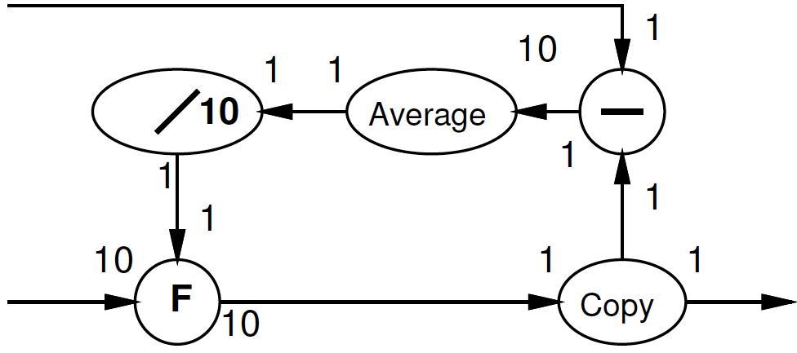
Multirate Synchronous Dataflow
Rates can be different
  Allow lower frequency operations
  Communicates rates to tools
    Use in scheduling, provisioning
  Rates must be constant
    Data independent
2
decimate
1

Slide 60
Dynamic Dataflow
(Less) restricted form of dataflow
Each operation
  Conditionally consume input based on data value
  Conditionally produce output based on data value
  When full set of inputs are available
    Can (optionally) produce output
  Can fire any (all) operations with data-specified necessary inputs available at any point in time

Slide 61
Blocking
Key to determinism: behavior doesn’t depend on timing
  Cannot ask if a token is present
If (not_empty(in))
  Out.put(3);
Else
  Out.put(2);

Slide 62
Process Network Roundup
Model | Deterministic Result | Deterministic Timing | Turing Complete
SDF+fixed-delay operators | Y | Y | N
SDF+variable delay operators | Y | N | N
DDF blocking | Y | N | Y
DDF non-blocking | N | N | Y

Slide 63
Motivations and Demands for Options
Time Permitting

Slide 64
Variable Delay Operators
Why might a multiplier have variable delay?
  Hint: consider shift-and-add multiply
Why might square root have variable delay?
Why might memory lookup on a processor have variable delay?

Slide 65
Variable Delay Operators
Operators with Variable Delay
  Cached memory or computation
  Shift-and-add multiply
  Iterative divide or square-root

Slide 66
GCD (Preclass 3)
What is delay of GCD computation?
while(a!=b)
  t=max(a,b)-min(a,b)
  a=min(a,b)
  b=t
return(a);

Slide 67
Dynamic Rates?
What is implication of static rates
  on compression?
  Filtering?
    (e.g. discard all spam packets)

Slide 68
Dynamic Rates?
Static Rates limiting
  Compress/decompress
    Lossless
    Even Run-Length-Encoding
  Filtering
    Discard all packets from spamRus
  Anything data dependent

Slide 69
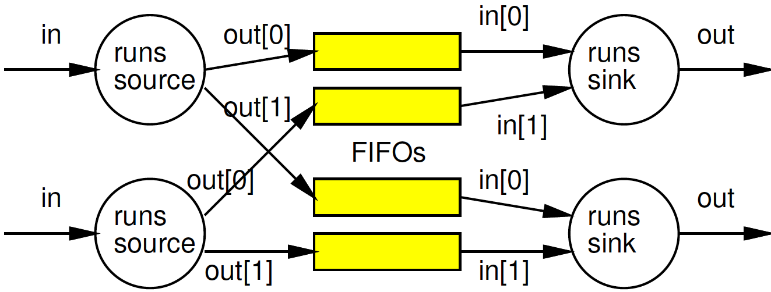
When non-blocking necessary?
What are cases where we need the ability to ask if a data item is present?
Consider an IP packet router:

Slide 70
Non-Blocking
Removed model restriction
  Can ask if token present
Gained expressive power
  Can grab data as shows up
Weaken our guarantees
  Possible to get non-deterministic behavior

Slide 71
Process Network Roundup
Model | Deterministic Result | Deterministic Timing | Turing Complete
SDF+fixed-delay operators | Y | Y | N
SDF+variable delay operators | Y | N | N
DDF blocking | Y | N | Y
DDF non-blocking | N | N | Y

Slide 72
Big Ideas
Capture gross parallel structure with Process Network
Use dataflow synchronization for determinism
  Abstract out timing of implementations
  Give freedom of implementation
Exploit freedom to refine mapping to optimize performance
Minimally use non-determinism as necessary

Slide 73
Admin
Remember feedback
  Today’s lecture and HW2
Reading for Day 6 on web
HW3 due Friday
  Implementing multiprocessor solutions on homogeneous (ARM) processor cores

