Slide 1

ESE532:
System-on-a-Chip Architecture
Day 17: Nov. 1, 2021
LZW, Associative Maps, Hash Tables

Slide 2
Today
LZW Compression (Part 1)
Associative Memory (Part 2)
  Custom
  FPGA
Software Maps
  Tree (Part 3)
  Hash Tables (Part 4)
    (time permit – else next time)

Slide 3
Message
Rich design space for Maps
Hash tables are useful tools

Slide 4
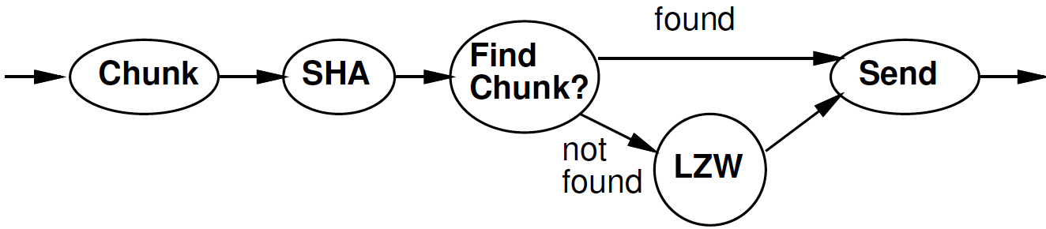
Part 1:
LZW Compression
Lempel-Ziv-Welch

Slide 5
Idea
Day 16 Reminder
Use data already sent as the dictionary
  Give short names to things in dictionary
  Don’t need to pre-arrange dictionary
  Adapt to common phrases/idioms in a particular document

Slide 6
Encoding
Day 16 Reminder
Greedy simplification
  Encode by successively selecting the longest match between the head of the remaining string to send and the current window

Slide 7
Algorithm Concept
Day 16 Reminder
While data to send
  Find largest match in window of data sent
  If length too small (length=1)
    Send character
  Else
    Send <x,y> = <match-pos,length>
  Add data encoded into sent window

Slide 8
Day 16: Preclass 4
How many comparisons per invocation?

Slide 9
Idea
Avoid O(Dictionary-size) work
  Only need to match against positions that start with the character(s) in string to encode
    Separate dictionary for each?
Only check position 0 for “starts with I”

Slide 10
Idea
Avoid O(Dictionary-size) work
  Only need to match against positions that start with the character(s) in string to encode
    Separate dictionary for each?
T-dictionary:
  Tap, The, Their, Then, There, Tuesday

Slide 11
Idea
Avoid O(Dictionary-size) work
  Only need to match against positions that start with the character(s) in string to encode
    Separate dictionary for each?
T-dictionary:
  Tap, The, Their, Then, There, Tuesday
If prefix same, why check redundantly?
  Generalize: Store things with common prefix together
    Share prefix among substrings
  Represent all strings as prefix tree

Slide 12
Idea
Avoid O(Dictionary-size) work
  Only need to match against positions that start with the character(s) in string to encode
    Separate dictionary for each?
If prefix same, why check redundantly?
  Store things with common prefix together
  Share prefix among substrings
  Represent all strings as prefix tree
Follow prefix trees with fixed work per input character

Slide 13
Tree Example
THEN AND THERE, THEY STOOD…
T
H
E
N
R
Y
E

Slide 14
Tree Algorithm
Tree Root for each character
Follow tree according to input until no more match
Send <name of last tree node>
  An <x,y> pair
Extend tree with new character
Start over with this character

Slide 15
Tree Example
Label with <lastpos,len> pair
THEN AND THERE, THEY STOOD…
T
T | H | E | N |  | A | N | D |  | T | H | E | R | E | , |  | T | H | E | Y
0 | 1 | 2 | 3 | 4 | 5 | 6 | 7 | 8 | 9 | 10 | 11 | 12 | 13 | 14 | 15 | 16 | 17 | 18 | 19
<0,1>
<1,2>
H
<2,3>
E
(only showing
Root for ’T’)
<3,4>
N
R
<12,4>
Y
<19,4>
<4,5>
E
<13,5>
<20,5>

Slide 16
Large Memory Implementation
int encode[SIZE][256];
Name tree node by position in chunk
  lastpos
c is a character
Encode[lastpos][c] holds the next tree node that extends tree node lastpos by c
  Or NONE if there is no such tree node

Slide 17
Tree Example
(only showing
Root for ’T’)
Label with <lastpos,len> pair
THEN AND THERE, THEY STOOD…
T
T | H | E | N |  | A | N | D |  | T | H | E | R | E | , |  | T | H | E | Y
0 | 1 | 2 | 3 | 4 | 5 | 6 | 7 | 8 | 9 | 10 | 11 | 12 | 13 | 14 | 15 | 16 | 17 | 18 | 19
<0,1>
<1,2>
H
encode[2][‘N’]=3
<2,3>
E
encode[2][‘R’]=12
<3,4>
N
R
<12,4>
Y
<19,4>
encode[2][‘Y’]=19
encode[2][‘A’]=NONE
<4,5>
E
<13,5>
<20,5>

Slide 18
Large Table for Tree
Addr | spc | A | … | D | E | … | H | … | N | … | R | S | T | … | Y
-1 |  | 5 |  |  |  |  |  |  |  |  |  |  | 0
0 |  |  |  |  |  |  | 1
1 |  |  |  |  | 2
2 |  |  |  |  |  |  |  |  | 3 |  | 12 |  |  |  | 19
3 | 4
4
5 |  |  |  |  |  |  |  |  | 6
6 |  |  |  | 7
7 | 8
8
9
10
12

Slide 19
Memory Tree Algorithm
curr – pointer into input chunk
// follow tree
y=0; x=-1; // for no match, yet…
while(encode[x][input[curr+y]]!=NONE)
x=encode[x][input[curr+y]]; y++;
If (y>0)
send <x,y>
else
send input[curr+y]
encode[x][input[curr+y]]=curr+y
curr=curr+y+1

Slide 20
Memory Tree Algorithm
curr – pointer into input chunk
// follow tree
y=0; x=-1; // for no match, yet…
while(encode[x][input[curr+y]]!=NONE)
x=encode[x][input[curr+y]]; y++;
If (y>0)
send <x,y>
else
send input[curr+y]
encode[x][input[curr+y]]=curr+y
curr=curr+y+1
Follow
Tree

Slide 21
Memory Tree Algorithm
curr – pointer into input chunk
// follow tree
y=0; x=-1; // for no match, yet.
while(encode[x][input[curr+y]]!=NONE)
x=encode[x][input[curr+y]]; y++;
If (y>0)
send <x,y>
else
send input[curr+y]
encode[x][input[curr+y]]=curr+y
curr=curr+y+1
How much work per
character
to encode?
Hint:
1) match case
2) not match

Slide 22
Compact Memory
int encode[SIZE][256];
How many entries in this table are not NONE?
  Hint: SIZE is total number of positions.
  How many characters process?
  How many insertions per character processed?

Slide 23
Compact Memory
int encode[SIZE][256];
Table is very sparse
If store as associative memory
  At most SIZE entries
Look at how to implement associative memories next

Slide 24
LZW So Far – 4KB chunks
Brute Force
  Needs one byte per byte = 4KB = 1 BRAM
  DICT_SIZE=4096 comparisons per byte
Dense memory encode[SIZE][256]
  Need 2*256B per byte = 512*4KB
  = 512 BRAMs
  1 comparison and lookup per byte

Slide 25
Associative Memories
Part 2

Slide 26
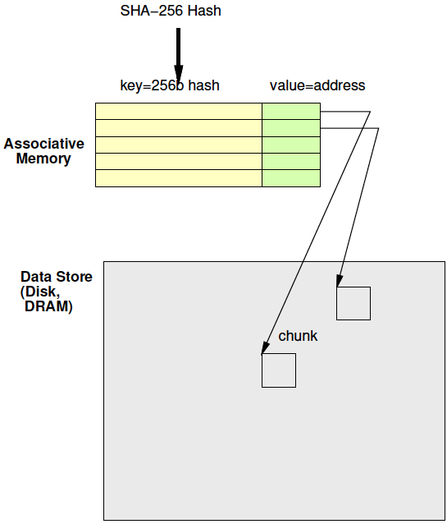
Associative Memory
Day 16 Review
Maps from a key to a value
Key not necessarily dense
  Contrast simple RAM
  Cannot afford 2²⁵⁶ word memory

Slide 27
Associative Memories
Use for deduplication
Also may use in LZW to reduce BRAMs
  Just saw
    Problem: Simple 2D tree table requires too many BRAMs
    Opportunity: Tree table sparse

Slide 28
Deduplicate
Day 16 Review
Compute chunk hash
Use chunk hash to lookup known chunks
  Data already have on disk
  Data already sent to destination, so destination will know
If lookup yields a chunk with same hash
  Check if actually equal (maybe)
If chunks equal
  Send (or save) pointer to existing chunk

Slide 29
Deduplication Architecture
Day 16 Review

Slide 30
Custom Hardware
Associative Memory

Slide 31
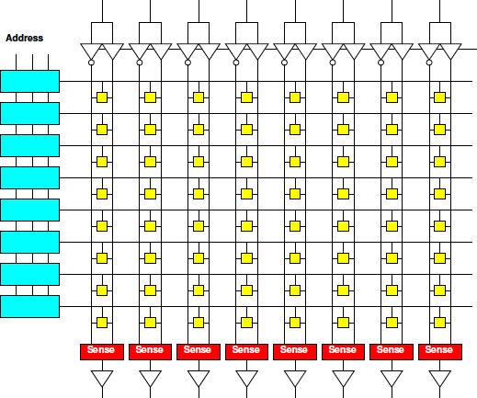
Memory Block Review
Match on address
Select wordline for a row
Reads out a word
Address dense
and hardwired
One row for
each 2^{Abits}
values
width
depth

Slide 32
Address Blocks
Each address match is AND
width
/A2&/A1&/A0
/A2&/A1&A0
depth

Slide 33
Address Blocks

Slide 34
Memory Block Associative
Want address as key
Word is value
Key sparse
Rows<2^{keybits}
Entries<2^{keybits}
Key
programmable
width
depth

Slide 35
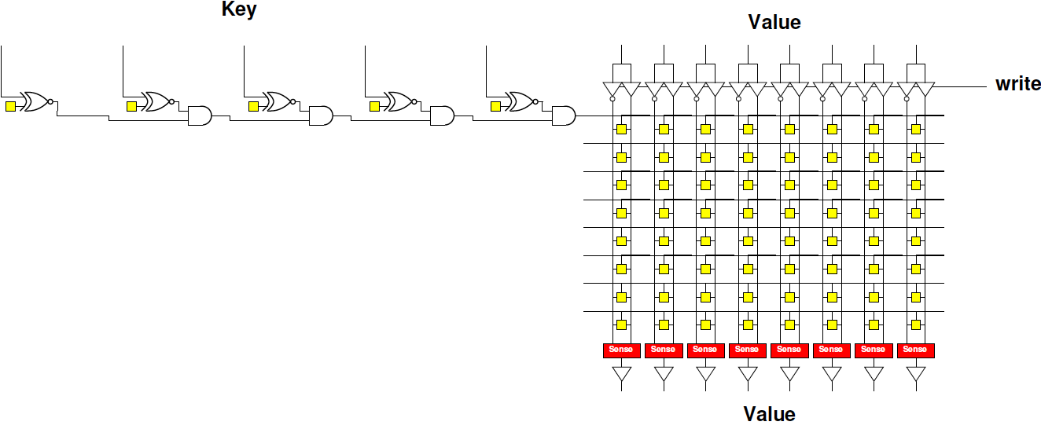
Programmable Key
Make row select programmable

Slide 36
Contrast
Assoc. and Dense Memory

Slide 37
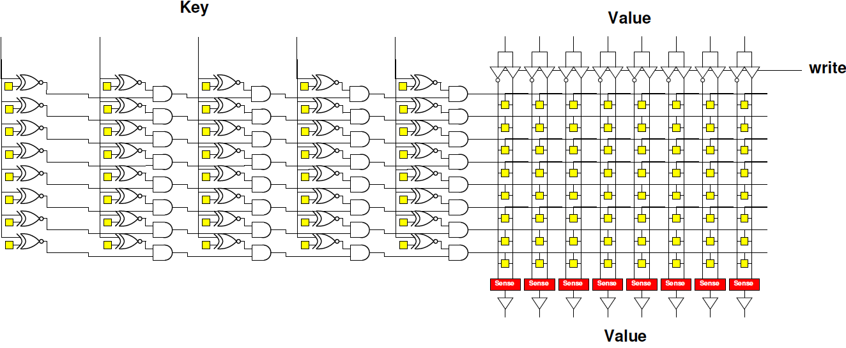
Associative Memory Bank

Slide 38
Programmable Key
Assoc: 5b key, 8 entries, 8b value
How many memory bits?
Direct: 8 entries, 8b value
How many memory bits?

Slide 39
Associative Memory Bank
Memory cells = entries*(keybits+valuebits)

Slide 40
Associative Memory Bank
Will need to be able to write into key
  Another “fixed” decoder to generate
  key-word line for programming

Slide 41
Associate Memory Cost
More expensive than equal capacity SRAM memory bank
  Memory cells in decoder
  Need to support write into key

Slide 42
Associate Memory Cost
Physical associative memory for 4KB LZW Chunk tree encode
  4K entries
  12b output
  12b+8b=20b key
Memory cells assoc.?
Compare direct 4Kx12 memory (cells)?
  How much larger is assoc. for same capacity?
Compare 4096*256 with 12b result for dense LZW case (cells)?
  How much larger to solve same problem

Slide 43
FPGA
Has BRAMs – normal memories, not associative
36Kb BRAM
  512x72
Can be 9b key → 72b value assoc.
  Just using the memory sparsely
Or interpret as programmable decoder with 72 match lines

Slide 44
Assoc. Mem from BRAM
For wider match
Cover 9b of key with each BRAM
Use 72 output bits to indicate if one of 72 entries match
AND together corresponding entries
Get 72 match bits
Re-encode match
bits to lookup value

Slide 45
BRAM Associative Memory
Previous slide expands match width
How would we expand capacity?
  Hint: how get a wider word (144b word)?

Slide 46
BRAM Associative Memory

Slide 47
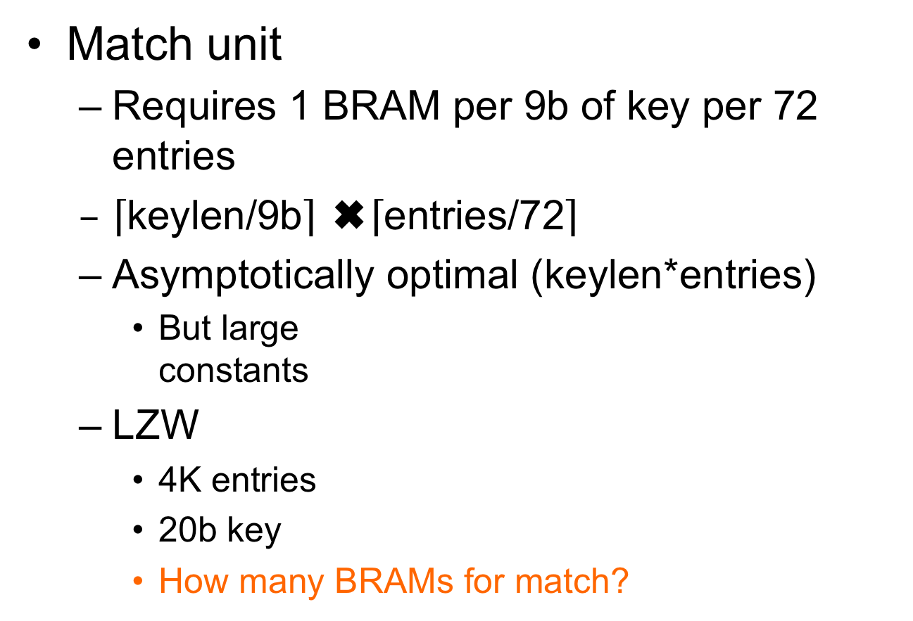
Associative Memory Cost
Match unit
  Requires 1 BRAM per 9b of key per 72 entries
  $\left\lceil \text{keylen}\text{/9}\text{b}\right\rceil$ ✖️$\left\lceil \text{entries}\text{/72}\right\rceil$
  Asymptotically optimal (keylen*entries)
    But large
    constants
  LZW
    4K entries
    20b key
    How many BRAMs for match?

Slide 48
4K LZW Chunk Search:
Fully associative
Match BRAMs:
  Match key: 20b
  Entries: 4096
Value BRAMS:
  20b (key) + 12b (state)
  32b x 4096 entries

Slide 49
Example Stored Values
Key[17:9] | Key[8:0] | Value
0x001 | 0x014 | 0x01
0x001 | 0x01 | 0x34
0x0F0 | 0x014 | 0xE3
0x0C8 | 0x113 | 0xCC

Slide 50
Memory Contents
Key[17:9] Match BRAM
Value BRAM
Addr | 7 | 6 | 5 | 4 | 3 | 2 | 1 | 0
0x001 | 0 | 0 | 0 | 0 | 0 | 0 | 1 | 1
0x014 | 0 | 0 | 0 | 0 | 0 | 0 | 0 | 0
0x0C8 | 0 | 0 | 0 | 0 | 1 | 0 | 0 | 0
0x0F0 | 0 | 0 | 0 | 0 | 0 | 1 | 0 | 0
0x113 | 0 | 0 | 0 | 0 | 0 | 0 | 0 | 0
Addr | Value
0x00 | 0x01
0x01 | 0x34
0x02 | 0xE3
0x03 | 0xCC
0x04
0x05
0x06
Key[8:0] Match BRAM
Addr | 7 | 6 | 5 | 4 | 3 | 2 | 1 | 0
0x001 | 0 | 0 | 0 | 0 | 0 | 0 | 1 | 0
0x014 | 0 | 0 | 0 | 0 | 0 | 1 | 0 | 1
0x0C8 | 0 | 0 | 0 | 0 | 0 | 0 | 0 | 0
0x0F0 | 0 | 0 | 0 | 0 | 0 | 0 | 0 | 0
0x113 | 0 | 0 | 0 | 0 | 1 | 0 | 0 | 0
(only show bottom 8 b; rest 0’s)

Slide 51
Code Snippet
ap_uint<72> key_low[512];
ap_uint<72> key_high[512];
int value[72];
match_low=key_low[key%512];
match_high=key_high[(key>>9)%512];
match=match_low & match_high;
addr=binary_encode(match);
res=value[addr];

Slide 52
How Lookup Work?
Key[17:9] | Key[8:0] | Value
0x001 | 0x014 | 0x01
0x001 | 0x01 | 0x34
0x0F0 | 0x014 | 0xE3
0x0C8 | 0x113 | 0xCC
Lookup 0x214 = 0x001 0x014

Slide 53
Code Snippet
ap_uint<72> key_low[512];
ap_uint<712> key_high[512];
int value[72];
match_low=key_low[key%512];
match_high=key_high[(key>>9)%512];
match=match_low & match_high;
addr=binary_encode(match);
res=value[addr];

Slide 54
Memory Contents
Key[17:9] Match BRAM
Addr | 7 | 6 | 5 | 4 | 3 | 2 | 1 | 0
0x001 | 0 | 0 | 0 | 0 | 0 | 0 | 1 | 1
0x014 | 0 | 0 | 0 | 0 | 0 | 0 | 0 | 0
0x0C8 | 0 | 0 | 0 | 0 | 1 | 0 | 0 | 0
0x0F0 | 0 | 0 | 0 | 0 | 0 | 1 | 0 | 0
0x113 | 0 | 0 | 0 | 0 | 0 | 0 | 0 | 0
match_low=key_low[key%512];
match_high=key_high[(key>>9)%512];
Key[8:0] Match BRAM
What match_low, match_high?
Addr | 7 | 6 | 5 | 4 | 3 | 2 | 1 | 0
0x001 | 0 | 0 | 0 | 0 | 0 | 0 | 1 | 0
0x014 | 0 | 0 | 0 | 0 | 0 | 1 | 0 | 1
0x0C8 | 0 | 0 | 0 | 0 | 0 | 0 | 0 | 0
0x0F0 | 0 | 0 | 0 | 0 | 0 | 0 | 0 | 0
0x113 | 0 | 0 | 0 | 0 | 1 | 0 | 0 | 0
(only show bottom 8 b; rest 0’s)

Slide 55
Memory Contents
Key[17:9] Match BRAM
Addr | 7 | 6 | 5 | 4 | 3 | 2 | 1 | 0
0x001 | 0 | 0 | 0 | 0 | 0 | 0 | 1 | 1
0x014 | 0 | 0 | 0 | 0 | 0 | 0 | 0 | 0
0x0C8 | 0 | 0 | 0 | 0 | 1 | 0 | 0 | 0
0x0F0 | 0 | 0 | 0 | 0 | 0 | 1 | 0 | 0
0x113 | 0 | 0 | 0 | 0 | 0 | 0 | 0 | 0
match_low=key_low[key%512];
match_high=key_high[(key>>9)%512];
match=match_low & match_high;
What match?
Key[8:0] Match BRAM
Addr | 7 | 6 | 5 | 4 | 3 | 2 | 1 | 0
0x001 | 0 | 0 | 0 | 0 | 0 | 0 | 1 | 0
0x014 | 0 | 0 | 0 | 0 | 0 | 1 | 0 | 1
0x0C8 | 0 | 0 | 0 | 0 | 0 | 0 | 0 | 0
0x0F0 | 0 | 0 | 0 | 0 | 0 | 0 | 0 | 0
0x113 | 0 | 0 | 0 | 0 | 1 | 0 | 0 | 0
(only show bottom 8 b; rest 0’s)

Slide 56
What does binary_encode do?
binary_encode(0000000…010000)=0x40
10000…0 → 71
0000…01 → 0
0000…010 → 1
for (i=0<i<72;i++)
  If (bit[i]==1) return i
Return(MISS); // if not find (i.e., all 0’s)
Technicalities – maybe check only one 1

Slide 57
Memory Contents
Key[17:9] Match BRAM
Addr | 7 | 6 | 5 | 4 | 3 | 2 | 1 | 0
0x001 | 0 | 0 | 0 | 0 | 0 | 0 | 1 | 1
0x014 | 0 | 0 | 0 | 0 | 0 | 0 | 0 | 0
0x0C8 | 0 | 0 | 0 | 0 | 1 | 0 | 0 | 0
0x0F0 | 0 | 0 | 0 | 0 | 0 | 1 | 0 | 0
0x113 | 0 | 0 | 0 | 0 | 0 | 0 | 0 | 0
match_low=key_low[key%512];
match_high=key_high[(key>>9)%512];
match=match_low & match_high;
addr=binary_encode(match);
Key[8:0] Match BRAM
What addr?
Addr | 7 | 6 | 5 | 4 | 3 | 2 | 1 | 0
0x001 | 0 | 0 | 0 | 0 | 0 | 0 | 1 | 0
0x014 | 0 | 0 | 0 | 0 | 0 | 1 | 0 | 1
0x0C8 | 0 | 0 | 0 | 0 | 0 | 0 | 0 | 0
0x0F0 | 0 | 0 | 0 | 0 | 0 | 0 | 0 | 0
0x113 | 0 | 0 | 0 | 0 | 1 | 0 | 0 | 0
(only show bottom 8 b; rest 0’s)

Slide 58
Memory Contents
Key[17:9] Match BRAM
Value BRAM
Addr | 7 | 6 | 5 | 4 | 3 | 2 | 1 | 0
0x001 | 0 | 0 | 0 | 0 | 0 | 0 | 1 | 1
0x014 | 0 | 0 | 0 | 0 | 0 | 0 | 0 | 0
0x0C8 | 0 | 0 | 0 | 0 | 1 | 0 | 0 | 0
0x0F0 | 0 | 0 | 0 | 0 | 0 | 1 | 0 | 0
0x113 | 0 | 0 | 0 | 0 | 0 | 0 | 0 | 0
Addr | Value
0x00 | 0x01
0x01 | 0x34
0x02 | 0xE3
0x03 | 0xCC
0x04
0x05
0x06
Key[8:0] Match BRAM
Addr | 7 | 6 | 5 | 4 | 3 | 2 | 1 | 0
0x001 | 0 | 0 | 0 | 0 | 0 | 0 | 1 | 0
0x014 | 0 | 0 | 0 | 0 | 0 | 1 | 0 | 1
0x0C8 | 0 | 0 | 0 | 0 | 0 | 0 | 0 | 0
0x0F0 | 0 | 0 | 0 | 0 | 0 | 0 | 0 | 0
0x113 | 0 | 0 | 0 | 0 | 1 | 0 | 0 | 0
res=value[addr];
What res?
(only show bottom 8 b; rest 0’s)

Slide 59
How Lookup Work?
Key[17:9] | Key[8:0] | Value
0x001 | 0x014 | 0x01
0x001 | 0x01 | 0x34
0x0F0 | 0x014 | 0xE3
0x0C8 | 0x113 | 0xCC
Lookup 0x214 = 0x001 0x014

Slide 60
Memory Contents
Key[17:9] Match BRAM
Value BRAM
Addr | 7 | 6 | 5 | 4 | 3 | 2 | 1 | 0
0x001 | 0 | 0 | 0 | 0 | 0 | 0 | 1 | 1
0x014 | 0 | 0 | 0 | 0 | 0 | 0 | 0 | 0
0x0C8 | 0 | 0 | 0 | 0 | 1 | 0 | 0 | 0
0x0F0 | 0 | 0 | 0 | 0 | 0 | 1 | 0 | 0
0x113 | 0 | 0 | 0 | 0 | 0 | 0 | 0 | 0
Addr | Value
0x00 | 0x01
0x01 | 0x34
0x02 | 0xE3
0x03 | 0xCC
0x04
0x05
0x06
Key[8:0] Match BRAM
Addr | 7 | 6 | 5 | 4 | 3 | 2 | 1 | 0
0x001 | 0 | 0 | 0 | 0 | 0 | 0 | 1 | 0
0x014 | 0 | 0 | 0 | 0 | 0 | 1 | 0 | 1
0x0C8 | 0 | 0 | 0 | 0 | 0 | 0 | 0 | 0
0x0F0 | 0 | 0 | 0 | 0 | 0 | 0 | 0 | 0
0x113 | 0 | 0 | 0 | 0 | 1 | 0 | 0 | 0
(only show bottom 8 b; rest 0’s)

Slide 61
Add another entry
match | Key[17:9] | Key[8:0] | Value
0 | 0x001 | 0x014 | 0x01
1 | 0x001 | 0x01 | 0x34
2 | 0x0F0 | 0x014 | 0xE3
3 | 0x0C8 | 0x113 | 0xCC
4 | 0x0C8 | 0x01 | 0x2B
How BRAM contents
change to add this entry
for 0x19001

Slide 62
Memory Contents
Key[17:9] Match BRAM
Value BRAM
Addr | 7 | 6 | 5 | 4 | 3 | 2 | 1 | 0
0x001 | 0 | 0 | 0 | 0 | 0 | 0 | 1 | 1
0x014 | 0 | 0 | 0 | 0 | 0 | 0 | 0 | 0
0x0C8 | 0 | 0 | 0 | 0 | 1 | 0 | 0 | 0
0x0F0 | 0 | 0 | 0 | 0 | 0 | 1 | 0 | 0
0x113 | 0 | 0 | 0 | 0 | 0 | 0 | 0 | 0
Addr | Value
0x00 | 0x01
0x01 | 0x34
0x02 | 0xE3
0x03 | 0xCC
0x04
0x05
0x06
Key[8:0] Match BRAM
Addr | 7 | 6 | 5 | 4 | 3 | 2 | 1 | 0
0x001 | 0 | 0 | 0 | 0 | 0 | 0 | 1 | 0
0x014 | 0 | 0 | 0 | 0 | 0 | 1 | 0 | 1
0x0C8 | 0 | 0 | 0 | 0 | 0 | 0 | 0 | 0
0x0F0 | 0 | 0 | 0 | 0 | 0 | 0 | 0 | 0
0x113 | 0 | 0 | 0 | 0 | 1 | 0 | 0 | 0
(only show bottom 8 b; rest 0’s)

Slide 63
Memory Contents
Key[17:9] Match BRAM
Value BRAM
Addr | 7 | 6 | 5 | 4 | 3 | 2 | 1 | 0
0x001 | 0 | 0 | 0 | 0 | 0 | 0 | 1 | 1
0x014 | 0 | 0 | 0 | 0 | 0 | 0 | 0 | 0
0x0C8 | 0 | 0 | 0 | 1 | 1 | 0 | 0 | 0
0x0F0 | 0 | 0 | 0 | 0 | 0 | 1 | 0 | 0
0x113 | 0 | 0 | 0 | 0 | 0 | 0 | 0 | 0
Addr | Value
0x00 | 0x01
0x01 | 0x34
0x02 | 0xE3
0x03 | 0xCC
0x04 | 0x2B
0x05
0x06
Key[8:0] Match BRAM
Addr | 7 | 6 | 5 | 4 | 3 | 2 | 1 | 0
0x001 | 0 | 0 | 0 | 1 | 0 | 0 | 1 | 0
0x014 | 0 | 0 | 0 | 0 | 0 | 1 | 0 | 1
0x0C8 | 0 | 0 | 0 | 0 | 0 | 0 | 0 | 0
0x0F0 | 0 | 0 | 0 | 0 | 0 | 0 | 0 | 0
0x113 | 0 | 0 | 0 | 0 | 1 | 0 | 0 | 0
(only show bottom 8 b; rest 0’s)

Slide 64
4K Chunk LZW Search
 | BRAMs | Operations
Brute Search | 1 | 4K
Tree with Dense RAM | 512 | 1
Tree with Full Assoc | 175 | 1
36Kb BRAMs on ZU3EG = 216

Slide 65
Software Map
Part 3

Slide 66
Software Map
Map abstraction
  void insert(key,value);
  value lookup(key);
Will typically have many different implementations

Slide 67
Preclass 1
For a capacity of 4096
How many memory accesses needed
  When lookup fail?
  When lookup succeed (on average)?

Slide 68
Tree Map (Preclass 2)
Build search tree
Walk down tree
For a capacity of 4096,
assume balanced…
How many tree nodes visited
  When lookup fail?
  When lookup succeed (on average)?

Slide 69
Tree Map LZW
Each character requires log₂(dict) lookups
  12 for 4096
Each internal tree node hold
  Key (20b for LZW), value (12b), and 2 pointers (12b)
  7B
Total nodes 4K*2
Need 14 BRAMs for 4K chunk

Slide 70
Tree Insert
Need to maintain balance
Doable with O(log(N)) insert
  Tricky
  See Red-Black Tree
    https://en.wikipedia.org/wiki/Red–black_tree
    https://www.geeksforgeeks.org/red-black-tree-set-1-introduction-2/

Slide 71
4K Chunk LZW Search
 | BRAMs | Operations
Brute Search | 1 | 4K
Tree with Dense RAM | 512 | 1
Tree with Full Assoc | 175 | 1
Tree with Tree | 14 | 12
36Kb BRAMs on ZU3EG = 216

Slide 72
Hash Tables
Part 4

Slide 73
High Performance Map
Would prefer not to search
Want to do better than log₂(N) time
Direct lookup in arrays (memory)
is good…

Slide 74
Hash Table
lookup_key
Attempt to turn into direct lookup
Compute some function of key
  A hash
Perform lookup at that point
If hash maps a single entry
(or no entry)
  Great, got direct lookup
    Like sparse table case
hash
Mem
match_key, value
Miss =
(match_key!=lookup_key)

Slide 75
Preclass 3a
Average number of entries per hash when N > HASH_CAPACITY?
  Concrete example
    N= 4096
    HASH_CAPACITY=256

Slide 76
Hash Table
lookup_key
Attempt to turn into direct lookup
Compute some function of key
  A hash
Perform lookup at that point
Typically, prepared for several keys to map to same hash → call it a bucket
  Keep list or tree of things in each bucket
hash
Mem
Bucket =
<k1,v1>,
<k2,v2>,
<k3,v3>

Slide 77
Hash Table
lookup_key
Compute some function of key
  A hash
Perform lookup at that point
Find bucket with small number of entries
  Searching that bucket easier
  …but no absolute guarantee on
  maximum bucket size
    Problem for hardware [next time]
hash
Mem
Bucket =
<k1,v1>,
<k2,v2>,
<k3,v3>

Slide 78
Preclass 3b
Probability of conflict if N<<HASH_CAPACITY ?
  Concrete example
    N=4096
    HASH_CAPACITY=409600
Impact of HASH_CAPACITY on average bucket size?

Slide 79
Big Ideas
Rich design space for engineering associative map solutions
Sparse, near O(1) Map access → Hash Table

Slide 80
Admin
Feedback (including HW7)
Reading for Wednesday on Web
First project milestone due Friday
  Including teaming

