Slide 1

ESE532:
System-on-a-Chip Architecture
Day 3: September 13, 2021
Memory

Slide 2
Today
Memory
Memory (part 1)
  Bottleneck
  Scaling
Latency Engineering (part 2)
  Scheduling
  Data Reuse: Scratchpad and cache
Throughput [Bandwidth] Engineering (part 3)
  Wide word

Slide 3
Message
Memory throughput (bandwidth) and latency can be bottlenecks
Minimize data movement
Exploit small, local memories
Exploit data reuse

Slide 4
Memory Scaling

Slide 5
On-Chip Delay
Delay is proportional to distance travelled
Make a wire twice the length
  Takes twice the latency to traverse
  (can pipeline)
Modern chips
  Run at GHz speeds
    (1ns, sub 1ns cycle times)
  Take 10s of ns to cross the chip
  Takes 100s of ns to reference off-chip data
What does this say about placement of computations and memories?

Slide 6
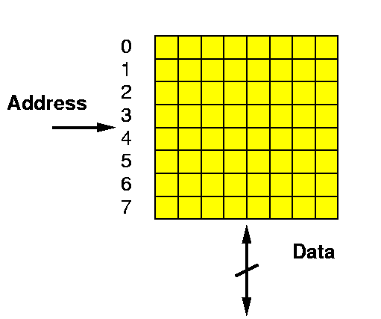
Random Access Memory
A Memory:
  Series of locations (slots)
  Can write values to a slot (specified by address)
  Read values from (by address)
  Return last value written
Notation:
slash on wire
means multiple bits wide

Slide 7
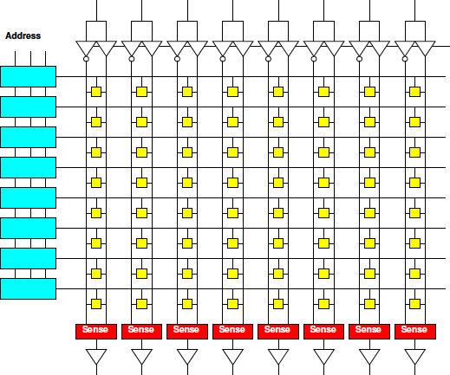
Memory Operation
Memory Read
  Present Address
  Decoder Matches
  Charge word line
  Enables Memory Cell
  to charge bitlines
  (column)
  SenseAmp
  detects
  bitline swing
  Buffered for output
1
2
3
4
5
6

Slide 8
Memory Block
Linear wire delay with distance
Assume constant area/memory bit
N-bit memory, arranged in square
  As shown N=64,
  width=depth=8
  N=width*depth
  (since square)
4x capacity (N)
delay change?
  (e.g. 1Gbit
  to 4Gbit)
width
depth

Slide 9
Memory Block
Linear wire delay with distance
Assume constant area/memory bit
N-bit memory, arranged in square
Width relate
to N?
Depth?
Delay
scale N?
width
depth

Slide 10
Memory Block Bandwidth
Bandwidth: data throughput
  How many bits per second can we transfer
N-bit memory, arranged in square
Bits/cycle
scale with N?
  (not quite
  bandwidth)

Slide 11
Memory Block Energy
Assume read full width,
  Energy scales with N
    Activate sqrt(N) wires
    Each wire sqrt(N)
    long
  Or, energy/bit
  scales as sqrt(N)
Larger memories
cost more energy

Slide 12
Memory Block Density
Address, sense amplifies are large
How do address bits scale with N?
Scale slower than bit area
  Bits scale N
  Address sqrt(N)*log(N)
  Sense amps sqrt(N)
Large memories
pay less per bit
  denser

Slide 13
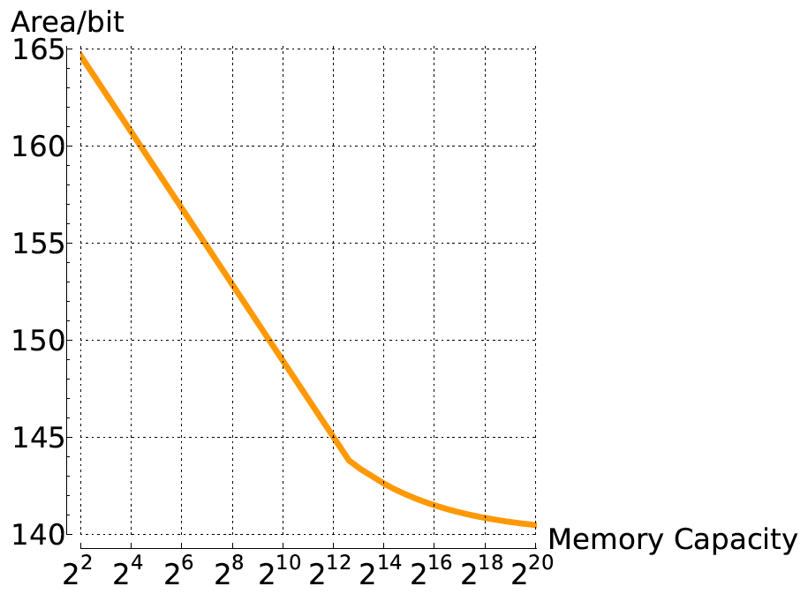
Compactness vs. Memory Size
(F² units)

Slide 14
Memory Scaling
Small memories are fast
  Large memories are slow
Small memories low energy
  Large memories high energy
Large memories dense
  Small memories cost
  more area per bit
Combining:
  Dense memories
  are slow

Slide 15
Latency Engineering
Scheduling
Part 2

Slide 16
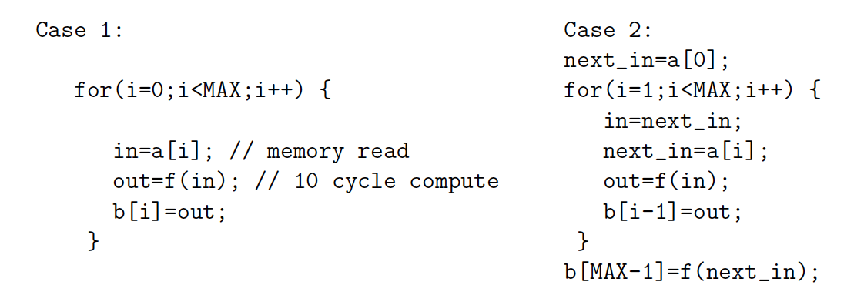
Preclass 2
Issue one read/write per cycle
10 cycle latency to memory
Memory read concurrent with compute
  only wait for memory when need value
Throughput (iters/cycle) in each case?

Slide 17
Lesson
Long memory latency can impact throughput
  When must wait on it
  When part of a cyclic dependency
Overlap memory access with computations when possible
  exploit parallelism between compute and memory access

Slide 18
Latency Engineering
Data Reuse

Slide 19
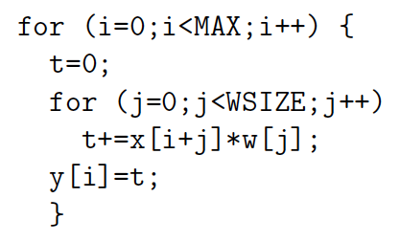
Preclass 3abc
MAX=10⁶ WSIZE=5
How many times execute t+=x[]*w[] ?
How many reads to x[] and w[]?
Runtime
read x,w 20
t+=… 5

Slide 20
Preclass 3c
T=MAX*WSIZE(T_{comp}+T_{x}+T_{w})
T=10⁶*5*(5+20+20)
T=2.25*10⁸

Slide 21
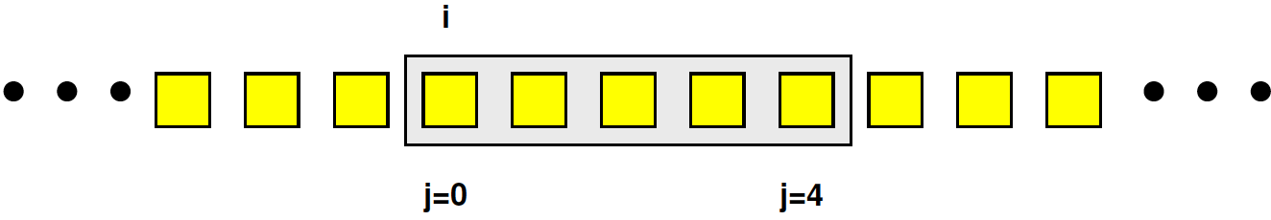
Preclass 3d
How many distinct x[], w[] read?

Slide 22
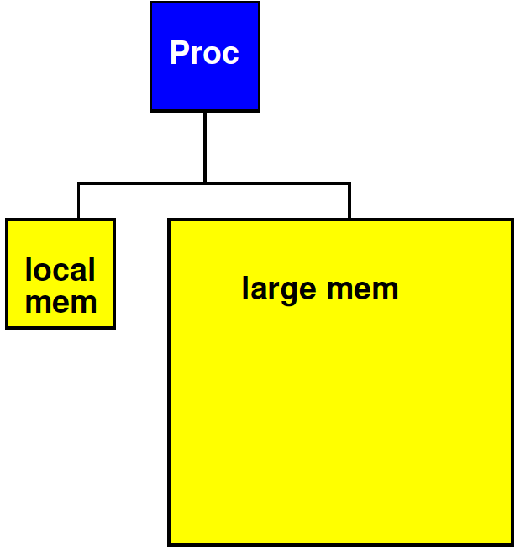
Strategy
Add small, local memory bank
  Small memories are faster

Slide 23
Preclass 3e
How use local memory to reduce large memory reads to 3d?
How much local memory need?

Slide 24
Preclass 3d
Which w’s read in each iteration of j loop?
Which x’s?
  i=0,
  i=1,
  Same i=0, i=1?
When never read x[0] again? x[4]?

Slide 25
Impact Small Memory
Remember how delay scale with N
How much faster might small [10 element] memory be? [compare 10⁶]
  as powers of 2: 2⁴ vs. 2²⁰

Slide 26
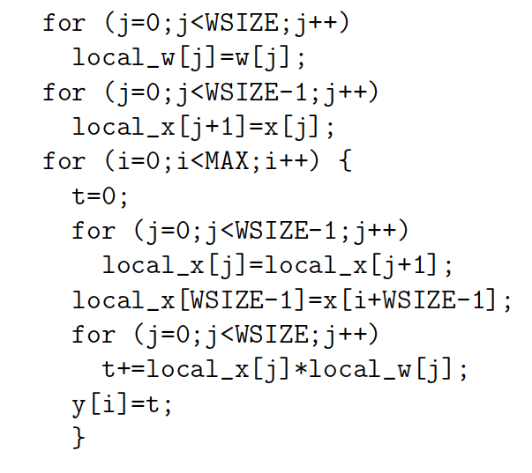
Preclass 3e

Slide 27
Preclass 3e
WSIZE*T_{w}
WSIZE*T_{x}
WSIZE*MAX*T_{local}
MAX*T_{x}
WSIZE*MAX*T_{comp}
WSIZE*MAX*2*T_{local}

Slide 28
Preclass 3e iii
WSIZE*MAX*(T_{comp}+3*T_{local})
+WSIZE*(T_{w}+T_{x})
+MAX*T_{x}
5*10⁶*(5+3)
+5*(20+20)
+10⁶*20
6*10⁷

Slide 29
Preclass 3e iii
2.25*10⁸ 6*10⁷
3.75x

Slide 30
Lesson
Data can often be reused
  Keep data needed for computation in
    Closer, smaller (faster, less energy) memories
  Reduces latency costs
  Reduces bandwidth required from large memories
Reuse hint: value used multiple times
  Or value produced/consumed

Slide 31
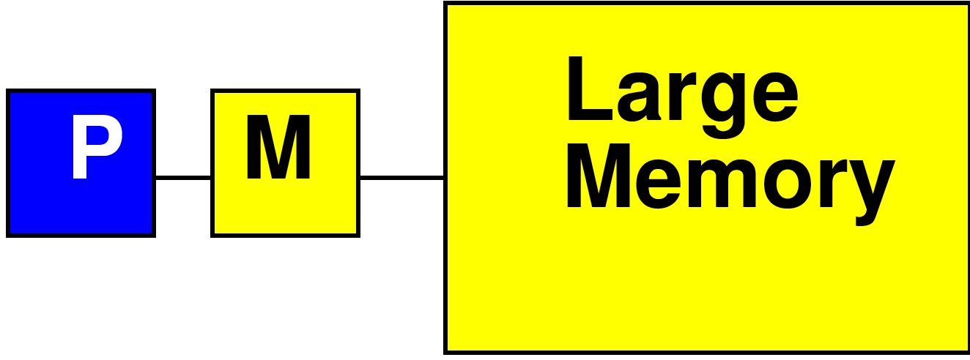
Processor Data Caches
Traditional Processor Data Caches are a heuristic instance of this
  Add a small memory local to the processor
    It is fast, low latency
  Store anything fetched from large/remote memory in local memory
    Hoping for reuse in near future
  On every fetch, check local memory before go to large memory

Slide 32
Cache
Goal: performance of small memory with density of large memory

Slide 33
Processor Data Caches
Demands more than a small memory
  Need to sparsely store address/data mappings from large memory
  Makes more area/delay/energy expensive than just a simple memory of capacity
Don’t need explicit data movement
Cannot control when data moved/saved
  Bad for determinism
Limited ability to control what stays in small memory simultaneously

Slide 34
Terminology
Cache
  Hardware-managed small memory in front of larger memory
Scratchpad
  Small memory
  Software (or logic) managed
  Explicit reference to scratchpad vs. large (other) memories
  Explicit movement of data

Slide 35
Bandwidth Engineering
Part 3

Slide 36
Terminology: Unroll Loop
Replace loop with instantiations of body
For WSIZE=5

Slide 37
Terminology: Unroll Loop
Replace loop with instantiations of body
For WSIZE=5

Slide 38
Terminology: Unroll Loop
Can unroll partially
For WSIZE even

Slide 39
Throughput Engineering
(Bandwidth Engineering)

Slide 40
Bandwidth Engineering
High bandwidth is easier to engineer than low latency
  Wide-word
  Banking (not today→come back to later)
    Decompose memory into independent banks
    Route requests to appropriate bank

Slide 41
Wide Memory
Can make memory wider (less square)
  Get more bits out per cycle
As long as we share the address
  One address to select
  wide word or bits
Efficient if all read
together

Slide 42
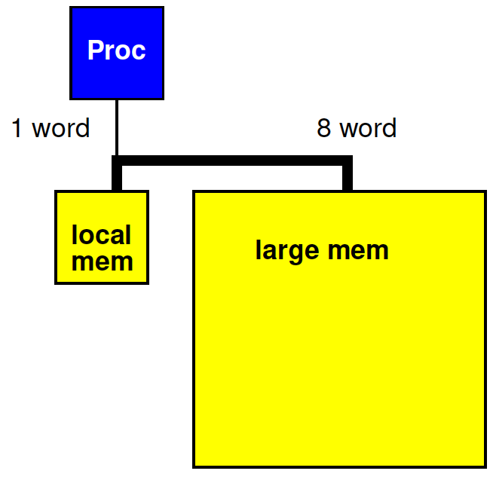
Revisit Preclass 3
Use wide memory access to move 8 words (x[]) between large and small memory in a single cycle

Slide 43
Preclass 3 + wide
Impact of 8 word datapath between
large and local memory?
WSIZE*MAX*(T_{comp}+3*T_{local})
+WSIZE*(T_{w}+T_{x})
+MAX*T_{x}
5*10⁶*(5+3)
+5*(20+20)
+10⁶*20
6*10⁷
What term(s) impacted?

Slide 44
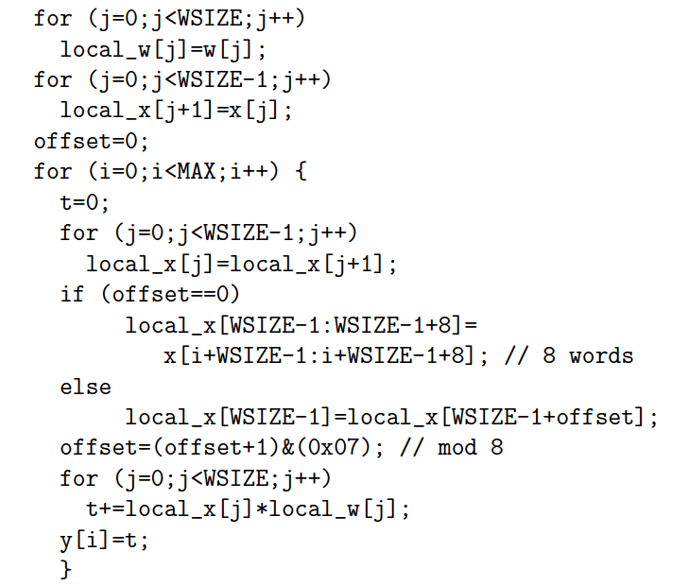
Preclass 3 + wide
WSIZE*MAX*(T_{comp}+3*T_{local})
+WSIZE*(T_{w}+T_{x})
+MAX/8*T_{x}
+MAX*(T_{local}+2)
5*10⁶*(5+3)
+5*(20+20)
+10⁶*20/8
+10⁶*3
4.55*10⁷

Slide 45
Amdahl’s Law

Slide 46
Amdahl’s Law
If you only speedup Y(%) of the code, the most you can accelerate your application is 1/(1-Y)
T_{before} = 1*Y + 1*(1-Y) = 1
Speedup by factor of S
T_{after}=(1/S)*Y+1*(1-Y)
Limit S→infinity T_{before}/T_{after}=1/(1-Y)

Slide 47
Amdahl’s Law
T_{before} = 1*Y + 1*(1-Y) = 1
Speedup by factor of S
T_{after}=(1/S)*Y+1*(1-Y)
Y=70%
  Possible speedup (S→infinity) ?
  Speedup if S=10?

Slide 48
Amdahl’s Law
If you only speedup Y(%) of the code, the most you can accelerate your application is 1/(1-Y)
Implications
  Amdhal: good to have a fast sequential processor
  Keep optimizing
    T_{after}=(1/S)*Y+1*(1-Y)
    For large S, bottleneck now in the 1-Y

Slide 49
Memory Organization
Architecture contains
  Large memories
    For density, necessary sharing
  Small memories local to compute
    For high bandwidth, low latency, low energy
Need to move data
  Among memories
    Large to small and back
    Among small

Slide 50
Big Ideas
Memory bandwidth and latency can be bottlenecks
Exploit small, local memories
  Easy bandwidth, low latency, energy
Exploit data reuse
  Keep in small memories
Minimize data movement
  Small, local memories keep distance short
  Minimally move into small memories

Slide 51
Admin
Reading for Wednesday on canvas
If never seen a Lego
  Plan to watch short (<3min) video before preclass for Wednesday
HW2 due Friday

